Slide 1
Problems at Flight foods…
Winston Hall 2422871

Slide 2
Overview
Flight Foods has been losing market share due to repeated complaints from airline clients regarding poor food standards—including undercooked food, poor packaging, and cross-contamination. The objective of this presentation is to analyse communication barriers and suggest evidence-based solutions to enhance food quality and business reputation.

Slide 3
Introduction to problems.
Declining market share tied to poor food standards.
Airline clients report: undercooked food, poor packaging, meat served in vegetarian meals.
40 staff from 5 cultural groups, varying English language abilities.
Lack of formal food hygiene training before employment.
Communication largely via wall signs, not always effective.

Slide 4
Barriers Identified
Language Barriers:
Most staff are immigrants with limited English proficiency; direct instructions often misunderstood. Manager Gary compensates by posting signs, but comprehension varies (Berlo, 1960).
Cultural Barriers:
Cultural differences affect food safety perception and compliance; staff may have diverse hygiene standards (Schramm, 1954).
Generational Gap:
Younger staff have difficulty understanding or following instructions compared to older staff (Flight Foods case study).
Organisational Barriers:
No formal induction or training in food hygiene and safety; operations rely on informal, on-the-job learning (Shannon & Weaver, 1949).

Slide 5
Shannon & Weaver
The Shannon & Weaver model explains how information travels from a sender to a receiver and highlights how “noise”—such as language and cultural differences—can distort or block the message.
At Flight Foods, the manager (sender) gives hygiene instructions, but many staff (receivers) struggle to understand due to limited English and cultural differences.
Result: Misunderstandings lead to undercooked food and cross-contamination, causing complaints from airlines.
Manager (Sender)
[Message: Hygiene Instructions]
[Channel: Spoken and Signs]
[Noise: Language & Cultural Barriers] (misunderstood)
Staff (Receiver)

Slide 6

Berlo
Berlo’s SMCR model breaks communication down into four key elements: Source, Message, Channel, and Receiver. At Flight Foods, the manager (Source) delivers hygiene instructions (Message) using signs and spoken words (Channel), but staff (Receiver) sometimes misunderstand because they have different language skills, attitudes, and backgrounds. (Berlo 1960) This breakdown in the SMCR model leads to errors in food preparation and safety.
Pixabay (2017)

Slide 7
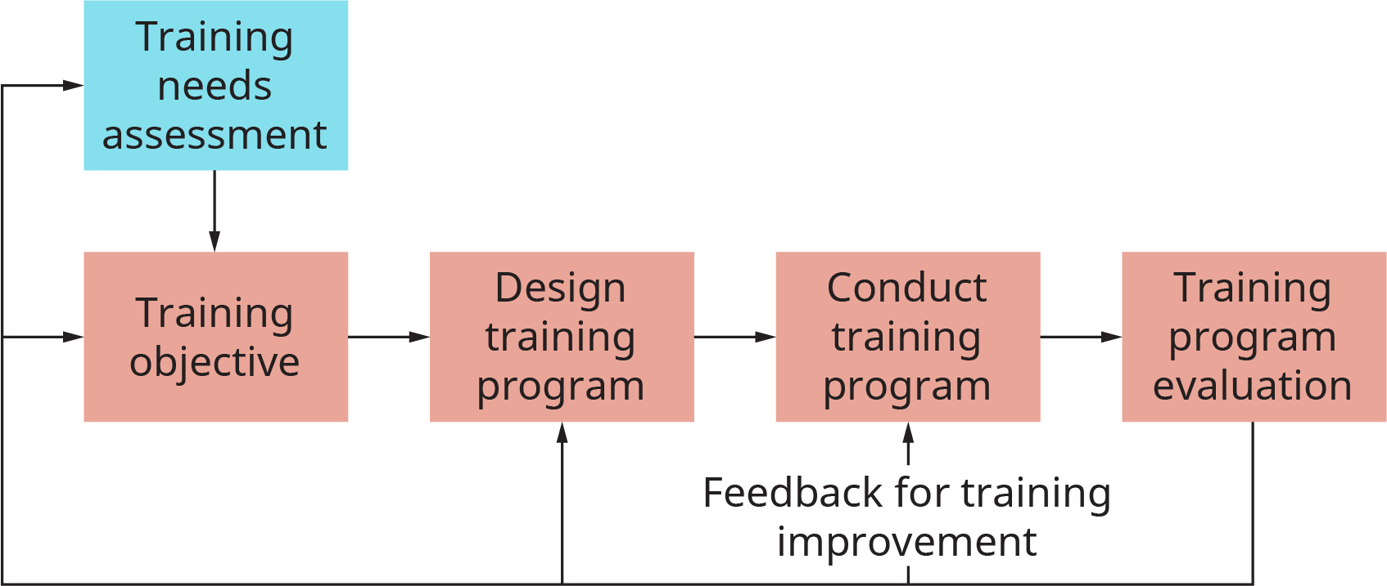
Overcoming Barriers
Language Solutions:
— Multi-lingual trainers/interpreters for clear instructions
— Pictograms and instructional videos for easier understanding
(Berlo, 1960; Shannon & Weaver, 1949)
Training Solutions:
— Compulsory pre-employment food hygiene training
— Regular refresher courses, culturally and linguistically adapted
(Schramm, 1954)
Cultural Solutions:
— Cross-cultural awareness workshops for staff/managers
— Integrate best practices from various cultures
(Schramm, 1954)
Organisational Solutions:
— SOPs translated to relevant staff languages (printed/digital)
— Expanded induction with mentoring/group activities
— Sub-group leadership to improve communication
(Berlo, 1960; Sy & D’Annunzio, 2005)
Feedback Mechanisms:
— Regular feedback sessions with interpreters; suggestion boxes
— Digital feedback platforms in staff languages
(Sy & D’Annunzio, 2005; Berlo, 1960)
External Support:
— Engage food safety consultants for audits and best practice advice
(Berlo, 1960; Flight Foods case study)
This Photo by Unknown Author is licensed under CC BY

Slide 8
Flight Foods is experiencing significant operational and quality issues stemming from barriers related to language differences, cultural diversity, varying employee skill levels, and inadequate training provisions. These challenges disrupt effective communication and result in poor food quality and client dissatisfaction. By applying established communication models, such as those proposed by Shannon and Weaver (1949) and Berlo (1960), alongside multi-level intervention strategies—including multilingual training, culturally responsive procedures, and robust feedback mechanisms—the company can address and mitigate these barriers. This holistic approach is essential to improving operational standards, restoring customer confidence, and ultimately increasing market share.
conclusion

Slide 9
References
Shannon, C. E. & Weaver, W. (1949) The Mathematical Theory of Communication. Urbana, IL: University of Illinois Press.
Pixabay (2017) Hand washing sign [image]. Available at: https://pixabay.com/photos/wash-hands-sign-hygiene-1624283/ (Accessed: 24 October 2025).
Gitman, L.J., McDaniel, C., Shah, M., Reece, M., Kaczmarek, S., Hyatt, J. and Firestone, S. (n.d.) Employee Training and Development | OpenStax Intro to Business. Available at: https://courses.lumenlearning.com/suny-osintrobus/chapter/employee-training-and-development/ (Accessed: 24 October 2025).
Berlo, D. K. (1960) The Process of Communication: An Introduction to Theory and Practice. New York: Holt, Rinehart and Winston.

Slide 10
Thank you
Questions are now welcome.

