Slide 1



405
Richard Davies
1806173
Hiclipart (2020)
Logo Created Adobe Spark (2020)

Slide 2
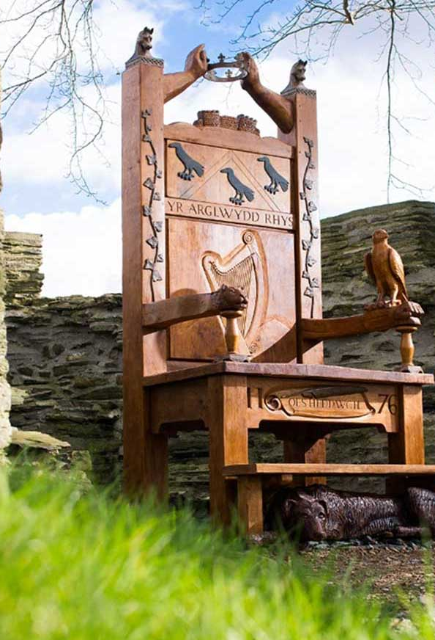
Eisteddfod
1176
1792
1847
1861
1914
1920-30
2020
Throughout this presentation I will look at the Eisteddfod and how during history it has provided a much-valued lifeline in retaining and developing the welsh language as well as Wales as a county.
The Eisteddfod can be tracked back to 1176 when Cardigan castle was in the reign of Lord Rhys.
The National Eisteddfod is the largest and oldest celebration of Welsh culture.
Other than 1914, when the outbreak of the First World War saw it postponed for a year, 2020 with COVID the Eisteddfod has been held every year.
The National Eisteddfod 2020 described the festival as Wales’ leading mobile regeneration project,.
The Eisteddfod brings together communities, people of all ages and background from all over Wales whilst celebrating the welsh culture but also all cultures all over the world.
Eisteddfod Genedlaethol Cymru (2020)
9ft replica of the Eisteddfod chair at Cardigan Castle the first known site of the Eisterddfod.
cardigancastle.com 2020

Slide 3
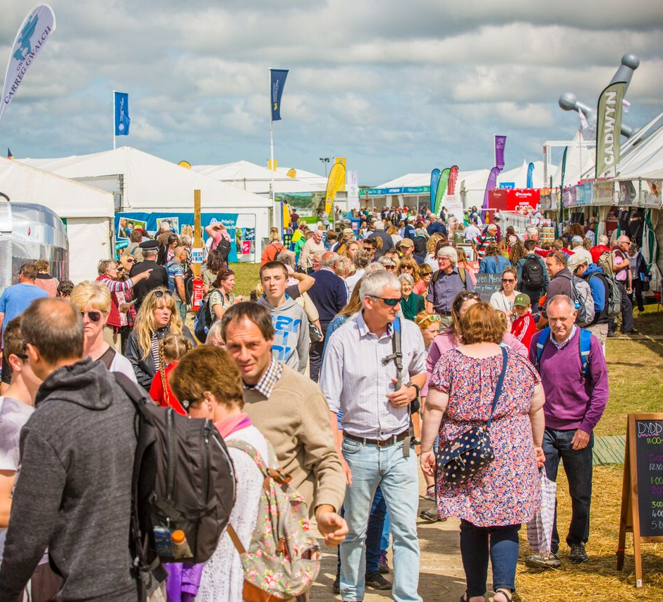
Benefits to the welsh economy
Mermaidquay (2018)
Over 160,00 visitors are attracted to the Eisteddfod every year.
More than 350 trade stands
Independent research concluded a positive economic effect of between £6-£8 million on the local area of where the Eisteddfod is held. Welsh Government (2012).
ASDA reported a 15% increase on welsh produced product for the week of the Eisteddfod when compared to previous weeks. Carmarthenshire County council (CCC) 2001.
75% of visitor expenditure was spent on locally produced goods according to Carmarthenshire county council.
The local tourism and hospitality sector is always one of the main beneficiaries of an Eisteddfod according to MyNewtown.com (2015)

Slide 4
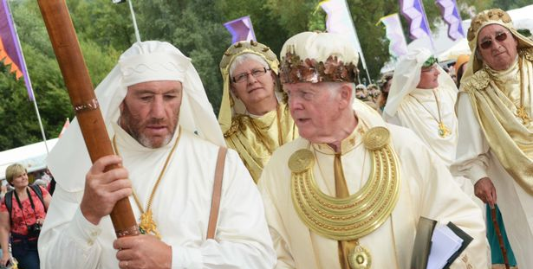
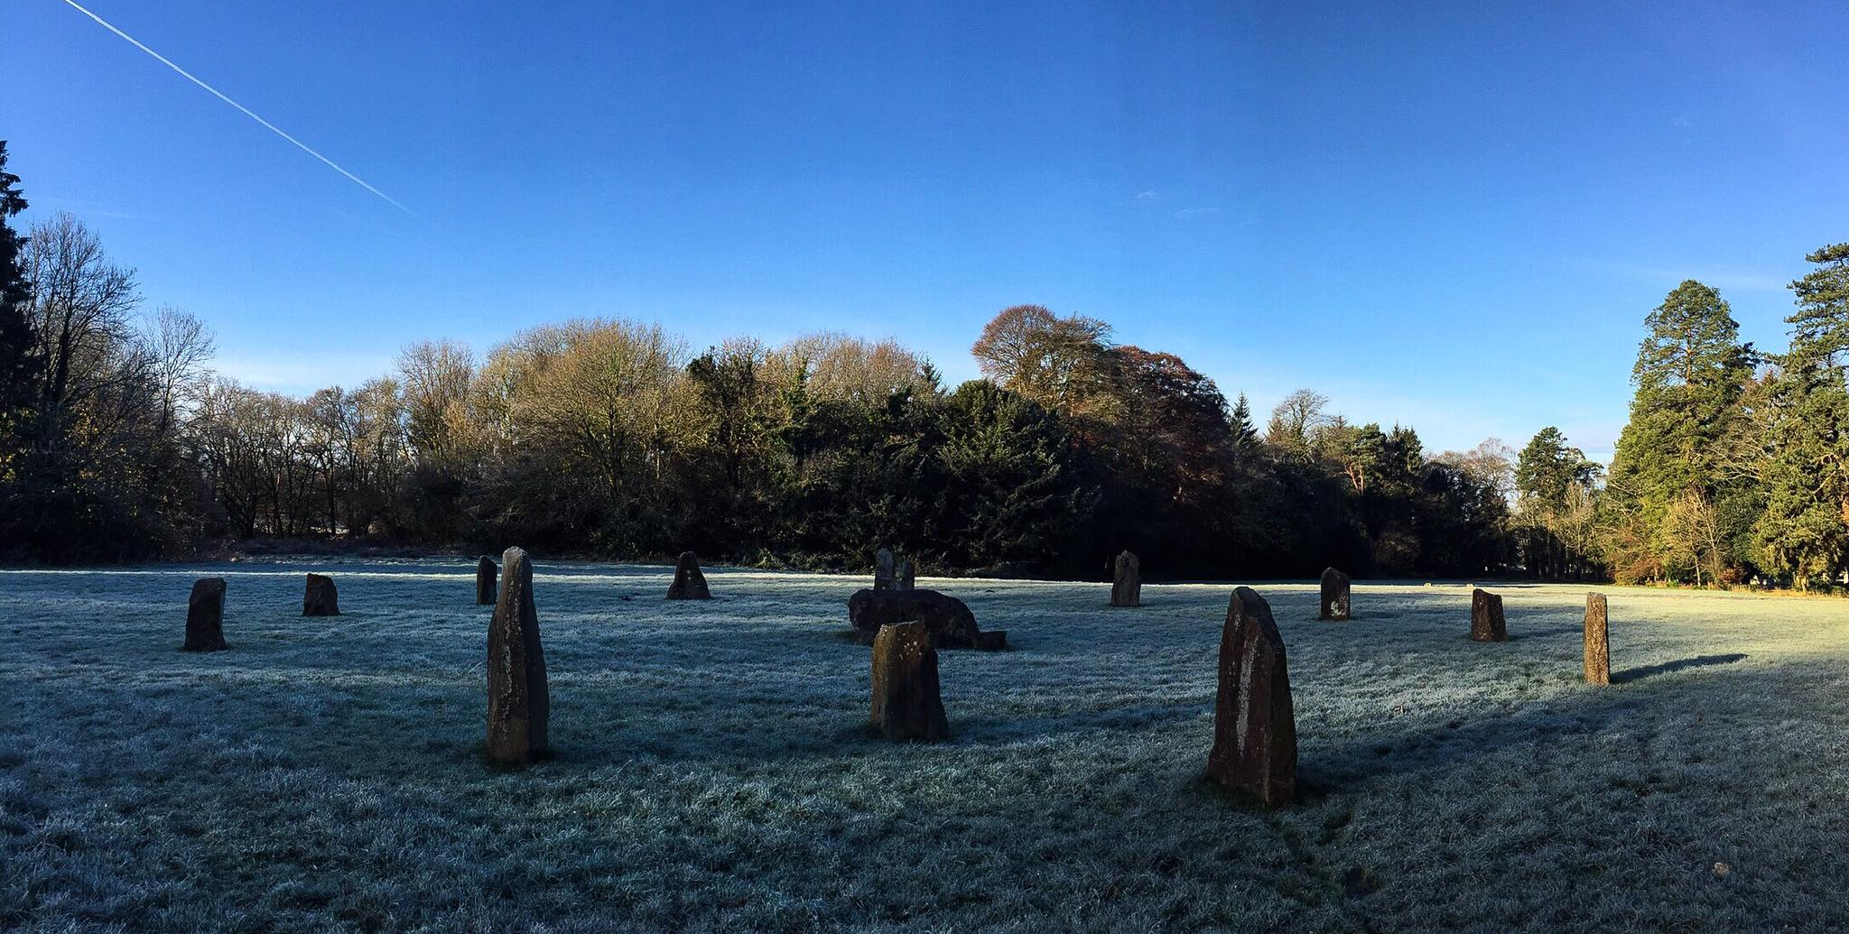

Belonging & Heritage
An integral part of todays Eisteddfod celebrates the Welsh language being that of Celtic heritage.
The Gorsedd of the Bards.
A cultural association made up of poets, writers, musicians, artists and other people who have made a distinguished contribution to the Welsh nation, the language, and its culture
BBC (2008)
Gorsedd Stones (Cerrig yr Orsedd)
Llandeilo. Davies, R (2019)
Established in 1792 on Primrose Hill in London by Iolo Morganwg with the purpose of letting the world know the Welsh had direct links to the Celtic culture and heritage.
Johnson, B. accessed (2020)
Marcel (2020)

Slide 5
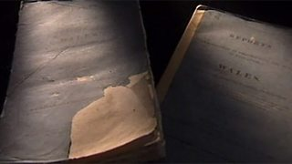
The unfit welsh language
Why was the Blue book commissioned?
1847
In the year 1847 the British government commissioned a report into the state of education in Wales.
National Library of Wales (2020)
British Empire a global superpower
Reynolds, D (2019).
Hywel Teifi Edwards (1990) explains,
“the eisteddfodau over these decades witnessed the intrusion of Anglicizing forces that sought to marginalize the Welsh language”
The Treason of the Blue Books
Those who conducted the report could not speak or understand welsh.
A commission into education yet comments and discriminates the welsh speaking population.
The report concluded;
* That schools in Wales were extremely inadequate
* That teachers only spoke English in areas where children only spoke Welsh
* Nonconformist Sunday Schools to acquire literacy
* That the Welsh were ignorant, lazy and immoral as a result of the use of Welsh and Nonconformity
In a time where the welsh language and those who spoke the language where scrutinised, Iolo Morgawg used his presence in London literacy circles to refashion the Eisteddfod from dying away in society and bring the Welsh culture into the public eye by transforming the bardic cultural roles into the Romantic . The Eisteddfod grew and grew for a number of decades until 1861 where the National Eisteddfod was established in Aberdare. Edwards, H, T (2019)

Slide 6
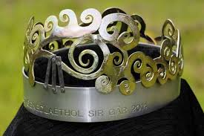
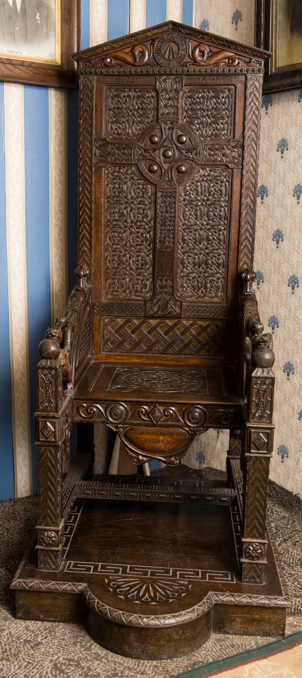
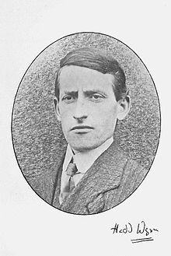
Ceremony of the Bard
THE CROWN
THE CHAIR
Designed by local artist and awarded to the best poet and writer at the Eisteddfod.
Crump, E (2014)
Visit Wales (2020)
It was in 1917 that the famous poet, Ellis Beavan or better known as Hedd Wyn won the chair for his poem 'Yr Arwr' (The Hero). He reluctantly served in the First World War and managed to get his poem sent past letter-censoring from France. Tragically, he died six weeks before the announcement that he'd won the Chair at this Eisteddfod in Birkenhead, England.
Visit Wales (2020)

Slide 7
The decline of the welsh language during 1920-30
Estimated some 20,000 Welsh speakers died in the conflict of the first World War. BBC Welsh History
The English language became more common in the 1920 and 30’s. Causing the welsh language to decline.
Disastrous consequences of the sharp fall in demand for coal.
Mass unemployment
Jobs where more likely to be found in England therefore the welsh language would not be passed down through generations as individuals would move away from Wales to find work else where. Taking the language with them.
BBC Welsh History (2014)

Slide 8
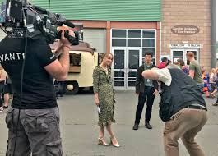

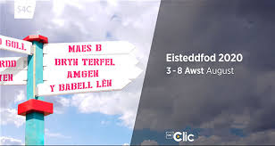
Urdd gobaith cymru
Sir Ifan ab Owen Edwards founded the organization, Urdd Gobaith Cymru in the attempt to revitalize the welsh language. Identifying there is a lost generation unable to speak welsh because of numerous factors previously discussed.
55,000 member.
Providing opportunities and experiences for children and your people to socialize and compete through the medium of welsh.
Member can compete in sport tournaments and attend residential setting established by the Urdd such as Gwersyll Llangrannog.
The Urdd Eisteddfod festival is broadcasted by S4C. Bringing the welsh language into homes.
Urdd Gobaith Cymru (2020)
S4C (2018)
Urdd Gobaith Cymru (2020)
S4C (2020)
Hiclipart (2020)

Slide 9
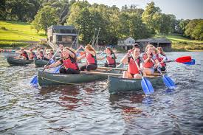

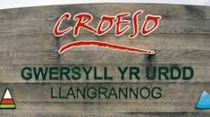
Gwersyll yr urdd
Urdd Gobaith Cymru (2020)
Urdd Gobaith Cymru (2020)
Socializing through the medium of welsh.
Enjoyable experiences through the medium of Welsh.
Providing a jobs
Apprenticeships
Urdd Gobaith Cymru (2020)

Slide 10

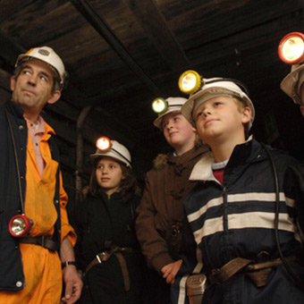

Eisteddfod within schools and national objectives.
The Urdd supports Welsh-medium secondary schools to develop activities to encourage learners informal use of Welsh as well as English-medium secondary schools to provide informal opportunities to use the language and intensive Welsh learning opportunities through the Urdd’s Cymraeg Bob Dydd project.
The Eisteddfod can can provide an invaluable opportunity to extend the educational experience for all pupils in Wales, through providing opportunities the Urdd possess such as its Youth working Scheme, Urdd sport programes, residential setting, Eisteddfod and cultural experiences. All this can only aid the welsh governments objectives of having one million people able to speak welsh by 2050.
Twincl accessed (2020)
Big pit national museum, (2020)
1,000,000 Welsh speakers by 2050. Welsh Government (2017)
Davies-Rana, A (2019)

Slide 11
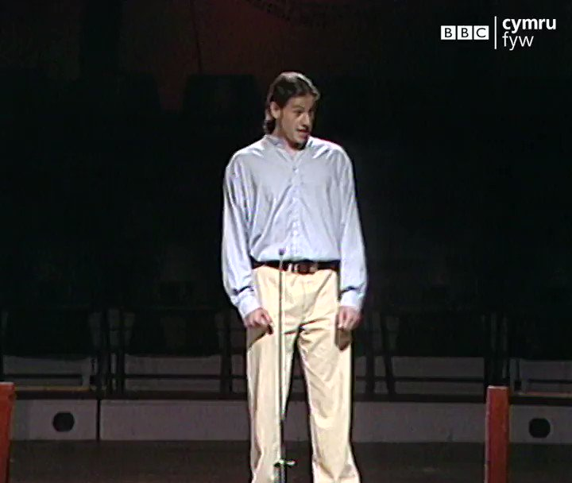

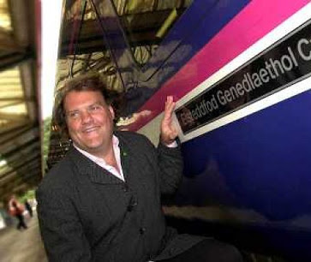
Developing skills for life
BBC Cymru Fyw. (2019)
Daily post Wales (2019)
North Wales Coast Railway (2016)
The Urdd National Eisteddfod has played a part in developing Welsh talent. Talent such as Bryn Terfel (opera singer), Matthew Rhys (actor), Iwan Rheon (Actor, Game of Thrones), Ioan Gruffydd (Actor) and Wyn Jones (Rugby Player). It develops skills that individuals can aid from later in life.
Whether you're signing in a choir, public speaking, raising funds or watching the event from your lounge. The Eisteddfod brings together communities, boosts Wales economic value and most importantly showcases the welsh language to the world..

Slide 12
References
BBC (2008), Eisteddfod Genedlaethol Cymru, [online] available at: https://www.bbc.co.uk/cymru/eisteddfod2008/sites/ormaes/sadwrn09/ymlaen.shtml accessed (2020)
BBC Cymru Fyw. (2019) Cymru Fyw, Ioan Gruffydd [online] available at: https://www.facebook.com/watch/BBCCymruWales/ accessed (2020)
BBC Wales History (2014), Between Wars [online] available at: https://www.bbc.co.uk/wales/history/sites/themes/society/language_betweenwars
Big pit national museum, accessed (October 2020). [online] available at: https://museum.wales/bigpit/visit/families/ accessed (2020)
Cardigan Castle (2020), Eisterddfod chair [online] available at: https://www.cardigancastle.com/visit/
Carmarthenshire county council 2001, The Economic and Cultural Impact of the National Eisteddfod - Llanelli 2000
Crump, E (2014), National Eisteddfod 2014: Chair and crown handed over to festival [online] available at: https://www.dailypost.co.uk/whats-on/whats-on-news/national-eisteddfod-2014-chair-crown-7493018
Daily Post Wales (2019), Iwan Rheon picture [online] available at: https://twitter.com/TheActorsPad/status/1167403783460130816 accessed (2020)
Davies-Rana, A (2019). Project un miliwn. [online] available at: https://twitter.com/AmeerPresenter/status/1168965724393660416 accessed (2020)
Davies, R 2019, Gorsedd Stones (Cerrig yr Orsedd) Llandeilo.
Edwards, H T (1990). The Eisteddfod. Cardiff: U of Wales P, 1990. Print.
Eisteddfod Genedlaethol Cymru (2020), [online] available at: https://eisteddfod.wales/about-us accessed (2020)
Hiclipart (2020), Mr Urdd logo, [online] available at: https://www.hiclipart.com/search?clipart=Eisteddfod
Johnson, B, The National Eisteddfod of Wales [online] available at: https://www.historic-uk.com/HistoryUK/HistoryofWales/The-National-Eisteddfod-of-Wales/ accessed (2020)

Slide 13
References
Jones, M (2019). “On Nineteenth-Century Welsh Literacies, and the ‘Blue Book’ Education Reports of 1847.” BRANCH:Britain, Representation and Nineteenth-Century History. Ed. Dino Franco Felluga. Extension of Romanticism and Victorianism on the Net. Web.
Marcels (2020), Clipart Celtic pattern. [online] available at: https://www.marcels-kid-crafts.com/celtic-knot-patterns.html accessed (2020)
Mermaidquay (2018), national eisteddfod comes to Cardiff bay. [online] available at: https://www.mermaidquay.co.uk/2018/03/national-eisteddfod-comes-to-cardiff-bay/. accessed (2020)
My Newtown. Com (2015) Newtown benefiting from National [online] available at: http://www.mynewtown.co.uk/viewernews/ArticleId/915 accessed (2020)
National Library of Wales (2020), Treachery of the Blue Books [online] available at: https://www.library.wales/discover/digital-gallery/printed-material/the-blue-books-of-1847 accessed (2020)
North Wales Coast Railway (2016) [online] available at: http://www.nwrail.org.uk/nw1607c.htm accessed (2020)
Reynolds, D (2019). Why Britain punched above its weight, BBC History Magazine
S4C (2018), Eisteddfod yr Urdd. [online] available at: https://twitter.com/eisteddfodurdd/status/1001042603574472704 accessed (2020)
S4C (2020), Eisteddfod clic [online] available at: https://www.s4c.cymru/en/entertainment/eisteddfod-genedlaethol/ accessed (2020)
Twinkl (2020), Our Eisteddfod, [online] available at: https://www.twinkl.co.in/resource/wl2-t-93-our-eisteddfod-achievements-banner accessed (2020)
Urdd Gobaith Cymru (2020), [online] available at: https://www.urdd.cymru/en/residential-centres/llangrannog/ accessed (2020)
Urdd Gobaith Cymru (2020), Our history [online] available at: https://www.urdd.cymru/en/about-us/what-urdd/our-history/
Visit Wales (2020), Hedd Wyn: the soldier poet of Snowdonia [online] available at; https://www.visitwales.com/en-us/things-do/culture/hedd-wyn-soldier-poet-snowdonia accessed (2020)
Welsh Government (2012), Eisteddfod National Eisteddfod task and finish group (2012).
Welsh Government (2017), Cymraeg 2017, one million welsh speakers by 2050.

