Slide 1
Challenges in Retrofitting a 1970s Semi‑Detached Council House Low‑Carbon, Low‑Energy Future with Social Value

Slide 2
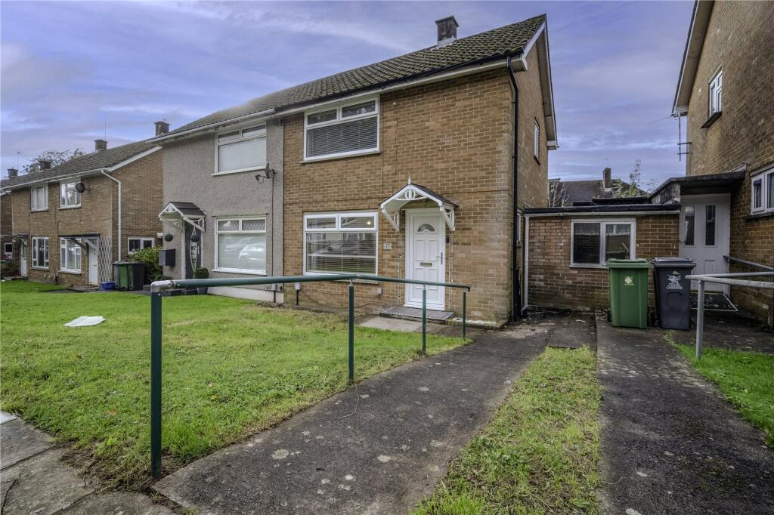
Introduction
1970s semi‑detached council houses were built quickly
and cheaply.
Cavity walls with no insulation
Outdated heating, and limited ventilation .
Moisture issues common due to cold surfaces and poor
airflow.
Semi‑detached layout
Ageing windows and doors
Gas‑fired boiler and outdated radiators
Limited electrical capacity
Evidence of damp and condensation

Slide 3
Existing Condition & Key Challenges
High heat loss through walls, roof, and
glazing.
Condensation and mould in bedrooms
and bathroom.
Low SAP rating and high heating
demand.
Budget insufficient for full deep retrofit .
Poor building fabric
Moisture and ventilation issues
Budget constraints
Semi‑detached layout complications
Social value requirements

Slide 4
Methods
Whole‑house, fabric‑first strategy(PAS 2035:2019, 2019)
Energy modelling ( U‑values)
Building systems
Moisture risk evaluation
Social value assessment

Slide 5
Results
The assessment of the 1970s semi‑detached council house revealed several significant findings relating to its current performance, moisture behavior, energy efficiency, and suitability for low‑carbon retrofit. These results highlight the areas requiring the most urgent attention and form the basis for developing an effective retrofit strategy.
1.Building Fabric Performance :-
High heat loss through uninsulated cavity walls, loft spaces, and
suspended floors.
Low‑performing glazing, contributing to draughts and cold spots.
Thermal bridging identified around window reveals, corners, and
Junctions.
Air leakage detected around doors, service penetrations, and loft
Hatches.
2. Moisture and Ventilation Findings :-
Condensation on cold surfaces, especially in bedrooms and the
Bathroom.
Damp patches on external walls due to poor insulation and
inadequate ventilation.
High indoor humidity levels, particularly during winter.
Insufficient extract ventilation, with outdated or non‑functional fans.
3. Energy Performance Results :-
A low SAP rating, reflecting poor energy efficiency.
High heating demand, significantly above modern standards.
Gas boiler inefficiency, with uneven heat distribution across rooms
Limited potential for renewable technologies without electrical upgrades.
4. Budget and Cost‑Benefit Outcomes :-
The available budget is insufficient for a full deep retrofit.
External wall insulation and heat pumps exceed current funding limits.
Low‑cost, high‑impact measures (loft insulation, draught‑proofing,
ventilation upgrades) offer the best initial return.
A phased retrofit approach is the most realistic option.
5. Social Value Assessment Results :-
Reducing moisture and improving insulation will enhance occupant health
and comfort.
Retrofit works can support local employment and training.
Improved indoor conditions contribute to better wellbeing and long‑term
Resilience.

Slide 6
Discussion
The results highlight the need for a fabric‑first, moisture‑aware retrofit strategy, consistent with PAS
2035 guidance (PAS 2035:2019, 2019).
Moisture issues must be addressed before insulation upgrades to avoid worsening damp, aligning
with Energy Saving Trust recommendations.
Budget constraints mean that a phased approach is necessary, focusing first on low‑cost, high‑impact
measures such as ventilation upgrades, loft insulation, and draught‑proofing.
The semi‑detached layout requires neighbor coordination, which is a common challenge in UK retrofit
projects.
Social value considerations—such as reducing fuel poverty and improving health—are central to the
retrofit strategy and align with national social value principles.
Fabric-First Initiative
Building System
Energy
Generation
Budget
Social
Value
Consideration

Slide 7
Conclusion
Retrofitting a 1970s semi‑detached council house presents technical, financial, and social challenges.
However, by adopting a phased, fabric‑first approach that prioritizes moisture control, ventilation, and
cost‑effective energy improvements, meaningful progress can be achieved even within budget limitation
The project demonstrates that low‑carbon retrofit is not only about reducing emissions but also about
improving comfort, health, and social wellbeing. With careful planning and resident‑centered delivery,
the home can move toward a sustainable, low‑energy future. The discussion emphasizes that successful
retrofit is not solely a technical exercise. It requires engagement with residents, coordinate with
neighboring properties, and consideration of long‑term community benefits.
Overall, the study demonstrates that while retrofitting older housing stock presents significant challenges,
it also offers substantial opportunities. With thoughtful planning, realistic budgeting, and a commitment
to social value, even modest interventions can set the foundation for a resilient, low‑carbon home that
meets the needs of both present and future generations.

Slide 8
References
1.BEIS. (2021). Heat and buildings strategy. UK Department for Business, Energy & Industrial Strategy.
2.BRE. (2016). SAP 2012: The government’s standard assessment procedure for energy rating of
dwellings.
3.CIBSE. (2020). CIBSE guide A: Environmental design. Chartered Institution of Building Services Engineer.
4.Energy Saving Trust. (2022). Moisture, ventilation and energy efficiency in homes. Energy Saving Trust.
5.LETI. (2021). LETI retrofit guide. London Energy Transformation Initiative
6.NICE. (2015). Excess winter deaths and illness and the health risks associated with cold homes.
7.PAS 2035:2019. (2019). Retrofitting dwellings for improved energy efficiency – Specification and
8.guidance. British Standards Institution.
9.RIBA. (2020). RIBA sustainable outcomes guide. Royal Institute of British Architects.
10.Social Value UK. (2020). The principles of social value. Social Value International.
11.UK Green Building Council. (2020). Building the case for net zero: Retrofit.
Some of these references were sourced using Google AI and ChatGPT

Slide 9
THANK YOU

