Slide 1
Reflective Writing

Slide 2
What is Reflective Practice?
Taking the opportunity to think about the work you are doing, as you do it , or after you have done it.
‘… looking back on an experience and making sense of it to identify what to do in the future.’
(Drew and Bingham, 2001 p221)

Slide 3
Why should you be reflective practitioners?
To enable professional development
To improve academic performance.
To maintain quality
  Reflecting on what went wrong and how improvements can be made
  Reflecting on what went well and why = good practice
Notes:
Practitioners have considerable power derived from legislation
Practitioners make difficult professional judgments

Slide 4
Reflection
Don’t just think about what went wrong/well and why – also plan to improve skills if necessary, or to use those skills in future events

Slide 5
What can reflective practice do for me?
Enhance your problem solving skills
Enhance your ability to evaluate
Enhance your ability to action plan for success
Make you are an effective student
Notes:
Challenge political and philosophical aspects of procedures and policies ----- attempt to shape future policy and practice
Value engaging children in reflecting ----- helping them to develop an insight into their world ------ takes the rights of young children seriously
Developing the skills of a reflective practitioner
Developing critical thinking skills
Learning from observing other people’s practice
Learning through doing
Managing diversity and uncertainty

Slide 6
Why reflecting on your work is important- Future Improvement.
do something, think about what you did, come to conclusions about what you did and plan to try again.
(Kolb 1984)

Slide 7
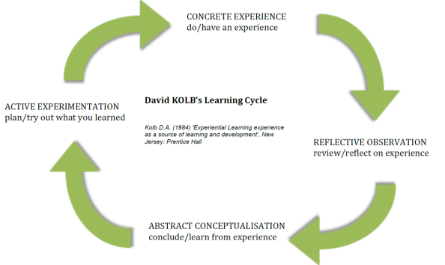
Kolb’s Model (1984)
Notes:
1.First, practitioners have a concrete experience. This means experiencing something new for the first time in the classroom. The experience should be an active one, used to test out new ideas and teaching methods.
This is followed by…
2.Observation of the concrete experience, then reflecting on the experience. Here practitioners should consider the strengths of the experience and areas of development. Practitioners need to form an understanding of what helped students’ learning and what hindered it.
This should lead to…
3.The formation of abstract concepts. The practitioner needs to make sense of what has happened. They should do this through making links between what they have done, what they already know and what they need to learn. The practitioner should draw on ideas from research and textbooks to help support development and understanding. They could also draw on support from other colleagues and their previous knowledge. Practitioners should modify their ideas or devise new approaches, based on what they have learnt from their observations and wider research.
4.The final stage of this cycle is when…
The practitioner considers how they are going to put what they have learnt into practice. The practitioner’s abstract concepts are made concrete as they use these to test ideas in future situations, resulting in new experiences. The ideas from the observations and conceptualisations are made into active experimentation as they are implemented into future teaching. The cycle is then repeated on this new method.

Slide 8
Application
Each section of the model should be given due consideration.
Concrete experience: being involved in a new experience
Reflective observation: watching others or developing observations about one’s own experience
Abstract conceptualization: creating theories to explain observations
Active experimentation: using theories to solve problems, make decisions

Slide 9
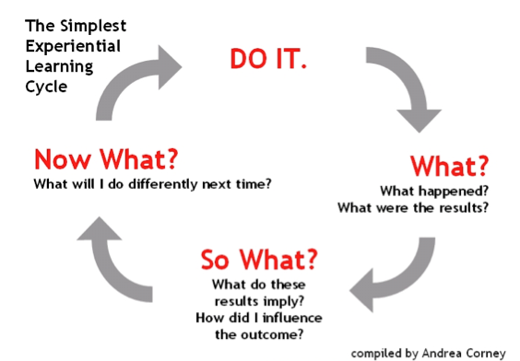
Kolb’s Model Simplified

Slide 10
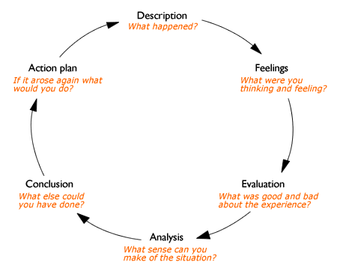
Gibbs’ Reflective Cycle (1988)
Notes:
The theoretical approach of reflection as a cyclical model was further developed by Gibbs (1998). This model is based on a six-stage approach, leading from a description of the experience through to conclusions and considerations for future events. While most of the core principles are similar to Kolb’s, Gibbs' model is broken down further to encourage the teacher to reflect on their own thoughts and feelings.
Gibbs' model is an effective tool to help you reflect after the experience, and is a useful model if you are new to reflection as it is broken down into clearly defined sections.

Slide 11
Description- What happened?
In this section, the practitioner should clearly outline the experience. This needs to be a factual account of what happened during the experience. It should not be analytical at this stage.

Slide 12
Feelings
This section encourages the practitioner to explore any thoughts or feelings they had at the time of the event. Here the practitioner should explain feelings and give examples which directly reference the experience. It is important the practitioner is honest with how they feel, even if these feelings might be negative. Only once the feelings have been identified can the practitioner implement strategies to overcome these barriers.

Slide 13
Evaluation
The evaluation section gives the opportunity for the practitioner to discuss what went well and analyse practice. It is also important to consider areas needed for development and things that did not work out as initially planned.
Specifically- what went well?
What didn’t go so well?
Do NOT start talking about why!

Slide 14
Analysis
This section is where the practitioner makes sense of the experience. They consider what might have helped the experience or hindered it. It is in this stage that the practitioner refers to any relevant literature or research to help make sense of the experience.
This is where you look at WHY thigs went well/didnt go well.

Slide 15
Conclusion
At this stage, the practitioner draws all the ideas together. They should now understand what they need to improve on and have some ideas on how to do this based on their wider research.

Slide 16
Action Plan
During this final stage, the practitioner sums up all previous elements of this cycle. They create a step-by-step plan for the new learning experience. The practitioner identifies what they will keep, what they will develop and what they will do differently. The action plan might also outline the next steps needed to overcome any barriers, for example enrolling on a course or observing another colleague.

