Slide 1
PROGRAMME: SUSTAINABLE ENTERPRISE/ SOCIAL ENTERPRISE MANAGEMENT
MODULE: SUSTAINABLE ENTERPRISE
GREENBOX: A ZERO-WASTE REFILL SOCIAL ENTERPRISE
Student ID: 2519996
Student Name: Somerda iancu

Slide 2
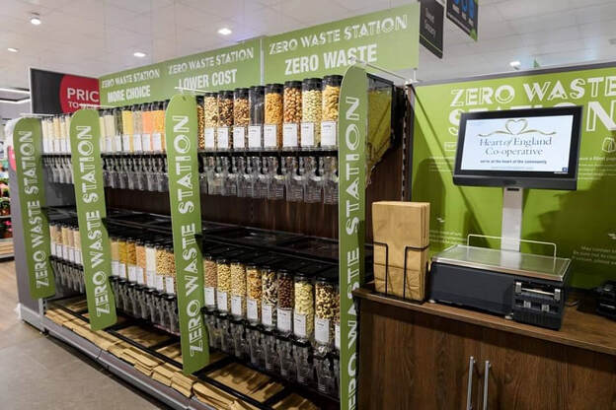
What is GreenBox?
GreenBox is a Community Interest Company (CIC), a zero-waste refill store in the UK.
Customers arrive with their own containers to buy the dry goods, cleaning products, and household staples by weight without any single-use packaging.
Excess profits are allocated to community sustainability projects under the CIC asset-locking model (GOV.UK, 2025).

Slide 3
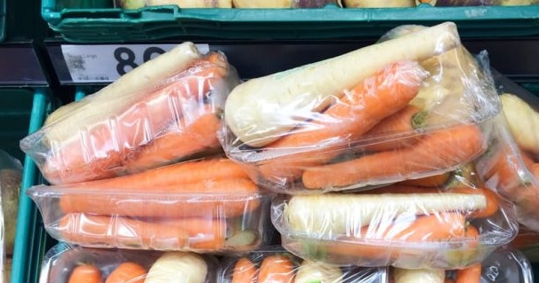
Why is it Sustainable?
GreenBox incorporates sustainability throughout the triple bottom line:
Environmental: Removes single-use plastic. A majority of grocery products in the UK are packed in plastic bags (70% of the total), with half of those (51% of the total) being avoidable (Jones, 2024).
Economic: Buy-by-weight will save households an estimated £730 per year in household food waste (The Guardian, 2022).
Social: Surplus stock will be addressed through a pay-as-you-can scheme, directly addressing food insecurity in the local community.
The real sustainable enterprise excellence involves coordinating stakeholder well-being with environmental performance - GreenBox is designed on this very concept (Edgeman and Eskildsen, 2014)

Slide 4
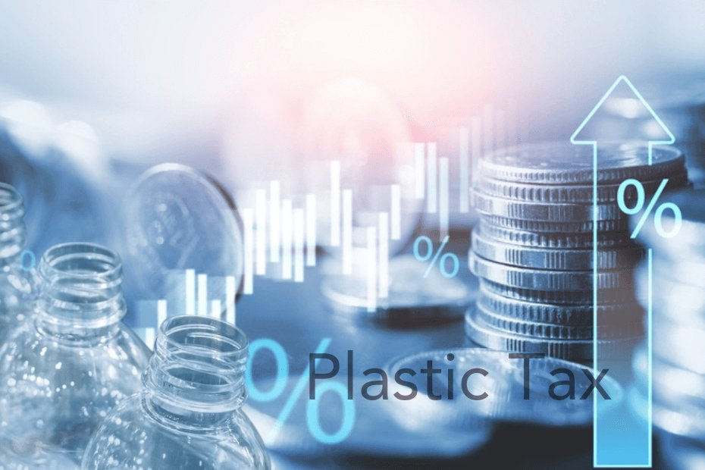
The Market Opportunity
Permanent in-store refill options are desired by 77% of UK consumers (YouGov, 2024)
In April 2025, the UK Plastic Packaging Tax increased to 223.69 per tonne, increasing the expenses of traditional packaged-goods retailers, but not GreenBox, which has no packaging (GOV.UK, 2025).
Affordability is cited as the primary obstacle to sustainable living by 53% of UK consumers (Deloitte, 2024). GreenBox directly addresses this through bulk pricing.

Slide 5
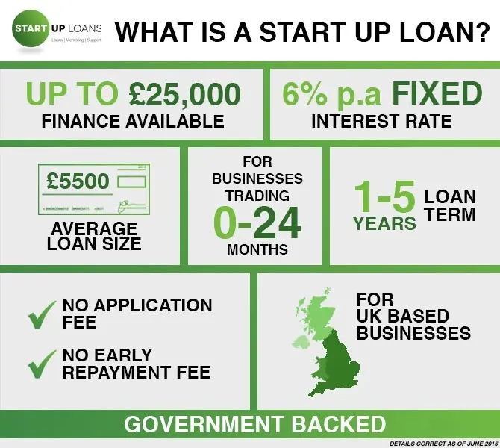
Business Viability
Start-up funding: £48,000-55,000 through UK Government Start Up Loan, community share offer, and social enterprise grants.
Break-even: estimated to be reached at Month 10 of Year 1.
Staffing: founder-director, two part-time staff, and university sustainability volunteer.
Contingency: With low footfall, the satellite refill points in the local cafes and shops will have a wider reach with no extra fixed cost.
CIC structure instills trust among the general public, unlocks grant funding that would not be accessible to a conventional company, and holds the business legally accountable to the community's benefit (Thompson, 2010).

Slide 6
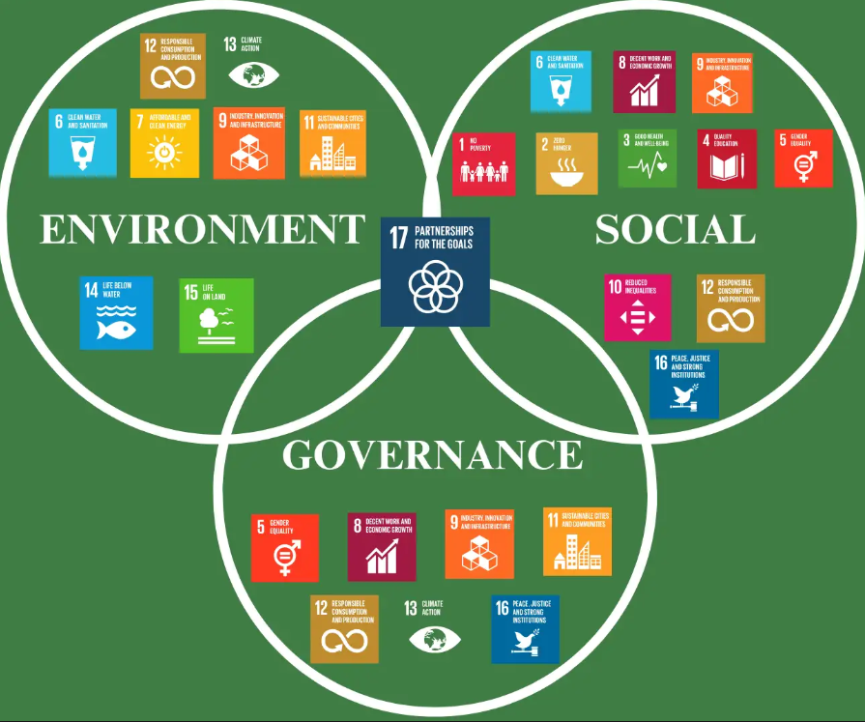
Conclusion
GreenBox is not a niche, environmentally focused project - it is a commercially-based answer to changes in regulation, increasing consumerism, and real community need.
With a clear triple bottom line model, a realistic budget, and a legal form with a social impact design, GreenBox proves that sustainability and business success are mutually reinforcing.
Alignment with the Sustainable Development Goals enhances enterprises' long-term resilience (Rahmana and Bawono, 2021).

Slide 7
References
Deloitte, (2024), Cost and sustainability fatigue stifle consumers’ efforts to adopt more sustainable lifestyles. Available at: https://www.deloitte.com/uk/en/about/press-room/cost-and-sustainability-fatigue-stifle-consumers-efforts-to-adopt-more-sustainable-lifestyles.html [Accessed on 11/04/2026]
Edgeman, R. and Eskildsen, J. (2014). Modelling and Assessing Sustainable Enterprise Excellence. Business Strategy and the Environment, Vol. 23(3), p.173-187. https://onlinelibrary.wiley.com/doi/abs/10.1002/bse.1779
GOV.UK, (2025), Community Interest Companies Guidance. Available at: https://www.gov.uk/government/publications/community-interest-companies-how-to-form-a-cic/community-interest-companies-guidance-chapters [Accessed on 11/04/2026]
GOV.UK, (2025), Plastic Packaging Tax: steps to take. Available at: https://www.gov.uk/guidance/check-if-you-need-to-register-for-plastic-packaging-tax [Accessed on 11/04/2026]
Jones, B. (2024). Over half of UK food and drink products wrapped in unnecessary plastic. Available at: https://resourcemedia.eco/article/over-half-uk-food-and-drink-products-wrapped-unnecessary-plastic [Accessed on 11/04/2026]
Rahmana, F. and Bawono, A. (2021). Sustainable development toward sustainable enterprise. Management Science Letters, 11(2), pp.657-668. https://pdfs.semanticscholar.org/6ed4/7e6077fd43eab1cc8851709674494da6888f.pdf
The Guardian, (2022), Food waste: are you throwing your money in the bin? Available at: https://www.theguardian.com/money/2022/jan/22/food-waste-are-you-throwing-your-money-in-the-bin [Accessed on 11/04/2026]
Thompson, F. M. M. (2010). Social enterprise: developing sustainable enterprises, New York:Palgrave Mcmillan. https://books.google.com/books/about/Social_Enterprise.html?id=ldsUOgAACAAJ
YouGov, (2024), British attitudes towards sustainability in 2024: Key insights from YouGov data. Available at: https://yougov.com/en-gb/articles/49572-british-attitudes-towards-sustainability-on-world-environment-day-2024 [Accessed on 11/04/2026]

Slide 8


