Slide 1



How history, legislation shaped world live in.

Slide 2

What changes have you noticed?
You are encouraged to think about collective and individual changes?
What has directly impacted you: positive and negative?

Slide 3
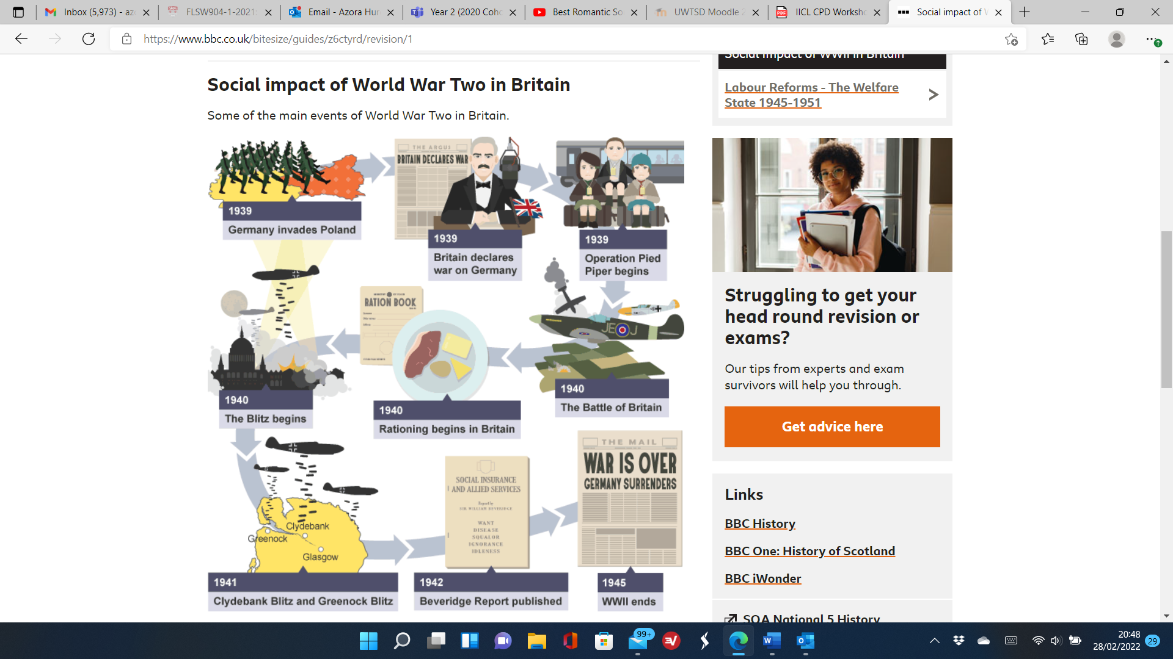
The social impact of World War II in Britain
Notes:
The social impact of the 2nd World War in Britain – You can also draw attention to the way this poster is laid out which the students can gain an idea for designing their poster for element 1 of the portfolio task.
The impact of the 2nd World War – Germany invades Poland which led to Britain joining the war.
The bombing of Britain – the Blitz begins which lead to the rationing of food and goods.
There was the battle of Britain.
The Beveridge report was commissioned and published in 1942.
1945 the 2nd world war ends as Germany surrenders.

Slide 4

Labour Reforms - The Welfare State
1945-1951
After World War II the Labour Government introduced reforms to establish the Welfare State.
The term “from cradle to grave” or “from birth to death” became the core driving force for which the new government took responsibility for in the lives of British citizens.
These tackled ‘Five Giants’ described in the Beveridge Report. These included disease, want, squalor, ignorance and idleness.
Notes:
History of Clement Attlee - GOV.UK (www.gov.uk)
The election - Labour Reforms - The Welfare State 1945-1951 - National 5 History Revision - BBC Bitesize

Slide 5
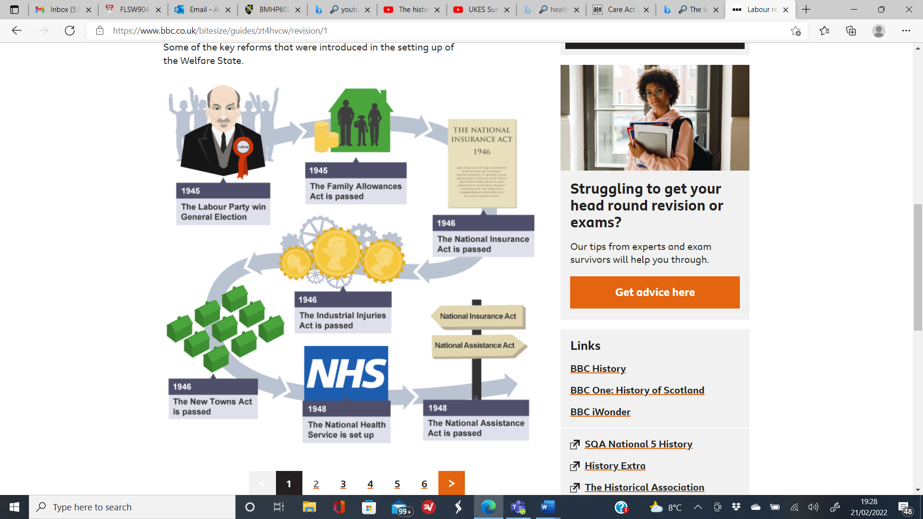
Notes:
The election - Labour Reforms - The Welfare State 1945-1951 - National 5 History Revision - BBC Bitesize
Key Reforms following the second world war.
National Health Service Act 1946: made healthcare free on the basis of citizenship and need rather than the payment of fees or insurance premiums.
National Insurance Act 1946: introduced social security, in which persons of working age had to pay a weekly contribution and in return were entitled to a wide range of benefits when they could no longer work.
Coal Industry Nationalisation Act 1946, Electricity Act 1947.
Transport Act 1947: nationalised the coal industry, electricity utilities, railways and long-distance haulage.
Town and Country Planning Act 1947: planning permission now required for land development; ownership alone no longer sufficient.
Children Act 1948: established a comprehensive childcare service, reforming services providing care to deprived and orphaned children.
Nurseries and Child-Minders Regulation Act 1948: paid child-minders now registered and regulated; inspection regime in place to check their methods and facilities meet basic minimum standards.
National Parks and Access to the Countryside Act 1949: allowed the creation of National Parks and Areas of Outstanding Natural Beauty in England and Wales, gave the public rights of way and access to open land.

Slide 6
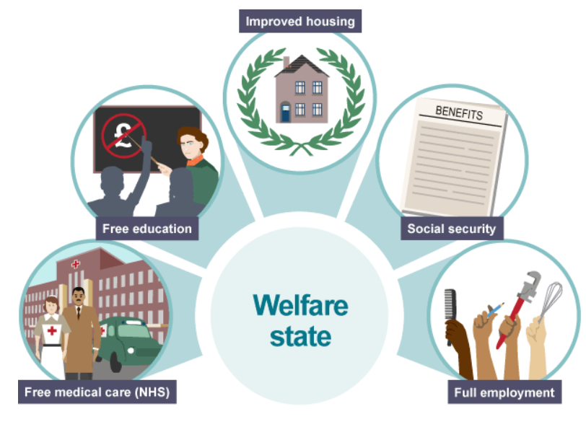
The Welfare State
Notes:
People had sacrificed so much during World War II, they believed they had fought for a better future and deserved it for their contribution to the war. Many believed in a fairer society with:
free medical care
old age pensions
affordable housing
The idea was to offer people a safety net from the cradle to the grave. It was a key Labour party policy, as promised in the 1945 election campaign.
The recommendations were for a system that would be:
comprehensive – cover all problems relating to poverty, from birth to death
universal – available to all
contributory – paid into from wages
non-means tested – available to all, even if unable to pay
compulsory – all workers were to contribute
The challenge of addressing the ‘Five Giants’ led to the establishment of the Welfare State under the Labour Government
From Lee, E. (2021) Effective Communication in Health and Social Care. Effective Communication In Health & Social Care | Techniques, Tips (cpdonline.co.uk) (September 2022)
Health care is the treatment of ill health and medical conditions.
Social care is the care and support of vulnerable people (with or without ill health and medical conditions) such as elderly people or children.

Slide 7

The NHS
The NHS came into existence in 1948 following the aftermath of World War II.
It promised free health care at the point of need for everyone.
The NHS has changed a lot over the years since its inception.
Citizens expect a lot from it today since it came into operation..
Changes in medical advances has made a huge difference in how individual’s are treated and supported in the health care section and afterwards in the social care sector.
Changes in expectations has made the NHS become more accountable.
The overall value base of ‘care, free for all’ is the most distinctive component of the NHS.

Slide 8

Human Rights Act 1998
The Act sets human rights act in a series of articles, with each article concentrating specifically on different rights.
Article 2: Right to Life
Article 3: Free from Torture and Inhuman Treatment
Article 4: Freedom from Slavery and Forced Labour
Article 6: Right to a Fair Trial
Article 7: No Punishment without Law
Article 10: Freedom of Expression
Article 12: Right to Marry and Start a Family
Notes:
Human Rights Act summary: https://www.equalityhumanrights.com/en/human-rights/human-rights-act
The United Kingdom passed the act in 1998 and was fully implemented into law in October 2000.

Slide 9
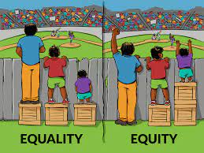
The Equality Act 2010
The Equality Act 2010 legally protects people from discrimination in the workplace and in wider society.
Amalgamated 116 pieces of legislation to improve understanding.
Individuals Characterises are protected:
Age
Sex/Gender
Married and Civil Partnerships
Disability
Religion
Sexual Orientation
Being pregnant/ having children
Notes:
https://www.legislation.gov.uk/ukpga/2010/15/contents
Gay Marriage was Illegal and not recognized prior 2010.
1918 the House of Lords gave approval for women over the age of thirty to have the right to vote.
1928 women over the age of 21 were allowed to vote:
In Wales, individuals aged 16 are allowed to vote in Welsh elections

Slide 10

The United Nations (UN)
The United Nations (UN) is an intergovernmental organization that aims to maintain international peace and security, develop friendly relations among nations, achieve international cooperation, and be a centre for harmonizing the actions of nations (UN, 2015)
The UN is headquartered on international territory in New York City; other main offices are in Geneva, Nairobi, Vienna and The Hague.

Slide 11
The United Nations (UN)
The UN was established post World War II with the aim of preventing future wars, succeeding the ineffective League of Nations.
The UN Charter was adopted in June 1945 and was fully functional and implemented in October 1945
Originally, the UN had 51 member states; United Kingdom (UK), United States (USA), Brazil and Argentina
This number grew to 196

Slide 12

The Northern Atlantic Treaty Organization
(NATO)
April 1949, NATO, an intergovernmental security alliance, was established by 12 countries to ensure:
Peace within Europe
To promote cooperation
Safeguard their freedom
Notes:
10 European and Canada and United States. Now it has 30 members which include 21 European union states.

Slide 13
NATO Summary
https://www.youtube.com/watch?v=8MQ59Ij5fkM
Notes:
Activity: during r watching the video, students are required to highlight key points concerning why NATO was established, and what is it purpose?

Slide 14

European Union
The European Union (EU) is a unique economic and political union between 27 countries (Excluding the U.K.)
Economic union (single trade market)
Climate
Justice (European Court)
Health
Security
Migration

Slide 15
European Union
Treaty on European Union describes the union was founded based on several values:
Human rights
Non-discrimination
Tolerance
Justice
Solidarity
Equality
Notes:
The union as we know it today began by European states signing several treaties, which was initially focused on economic prosperity post WW2.
European Economic Community, created in 1958 with the initial aim of increasing economic cooperation between six countries: Belgium, Germany, France, Italy, Luxembourg and the Netherlands.

Slide 16
https://www.youtube.com/watch?v=8RkwIlr912A
Notes:
Activity: Students are required to highlight the EU role and purpose and share answers to the class.

Slide 17

Brexit
Limited Free movement (cannot reside in Europe without a Visa)
Left the Single Market
Immigration (Boarder Control)
Extra NHS Investment (Approx. £350m).
Economy shrinkage (Medium to Long-term)
Separation from the EU laws
EU funding (Approx £5-6 bn)
Notes:
https://commonslibrary.parliament.uk/research-briefings/cbp-7847/
Wales to experience a shortfall of investment equaling £1.1 billion
https://wcva.cymru/eu-funding-in-wales-a-legacy-not-to-be-forgotten/
https://www.walesonline.co.uk/news/politics/take-years-match-eu-funding-22944152
Wales currently receives around £680 million per year in EU funding. This equates to £83 per person per year, considerably more than any of the devolved nations and English regions. Through the different EU funding programmes there has been millions of pounds given to support health research and innovations throughout Wales. The result of the referendum in 2016 and the possibility of a ‘no deal’ Brexit means that there is uncertainty around the future of European funding to Wales (NHS Confederation).

Slide 18
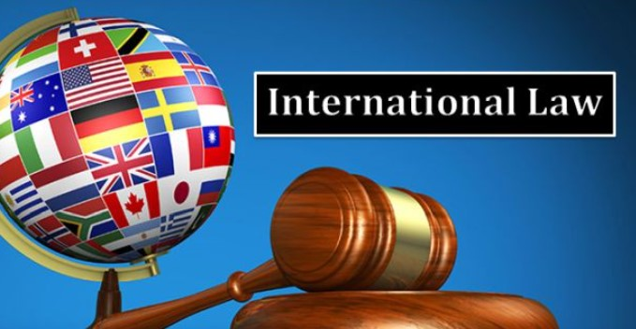
International Law: Activity
https://www.youtube.com/watch?v=jTzKgI68VLc
https://www.youtube.com/watch?v=ePV1J48cGYI
https://www.youtube.com/watch?v=kE137_iMwqw
https://www.youtube.com/watch?v=-VSD2d35ijI

Slide 19

Paris Climate Change Agreement
https://www.youtube.com/watch?v=5THr3bFj8Z4

Slide 20
Paris Climate Change Agreement
The Paris Agreement is a legally binding international treaty on climate change.
196 countries adopted the treaty
5- year cycle of increasingly ambitious climate action by countries.
Reduce Greenhouse Gases Emissions (Net Zero)
Notes:
https://unfccc.int/process-and-meetings/the-paris-agreement/the-paris-agreement

Slide 21

COP 26
https://www.youtube.com/watch?v=qmkJ8QqFlU4
Notes:
BBC article regarding UK commitments to climate change by 2050 https://www.bbc.co.uk/news/58160547

Slide 22

Climate Change Impacts
Flooding
Droughts
Food shortage
Extreme Weather (Heatwaves and Freezes)
Rising Sea Levels
Deforestation
Ecological Damage

Slide 23
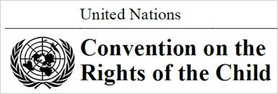
United Nations Convention on the Rights of the Child (UNCRC)
The United Nations Convention on the Rights of the Child (UNCRC) is a legally-binding international agreement setting out the civil, political, economic, social and cultural rights of every child, regardless of their race, religion or abilities.
In 1989, governments worldwide promised all children the same rights by adopting the UNCRC.
The Convention changed the way children are viewed and treated – in other words, as human beings with a distinct set of rights instead of as passive objects of care and charity.

Slide 24
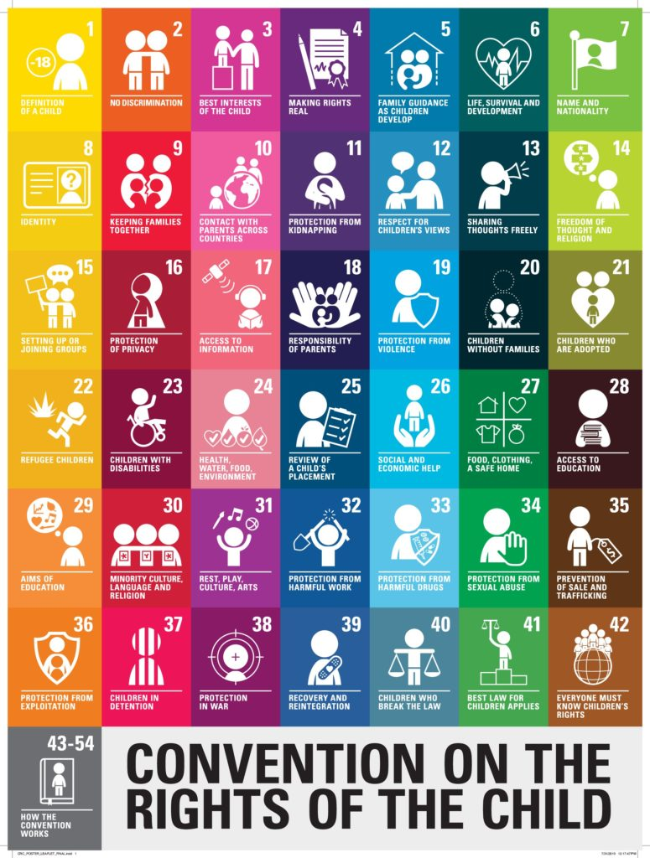
What is the UNCRC?
The UNCRC is a treaty that lays out the rights of children and the standards to which all governments must aspire in order to promote these rights.
Children and Young People need special rights because they are relatively more vulnerable to abuse, and exploitation compared to adults.
The UNCRC brings together children’s human rights into one international convention.
(UNICEF, 2019)

Slide 25

What makes the UNCRC so special?
Every child has rights, whatever their ethnicity, gender, religion, language, abilities or any other status.
Unicef are the only organisation working for children recognised by the Convention.
There are four articles in the convention that are seen as special. They are known as the “General Principles” and they help to interpret all the other articles and play a fundamental role in realising all the rights in the Convention for all children. They are:
Non-discrimination (article 2)
Best interest of the child (article 3)
Right to life survival and development (article 6)
Right to be heard (article 12)
(Unicef, 2019)

Slide 26
UNCRC

Slide 27
UNCRC: Summary Video
https://www.youtube.com/watch?v=5KQGz-toMnk

Slide 28


Slide 29
The United Nations (UN): Sustainable Development Goals: Summary Video
https://www.youtube.com/watch?v=E67ln5yJtyE
Notes:
Activity: Using the following Link: students to look at one specific goal and highlight each intentions.

Slide 30
Overview of the Sustainable Development Goals
The 2030 Agenda for Sustainable Development was adopted by 193 UN member states at the United Nations Sustainable Development Summit in 2015.
It provides an ambitious, globally agreed, shared blueprint for the world we want to see by 2030 and is centered around the 17 Sustainable Development Goals (also known as the Global Goals or SDGs).
The Sustainable Development Goals are underpinned by 169 targets that address a wide range of issues facing both developed and developing countries.
Notes:
https://sdgs.un.org/goals: students to research 1 goal and highlight what countries (particular the UK) are doing to ensure that these are met. These answers are expected to be presented in next weeks lesson.

