Slide 1
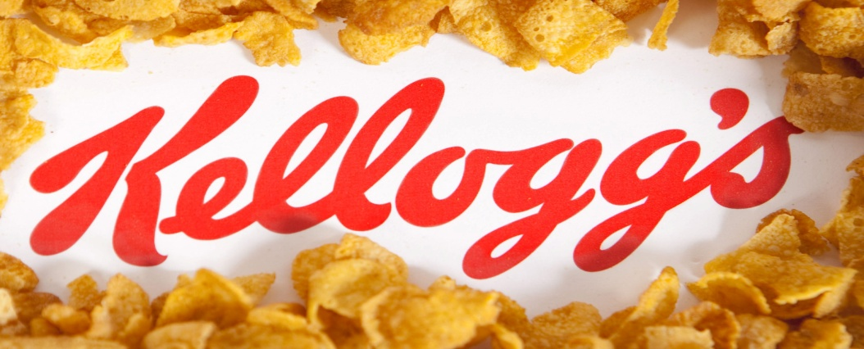
INTRODUCING IN A MODERN WORKPLACE
LECTURER : HUSAM HELMY

Slide 2
Members of the team
Liliana Hartan student number: 1811830
Background /outline of your project and related organisational
Andrei David student number: 1814707 Leadership and management behaviours
Zuzanna Tusk, student number: 1708231
Group and team behaviours
Veronica Andrisan, student number:1811269 Goals and Objectives

Slide 3

Background of Kellogg’s
Kellogg’s regarded as one the largest food manufacturing corporation
It was established in 1906 and founded by K.W. Kellogg
Kellogg’s headquarters situated in Battle Creec, US.
The vision of this company, To enhance and rapture the universe through foods
Kellogg’s produces convenience goods such as cracker, toaster etc.

Slide 4
Background of Kellogs
Earlier 1900, Kellogg and his brother founded Sanitas food producing corporation
In 2017, Kellogg’s total assets was $16.350 billion, net income $1.269 billion
Right now Kellogg’s CEO is Steven Chahillane.
Almost 32,944 employees works in Kellogg’s
In 2019, Kellogg’s declare that it exchanged its top two brands.

Slide 5

Leadership and management behavior
The process of leading the employee of the business toward specific organisation goal achievement is known as leadership.
Kellogg leadership types:
Transformational leadership
Charismatic leadership

Slide 6
Transformational leadership
Helps the leader of the business to bring out the best of the employee
Information sharing creates a favourable environment where the employees know about the vision of the company
Helps creating good relationships with the employees

Slide 7
Charismatic leadership
It motivates employees
It focuses on monetary motivation
The leaders are enthusiastic and believe in themselves more than in the team which can be a treat for team work

Slide 8
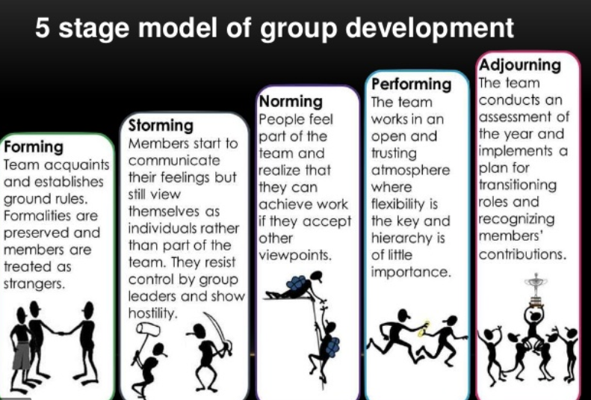
Group and team behaviours
Group is more clearly focused comparing with team
In case of team, employees are individually accountable
Purpose of both group and team is same in an organisation

Slide 9
Group Behaviour
The management comprises of groups
They are liable for products, cost-effectively, finance, account billing,
They coordinate all types of behaviour and operations with seniors

Slide 10

Team Behaviour in Kellogs
They motivate and sell products to customers,
keeping relations personally for the future prospect of the company.
There is a committee in the company where groups and teams can

Slide 11
Goals and objectives
The goal of an organization shows the destination to meet. It is the lifelong aim of the organization that it is supposed to attain to achieve the vision of the organization (Kruglanski et al. 2018).

Slide 12
Kellogg’s goals and objectives
Provides guideline
Contributes to planning and actions:
Motivates the workforce
Assist in controlling the outcome

Slide 13
References
Kruglanski, A.W., Shah, J.Y., Fishbach, A. and Friedman, R., 2018. A theory of goal systems. In The Motivated Mind (pp. 215-258). Routledge.
Reczek, R. W., Trudel, R., & White, K. (2018). Focusing on the forest or the trees: How abstract versus concrete construal level predicts responses to eco-friendly products. Journal of Environmental Psychology, 57, 87-98.

