Slide 1
Welcome !!
Week One Project management and professional development
Julie hayward

Slide 2


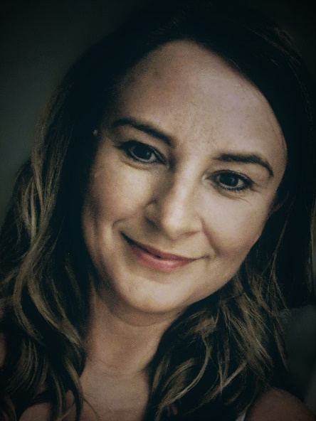



JULIE HAYWARD
MCIPD, FHEA
NAAFI
Scottish & Newcastle
About Me
Before joining the team here at UWTSD in 2016 I had a varied career in retail management and in HR in various sectors. Most recently I was a Talent Manager at Tata Steel Europe, based in Port Talbot but covering a number of UK and European operations.
The pins on the maps represent places I have lived over the past 20 years and where I have worked.
I now lecture in HRM, and Leadership and Management on both undergraduate and post graduate programmes here at UWSTD and am the Programme Director for the Undergraduate Business Portfolio.
I am a qualified coach, hold a PG Cert in Technology Enhanced Learning and am studying towards a DBA.
NAAFI
ARGOS
P4U
TSE
CARGO
UPL
NAAFI
Research Interests: Industry 4.0, Education 4.0, Complexity
MOD

Slide 3

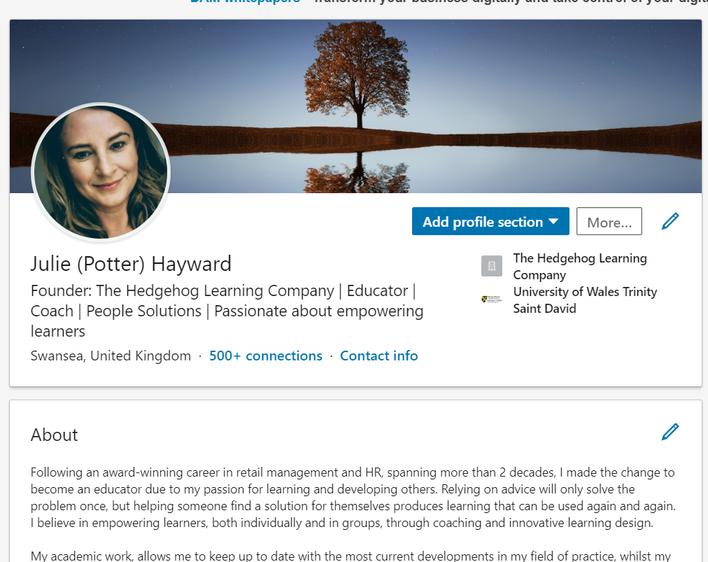
More from me at…
“The best thing for being sad," replied Merlin, beginning to puff and blow, "is to learn something. That's the only thing that never fails. You may grow old and trembling in your anatomies, you may lie awake at night listening to the disorder of your veins, you may miss your only love, you may see the world about you devastated by evil lunatics, or know your honour trampled in the sewers of baser minds. There is only one thing for it then — to learn. Learn why the world wags and what wags it. That is the only thing which the mind can never exhaust, never alienate, never be tortured by, never fear or distrust, and never dream of regretting. Learning is the only thing for you. Look what a lot of things there are to learn.”
https://whytheworldwagstoday.wordpress.com/
www.linkedin.com/in/julie-hayward-82a49559

Slide 4



WWW.Slido.com

Slide 5

Module Structure – Academic year
Most of Modules across level four (first Year) occur in one Semester
This module will be delivered in two blocks (one now and one in the new year) – with occasional support sessions

Slide 6

What will be covered
Week 1
Session one – Overview of module and assignments + Q&A session
Session one – Critical writing
Session Three – Credible Information
Session Four – Referencing an modes of presentation

Slide 7
What will be covered
Week 2
Session Five – Project Management
Session Six - Planning a project
Session Seven – the project team
The remaining topic of professional development wil be covered at the end of the semester in January

Slide 8

Module Structure
So Why do it this way??.....
To Get everyone up to speed
To Give the essential foundational skills immediately
To make the time spent in other modules more valuable, efficient and Enjoyable
To Get you better Grades

Slide 9

Project Management and Professional Development

Slide 10

Module Structure – All Modules
It is important to note the inter-relation of modules in Semester one
The modules have been developed to give you a better simulation of a real world work environment to aid employability
This makes participation in all modules essential to achieving good grades

Slide 11

Today’s Session
Overview of the module
Overview of Assignment one
Critical writing

Slide 12
Why is this module Important
It is foundational to your experience in University
It will Provide you with the essential skills that will ultimately allow you to perform well in your assignment
It will accelerate your learning
Help to Bridge to gap between the academic and professional

Slide 13
Why is this module Important
provides you with Transferable Skills
Gives you the confidence to be critical
Develops you Skills of Self Reflection

Slide 14

Some Skills you can start developing now
Come to Class…..On time
Participate
Be Organised
Be Good…..Not Perfect
Be Realistic

Slide 15
Some Skills you can start developing now
Follow Instructions
Do not Plagiarise
Stay Focussed
Stay Positive !!!

Slide 16

What will you Learn
How to Gather information
How to Analyse and Assess information
Communicating and presenting information in a variety of mediums
Project Management tools and techniques

Slide 17
What will you Learn
Harvard Referencing
The use of IT in an academic and professional setting
Analytical skills
Standards expected of you in university

Slide 18
Assessment
Task 1 - Project Management Task
The first task is worth 50% and is due during w/c 28th October 2019
As a project team produce a presentation and supporting documents which demonstrate the application of project management skills to a project you are currently undertaking.
The presentation and supporting documents should include:
An analysis of the context in which the organisation/sector you are working with operates and the challenges they face
A compelling story about the purpose of your project
The aims and objectives of the project applying a recognised model e.g. SMART, FAST
Evidence you have used project management techniques in the planning of your project
Each member of the group should contribute 5 minutes to the presentation and (1400 words/equivalent) to the supporting documents. The supporting documents might include such things as Gantt charts, fishbone analysis, PEST analysis, stakeholder map, meeting minutes, project charters, risk analysis or any other documents created in the process of planning the project.
The supporting documents should be compiled into one submission which clearly identifies who has contributed to each element (you could do this in the form of a table in the appendix) and submitted by a nominated team member via Turnitin.

Slide 19
Assessment
Task 2 – Professional Development Task
This task is worth 50% and is due during January 2020
Produce a professional development plan (PDP) using the template provided, of approximately 600 words, detailing development achievements and future development needs based on participation in a project.
This will be supported with an individual 5 minute presentation, which reflects on the transferable skills that have been developed over the course of the project and identifies, where there was a personal shortfall in skills and abilities, what plans are in place to address these skills gaps.
*Please note 20% of the marks for this module will be allocated for in-class/Moodle based activities which will take place across the module.

Slide 20

SLIDO – Question and Answer Session

