Slide 1



ACHA4008: Integrating Project Microsoft Project
Delivered By: David A Williams BSc.(hons), MSc.

Slide 2
MS Project Getting Started
Creating a New Plan
Create Blank Project
MS Project will display a list of options. In the list of available templates.
Click Blank Project.

Slide 3
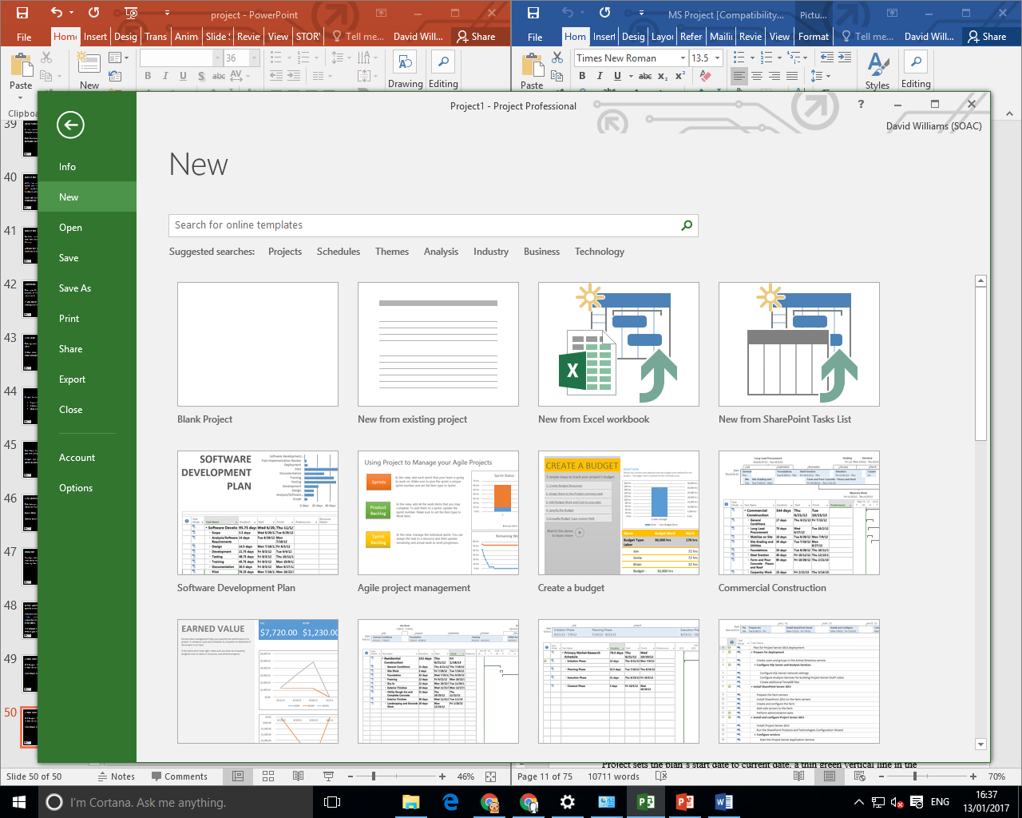
MS Project Getting Started
Creating a New Plan

Slide 4
MS Project Getting Started
Creating a New Plan
Project sets the plan’s start date to current date, a thin green vertical line in the chart portion of the Gantt Chart View indicates this current date.
In a new project both the start and end dates are set to the current date

Slide 5
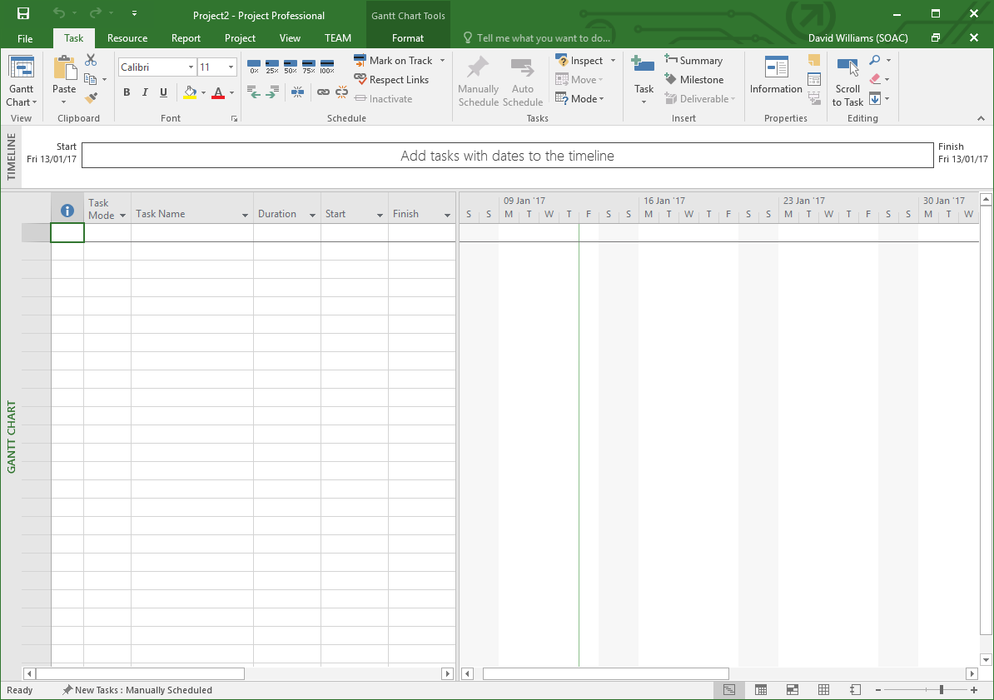
MS Project Getting Started
Creating a New Plan

Slide 6
MS Project Getting Started
Start Date
Let us change the project start date and add some more information.
Step 1 − Start Date
Click
      Project tab →
      Properties Group →
      Project Information

Slide 7
MS Project Getting Started
Start Date
A dialog box appears.
In the start date box-
click the down arrow to display the calendar, select any date of your choice
or
manually type it into the text box provided
Click OK to accept the start date.

Slide 8
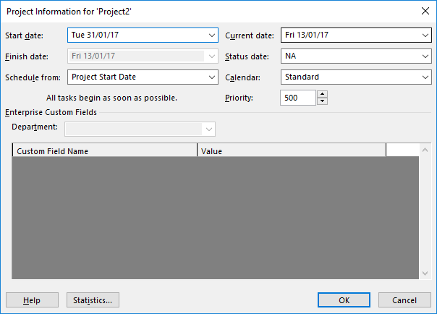
MS Project Getting Started
Start Date

Slide 9
MS Project Getting Started
Set Up Calendar
Step 2 − Set Up Calendar
Click
Project tab →
Properties Group →
Project Information.
Click the arrow on the calendar dropdown box. A list appears containing three base calendars.

Slide 10
MS Project Getting Started
Set Up Calendar
Base calendars.
• 24 Hour − A calendar with no non-working time.
• Night Shift − Covers 11 PM to 8 AM, night shifts covering all nights from Monday to Friday, with one hour breaks.
• Standard − Regular working hours, Monday to Friday between 8 AM to 5 PM, with one hour breaks.

Slide 11
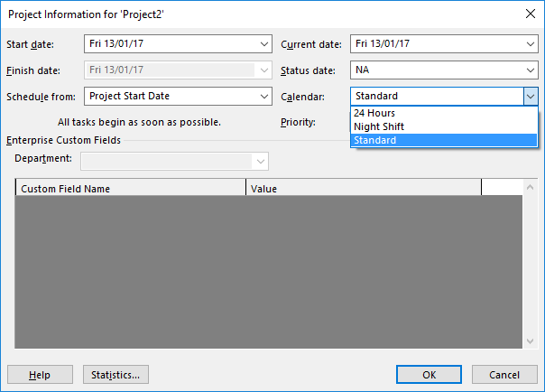
MS Project Getting Started
Set Up Calendar

Slide 12
MS Project Getting Started
Project Information
Select a Standard Calendar as your project Calendar.
Click “Cancel” or “OK” to close the dialog box.
Now let us add exceptions.

Slide 13
MS Project Getting Started
Exceptions to Calendar
Step 3
Adding Exceptions to Calendar
Exceptions are used to modify a Project calendar to have a non-standard workday or a non-working day.
You can also allot unique working hours for a particular resource as well.

Slide 14
MS Project Getting Started
Exceptions to Calendar
Here is an example to create a non-working day, which could be because of a holiday or office celebrations or events other than the standard office work effort.
Click
Project tab →
Properties Group →
Change Working Time.

Slide 15
MS Project Getting Started
Exceptions to Calendar
Change Working Time dialog box appears.
Under Exceptions Tab click on the Name Field, enter event as
“Action For Change Meeting”.
In the Start field enter the date, and then enter the same date in the Finish field.

Slide 16
Getting Started
Exceptions to Calendar
This date is now scheduled as a non-working day for the project.
You can also verify the changed colour indicated in the calendar within the dialog box as below.
Click Ok to close.

Slide 17
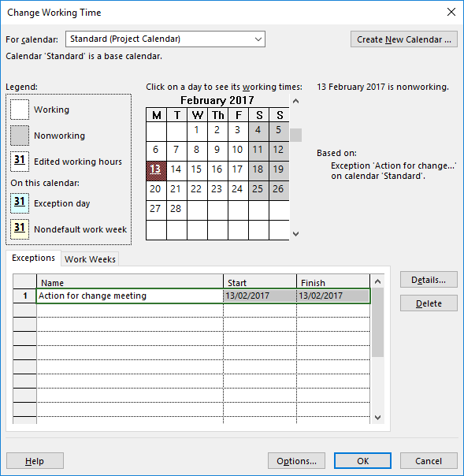
MS Project Getting Started
Exceptions to Calendar

Slide 18
MS Project Getting Started
Resources
Resources
In project management terminology, resources are required to carry out the project tasks.
They can be people, equipment, facilities, funding, or anything except labour required for the completion of a project task. Optimum Resource Scheduling is the key to successful project management.

Slide 19

MS Project Getting Started
Resources
Resource Types
Work − People and equipment to complete the tasks.
Costs − Financial cost associated with a task. Travel expenses, food expenses, etc.
Materials − Consumables used as project proceeds. For example, paint being used while painting a wall

Slide 20
MS Project Getting Started
Resources
Be aware of the crucial difference between People and Equipment resources.
People resources will have limited work hours, say 6, 8 or 12 hours.
Equipment resources have different working capacities of 2, 8 or 24 hours and could have maintenance breaks as well.

Slide 21
MS Project Getting Started
Resources
Also note, that it is possible multiple people resources might be using one equipment resource, or one piece of equipment might be accomplishing multiple tasks.

Slide 22
MS Project Getting Started
Resources
Enter Work Resource Names
You can enter resource names according to your convenience.
Work resource as an identified person -
John, Kevin
Work resource as a job function or group
Engineer, Coordinator, Typist
Work resource as an equipment
Lathe machine, Earth mover

Slide 23
MS Project Getting Started
Resources
Steps involved −
Click View tab → Resource Views group → Click Resource Sheet.
Click the cell directly below the Resource Name heading column.
Enter Resources as an individual person, job function or group.

Slide 24
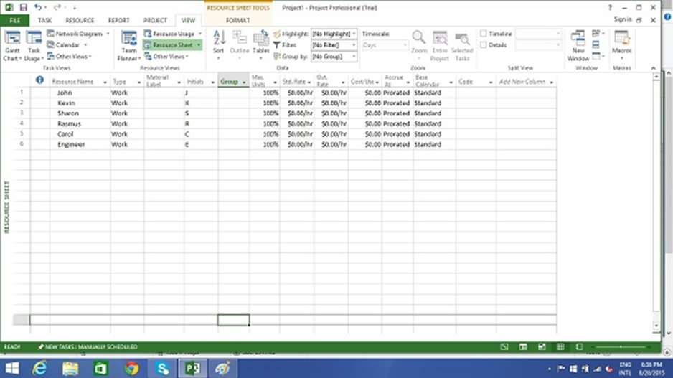
MS Project Getting Started
Resources

Slide 25
MS Project Getting Started
Resources
Max Units field represents the maximum capacity of a resource to work on assigned tasks.
100% stands for 100 percent of resource’s working time is available for work on task assigned.

Slide 26

MS Project Getting Started
Resources
If a resource does not represent an individual person but a job function, where a group of people with the same skill set can work on the task, we can enter larger Max Units to represent the number of people in the group.
So 400% would indicate, 4 individual people working full-time every workday.

Slide 27
MS Project Getting Started
Resources
Work Resources as a Group
Click View tab → Resource Views group → Click Resource Sheet
Click the cell directly below Resource Name heading column

Slide 28
MS Project Getting Started
Resources
Enter Resources as group, here we take an example of Engineers.
Click the Max. Units field for the Engineers resource.

Slide 29
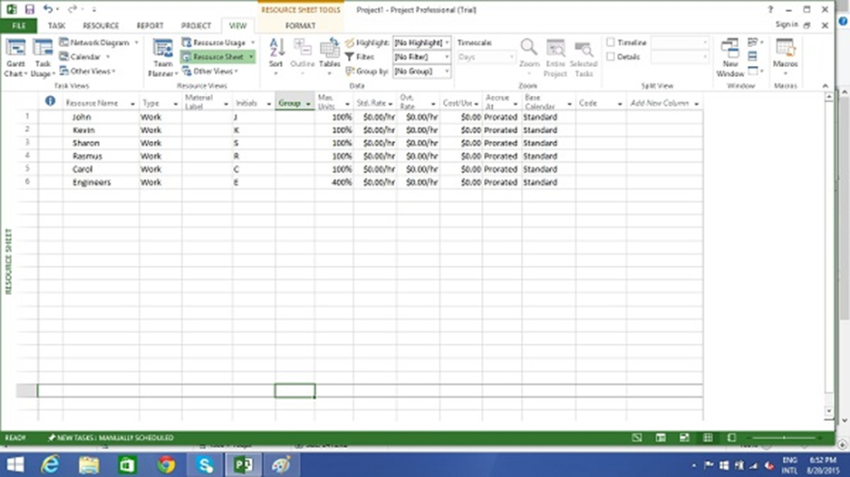
MS Project Getting Started
Resources
Type or select 400%. Press Enter.

Slide 30
MS Project Getting Started
Resources
Work Resource as Part-time
Entering a value less than 100% in Max. Units would mean you expect the resource capacity to be lower than a full-time resource.
So 50% would mean the individual works for half of the normal full capacity, so if a normal work week is 40 hours, this equals 20 hour capacity.

Slide 31
MS Project Getting Started
Resources
Click View tab → Resource Views group → Click Resource Sheet.
Click the cell directly below Resource Name heading column.
Enter Resource as an individual or job function. Here let’s take an example.

Slide 32
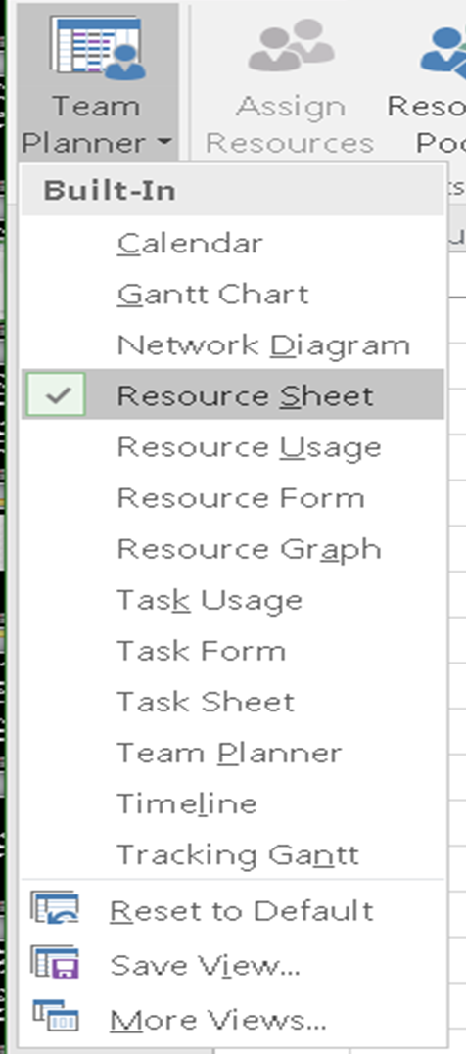
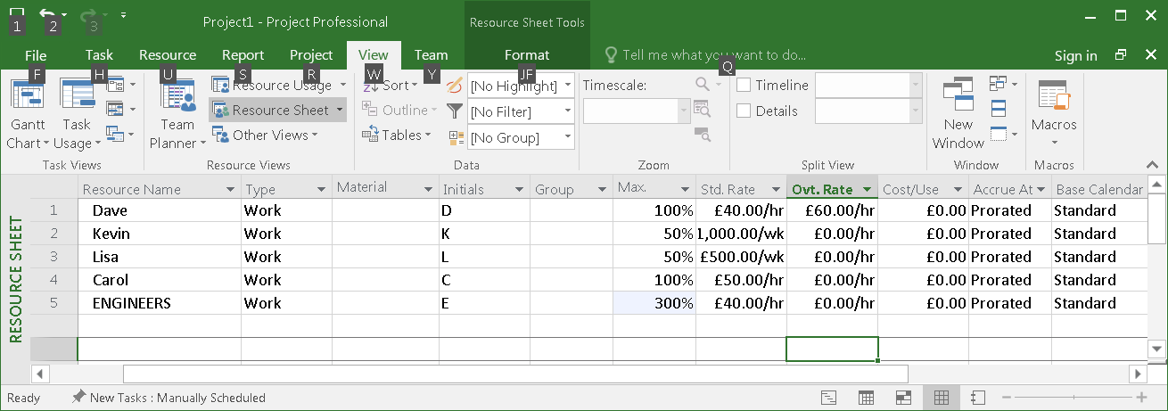
MS Project Getting Started
Resources

Slide 33
MS Project Getting Started
Resource
You can enter standard rates and costs per use for work and material resources.
You can also enter overtime rates for work resources. Standard rates are calculated on per hour basis.
Costs per use on the other hand are costs that do not vary with task.

Slide 34
MS Project Getting Started
Resource
Cost per use is a set fee used up to complete a task.
There are three types of resources − work, material, and cost.

Slide 35
MS Project Getting Started
Resource
Cost resources do not use pay rates. Remember cost per use and cost resources are two different things.
Cost resources are financial cost associated with a task, like travel expenses, food expenses, etc.

Slide 36

MS Project Getting Started
Resource
The cost value of cost resource is only assigned when you assign cost resource to a task.

Slide 37
MS Project Getting Started
Resource
Project calculates the cost of a task by using this formula −
Cost of Task = Work Value (in number of hours) x Resource’s Pay Rate.
You can then see the cost per resource and cost per

Slide 38
MS Project Getting Started
Resource
You can then see the cost per resource and cost per task as well as costs rolled up to summary tasks and the entire plan
MS Project will not automatically apply overtime calculations.
To enter standard and overtime pay rates for work resources −

Slide 39
MS Project Getting Started
Resource
Click View tab → Resource Views group → Resource Sheet.
Click the cell directly below Resource Name heading column to create Resources.
Click the Std. Rate field for each resource to costs in hourly (default), daily, weekly, monthly and yearly rates.

Slide 40
MS Project Getting Started
Resource
In the following example, the resource Carol is left at zero.
This is useful when you don’t have to track rate-based costs for some resources.
Click the Ovt. Rate field to enter overtime rates.

Slide 41
MS Project Getting Started
Resource
Add Notes to Resources
Click View tab → Resource Views group → Resource Sheet.
Double-click the Resource, a Resource Information dialog box opens.

Slide 42
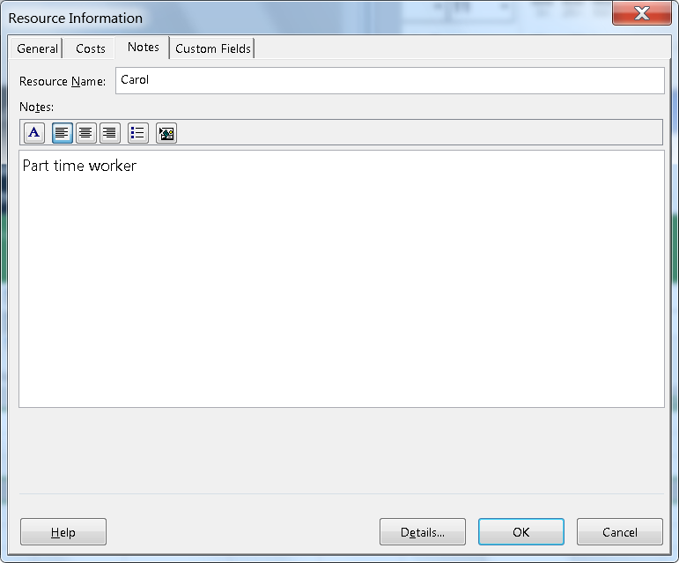
MS Project Getting Started
Resource

Slide 43
MS Project Getting Started
Resource
A note icon now appears to the left of Carol’s name in the Resource Sheet view.
Hovering over it will make the note appear.

Slide 44
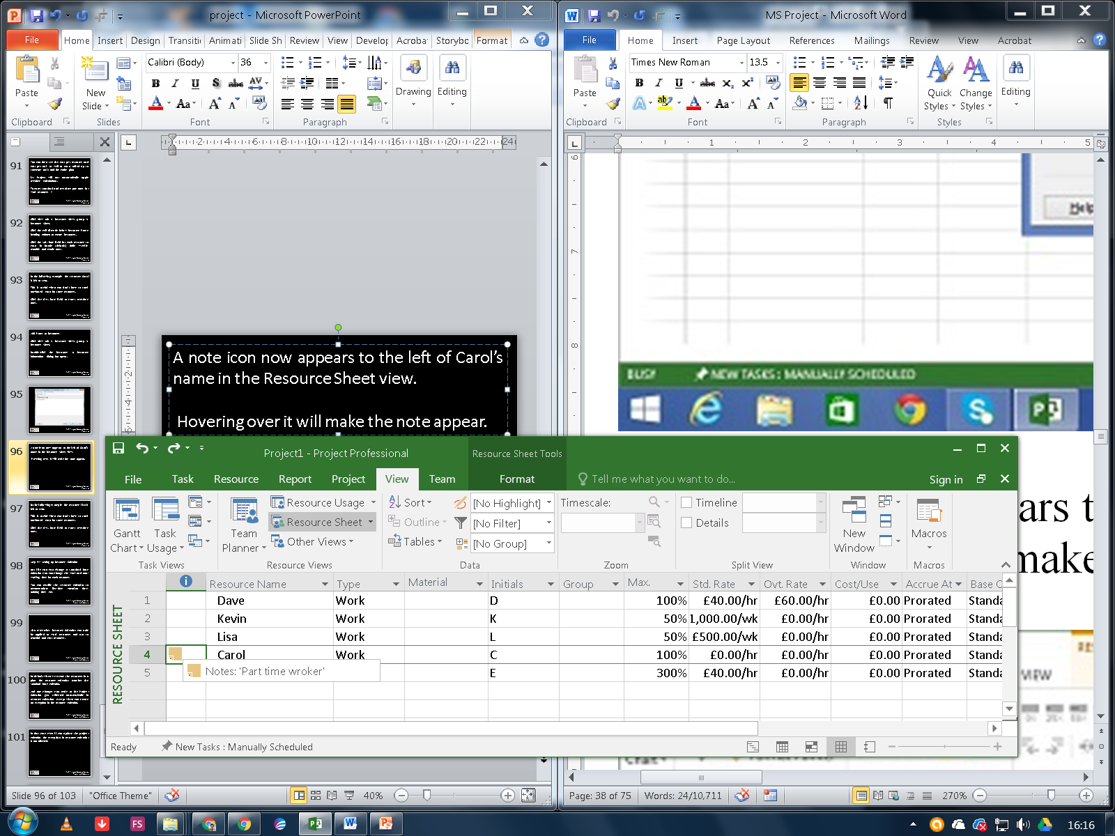
MS Project Getting Started
Resource

Slide 45
MS Project Getting Started
Resource
Set Up Cost Resources
You can use a cost resource to represent a financial cost associated with a task in a plan.
Examples of cost resources are travel, food, entertainment and training.
So it is obvious that cost resources do no work on a task and do not affect scheduling of a task.

Slide 46
MS Project Getting Started
Resource
Cost value of the cost resource is entered when assigning it to a task.
Click
View tab →
Resource Views group →
Resource Sheet.

Slide 47
MS Project Getting Started
Resource
Click the empty cell in the Resource Name column.
Type Training and press the Tab Key.
In the Type field, click the down arrow to select Cost.

Slide 48
MS Project Getting Started
Resource Calendar
Step 4 − Setting up Resource Calendar
Just like you can change a Standard Base Calendar, you can change the work and non-working time for each resource.
You can modify the resource calendar to accommodate flex-time, vacation time, training time, etc.

Slide 49
MS Project Getting Started
Resource Calendar
Also remember, Resource Calendar can only be applied to work resources and not to material and cost resources.

Slide 50
MS Project Getting Started
Resource Calendar
By default when we create the resources in a plan, the resource calendar matches the Standard base calendar.
And any changes you make to the Project Calendar, gets reflected automatically in resource calendars, except when you create an exception in the resource calendar.

Slide 51
MS Project Getting Started
Resource Calendar
In that case even if you update the project calendar, the exception in resource calendar is not affected.

Slide 52
MS Project Getting Started
Resource Calendar
Click Project tab → Properties group → Click Change Working Time
Change Working Time dialog box appears.
Click the down arrow for the “For Calendar” drop-down box.
Select the resource for whom you want to create an exception. In example below I have chosen John.

Slide 53
MS Project Getting Started
Resource Calendar
In the Start field enter the date example 19/02/2017.
Then enter the same date in the Finish field.

Slide 54
MS Project Getting Started
Resource Tasks
MS Project - Assign Resources to Task
Once the task and resource list are complete, resources need to be assigned to tasks in order to work on them.
With MS Project you can track task progress, resource and tasks costs.

Slide 55
MS Project Getting Started
Resource Tasks
Assign Material Resource to Task
Method 1
Click View Tab → Gantt Chart View → Resource Name column.
Click the box below the Resource Name column for the task you need the resource to be assigned.

Slide 56
MS Project Getting Started
Resource Tasks
From the dropdown, choose the resource name. In the following screenshot as an example.
For Task 1 “PT1”, we have chosen the resource “Dave”.
You can also select multiple resources to work on a single task.

Slide 57
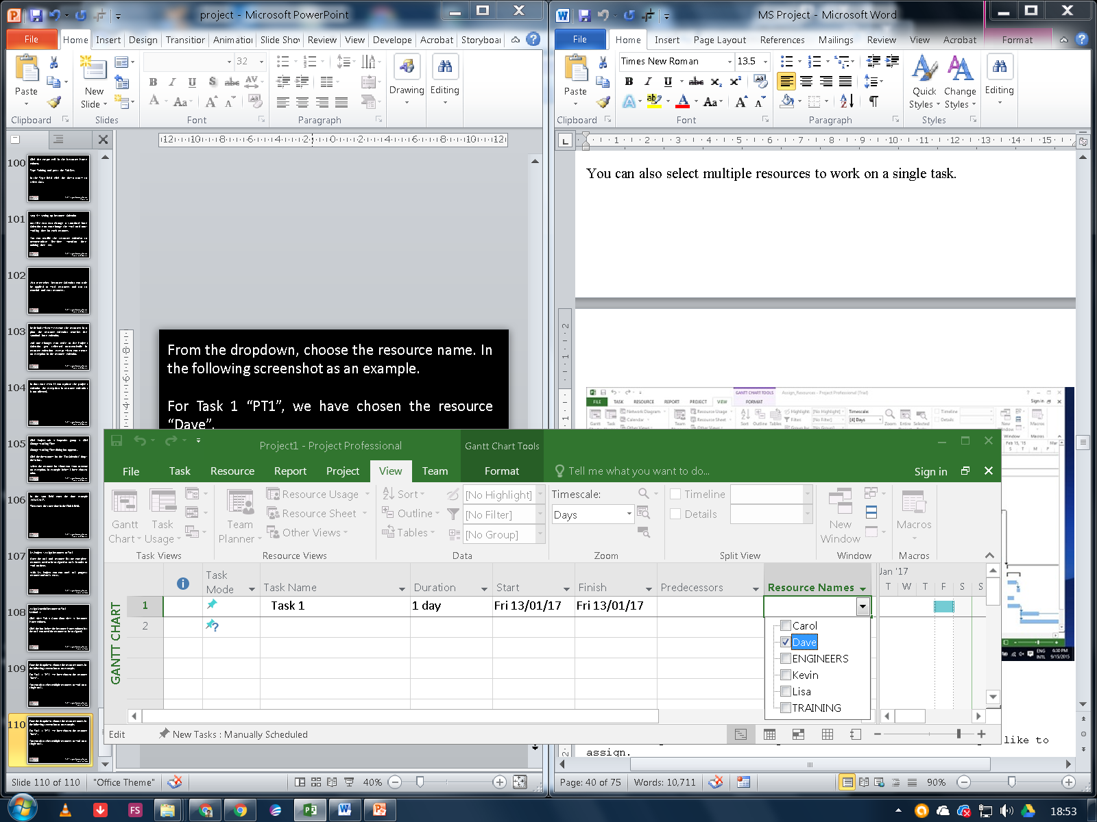
MS Project Getting Started
Resource Tasks

Slide 58
MS Project Getting Started
Resource Tasks
Method 2
Click
  Resource tab →
  Under Assignments group →
  Assign Resources.
In the Assign Resources dialog box, click the resource name you like to assign.

Slide 59
MS Project Getting Started
Resource Tasks
Here let’s choose “Lisa”.
Now click the Assign button.
You can also select multiple resources to work on a single task.

Slide 60
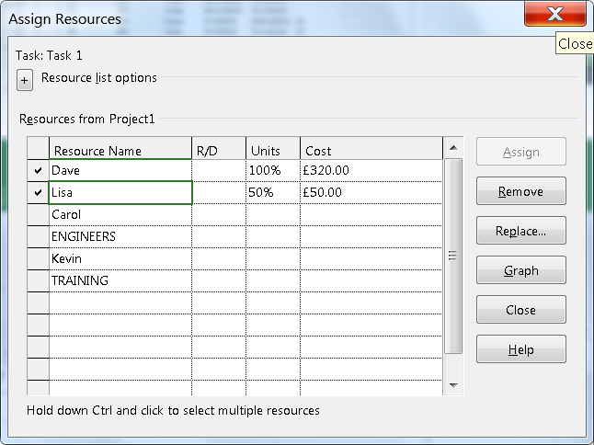
MS Project Getting Started
Resource Tasks

Slide 61
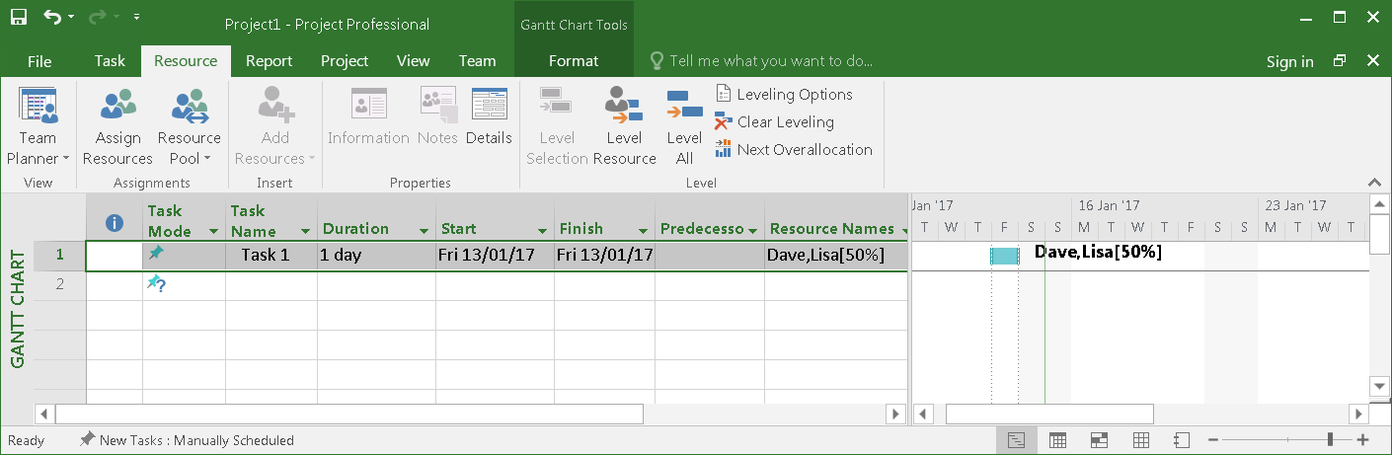
MS Project Getting Started
Resource Tasks

Slide 62
MS Project Getting Started
Resource Tasks
Method 3
Click View Tab → Gantt Chart → Task Name column.
Double-click the Task Name. Task Information dialog box opens.
Click the Resources tab.
Click the cell below the Resource Name column. Select the resource from the dropdown list.

Slide 63
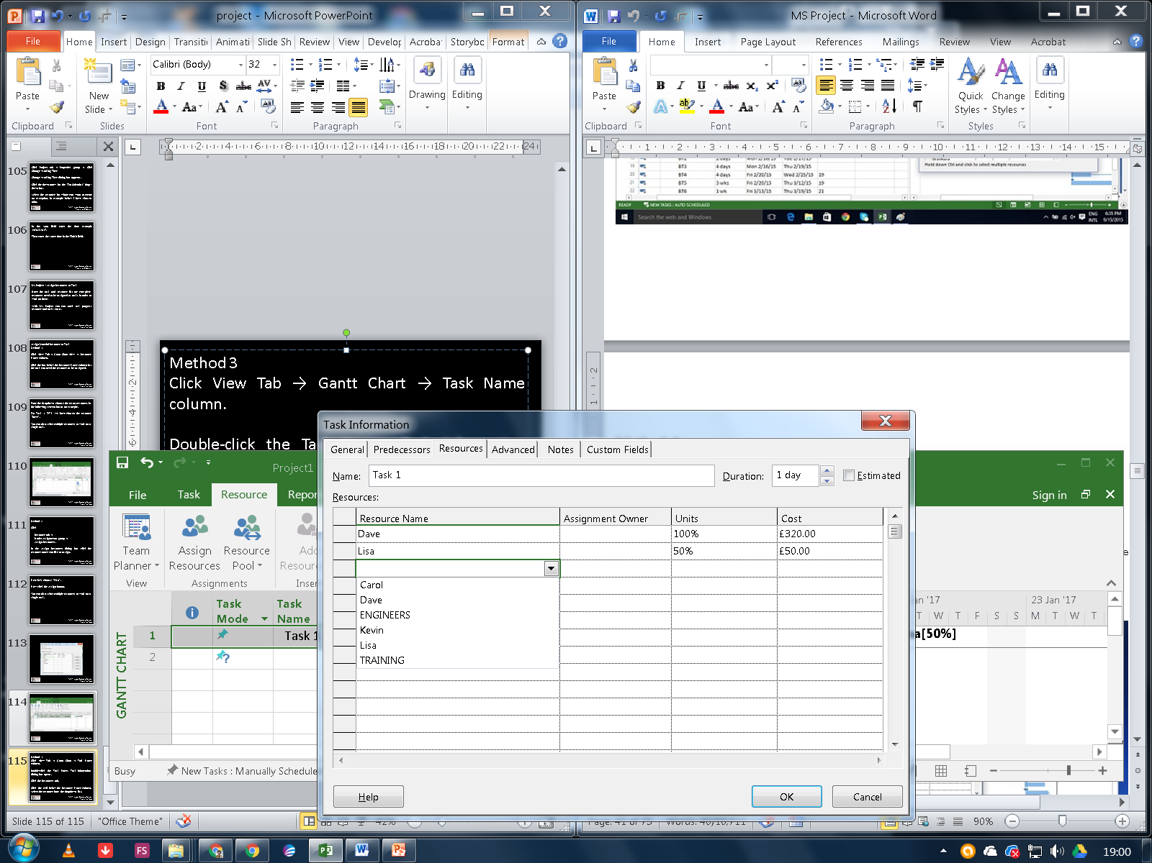
MS Project Getting Started
Resource Tasks

Slide 64
MS Project Getting Started
Resource Tasks
Method 4
Click View Tab → Split View group → Details → Task Form.
The window is split in two, Gantt Chart view and Task Form view below it.
In the Task Form view, click under the Resource Name column and select the resource.

Slide 65
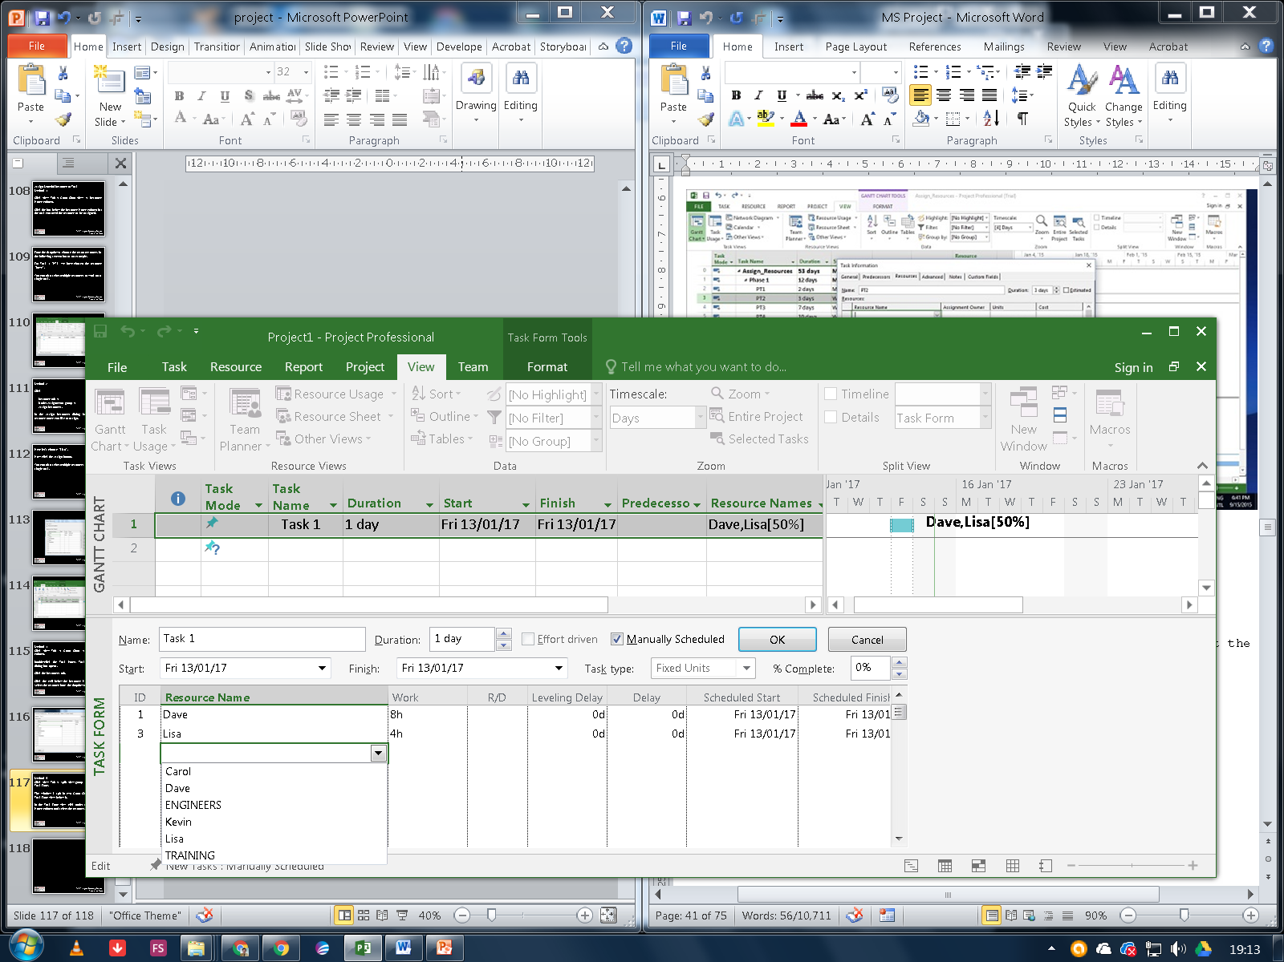
MS Project Getting Started
Resource Tasks

Slide 66
MS Project Getting Started
Resource Tasks
Assign Cost Resource to Tasks
Click View Tab → Gantt Chart View → Task Name column.
Double-click the Task Name. Task Information dialog box opens.
Click the Resources tab.
Click the cell below the Resource Name column. Select the resource from the dropdown list.

Slide 67
MS Project Getting Started
Resource Tasks
In the following example below,
let’s choose “Travel” as cost resource and enter the cost at £100.
We can also assign other material resources to the same task.

Slide 68
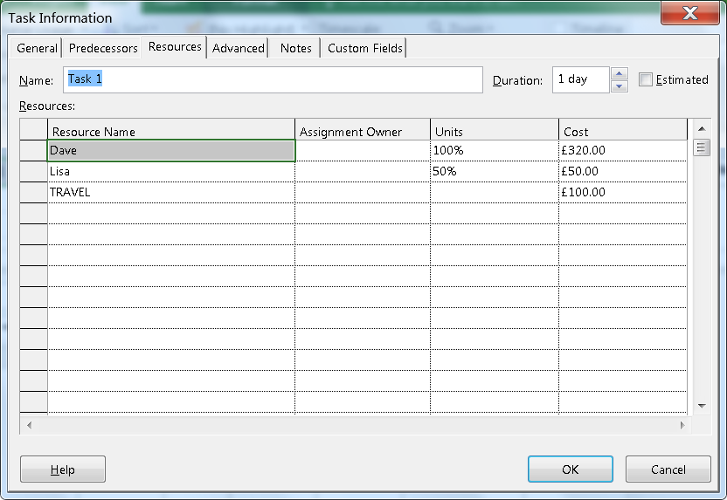
MS Project Getting Started
Resource Tasks

Slide 69
MS Project Getting Started
Duration
MS Project - Plan Duration Cost & Time
After assigning resources to tasks you can view the cost, duration and work required for the plan to complete.
Check Plan’s Duration
In Gantt Chart View → View Tab → Split View group → Timeline checkbox.

Slide 70
MS Project Getting Started
Duration
You will be able to see the plan’s start and finish dates.
In the Gantt Chart view, you can also look at –
project summary task
to note the duration
start and finish dates of the plan.

Slide 71

MS Project Getting Started
Duration
In the following example, Assign Resources is the project summary task identified as Task 1.
  Duration=53 days,
  Start date: 13/01/17
  Finish Date: 28/03/17

Slide 72
MS Project Getting Started
Duration
One can switch Project Summary Task on by following these steps −
  In Gantt Chart View →
  Format Tab →
  Show/Hide →
  To check Project Summary Task on.

Slide 73
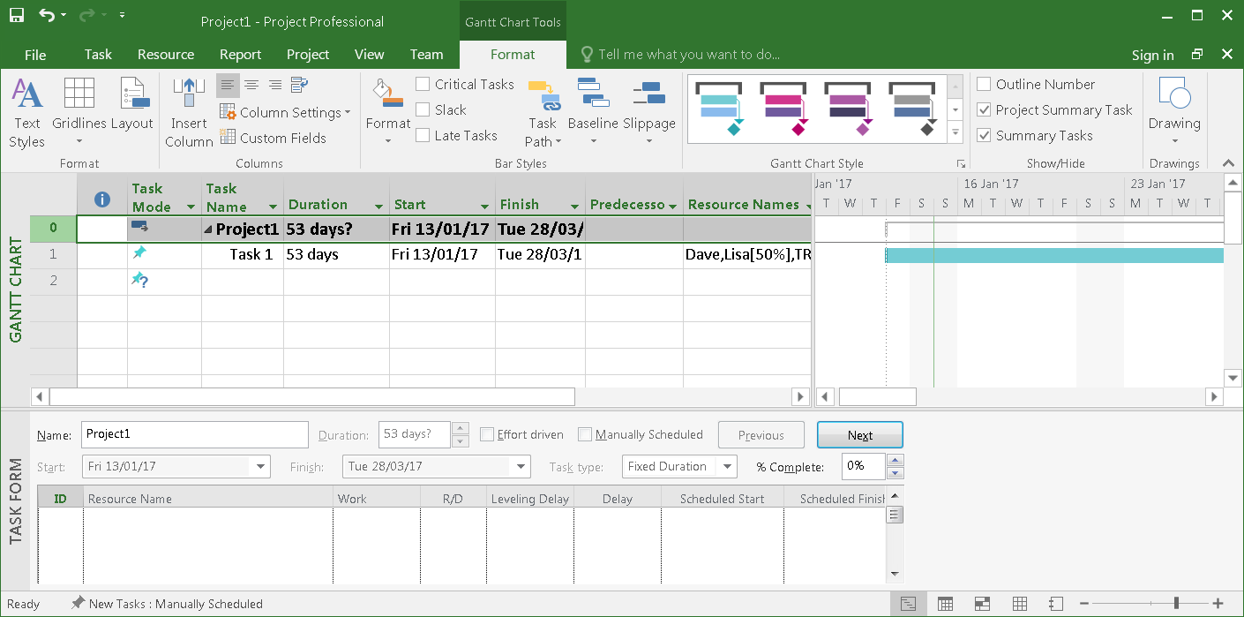
MS Project Getting Started
Duration

Slide 74
MS Project Getting Started
Duration
Check Plan’s Cost
Click View tab →
Data group →
Tables →
Cost.
Cost for each task gets rolled up into summary tasks, and then ultimately to project summary task.

Slide 75
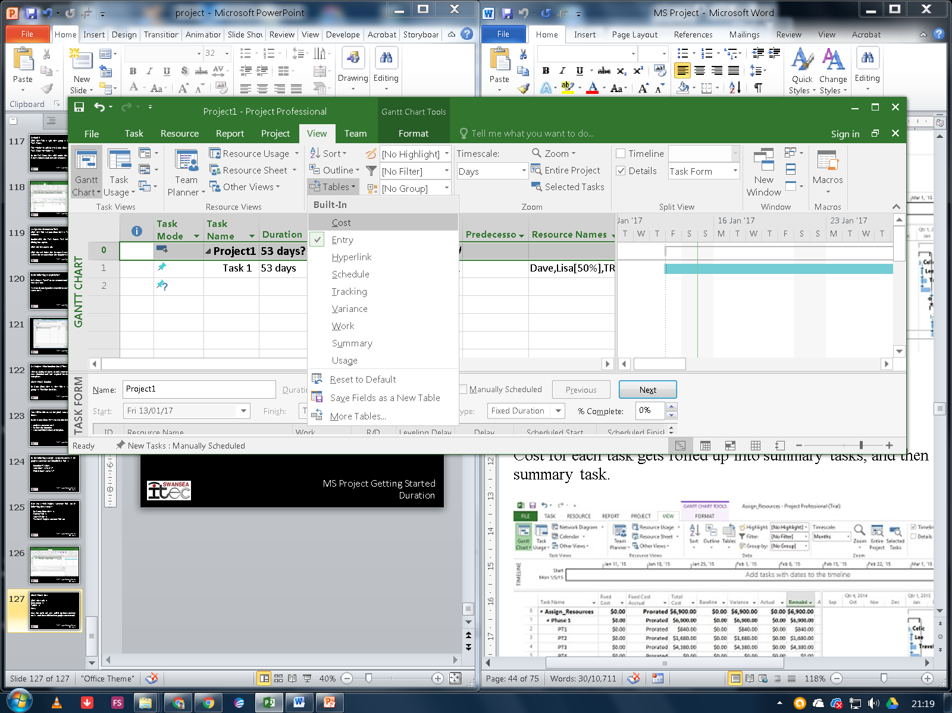
MS Project Getting Started
Duration

Slide 76
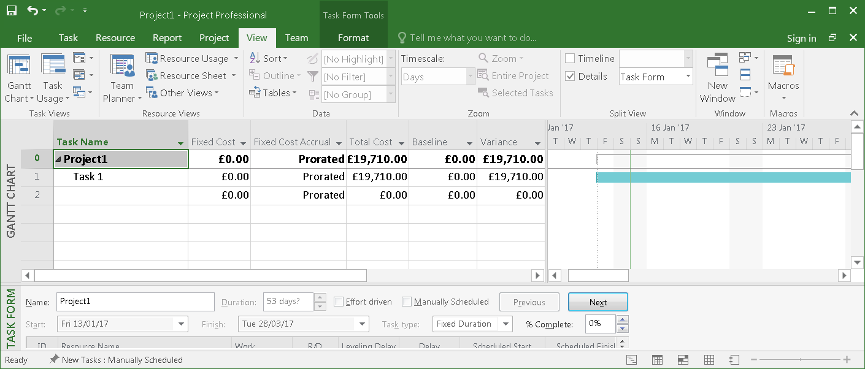
MS Project Getting Started
Duration

Slide 77
MS Project Getting Started
Duration
Check Plan’s Work
  Click Report Tab →
  View Reports group →
  click Resources →
  click Resource overview

Slide 78
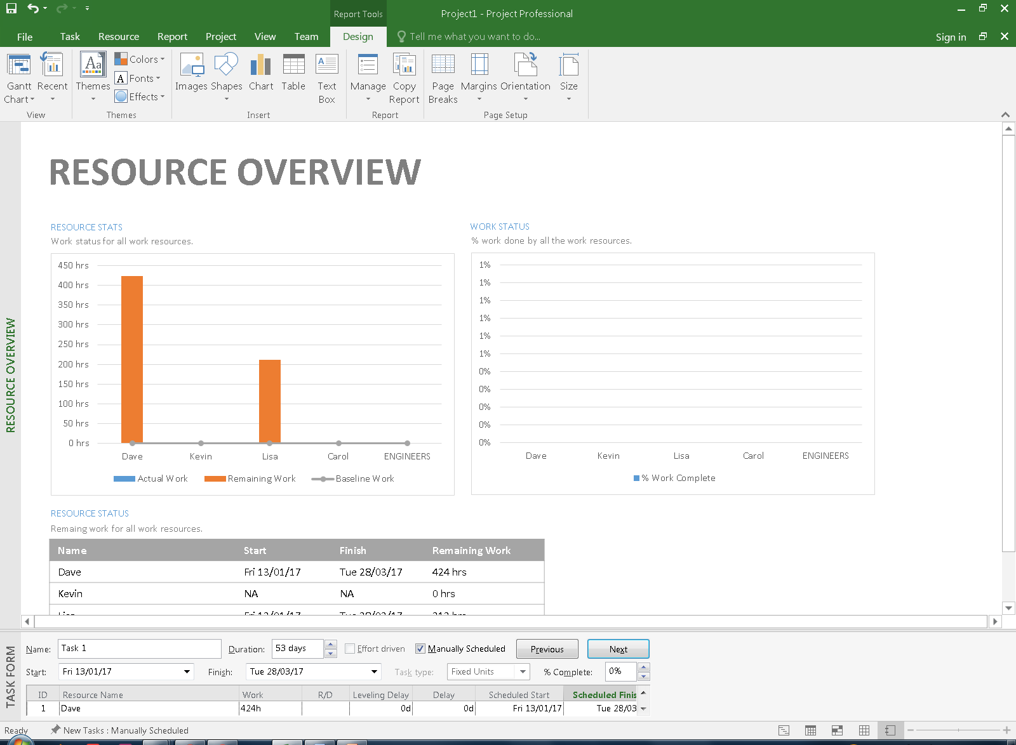
MS Project Getting Started
Duration

Slide 79
MS Project Getting Started
Duration
In Resource status table which appears at the bottom, you will get a summary of resource’s earliest start dates and latest finish dates as well as remaining work.

Slide 80
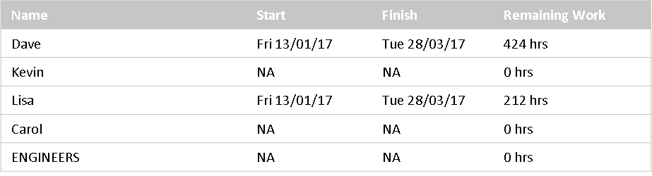
MS Project Getting Started
Duration

Slide 81
MS Project Getting Started
Duration
Check Project Statistics
  Click Project Tab →
  Properties group →
  Project Information →
  In the new dialog box click Statistics

Slide 82

MS Project Getting Started
Duration
MS Project - Track Progress
Once your project plan is ready in MS Project, it becomes essential for a project manager to measure the actuals in terms of work completed, resources used and costs incurred and to revise and change information about tasks and resources due to any changes to the plans..

Slide 83
MS Project Getting Started
Duration
A Project Manager should not assume that everything is progressing according to plan and should always keep track of each task.
Resistance to formal tracking of project management data is normal.
You can overcome resistance to tracking by explaining your expectations, explaining the benefits of tracking, and training people to track the task themselves

Slide 84
MS Project Getting Started
Duration
Save a Baseline
To evaluate project performance you need to create a baseline against which you will compare the progress. One needs to save the baseline, once a plan is fully developed.
Of course, due to rolling wave planning or progressive elaboration needed to manage projects one can always add new tasks, resources, constraints and costs to the plan.

Slide 85
MS Project Getting Started
Base-Lines
Also note, it makes sense to save the baseline before entering any actual values such as percentage of task completion.
Note − With MS Project, you can save up to 11 Baselines in a Single plan.
These multiple baselines seem contrary to the definition of baseline. You can use this flexibility when −

Slide 86

MS Project Getting Started
Base-Lines
You have a baseline plan for the external customer and another for the internal team.
You are preparing for a risk event. You want to develop separate baseline plans for risk response and recovery.
You are accommodating a big change request, you might still want to keep the original plan for future reference when communicating with a stakeholder.

Slide 87
MS Project Getting Started
Base-Lines
Create a Baseline
    Click Project Tab →
    Set Baseline →

Slide 88
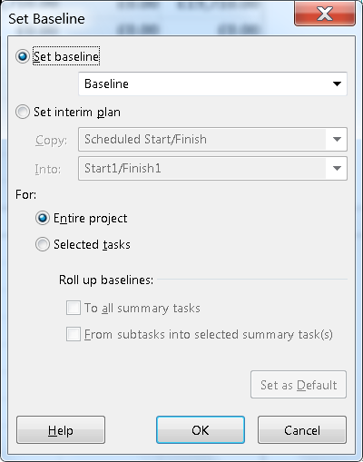
MS Project Getting Started
Base-Lines

Slide 89
MS Project Getting Started
Base-Lines
View Baseline on Gantt Chart
Click View Tab →
Task Views group →
Gantt Chart.
Click Format Tab →
Bars and Styles group →
Baseline (that you want to display).

Slide 90
MS Project Getting Started
Base-Lines
Update the Baseline for the Entire Project
This simply replaces the original baseline values with the currently scheduled values.
Click Project Tab →
Schedule group →
Set Baseline →
OK.

Slide 91
MS Project Getting Started
Base-Lines
Update the Baseline for Selected Tasks
This does not affect the baseline values for other tasks or resource baseline values in the plan.
Click Project Tab →
Schedule group →
Set Baseline →
For select Selected tasks →
OK.

Slide 92
MS Project Getting Started
Interim Plans
An interim plan saves only two kinds of information for each task − Current start dates and Current finish dates.
It can be used as a project marker.
It is visually easy to see how off-track or on-track the project progress is.
Because it only specifies dates, it is simple, clear and easy information.

Slide 93
MS Project Getting Started
Interim Plans 2013 only
Click
Project Tab →
Schedule group →
Set Baseline →
Set interim plan →
OK.

Slide 94
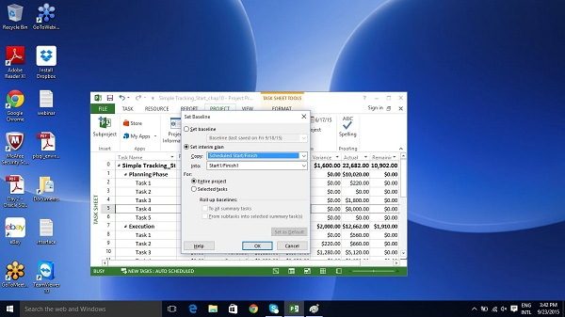
MS Project Getting Started
Interim Plans

