Slide 1
Financial Management
Capital Investment Appraisal
  Making capital investment decisions
  Methods of investment appraisal
  Capital rationing

Slide 2
At the end of this session you will be able to:
Explain the nature and importance of investment decision making
Identify three main investment appraisal methods used in practice
Use each method to reach a decision on a particular practical investment opportunity
Discuss the attributes of each of the methods

Slide 3
What is capital appraisal and rationing?
Capital appraisal is the determination of whether investment projects to acquire new assets (equipment, buildings employees etc.) are worth pursuing, by assessing return on investment using various recognised methods of appraisal
Following completion of the appraisal process to determine viable projects, capital rationing is the determination of which project, or projects, to pursue based on the amount of funds available for investment

Slide 4
Potential reasons for capital investment
Replacement of expired or obsolete assets
Expansion requiring new assets such as, buildings or equipment
Cost reduction such as, introduction of automation
Strategic proposal: improve customer service or staff training
Product or service diversification for risk mitigation

Slide 5
Making capital investment decisions
Essential feature is time
Outlay of investment precedes benefits
Outlay is typically a single large amount of investment
Benefits are typically a stream of revenues over a period of time
Wrong investment decisions can be catastrophic
Difficult to withdraw once investment is made
Companies may use combination of appraisal methods while some use ‘gut feel’ only
Notes:
The essential feature of investment decisions, irrespective of who is to make the decision, is time. Investment involves making an outlay of something of economic value, usually cash, at one point in time which is expected to yield economic benefits to the investor at some other point in time. Typically, the outlay precedes the benefits. Also, the outlay is typically a single large amount and the benefits arrive in a stream of smaller amounts over a fairly protracted period.
Investment decisions tend to be of crucial importance to the investor for the following reasons:
Large amounts of resources are often involved. Many investments made by a business involve committing a significant proportion of its total resources. If the wrong decision is made, the effects on the business could be significant, if not catastrophic.
It is often difficult and/or expensive to ‘bail out’ of an investment once it has been undertaken. It is often the case that investments made by a business are specific to its needs. For example, a manufacturing business may have a factory built which has been designed to accommodate its particular flow of production. This may make the factory of little value to other potential users with different needs. If the business found, after having made the investment, that the product which is being produced in the factory is not selling as well as expected, the only course of action may be to close down production and sell the factory at a significant loss.

Slide 6
Methods of appraisal
Accounting Rate of Return (ARR)
Payback Period (incl. Discounted option)
Net Present Value (NPV)
Internal Rate of Return (IRR)
Notes:
Given the importance of investment decisions to investors, it is vital that proper screening of investment proposals takes place. An important part of this screening process is to ensure that appropriate methods of evaluating the profitability of investment projects are employed.
Research shows that there are basically four methods used in practice by businesses in the UK (and elsewhere in the world) to evaluate investment opportunities.
HANDOUT

Slide 7
Payback period
Payback period is:
the length of time it takes for the initial investment to be recouped from the net cash inflows from the project

Slide 8
Payback period
Decision rule
For a project to be accepted it should have a shorter payback period than the maximum payback period set by the business
For competing projects that have payback periods shorter than the maximum payback period, the project(s) with the shorter or shortest payback period should be chosen

Slide 9
Comparisons of Payback Periods
Initial outlay
Payback period
Project 1
Yr 1
Yr 2
Yr 3
Yr 4
Yr 5
Yr 1
Yr 3
Yr1
Yr 2
Yr
5
Project 2
Yr
4
Project 3
Yr 1
Yr 2
Yr 3
Yr 4
Yr 5
0
100
200
300
400
500
600
700
800
900
Cash flows (£000)
Source: Atrill & McLaney

Slide 10
Drawbacks of using PP
PP sees all qualifying projects as equally acceptable
It cannot distinguish between qualifying projects that payback a significant amount of investment early in the period
PP ignores cash flows after the payback period
PP is not concerned with profitability

Slide 11
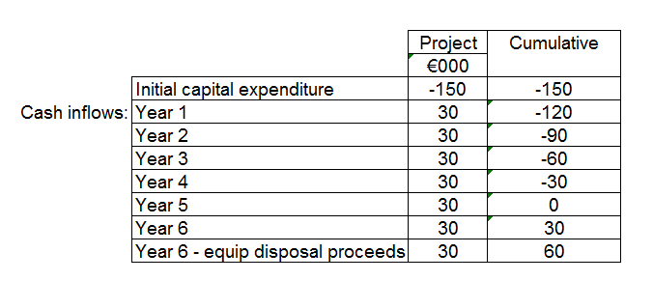
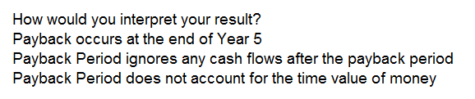
Example of Payback Period project appraisal

Slide 12

Net Present Value (NPV)
Net Present Value:
Accounts for all of the costs and benefits of each investment opportunity and makes a logical allowance for the timing of those costs and benefits

Slide 13
Net Present Value (NPV)
The timing element of NPV:
Would you prefer to have £1 paid to you now or in a year’s time?
The answer is NOW……..why?

Slide 14
Net Present Value (NPV)
If £1 is paid to you in a year’s time then:
You lose interest that you could have earned on it during that period*
There is a risk you won’t receive it
Inflation would erode its value over the time period
Therefore its value in a year’s time is considered less than it is now!!
* By investing funds another way we are incurring an opportunity cost

Slide 15
Interest Lost & Opportunity Cost
An opportunity cost occurs where one course of action, such as, making a business investment, deprives us of the opportunity to derive some benefit from an alternative action, such as, putting money in the bank to earn interest.
Therefore, in the context of NPV, any investment opportunity must do better than the returns from the next best opportunity, such as, putting the money on deposit to earn interest.

Slide 16
Risk
Examples of risk that could affect returns:
Sales of the product or service may not be as expected
Equipment that is key to supporting the project could malfunction
Labour costs could be higher than expected
Disposal income at the end of the term could be less than anticipated
Other examples??

Slide 17
Effects of Inflation
Examples of the effects of inflation:
Higher prices paid for raw materials
Higher overheads and labour costs incurred
Effects on demand for products and services that have higher prices imposed in order to cover increasing costs
Economic downturn leading to uncertainty on returns

Slide 18
The factors influencing the returns required by investors from a project (opportunity cost of finance)
Interest foregone
Required return
Inflation
Risk premium
Source: Atrill & McLaney
Investors will only invest where they are certain of expected returns that compensate for the influence of loss of interest, risk and inflation.

Slide 19
Understanding the time-value of money
Time Value of Money (TVM)
£100 today is worth more than £100 in one year because money can earn interest.
At an interest rate of 5%:
  £100 today becomes £105 in one year.
Therefore:
  £105 in one year = £100 today (at 5%)
Investment meaning:
If a project pays £105 in one year and the required return is 5%, its value today is £100.
To compare future cash inflows with today’s money, we discount them back to the present.
For cash inflows over several years, the interest rate is compounded.
Key idea: The time value of money explains why future cash flows must be converted into today’s value (present value).

Slide 20

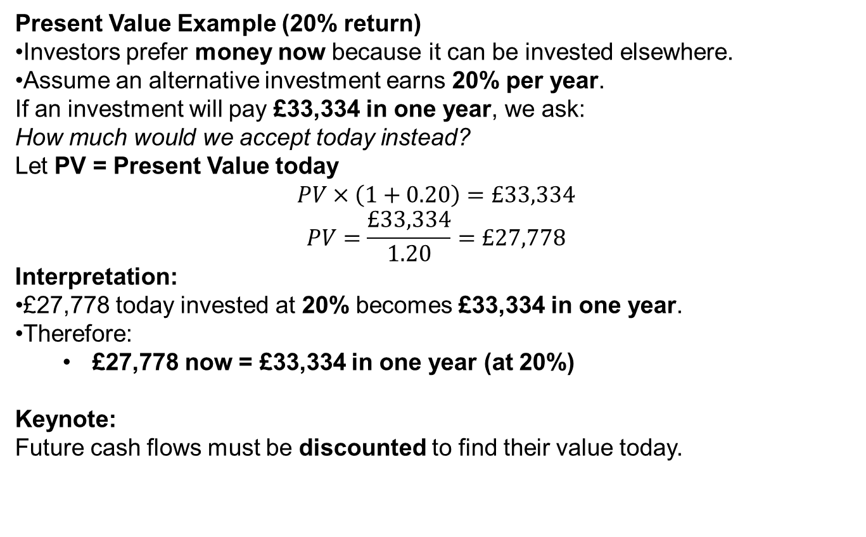
How Present Value is derived
Present Value Example (20% return)
Investors prefer money now because it can be invested elsewhere.
Assume an alternative investment earns 20% per year.
If an investment will pay £33,334 in one year, we ask:
How much would we accept today instead?
Let PV = Present Value today
$$PV×\left(1+0.20\right)=£33,334$$
$$PV=\frac{£33,334}{1.20}=£27,778$$
Interpretation:
£27,778 today invested at 20% becomes £33,334 in one year.
Therefore:
  £27,778 now = £33,334 in one year (at 20%)
Keynote:
Future cash flows must be discounted to find their value today.

Slide 21
Simple example of PV
Amount available for investment immediately = £27,778
Interest rate = 20%
Income for year 1 (20% x 27,778) = £5,556
Total income at end year 1 = 27,778 + 5,556 = £33,334
Income for year 2 (20% x £33,334) = £6,667
Total income at end year 2 = 33,334 + 6,667 = £40,000
The investor can turn £27,778 into £40,000 in two years time, therefore we can say:
£27,778 NOW equals £40,000 in 2 years
or to phrase it another way……
£27,778 is the present value of £40,000 receivable after 2 years at a 20% cost of finance*
(*also known as cost of capital)

Slide 22
A note about WACC
“Weighted Average Cost of Capital”
What is WACC?
WACC is weighted average cost of capital that corporations use in capital budgeting project evaluation. The WACC usually consists of sum of three weighted costs:
Cost of Common Equity
Cost of Preferred Stock
Cost of Debt
The WACC is calculated taking into account the relative weights of each component of the capital structure. The more complex the company's capital structure, the more laborious it is to calculate the WACC.
It is therefore more than simply the interest on a long term bank loan!

Slide 23
How PV is calculated….
The PV calculation is as follows:
PV of the cash flow of year n = actual cash flow of year n divided by (1 + r)^{n}
Where n = the year, and r = the cost of capital (also known as cost of finance or interest rate)
So for the previous example over 2 years:
PV for year 2 = £40,000 / (1 + 0.2) ² = £27,778
Where £40,000 is the cash flow of year 2 (n) at 20% cost of capital (r)

Slide 24
Net Present Value (NPV)
A project will typically have:
Significant single investment cash outflow at the start
A stream of cash inflows at different time intervals in the future
NPV accounts for the values of those cash inflows because of their timing

Slide 25
Present value of £1 receivable at various times in the future, assuming an annual financing cost of 20%
100
£1
90
Pence
80
70
60
50
40
30
20
10
0
1
2
3
4
5
6
7
8
9
10
Years into the future
Source: Atrill & McLaney
Notes:
£1 received sooner is worth more today.
£1 received later is worth less today because of interest and risk.
At a high rate (20%), the value drops quickly over time.

Slide 26
Net Present Value (NPV)
If a project has a positive NPV…
then it means that the benefits from the investment are worth more than the cost of entering into it
Conversely if a project has a negative NPV…
then it means that the benefits from the investment are worth less than the investment

Slide 27
Net Present Value (NPV)
Decision rule
For a project to be accepted it should have a positive NPV; if it has a negative NPV then reject it
For competing projects that have positive NPVs, the project(s) with the highest NPVs should be chosen in order

Slide 28
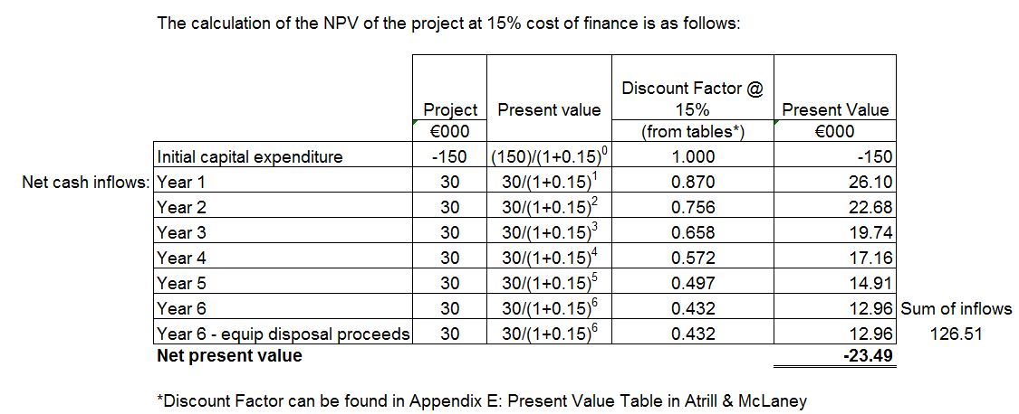
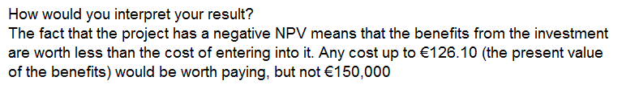
Example of negative NPV project appraisal

Slide 29
Net Present Value (NPV)
NPV addresses fully the following:
The timing of the cash flows
All of the relevant cash flows irrespective of when they occur
The objectives of the business with regard to increasing investor wealth
It is therefore a more thorough appraisal method than Payback Period

Slide 30
Discounted Payback Period
Payback Period does not take into account the time value of money
Discounted Payback Period includes time value of cash flows

Slide 31
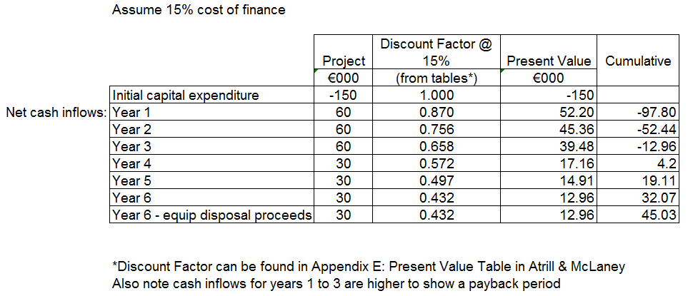


Example of Discounted Payback Period project appraisal

Slide 32
Internal Rate of Return (IRR)
Internal Rate of Return:
Essentially represents the yield from an investment opportunity
It is the discount rate which, when applied to future cash flows, will make them equal to the initial outlay

Slide 33
Internal Rate of Return (IRR)
Closely linked to NPV – How?
If NPV is positive when discounting at X%, then it implies that the rate of return (IRR) the project generates is greater than X%
The more positive NPV is then the greater is the rate of return above X%
Increasing the size of the discount rate will reduce NPV because a higher discount rate gives lower discounted cash inflows
IRR is the discount rate which has the effect of producing an NPV of zero

Slide 34
Internal Rate of Return (IRR)
How is IRR calculated?
It cannot be calculated directly – trial and error or iteratively only
How do we do this?

Slide 35
Internal Rate of Return (IRR)
Extrapolation Method to Calculate IRR – Simple Version
Start with a discount rate and calculate NPV:
  Example: At 20%, NPV = 24,190
Increase the discount rate to reduce NPV:
  Try 30%, NPV = –1,880
Now we know the IRR (where NPV = 0) is between 20% and 30%.
Find how much NPV changes for a 10% increase in discount rate:
  Change in NPV = 24,190 – (–1,880) = 26,070
Change in NPV for 1% increase in discount rate:
  26,070 ÷ 10 = 2,607
How much to increase the rate to bring NPV to zero:
  24,190 ÷ 2,607 ≈ 9.28%
Add this to the original rate:
  20% + 9.28% ≈ 29.28%
So, IRR = 29.28%, the discount rate that makes NPV = 0.

Slide 36

The relationship between the NPV and IRR methods
NPV (£000)
70
60
50
40
30
20
IRR
10
0
10
20
30
40
Rate of return (%)
Source: Atrill & McLaney

Slide 37
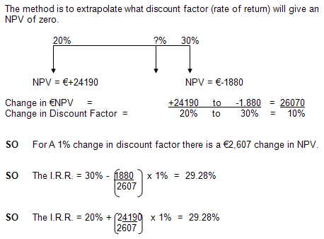
Internal Rate of Return (IRR)
Source: Billingsgate Battery example

Slide 38
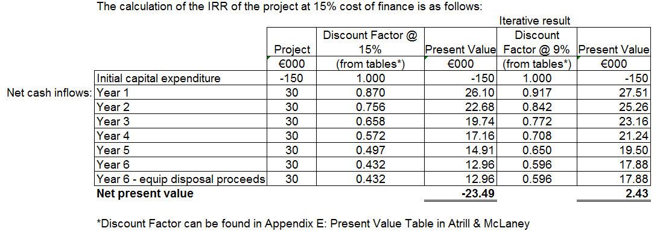
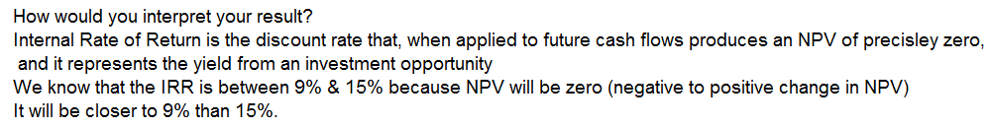
Example of IRR project appraisal

Slide 39
Internal Rate of Return (IRR)
Decision rule
For a project to be acceptable, it must meet a minimum IRR requirement - this should be the opportunity cost of finance
For competing projects that exceed the minimum IRR, those with the higher (or highest) IRR should be chosen

Slide 40
Drawbacks of using IRR
IRR does not address the issue of wealth maximisation
Accepting the project with highest IRR will often maximise shareholder wealth but may not always be the case because scale of investment is not considered
Therefore NPV is most reliable method of assessment

Slide 41
Practical conclusions
Businesses may use more than one method to assess each investment decision – this is particularly so in larger businesses
Payback period methods continue to be popular as a screening method
There has been increased use of the discounting methods (NPV and IRR) over time – again in larger businesses this is the case

Slide 42
Capital rationing
All projects appraised that pass the decision rule should be selected
This assumes unlimited funds available for investment
If funds are limited then choices have to be made regarding project selection
In the latter case capital has to be rationed!!

Slide 43
Capital rationing
Types of rationing:
  Soft rationing
  Hard rationing
  One-period rationing
Soft rationing are internally imposed limits by the business
Hard rationing relates to capital made available from external sources
One-period rationing is the simplest because limits are placed on finance availability for one year only; for subsequent years funds are unlimited

Slide 44
Capital rationing
One-period capital rationing carry two options:
  Divisible projects
  Indivisible projects
Divisible projects are projects for which a fraction can be undertaken
  Such as, plan to open 5 new stores but only open 3.
Indivisible projects are projects which have to be completed in full
  Such as project to build a bridge

Slide 45
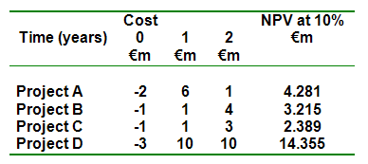
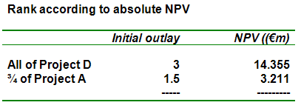
Capital rationing
Example of projects with capital allocation of £4.5M
Relying on NPV as an indicator would give a priority order of D,A,B,C and with only £4.5M capital available then result would be as follows:
The resulting NPV for doing Project D and ¾ of Project A is 14.355+ 3.211 = £17.566M

Slide 46
Capital rationing
We need to determine the optimal combination for project selection within the capital constraints
Selecting highest NPV projects in order of rank will favour large projects only, when a combination of smaller projects might be optimal
To find the optimal combination we deploy either:
Profitability Index
Benefit-cost ratio

Slide 47
Capital rationing
Profitability index:
Gross present value*
Initial outlay
*GPV is total present value of all cash flows excluding the initial investment
Benefit-cost ratio:
Net present value
Initial outlay
Both ratios provide a measure of profitability per unit of monetary value invested; selection of these ratios is down to individual choice

Slide 48
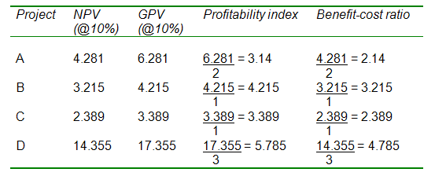
Capital rationing
Using the Profitability Index / Benefit-cost ratio
Arrange projects in order of the highest profitability index or benefit-cost ratio and work down the list until the capital limit is reached.
This now changes the priority order to D,B,C,A from D,A,B,C

Slide 49
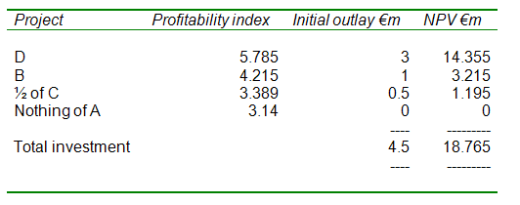
Capital rationing
Example of projects with capital allocation of £4.5M
Assumes projects are divisible.
Project A no longer ranks second because this provides the lowest return per unit of initial investment.
Net result is that an extra £1.199M (18.765-17.566) is created for shareholders by selecting projects via ratios rather than relying on NPV alone

Slide 50
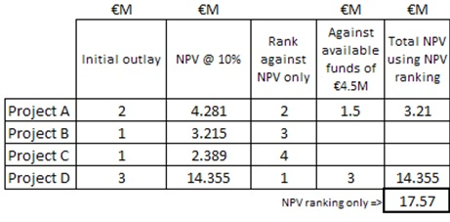
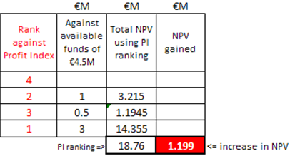
Capital rationing
In summary…..comparing the two approaches!
The return on the project will be increased by £1.199M by using Profitability Index ranking as opposed to NPV alone
If projects were not divisible then only projects D and B could be completed with the investment funds available as insufficient funds remain to complete the whole of Project C.
Notes:
With multiple period capital rationing, neither of these methods takes into account the restriction in finance in future periods – this needs linear programming where there are 2 variables shown graphically. If more then need a computer programme.

Slide 51
PAYBACK: Appraisal based on time taken to get back initial investment Easy to calculate No time value of money considered or timing of cash flows Ignores cash flows after payback period | DISCOUNTED PAYBACK: Includes time value of cash flows Still ignores relevant data after payback period
NPV: Measures cash flow accounting for all costs and benefits and an allowance made for their timing Mathematical calculation Proportional relationship between discount rate and NPV | IRR: Discount rate that gives a value of zero to NPV Measures efficiency of capital investment Considers time value of money over project life time Represents the yield from an investment

Slide 52
Practical Problems
There can be a high degree of intangible aspects within a project
Trying to attach exact accounting numbers to uncertain future events.
Sales volume forecasting. Can future sales be accurately forecasted for an NPI project?
Not easy to quantify the cash flow benefits for quality-improvement projects (cost-saving projects are easier to quantify)
Effects of inflation
Project scope and scale creep

Slide 53
Risk margin - (mitigating by being too cautious or not cautious enough in applying discount factors)
Project overrun
Rising component costs
Unpredictable changes in discount or interest rates
Unpredictable changes in tax rates
Unpredictable changes in market conditions
Unforeseen changes in competition (new entrants?)
Unforeseen product obsoletion (superseded by new technology)
Effect of unpredicted changes in working capital management (RM; WIP; Finished goods; debtor & creditor management)
Effect of regulatory or legislative changes

Slide 54
Improving Capital Appraisal Process
Scope project out thoroughly and accurately during appraisal process
Make effective allowances for some of the aspects that may move uncontrollably
Use more than one method of capital appraisal
Others?

Slide 55
Thanks
Any Question

