Slide 1
ECSO5002: Experiential Placement: Becoming a Reflective Practitioner
Writing and Referencing in the 1st and 3rd Person
2024

Slide 2

Placement & Paperwork
For the first part of this session, we will be catching up on placement paperwork and any placement queries that you may have.

Slide 3
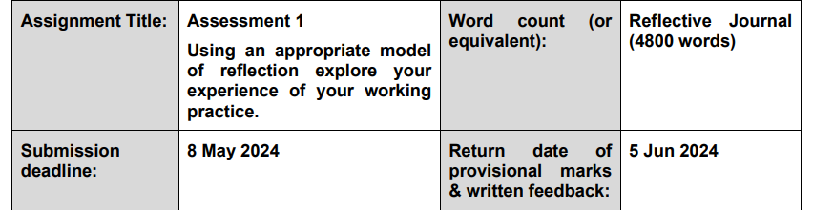
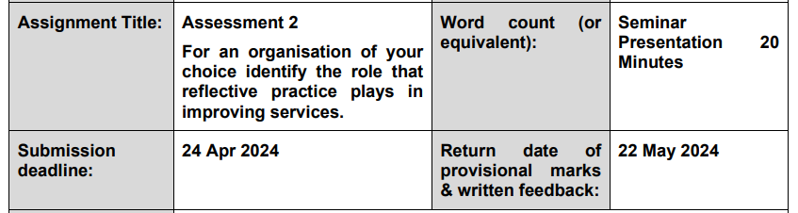
Recap of Assignment Questions

Slide 4

Assignment Questions?

Slide 5
Writing Reflectively
In our last session we looked at Gibb’s reflective practice in Detail
What do you remember?

Slide 6
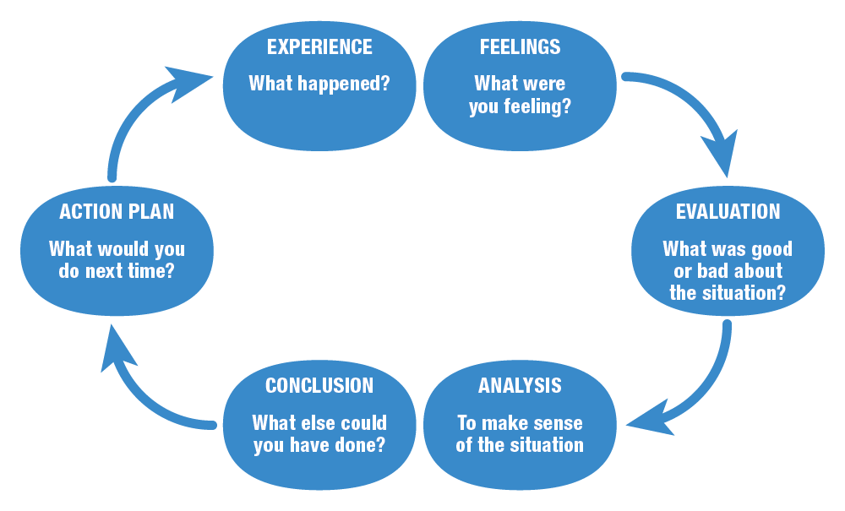
Gibb’s Reflective Cycle

Slide 7
Gibb’s Reflective Cycle
What did you notice about Gibbs reflective cycle?
It is repetitive
And
It allows you to analyse WHY something has happened

Slide 8

Other Reflective Frameworks
Kolb
  Kolb’s Learning Cycle
Schön
  Schön’s Framework
Rolfe et al.
  Rolfe et al’s. Framework
ERA
  The ERA Framework
Brookfield
  Brookfield’s Four lenses

Slide 9
Learning other Frameworks
In our next session, we will be looking deeper into:
Kolb’s Learning Cycle
And
Schön’s Framework
Using Guidance by Hull University:
Reflective frameworks - Reflective writing - Library at University of Hull

Slide 10
Critical Reflective Writing
When writing reflectively, you, the writer are the primary subject.
As such, your own thoughts, feelings, and experiences should form the bulk of the examples you use.
However,
It is essential to understand that the purpose of writing reflectively is not merely to describe our experiences, but rather to understand your experiences and your reactions to them with a goal of personal growth and transformation.

Slide 11
Critical Reflective Writing
Critically exploring your own values, beliefs, and practices in a structured and explicit way, facilitates life-long learning and allows you to develop as a practitioner.
‘Now I know better, I do better’
-Maya Angelou

Slide 12
Critical Reflective Writing
As reflective writing is a formal academic genre, it is important that you still use published theory against which to reflect and analyse your experiences with a current and cohesive writing structure.

Slide 13
Writing in the ‘First Person’
For the rest of this session, we will be analysing a reflection and will focus on finding evidence to support and analyse the description.
Please open Moodle document entitled Description and Analysis

Slide 14
I was observing a social worker in a looked after child (LAC) review within the school environment. Present at the meeting was the child, the child’s teacher, a social worker, the foster parents, the school’s head of learning, the advocate and myself. I noticed that the child looked upset and worried and insisted on sitting next to her class teacher whom she seemed to be very fond of. The first part of the meeting focussed on the educational elements of the child, including, how the child was progressing in school, and the child was very happy to talk about a science project that they had been doing in the classroom.
The second part of the meeting focussed on the child’s home needs, where the social worker wanted to discuss how the child was feeling about the foster placement. The child appeared to get upset and did not want to answer any questions. The advocate asked the child if she wanted to get something for lunch, to which the child agreed, and then they both left the room. When the child and advocate left the room, the social worker asked the foster parents if they had any problems in the home environment. The Foster parents said that the child had been experiencing difficulties sleeping and was irritable throughout the day, displaying anger and frustration. They believed this was a result of the lack of contact the child had with mum.
The social worker noted down the comments from the foster parents and asked them what interventions they had tried in the home environment to support the child. Following a lengthy discussion, the social worker left the room to see if the child and advocate wanted to rejoin the meeting. They came back in, and the social worker talked to the child about what had been discussed, and asked the child if they had any worries. The child said that they did not have any worries but wanted more time with mum.
The social worker seemed to understand the child’s wishes and asked what the child would want to do while spending time with mum. The child said they wanted to go bowling with mum as this is something that they used to do together. The social worker spent time listening to the child and noted everything down on her notepad. When the child had finished speaking, the social worker said that she would take the request to the meeting with the mum, and they would integrate more time with mum into the child’s schedule.

Slide 15
Task
We will now look at each part of the description and highlight areas that can be analysed.

Slide 16
I was observing a social worker in a looked after child (LAC) review within the school environment. Present at the meeting was the child, the child’s teacher, a social worker, the foster parents, the school’s head of learning, the advocate and myself. I noticed that the child looked upset and worried and insisted on sitting next to her class teacher whom she seemed to be very fond of. The first part of the meeting focussed on the educational elements of the child including, how the child was progressing in school, and the child was very happy to talk about a science project that they had been doing in the classroom.

Slide 17
Task
Here is my analysis USING CREDIBALE SOURCES of this paragraph:

Slide 18
I was observing a social worker in a looked after child (LAC) review within the school environment. Present at the meeting was the child, the child’s teacher, a social worker, the foster parents, the school’s head of learning, the advocate and myself. I noticed that the child looked upset and worried and insisted on sitting next to her class teacher whom she seemed to be very fond of. The first part of the meeting focussed on the educational elements of the child including, how the child was progressing in school, and the child was very happy to talk about a science project that they had been doing in the classroom.
What is a looked after child (LAC) review?
  The Family Rights Group (2024) suggests that a LAC review is a meeting that is held on a regular basis that takes place for every child that is ‘looked after’ in the care system (Family Rights Group, 2024, np) with Coram (2024) further stating that the Childrens Act (1989) has placed a legal duty on local authorities to ‘safeguard and promote the welfare of looked after children’ (Coram, 2024, np). It was evident within the review that this was a repeated process as at the beginning of the meeting points raised within previous meetings were readdressed and the changes made within the school environment were confirmed.
Why were these people present in the meeting?
  Gomes (2021, p.1) further explores the relevance of multi-agency working when supporting the outcomes for looked after children, suggesting that ‘at risk children and their families will frequently interact with multiple agencies and services’ (Gomes, 2021, p.1). This is supported by research by (Jones, 2022, p.257) evidencing that multi-agency working in children’s services demonstrates positive outcomes for children in care due to the fluidity of the information, and first hand understanding of the practitioners involved with the case. Similar research has been conducted by Uni (2022, p.134) who further evidenced that it is not only beneficial for the child, but also for the practitioners, as it allows cohesion, resulting in faster action should it be required (Uni, 2022, p.134; Mapps, 2013, p.563). Following the meeting, the social worker, who was the main spokesperson for the meeting agreed to uniform the notes made and would email a copy to all at the meeting, demonstrating the cohesive and fluid nature described by Gomes (2021, p.1) and Uni (2022, p.134).
Why might the child have a strong relationship with the teacher?
  Ofsted (2008, p.9) focusses on the educational element of looked after children, highlighting the importance of children feeling safe in their learning environment, including the adults that they are in contact with (Crenshaw, 2017; Jones, 2019). Section 20 of the Children and Young Persons Act (2008) requires a designated member of staff at school for pupils looked after by the local authority, and published guidance by the Welsh Government’s Department for Education (2018) suggests that this person(s) should be available to the child as a ‘safe and friendly’ environment should they need it (Department for Education, 2018). Research by Verschueren and Koomen (2012) considers the teacher-child relationships from an attachment perspective, suggesting that attachment theory could be utilised to demonstrate the close bond observed between the teacher and the child. Coined by Bowlby (1969), attachment theory recognises the characterisation that is seen between the child and the teacher within the LAC meeting, suggesting that the child is seeking proximity to a person who has demonstrated kindness, Bowlby (1969) suggests that this is a ‘deep and enduring emotional bond that connects one person to another across time and space’ (Bowlby, 1969, p.73).

Slide 19
Task
Please use your devices to find evidence and information to support the remaining paragraphs.
You can work together or alone
Please ensure that your citations are correct

