Slide 1


Slide 2


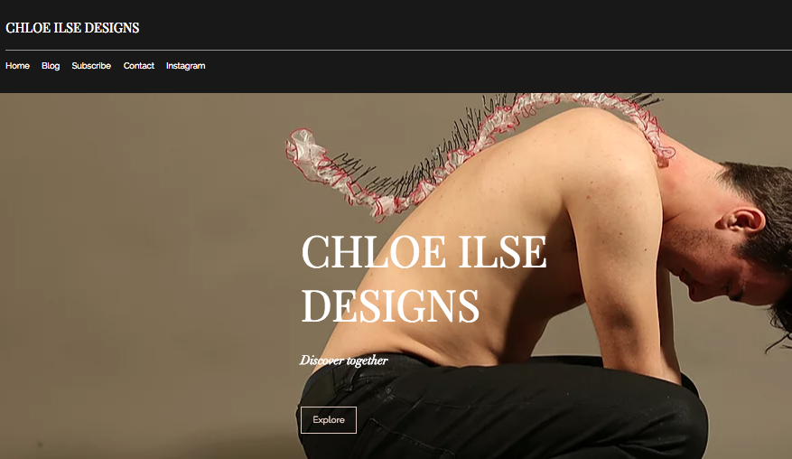
My website before was very basic,
consisting of only a home page. I did
include a photograph of my work but
this was a piece of work from first
year. Even though it was a very
successful project it does not reflect
my most current work. My choice to
have a sculptural piece on my home
page suggested to the viewer that I
specialise in this field which is not
the case. I did not have a logo when
I first created my website therefore
It did not have a clear brand identity.
however I do like my initial idea of
having my name in the centre as a
focal point, which is something I have
stuck with when updating my webpage.

Slide 3
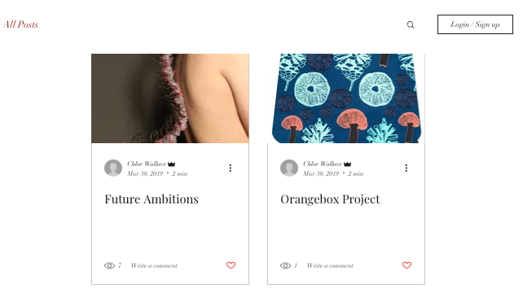
When I first created my website I posted two blog
posts. I really Like the idea of having a series of blog
posts on my website because it is a fantastic way to
engage with my audience. There is an option to link
blog posts to all social media accounts so viewers are alerted when a new blog post has been posted to the webpage. With regular updates to my webpage it will encourage people to keep looking at my content. I have not recently created a new post for my website but this is definitely something I intend to pursue in the future. I want to treat this section of my website as a diary, a platform which I can use to share my journey as a surface pattern designer. Everytime I share something new on my Instagram or linked in account I will also post it to my website. This will not only increase the chances of people viewing my content but show a consistency within my social media for a more proffessional outlook.

Slide 4

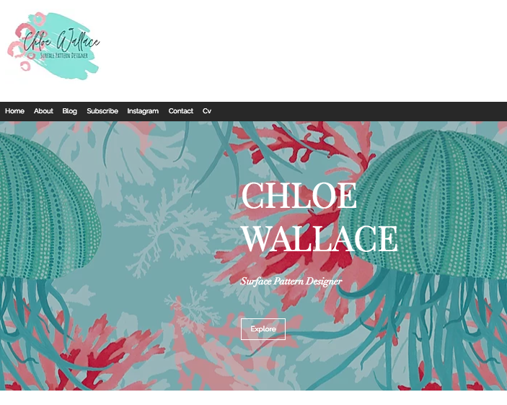
I have fully updated my website with new imagery,
links and a logo. My main homepage photo has now been changed from my first year project to a
hero print from my current project Elements of the Sea. I have used this print and logo throughout
my social media accounts for consistency. Not only is it good for consistency, including the same visual features for all media accounts makes my brand more recognizable to the audience as they have a visual aid to associate my brand with. All of the headings at the top of the webpage link to separate pages, this is a feature my webpage did not have before. I have added separate pages to my website for a more professional feel and to avoid overcrowding on the home page.

Slide 5
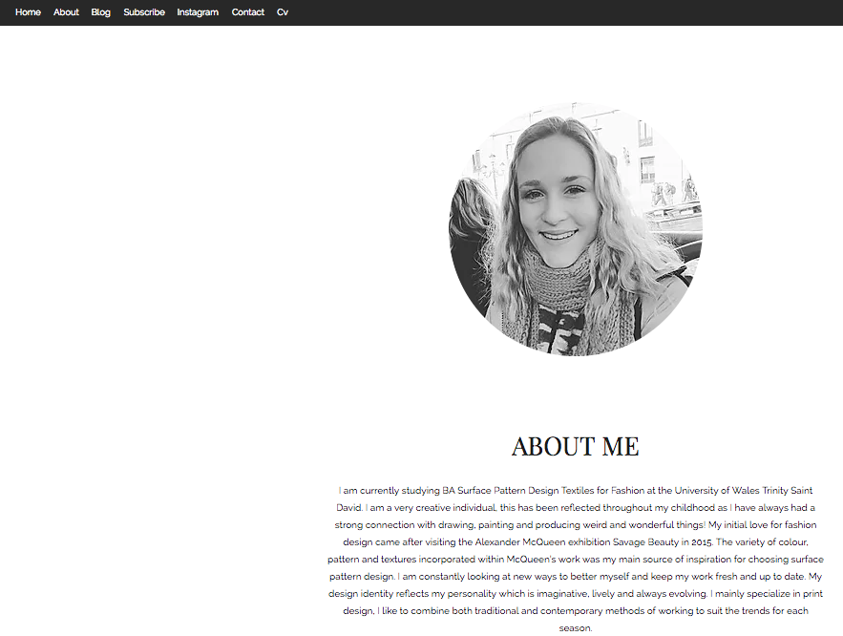
My website before did not include an about page this is something I was eager to include when updating. An about me page is an essential feature on a website as it gives the audience an insight into the brand and who I am as a designer. Without this the viewer may struggle to understand exactly what I do. An about me page is also a friendly way of introducing myself, giving me an opportunity to express my personality and explain my practice in a bit more detail. I have provided a link on my homepage to my about me page for easy access.

Slide 6
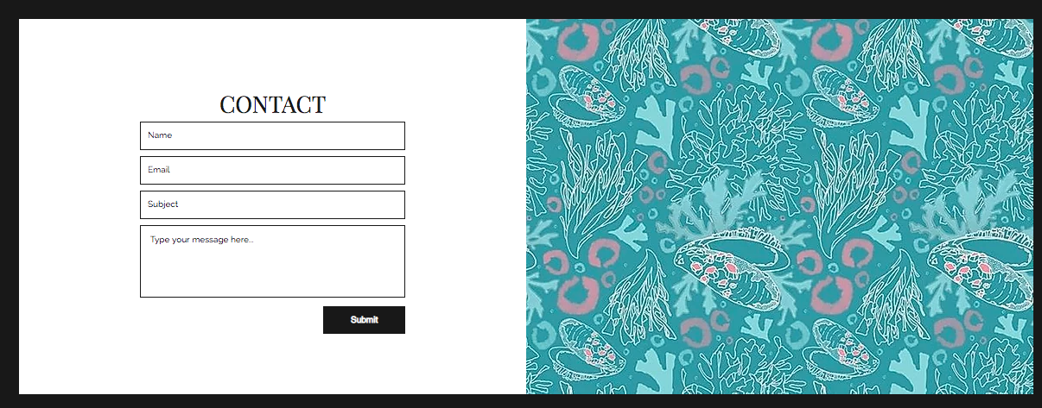
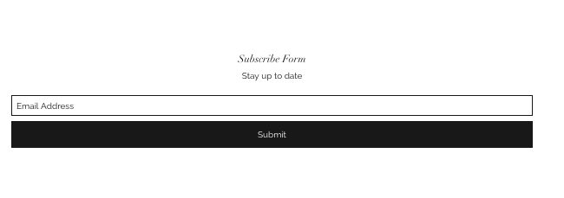
I have included a separate page for my contact details giving my audience easy access. I have provided a a small section where viewers can contact me directly. The messages are linked to my email so I am alerted when a new message is sent to my inbox.

Slide 7
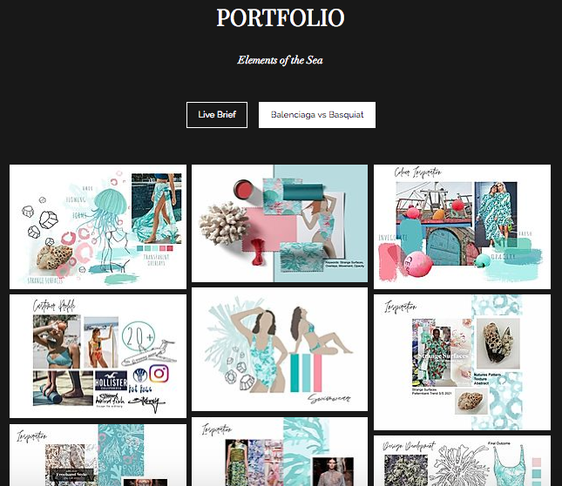
I have added a section to my website for viewers to have a browse at my portfolio. I made this decision because it could be a potential platform which employers look at giving them insight into my skills. I chose to have my most current project as the homepage for my portfolio because it is my best work. It is important for employers to see your most recent work because it shows them your level of abilities now. Presenting my portfolio online is a quick and easy way to show people your work without having to meet them in person.

Slide 8
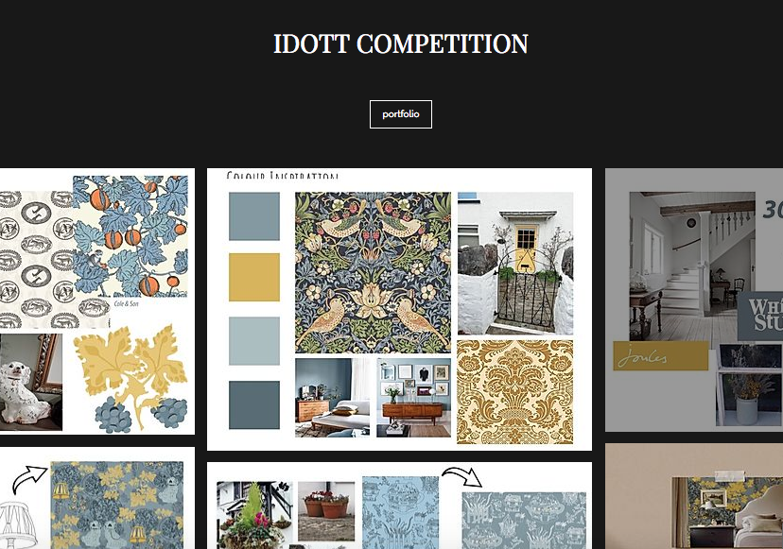
I decided to incorporate Idott into my portfolio because it is a large body of work and shows that I can do interiors aswell as fashion.

Slide 9
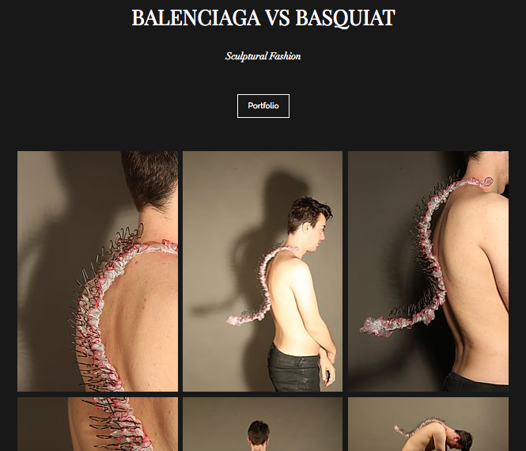
This was one of my favourite projects during my time at university. I think it is one of my most successful pieces of work and really shows off my range of skills. Considering this was a project in the first year I think it is well made and very professional. Although this piece is very different to the work I am producing now I thought it was important to include because it is different and something you don’t see everyday.

Slide 10



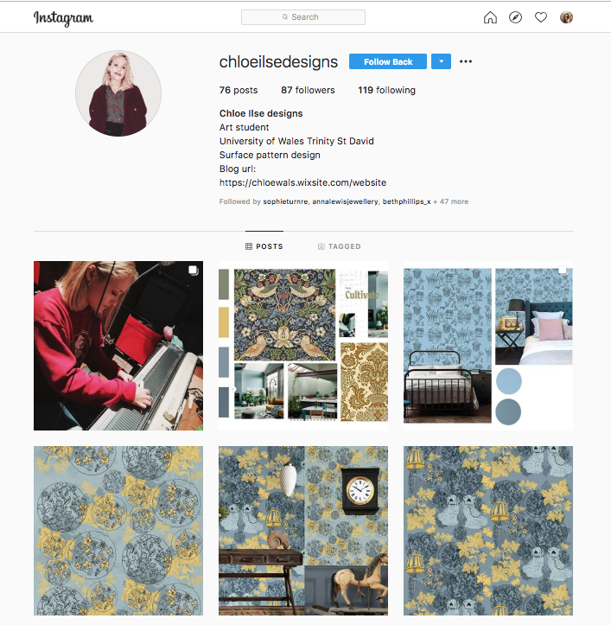
Posts: 76
Followers: 87
Following: 119
I have taken this screenshot a few weeks ago to show my progression. I initially did not have a logo, my profile picture was a photograph of myself with a handrawn effect. This was a nice personal touch because the handrawn effect was a quirky way to show my creativity. I started becoming a lot more confident with my posts and even included a photograph of me working on my internship. At this moment in time I did not post very often and I did not have an organized posting plan. My content was very random and the length of time between each post was very irregular.

Slide 11
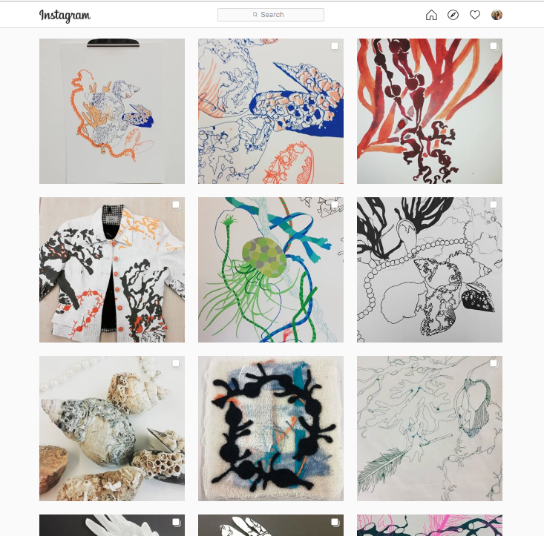
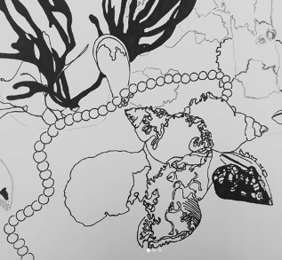
I started to post content relating to my final major project consisting of drawings, paintings and inspirational imagery. I started to be consistent with the content I was posting in regards to my new project but this consistency was then broken when I started to post pictures of previous work, this is something I need to be more mindful of in the future.

Slide 12

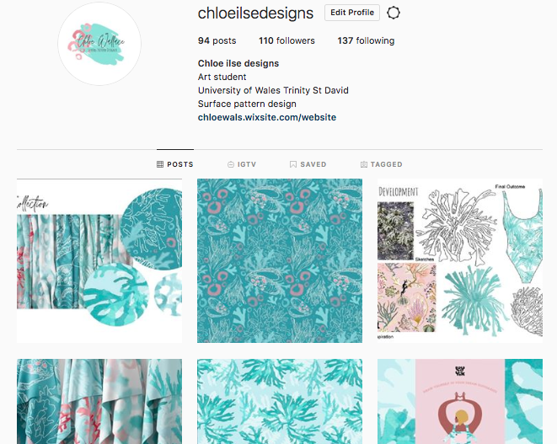
Posts: 94
Followers: 110
Following: 137
Since the screenshot on the previous page I have updated my Instagram. I now have a logo as my profile picture instead of a photograph of my myself. I made this decision because people may struggle to recognize my brand if I kept the picture of myself. With a logo people will have no doubts that this is my official Instagram account. Also I have incorporated my logo into all of my social media platforms for consistency. In my bio I have included a link to my website for easy access. Hopefully this will encourage more people to view my webpage. I now have a posting plan and post much more frequently.

Slide 13

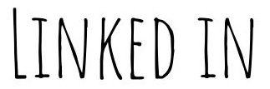

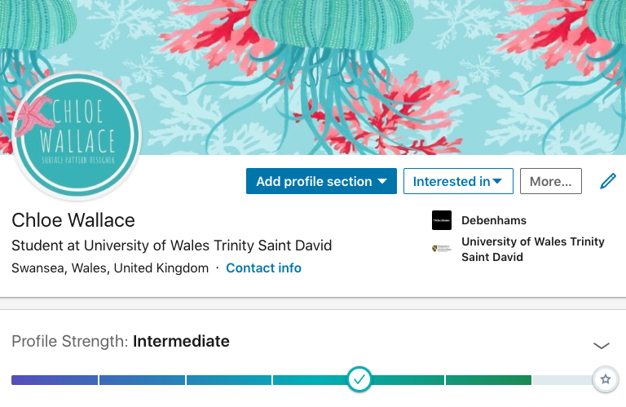
I have only recently created a linked in account as another social media platform. Therefore it is not as developed as I would like it to be. I made a start by incorporating my then logo design and a snippet of one of my prints. At this point I did not have any connections at all on linked in so my profile strength was intermediate. I did include all of my basic information like contact details and place of work.

Slide 14

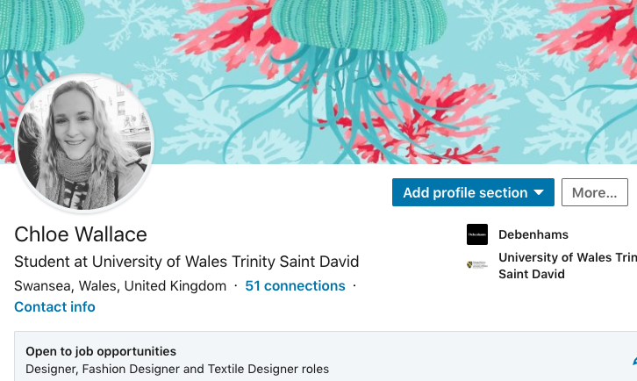
This is a recent screenshot of my linked in account. I have changed my profile picture from my old logo to a photograph of myself. Unlike my other social media accounts I have not included my logo because I think it is important on linked in to show what I look like. I have now made 51 connections which is not a massive following but a good start considering I only started this account within the past two weeks.

Slide 15
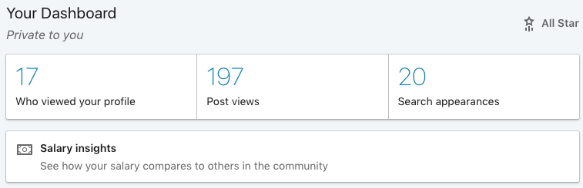
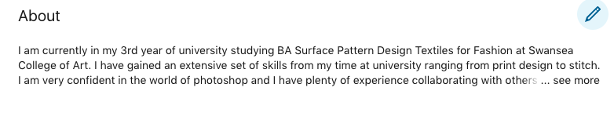

Slide 16
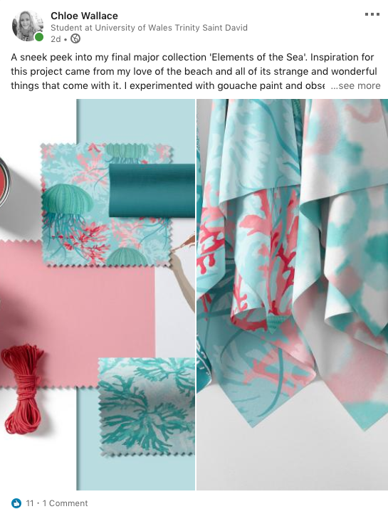
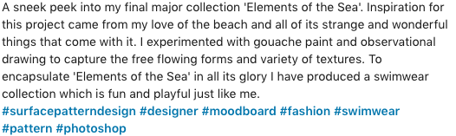
I created my first post on linked in, this was a challenge at first because I have never used this platform before but I managed to create a post explaining my current project. I thought this was a really easy way to engage with my audience and it took less than 15 minutes. This would be a really quick and easy task to incorporate within my weekly routine. Everytime I post something on Instagram it would be great if I could link the two posts together to save the hassle of posting to three different accounts, this is something I want to look into and pursue further in the future.

Slide 17

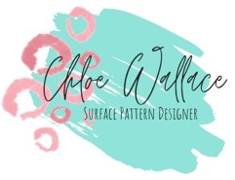

https://chloewals.wixsite.com/website
https://www.instagram.com/chloeilsedesigns/?hl=en
https://www.linkedin.com/in/chloe-wallace-9112331a6/

Slide 18
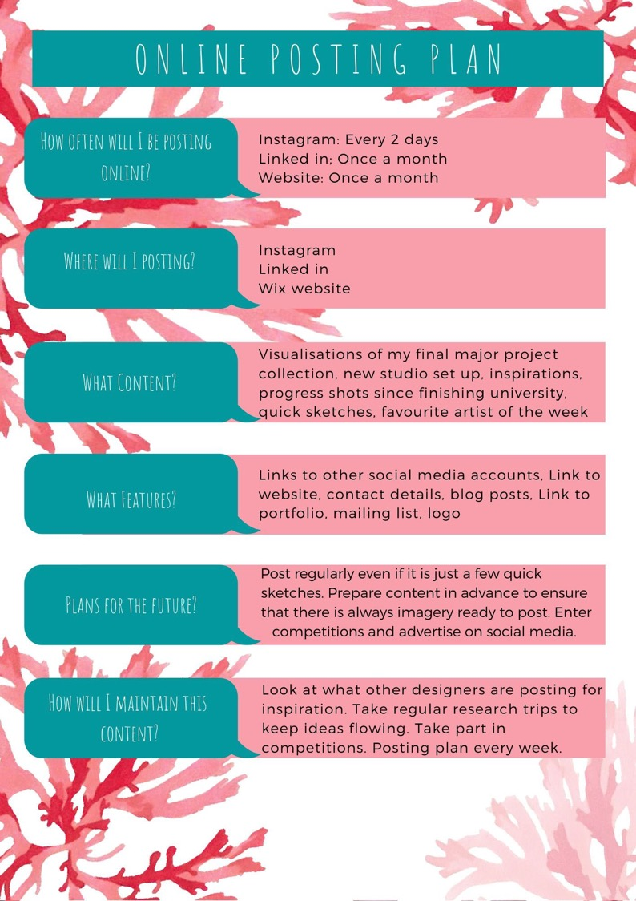
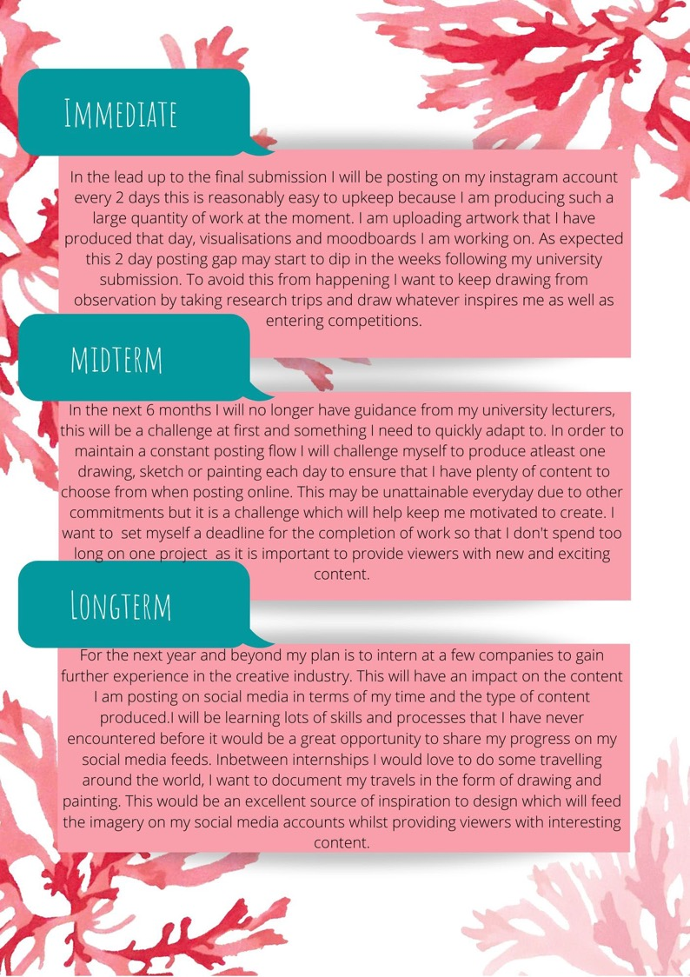
The images on the
right show my online
posting plan I created
to help me stay
organised before my
final deadline and
after. This was a really
good idea because I
now have something
to stick to when I finish
university to help me
keep on track with my
social media accounts.

