Slide 1
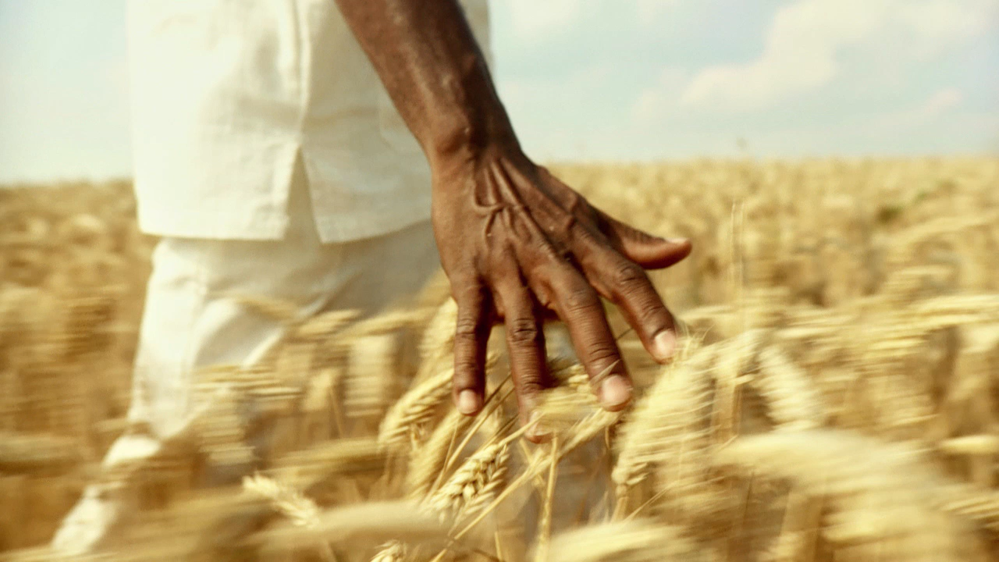
Evaluating the link between economic diversification and sustainable development: The case of Tourism sector in Sierra Leone
Doctor of Business Administration (DBA) Research Proposal
Presented by: Abdulai Turay
Supervisor: Prof. Amare Desta
UWTSD
Notes:
Good morning, everyone. Thank you for being here. My name is Abdulai Turay, and today I will be presenting my DBA research proposal entitled: Evaluating the link between economic diversification and sustainable development: the case of Tourism sector in Sierra Leone. Let me walk you through the expected contributions of this study. I welcome your questions at the end."

Slide 2

Introduction & Background
Sierra Leone’s economy is heavily dependent on iron ore and diamonds (commodity price volatility).
Post-war, Post-Ebola, post-COVID-19, and economic shocks exposed vulnerability.
Government priority: Economic diversification through tourism (National Development Plan – Medium-Term National Development Plan).
Key question: Can tourism drive both economic diversification and sustainable development?
(Government of Sierra Leone, 2024; UNDP, 2025).
Notes:
Let me begin with some context. Sierra Leone is a country richly endowed with natural resources, yet its economy remains heavily dependent on iron ore and diamonds. As we have seen globally, commodity price shocks combined with the Ebola crisis and the COVID-19 pandemic have repeatedly exposed the fragility of this model. In response, the government’s Medium-Term National Development Plan has explicitly identified tourism as a strategic sector for economic diversification. However, the central question remains: can tourism genuinely drive both economic diversification and sustainable development? This proposal seeks to answer that question."

Slide 3
Problem Statement/Gap
Core problem: Unclear whether current tourism expansion contributes to genuine diversification without compromising sustainability.
The tourism sector in Sierra Leone is under-researched in terms of its dual impact.
Existing studies focus on either economic growth or environmental/social sustainability – rarely both.
Lack of empirical evidence linking tourism-led diversification to long-term sustainable development outcomes.
Notes:
This means that even though there is a lot of interest in growing tourism in Sierra Leone, there is still an important gap in research. Most studies only look at one aspect, like how tourism helps the economy, or they focus separately on environmental or social issues. Very few studies look at all three together, how tourism affects the economy, society, and the environment at the same time. Because of this, policymakers don’t have enough solid evidence to know whether expanding tourism is truly beneficial in the long run or if it might create new problems. My research aims to fill this gap by examining all these aspects together.

Slide 4
Research Aim & Objectives
Aim: To evaluate the relationship between tourism-led economic diversification and sustainable development in Sierra Leone.
Objectives:
Assess tourism’s contribution to economic diversification (income, employment, foreign exchange).
Examine the environmental and social sustainability impacts of tourism activities.
Analyse stakeholder perceptions (government, businesses, local communities, tourists).
Propose a strategic framework for balancing tourism growth with sustainability.
Notes:
To address this problem, the overall aim of my research is to evaluate the relationship between tourism-led economic diversification and sustainable development in Sierra Leone. To achieve this, I have four specific objectives. First, to assess tourism’s contribution to economic diversification in terms of income, employment, and foreign exchange. Second, to examine the environmental and social sustainability impacts of tourism activities. Third, to analyse stakeholder perceptions of the trade-offs involved. And fourth, to propose a strategic framework that helps balance tourism growth with sustainability

Slide 5
Research Questions
How does tourism development contribute to economic diversification and sustainable development in Sierra Leone?
Sub-Questions
What is tourism’s contribution to GDP, employment, and foreign exchange?
Does tourism reduce dependence on extractive sectors?
What are its social and environmental impacts?
What institutional factors influence sustainable tourism outcomes?
Notes:
These objectives translate into four research questions. First: To what extent does the tourism sector actually contribute to economic diversification in Sierra Leone? Second: What are the positive and negative environmental and social outcomes associated with current tourism development? Third: How do key stakeholders, government, businesses, and local communities perceive the trade-offs between growth and sustainability? And fourth: What strategic mechanisms can align tourism diversification with the Sustainable Development Goals? These questions guide the entire research design."

Slide 6
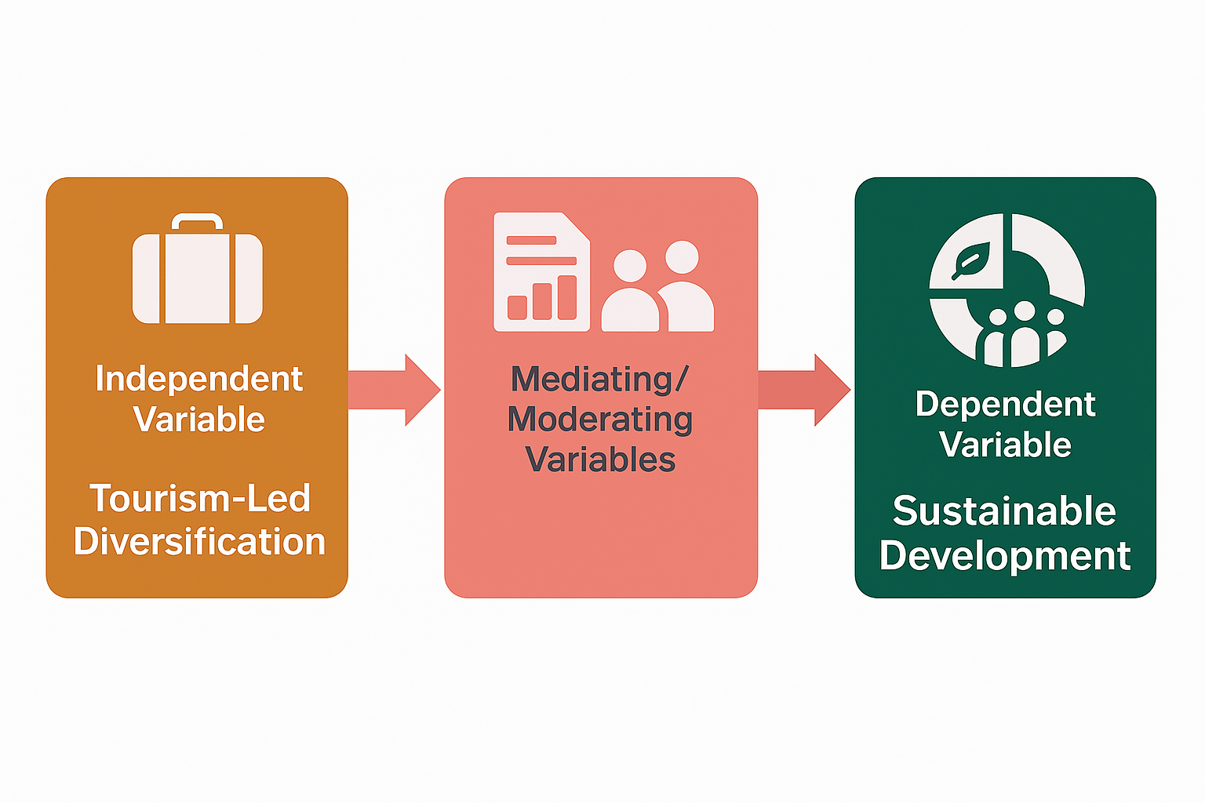
Conceptual Framework
Independent Variable: Tourism-led diversification (tourism GDP share, employment, infrastructure, visitor numbers)
Dependent Variable: Sustainable development (economic resilience, environmental conservation, social equity)
Mediating/Moderating Variables: Policy environment, community participation, private sector investment
Key linkage: Diversification → Sustainable development (tested via triple bottom line)
Notes:
Here is the conceptual framework underpinning my study. The independent variable is tourism-led diversification, measured by tourism’s share of GDP, employment, infrastructure investment, and visitor numbers. The dependent variable is sustainable development, operationalised through economic resilience, environmental conservation, and social equity. I also consider moderating factors such as government policy, community participation, and private sector investment. The core hypothesis is that tourism-led diversification, when managed well, can positively influence sustainable development. My research tests this link empirically."

Slide 7

Research Paradigm/Thomas Kuhn’s Theory
Thomas Kuhn’s theory of paradigm shifts provides a framework to examine how shifts in economic thought influence the relationship between economic diversification and sustainable development (Kuhn, 1962). Understanding these shifts can help identify new approaches to enhancing the tourism sector’s role in Sierra Leone (UNWTO, 2018)
Notes:
Thomas Kuhn’s theory of paradigm shifts highlights how dominant economic ideas change when existing models fail to address new challenges. In development thinking, there has been a shift from reliance on single-sector growth toward more diversified and sustainable approaches that integrate economic, social, and environmental goals. For Sierra Leone, this shift underscores the need to move beyond dependence on extractive industries by promoting tourism as a driver of inclusive and sustainable development. When effectively managed, tourism can support job creation, community development, and environmental conservation, making it a key component of economic diversification strategies.

Slide 8
Literature Review Highlights
Economic diversification theory: Reducing reliance on primary commodities (Hesse, 2008).
Sustainable tourism: Triple bottom line – Planet, People, Profit (Elkington, 1997).
Sierra Leone context: Beach tourism, ecotourism (Tacugama Chimpanzee Sanctuary, Tiwai Island), but limited value chain integration.
Gap: No DBA-level empirical study linking tourism diversification quantitatively and qualitatively to SDG indicators in Sierra Leone.
Notes:
A brief look at the literature. Economic diversification theory, from scholars like Hesse and UNCTAD, argues that reducing reliance on primary commodities builds resilience. Sustainable tourism literature, rooted in Elkington’s triple bottom line, emphasises balancing profit, people, and planet. In the Sierra Leone context, we see emerging beach and ecotourism, for example, at Tacugama Chimpanzee Sanctuary and Tiwai Island, but value chains remain weak and local benefits are limited. The critical gap is this: no DBA-level empirical study has quantitatively and qualitatively linked tourism diversification to specific SDG indicators in Sierra Leone. That gap is my entry point."

Slide 9
Research Methodology
Philosophy: Pragmatism (mixed methods)
Approach: Abductive (integrating quantitative and qualitative insights)
Strategy: Single case study (Sierra Leone’s tourism sector)
Time horizon: Cross-sectional (with retrospective data)
Notes:
Methodologically, I adopt a pragmatist philosophy because the research question demands both numbers and narratives. The approach is abductive, moving between quantitative patterns and qualitative insights. The strategy is a single case study of Sierra Leone’s tourism sector, which allows for depth and contextual richness. The time horizon is cross-sectional, supplemented by retrospective secondary data from 2010 to the present."

Slide 10
Data Collection Methods
Type | Source | Method
Quantitative | Government statistics (STATS SL), Bank of Sierra Leone, SLTU, NGOs | Time-series analysis (2010–2025)
Quantitative | Tourism enterprises survey (n=150) | Structured questionnaire
Qualitative | Ministry of Tourism, NRA, EPA, local communities, tourist | Semi-structured interviews (30 -50)
Qualitative | Policy documents, tourism development plans | Documentary analysis
Notes:
This slide shows my data collection methods. Quantitatively, I will gather time-series data from Statistics Sierra Leone, the Bank of Sierra Leone, and the Sierra Leone Tourism Board. I will also administer a structured questionnaire to 150 tourism enterprises, hotels, tour operators, and restaurants using stratified random sampling. Qualitatively, I will conduct 30 semi-structured interviews with officials from the Ministry of Tourism, the Environmental Protection Agency, local councils, and community representatives. Finally, I will analyze policy documents and tourism development plans. This mixed-methods design allows triangulation and richer findings."

Slide 11

Sampling & Data Analysis
Sampling:
  Quantitative: Stratified random sampling (tourism businesses – hotels, tour ops, restaurants)
  Qualitative: Purposive sampling (key informants in policy, community leaders)
Analysis:
  Quantitative: Descriptive stats, correlation, regression (diversification index vs. sustainability indicators) - SPSS
  Qualitative: Thematic analysis (NVivo) – identifying diversification-sustainability themes
  Integration: Joint display matrix for mixed-methods synthesis
Notes:
The study uses two approaches to choose participants and analyse data. For the quantitative part, the population is divided into three regions: Western Area, Southern Province, and Northern Province, and people are randomly selected from each so that all regions are fairly represented. For the qualitative part, participants are deliberately chosen because they have important knowledge or experience relevant to the study. When analysing the data, the quantitative information is summarized using basic statistics, then relationships between variables are examined using correlation and regression, including creating a diversification index to measure how varied activities are and testing how this relates to sustainability. The qualitative data, such as interview responses, are examined by identifying common themes and patterns with the help of NVivo software. Finally, both sets of results are brought together in a joint display table to compare and contrast the findings, giving a more complete understanding of the research problem.

Slide 12
Ethical Considerations & Limitations
Ethics:
  University ethical approval
  Informed consent (verbal/written in Krio if needed)
  Anonymity & confidentiality for vulnerable communities
  No coercion, especially in post-conflict settings
Limitations:
  Data gaps in informal tourism sector
  Seasonal variations affecting generalizability
  Potential social desirability bias in interviews
Notes:
This means I will follow proper ethical standards by getting approval from your university before starting the research and making sure participants clearly understand the study and agree to take part, with information provided in English or Krio if needed. You will protect people’s identities and keep their information private, especially for those who may be vulnerable, and no one will be forced to participate since they can leave the study at any time. You also recognize some possible weaknesses in your study, such as missing information from informal tourism activities, changes depending on the season, and the chance that people may not always give completely honest answers in interviews. To deal with these issues, I will compare different sources of data and be careful when interpreting my results.

Slide 13
Expected Outcomes & Contribution
For practice: Evidence-based policy recommendations for Ministry of Tourism and Environmental Protection Agency (EPA)
For theory: Extended triple bottom line framework for post-conflict, resource-dependent economies
For DBA: A strategic diversification-sustainability matrix for tourism SMEs and investors
Alignment with SDGs: SDG 8 (decent work), SDG 12 (responsible consumption), SDG 14 (life below water – coastal tourism)
Notes:
This research will produce three main outcomes: first, it will give practical, evidence-based recommendations that government bodies like the Ministry of Tourism and the Environmental Protection Agency can use to improve policies; second, it will contribute to academic knowledge by developing a better version of the “triple bottom line” framework that fits countries recovering from conflict and relying on natural resources; and third, for my DBA, it will create a simple tool (a diversification–sustainability matrix) that tourism businesses and investors can use to make smarter decisions. Overall, the research also supports global goals by promoting job creation and economic growth, encouraging responsible use of resources, and protecting marine life, which is especially important for Sierra Leone’s coastal tourism.

Slide 14
Timeline & Next Steps
Phase | Duration | Activities
1. Proposal refinement | 1 month | Supervisor feedback
2. Ethical approval | 1-2 months | Submit to university ethics board
3. Pilot study | 3 months | Test survey in Freetown/Western Area
4. Main data collection | 6 months | Surveys + interviews + secondary data
5. Analysis & writing | 3 months | Mixed-methods integration
6. Submission | 1 month | Final dissertation
Notes:
Finally, the timeline. Phase one: proposal refinement with my supervisor over one month. Phase two: ethical approval, also one month. Phase three: a two-month pilot study in the Freetown and Western Area to test my survey instrument. Phase four: four months of main data collection. Phase five: three months of analysis and writing. Phase six: final submission. My immediate next steps are to secure local partnerships with the National Tourist Board and the Sierra Leone Tourism Union, and to finalise my survey instrument. I am confident this research will make a meaningful contribution to both academic knowledge and national policy. Thank you for your attention. I now welcome your questions."

Slide 15
References
Elkington, J. (1997) Cannibals with Forks: The Triple Bottom Line of 21st Century Business. Oxford: Capstone.
Government of Sierra Leone (2024) Medium-Term National Development Plan 2024-2030. Freetown.
Hesse, H. (2008) 'Export diversification and economic growth', World Bank Commission on Growth and Development Working Paper, No. 21.
Kuhn, T.S. (1962). The structure of scientific revolutions. Chicago: University of Chicago Press.
UNDP (2025) UNDP leads Groundbreaking of Sierra Leone's first canopy walkway at Tacugama. Available at: https://sierraleone.un.org (Accessed: 6 April 2026).
UNWTO (2018) Tourism and the Sustainable Development Goals – Journey to 2030. Madrid: World Tourism Organisation.

