Slide 1
Industrial revolution/The case of Swansea
Corneliu Ciobanu

Slide 2
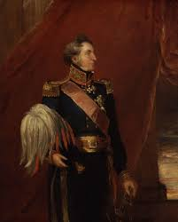
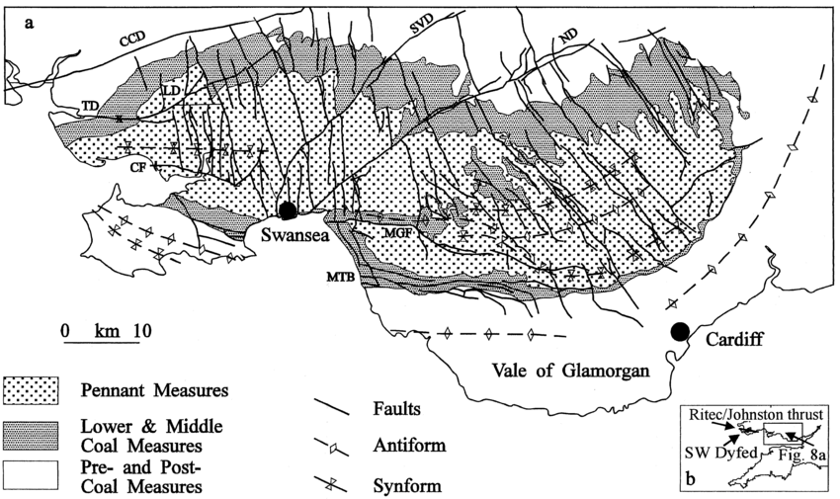
Foundations of Swansea’s Prosperity
Key Context:
Copperopolis, this was the world's center of copper smelting during the 18th and 19th centuries.
Accessibility: adjacent to the South Wales Coalfield, a deep-water port, effective transport links (such as the Swansea Canal and docks, and then later rail links).
Key Figures:
Vivian family; owners of Vivian & Sons, an international copper company.
Pascoe Grenfell; grew smelting connections to Cornwall.
Henry Hussey Vivian (Lord Swansea); took the lead in industrial growth and civic pride.
Main Process:
Welsh Copper Smelting Process; the process that used coal instead of charcoal.
Efficient at importing ore from Cornwall and abroad and exporting finished metals.
Notes:
During the Industrial Revolution, Swansea became known as “Copperopolis”, as the principal centre of copper smelting in Britain, and even the world.
Its success and prosperity could be attributed greatly to its geographic situation; the South Wales Coalfield in the nearby hills provided plentiful fuel, and the town was situated by a harbor and had a canal which made it very easy to import copper ore and export copper metal.
Local industrialists, such as John Vivian and Pascoe Grenfell, as well as Henry Hussey Vivian, certainly contributed to Swansea’s transformation, not only by building smelting works, but also seeking more productive processes. For example, the Welsh process which used coal rather than charcoal which was both less expensive and more efficient, helped to increase Swansea’s preeminence in the metal trade.

Slide 3
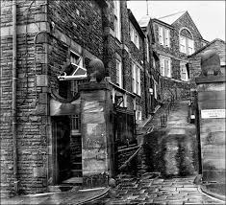
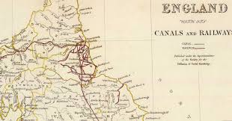
Regional Connections & Workforce
Adjacent Areas:
Cornwall: provided copper ore; received Welsh coal in exchange.
Neath/Llanelli: enlarged industrial area for tinplate and metals.
Bristol & Liverpool: export points for finished goods.
Labour/Community:
An amalgamation of Welsh, Cornish, and Irish immigrant labor.
Work was skilled but dangerous; toxic fume inhalation, heat, and inadequate safety.
Rapid urbanisation; overcrowded housing, health concerns.
Notes:
Swansea's achievement was not developed in isolation; it was part of a wider regional industrial system. Cornwall contributed much of the copper ore in the industrial era, while Neath and Llanelli evolved as significant industrial hubs for tinplate and other metals, contributing to a wider industrial corridor across South Wales. The Labour supply was a mixture of local and Welsh labour, as well as Cornish and Irish migrants, it was arduous and dangerous labour, which brought exposure to heat and fumes and to disease, but while wages were modest, smelting works provided various levels of protection against the worst forms of casual unemployment, and urban development developed urban working-class communities over time. However, industrialisation and rapid urbanisation generated social problems/ issues for the community of the cities, where housing was inadequate, overcrowded, and subject to sanitation problems, which later produced early forms of both trade unionism and philanthropy around education and welfare.

Slide 4
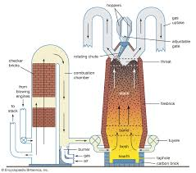
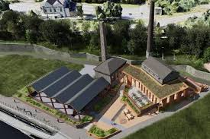
Conclusion
Technological Advancements:
The effectiveness of the furnace became enhanced through steam power.
The purity of metals was advanced through chemical refining.
Trade and ore transport became enhanced through the railways.
Environmental consequences:
Terribly polluted environments (sulphur smelly air, polluted rivers).
The landscape turned into a desolate industrial wasteland which recovered in the future.
Economic significance:
Instigated local development increasing wealth in towns.
Strengthened Britain's position as the world leader in industrialisation (copper for ships, telegraphs, manufacturing).
Illustrated regional specialisation and innovation that created national prosperity.
Notes:
The technological advancement of Swansea was a significant factor in the area's success. For example, steam engines improved the output of furnaces, while chemical innovations enhanced refining processes. The development of railways established a further connection between Swansea and other local, national, and international markets.

Slide 5
References
Evans, C., & Miskell, L. (2020). Swansea copper: A global history. Johns Hopkins University Press.
Gilbert, M. (2019). Evading constraints? 200 years of uncontrolled pollution by the Swansea copper industry.
Gwynn, D. (2021). The Little History of Swansea. The History Press.
Hughes, S. (2008). The characteristics of extractive and smelting landscapes of the Industrial Revolution at Swansea and Blaenavon. Landscape History, 30(1), 21-47.
Jenkins, D. A., Timberlake, S., Davidson, A., Mal, K., Marshall, P., Mighall, T., ... & Smith, D. N. (2021, December). Copper Mining in the Bronze Age at Mynydd Parys, Anglesey, Wales. In Proceedings of the Prehistoric Society (Vol. 87, pp. 261-291). Cambridge University Press.
Thornton, G. J., & Walsh, R. P. (2001). Heavy metals in the waters of the Nant-y-Fendrod: change in pollution levels and dynamics associated with the redevelopment of the Lower Swansea Valley, South Wales, UK. Science of the total environment, 278(1-3), 45-55.
https://cadw.gov.wales/sites/default/files/2019-05/Hafod%20and%20the%20Lower%20Swansea%20Valley-%20Understanding%20Urban%20Character_0.pdf
https://www.cymmrodorion.org/wp-content/uploads/2018/06/3-PRE-INDUSTRIAL-SWANSEA-SITING-AND-DEVELOPMENT.pdf
https://cadw.gov.wales/sites/default/files/2019-04/First_Industrial_Nation.pdf

