Slide 1
EAEY6005/C
Regaining Paradise: Sustainability in the early years
Lecture 3

Slide 2
Content
Measuring our impact
Citizenship, inclusion and sustainability
Masnach Deg
Sefydliadu defnyddiol

Slide 3
Resources
PP for the lecture
Research
Leganto
Moodle
Library
Google Scholar

Slide 4
Ecological Footprint
or
Carbon footprints
How much land, energy we use or carbon dioxide we genarate in our life
Notes:
Julia Davis sued a carbon footprint to assess sustainability of an early childhood centre. Paper on Moodle

Slide 5
How can we use ecological footprints with children?
Look at our impact on the world.
Solutions on a personal and collective level -
reducing consumption or offsetting carbon
reducing unsustainable behaviour
Discussion tool
Notes:
STABUCKS- are cups able to be recycled?
Polystyrene ? Can’t be recycled

Slide 6
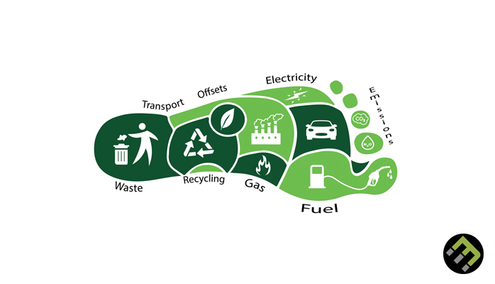

Slide 7
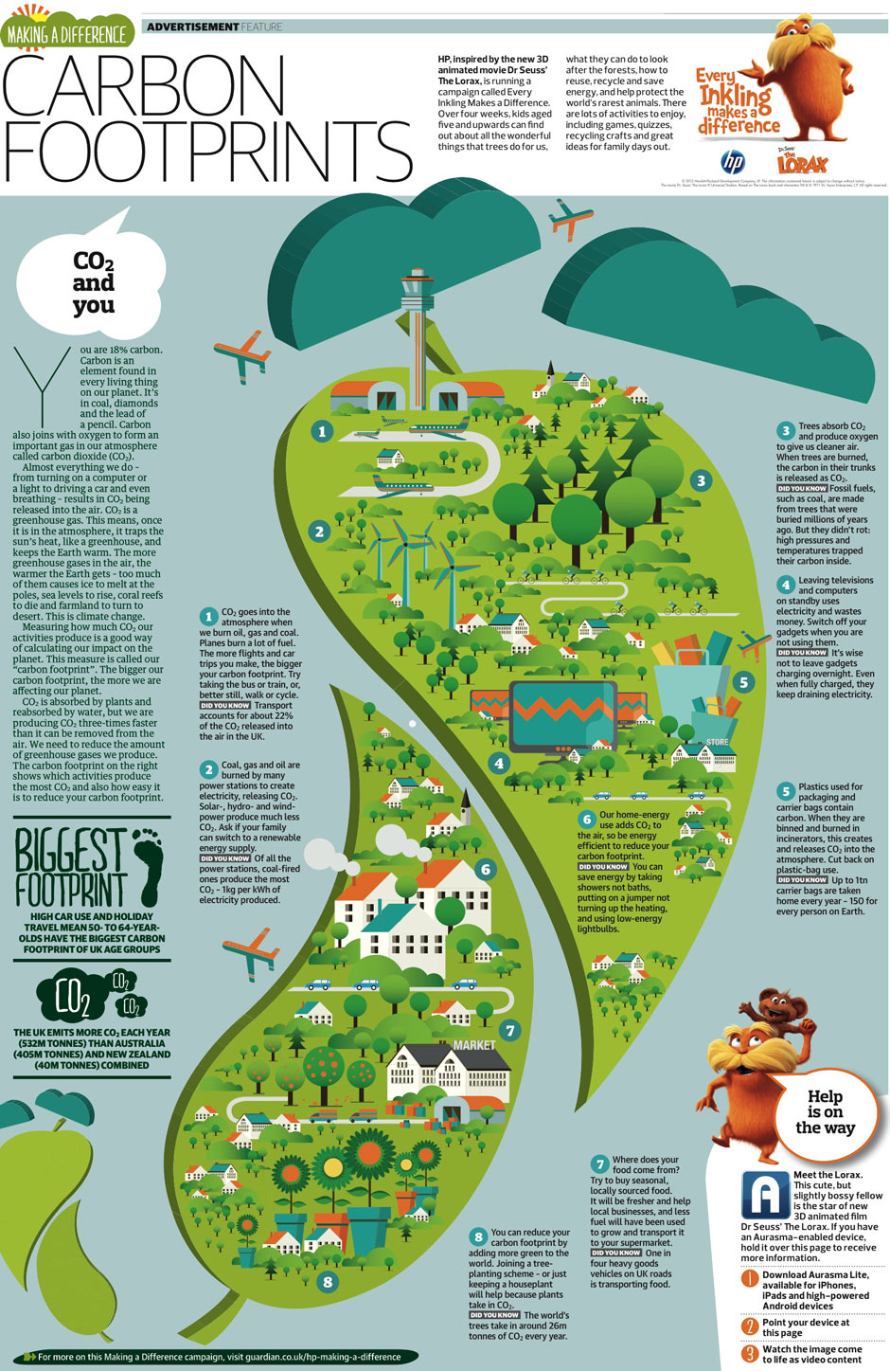

Slide 8
Useful Resources
http://assets.wwf.org.uk/downloads/wwfschoolsglobalfootprint09.pdf
https://www.co2nsensus.com/blog/reducing-carbon-footprint-in-schools

Slide 9
Questions regarding setting or pesonal use of reources
Consider the choices you make when shopping
Walk, cycle, bus, car or other ?
Supermarket, farmers market, small local shops?
Meat, fish or only vegetables, fruit and pulses?
Packaging or not? Type of packaging-Plastic, tins, paper
Notes:
God public transport links?

Slide 10
Air miles?
Chocolate Bar
Cheese
Bara

Slide 11
Ecological footprint websites
https://footprint.wwf.org.uk/

Slide 12
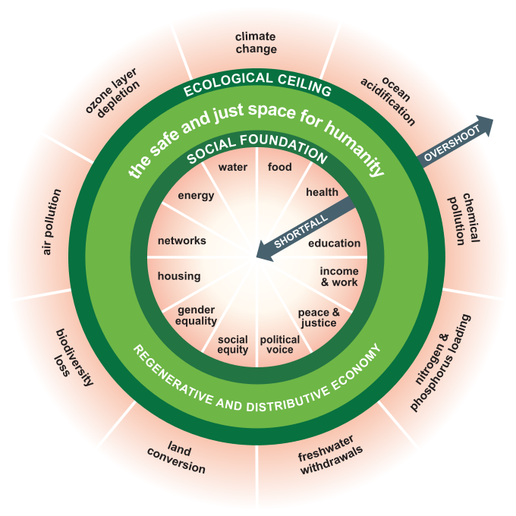
Doughnut economy Raworth, 2017
Moving away from Gross Domestic Product GDP and uncontrolled economic growth to looking at holistic human and wider world’s wellbeing. Limits to economic growth if damaging and unfair to some people or wider planet .
Balance
Ecological ceiling
Harmony?
Cyclic

Slide 13
Doughnut Economics Action Lab, 2021
https://doughnuteconomics.org/about-doughnut-economics

Slide 14
How can early year’s educators help with being more sustainable?
In your own choice of activities and materials?
In how you work with children and young people?
In your use the outdoors?
Notes:
A discussion – reusing, material . Reusing packaging, waste?
Activities with children #children planting , composting, being encouraged to be kind.

Slide 15
You are designing a new outdoor centre
How could you consider the health of the ecosystem and climate change?
What would make your nursery sustainable?
Consider new legislation such as Wellbeing of Future Generations Act.
Consider United Nations Sustainable Development Goals.
Consider United Nations Convention on Rights of Child.
Notes:
Discussion
What they use to build, heat the nursery?
What they plant?
What they use to clear with?
Food they purchase?
What they might grow
Vehicle use?
Use of plastic?

Slide 16
Reading
Moodle has several interesting articles.
Read Educating for sustainability in the early years: Creating cultural change in a child care setting by Julia Davis
The article McNichol et al, also links well to today’s sessions
An ecological footprint for an early learning centre: identifying opportunities for early childhood sustainability education through interdisciplinary research

Slide 17
However can methods such as ecological footprints simplify and ignore issues of justice and fairness and the holistic nature of sustainability
Global Citizenship
Environmental justice
Interrelatedness https://fcpablog.com/2016/01/18/dr-king-before-you-finish-breakfast-youve-depended-on-half-t/
(Dr Martin Luther King Jnr. (clip ar ol 6.5 mintues-9 minutes)
Systemic racism
Black lives matter

Slide 18
Caution
Stereotypes.
Negative Images.
Considering resources, books, toys, images that promote diversity and positive images
Notes:
Dim wastad am tlodi
Beth allwn ddsygu o wledydd eraill? A ydym ambell waith yn creu sterotype
Er enghraiift
Rhai o wledydd tlawd Affrica yn cael eu gweld fel gwan, bod angen i ni teimlo’n wael amdanynt. Hela arian draw ayb. Ond a’i hwn yw’r stori wir?
Dylai ein bod yn rhannu gwerthoedd, syniadau ayb, nid yn unig gwled bod ein fordd ni yn iawn.

Slide 19
Consider
How diverse are the resources we use?
Are there positive images?
Are there images support children in terms of citizenship and inclusion?

Slide 20

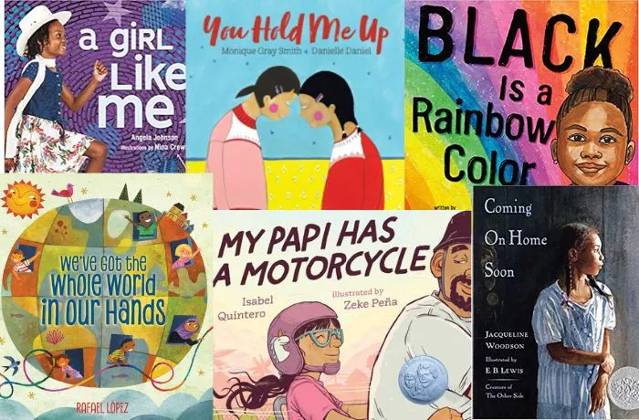
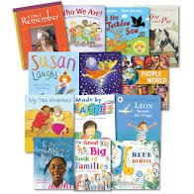

Slide 21
Easy fixes?
Send money / charity but do not tackle the reason for the inequality.
International policies and unfair trade agreements may impact on equality globally and retain the power imbalance.

Slide 22
Environmental justice and Fair Trade?
Where does our waste go?
Old tablets / phones?
How does power influence how degraded different people’s environments become?
Have Euro-American countries used other countries to hide or get rid of their own waste or take resources without paying a fair price ?
Have Euro-American countries exploited other counties and other people?
Is this situation a result of long term history and how this impacts on our political and socio-cultural systems?
Some resources on Moodle

Slide 23
What organisations might help?

Slide 24

Fair Trade
http://www.fairtrade.org.uk/What-is-Fairtrade
http://www.fairtrade.org.uk/What-is-Fairtrade
Notes:
Her repeat some of Anthony’s past ideas re symbol
Re status of Fair Trade
Where it is moving
Ammanford first Fair Trade town in Wales 2002
Wales is first Fair Trade county in world
TSD Fair Trade campus
The eye-catching blue, green, white and black FAIRTRADE Mark began being used by FLO International in 2002. The symbol has different interpretations; as some say it’s a parrot, others a green leaf, some see the black swirl at the centre as a road leading to a brighter future. The most common interpretation is to imagine the sky as blue, the green as grass, and the black dot and swirl at the centre as a person holding one arm aloft. That person represents the people who are at the heart of the Fairtrade system and it could be a farmer holding up their product, a shopper reaching to purchase, or a campaigner fighting for greater justice in international trade.

Slide 25
What is Fair Trade?
Minimum Price
Fair Trade Standards
Certification all through the system, from growers to traders
People receive a fair deal for what they produce and are given a fair price
Working conditions
Safety and wellbeing
http://www.fairtrade.org.uk

Slide 26
Fair Trade in the setting?
Shopping for resources
Cooking with Fair Trade
Fair Trade Banana Smoothies
Fair Trade Chocolate Cakes
http://www.fairtradecookbook.org.uk/alphabetic_index/c.htm

Slide 27
Fair Trade Learning Resources
Learning Resources
http://schools.fairtrade.org.uk/

Slide 28
Oxfam
Education Resources
http://www.oxfam.org.uk/education/resources

Slide 29
Amnesty International
Learning Resources
https://www.amnesty.org.uk/education-resources
http://www.amnesty.org.uk/issues/Education?gclid=CJLsk4rcgL0CFaQfwwodXq0AQA

