Slide 1

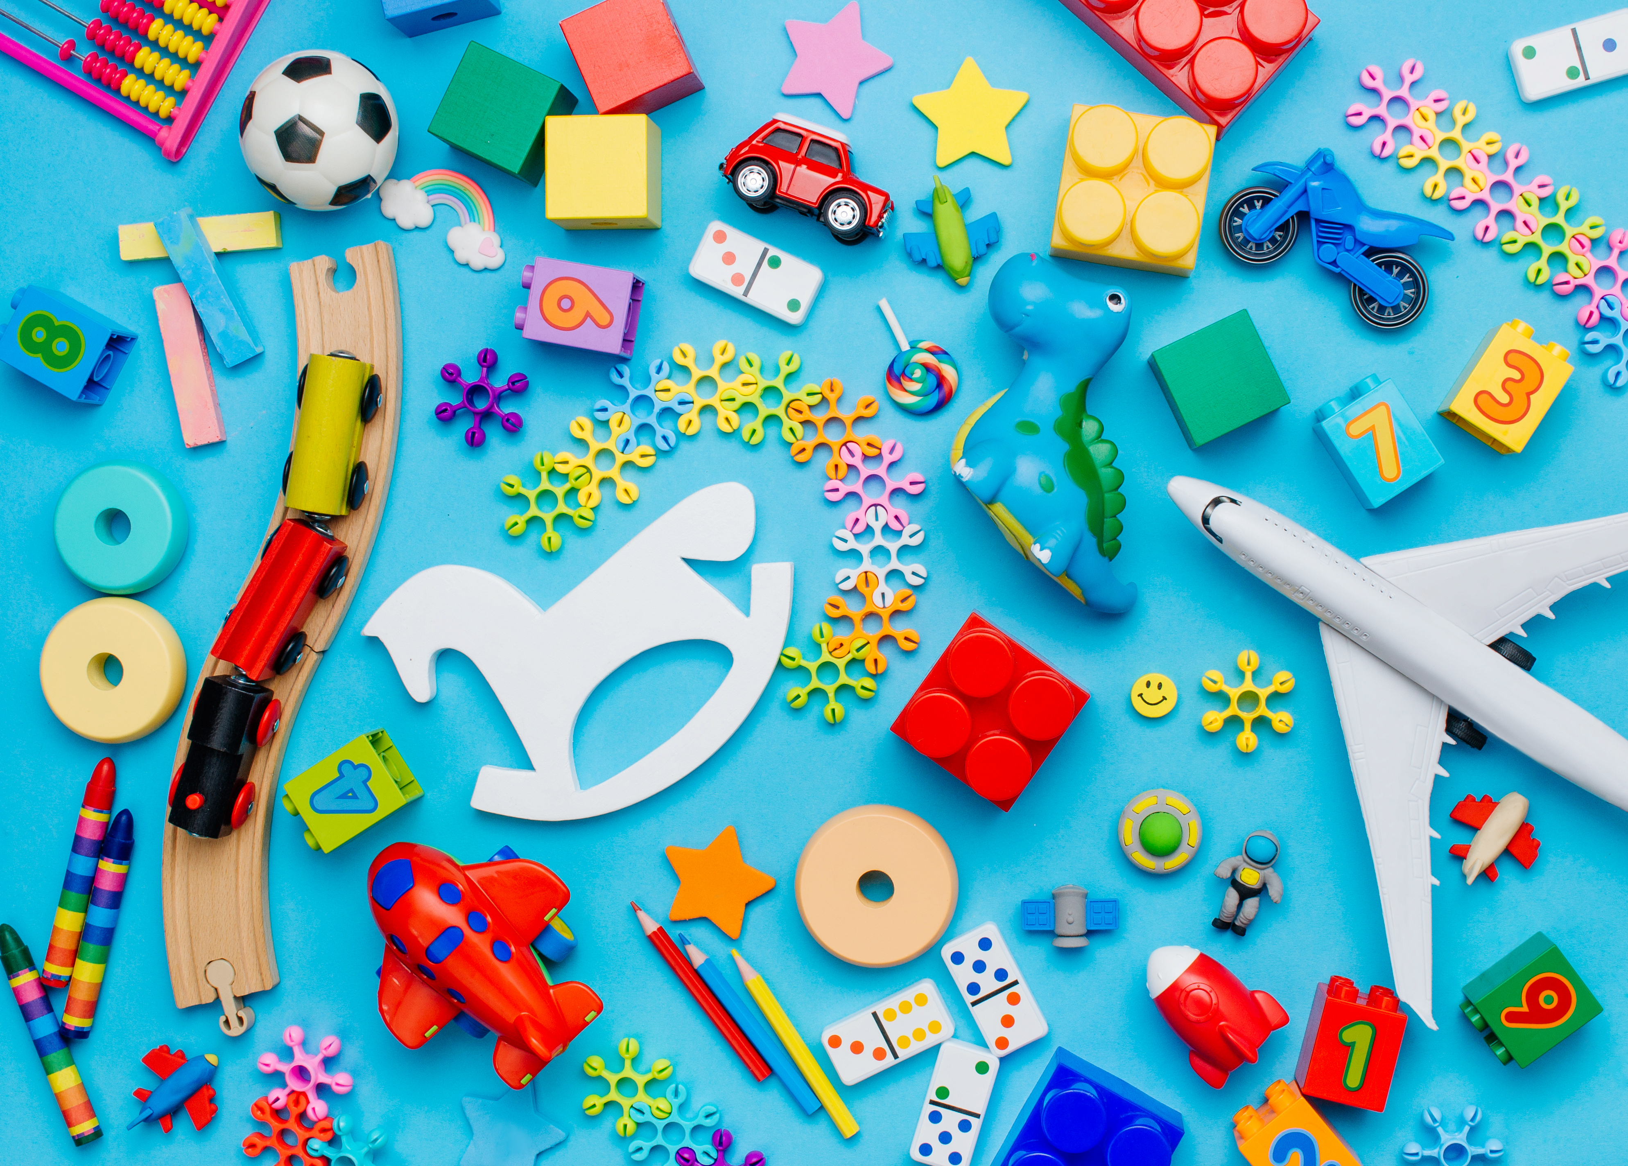
Kodi Duxberry (2114558)
ECES4010
How learning theories can support effective teaching and learning.

Slide 2
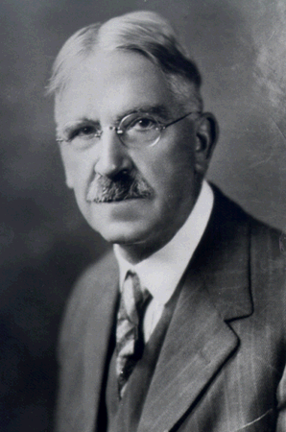
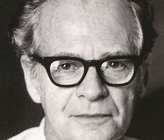
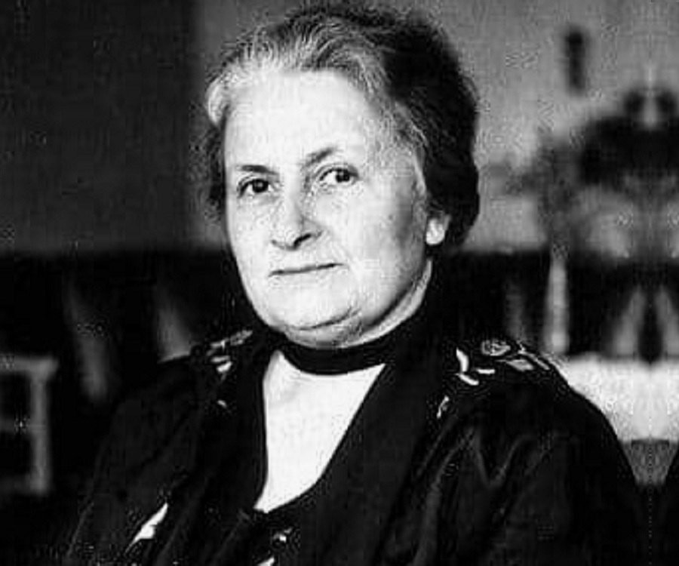
Introduction of Theorists
The three theorists we are looking at in our presentation
Maria Montessori (1870 – 1952)
By Kodi Duxberry
John Dewey (1859 – 1953)
By Steve Taylor
B F Skinner (1904 – 1990)
By Skye Stevens
(John Dewey, 1997)
(B.F Skinner, 2013)
Maria Montessori, n.d.)

Slide 3
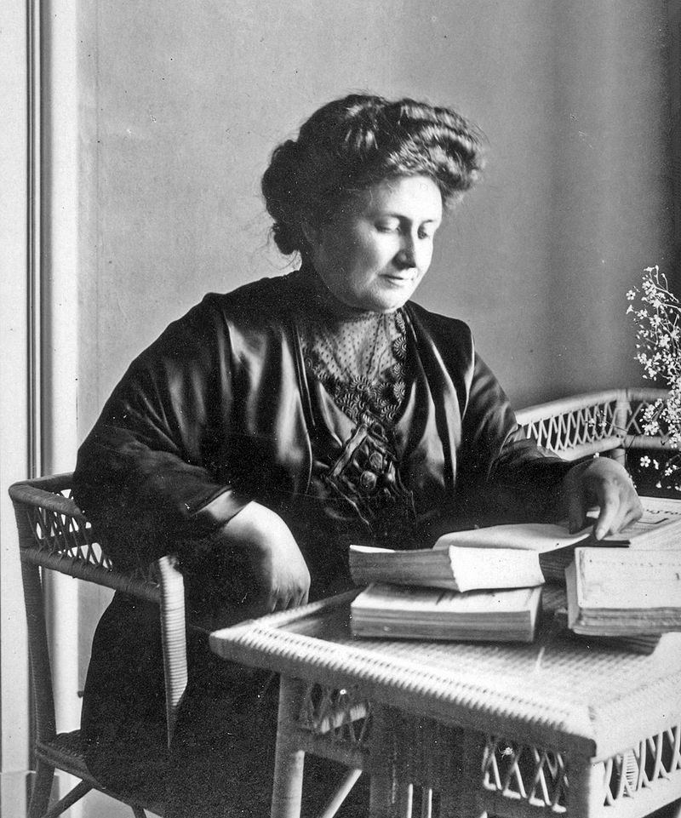
Maria Montessori
Maria Montessori
1896 became the first woman to be awarded a degree in medicine in Italy.
She researched education around children who were disadvantaged intellectually and environmentally.
Montessori opened her first Casa Dei Bambini in 1907
Was one of the early childhood theorist that backed up her theory by science.
(Pound, 2011)
(Maria Montessori -The Vintage News - Goran Blazeski, 2017)

Slide 4
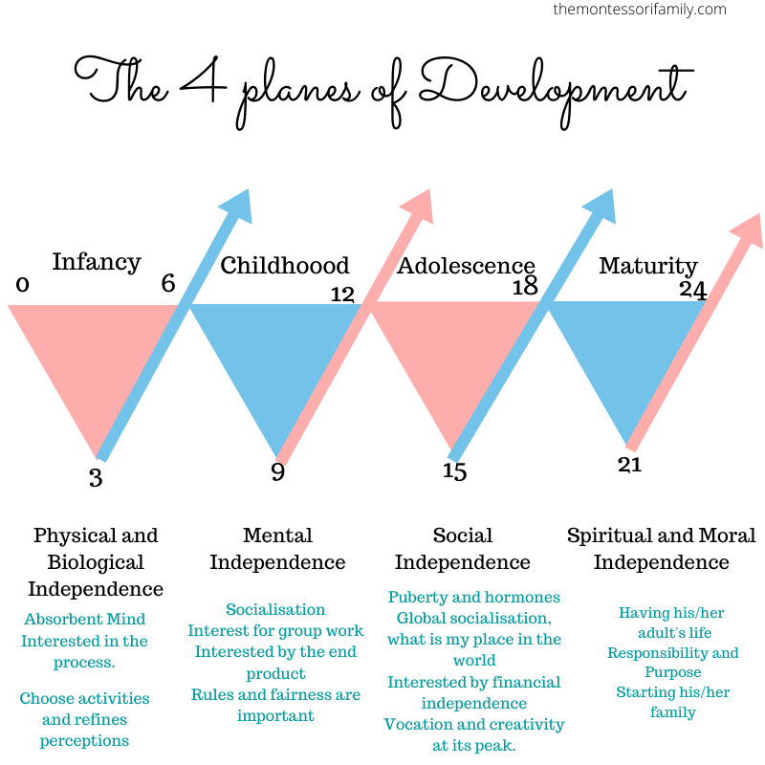
Montessori and Development of Skills
Montessori focuses on 9 senses (Sensorial Archives — The Montessori-Minded Mom, n.d.)
The Development stages are called PLANES (nruiz, 2018)
1. First Plane – birth to 6 years
2. Second Plane - 6 – 12 years
3. Third Plane – 12 – 18 years
4. Forth plane – 18 -24 years
(Robin, 2020)

Slide 5
Linking Theory and Practice
Play and active learning A toolkit for Foundation Phase practitioners (Estyn,2009, pg. 24-26)
- Play areas, feeling the weather and independence.
Ysgol Gymraeg Y Gwernant (Estyn,2019)
- Observations of children
- How this report links Montessori, Dewey and Skinner.
“Children need a cycle of work for which they have been mentally prepared; such intelligent work with interest is not fatiguing and they should not be arbitrarily cut off from it by a call to play. Interest is not immediately born, and if when it has been created, the work is withdrawn, it is like depriving a welded appetite on the food that will satisfy it. “ Montessori (1948: 95 – 6)

Slide 6
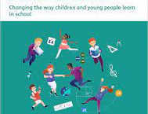
HOW LEARNING THEORIES CAN SUPPORT EFFECTIVE TEACHING AND LEARNING
(Welsh Government, 2020)

Slide 7
Bibliography
2013. B.F Skinner. [image] Available at: <http://3.bp.blogspot.com/-bss0kRiR6xU/URgdv07g1EI/AAAAAAAAAAk/_y1qEYfiX0Q/s320/Skinner+3.jpg> [Accessed 10 January 2022].
Estyn, 2019. Using activities to promote independence skills. [online] Estyn. Available at: <https://www.estyn.gov.wales/effective-practice/using-activities-promote-independence-skills> [Accessed 10 January 2022].
Redhillprepschool.co.uk. 2018. Estyn report for Redhill prep school. [online] Available at: <https://redhillprepschool.co.uk/wp-content/uploads/2020/09/Redhill-Preparatory-School-Inspection-2018.pdf> [Accessed 10 January 2022].
Estyn.Gov.Wales, 2009. Play and active learning. [online] Estyn, p.25. Available at: <https://www.estyn.gov.wales/system/files/2020-07/Play%2520and%2520Active%2520Learning%253A%2520A%2520toolkit%2520for%2520Foundation%2520Phase%2520practitioners%2520-%2520September%25202009.pdf> [Accessed 7 January 2022].
1997. John Dewey. [image] Available at: <http://www.columbia.edu/cu/record/23/02/24.html> [Accessed 12 September 1997].
n.d. Maria Montessori. [image] Available at: <https://www.thefamouspeople.com/profiles/maria-montessori-2252.php> [Accessed 10 January 2022].
Montessori, M., 1948. From Childhood to Adolescence. New York: Schocken Books, pp.95-96.
Nruiz, 2018. Four Planes of Development in a Montessori School. [online] Silverline Montessori. Available at: <https://silverlinemontessori.com/four-planes-of-development-in-a-montessori-school/> [Accessed 10 January 2022].
Pound, L., 2011. Influencing early childhood education. Berkshire, England: McGraw Hill, pp.42-46.
Robin, C., 2020. 4 planes of development explained. [image] Available at: <https://themontessorifamily.com/montessori-theory-4-planes-of-development-explained/> [Accessed 16 January 2022].
The Montessori-Minded Mom. n.d. Sensorial Archives — The Montessori-Minded Mom. [online] Available at: <https://reachformontessori.com/category/montessori-learning/montessori-sensorial-activities/> [Accessed 10 January 2022].
The Vintage News - Goran Blazeski, 2017. Maria Montessori. [image] Available at: <https://www.thevintagenews.com/2017/01/16/maria-montessori-the-woman-who-revolutionized-the-education-systems-of-the-world/> [Accessed 4 January 2022].
Welsh Government, 2020. A new curriculum in Wales. [online] Welsh Government. Available at: <https://hwb.gov.wales/api/storage/016a744a-d1f4-4d61-8b35-0fe1648c1009/a-new-curriculum-in-wales.pdf> [Accessed 16 January 2022].

