Slide 1
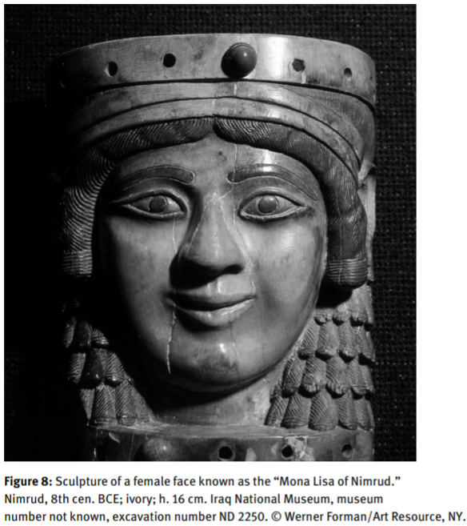
Neo-Assyrian Royal Ideas of Feminine Beauty
Ideal Feminine Beauty – considered by Gansell to be a combination of physical features and personality traits that were considered to be the most desirable.
Gansell suggests that desirable traits included
  Dark, elaborately styled hair,
  Dark eyes
  Voluptuous body
  Highly decorative clothing
  Fertility
  Moral and sexual purity
  Sexual allure and availability
Royal tombs provide a wealth of evidence for the beauty of those buried within, including:
  Inscriptions
  Adornments
  Grave goods
Ethnographic studies have also been used as evidence, but it should be remembered that millennia of cultural change have passed.
Assyrian queens may have been an incarnation of the themes that the elite intended to present: abundance and imperial ideology.
A very interesting article, that clearly sets out, with examples, what the Assyrians would have considered the markers and traits of the ideal feminine.
“Mona Lisa of Nimrud”
  Plump, round face
  Lots of hair, that has been elaborately styled
  Large, accentuated eyes – with a preserved black outline
  Elaborate, decorative headdress
Gansell, A., (2013) ‘Images and Conceptions of Ideal Feminine Beauty in Neo-Assyrian Royal Context, c. 883-627 BCE’, pp. 391-420, in ed. Feldman, M,. and Brown, B., Critical Approaches to Ancient Near Eastern Art, Boston: Walter de Gruyter,

