Slide 1
Academic writing
Jonathan Butterworth

Slide 2
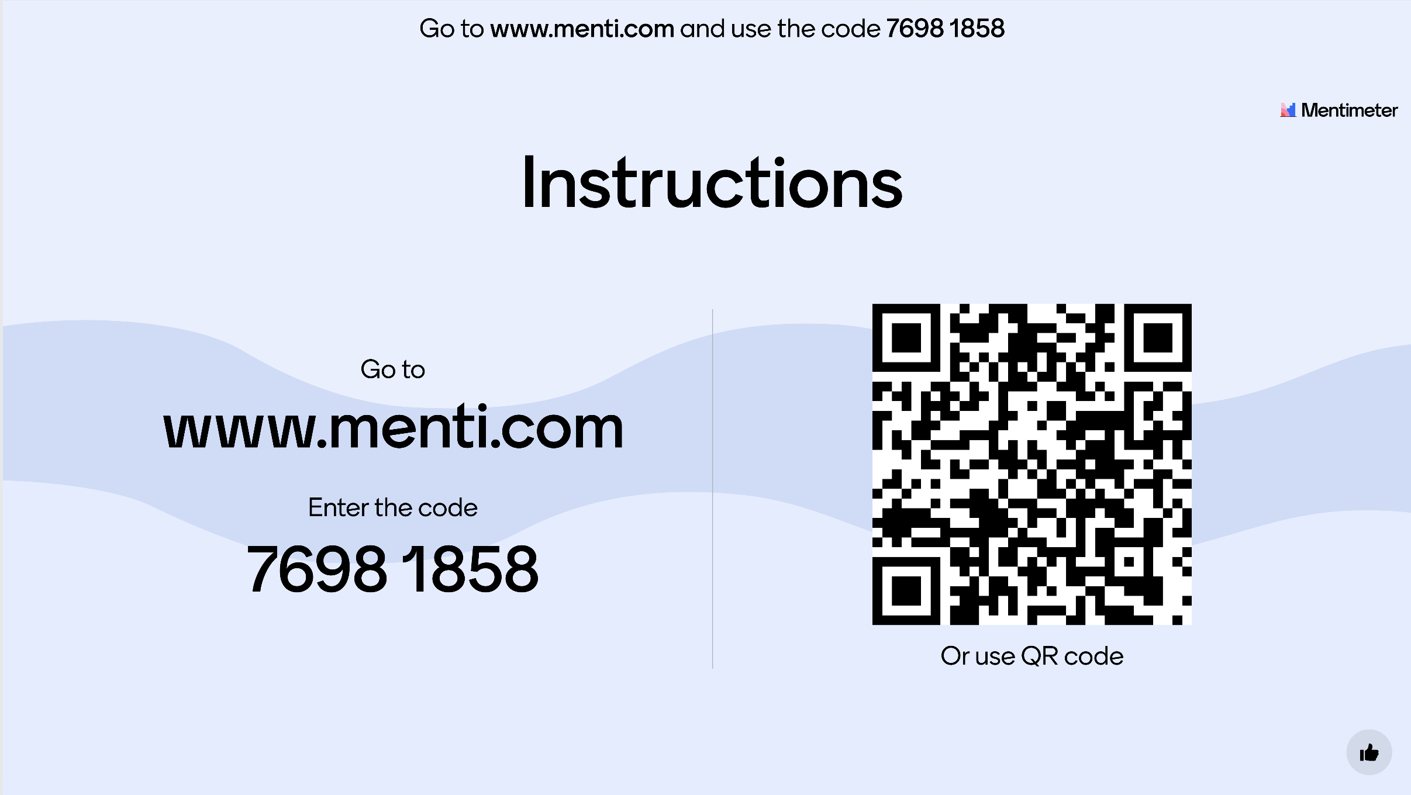

Slide 3


Slide 4


Slide 5
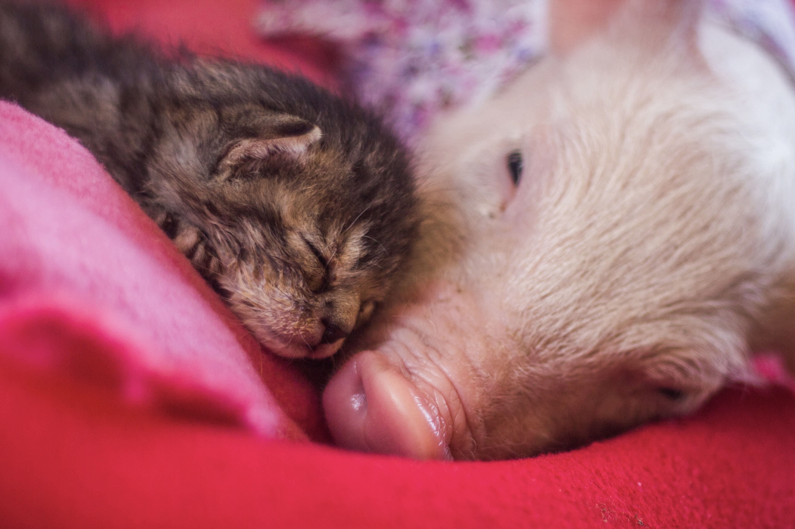

Slide 6
Academic writing
Framework
Layout
Content

Slide 7
Essays and assignments are not tests

Slide 8
Essays and assignments are not tests
Teachers want you to pass
University wants you to pass

Slide 9
Essays and assignments are not tests
Teachers want you to pass
University wants you to pass
There is lots of support available
Teachers
Librarians
Student services

Slide 10
Framework
Academic writing

Slide 11
Essay questions

Slide 12
Essay questions
Essay questions are often statements
Discuss
Define
Explore
Identify

Slide 13
Essay questions
The golden ticket
Reflect

Slide 14
Layout
Academic writing

Slide 15
Academic writing - layout
Three sections

Slide 16
Academic writing - layout
Three sections
Introduction

Slide 17
Academic writing - layout
Three sections
Introduction
Argument

Slide 18
Academic writing - layout
Three sections
Introduction
Argument
Summation

Slide 19
Academic writing - layout
Three sections
Tell ‘em what you’re gonna tell ‘em
Tell ‘em what you’ve got to tell ‘em
Tell ‘em what you’ve told ‘em

Slide 20
Academic writing - layout
For a 2000 word essay
Introduction – 150 - 200 words
Argument – 1600 - 1700 words
Summation – 150 - 200 words

Slide 21
Academic writing - layout
For a 2000 word essay
Introduction – 150 - 200 words
Argument – 1600 - 1700 words
Summation – 150 - 200 words
Word count allows 10% margin

Slide 22
Content
Academic writing

Slide 23
Academic writing – content
Layout an academic argument
Contain references to established knowledge
Academic honesty

Slide 24
Academic writing – content
Third person*
Never use contractions eg. It’s, they’re, won’t
Do not give your opinion

Slide 25
Academic writing – content
References
Peer reviewed books, journals, essays etc.

Slide 26
Academic writing – content
References
Peer reviewed books, journals, essays etc.
University library
www.jstor.org
Google scholar

Slide 27
Academic writing – content
References
Other sources, look for:

Slide 28
Academic writing – content
References
Other sources, look for:
Reviewed by, name and credentials
Fact checked by, name and credentials

Slide 29
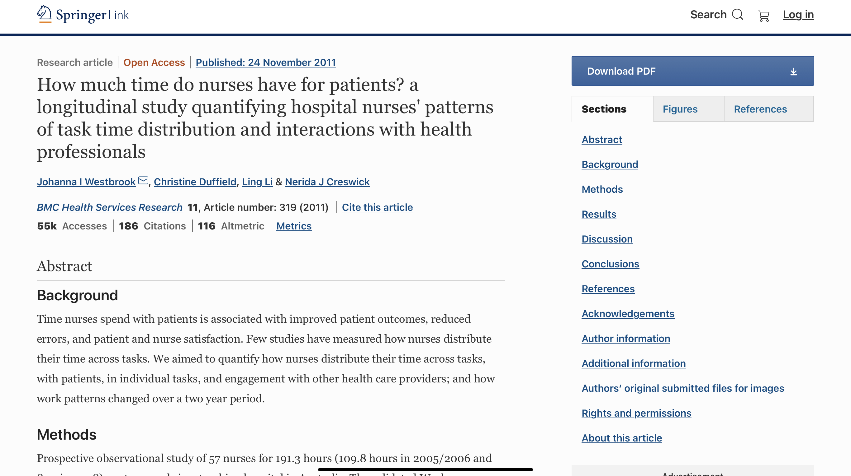

Slide 30
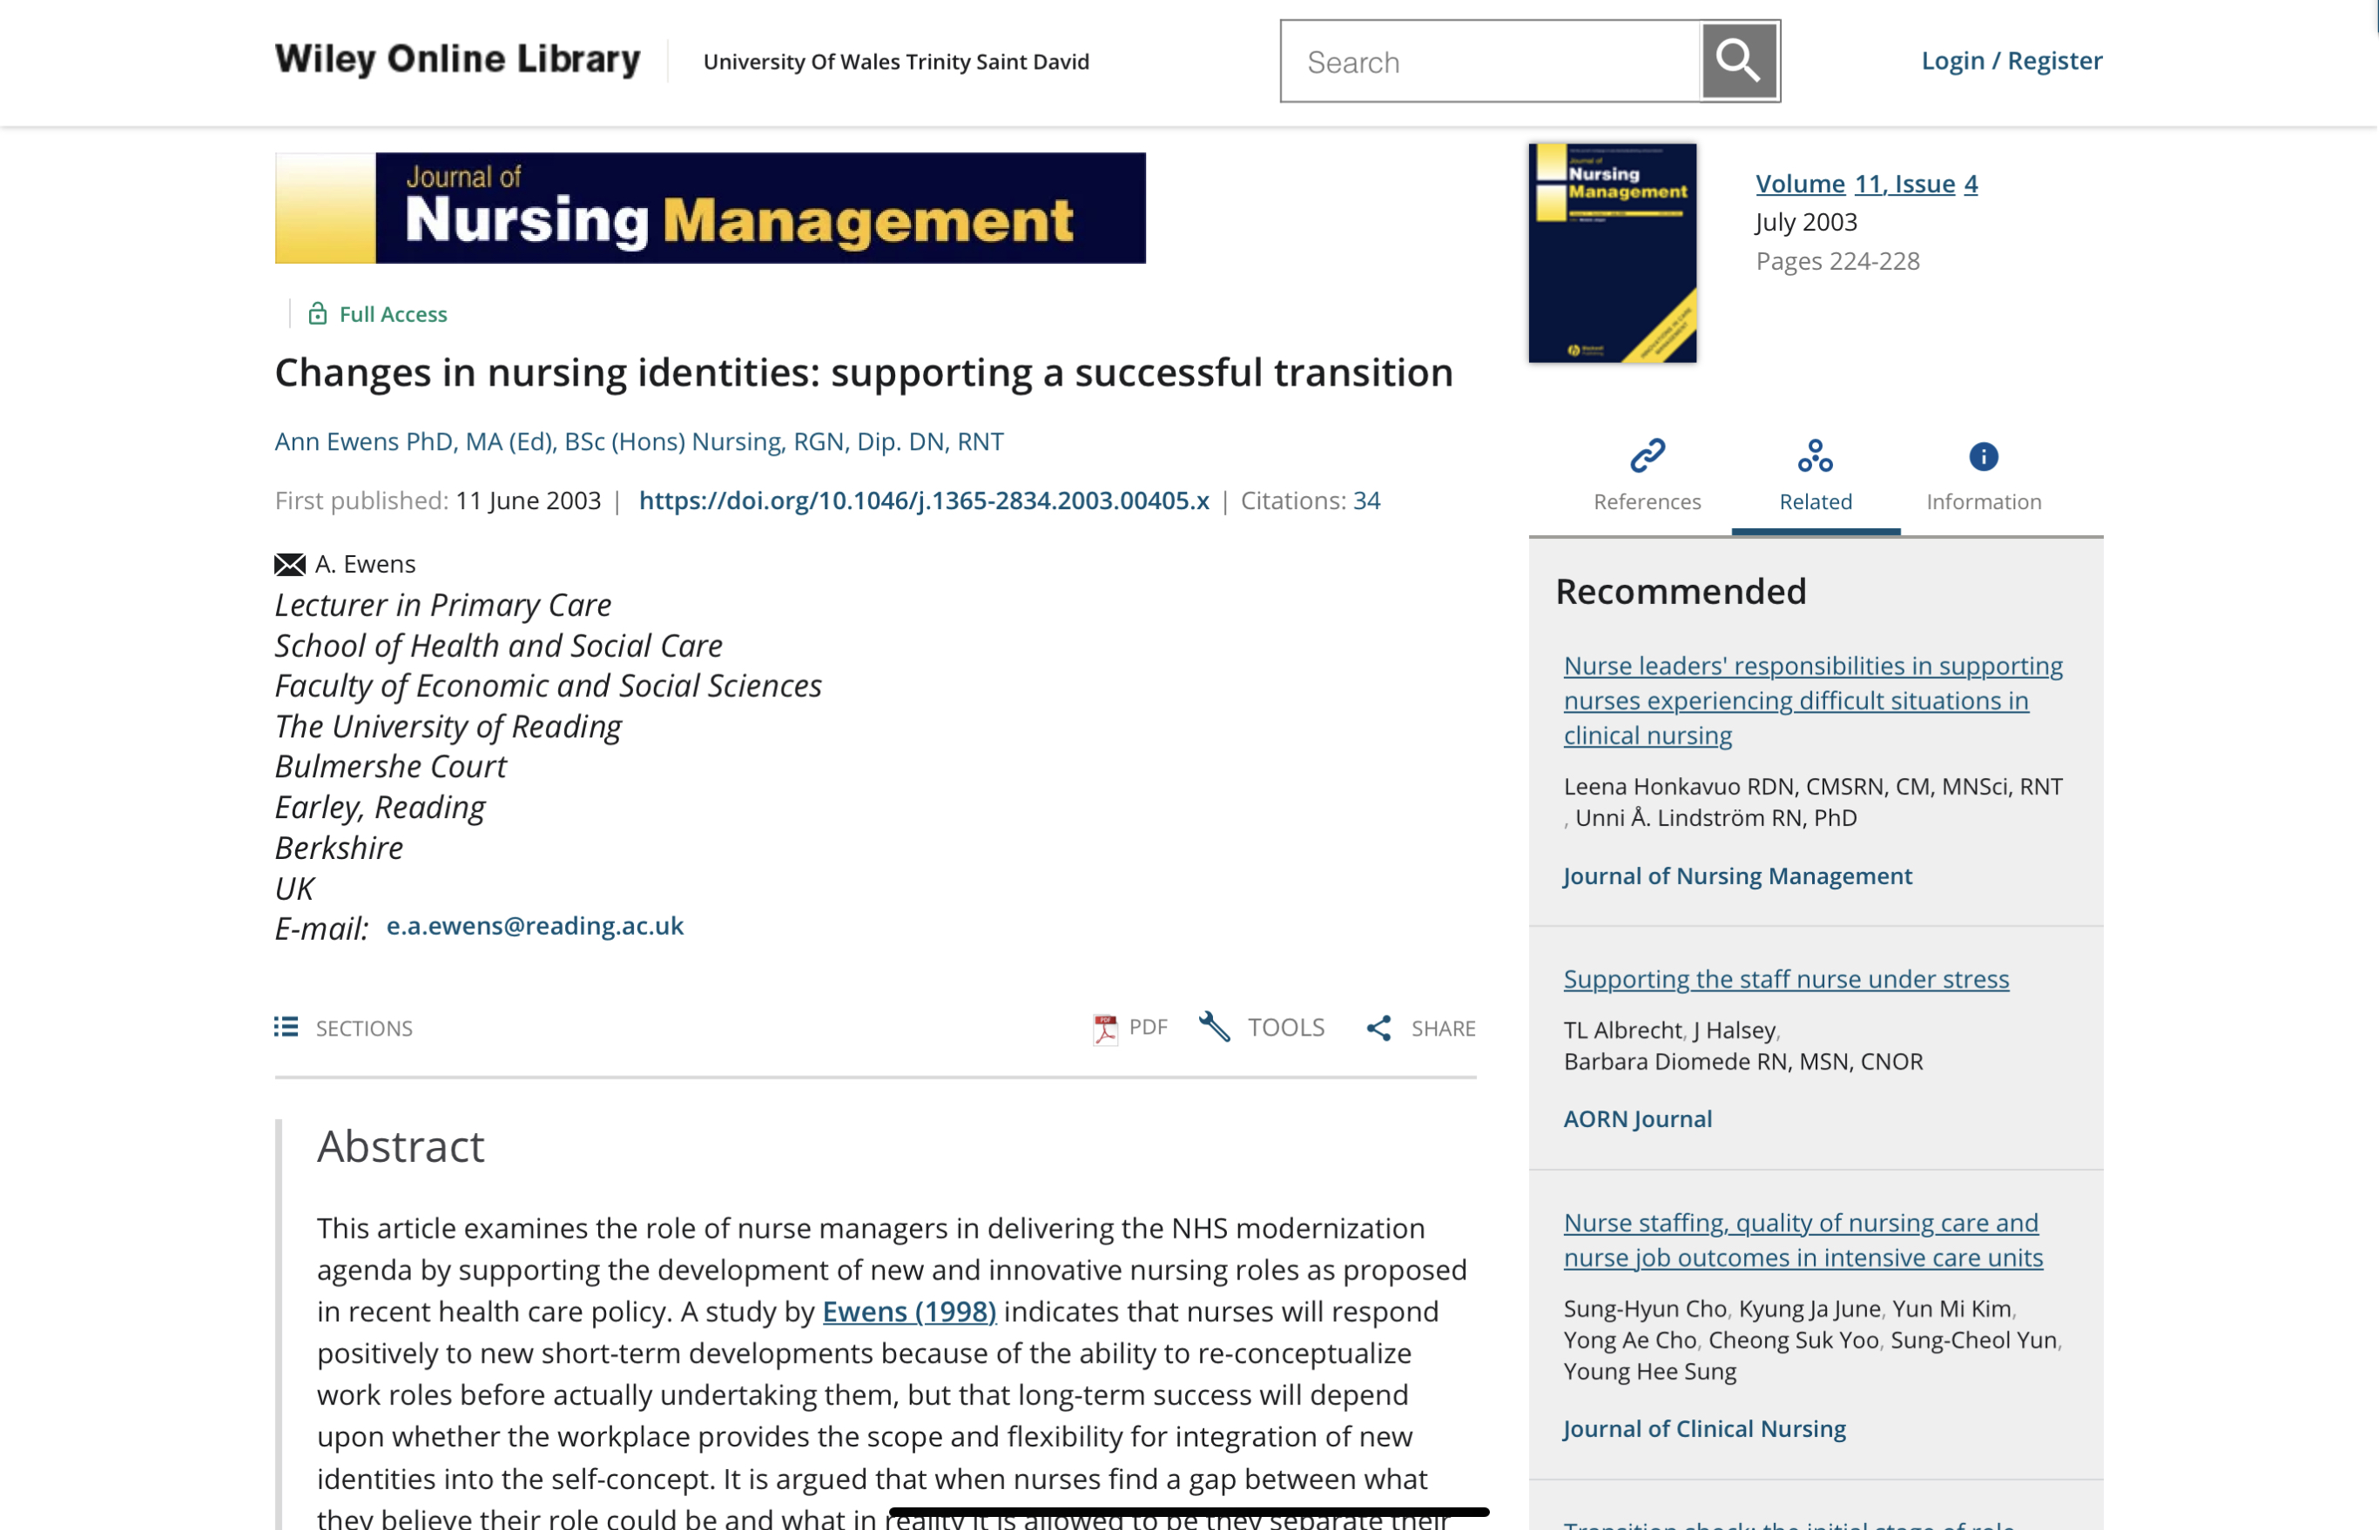

Slide 31


Slide 32
Referencing
Academic writing

Slide 34
Referencing
Harvard
In-text citation (Author surname, year of publication)

Slide 35
Referencing
Harvard
In-text citation: (Author surname, year of publication, page number if direct quote)
Reference list: full reference

Slide 36
Referencing
Harvard
Full reference:
Author surname, initial. (Year of publication) Book title, place of publication, publisher.

Slide 37
Referencing
Quote

Slide 38
Referencing
Quote
Paraphrase

Slide 39
Referencing
Quote
Depending on the number of words used

Slide 40
Referencing
Quote
If less than 30 words
Should be placed in “speech marks”
(Citation at the end) before the full stop.

Slide 41
Referencing
Quote
If more than 30 words
In its own indented paragraph
No speech marks
Citation at the end

Slide 42
Referencing
Short quote

Slide 43
Referencing
Short quote
“Suggesting that nurses take on new roles is not a new idea” (Ewens, 2003).

Slide 44
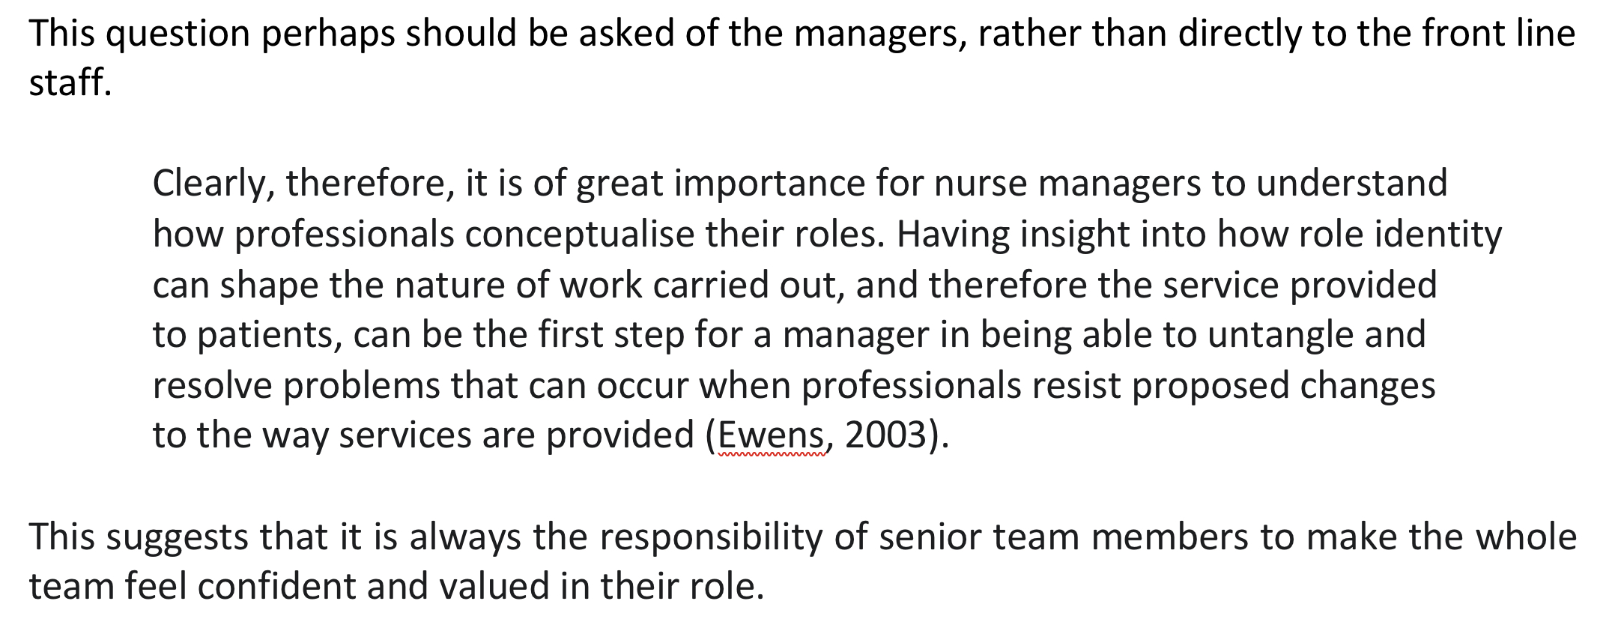
Referencing
Longer quote

Slide 45
Referencing
University referencing handbook
Google: UWTSD Harvard referencing

Slide 46
Referencing
University referencing handbook
Google: UWTSD Harvard referencing
Cite Them Right
www.citethemrightonline.com

Slide 47
Exercise
Academic writing

Slide 48
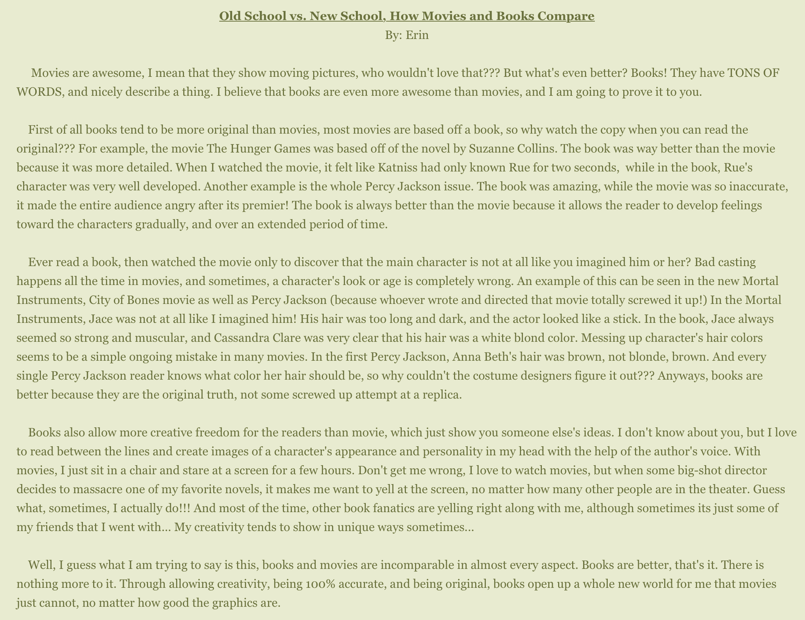

Slide 53
Two Content Layout with Table
First bullet point here
Second bullet point here
Third bullet point here
Class | Group A | Group B
Class 1 | 82 | 95
Class 2 | 76 | 88
Class 3 | 84 | 90

Slide 54
Two Content Layout with SmartArt
Group A
Task 2
Group B
Task 1
Task 2
Group C
Task 1
Task 1
First bullet point here
Second bullet point here
Third bullet point here

Slide 55
Add a Slide Title - 1
Subtitle

Slide 57
Add a Slide Title - 2

Slide 58
Add a Slide Title - 3

Slide 60
Add a Slide Title - 4

Slide 61
Add a Slide Title - 5

