Slide 1
ECES6020
Therapeutic Work with Individuals
Session 3
04.03.2026
Sue Ainsworth
s.ainsworth@uwtsd.ac.uk

Slide 2
Today
Theories of self-esteem and self-worth
Analysis of the interventions and support available for trauma

Slide 3

What is the impact of childhood trauma on the brain?
Https://youtu.be/xYBUY1kZpf8
(Anna Freud Centre, 2020)

Slide 4
Self-esteem and self-worth: how we feel about ourself
Multi-dimensional
Influenced by biological, social and psychological factors across our lifespan
Some of the theories:
Bowlby’s Attachment Theory (1969) (NSPCC Learning, 2021)
Maslow’s Hierarchy of Needs (1943) (Maslow, 2013)
Carl Rogers’ Humanistic Theory (1951) (Rogers, 1977)
William James’ Ratio Theory (1890) (James, 2002)

Slide 5

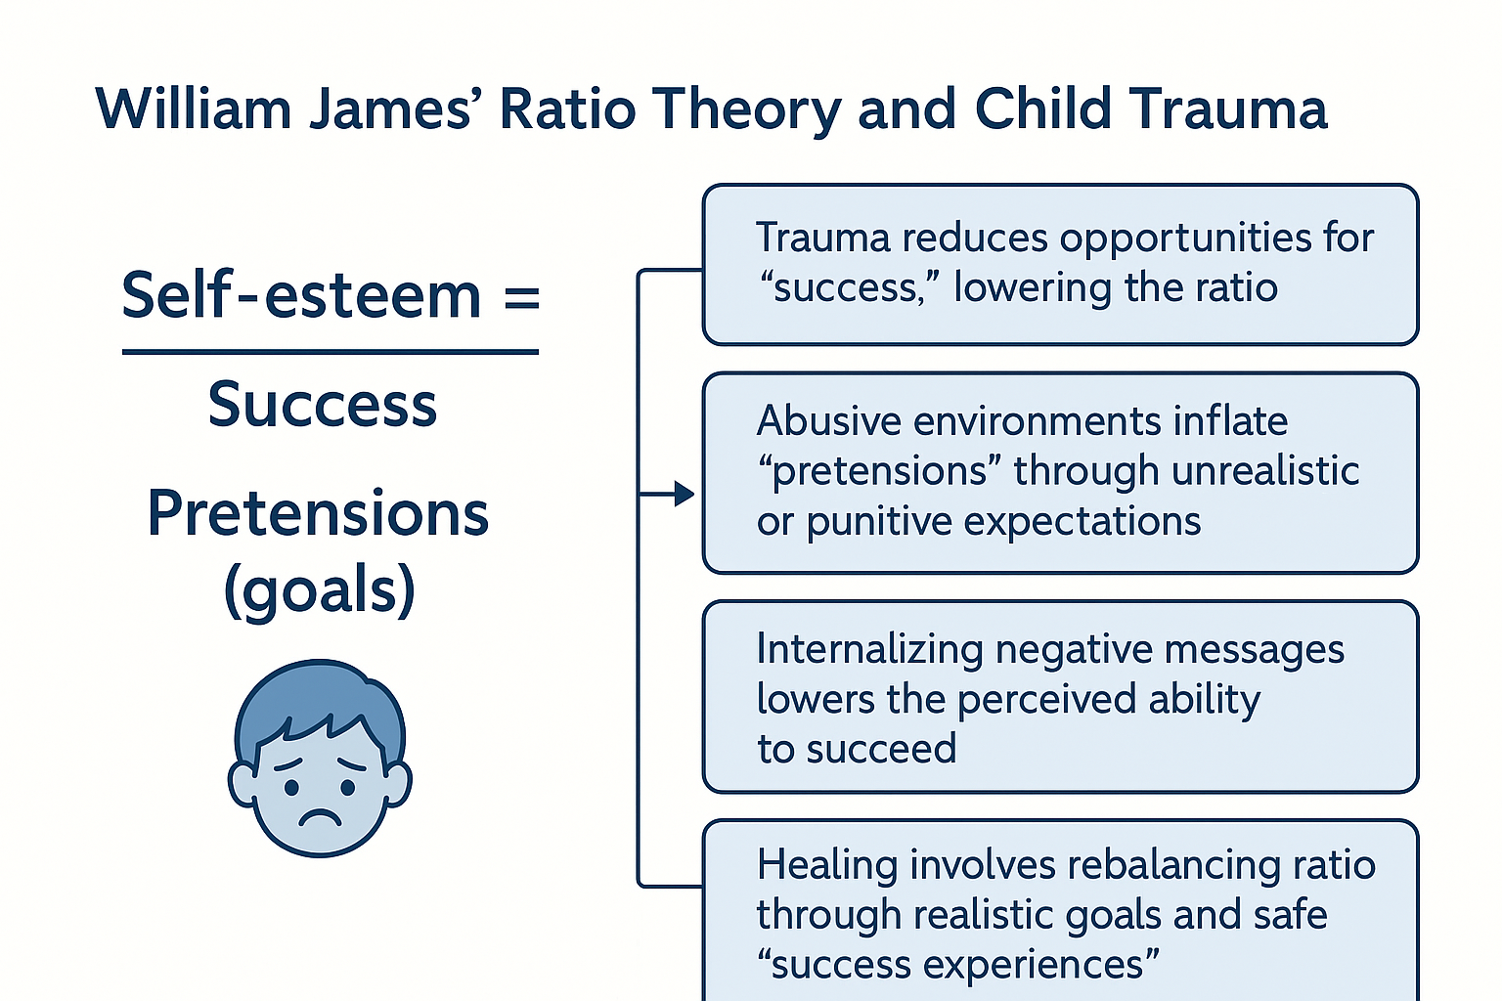
Image generated by AI. 04/03/2026

Slide 6
Lifelong impact of trauma
The initial trauma of a young child may go underground but it will return to haunt us.
(Garbarino et al cited in Greenbaum et al, p.70, 2021)

Slide 7
Lifelong impact
A ‘cycle of violence’(carry on through the generations)
Parents who have experienced or witnessed significant interpersonal trauma may struggle to build caring and trusting attachments with their children
If they have not been shown love, compassion, kindness and comfort, they may have a reduced ability to express empathy or to regulate their own emotions and behaviours in relation to their children
Children learn from their parents, so modelling poor behaviours and coping strategies means they are passed on through generations
However, parents will not always pass adversity and trauma on to their children, many get support to help them break the cycle of violence they have experienced
(Mental Health Foundation, 2025).

Slide 8
Chronic activation of the sympathetic nervous system
Trauma in childhood can lead to health concerns in adolescence and adulthood:
Heart disease
Stroke
Cancer
PTSD
(UK Trauma Council, 2026)

Slide 9
PTSD
Can experience PTSD
Flashbacks
Nightmares
Intrusive thoughts
Reactions to something that reminds them of the experience
Avoidance (block out memories)
Avoidance (people, places or activities) (PTSD UK, 2025)

Slide 10
Complex post traumatic stress disorder (CPTSD)
Another experience related to trauma is CPTSD
A young person who is diagnosed with this will be experiencing more severe symptoms and is likely to have gone through a childhood trauma that lasted a long time, such as abuse.
(PTSD UK, 2025)

Slide 11
Layard and Hagell (2015)
Early intervention is crucial.
Mental health problems need to be tackled when they first appear.
They need to be recognized by parents, doctors and teachers, and our whole society needs to become much more open and matter-of-fact about what is a common part of life.
Our schools need to embed children’s wellbeing as one of their major objectives – both in their ethos and their teaching.
Life skills and talking about how we feel can and should be taught as professionally as mathematics or literature.

Slide 12
What support and interventions are available?
Trauma-informed care (TIC)
Evidence-based psychological interventions (e.g. CBT)
Community and peer support
Long-term system level trauma interventions
Crisis hotlines and emergency support

Slide 13
How effective are these interventions?
TIC
Increases safety, trust and engagement with mental health services, especially when embedded across whole systems (e.g. schools, health care, social care) (Mental Health Foundation, 2025)
CBT
Consistently large reductions in PTSD symptoms, depression & anxiety, emotional dysregulation (PTSD UK, 2025)
Community/Peer support groups
Reduces isolation, increases engagement in therapy, promotes long-term resilience, especially when integrated with clinical care (We Are Beyond, 2026)
Long-term system level trauma & interventions
Public health strategies, including trauma-informed policies and workforce training, improve identification and early intervention (Mental Health Foundation, 2025)
Crisis hotlines
Rapid reduction of acute emotional distress, suicide prevention; act as a gateway to treatment and emotional support (Gradus & Galea, 2022)

Slide 14
Asynchronous task for week 1
Trauma-informed practices
Available at:
https://wke.lt/w/s/TetDBp

Slide 15
Next week
Tuesday 10th March
Childhood bereavement
Theories of Grief and Loss
Supporting a bereaved person
Wednesday 11th March
Impact of bereavement on an individual’s health and development across their lifespan
Analysis of the support and interventions available

Slide 16
References
Garbarino, J., Governale, A. & Nesi, D. (2021) ‘Growing up with fear: The impact of terrorism and political violence on the development of children’, in Greenbaum, C.W., Haj‑Yahia, M.M. & Hamilton, C. (eds.) Handbook of political violence and children: Psychosocial effects, intervention, and prevention policy. Oxford: Oxford University Press, pp. 70–95.
Gradus, J.L. & Galea, S. (2022) ‘Reconsidering the definition of trauma’, The Lancet Psychiatry, 9(8), pp. 608–609.
James, W. (2002) Pragmatism: A new new name for some old ways of thinking. E-book. Available at Pragmatism, by William James (Accessed 17.02.2026)
Layard, R. & Hagell, A. (2015) Healthy Young Minds. Available at https://www.researchgate.net/publication/280646284_Healthy_Young_Minds_Transforming_the_mental_health_of_children_Report_of_the_WISH_Mental_Health_and_Wellbeing_in_Children_Forum_2015 (Accessed 13.02.2023)
Maslow, A. 92013) A Theory of Human Motivation. Martino Fine Books.
Mental Health Foundation (2025) Trauma Informed Practice. Available at Trauma-informed practice | Mental Health Foundation (Accessed 04.02.2026)
NSPCC Learning (2021) Attachment & Child Development. Available at Attachment and child development | NSPCC Learning (Accessed 17.02.2026)
PTSD UK (2025) What is PTSD? Available at What is PTSD? – PTSD UK (Accessed 04.02.2026)
Rogers, C. (1977) On Becoming a Person. Robinson Publishing.
UK Trauma Council (2026) Research Round-Up. Available at Childhood Trauma and Domestic Abuse Research Round Up - UK Trauma Council (Accessed 04.02.2026)
We Are Beyond (2026) Our Impact. Available at Our impact – Beyond (Accessed 04.02.2026)

