Slide 1
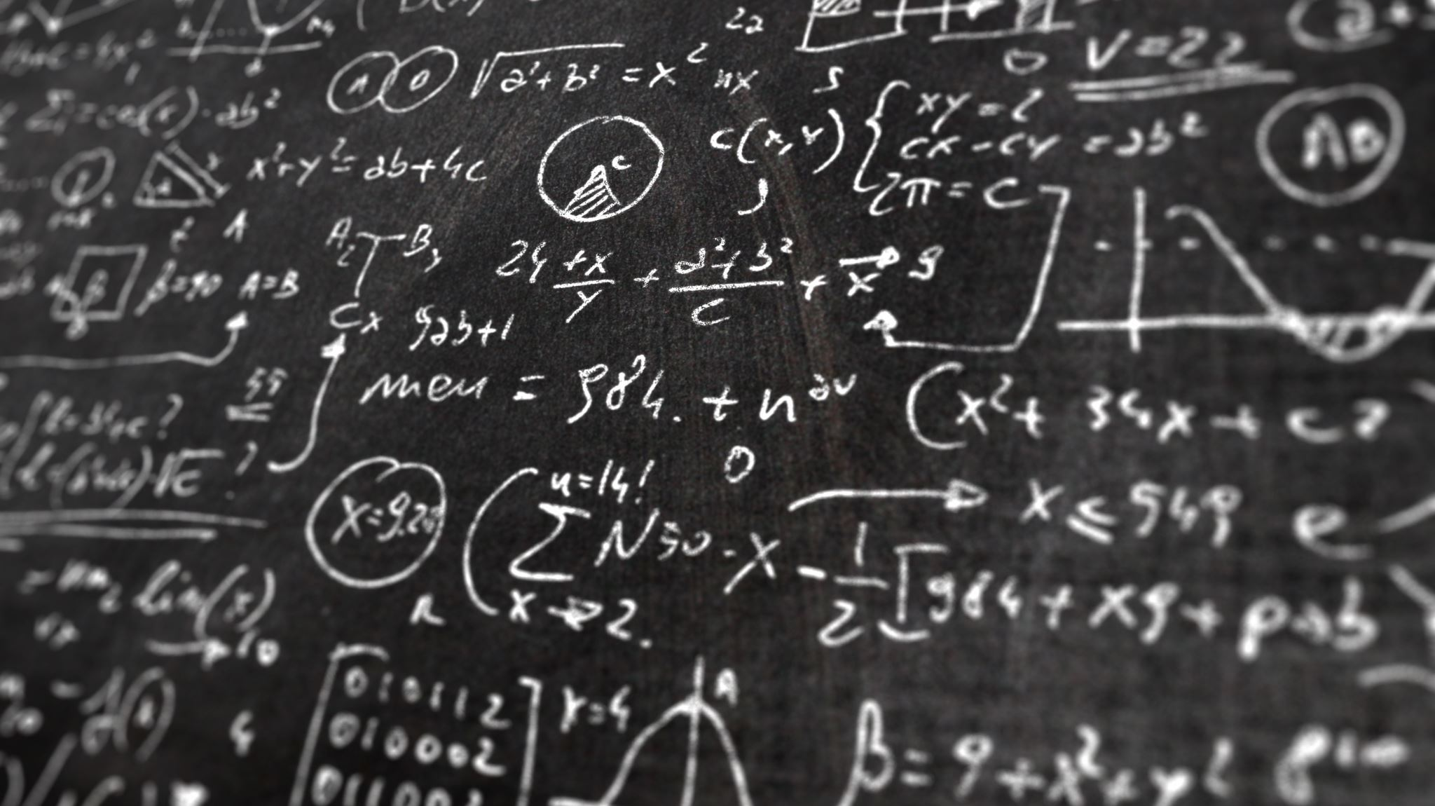
Principles of Learning and Teaching
By Lianne Bowen

Slide 2
Learning and Knowing?
Do humans learn all that they know?
How do we come to know things?
Is all learning the same?
Do we learn in different ways?
How do we use different approaches and theories of learning in schools?

Slide 3
Module Learning Outcomes
Apply knowledge of some learning theories to school practice
Reflect on the impact of a child-centred and inclusive approach to teaching and learning
Identify resources and strategies that can support effective teaching and learning
Organise their knowledge and learning through the use of a range of information sources, including ICT, and present their work at the appropriate level.

Slide 4
Assessment 1
Essay (1500 words)
With reference to classroom observation and practice, demonstrate an understanding of the effective application of three educational theories. (Bruner, Dewey, Skinner, Piaget, Froebel or Vygotsky). Reference academic literature as appropriate.
Submission Date: 1st of November 2020, 23:39pm via Turnitin

Slide 5
Assessment 2
Academic Scrapbook (equivalent to 1500 words)
Demonstrate how theoretical approaches to learning underpin classroom practice. Refer to classroom strategies in your own setting, the academic literature and news articles.
Clear guidelines will be provided at the end of the module regarding the compilation of an appropriate standard of academic scrapbook
Submission Date: 1st of November 2020, 23:59pm via Turnitin

Slide 6
Evolution and Education
The brain has evolved to educate and to be educated, often instinctively and effortlessly.
The brain is the machine that allows all forms of learning to take place— from baby squirrels learning how to crack nuts, birds learning to ﬂy, children learning to ride a bike and memorising times tables, to adults learning a new language.
The brain is also our natural mechanism that places limits on learning. It determines what can be learned, how much, and how fast.
Knowledge of how the brain learns could, and will, have a great impact on education. Understanding the brain mechanisms that underlie learning and memory, and the effects of genetics, the environment, emotion, and age on learning could transform educational strategies and enable us to design programs that optimize learning for people of all ages and of all needs.

Slide 7
Theories of Education
There are many different theoretical approaches connecting learning and development.
Educational theories have an important role throughout teaching and learning, they are linked to what we do in our settings in so many ways.
There are many theories within the field of education, therefore, some educators may question what and who’s theory is correct.
All settings are different, children and young people learn in different ways.

Slide 8
Theories of Education
Inclusion is important for all children in education to help them progress and give them a sense of belonging to help them develop knowledge and mature as they grow. All children are different, many have different back grounds from upbringing’s low/high income families or even have Additional Learning Needs. This alone will have a big impact on the way the learner is capable to learn.
Also, age has an importance to the way the learner can process things. As years pass many things change within the world, from the way children are brought up differently to those of their parents, grandparents or even great grandparents.
Frameworks and policies in education have also changed for example, the recent changes to the Additional Learning Needs and Education Tribunal (Wales) Act 2018.

Slide 9
What are Learning Theories?
They are a set of principles organised to explain how individuals retain, acquire, and recall knowledge, a better understanding on how learning occurs will be developed from knowing the different learning theories and studying them.
Recognising the theories and their principles will equip practitioners within education with strategies to promote learning in different ways.

Slide 10
The Three Major Theories of Learning
The three central theories we will consider are:
  Behaviourism: Responding to external stimuli
  Constructivism: Making meaning of experience for oneself
  Social Constructivism: Making meaning of experience through social negotiation

Slide 11
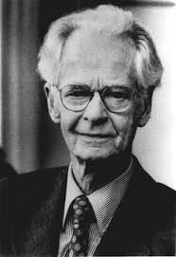
Behaviourism (Skinner)
Behaviourism looks at the environmental factors that have an important role in influencing behaviour.
Burrhus Skinner (1904 – 1990). American psychologist, founder of Operant Conditioning.
Following extensive research with rats and pigeons in his Skinner box he coined the term Operant Conditioning.
Operant Conditioning is a method of learning when rewarded or punished for behaviours.

Slide 12
Operant Conditioning
A type of learning that occurs through rewards and punishments.
It can occur in two ways:
Operant Conditioning
Reinforcement Punishment
Positive Negative Positive Negative
Reinforcement Reinforcement Punishment Punishment

Slide 13
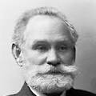
Pavlov’s Dogs
Behaviourism is similar to Pavlov’s theory of classical conditioning.
It is a stimulus-response model
Assumes learners modify their behaviour (the stimulus) until they receive a positive response
Repeated positive response will ensure the behaviour is learnt
Suggests that without positive reinforcement a behaviour becomes extinct;

Slide 14
Behaviourism in the classroom
Rewards and punishments are used in an educational setting
Can encourage an individual or a group of individuals
Not all students will benefit from the same reinforcements
Skinner talked of things such as a smile encouraging a positive reinforcement, yet we are aware as practitioners working in educational settings that this is not always the case.
For example: An autistic student may lack the ability to understand feeling’s. They may not be capable of recognising another’s feeling, emotions, anger, smiles etc. The student would not relate in the same way as other children to a smile and therefore would be at risk of being excluded.

Slide 15
Behaviourism teaching approaches
Repetition of desired responses (flash cards, chanting times tables…)
Reward for desired behaviour (smiley faces, praise, house points, reward chart …)
Punishments for undesirable behaviour (missing playtime, loss of ‘golden time’, detention, warnings, sanctions …)
Have been adopted for behaviour management programmes (‘catch them being good’)

Slide 16
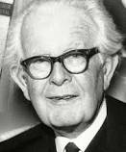
Constructivism (Piaget)
Constructivism is a cognitive approach to learning, rather than the focus being on observable behaviour such as behaviourism
Jean Piaget (1896-1980)
Swiss biologist
Observed children’s cognitive development and thinking
Piaget’s work centred around how children think and learn

Slide 17
Constructivism (Piaget)
Piaget’s theory remains the standard against which all other theories are judged
Children are seen as
  Active
  Learning many important lessons on their own
  Intrinsically motivated to learn
He concluded that a very young child actively seeks to make sense of the world.
The learning proceeds through the child’s exploration of and interaction with the environment.

Slide 18
Constructivism (Piaget)
Piaget’s theory is labeled constructivist because it depicts children as constructing knowledge for themselves
Piaget identified that very young children are intrigued by their environment and their own abilities to interact with it.
He believed that it was through their interactions with the environment that learning proceeds, however, for learning to take place it is necessary for children to construct their knowledge by making meaning of their experiences.
However, for learning to take place it is essential for children to construct their knowledge by making meaning of their experiences.
Piaget proposed that that the brain contains structures which allow it to make sense of the world, he referred to these as schemas.

Slide 19
Mental Structures (Schemas)
Piaget believed that babies are born with schemas
The more experiences a baby has the more schemas they construct.
Once the baby can understand everything around them they are said to be in a state of equilibrium. This is a state where the world can be understood through existing schemas.
A baby will probably be exposed to a huge number of new experiences, it is often the case that the existing schema can’t explain a new situation, in which case the baby finds themselves in a state of disequilibrium.

Slide 20
Mental Structures (Schemas)
Piaget believed that humans are programmed to try and make sense of the world, so being in a state of disequilibrium is a very uncomfortable place to be.
He identified 2 ways by which equilibrium could take place. He referred to these as Assimilation and Accommodation.
Assimilation is where the baby would be able to adapt the existing schema and make sense of the new experience.
Accommodation on the other hand is where the experience may not fit into the existing schema on the first encounter and the schema may not be formed.

Slide 21
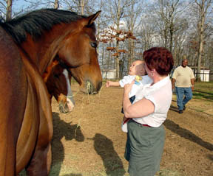
What is a schema?
A schema is a mental process responsible for activities as simple as naming and labeling, and as complex as creating experiments/scenarios . Schemas guide behaviour.
For example, a baby sees his first horse:

Slide 22
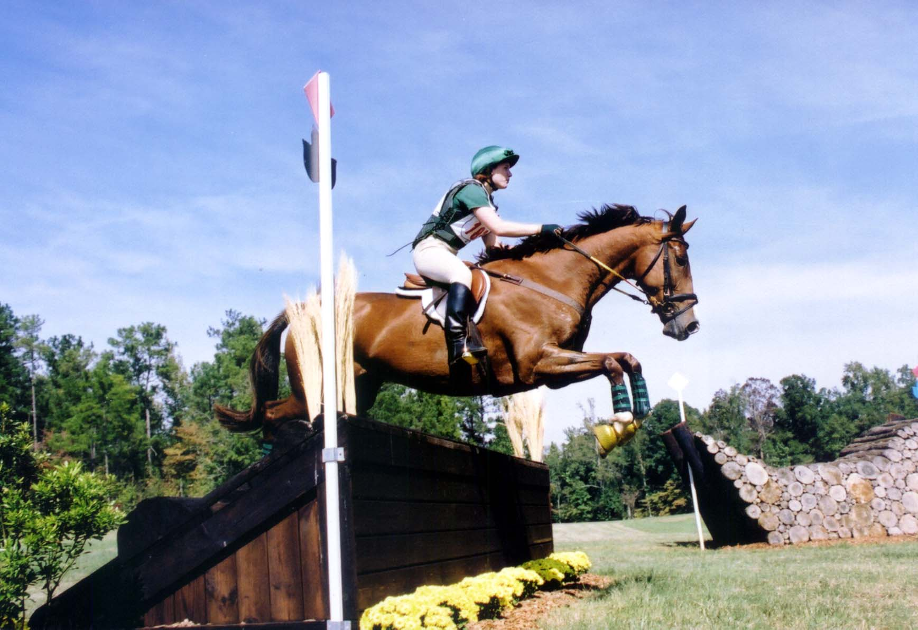
Then he sees…

Slide 23
Assimilation:
Through this process of assimilation the baby is able to adapt an existing schema in order to make sense of the new experience

Slide 24
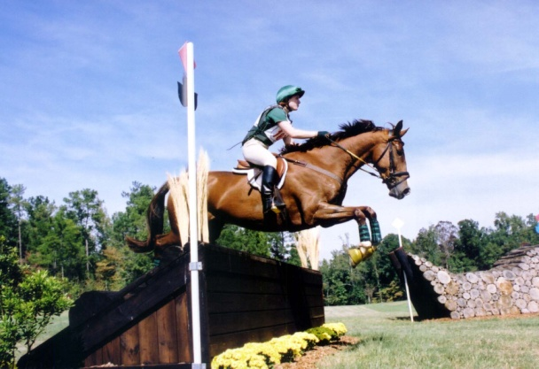
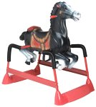

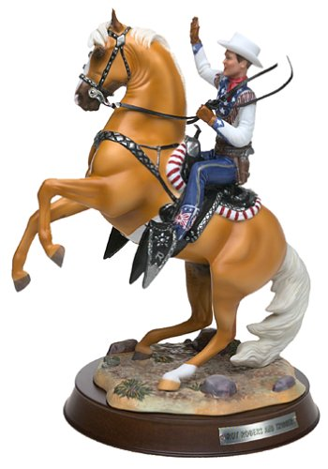
Asssimilation

Slide 25
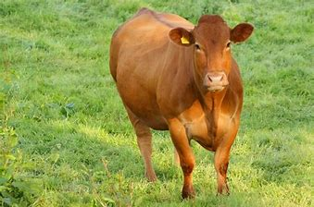
What ???

Slide 26

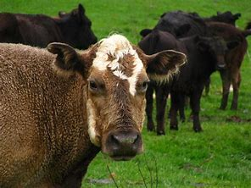
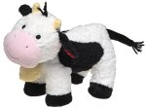
Accommodation:
A new experience does not ‘fit’ with existing understandings and some adjustment (accommodation) in understanding must take place
Horses
Cows

Slide 27
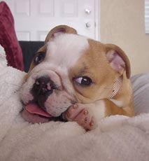
What???
?
Horses
Cows

Slide 28

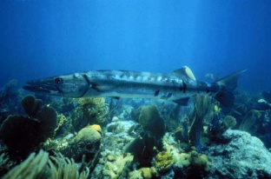
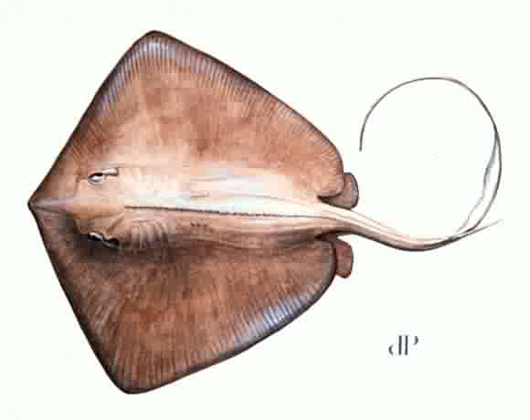

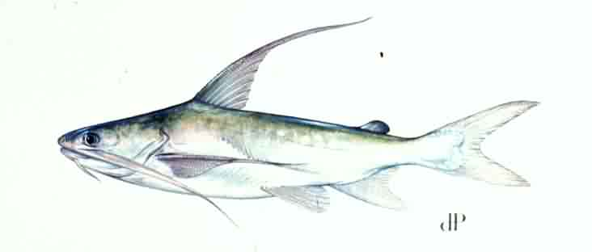
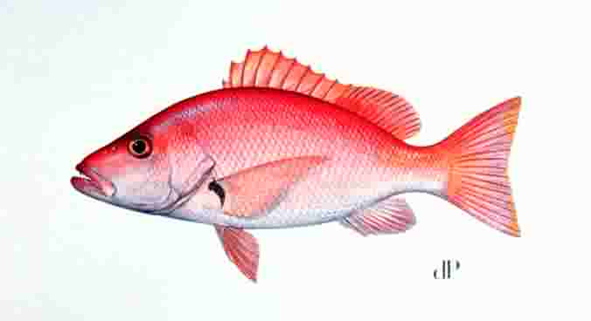
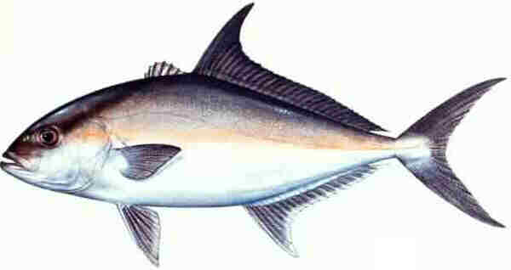
Categories become increasingly complex as children learn
?
Mammals
Fish

Slide 29
Equilibrium
The goal of every learner – a balance is achieved (temporarily – until another challenge to that equilibrium comes along and more accommodation is needed)

Slide 30
Piaget’s stages of cognitive development
Piaget is also associated with the ‘stage theory’ of cognitive development
  This has been heavily critiqued but is still highly influential in UK educational provision.
  Piaget recognised that that children also need to understand rules as operations, and that these operations develop as the brain matures rather than experience.
Children progress through FOUR stages of cognitive development, each building on the previous one

Slide 31
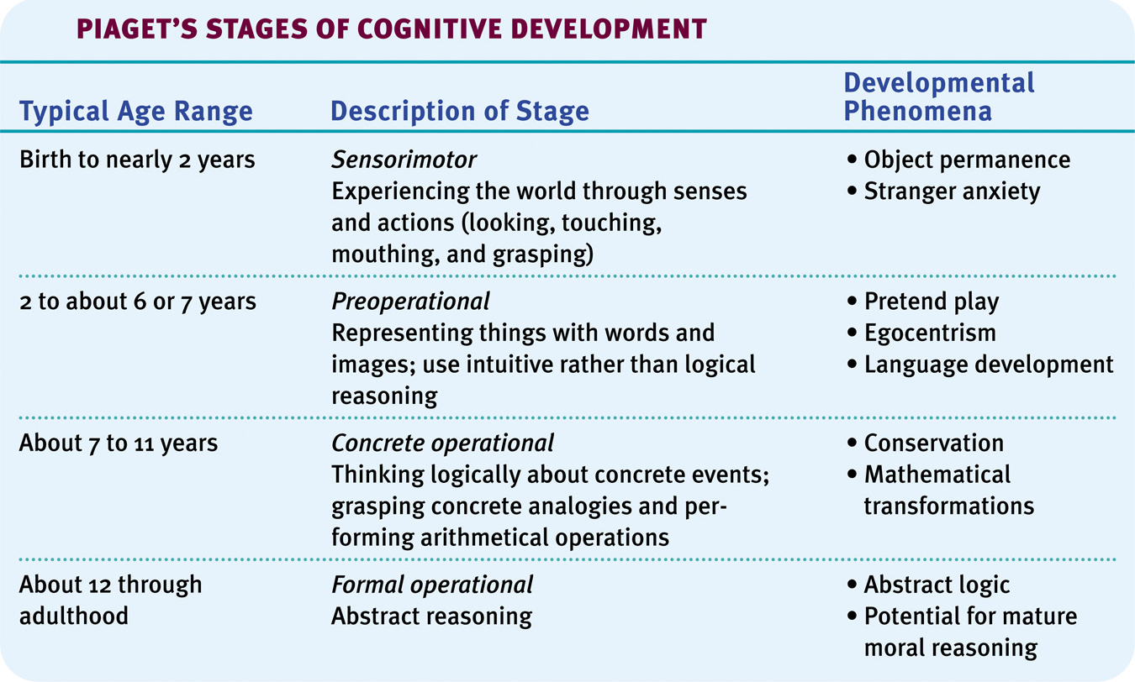
Piaget’s Stages of Cognitive Development

