Slide 1
Module Name : Signals and System
Module Code : ACDA4009
Topic : Exercise - Signals
Lecture : 6
Lecture By,
Mrs. Jenifer Prince Devaraj,
Lecturer - Embedded Electronics,
Faculty of Applied Computing,
UWTSD
Email:j.prince-devaraj@uwtsd.ac.uk

Slide 2
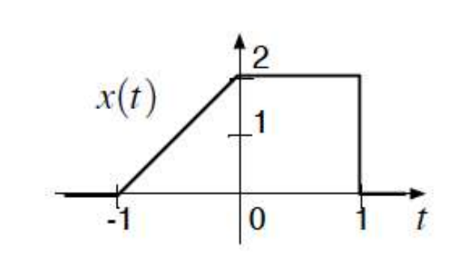
Exercise - Signals
Exercise 1
Find the Odd and Even Signals for the Plot given below
ACDA4009 – Signals and System

Slide 3
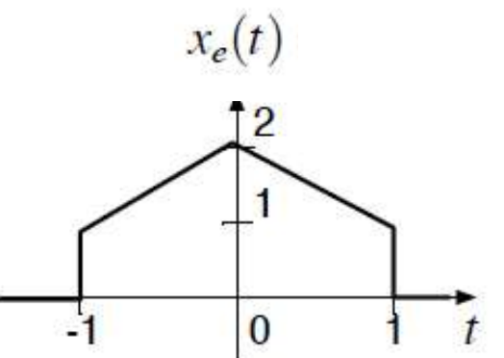
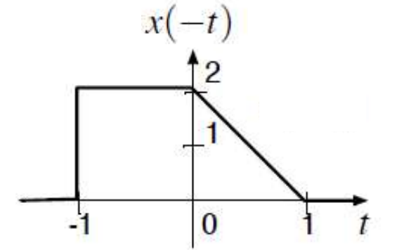
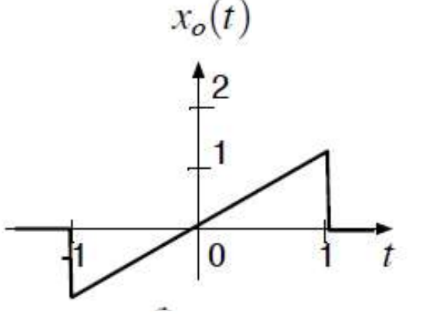
Exercise - Signals
Exercise1
Find the Odd and Even Signals for the Plot given below
ACDA4009 – Signals and System

Slide 4
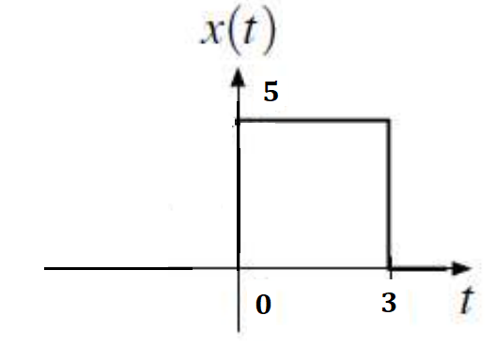
Exercise - Signals
Exercise 2
Calculate the Energy of the signal for the plot given below.
ACDA4009 – Signals and System

Slide 5
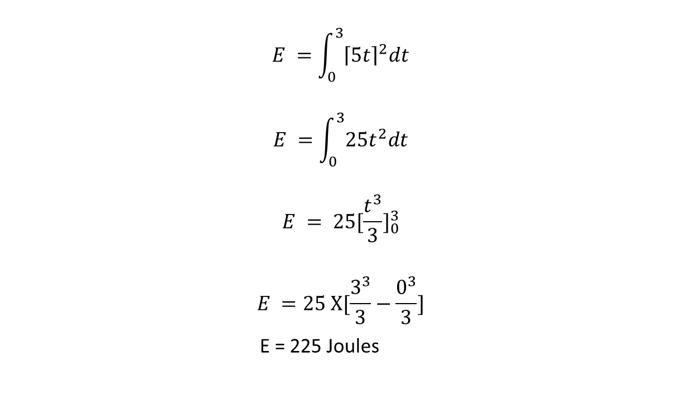

Exercise - Signals
Exercise 2
Calculate the Energy of the signal for the plot given below.
$$E =\int_{0}^{3}{{\left\lceil 5t\right\rceil }^{2}dt}$$
$$E =\int_{0}^{3}{25t^{2}dt}$$
$$E = {25[\frac{t^{3}}{3}]}_{0}^{3}$$
$$E =25 X[\frac{3^{3}}{3}−\frac{0^{3}}{3}]$$
E = 225 Joules
The Energy can be calculated using
$$E =\int_{−∝}^{∝}{{\left\lceil x\left(t\right)\right\rceil }^{2}dt}$$
ACDA4009 – Signals and System

Slide 6
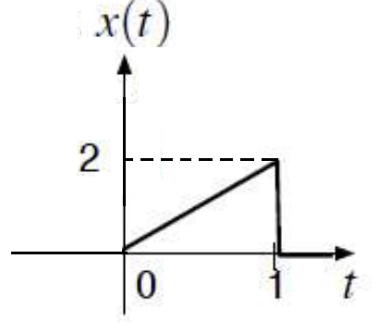
Exercise - Signals
Exercise 3
Calculate the Energy of the signal for the plot given below.
ACDA4009 – Signals and System

Slide 7
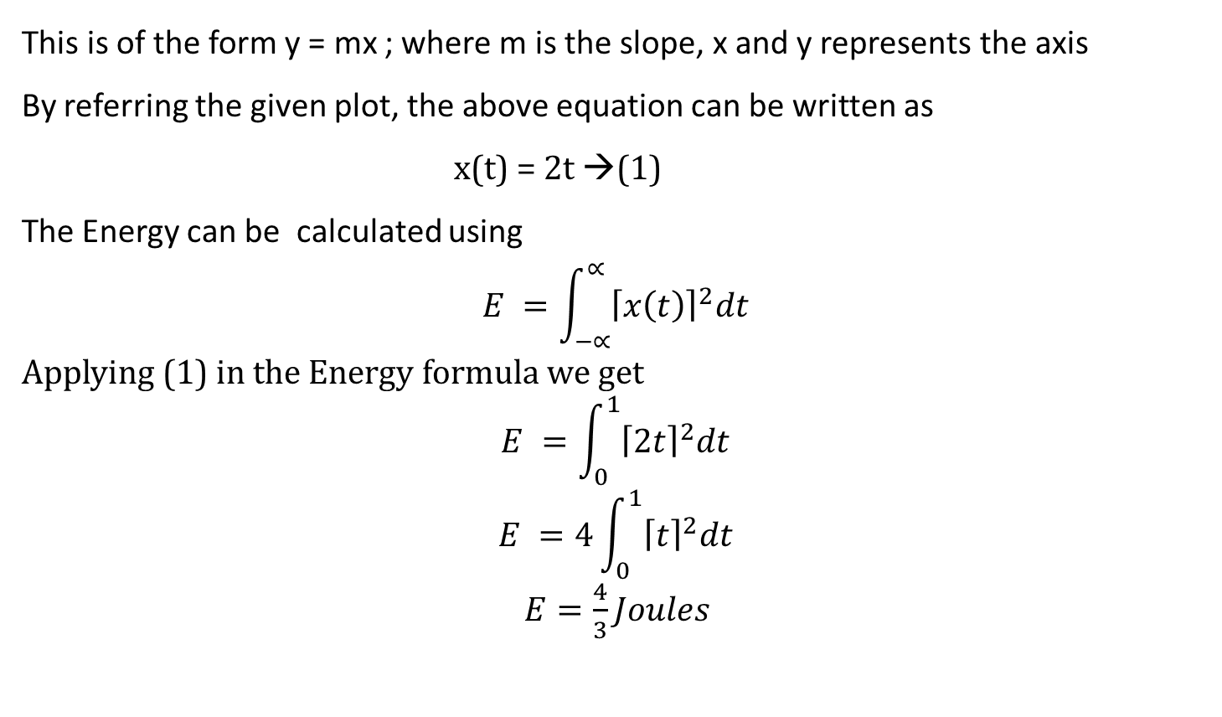
Exercise - Signals
Exercise 3
This is of the form y = mx ; where m is the slope, x and y represents the axis
By referring the given plot, the above equation can be written as
x(t) = 2t →(1)
The Energy can be calculated using
$$E =\int_{−∝}^{∝}{{\left\lceil x\left(t\right)\right\rceil }^{2}dt}$$
Applying (1) in the Energy formula we get
$$E =\int_{0}^{1}{{\left\lceil 2t\right\rceil }^{2}dt}$$
$$E =4\int_{0}^{1}{{\left\lceil t\right\rceil }^{2}dt}$$
$E=\frac{4}{3}Joules$
ACDA4009 – Signals and System

Slide 8
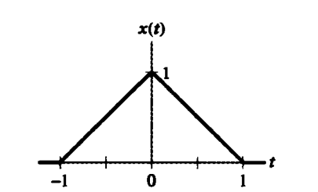
Exercise - Signals
Exercise 4
For the triangular pulse x(t) shown below, sketch the time scaling for each of the following derived from x(t)
x(2t)
x(2(t+2))
x(2(t-2))
ACDA4009 – Signals and System

Slide 9
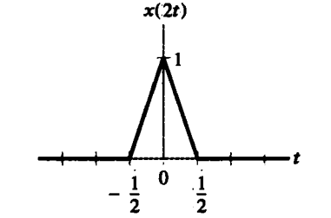
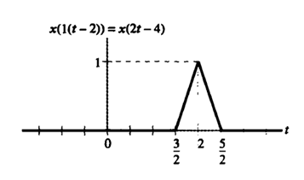
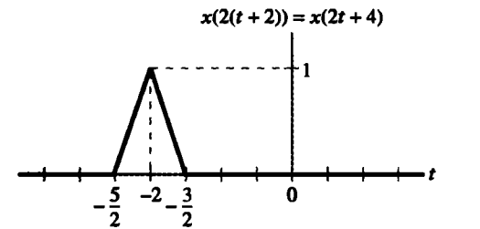
Exercise - Signals
Exercise 4
For the triangular pulse x(t) shown below, sketch the time scaling for each of the following derived from x(t)
(a) x(2t) (b) x(2(t+2)) (c) x(2(t-2))
ACDA4009 – Signals and System

Slide 10
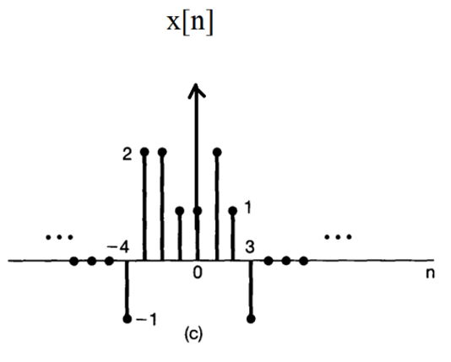
Exercise - Signals
Exercise 5
ACDA4009 – Signals and System

Slide 11
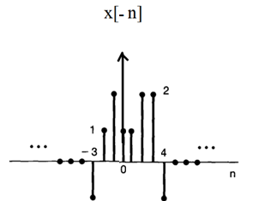
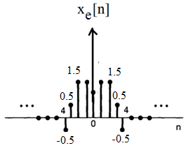
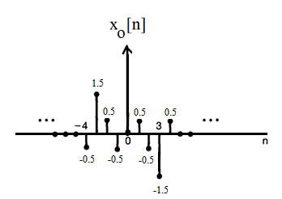
Exercise - Signals
Exercise 5
ACDA4009 – Signals and System

Slide 12
Thank You

