Slide 2
Hospitality & Guest Services
in the Hotel Industry
[BMIH4003]
Week 8 – Guest Service Expectations & Developing A Culture of Service Style

Slide 3
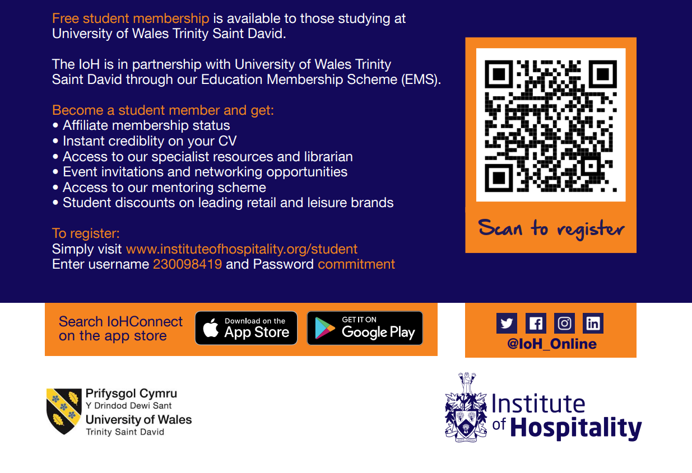
Education Membership Scheme (EMS)

Slide 4

Last Week…
What is a skill?
Hard and soft skills in the hospitality industry
Hospitality skill requirements
New skill requirements in hospitality
Individual values and personality traits
First and last impressions
Notes:
-Quick 5-minute recap

Slide 5
Today’s Content
Guest Service Expectations
What is Service Culture? Why is it important?
How to Create a Service Culture
The Importance of Service Recovery
Service Recovery Paradox (SRP)
Employee Empowerment

Slide 6

Report - Structure
Title Page
Content Table
Introduction
Main Body
Conclusion
Recommendations
Reference List
Notes:
A minimum of 10 references is required
An example report will be provided to students next week

Slide 7
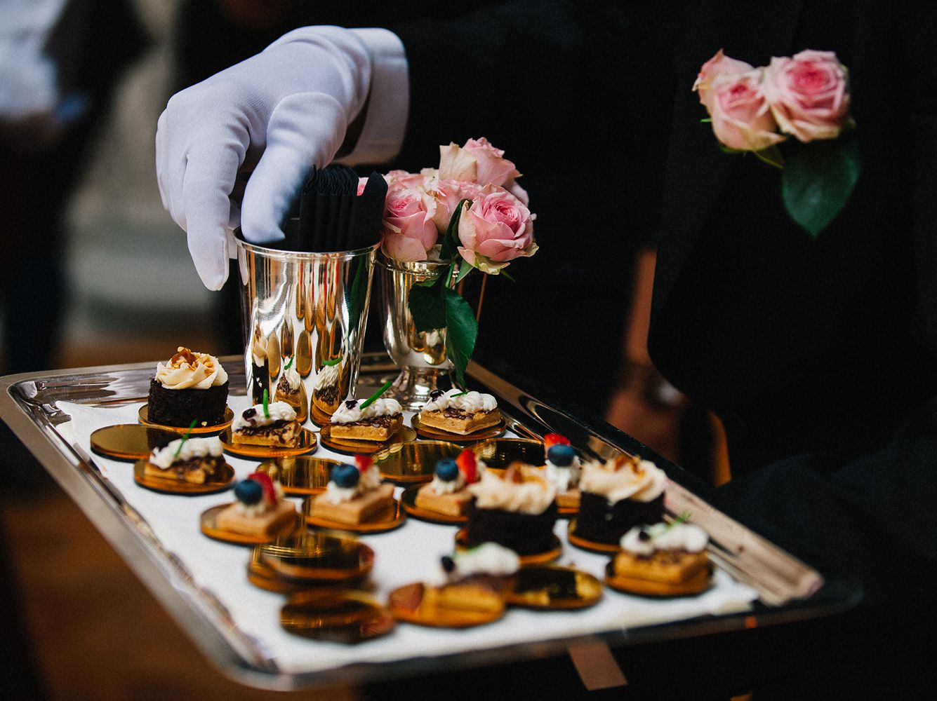
Week 8
Guest Service Expectations & Developing a Culture of Service Style

Slide 8
Guest Service Expectations
Group Discussion:
What areas should we consider when creating Guest Service Experiences?
Type your answers in the chat box or raise your yellow hand.
Guest Service Experiences

Slide 9
Guest Service Expectations
Culture
People
Service Process
Relationships
What areas should we consider when creating Guest Service Experiences?
Guest Service Experiences

Slide 10

1. People
Human interactions are important to guest experiences
Exceed expectations
WOW factor
Organisational culture
Customer satisfaction

Slide 11
2. Building Relationships
Just like personal relationships, it is important to cultivate and nurture customer relationships.
Needs and wants
‘Wow’ moments
Emotional connections

Slide 12

3. Service Process
Some service processes we can consider are:
Service standards
Communication between the team and interdepartmental communication
Service culture
Service systems (how we carry out a task)
Policies, procedures and training.

Slide 13
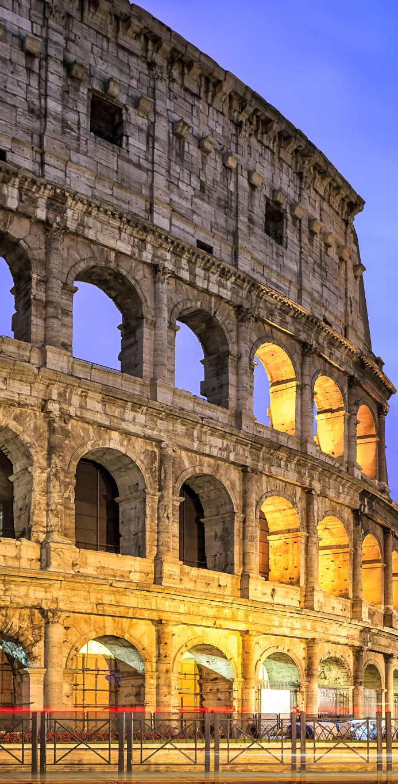
4. Culture
More and more people travel, and a new trend is to experience culture in all ways.
Languages – speaking to a
customer in their own language makes
them feel connected, happy, comfortable
Cultural life – Upbringing, behaviour, preferences, an appreciation for opera, or classical music or maybe an appreciation for gourmet food and wine.

Slide 14
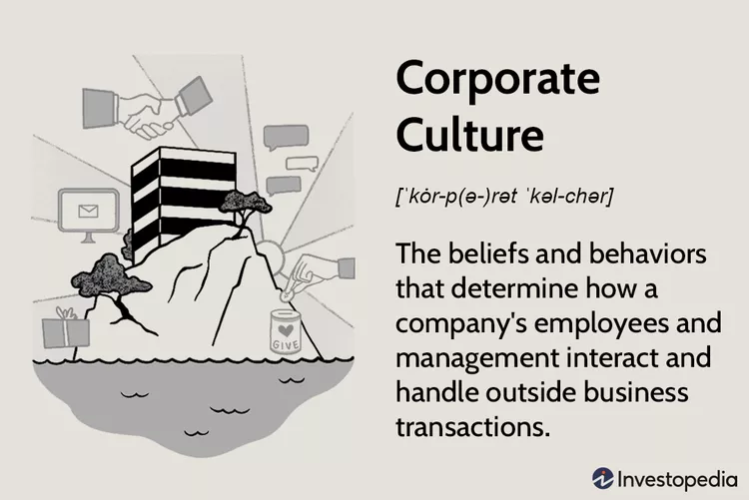
Corporate Culture

Slide 15
Corporate Culture
Corporate culture refers to the beliefs and behaviours that determine how a company's employees and management interact.
Corporate culture is also influenced by national cultures and traditions, economic trends, international trade, company size, and products
Corporate cultures, whether shaped intentionally or grown organically, reach to the core of a company’s ideology and practice, and affect every aspect of a business.

Slide 16
Emphasis on Service Culture
Notes:
An emphasis on guests must be an integral part of the hotel’s corporate culture: a collection of understandings shared by the employees that influence organisational decision making. This culture is passed on to new members of the group.

Slide 17

What is Service Culture?
It refers to a company culture that is focused on customer service.
A company with a service culture focuses its mission and processes on serving the customer first and foremost.
The goal is to provide the best experience and most value for the customer, and each employee’s duties should be focused on that goal. An effective service culture motivates team members to put the customer first.
A service culture is a place where employees love to come to work and customers love to do business with you.

Slide 18

Service Culture
Group Discussion:
Why is service culture important?
How do customers experience service culture?
Type your answers in the chat box or raise your yellow hand.

Slide 19
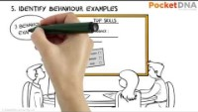
How to Create A Customer Service Culture

Slide 20

Service Culture Best Practices for Creating A Service Culture

Slide 21
Service Culture Best Practices for Creating A Service Culture
Provide service culture training
1
Communicate with customers
2
Include all parts of the company
3
Seek out the right hires
4
Encourage a customer focus
5

Slide 22
Service Recovery

Slide 23

Service Recovery
“The customer is always right.”
Group Discussion:
Do you agree or disagree with this statement, and why?
Type your answers in the chat box or raise your yellow hand.

Slide 24
Service Recovery
Group Discussion:
What is the importance of service recovery?
Type your answers in the chat box or raise your yellow hand.

Slide 25

Service Recovery

Slide 26
Service Recovery
A service failure refers to service performance that fails to meet customer expectations.
Service recovery refers to the systematic efforts made by a business to rectify a service failure and to retain customers’ goodwill.
Service recovery plays an important role in achieving/restoring customer satisfaction and loyalty.
Notes:
The term “service recovery paradox” was first coined by McCollough and Bharadwaj (1992) and refers to situations in which a customer’s post-failure satisfaction exceeds pre-failure satisfaction. The recovery paradox theory contends that an effective recovery cannot only maintain customer satisfaction, but also propel it to a higher level.

Slide 27
Service Recovery Paradox (SRP)
It has been observed that customers become more loyal to a business after they have experienced a service failure, then if it had never occurred in the first place.
If second service failure occurs, the paradox disappears
Best Strategy: Do It Right the First Time!
Notes:
The term “service recovery paradox” was first coined by McCollough and Bharadwaj (1992) and refers to situations in which a customer’s post-failure satisfaction exceeds pre-failure satisfaction. The recovery paradox theory contends that an effective recovery cannot only maintain customer satisfaction, but also propel it to a higher level.

Slide 28
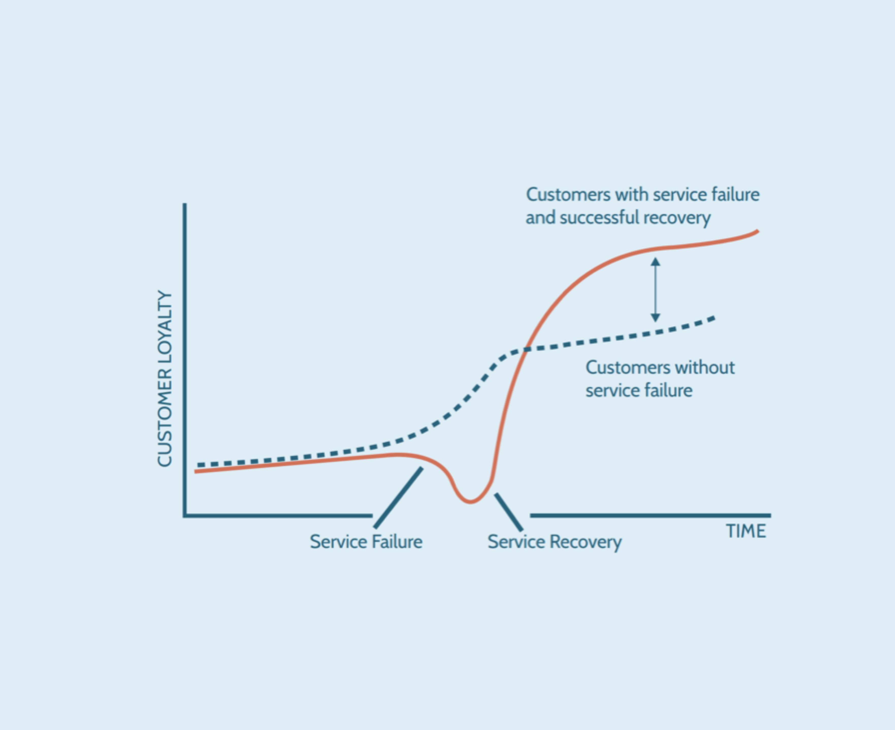
Service Recovery Paradox (SRP)
Notes:
The graph shows how the customer tend to become loyal after a service recovery.
When things go not as per the plan, you can see that line taking a dip as a problem occurs and that loyalty starts to decline or disappear.
This service recovery paradox can only take place when a business faces a gap or service failure, the situation can only improve when the company takes action to rectify their mistakes by satisfying the customer

Slide 29

A Service Recovery Story
Notes:
Customer Experience keynote speaker Jon Picoult tells his classic story of customer service recovery, illustrating how great customer experiences are sometimes shaped by subtle but unforgettable gestures.

Slide 30
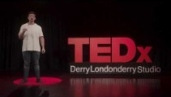
Why the Customer is Not Always Right

Slide 31

Are some customers better than others?

Slide 32
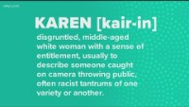
The “Karen” Phenomenon

Slide 33
The “Karen” Phenomenon
Group Discussion:
Have you ever encountered a “Karen” situation?
How did you deal with and resolve this situation?
Type your answers in the chat box or raise your yellow hand.

Slide 34

Empowerment

Slide 35

Empowerment
Group Discussion:
What does Empowerment mean to you?
Why is it important?
Why are some companies reluctant to empower their employees?
Type your answers in the chat box or raise your yellow hand.
Notes:
authority or power given to someone to do something:

Slide 36
Empowerment
Empowerment: To enable, permit, or give power to; to promote individual self-actualisation for influence within a specific relationship
Employee empowerment is the management philosophy of giving employees the freedom and authority to make independent decisions and act on them.
Does this definition match your original thoughts on empowerment? Why, or why not?

Slide 37

Empowerment
The best companies empower their employees to make good customer-focused decisions.
It is time to venture out of your comfort zone and empower your employees.

Slide 38

How can we make employees feel empowered?
Build trust and respect
Practise robust communication
Convey vision and goals of the company clearly
Provide state-of-art tools and resources
Practise feedback
Nurture a culture of rewards and recognition
Inspire creative thinking
Make employee engagement a top priority

Slide 39

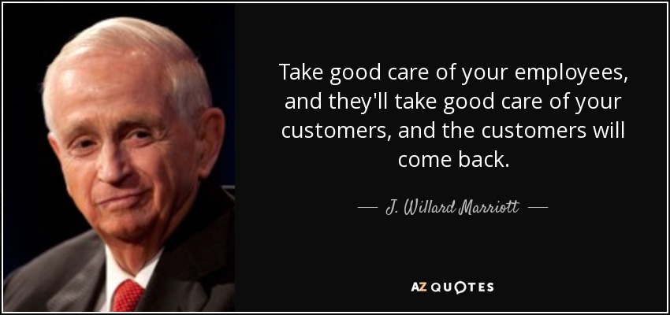
Marriott culture focuses primarily on the employees’ welfare with their contributions to the performance of the company are constantly emphasised and duly appreciated.

Slide 40


Case Study: Ritz-Carlton
Notes:
The Ritz Carlton as a company build a culture where mistakes are embraced rather than seen as a negative situation, and where guest complaints are seen as opportunities for improvement.

Slide 41
Case Study: Ritz-Carlton
Build a culture where mistakes are embraced as learning opportunities and guest complaints as opportunities for improvement.
12 service values – known as ‘the sixth diamond’
3 categories:
Mystique- a guest experience tracking system; empowerment to provide unique, memorable, personalised experiences.
Emotional engagement – involving employees, training costs,
Functional – providing clear guidelines for employees, giving responsibility /meaning
Two habits that continually improve quality of experience:
1. Using quality language – Ritz-Carlton ‘ladies and gentlemen, serving ladies and gentlemen’
Marriott calls everyone ‘associates’ - Disney calls employees ‘cast members’
2. Daily quality exercises for continuous improvement – focus throughout the organisation – Marriott ‘Spirit to Serve’
Notes:
The Ritz Carlton as a company build a culture where mistakes are embraced rather than seen as a negative situation, and where guest complaints are seen as opportunities for improvement.

Slide 42

What is Service Culture? Why is it important?
How to Create a Service Culture
The Importance of Service Recovery
Service Recovery Paradox (SRP)
Employee Empowerment

Slide 43


Next Week…
Part 1: Reputation Management
Social media influences
TripAdvisor
Digital management responses
Guest reviews management
Part 2: Brand Consistency Standards and Grading
Hotel and restaurant ratings
AA, Rosettes etc.
Mystery shoppers
…and much more!

Slide 44
References
Hayes, D. K., Ninemeier, J. D. and Miller, A. A. (2020) Hotel Operations Management, 3rd Ed. Uttar Pradesh: Pearson India Education Services.
Hyken, S. (2017) Ritz Carlton Customer Service Tips [video]. Available at: https://www.youtube.com/watch?v=2pM-beKX0Vk (Accessed: 2nd November 2022).
Louveau, F. (2022) What Is Service Culture?. Available at: https://hospitalityinsights.ehl.edu/service-culture-definition (Accessed: 2nd November 2022).
Media Partners (2015) The Right Words at the Right Time – Customer Service Recovery for Hospitality [video]. Available at: https://www.youtube.com/watch?v=tWnaKsmQ6k8 (Accessed: 2nd November 2022).

Slide 45
References
Picoult, J. (2017) The Best Service Recovery Story Ever [video]. Available at: https://www.youtube.com/watch?v=Z2iBxdF1lNg (Accessed:2nd November 2022).
TEDx Talks (2019) The customer isn’t always right, but some customers are better than others, Peter Fader, TEDxPenn [video]. Available at: https://www.youtube.com/watch?v=dHRoO4kbtug (Accessed: 2nd November 2022).
TEDs Talks (2021) Why the customer is nearly always wrong, Phil Graham TEDxDerryLondonderryStudio [video]. Available at: https://www.youtube.com/watch?v=T7D7BhIp7b0 (Accessed: 2nd November 2022).
WKYC Channel 3 (2020) Mike Polk Jr. explains the 'Karen' phenomenon [video]. Available at: https://www.youtube.com/watch?v=LLv16N2e6wA (Accessed: 2nd November 2022).

