Slide 1
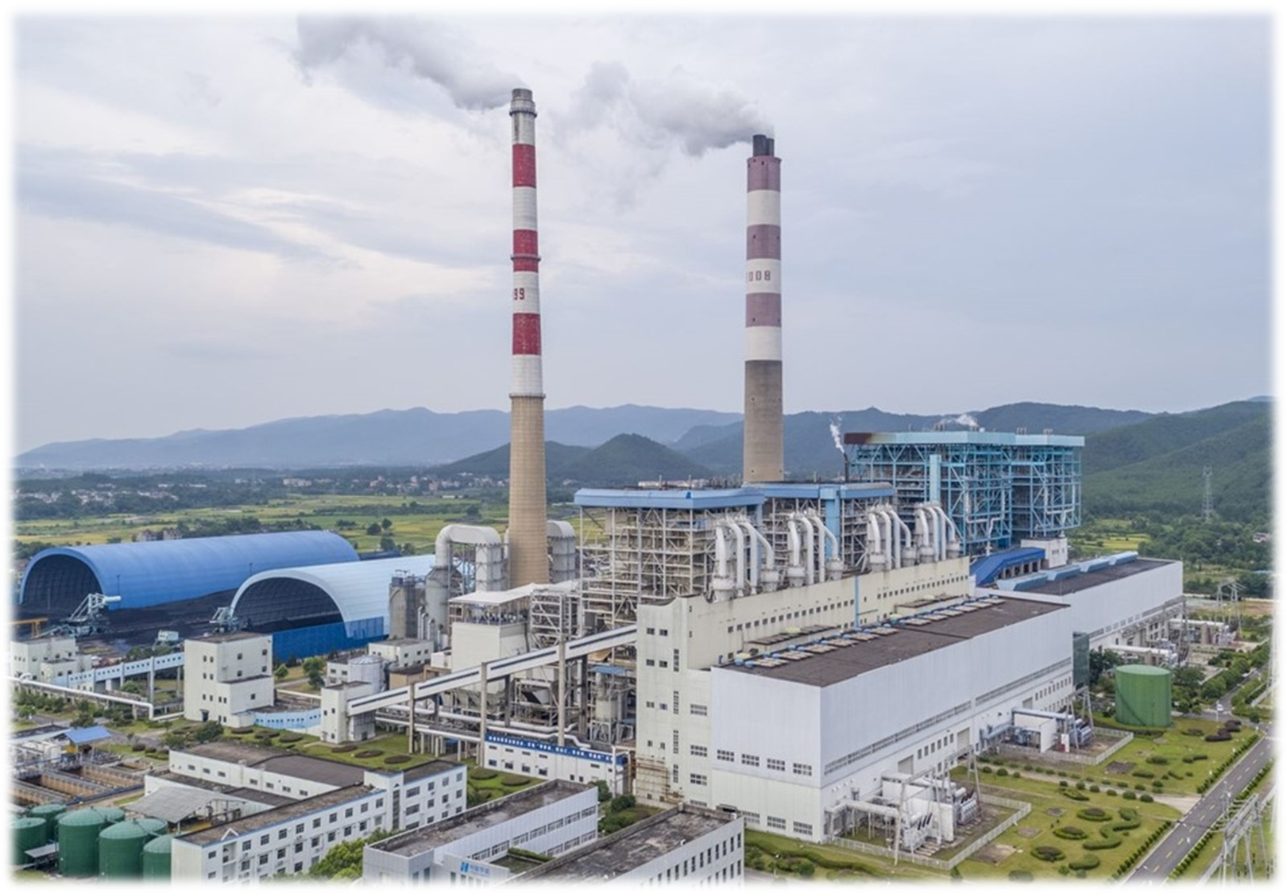

Environmental Planning & Policy
ACBA 7004
Alisdair Cunningham
a.cunningham@uwtsd.ac.uk

Slide 2




Welcome…
During this module, I aim to provide the following:
Open door policy
I welcome the opportunity to respond to questions and discuss topics
Please contact me via email and Teams
Interaction / Engagement
I will include interactivity in my lectures, to facilitate hands-on learning and experience
This will include questions, activities (individual and group) and exercises.
Please take part if you are able
Tailoring
Where possible, I will try to tailor some content to your interests.
Feedback
- I value your feedback, on things that do / do not work well

Slide 3
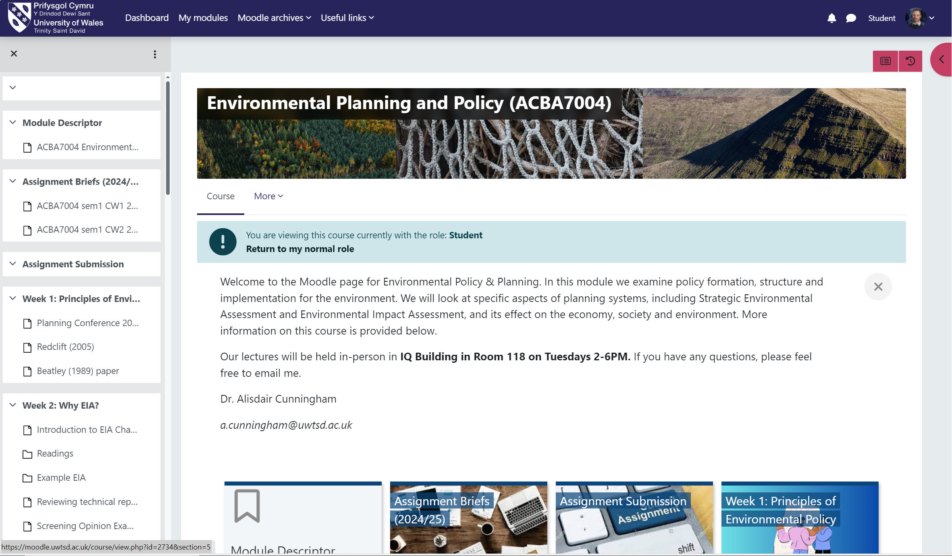
Module Learning Outcomes
On successful completion of this module students will be able to:
1) Critically assess theory and practice in environmental policy and planning.
2) Research and identify appropriate environmental impacts for a specific project.
3) Assess development options within a strategic policy framework and apply theoretical constructs to this.
Further details on your Moodle page:
Course: Environmental Planning and Policy (ACBA7004) | Home (uwtsd.ac.uk)

Slide 4
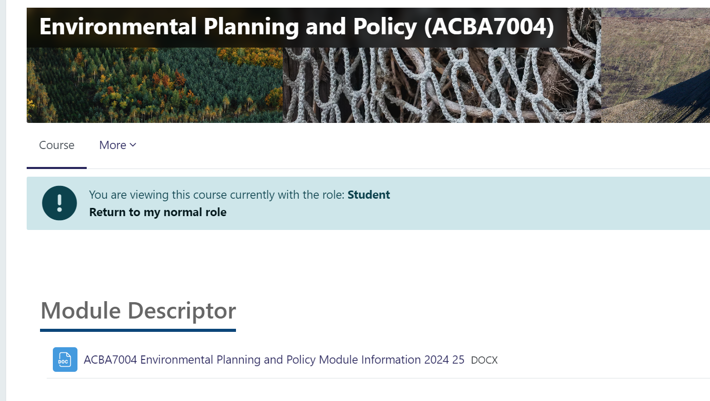
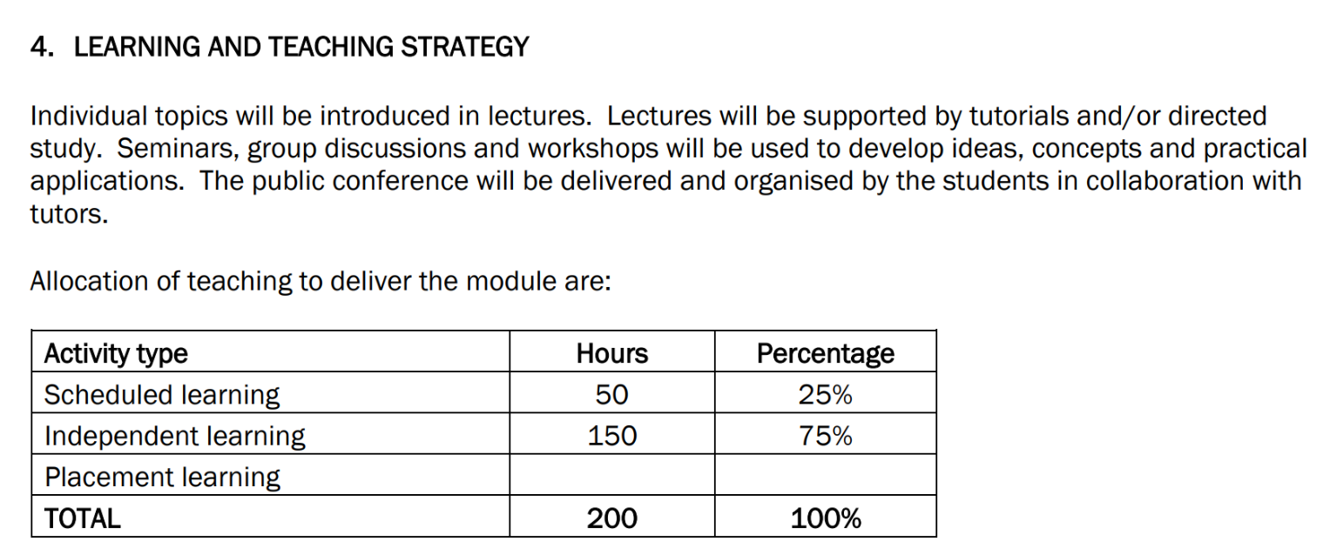
Course Structure
View Module Descriptor for details of course structure and assessments:

Slide 5
Course Schedule
ACBA7004: Environmental Planning and Policy Tues 2-6pm : IQ 118
Teaching Week | Date | Lecture content | Activities | Assessments
1 | 01/10/2024 | Principles of Environmental Policy
2 | 08/10/2024 | Reviewing environmental assessment articles | Selecting EIA article before Week 2 lecture
3 | 15/10/2024 | Fundemants of EIA
4 | 22/10/2024 | Fieldwork Week
5 | 29/10/2024 | Future strategies of sustainable policies
6 | 05/11/2024 | Introduction to planning
7 | 12/11/2024 | Examples of practice
8 | 19/11/2024 | Examples of marine environment
9 | 26/11/2024 | Future planning strategies
10 | 03/12/2024 | Coordination of environmental planning and policy
11 | 10/12/2024 | Assignment clinic and policy comunication
 | 17/12/2024 | CHRISTMAS BREAK
 | 24/12/2024
 | 31/12/2024
12 | 07/01/2025 | Sustainable urban planning |  | Wed 8th January CW1 submission (EIA critique report)
13 | 14/01/2025 | Conference preparation
14 | 21/01/2025 | Conference presentation |  | Tuesday 21st January CW2 presentation (EIA Conference presentation)

Slide 6

Course Assessment
Moodle: Course: Environmental Planning and Policy (ACBA7004) (uwtsd.ac.uk)
Assessment:
EIA critique – Case Study
(70% of the module mark)
4000 word report
Conference (Collection of reports in journal)
(10% of the module mark)
10-minute presentation/crit
(20% of the module mark)

Slide 7
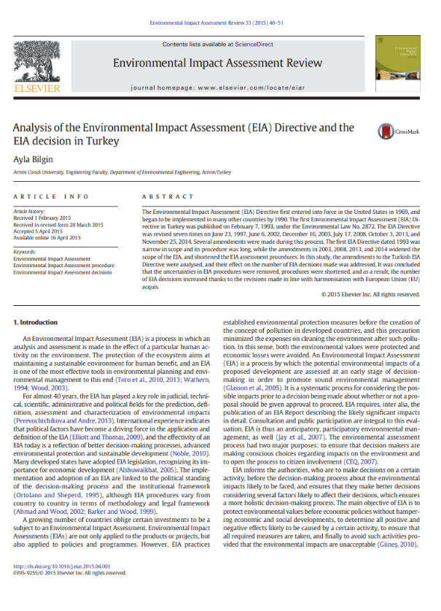
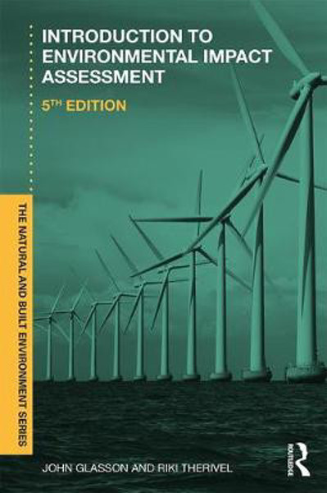
Environmental Impact Assessment Critique
EIA critique – Case Study (70% of the module mark)
4000 word report (+/- 10%)

Slide 8
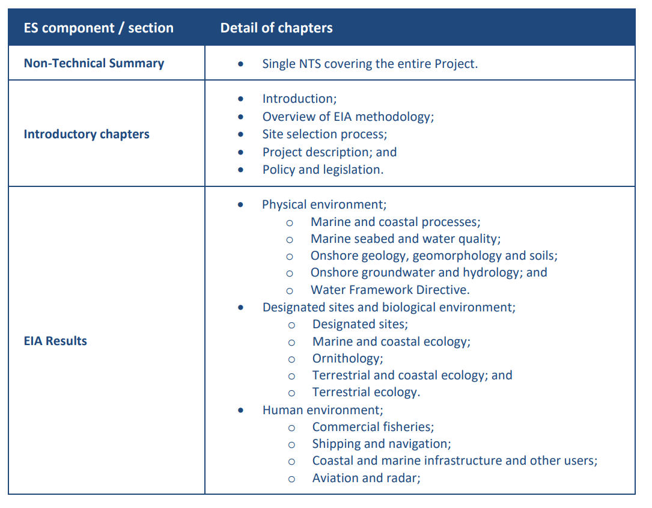
Environmental Impact Assessment Critique
EIA critique – Case Study (70% of the module mark)
4000 word report (+/- 10%)
Blue Gem Wind Erebus ES Volume 1

Slide 9
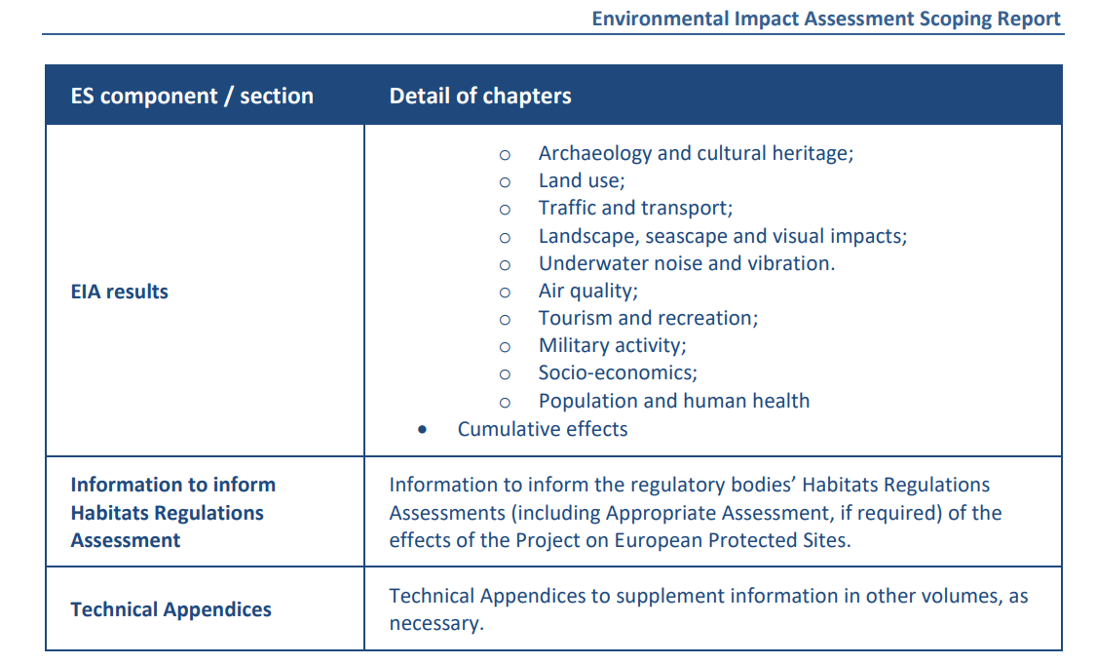
Environmental Impact Assessment Critique
EIA critique – Case Study (70% of the module mark)
4000 word report (+/- 10%)
Blue Gem Wind Erebus ES Volume 1

Slide 10
Course Assessment
Assessment:
Conference (Collection of reports in journal) (10% of the module mark)
10 minute presentation/crit (20% of the module mark)
See Masters degree assignment specification

Slide 11

Course Assessment

Slide 12
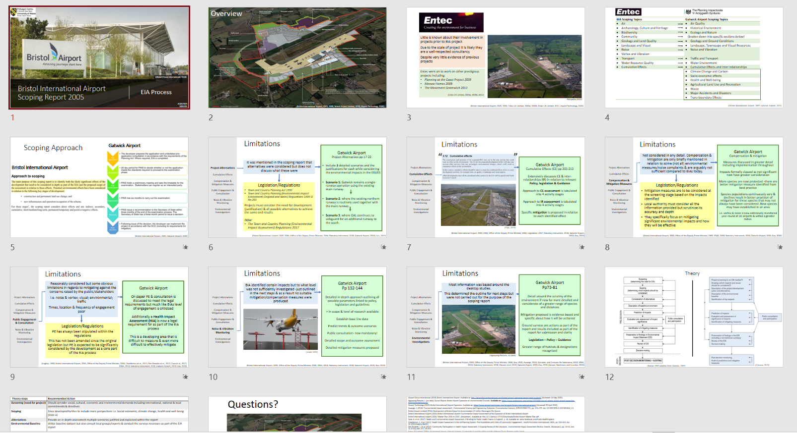
Course Assessment

Slide 13
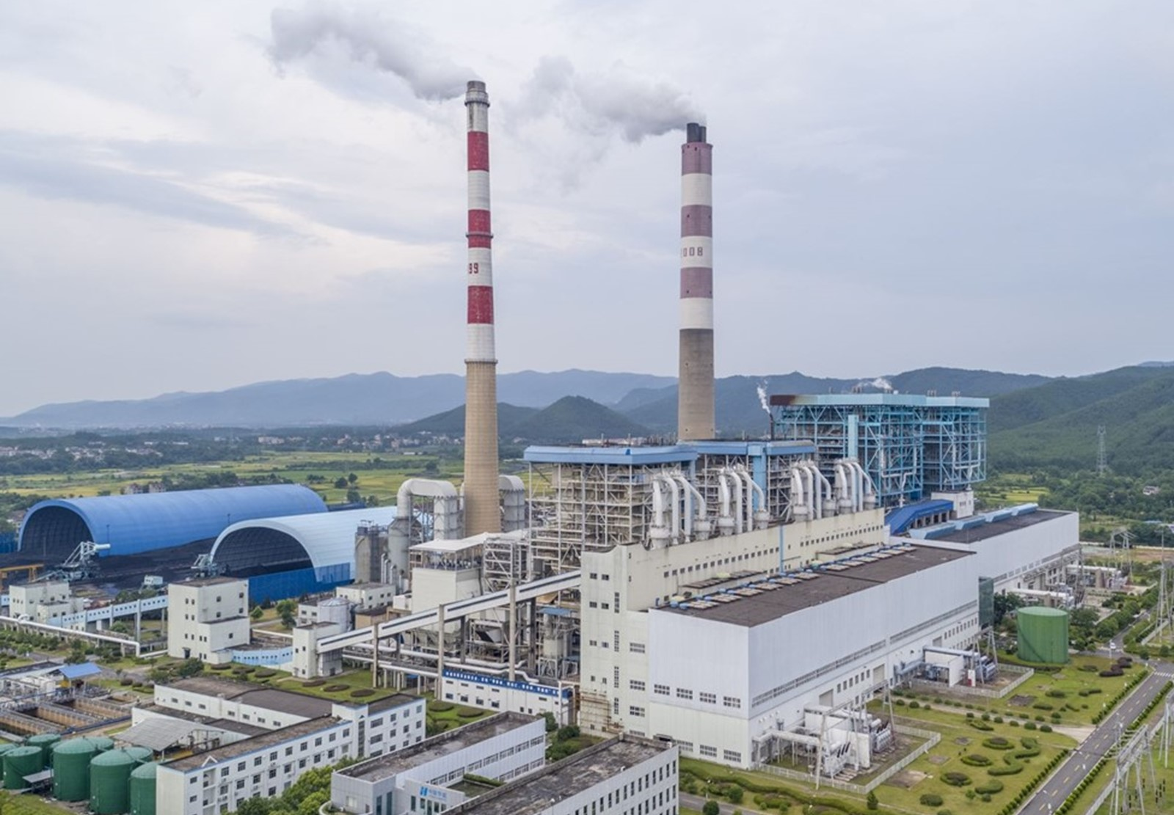
Principles of Environmental Policy - Development, ethics and experts
ACBA 7004
Alisdair Cunningham
a.cunningham@uwtsd.ac.uk

Slide 14
Outline
Principles of Environmental Policy
Definitions and Ideas
Sustainable Development
BREAK
Environmental Ethics
Environmental Experts
Assessment

Slide 15
Outline
Principles of Environmental Policy
Definitions and Ideas
Sustainable Development
BREAK
Environmental Ethics
Environmental Experts
Assessment
2 hours

Slide 16
Outline
Principles of Environmental Policy
Definitions and Ideas
Sustainable Development
BREAK
Environmental Ethics
Environmental Experts
Assessment
2 hours
2 hours

Slide 17


Principles
In your group, produce a definition for:
Environment
Sustainability
Policy

Slide 18

Sustainability
Principles

Slide 19

Environment
Principles

Slide 20
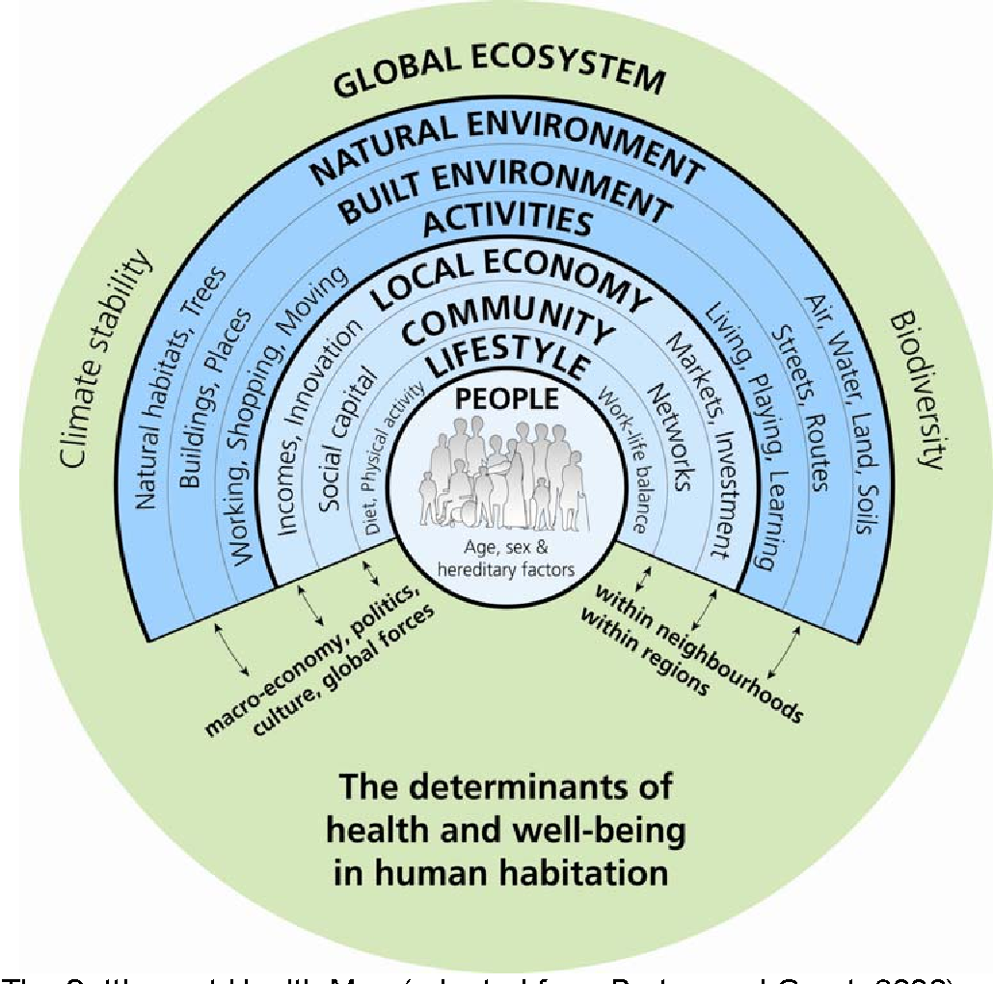
Environment
Environment
The Settlement Health Map (adapted from Barton and Grant, 2006)

Slide 21

Policy

Slide 22

Policy Definition
a set of ideas or a plan of what to do in particular situations that has been agreed to officially by a group of people, a business organization, a government, or a political party (Cambridge Dictionary).

Slide 23

Why do we have policy?
Principles

Slide 24
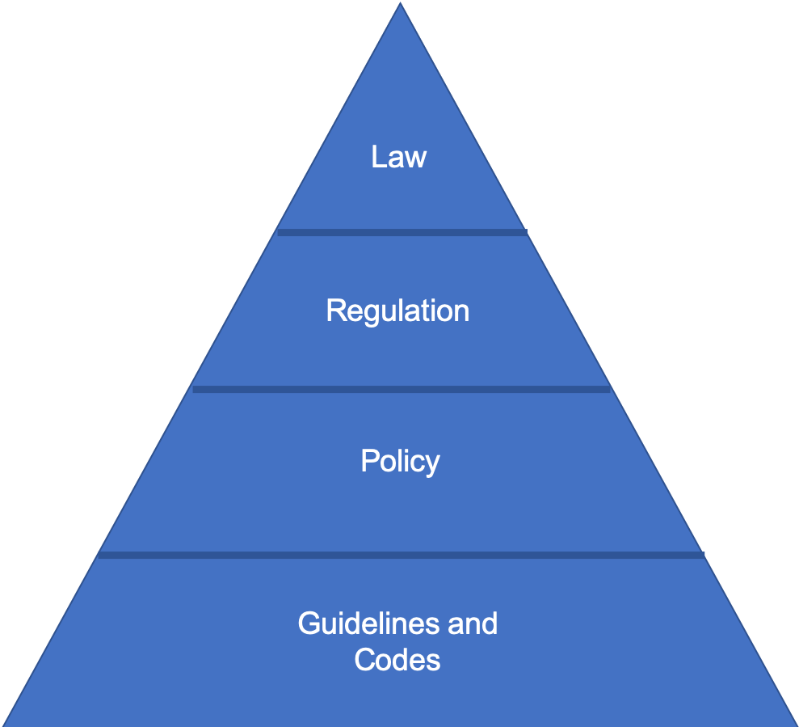
Why do we have policy?

Slide 25

Think of a policy?
Why did it come about?
How was it received?
What key changes did it bring?
Spend 10 mins researching it & report back to the group.

Slide 26

Principles of Good Environmental Policy
In pairs consider the follow:
What do you think are the principles of a good policy?
What do you think are the principles of good policies for sustainability ?
What do you think is the order of these principles and why?
Why is good policy principles important to consider within the environmental agenda?

Slide 27
Principles of Environmental Policy
Consensus orientated
Accountable
Participation
Transparent
Responsive
Effective / efficient
Equitable
Inclusive
Rule of law

Slide 28
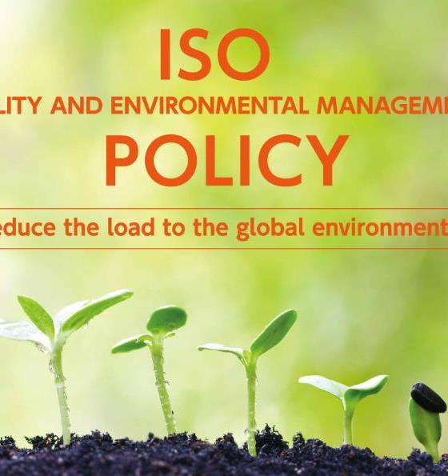
Lessons for good policies for sustainability (UN, 2020)
Sustainability is the supreme consideration for managing all human activities—political, social and economic.
Policy governance includes government, business and civil society, and emphasizes whole system management.
To capture this diverse range of elements, environmental policy often employs alternative systems of governance, for example watershed-based management (Nutshell, 2015: 8).

Slide 29
Lessons for good policies for sustainability (UN, 2020)
Awareness
Of environmental problems
Empowerment
Control of situation
Coordination
Keys for project success
Enforcement. Achieving agreed targets

Slide 30

Awareness
Awareness of environmental problems
Recognising issues
Differences in Awareness (e.g. individual, corporate, government).

Slide 31
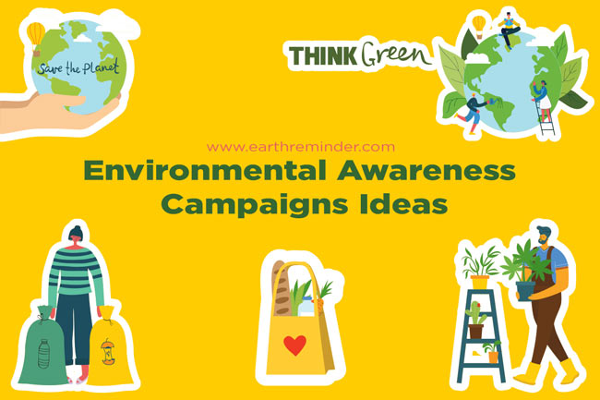
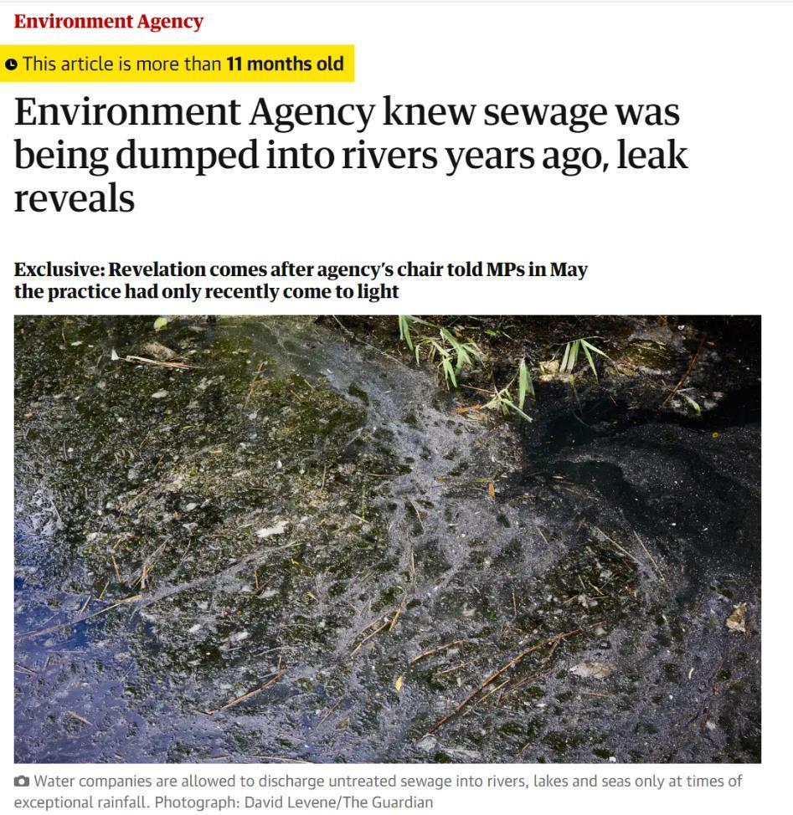
Awareness
Awareness of environmental problems
Science
Politics
Trust

Slide 32
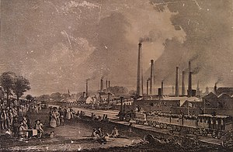
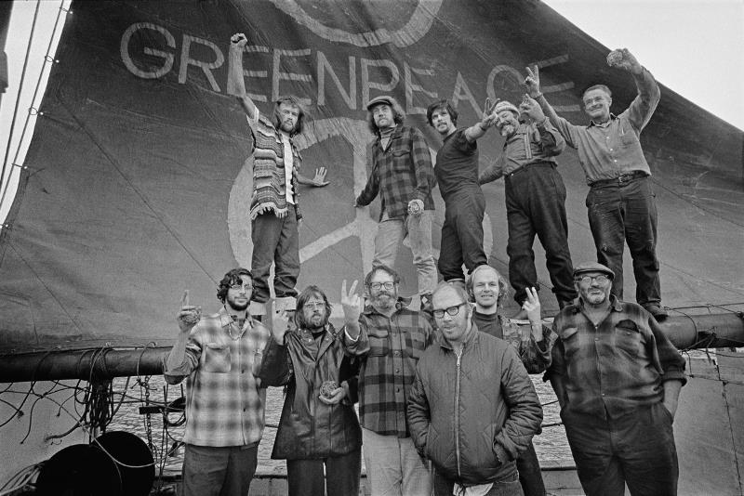
History of Awareness?
Awareness of environmental problems
Global Warming in the Public Sphere on JSTOR
How 19th Century Scientists Predicted Global Warming - JSTOR Daily

Slide 33
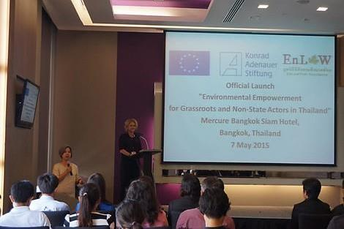
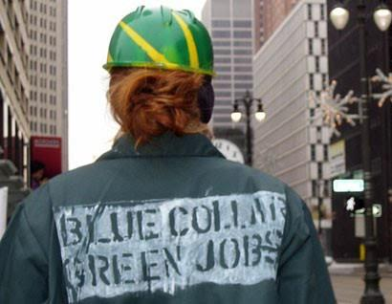
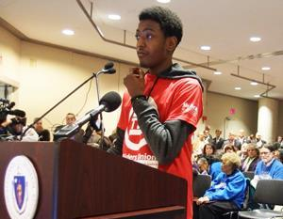
Empowerment
Empowerment
Control of situation
Integrate pro‐poor perspectives and opportunity creation for enhancing livelihoods
Make use of the power of institutionalisation

Slide 34


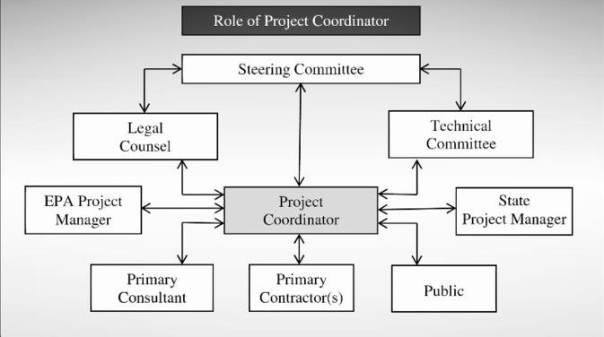
Coordination
Coordination
Enhance networking and partnership
Mainstream and share a common understanding on the activity aims

Slide 35


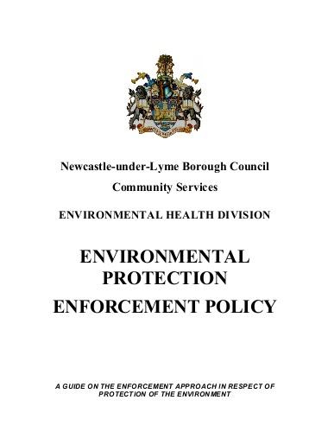
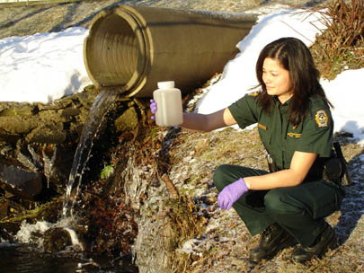

Enforcement
Ensure effective application of legal power
Monitor and survey progress for long term commitment and adaptation
e.g. Wildlife Crime Kenya 2016 (Kenya initiated the need to discuss wildlife crime)
Enforcement. Achieving agreed targets

Slide 36
Enforcement
Enforcement. Achieving agreed targets
Legislative hierarchy for environmental protection
(we will expand on this later in the module)

Slide 37

Why environmental policies?

Slide 38
Why environmental policies?
Awareness
Coordination
Behavioural Change
Enforcement
Empowerment

Slide 39

Behaviour Change
Is awareness enough?
How to we convince people, business etc to change their action?
Change can be:
  Cultural
  Community
  Individual
  Business
  International

Slide 40
Behaviour Change
Is awareness enough?
How to we convince people, business etc to change their action?
Change can be:
  Cultural
  Community
  Individual
  Business
  International
Notes:
Worse? E.g. fast fashion

Slide 41
Behaviour Change
Is awareness enough?
How to we convince people, business etc to change their action?
Change can be:
  Cultural
  Community
  Individual
  Business
  International
Notes:
Recycling?

Slide 42
Behaviour Change
Is awareness enough?
How to we convince people, business etc to change their action?
Change can be:
  Cultural
  Community
  Individual
  Business
  International
Notes:
Single use plastics / keep cups /

Slide 43
Behaviour Change
Is awareness enough?
How to we convince people, business etc to change their action?
Change can be:
  Cultural
  Community
  Individual
  Business
  International
Notes:
Single use cutlery / biopak natural packaging?

Slide 44
Behaviour Change
Is awareness enough?
How to we convince people, business etc to change their action?
Change can be:
  Cultural
  Community
  Individual
  Business
  International
Notes:
TBT bans on
Fishing? Bans on shark finning?

Slide 45
Behaviour Change?
What might be the processes / stages in changing behaviour?
Discuss with your neighbour & report back to the group.

Slide 46

Behaviour Change: the Theory
The stages of change are:
  Precontemplation (unaware or denial)
  Contemplation (Aware but ambivalent)
  Preparation/Determination (planning) Prochaska, 2020 shows that 50% of people who skip this stage fail within 21 days
  Action/Willpower (Modify behaviour)
  Maintenance (consolidate the gains)
  Relapse (How do you guide against this?)
Transtheoretical Model of Behavior Change | SpringerLink

Slide 47

Behaviour Change: the Theory
To move from one stage to another psychologists talk about processes of change e.g. in Stage 2 (Contemplation) The process involves
  A. Consciousness raising and
  B. Self-reevaluation
Other considerations are
  Readiness to change
  Barriers to change
  Likelihood of relapse

Slide 48
Behaviour Change: the Theory
To move from one stage to another psychologists talk about processes of change e.g. in Stage 2 (Contemplation) The process involves
  A. Consciousness raising and
  B. Self-reevaluation
Other considerations are
  Readiness to change
  Barriers to change
  Likelihood of relapse

Slide 49

5 min break

Slide 50
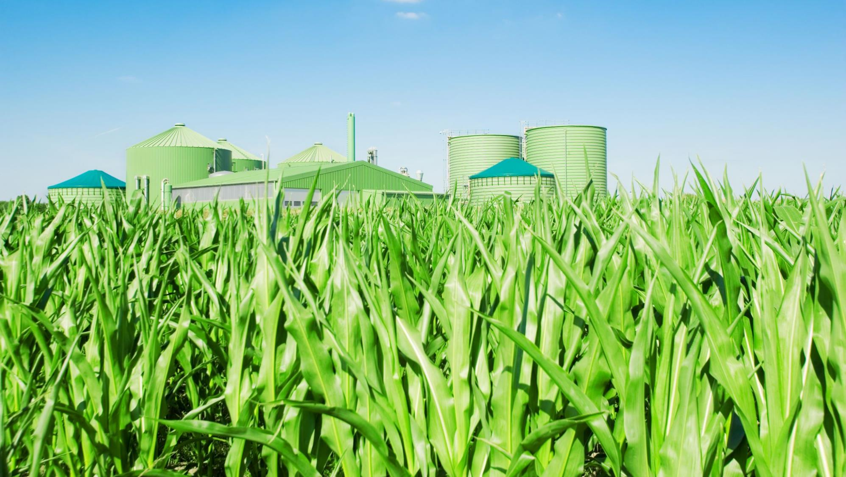
Sustainable Development

Slide 51
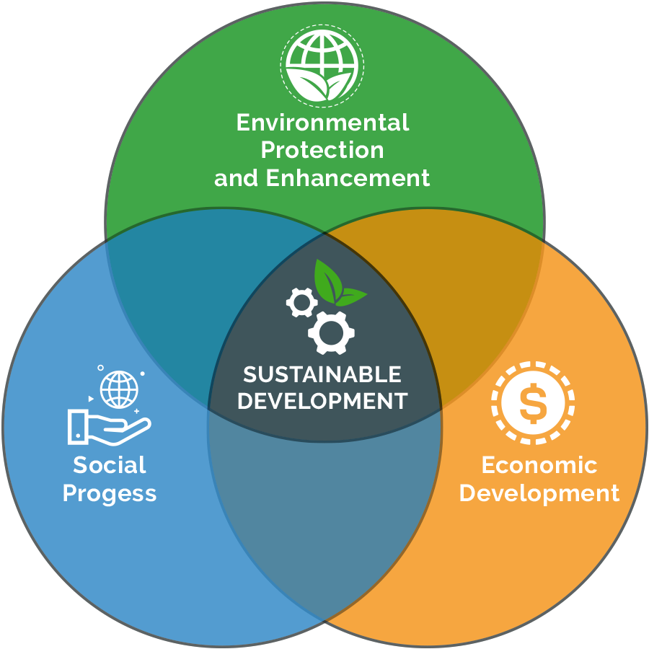
Sustainable Development
Sustainable development is a strategy of driving growth while using resources efficiently. It takes into consideration the immediate and long-term well-being of our environment and people.
Sustainable Development Definition | Arena (arenasolutions.com)

Slide 52

Pre-Sustainable Development
1949: Sand County Almanac (Leopold)
1956: Peak Oil (Hubbert)
1962: Silent Spring (Carson)
1966: Spaceship Earth (Boulding)
1969: Making a counterculture (Roszak)
1972: A Blueprint for Survival (Goldsmith et al.)
1972: Limits to Growth (Meadows et al.)
  Also called ‘Club of Rome’
1973: Small is beautiful (Schumacher)
1979: Gaia Hypothesis (Lovelock)
1980: North-South: A program for survival (Brandt)
1987: Our Common Future
  Also called the Bruntland Report

Slide 53
Events that influenced Sustainable Development
1967: Environmental Defense Fund formed (Legal Action)
1969: Friends of the Earth formed (Advocacy)
1970: Earth Day
1972: DDT ban (in U.S.)
1973: Oil Crisis
1973: Endangered Species Act (U.S.)
1974: CFC research
1976 - 1994: Love Canal Disaster
1979: Oil Crisis II (Iranian Revolution)
1979: Three Mile Island (Partial Nuclear Meltdown)
1984: Bhopal disaster
1984: Ethiopian Drought (~1,000,000 dead)
1985: Ozone hole discovered
1986: Chernobyl
1986: Space Shuttle Challenger Disaster
1987: Montreal Protocol (CFC ban)

Slide 54

How is Sustainable Development defined?
“Hajer (1995, page 14) made a very powerful point when he observed that the coalition for sustainable development would collapse if it were it ever defined precisely, given its potentially unstable mixture of radical and conservative elements” (Jordan 2008: 20).

Slide 55

How is Sustainable Development defined?
“development that meets the needs of present without compromising the ability of future generations to meet their own needs” (Our Common Future 1987: 15).
“current decisions should not impair the prospects for maintaining or improving future living standards. This implies that our economic systems should be managed so that we can live off the dividends of our resources” (Repetto 1986).

Slide 56

How is Sustainable Development defined?
“sustainable development is an approach that will permit continuing improvements in the quality of life with a lower intensity of resource use, thereby leaving behind for future generations an undiminished or even enhanced stock of natural resources” (Munasinghe 1991).
A “collective responsibility to advance and strengthen the interdependent and mutually reinforcing pillars of sustainable development – economic development, social development, and environmental protection – at the local, national, regional, and global levels” (World Summit on Sustainable Development 2002).

Slide 57

Birth of (modern) Sustainable Development
“development that meets the needs of the present without compromising the ability of future generations to meet their own needs” (UNWEP 1987).

Slide 58
But what is Sustainable Development?
An analytical framework;
A normative agenda;
A language to discuss our world and future;
A promise to integrate people and the environment;
A recipe book;
A response to unprecedented change (population, social, enviro)
A governance model;
A con or sham;
A process;
An outcome;
Socialism in drag;
A way to control people;
Anti-capitalism (hiding behind environmentalism)
…?

Slide 59
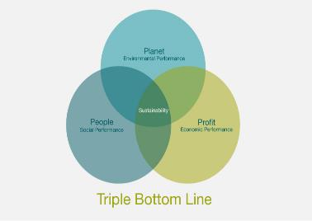
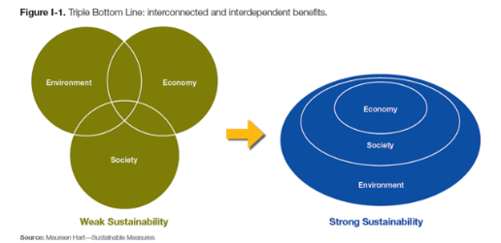
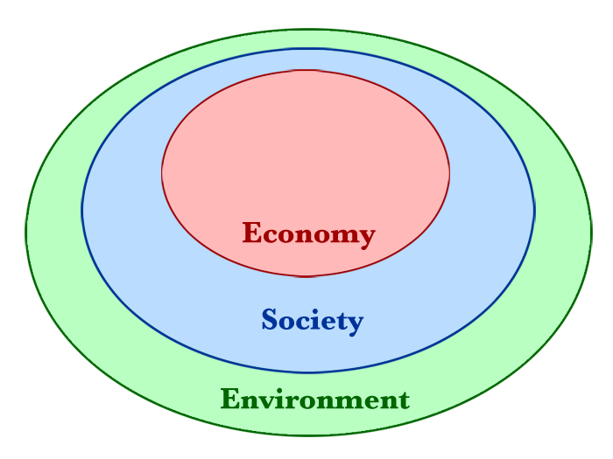
My understanding of Sustainable Development
Governed By:
Culture – Society – Values
Environment
(Production)
Economy
(Consumption)
(2) Triple bottom line (3 pillars): sustainability in business - YouTube

Slide 60
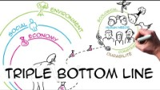

Slide 61
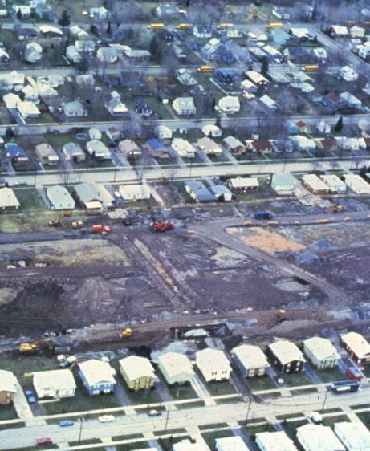
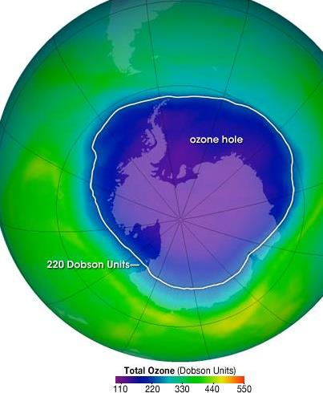
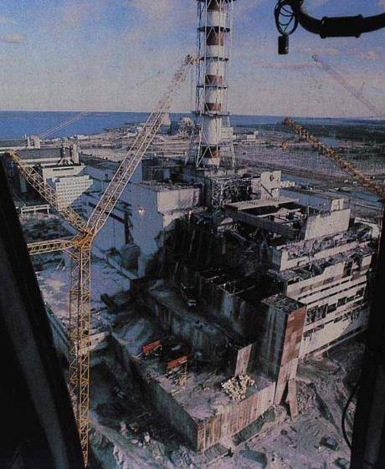
Catastrophe prompting sustainable development

Slide 62
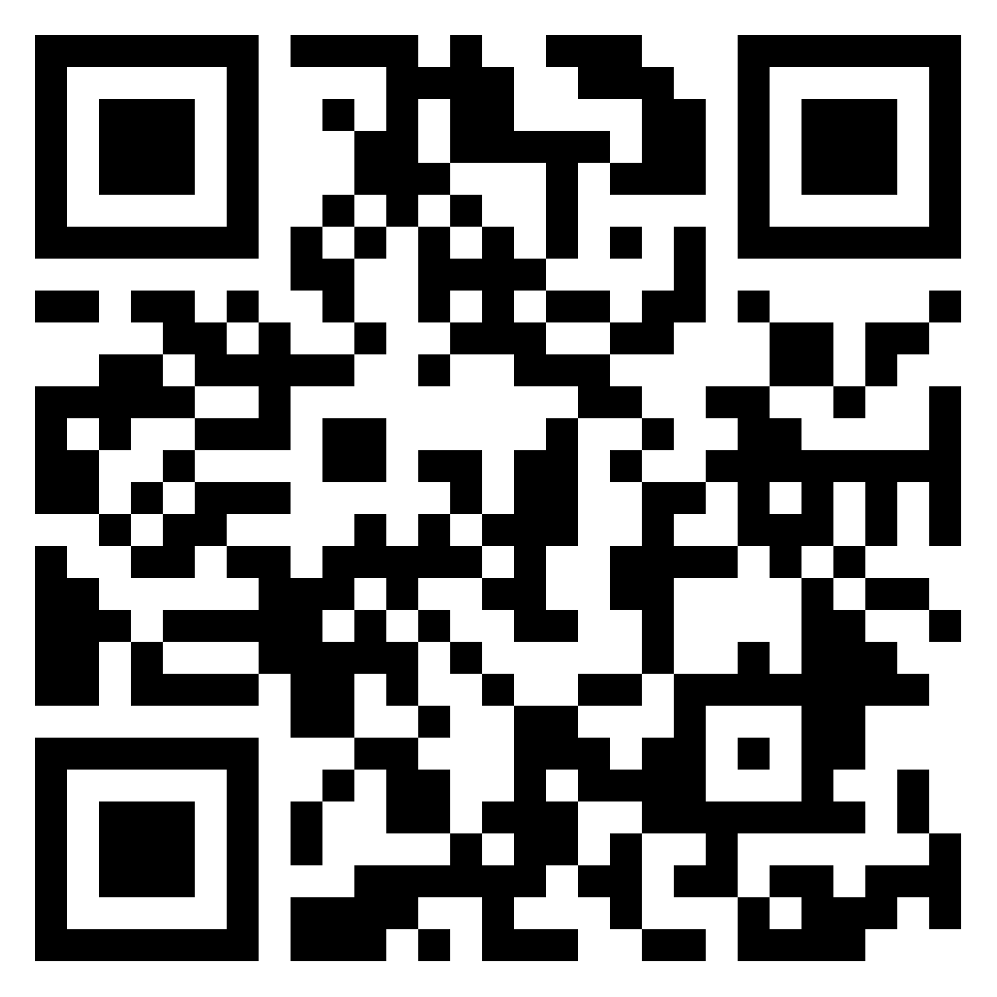
Sustainable Development and Catastrophe?
Can you think of a catastrophe that has prompted progress in sustainable development?
What developed?
How did people’s behaviour change?
(15 mins)
https://padlet.com/acunningham142/MapEnvCatastrophes

Slide 63
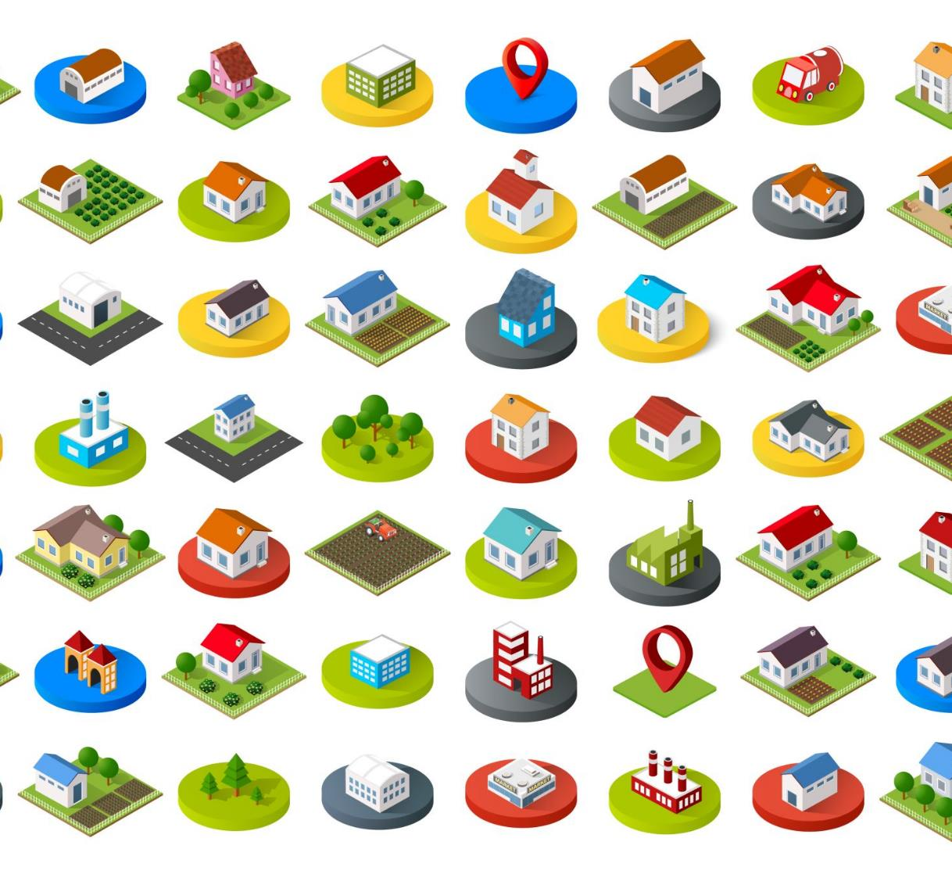
Major Environmental Disasters
Timeline: Major Environmental Disasters (cfr.org)

Slide 64
What is this Brundtland Report?
"Humanity has the ability to make development sustainable to ensure that it meets the needs of the present without compromising the ability of future generations to meet their own needs. The concept of sustainable development does imply limits - not absolute limits but limitations imposed by the present state of technology and social organization on environmental resources and by the ability of the biosphere to absorb the effects of human activities.
But technology and social organization can be both managed and improved to make way for a new era of economic growth. The Commission believes that widespread poverty is no longer inevitable. Poverty is not only an evil in itself, but sustainable development requires meeting the basic needs of all and extending to all the opportunity to fulfil their aspirations for a better life. A world in which poverty is endemic will always be prone to ecological and other catastrophes" (Our Common Future (i.e., Brundtland Report) 1987: article 25).
Notes:
It developed guiding principles for sustainable development as it is generally understood today. The Brundtland Report stated that critical global environmental problems were primarily the result of the enormous poverty of the South and the non-sustainable patterns of consumption and production in the North.

Slide 65
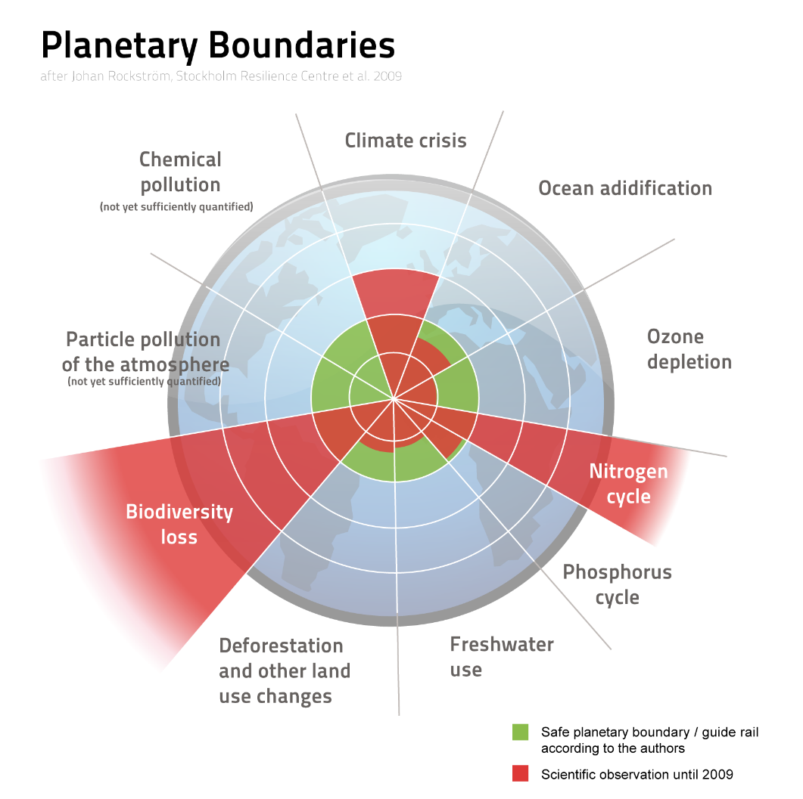
Our common Future (1987)
“The scale and complexity of our requirements for natural resources have increased greatly with the rising levels of population and production. Nature is bountiful, but it is also fragile and finely balanced. There are thresholds that cannot be crossed without endangering the basic integrity of the system. Today we are close to many of these thresholds; we must be ever mindful of the risk of endangering the survival of life on Earth” (Our Common Future 1987: 28).

Slide 66
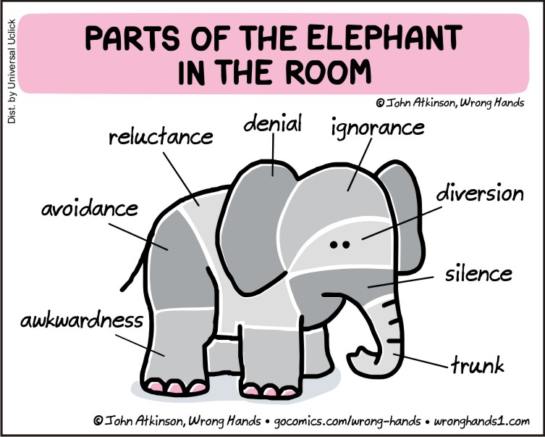
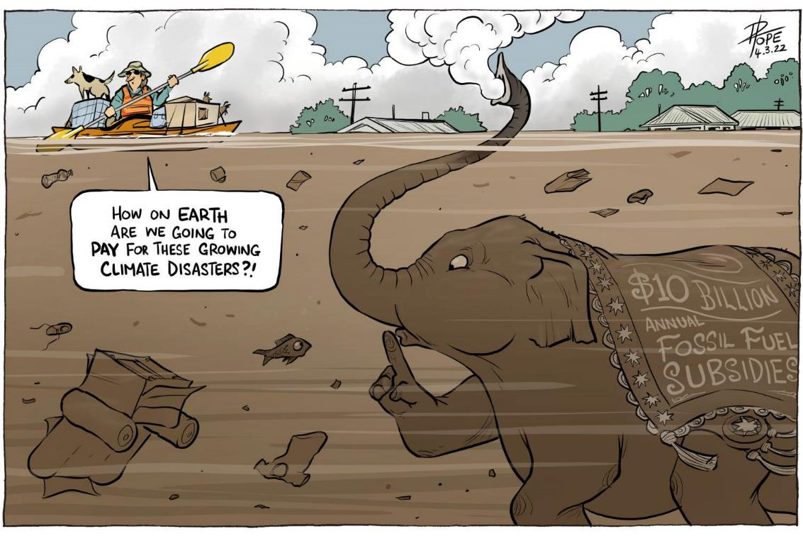
Gross inequality

Slide 67
Gross inequality
“The principal defect of the industrial way of life with its ethos of expansion is that it is not sustainable. Its termination within the lifetime of someone born today is inevitable - unless it continues to be sustained for a while longer by an entrenched minority at the cost of imposing great suffering on the rest of mankind" (Goldsmith et al, 1972: 110).
Oxfam 2020

Slide 68
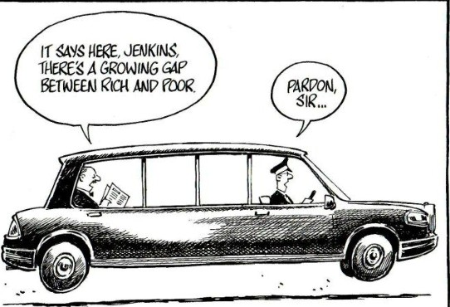
Gross inequality
The 22 richest men in the world have more wealth than all the women in Africa.
Women and girls put in 12.5 billion hours of unpaid care work each and every day —a contribution to the global economy of at least $10.8 trillion a year, more than three times the size of the global tech industry.
Getting the richest one percent to pay just 0.5 percent extra tax on their wealth over the next 10 years would equal the investment needed to create 117 million jobs in sectors such as elderly and childcare, education and health.
Oxfam 2020

Slide 69
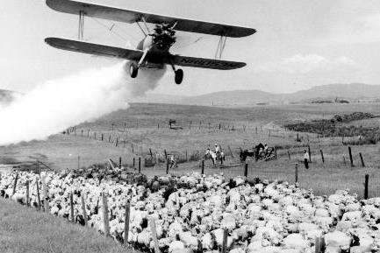
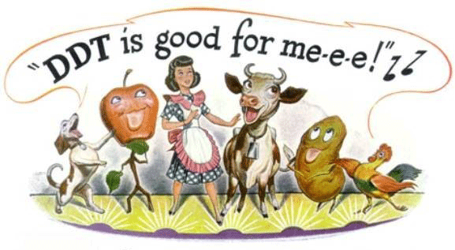
Doom and Gloom?
“We stand now where two roads diverge. But unlike the roads in Robert Frost’s familiar poem, they are not equally fair. The road we have long been traveling is deceptively easy, a smooth superhighway on which we progress with great speed, but at its end lies disaster. The other fork of the road — the one less traveled by — offers our last, our only chance to reach a destination that assures the preservation of the earth”
(Rachel Carson 1962: 277) The Silent Spring

Slide 70
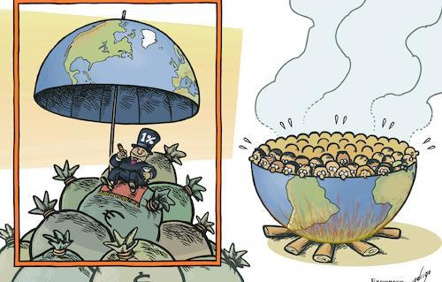
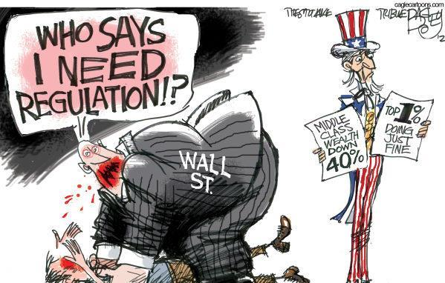
How does change happen?
How do you change something that is 'common sense', the natural system, and one that so many of us are invested in?

Slide 71
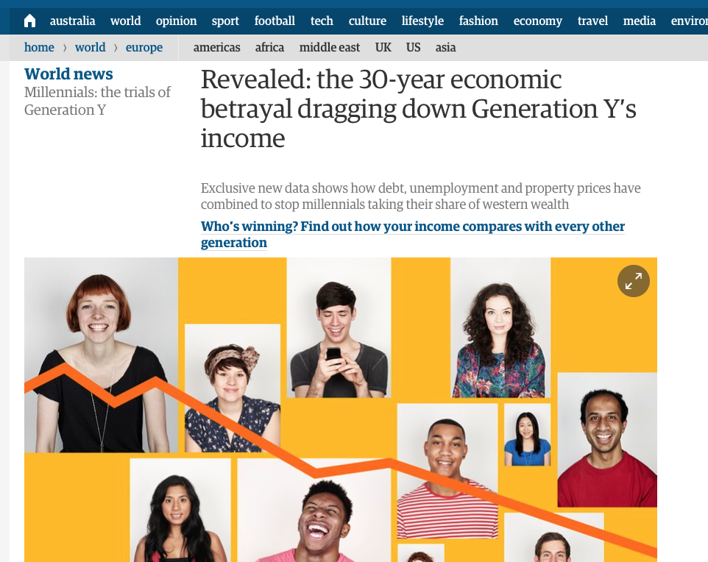
“30-year betrayal”… and SD?
“Paul Johnson, director of the Institute of Fiscal Studies, said he feared intergenerational inequality would fuel wider inequality in society because youngsters with rich parents would retain such an unfair advantage in the important years of early adulthood” (2016).
Batt and Malik. The Guardian. 2016

Slide 72
Review Redclift (2005)
Chose a heading in the Redclift (2005) paper ‘Sustainable Development (1987-2005): An Oxymoron Comes of Age. (e.g. the corporate response to sustainable development) (15 mins)
1) Summarise main content to the group.
2) In your opinion… Has anything changed since 2005 onward?

Slide 73
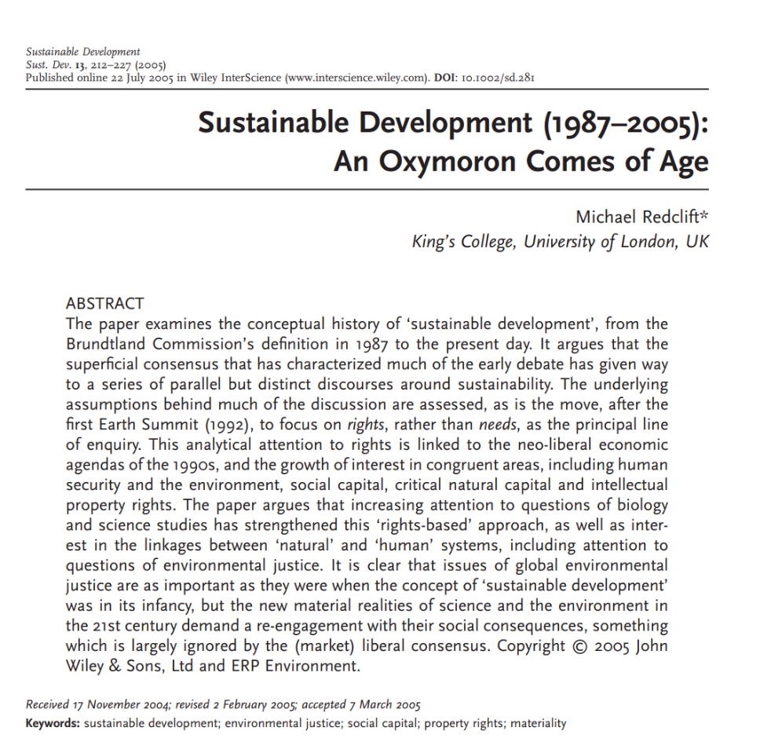
Sustainable Development

Slide 74
Criticisms of Sustainable Development
Oxymoron
Is incompatible with neoliberal economics and ‘free markets’
Ambiguous (‘needs’ vs. ‘wants’)
Implies (or used to imply) that ‘development’ and ‘GDP or economic growth’ are the same
Conflation of social, environmental, and ecological processes (i.e. do we accept they are inseparable?)
Futuristic – worry about 100 years from now and ignore the present
Doomsday implications
Impractical (is a critique of current power and privilege)
Idealistic (i.e. against human nature and history)
Elitist (i.e. socialist, anti-capitalist)
Uncritical binary (simplification) ‘environment OR people’
Co-opted or co-optable (does not challenge current system)
Incongruous ‘group’ and ‘individual’ goals
Integration of People (development) and Ecological (sustainability) concepts
Cannot be measured / our measurements do not measure what needs to be measured (i.e. GDP vs. wellbeing)

Slide 75
Major Faults
Contradiction between economic growth (needed in developing nations) AND ecological conservation;
Inattention to power at all scales, and to the vested interests that profit from unsustainable development;
Vague and (possibly) impossible to implement;
‘Green-washing’ – providing cover for the status quo;
Implies constant growth possible (delusional?);
Distraction from meaningful change (system the problem);
Inclusion or exclusion of people from the equation.

Slide 76
Knowledge/Power
Sustainability aligns with existing socio-economic distributions of power, reinforcing the system that brought us to this point.
More guns will solve the gun violence problem.
More booze will solve the binge drinking problems.
More patriarchy will solve gender inequality?
More X will solve problems rooted in X?

Slide 77
Things are changing
What to make of the successes?
  Are they a con (sleight of hand)?
  Are they the initial steps along a journey?
  Are they about training the next generation?
  Are they temporary and unsustainable?
    Are we simply being too impatient for the impacts of this radical ‘sustainable’ change to be realised?
Drummond, I. & Marsden, T. K. (1995), "Regulating sustainable development." Global Environmental Change, Vol. 5, Nos 1 pp. 51-63.

Slide 78
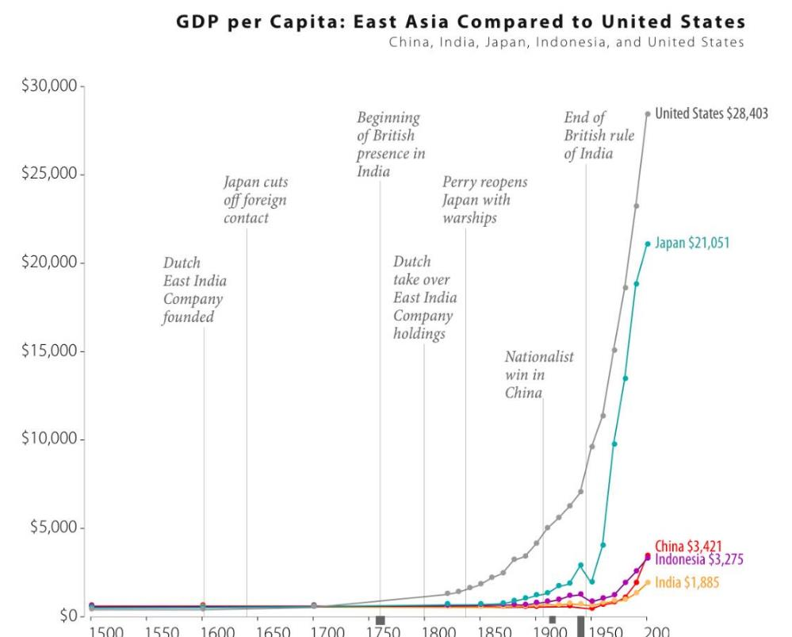
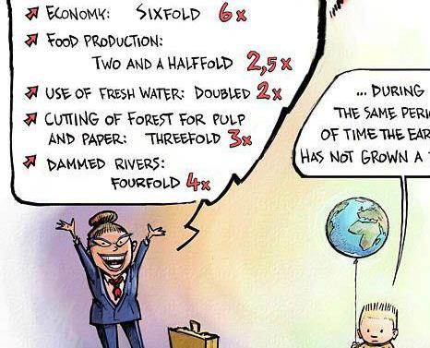
Global Trends
Economics

Slide 79
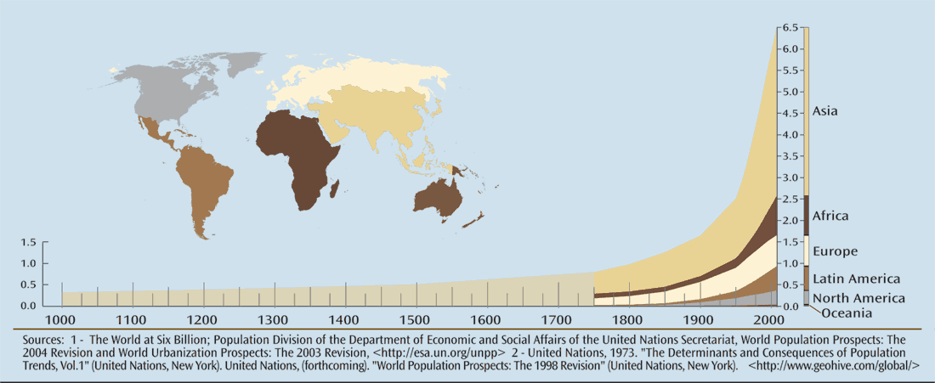
Global Trends
Population

Slide 80
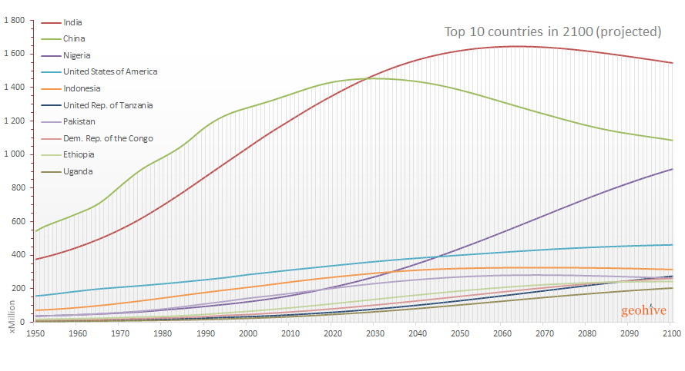
Global Trends
Population

Slide 81
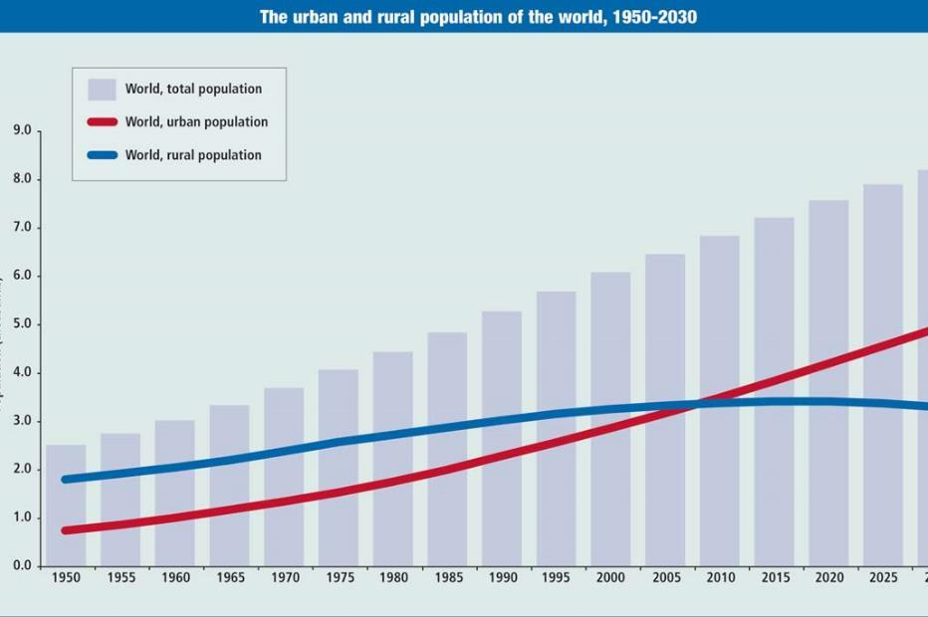
Global Trends
Population

Slide 82
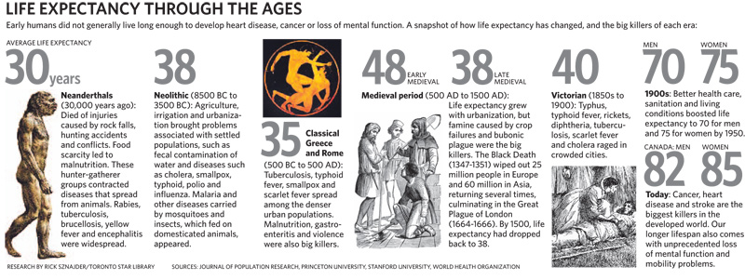
Global Trends
Socio-Cultural

Slide 83


Global Trends
Socio-Cultural

Slide 84

Global Trends
Literacy

Slide 85


Global Trends
+ The Environment
Do we have the resources to increase the current successes, to extend them to everyone, and to make them last into the future?

Slide 86
Learning Points
Sustainable development is about the creation of:
  “sustainable economies that equitably meet human needs without extracting resource inputs or expelling wastes in excess of the environment’s regenerative capacity, and ii) sustainable human institutions that assure both security and opportunity for social, intellectual, and spiritual growth” (Korten 1996: 1)
  Sustainable development problems “are extensions of existing global patterns of environmental degradation, natural resource-exploitation, and widespread impoverishment. Also, there is greater inequality of wealth, major decreases in international assistance, and increases in foreign debt, among other ‘plagues of globalization’” (Potter et al. 2012: 102).

Slide 87

Thoughts?
Will the currently wealthy countries, and groups within them, be willing to reduce their consumption of the planet’s resources and also be willing to reduce the environmental effects associated with the current use of resources?
What are the political, social, and economic mechanisms that could be used to facilitate such compromises?
Will these compromises have to be enforced by multilateral (UN) actions, or can they arise out of negotiated agreements among the wealthy countries themselves, or between the wealthy and the poor countries?
What is to be expected of the poor countries? To what extent will their economic growth be reduced by the need to compromise on the environment? (Rogers et al. 2008: 380).

Slide 88

Take a break
15mins

Slide 89

Environmental Ethics and Experts
acba7004

Slide 90
Thoughts?
What is ethics?
What does it mean if something is ethical?
What is an expert?
What makes an expert?

Slide 91

Human Interference with Nature - It Doesn't Work! | BBC Studios

Slide 92
RECAP: Policy Definition
a set of ideas or a plan of what to do in particular situations that has been agreed to officially by a group of people, a business organization, a government, or a political party (Cambridge Dictionary).

Slide 93

Ethics
Ethics is based on well-founded standards of right and wrong that prescribe what humans ought to do, usually in terms of rights, obligations, benefits to society, fairness, or specific virtues.
What is Ethics? - Markkula Center for Applied Ethics (scu.edu)

Slide 94

Ethics
What, then, is ethics? Ethics is two things.
First, ethics refers to well-founded standards of right and wrong that prescribe what humans ought to do, usually in terms of rights, obligations, benefits to society, fairness, or specific virtues.
Matouskova and Vandenberg, 2022.
Notes:
Ethical standards also include those that enjoin virtues of honesty, compassion, and loyalty. And, ethical standards include standards relating to rights, such as the right to life, the right to freedom from injury, and the right to privacy. Such standards are adequate standards of ethics because they are supported by consistent and well-founded reasons.

Slide 95


Ethics
Secondly, ethics refers to the study and development of one's ethical standards. As mentioned above, feelings, laws, and social norms can deviate from what is ethical. So, it is necessary to constantly examine one's standards to ensure that they are reasonable and well-founded.
What is Ethics? - Markkula Center for Applied Ethics (scu.edu)
Notes:
Ethical standards also include those that enjoin virtues of honesty, compassion, and loyalty. And, ethical standards include standards relating to rights, such as the right to life, the right to freedom from injury, and the right to privacy. Such standards are adequate standards of ethics because they are supported by consistent and well-founded reasons.

Slide 96

Environmental Experts

Slide 97


Environmental Experts
acba7004

Slide 98

Environmental Ethics
Environmental Ethics | Learn Science at Scitable (nature.com)
Environmental Ethics is that sub-field of philosophy which seeks to articulate reasons why non-human "nature" — usually writ large to include collective entities like species and ecosystems — has value that cannot be reduced solely to economic value. The central move of most work in environmental ethics has been to argue that there is a need for a "new environmental ethic" that breaks radically with the existing Western traditions of ethical theory.
Notes:
This course will familiarise students with both the content and the processes involved in ethical decision-making in issues concerning the natural and social environment. This course will introduce students to the main ethical theories pertaining to the environment and consider the implications of environmental ethics for environmental policy, planning and decision making, and develop the nexus between ethical theory and practice in environmental decision making contexts. Case studies from across the world will be considered, and highlight how issues of equity, justice, and other ethical dimensions are part of environmental planning and policy and will highlight how ethics can shape environmental planning and policy in different domains - from global (climate change) to local (NRM or coastal management) contexts.

Slide 99

Environmental ethics and policy development
Environment Act 2021 (legislation.gov.uk)
Notes:
This course will familiarise students with both the content and the processes involved in ethical decision-making in issues concerning the natural and social environment. This course will introduce students to the main ethical theories pertaining to the environment and consider the implications of environmental ethics for environmental policy, planning and decision making, and develop the nexus between ethical theory and practice in environmental decision making contexts. Case studies from across the world will be considered, and highlight how issues of equity, justice, and other ethical dimensions are part of environmental planning and policy and will highlight how ethics can shape environmental planning and policy in different domains - from global (climate change) to local (NRM or coastal management) contexts.

Slide 100
Policy Making
The legal duty to have due regard to this policy statement applies to Ministers when making policy. Policy can be broadly understood as an intended course of action adopted to achieve an objective. Examples of policy include:
proposals that lead to legislation
national policy statements, strategies and frameworks
ministerial statements setting out the government’s formal position on an issue
documents, strategies and frameworks prepared by public bodies that ministers are required by statute to approve
any other document that sets out a substantial change in approach to an established position
Making policy includes making, developing, adopting, revising, or repealing policy. An insubstantial change to an existing policy will not amount to revising a policy.
Environmental principles policy statement - GOV.UK (www.gov.uk)
Notes:
This course will familiarise students with both the content and the processes involved in ethical decision-making in issues concerning the natural and social environment. This course will introduce students to the main ethical theories pertaining to the environment and consider the implications of environmental ethics for environmental policy, planning and decision making, and develop the nexus between ethical theory and practice in environmental decision making contexts. Case studies from across the world will be considered, and highlight how issues of equity, justice, and other ethical dimensions are part of environmental planning and policy and will highlight how ethics can shape environmental planning and policy in different domains - from global (climate change) to local (NRM or coastal management) contexts.

Slide 101
Examining Policy Papers?
The 5 principles in this policy statement, as set out in section 17(5) of the Environment Act, are internationally recognised as successful benchmarks for environmental protection and enhancement. When making policy, and where relevant, ministers will need to consider the:
integration principle
prevention principle
rectification at source principle
polluter pays principle
precautionary principle
Environmental principles policy statement - GOV.UK (www.gov.uk)
Notes:
This course will familiarise students with both the content and the processes involved in ethical decision-making in issues concerning the natural and social environment. This course will introduce students to the main ethical theories pertaining to the environment and consider the implications of environmental ethics for environmental policy, planning and decision making, and develop the nexus between ethical theory and practice in environmental decision making contexts. Case studies from across the world will be considered, and highlight how issues of equity, justice, and other ethical dimensions are part of environmental planning and policy and will highlight how ethics can shape environmental planning and policy in different domains - from global (climate change) to local (NRM or coastal management) contexts.

Slide 102
Activity
Examine the Environmental principles policy statement: Environmental principles policy statement - GOV.UK (www.gov.uk).
In what ways are ethical considerations incorporated?

Slide 103

Experts
Expertise and Environment

Slide 104


Experts
Environmental Expert means an individual who is qualified as a professional with a recognized geotechnical, engineering, or environmental consulting firm
Environmental Expert means a reputable environmental consulting firm selected by the Concessionaire and agreed to by the Government
Environmental Expert Definition | Law Insider

Slide 105

Experts
Current role holder
The Rt Hon Thérèse Coffey MP
Thérèse Coffey was appointed Secretary of State for Environment, Food and Rural Affairs on 25 October 2022.
Ministerial role Secretary of State for Environment, Food and Rural Affairs

Slide 106


Traditional Knowledge
Taking Care of Culture Discussion Paper_04012021_2.pdf (content.vic.gov.au)
Tapping into indigenous knowledge to protect nature (unep.org)

Slide 107



Local Knowledge
: Informing decision‐making with Indigenous and local knowledge and science (wiley.com)

Slide 108

Local Knowledge
Climate change: Inuit culture on thin ice (youtube.com)

Slide 109


Citizen Science
Winther | Engaging communities in citizen science | Journal of Science Communication (sissa.it)
Citizen Science at NOAA

Slide 110


Community Based NRM
There are a variety of terms used to refer to CBNRM mechanisms, including participatory, community, community-based, collaborative, joint and popular natural resource management. CBNRM is an approach that evolved in the 1980s as a result of the failure of Western-born and -developed conservation models and paradigms in Third World countries.
Indigenous Community-based Natural Resources Management Mechanisms – ACCORD

Slide 111

Community Based NRM
Indigenous Community-based Natural Resources Management Mechanisms – ACCORD

Slide 112
Assessment: Report, collection of reports (Journal) and Conference presentation
Select an EIA of your choice. It is preferable to pick an EIA with which you are familiar for example, a bypass near your family home or Swansea Bay tidal lagoon. It is important you select and get hold of the document in plenty of time to be able to assess its application.
Report: Using your chosen example, evaluate the process of EIA, comment on its supporting legislation, review academic literature and express opinion on any recent changes. This should include gaps that your example identifies between theory/law and practice. Report format based on Environmental Impact Assessment Review (Journal). No more than 5,000 words excluding appendices. 70% of module mark.
Conference
  Collection of reports
After the comments from staff have been returned, the group needs to organise editorial meetings to publish the collection of reports (which should address any issues raised in the staff comments) using the guidelines from the journal Environmental Impact Assessment Review. Hence you ALL need to coordinate report format prior to the conference. The conference reports should be bound (spiral or could be in the form of a website) and published ready for distribution at the conference. Remember presentation and consistency is important in journal compilation. 10% of module mark
  Conference Presentation
Your report and response to staff comments should then be presented at a public conference. 10 mins presentation plus 5 mins discussion. 20% of module mark.

Slide 113

Finding EIA?
Planning | Blue Gem Wind
Written questions and answers - Written questions, answers and statements - UK Parliament (HS2)
A4 pagesv2.pdf (aerohabitat.eu) Bristol Airport
acba7004

Slide 114
For next week…
Read the following:
Beatley (1989) Environmental Ethics and Planning Theory
Select an EIA for your assessment

Slide 115

Activity
Find news/video clips about the October 2019 Extinction Rebellion protest in London or Insulate Britain 2021. Pay particular attention to how it relates to good governance.
Consider its relationship with
  Enforcement
  Coordination
  Empowerment
  Awareness
In relation to the groups action is it lawful, appropriate, ethical and effective?

