Slide 1
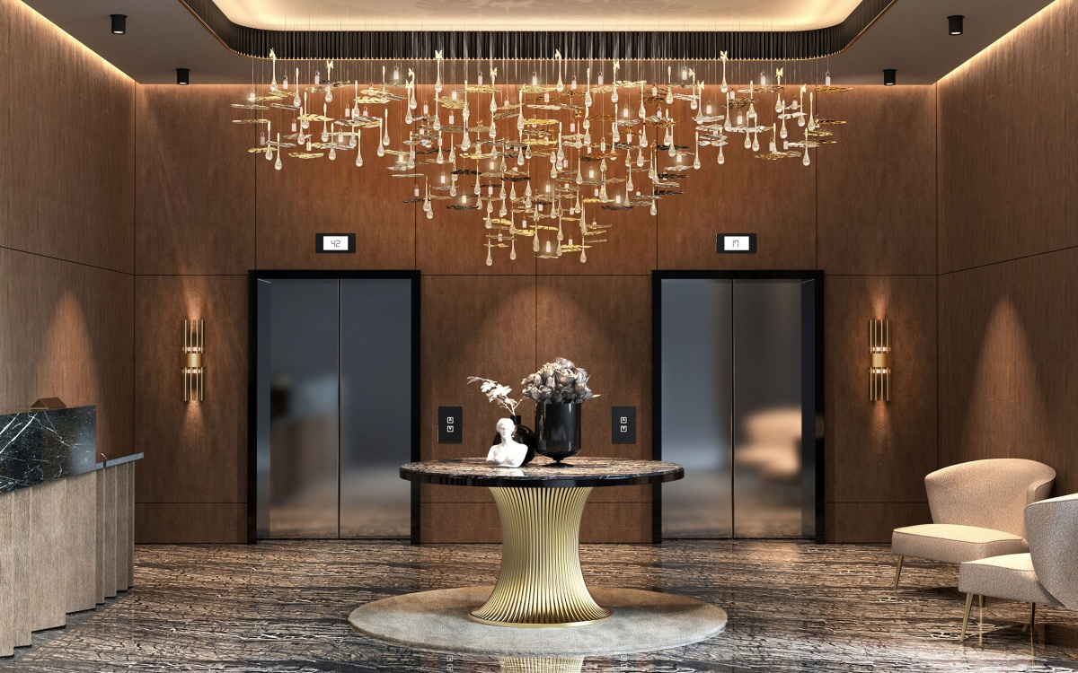
Experience-Led and Personalised Hospitality
Transforming Guest Experiences in Modern Hotels
Presented by Viktoria Benko (2130343)
Contemporary Themes in the Hotel and Hospitality Sector (BMIH6001)

Slide 2



Slide 3
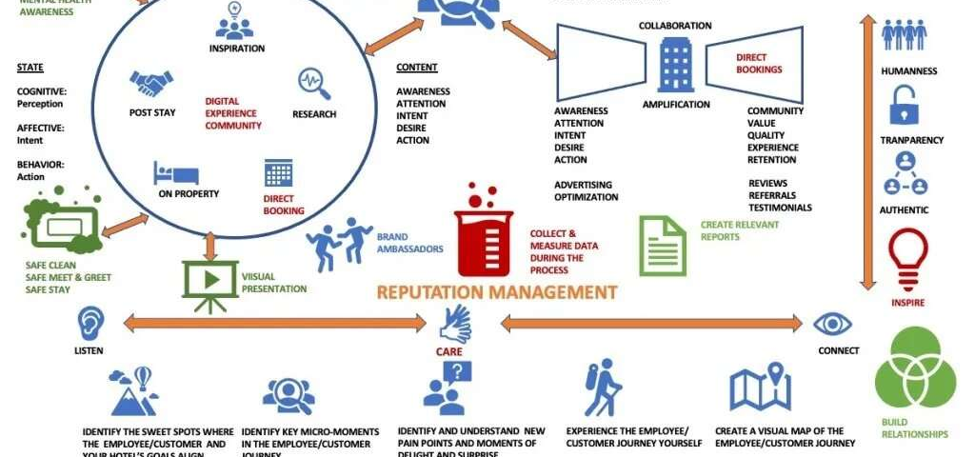
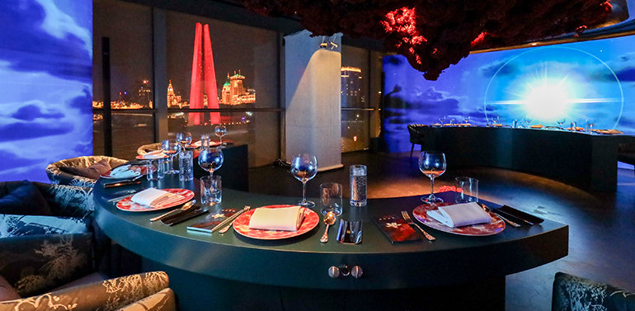
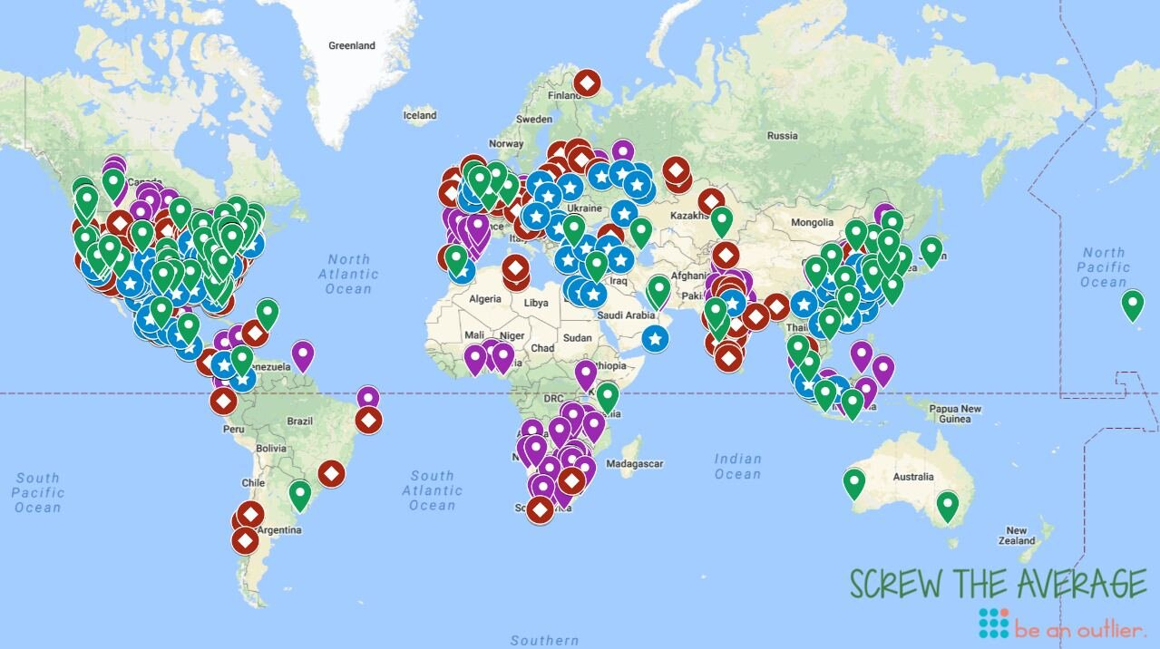
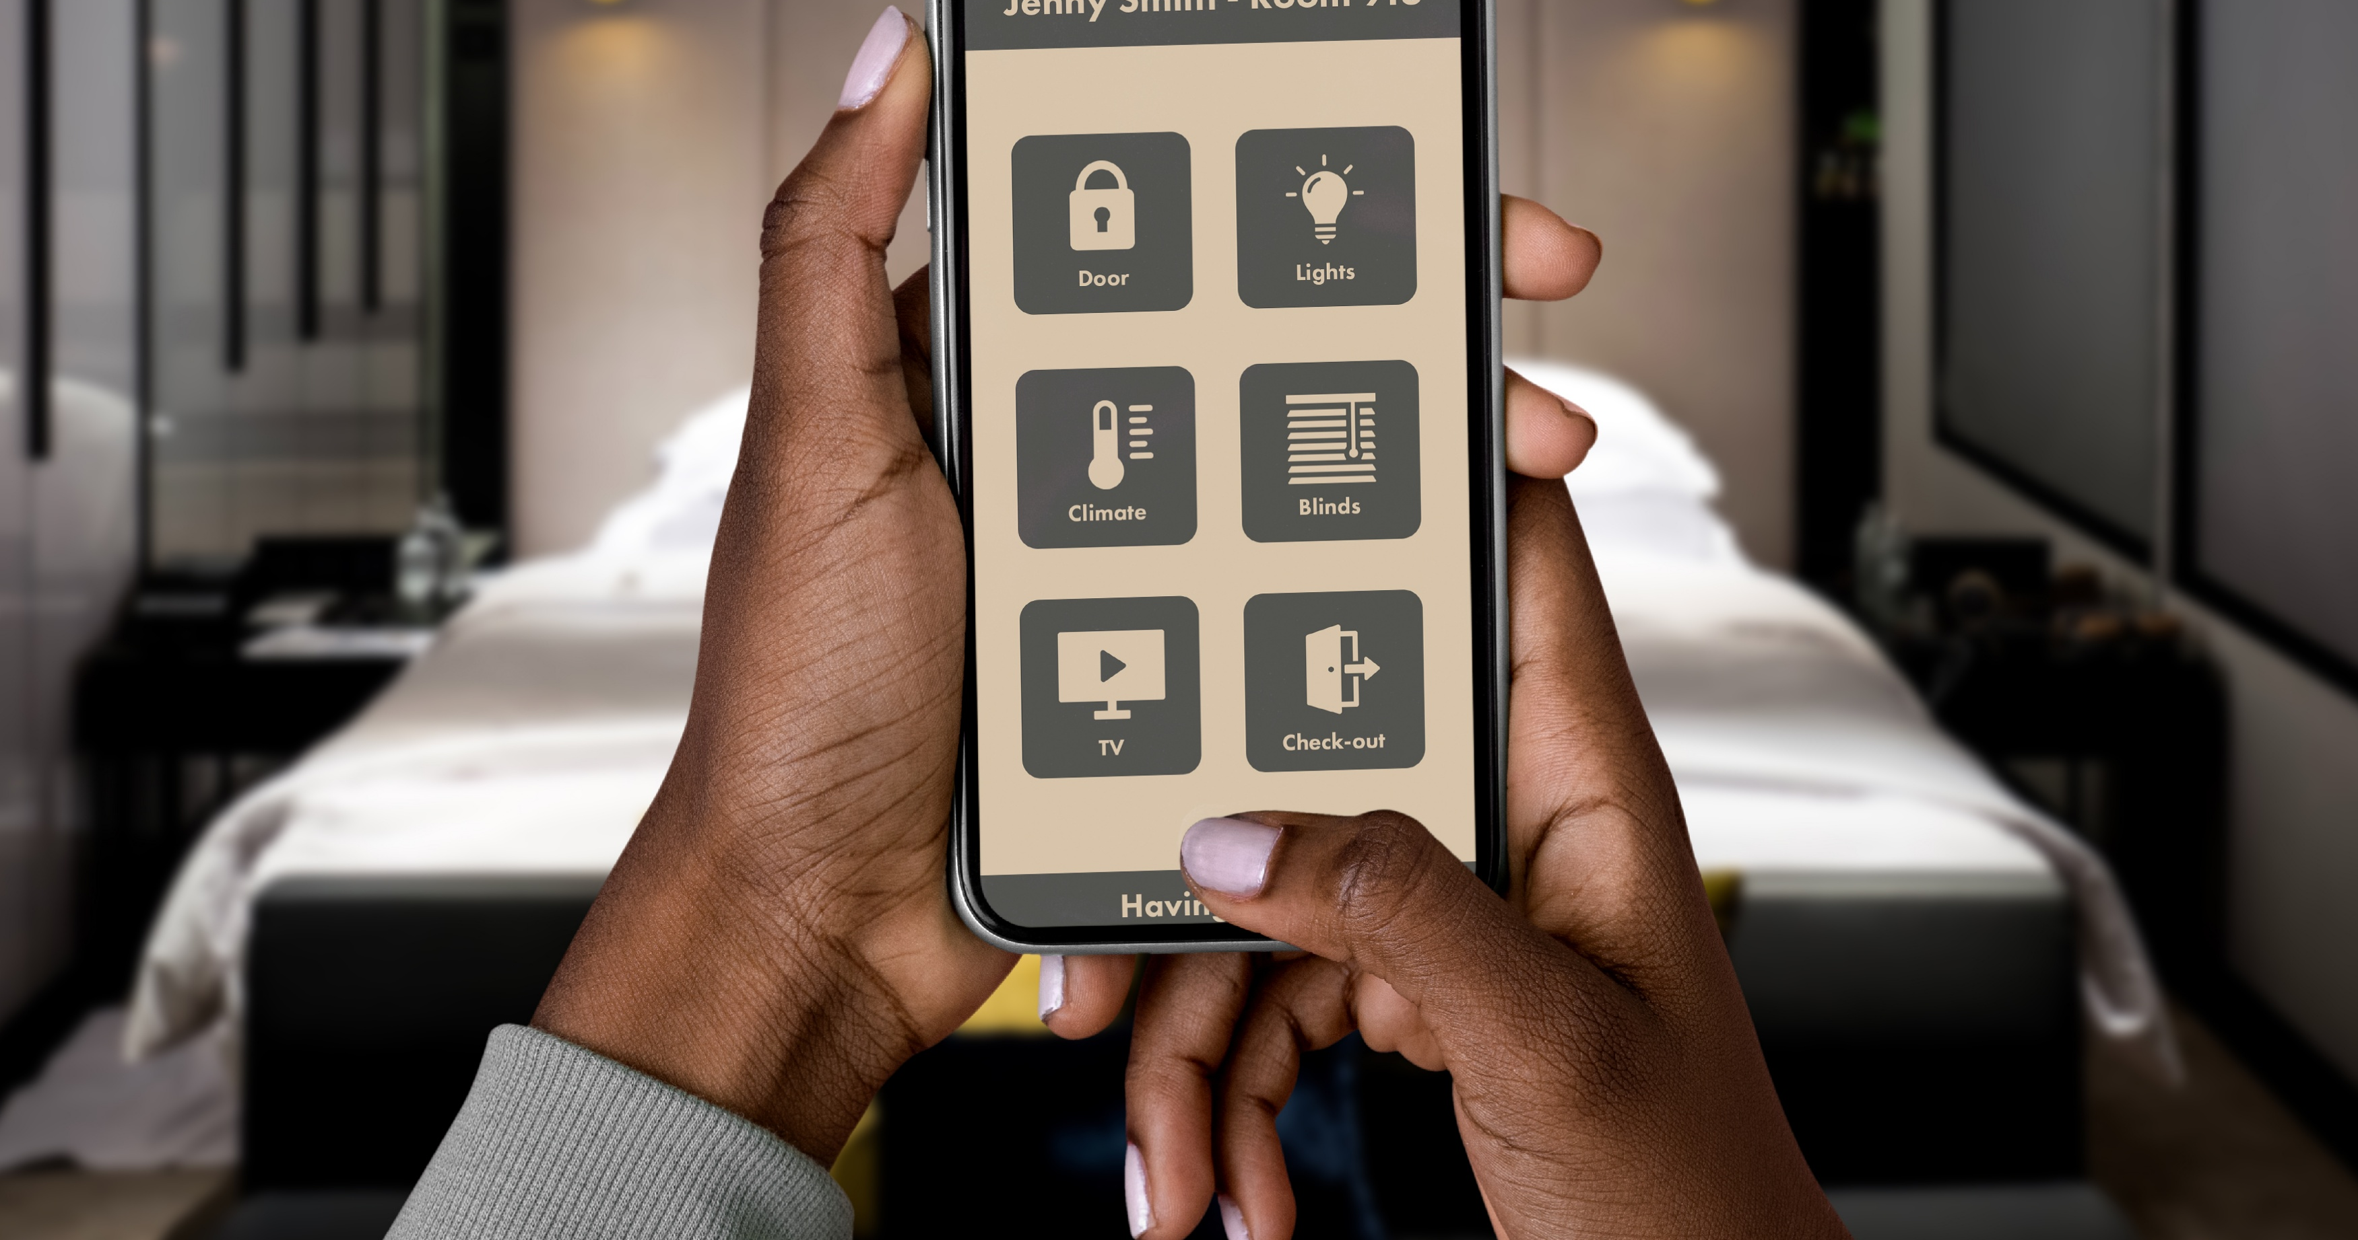
Industry Context & Strategic Shift
Hospitality transitioning from efficiency-driven models to experience-based differentiation
Globalisation and digital transformation reshaping guest expectations
Competitive advantage increasingly derived from emotional and experiential value (Pine, 1999)
Personalisation emerging as a core strategic capability (Dixit, 2020)

Slide 4
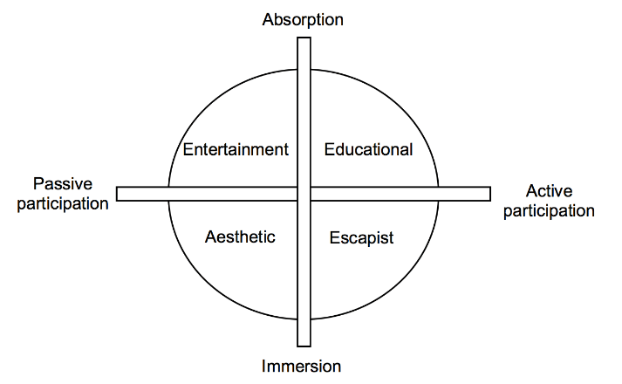
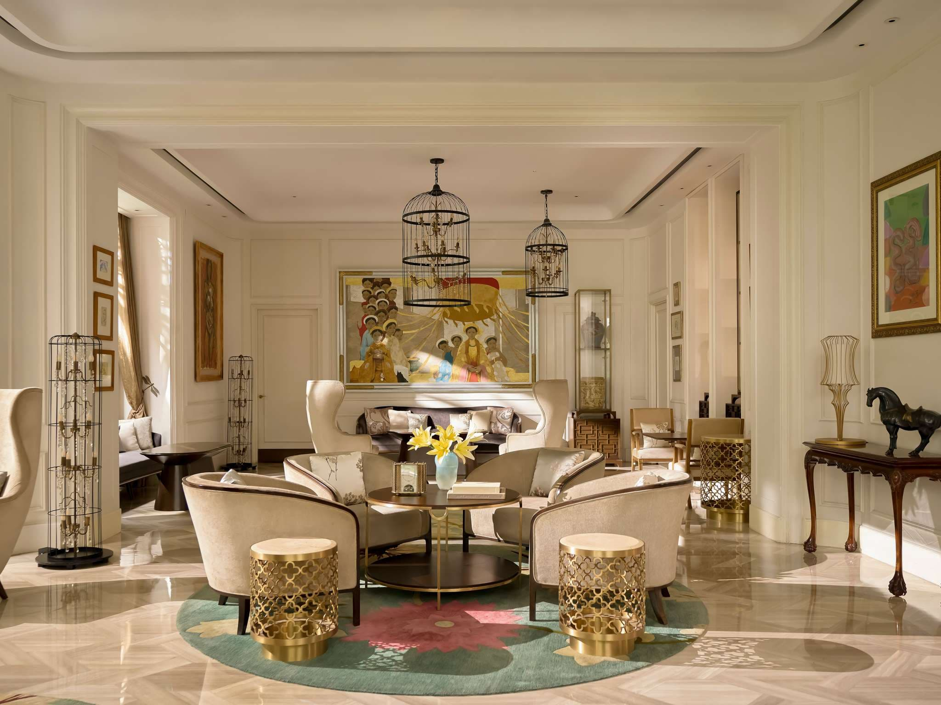
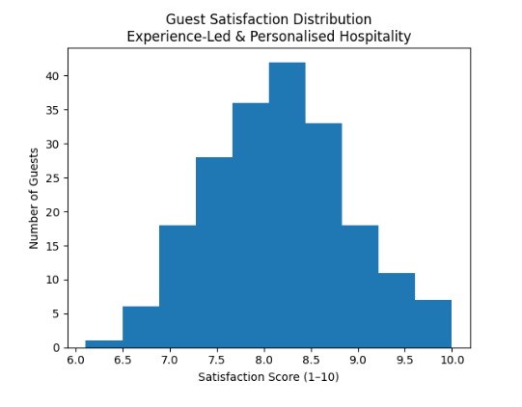
Experience Economy Framework
Economic progression: commodities → goods → services → experiences (Pine, 1999)
Memorable experiences generate emotional and economic value (Pine, 2011)
Hotels stage immersive journeys beyond functional accommodation
Experience-led strategies enhance loyalty and premium pricing potential (Pine, 2011)

Slide 5

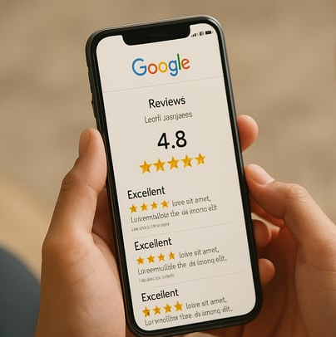

Competitive Strategy & Value Co-Creation
Experience differentiation reduces price-based rivalry (Porter, 2008)
Digital platforms increase buyer power and transparency (Porter, 2008)
Sustainable advantage depends on relational value creation (Vargo, 2008)
Guests act as active co-creators of personalised experiences (Vargo, 2008)
Competitive positioning increasingly shaped by experience-based engagement rather than cost leadership

Slide 6
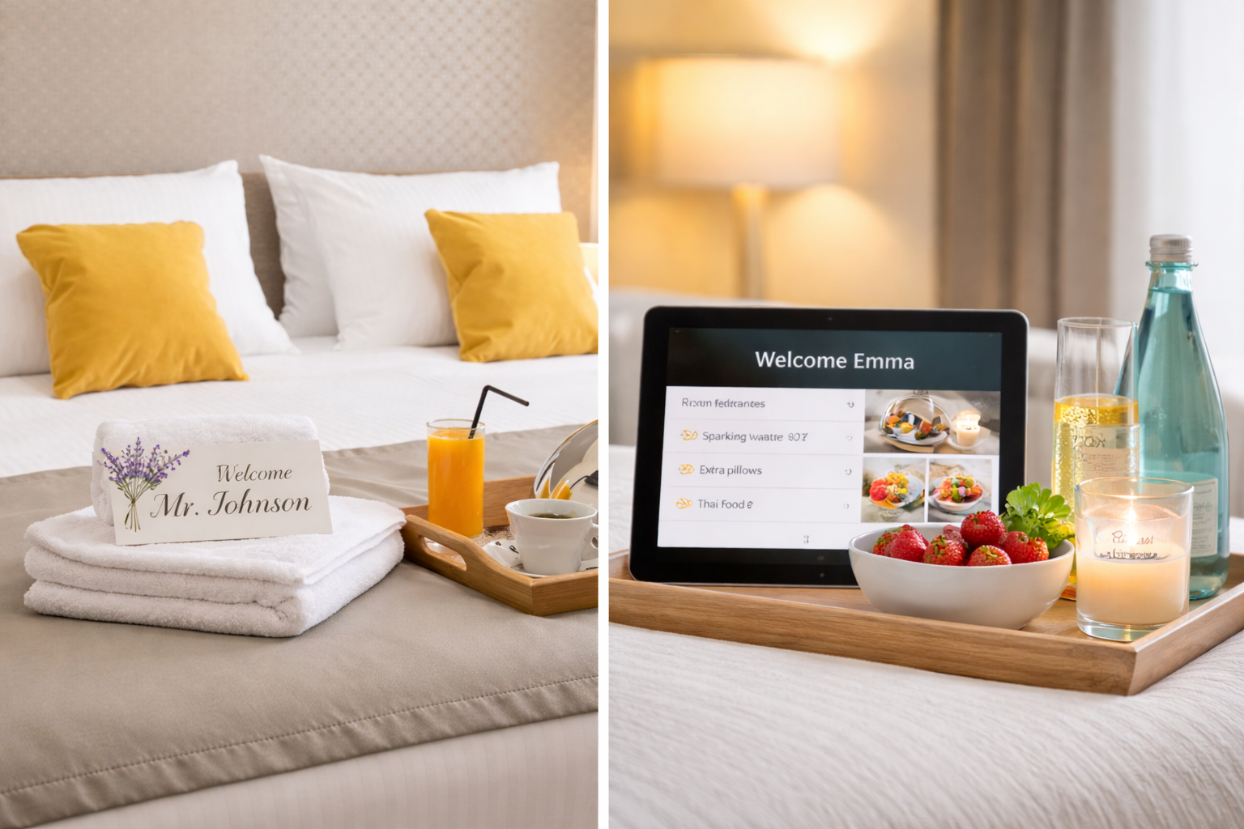
Personalisation in Hospitality
Tailoring services based on guest data and behavioural insight (Dixit, 2020)
Perceived personalisation strengthens satisfaction and loyalty (Zhang, 2019)
Stronger influence on revisit intention than standardised service (Zhang, 2019)
Over-automation risks undermining authenticity and emotional warmth (Buhalis, 2019)

Slide 7
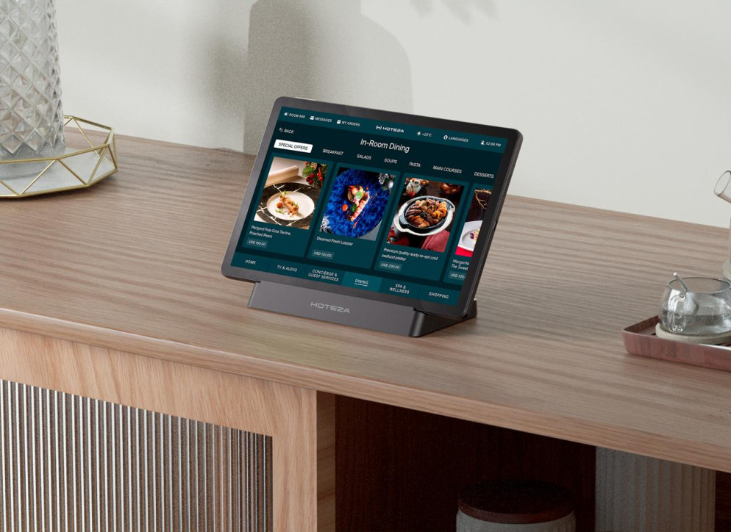
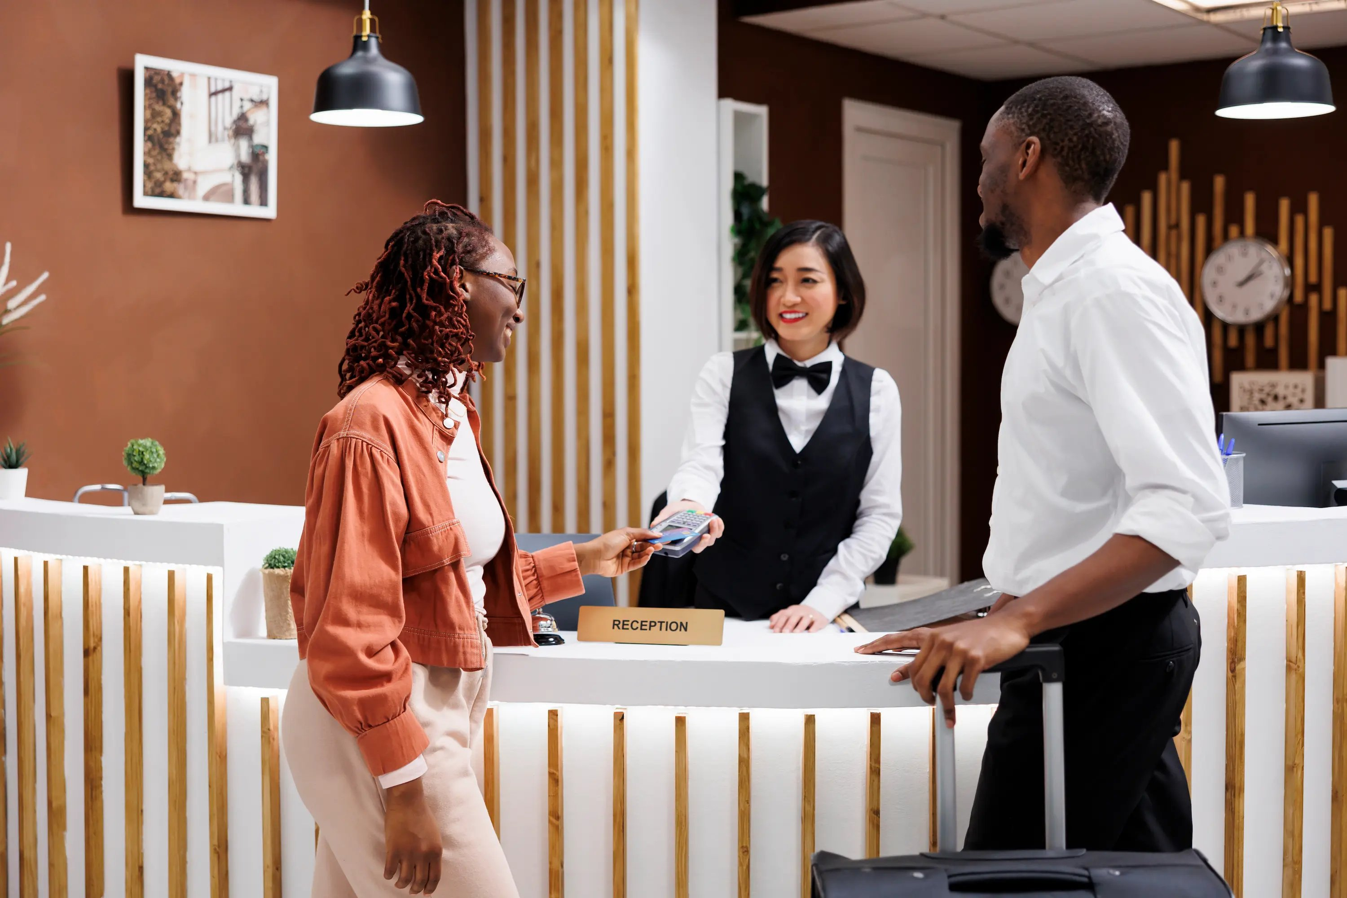
Technology & Human Interaction
AI, CRM and analytics enable scalable personalisation (Buhalis, 2019)
Smart systems enhance efficiency and predictive capability
Emotional intelligence remains critical in frontline service delivery (Vargo, 2008)
Strategic balance required between automation and human authenticity

Slide 8

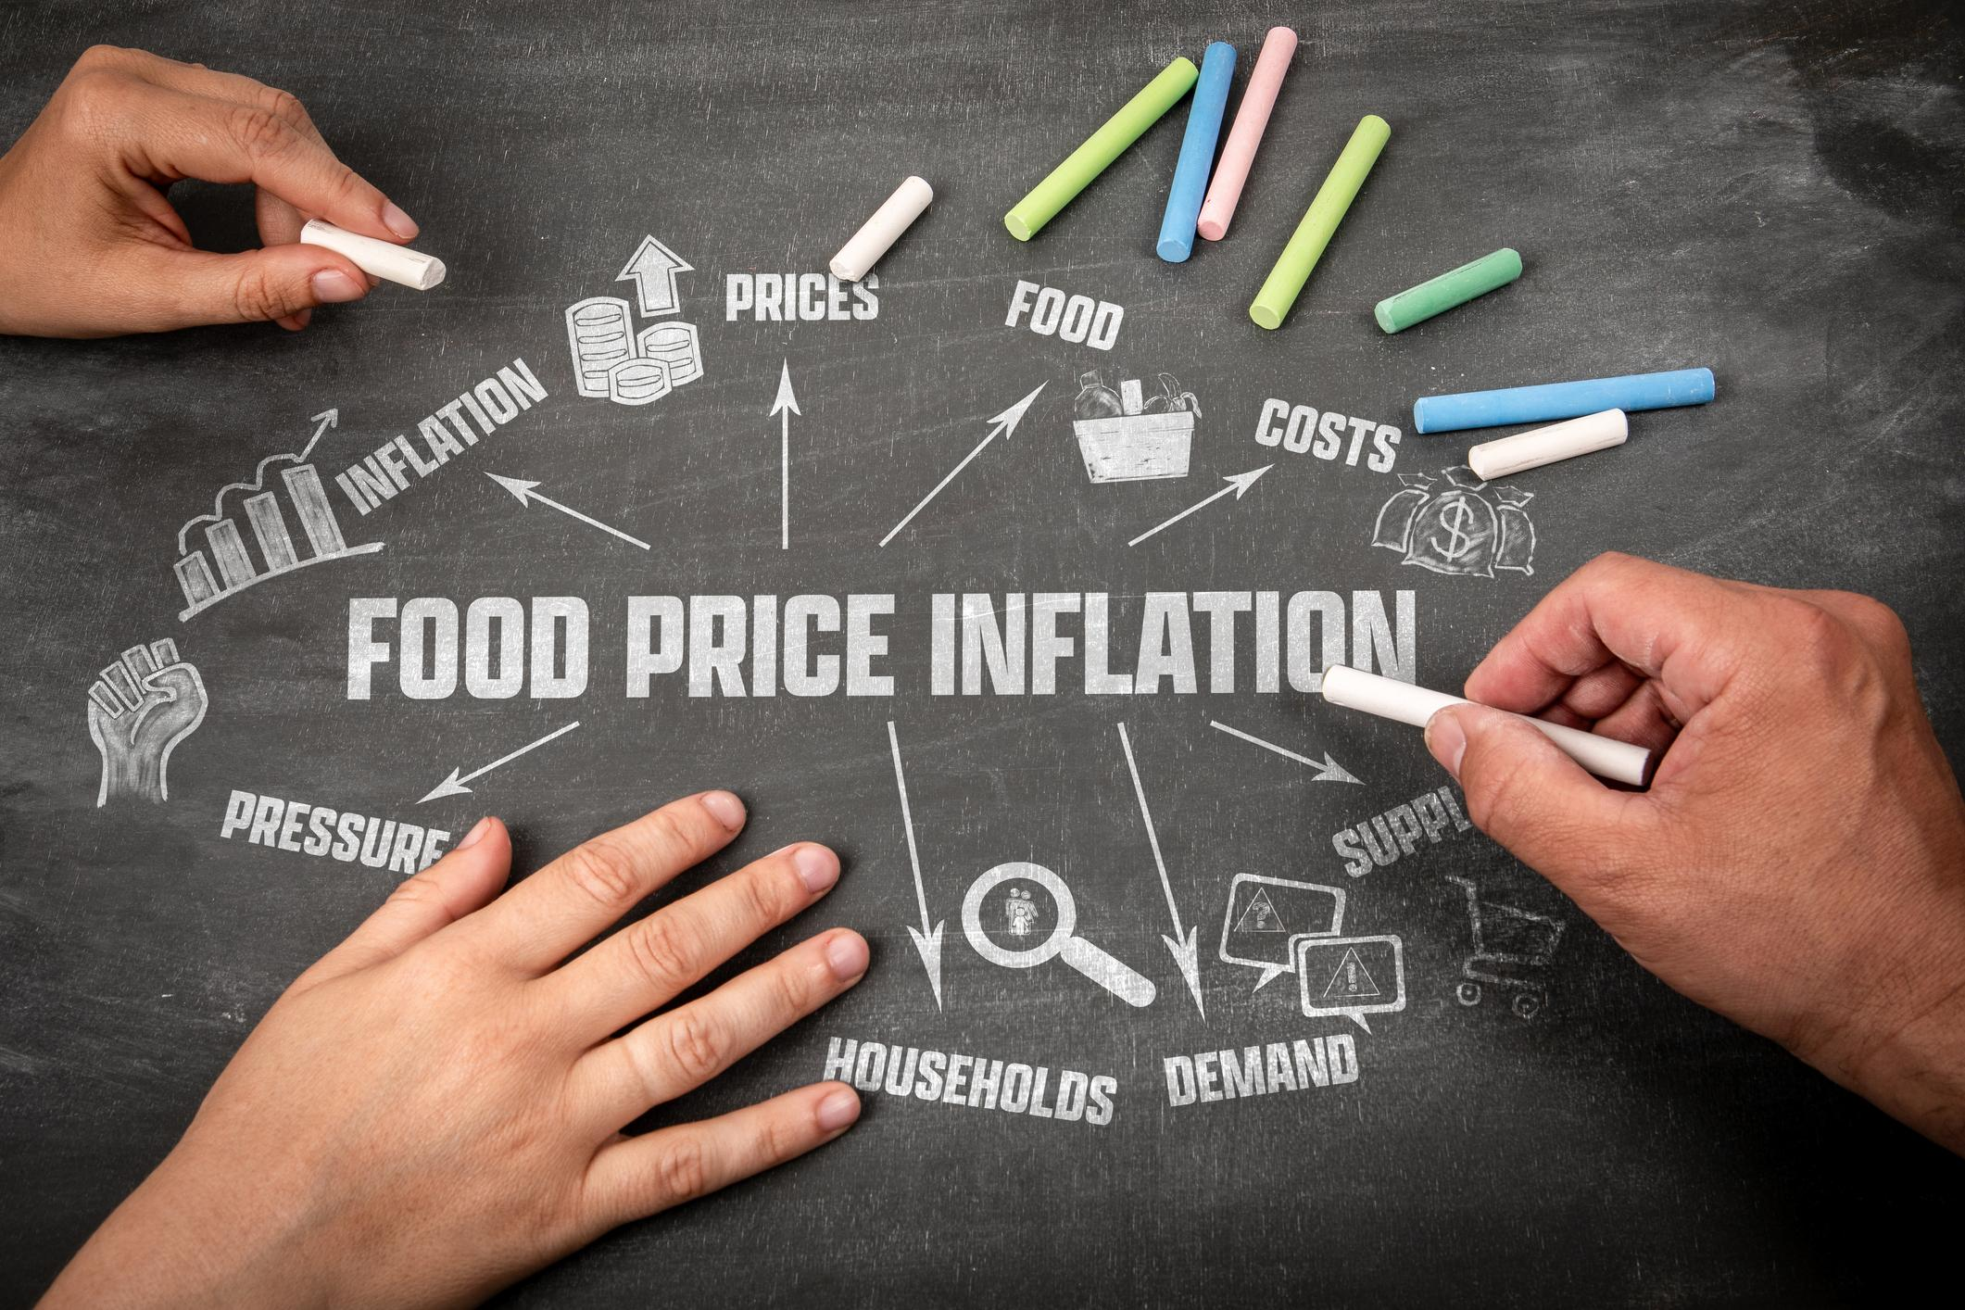




PESTLE Analysis: Macro-Environmental Influences
Political: GDPR and regulatory compliance shape data usage (Tussyadiah, 2020)
Economic: High technology investment balanced against revenue premium (Dixit, 2020)
Social: Demand for authenticity and ethical transparency (Zhang, 2019)
Technological: Rapid AI innovation driving competitive transformation (Buhalis, 2019)
Environmental: Sustainable personalisation enhances efficiency and brand equity (Pine, 2011)
Legal: Compliance failures risk reputational damage (Tussyadiah, 2020)

Slide 9

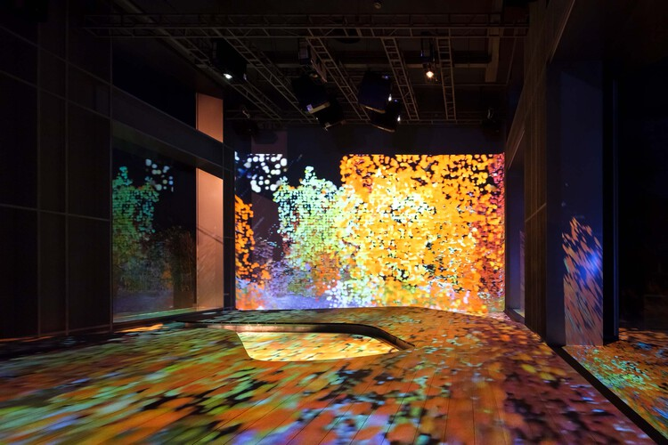

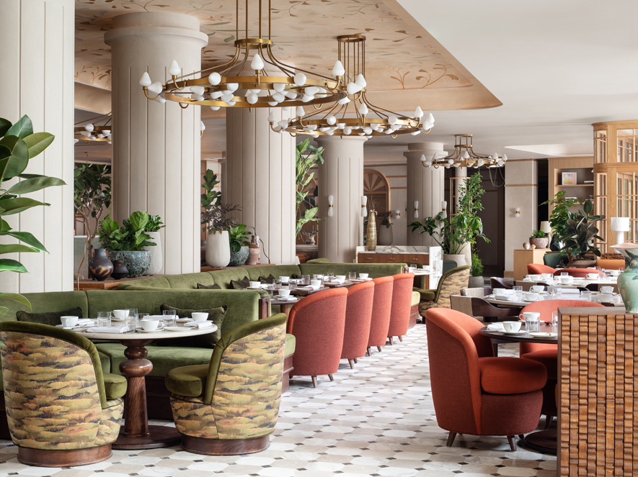
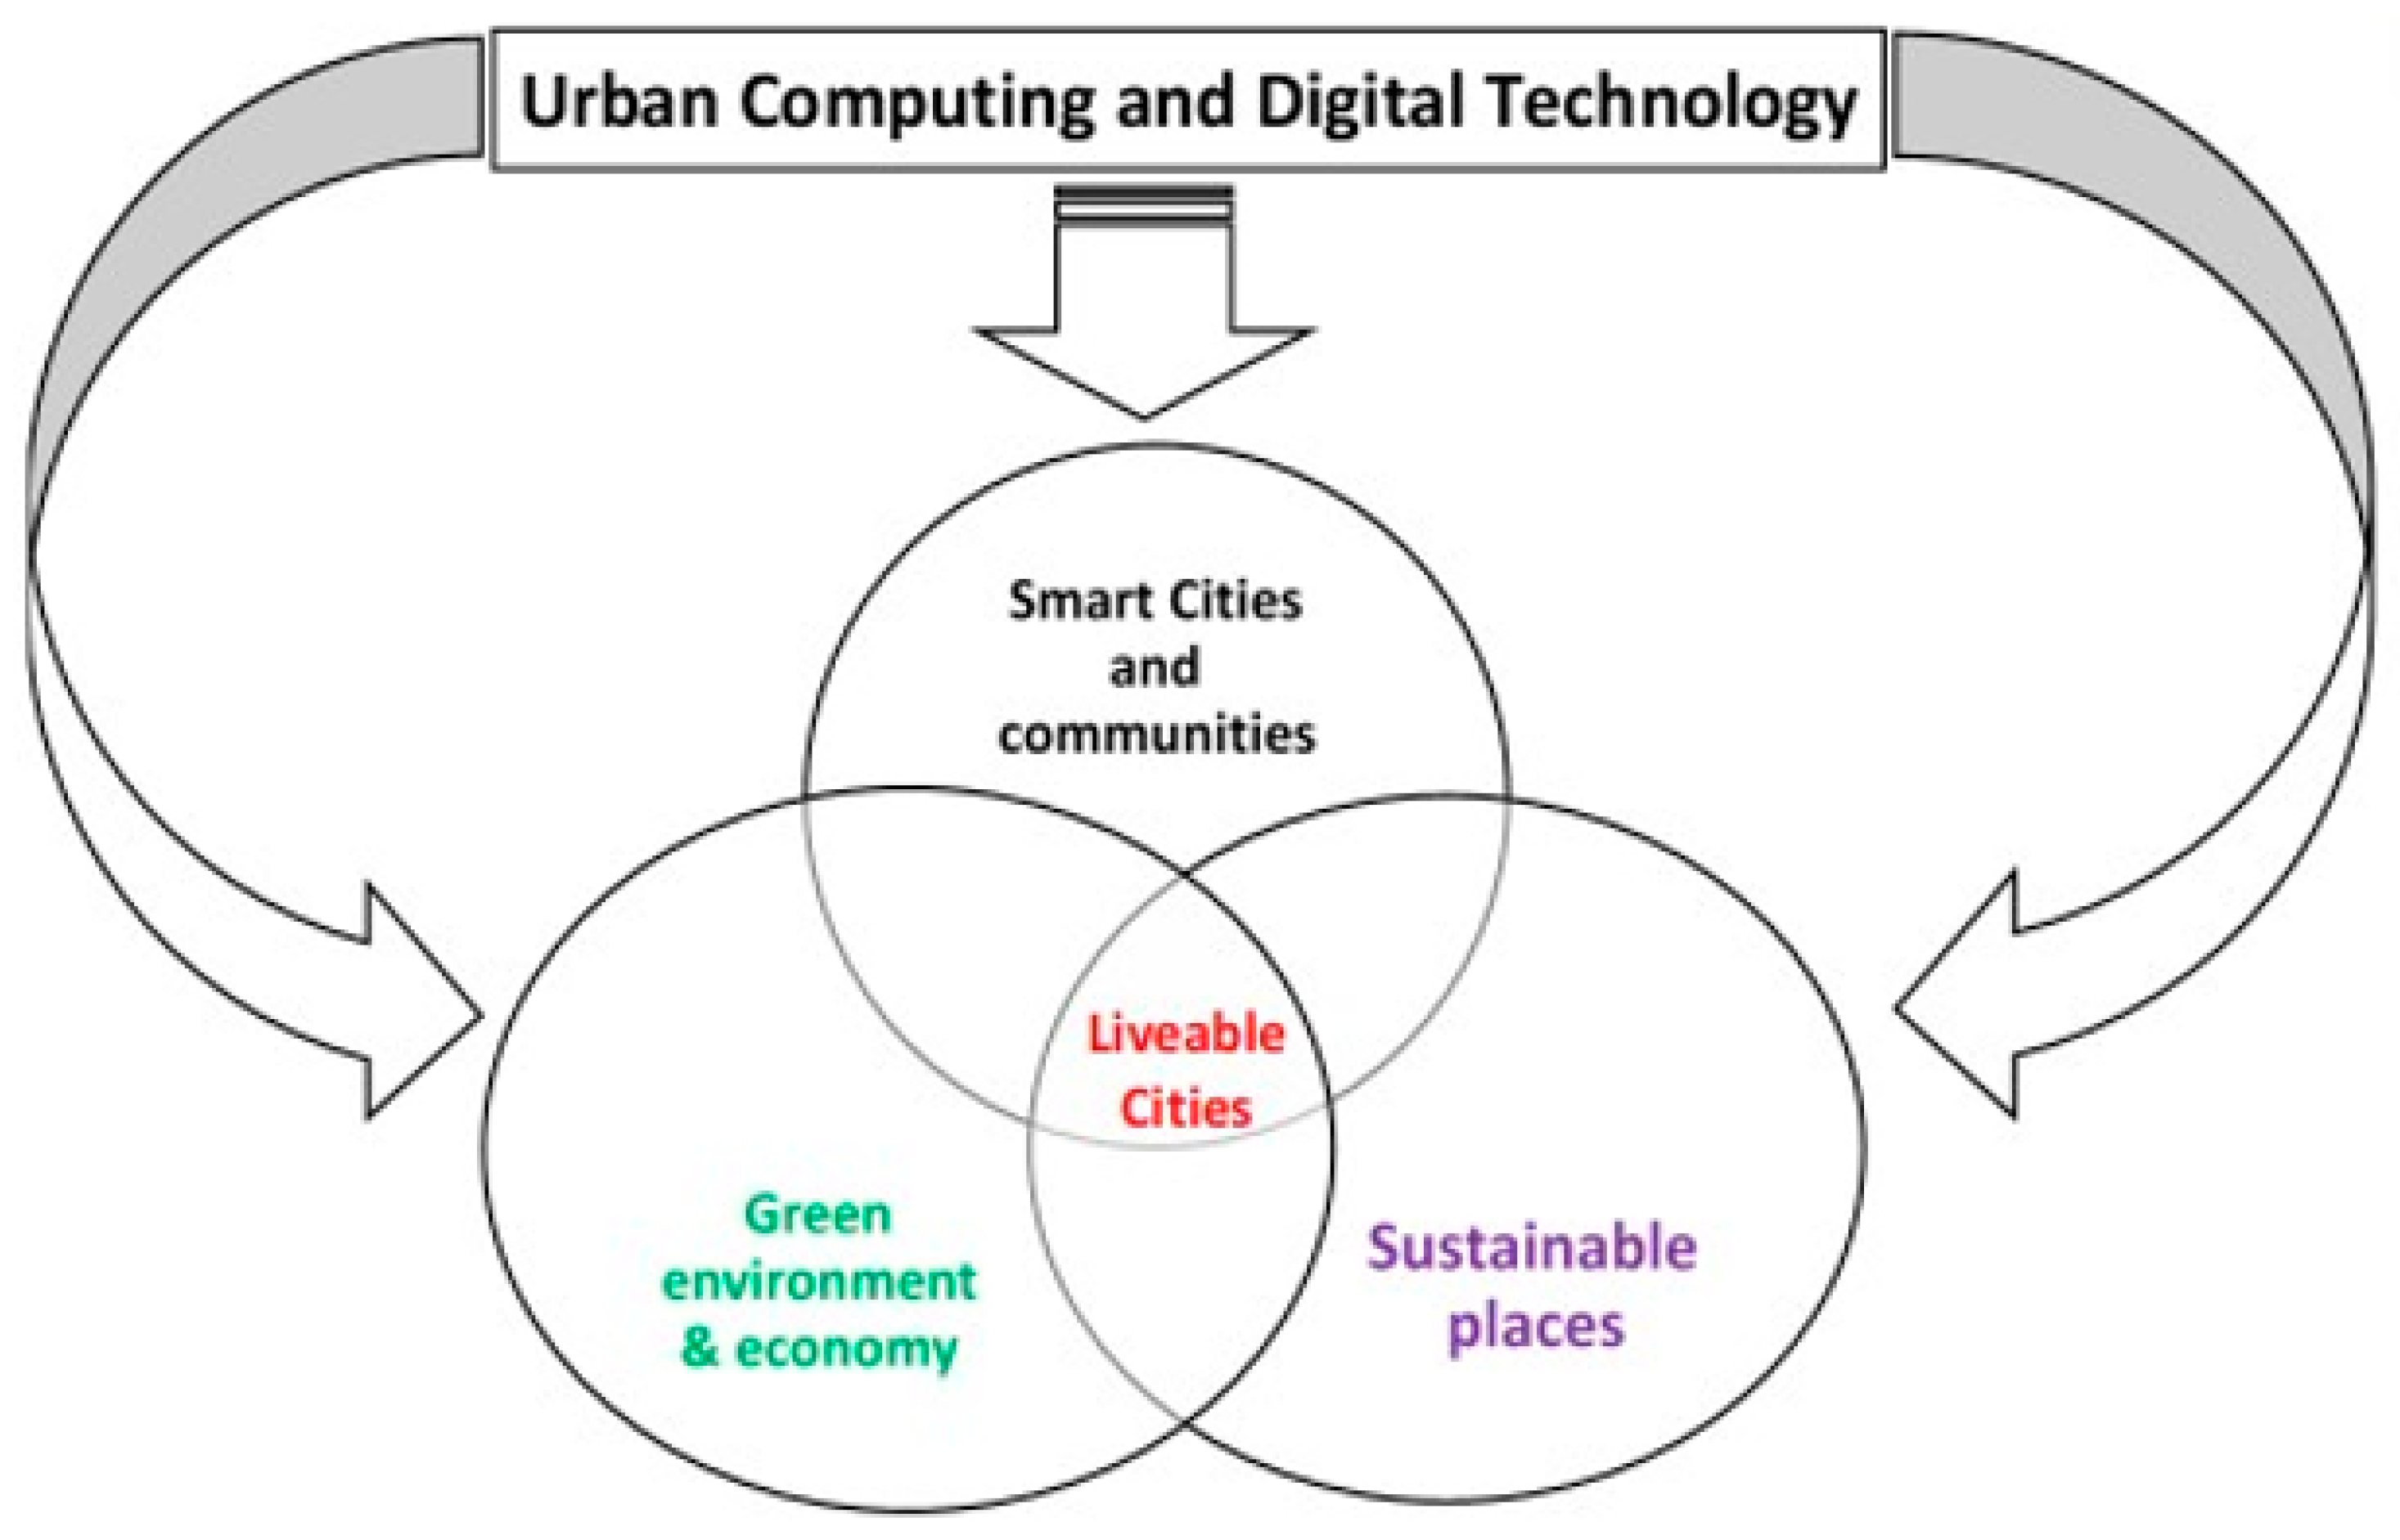
Industry Innovation & Responsible Personalisation
Immersive themed environments reinforce experiential positioning (Pine, 2011)
Wellness and lifestyle programs enhance emotional engagement
Local cultural integration strengthens authenticity
Data privacy and algorithmic bias pose ethical risks (Tussyadiah, 2020)
Sustainable personalisation aligns profitability with responsibility

Slide 10
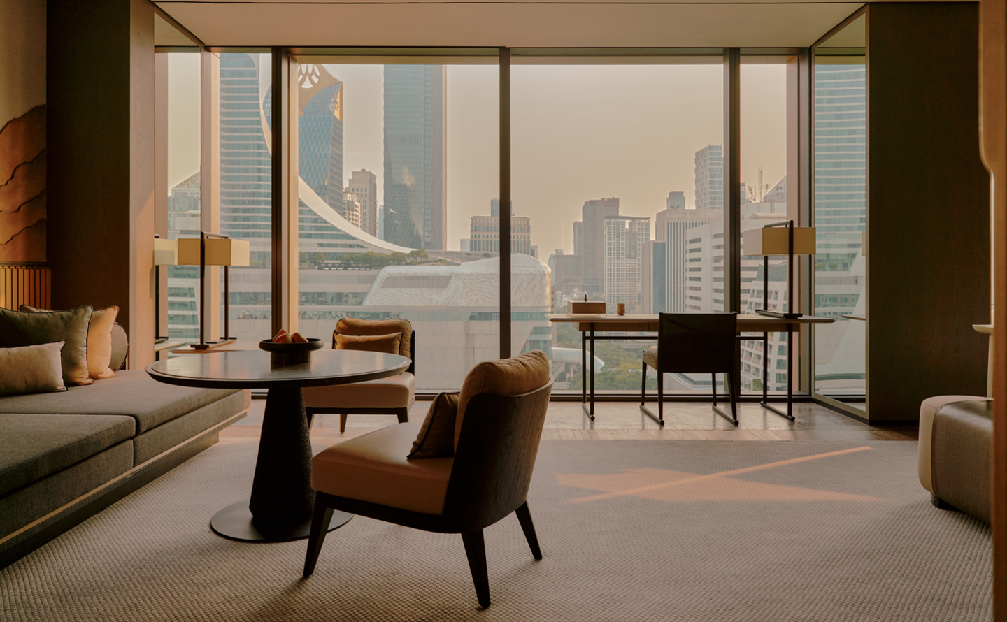
Conclusion
Experience-led personalisation is now central to long-term competitive success in hospitality.
Strategic Recommendations
• Integrate technology with human interaction
• Ensure ethical and transparent data use
• Align personalisation with sustainability goals

Slide 11
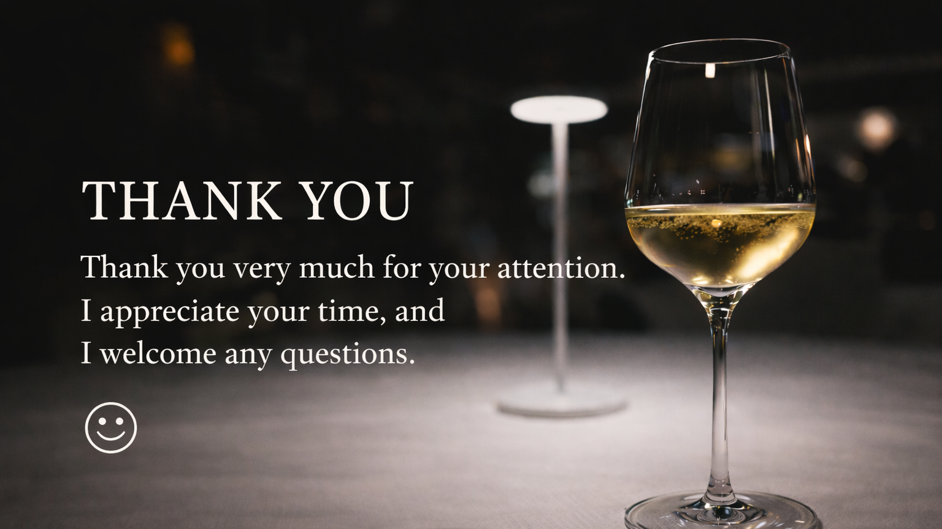

Slide 12
References (Selected)
Buhalis, D. and Sinarta, Y. (2019) ‘Real-time personalisation in hospitality’, Journal of Hospitality and Tourism Technology, 10(2), pp. 221–238.
Dixit, S. (2020) ‘Personalisation and guest satisfaction’, International Journal of Contemporary Hospitality Management, 32(7), pp. 2431–2452.
Pine, B.J. and Gilmore, J.H. (1999) The Experience Economy. Boston: Harvard Business School Press.
Pine, B.J. and Gilmore, J.H. (2011) The Experience Economy (Updated ed.). Boston: Harvard Business Review Press.
Porter, M.E. (2008) ‘The five competitive forces that shape strategy’, Harvard Business Review.
Tussyadiah, I. (2020) ‘Ethical implications of personalization in hospitality’, Journal of Hospitality and Tourism Technology, 11(1), pp. 1–15.
Vargo, S.L. and Lusch, R.F. (2008) ‘Service-dominant logic’, Journal of the Academy of Marketing Science, 36, pp. 1–10.
Zhang, T. et al. (2019) ‘Guest experience and loyalty in personalised hotel services’, International Journal of Contemporary Hospitality Management, 31(11), pp. 4425–4447.

