Slide 1
AHHI5016 Week 7
The New Urban Americans: From the White City to ‘the Shame of the Nation’
In focus: Representing the Immigrant City
Required workshop readings:
Emma Lazarus, ‘The New Colossus’ (1883).
Henry Roth, Call it Sleep (1934) prologue.
Mary Antin, The Promised Land (1912) extracts.
Anzia Yezierska, ‘America and I’ (1923).
AIMS
Elaborate discussion of Gilded Age and early-20th-century American city through analysis of literary descriptions by Jewish immigrants
Evaluate extent to which lived experience of American cities matched immigrants’ expectations prior to moving to the United States
Discuss ways in which immigrants were ‘initiated’ into American society, culture and modes of work

Slide 2
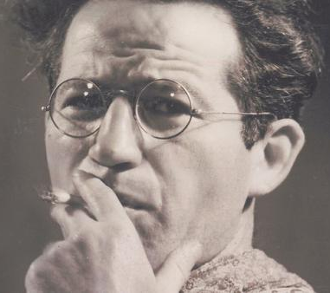
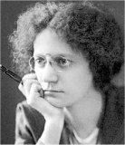
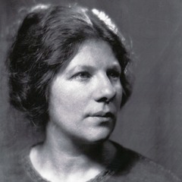
Henry Roth (1906–1995)
b. Galicia in Austria-Hungary (now in Ukraine); immigrated with his mother to United States c. 2-years-old (his father already having done so in 1907)
Grew up in Brooklyn, then Manhattan’s Lower East Side (setting for Call It Sleep, described by Roth as a “virtual Jewish mini-state”), and later Harlem
Call It Sleep a modernist classic – but only acclaimed in 1960s
Mary Antin (1881–1949)
b. Maryashe Antin in Polotzk, Russia (part of Pale Settlement today in Belarus); immigrated to United States 1894, settling in Boston
Personal friend of Emma Lazarus
Anzia Yezierska (c. 1881–1970)
b. in Russian Poland, immigrated to United States in 1890, settling in Lower East Side
In adulthood, rejected name “Hattie Mayer” given to her on Ellis Island
Short story writer, novelist, essayist, screenwriter – often semi-autobiographical

Slide 3
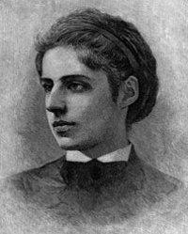
Emma Lazarus (1829–1887)
b. New York to Sephardic Jewish family, with long-established roots in North America
Poetry explored Jewish history, culture and identity – e.g. Songs of a Semite: The Dance to Death, and Other Poems (1882) responding to Russian pogroms
Proto-Zionist politics; advocate against anti-Semitism and anti-immigrant sentiments in United States

Slide 4
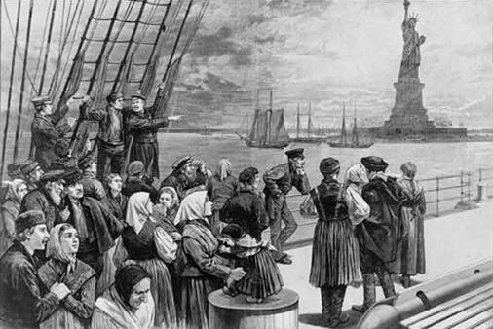
Emma Lazarus, ‘The New Colossus’ (1883)
Not like the brazen giant of Greek fame,
With conquering limbs astride from land to land;
Here at our sea-washed, sunset gates shall stand
A mighty woman with a torch, whose flame
Is the imprisoned lightning, and her name
Mother of Exiles. From her beacon-hand
Glows world-wide welcome; her mild eyes command
The air-bridged harbor that twin cities frame.
“Keep, ancient lands, your storied pomp!” cries she
With silent lips. “Give me your tired, your poor,
Your huddled masses yearning to breathe free,
The wretched refuse of your teeming shore.
Send these, the homeless, tempest-tost to me,
I lift my lamp beside the golden door!”
Written as fundraiser for Statue of Liberty (dedicated 1886) and inscribed on a plaque beneath statue (1903)
What impression does Lazarus’ poem convey about the immigrant experience in the United States, and of the attitude of Americans towards immigrants?
In what ways might ‘The New Colossus’ be interpreted as being expressive (and constitutive) of myths and ideas about US society?

Slide 5
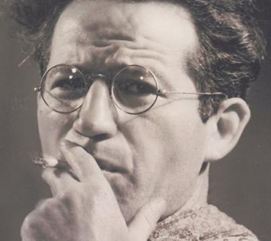
Henry Roth, Call it Sleep (1934) prologue
How does Roth describe the arrival of Jewish immigrants to New York?
  Is it a positive or negative experience?
  Does it fit the type of sentiments expressed by Lazarus in ‘The New Colossus’?
How does Roth describe the newly-arrived mother and child? How does their behaviour and appearance compare with their fellow immigrants? How does their behaviour and appearance compare with the father character, Albert? Why is Albert so annoyed at his wife when he greets her?

Slide 6
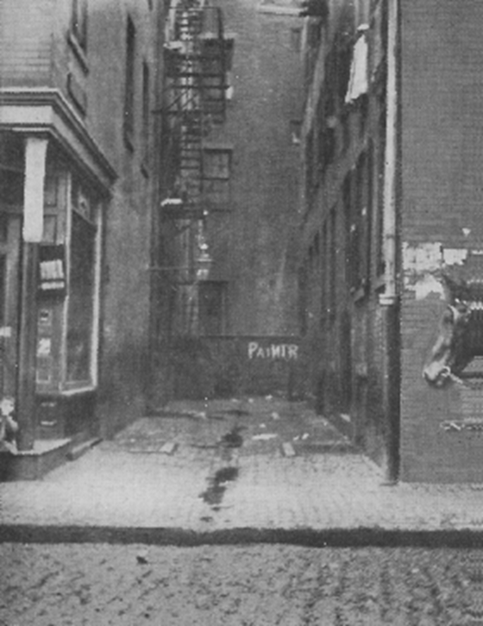
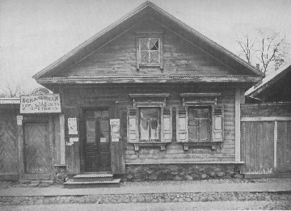
Mary Antin, The Promised Land (1912)
What contrasts does Antin draw between her life in Russia and the United States? How does the new family home compare with her old one? What differences does she identify when comparing Polotzk and Boston?
Photographs of Antin family home in Polotzk and Union Place, Boston from Promised Land

Slide 7
Mary Antin, The Promised Land (1912)
What does Antin’s “initiation into American ways” involve? What ‘ways’ does she refer to? What behavioural practices and social norms does she absorb during her ‘initiation’?
What reasons does Antin provide for her father’s desire to gain naturalisation as an American citizen? What hopes does he have for his children?
How do Antin’s experiences compare and contrast with those of her sister Frieda?

Slide 8
Anzia Yezierska, ‘America and I’ (1923)
Do Yezierska’s experiences of American society match her prior expectations before reaching the United States?
What comparisons and contrasts can be drawn between Yezierska’s account of American society and Antin’s?

Slide 9
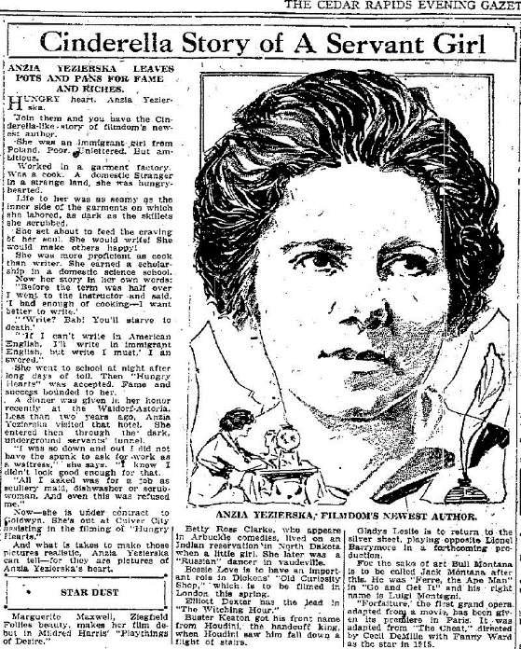
Anzia Yezierska, ‘America and I’ (1923)
How does Yezierska describe the experience of living in New York? What physical and emotional features/characteristics of urban life does she comment upon?
How does Yezierska characterise the concept and practice of ‘work’ in American society? What does she say about wage labour? What does she say about ‘efficiency’?
How does Yezierska suggest that she ultimately “found America”?
Re: efficiency see Chaplin Modern Times scene: https://www.youtube.com/watch?v=DfGs2Y5WJ14

Slide 10

ESSAY TWO QUESTION
Did immigrant literature of the 1900s–1930s endorse or challenge the sentiments espoused in Emma Lazarus’s poem ‘The New Colossus’ (1883)?

