Slide 1
Present a critically reflective PowerPoint presentation on one aspect of ALN organisation within your setting.
Speech and Language Therapy
Student Number: 1911477

Slide 2
Context
(Welsh Government, 2019).
Notes:
My setting is a primary school that currently has around 380 pupils on roll aged between three to eleven. The percentage of pupils with additional learning needs is identified at around 34% of pupils. This is higher than the national average of 22% (Welsh Government, 2019).

Slide 3
Context
Space for 12 pupils.
Aged between 3-5.
Additional learning needs:
Autism Spectrum Disorder (ASD)
Speech, Language and Communication difficulties,
Global developmental delays,
Social communication difficulties,
Social, Emotional Behavioural difficulties
Medical needs
1 teacher, 7 teaching assistants.
Notes:
My current position is class teacher and ALNCo of the Early Years Assessment Centre. Within my provision there is space for 12 pupils aged between 3 and 5 years of age. All children that attend the Early Years Assessment Centre have a statement of educational needs and have difficulty coping in mainstream settings. The Early Years Assessment Centre provides support for children with various educational needs, including diagnosis’ of Autism Spectrum Disorder, Speech, Language and Communication difficulties, global developmental delays, social communication difficulties, social emotional behavioural difficulties and medical needs. The Early Years Assessment Centre is the only one of its kind within the local authority for primary school aged children. Within the class there is 1 teacher and 7 teaching assistants and the class is supported by various outside agencies. These professionals have included Educational Psychologists, Occupational therapists, ASD advisory teachers and Speech and Language therapists.

Slide 4
Communication
“UNICEF, UNESCO and the World Health Organisation (WHO) identify effective communication skills as one of the top ten core life skills”
(National Literacy Trust, 2011 page 8).
Speech, language and communication needs are the most prevalent
Additional Learning Need in 3 - 11 year old pupils.
(Gascoigne, 2012)
Notes:
Within this presentation, I have decided to reflect on the organisation of speech and language therapy within my setting. All pupils within my setting have speech, language and communication difficulties, as outlined in their statements of special educational needs. UNICEF, UNESCO and the World Health Organisation (WHO) identify effective communication skills as one of the top ten core life skills (National Literacy Trust, 2011 page 8). However, Gascoigne (2012) found that Speech, language and communication needs are the most prevalent Additional Learning Need in 3 - 11 year old pupils.
The Welsh Government (2017) have identified speech and language as one of the priority areas essential for positive outcomes
Analysis by the Department of Education in 2010 shows that good speech and communication skills early in life have a positive correlation with outcomes in school when entering key stage 2.

Slide 5
Communication
Speech and communication difficulties can control emotional development, and therefore result in behavioural difficulties and create troubles with children making friends.
(Ripley, 2008).
Without timely intervention, these speech and language difficulties can be persistent, with widespread and compressive difficulties resulting in lower chances in the future.
(Clegg, Hollus and Rutter, 1999)
Notes:
Learners in the foundation phase with increased speech and language difficulties can struggle with accessing the curriculum.

Slide 6
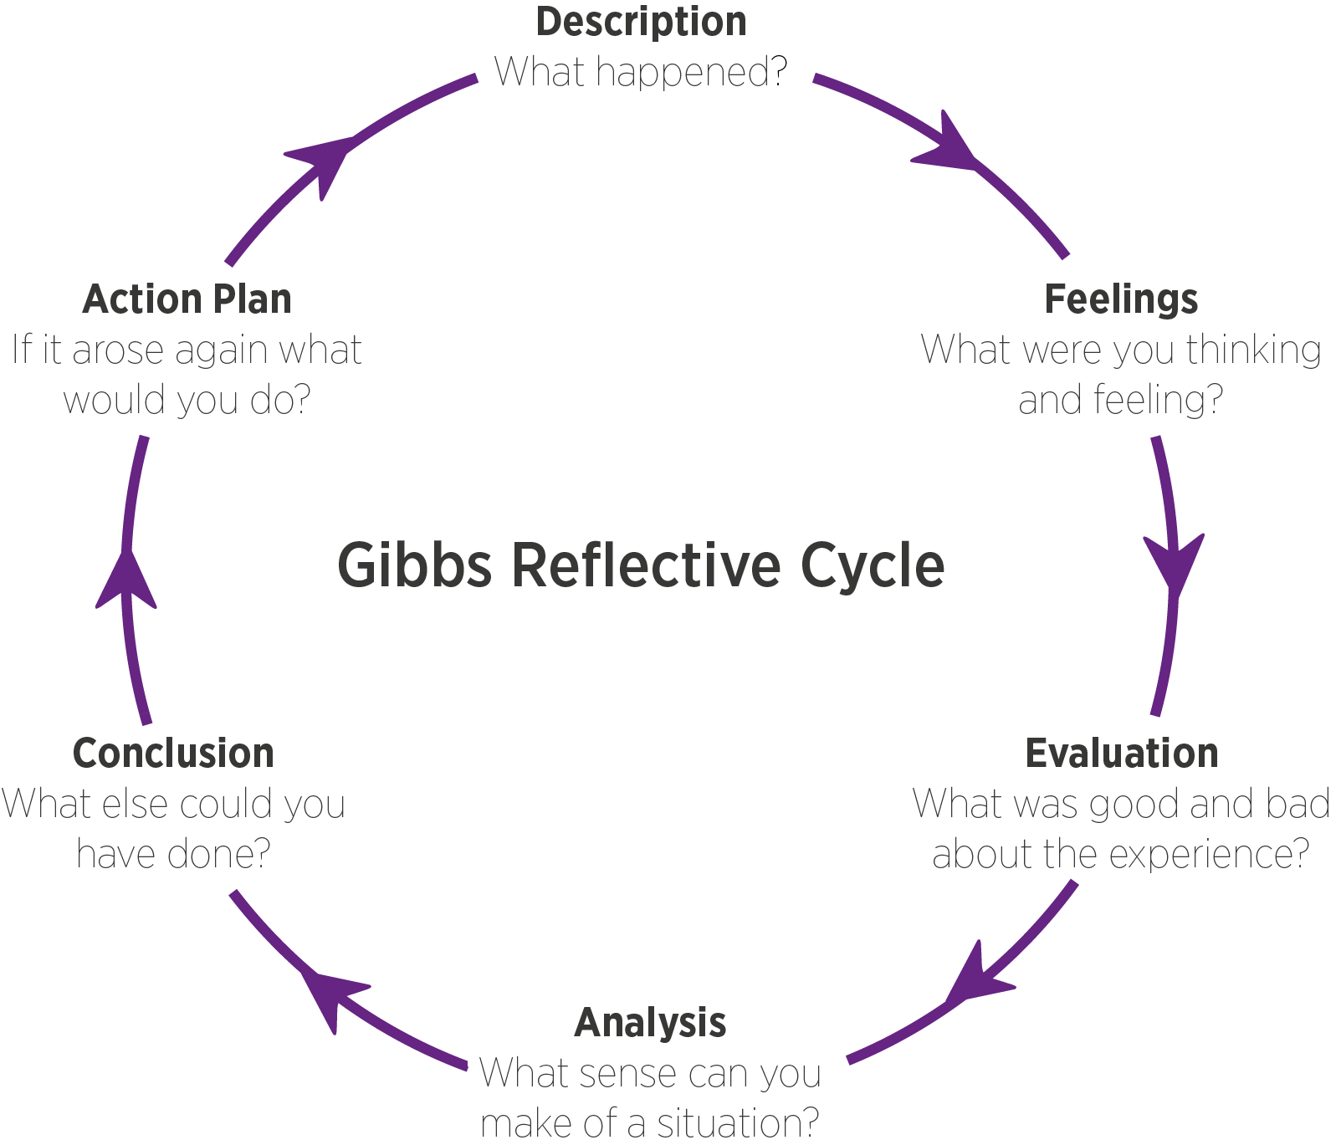
Critical Reflection
Gibbs (1988)
Notes:
To critically reflect on speech and language therapy within my setting I have decided to use Gibbs (1988) reflective cycle.
Description
Feelings
Analysis
Conclusion and Action plan

Slide 7
Working with Outside Agencies
Overcoming children’s communication difficulties requires collaboration between schools and health professionals
(Pring et al, 2012)
Successful joint working can improve children’s communication skills by encouraging a holistic approach to meet the learners needs
(Wright & Kersner, 2004)
Notes:
Research by Florian and Linklater (2010) concluded that collaboration among education professionals and speech and language therapists in school settings is vital to develop valuable provision for pupils with additional learning needs. Within my setting, we have a designated speech and language therapist from the local authority, who works with the children who have therapy outlined in their statements. It is essential that we form a close working relationship and plan hold half termly meetings to discuss any progress that the pupils have made. In these meetings, we will be able to discuss any areas of improvement and the speech and language therapist give us new tasks to be working on.
Wright (1996) emphasises the importance of time, concluding that the more time spent collaborating, the more successful the collaboration. Although we have a successful working relationship, critically it could be improved by an increase of time. Due to the number of children with speech and language difficulties in my setting, it is clear to me that there is not enough time available to discuss, plan, feedback and develop new skills. Although time is limited, in my opinion, the more experience I gain around speech and language the quicker and more effective our meetings will become.

Slide 8
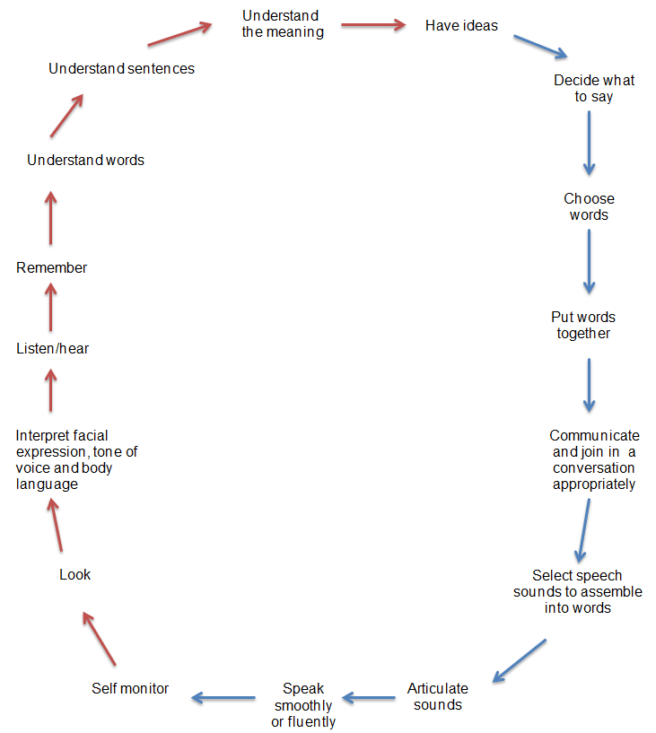
(McLachlan and Elks, 2012)
Notes:
The local authority speech therapist is unable to work with all the pupils within my class. All the learners within my class have speech and language difficulties however not all of them have speech and language therapy identified on their statements. The Communication Chain (McLachlan and Elks, 2012) could help me to understand the process of the development of language and could provide an insight into the language stages of the children within my class. The Communication Chain could also be a useful tool to use to help us to identify the relevant area of language development. This would then allow us to target strategies and interventions based upon the identified area of need. The Communication Trust (2017) have also created a checklist to identify and target different areas of speech and language. I could use this within my setting, alongside the Communication Chain, to ensure all areas of speech and language are being covered. The Communication Trust (2017) also provides a wide range of tools and resources to be used in collaboration with the checklist to support professionals in supporting pupils with speech and language difficulties, which would be fundamental to me to provide support for the pupils that do not have access to a speech therapist.

Slide 9
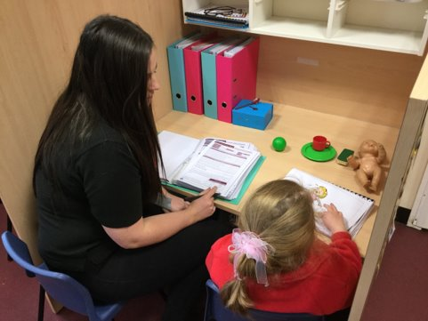
Wellcomm Speech and Language Toolkit
Notes:
When I started in my role in 2018, there was no screening tools used to support children with additional learning needs with their speech and language. I was advised, to visit a nursery to observe good practice. From this visit, I was able to attend training implement a speech and language program. Pupils within my class are now screened termly using the Wellcomm Speech and Language Toolkit. This early identification programme was introduced in Flying Start settings with the view of improving language skills in socially deprived areas (NHS Wales, 2015). The program specifically recognises the areas in need of improving based on language development in relation to the child’s chronological age. Although, this intervention is implemented for mainly nursery children which is below some of the pupils within my class chronological age, I felt, due to the pupil’s levels of development generally being below their ages, that Wellcomm would be a beneficial tool to use in my setting. We can use the screening tool to identify the lower scoring areas and use activities taken from the resource to develop these areas.

Slide 10
Staff Training
All learners need to experience rich language environments
(Draft Curriculum for Wales, 2019)
Using adults with an increased training can help to create higher qualities of provisions and therefore can promote better outcomes for the learners.
(The Communication Trust)
Notes:
Vygotsky’s (1978) findings stress the fundamental role of social interaction and that language development is heavily influenced on social exchanges. That for a child to develop the skills required to express language effectively, they must receive guidance from adults. Within my setting, we aim to provide an immersive language environment as set out in the Draft Curriculum for Wales (2019). Targeted speech and language therapy is undertaken by members of staff who have received explicit training regarding speech and language. As I have received no additional training regarding speech and language therapy, when organising this within my setting, I felt that the staff that had received the training would be best suited to undertake the activities.

Slide 11
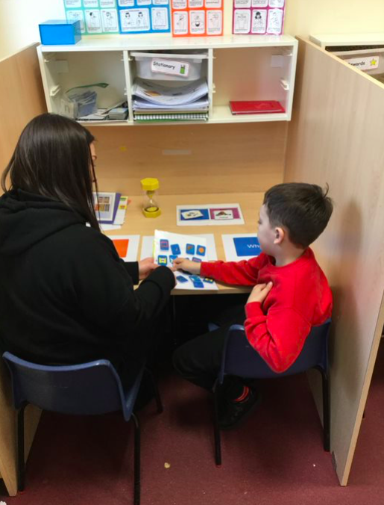
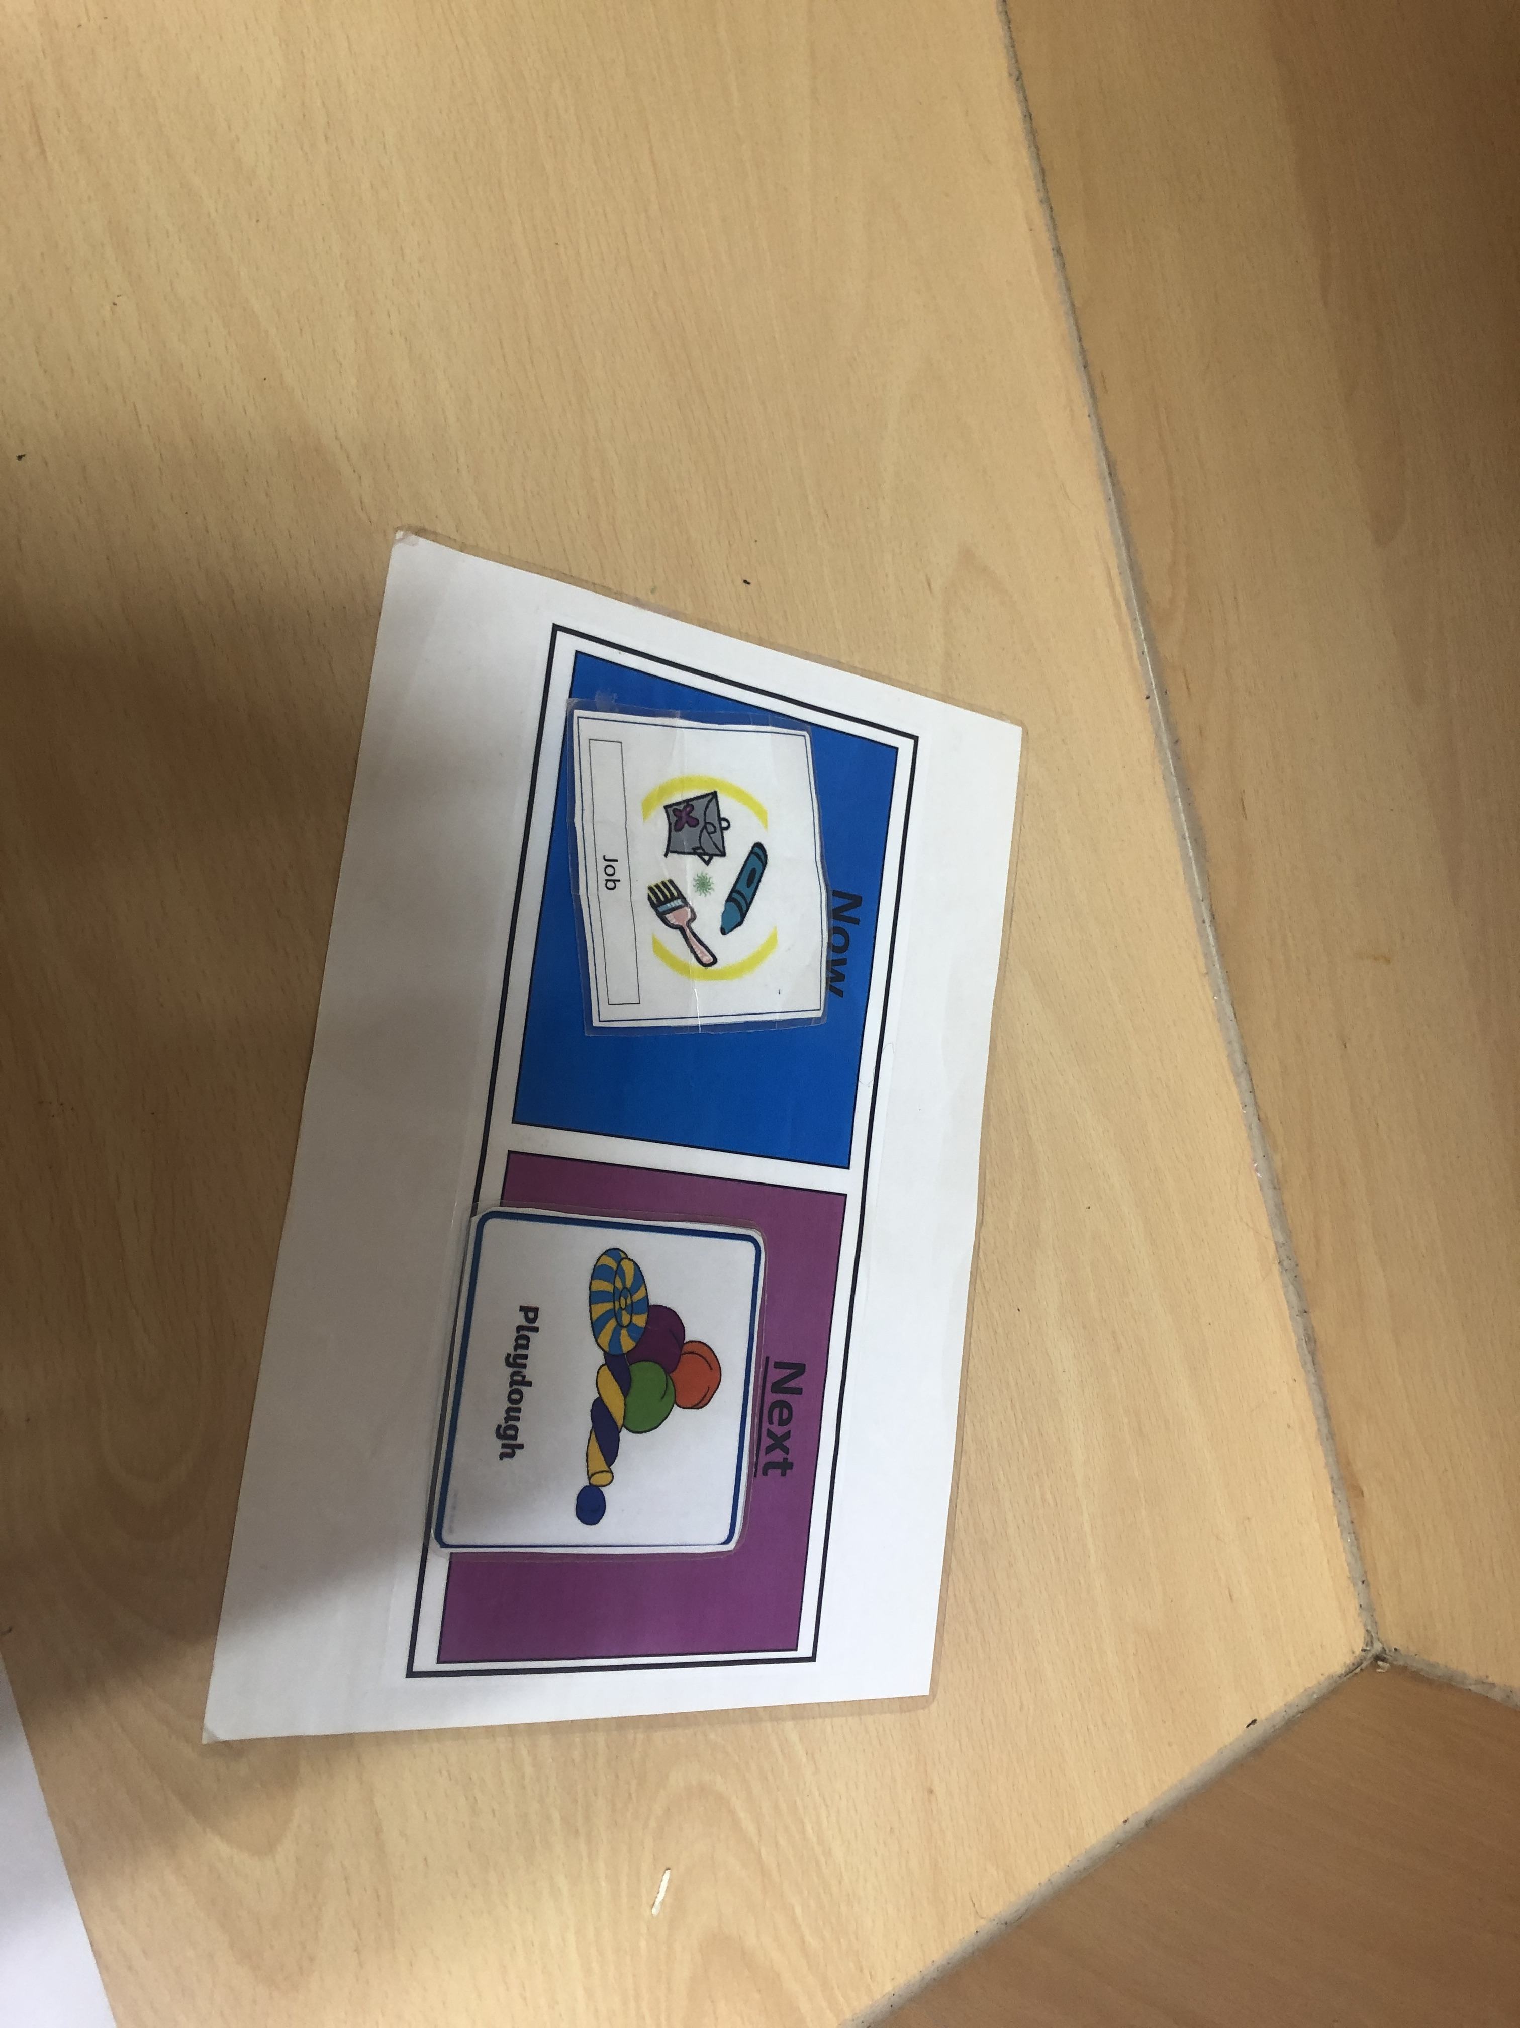
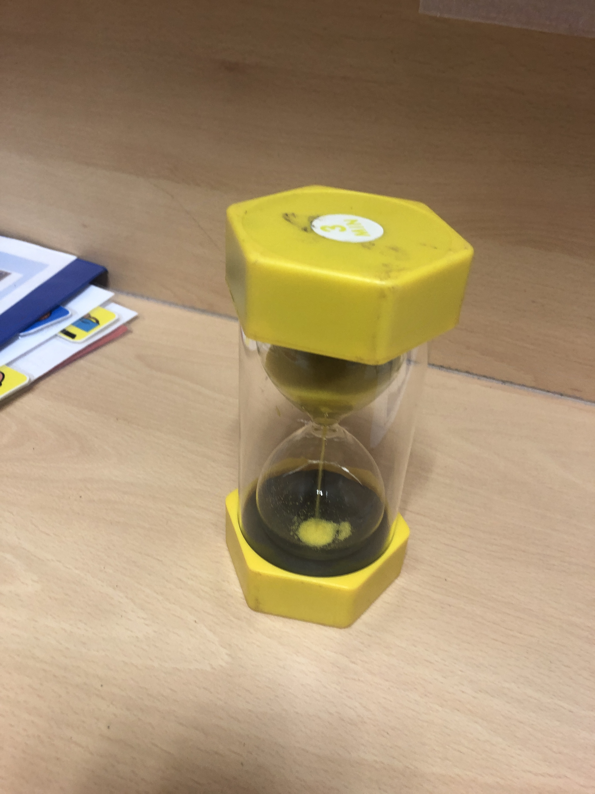
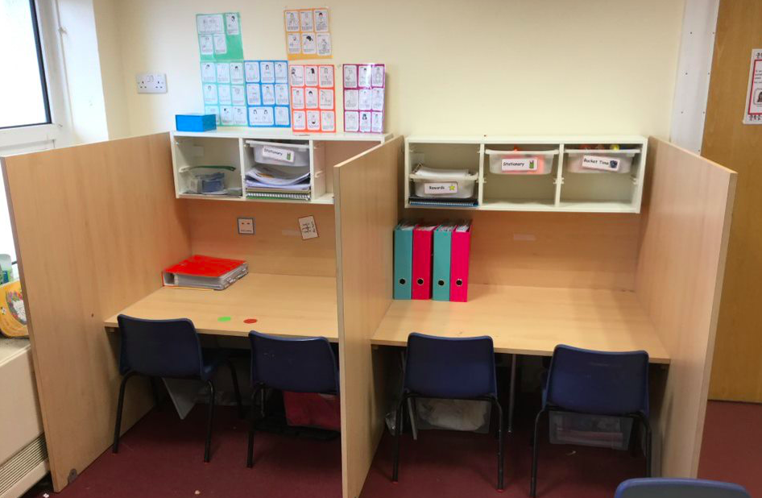
Classroom Set up
Notes:
Within my class, explicit 1:1 speech and language therapy is undertaken in one out of our two individual work stations. Speech and language therapy is always completed in the same work station for consistency. The work station is set up with visual aids, now and next boards and timers to support the learners. The Communication Trust has created a checklist of key features that should be present in a communication friendly environment who emphasise that these should be present;
An area suited for communication, minimal distractions, using visuals and timetables to support, clear and consistent routines and supportive adults.

Slide 12
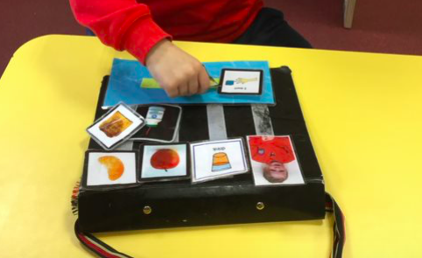
Picture Exchange Communication System
PECS are an effective tool in helping children with additional needs use pictures to communicate.
Flippin et al (2010)
Notes:
One way, as identified in a recent review undertaken by the local authority, my setting is successful in supporting whole class speech and language is through the Picture Exchange Communication System or PECS and visual aids. The learners have an individual PECS book which they use to communicate. We use PECS throughout the class to encourage the pupils to communicate with us and one another.
I have witnessed the success of PECs and visual aids in allowing pupils, who previously could not communicate, get their needs met. It is clear to me how important PECS and visual aids are for speech and language in my setting. Although, we are successful at implementing and organising PECS, I could develop my use of other communication techniques to support all pupils.

Slide 13
Research has emphasised that a correlation exists between high levels of childhood sign and increased vocabulary in later child development.
(Rowe, 2006)
Signs language gives preverbal learners opportunity to communicate in a simple form and can decrease frustrations quickly.
(Acredolo and Goodwyn, 2001).
Notes:
Evidence from a study by Moran (2012) found that the use of PECS to help children develop vocal speech is not as strong. As of a result of this, to increase communication and develop speech within my setting, it would be beneficial for me to improve my knowledge of other tools to support speech and language.
Consequently, as we have been identified as successfully using PECS, I feel it would be beneficial to the pupils in my setting, to develop my use of sign language and gestures to support.

Slide 14
Supporting Parents
Partnerships between parents and schools can have a substantial positive affect on pupils attainment.
Desforges and Abouchaar (2003)
“Parents need to be provided with support and guidance on how they can help their child to reach their full potential.”
(Welsh Government, 2018, page 35)
Notes:
Finally, I would like to reflect on the relationship with parents. Currently, we do not offer any additional support for parents of pupils within my class in relation to their speech and language therapy. Mainly, communication with parents is done through the speech and language therapist. When speaking to parents, I feel that speech and language is a priority to them. Many parents have requested additional resources to support their child in speech and language.
A study by Roberts and Kaiser (2011) found positive outcomes for children’s language development when parents had learnt how to support.
Moving forward, it would be beneficial to organise coffee mornings to collaborate with parents and speech and language therapists. This would create strong home-school links which as research suggest are essential for pupil progress. With the development of the new ALN code in Wales, relationships with parents are a high priority within my setting. Based on previous research the impact that this would have on the pupils could positively affect pupil progress.

Slide 15
References
Acredolo, L., and Goodwyn, S. (1985). ‘Symbolic gesturing in language development’ Human Development, 28, pp. 40-45.
Clegg, J., Hollis, C. and Rutter, M. (1999) Life Sentence: What Happens to Children with Developmental Language Disorders in Later Life? Royal College of Speech and Language Therapists November Bulletin
Desforges, C. and A. Abouchaar. (2003) The Impact of Parental Involvement, Parental Support and Family Education on Pupil Achievement and Adjustment: A Literature Review. Department of Education and Skills.
Flippin, M., Reszka, S., & Watson, L. R. (2010). Effectiveness of the picture exchange communication system (PECS) on communication and speech for children with autism spectrum disorders: A meta-analysis. American Journal of Speech-Language Pathology, 19, 178-195.
Florian, L, Linklater, H (2010) Preparing teachers for inclusive education: Using inclusive pedagogy to enhance teaching and learning for all. Cambridge Journal of Education 40: 369–86.
Gascoigne, M.T. (2012) Better communication – shaping speech, language and communication services for children and young people. London: RCSLT.
Gibbs, G. (1988) Learning by Doing: A guide to teaching and learning methods. Further Education Unit. Oxford Polytechnic: Oxford.
McLachlan, H, and Elks, L. (2012) Language Builders. ELKLAN
Moran, K. (2012). Research review: The effectiveness of the picture exchange communication system (PECS) on communication and speech for children with autism spectrum disorders: A meta-analysis. Science in Autism Treatment, 9(2), 23.
NHS Wales (2015) Story Board Entry Form 2015. Available from: http://www.nhswalesawards.wales.nhs.uk/opendoc/275784 (Accessed 19 January 2020)
Pring, T., Flood, E., Dodd, B., and Joffe, V. (2012). The working practices and clinical experiences of paediatric speech and language therapists: a national UK survey. International Journal of. Language Communication. Disorders. 47, 696–708.
Ripley, K. (2008) Outcomes of early intervention for pre-school children with behaviour problems and SLI: Can we really make a difference? Presentation to NAPLIC conference.
Notes:
In conclusion, when critically reflecting on speech and language therapy within my setting I was able to identify many strengths that could be supported by literature. Using Gibbs Reflective Cycle I was also able to identify area’s for development. With strong relationships with outside agencies, increased training for staff, reflecting on my classroom set up and creating strong partnerships with parents, I will hopefully create an environment where speech and language is done successfully, leading to increased pupil outcomes.

Slide 16
References
Roberts, M. Y. and Kaiser, A. P. (2011) 'The effectiveness of parent -implemented language interventions: A meta-analysis.' American Journal of Speech-Language Pathology, 20(3) pp. 180-199.
Rowe, M.L., Özçalıskan, S., and Goldin-Meadow, S. (2006). ‘The added value of gesture in predicting vocabulary growth’ in Bamman, D., Magnitskaia, T., and Zaller, C., (eds.) Proceedings of the 30th Annual Boston University Conference on Language Development pp. 501–512.
The Communication Trust. (2017) https://www.thecommunicationtrust.org.uk/media/7415/universally_speaking_5-11_checklist_final.pdf Accessed 11 January 2020)
The National Literacy Trust (2011) Investigating communication, language and literacy development in the early year’s sector. London: National Literacy Trust.
Vygotsky, L. S. (1978). Mind in society: The development of higher psychological processes. Cambridge, MA: Harvard University Press.
Welsh Government (2017) Flying Start – Annex. Guidance on Speech Language and Communication. Available from: https://gov.wales/sites/default/files/publications/2019-07/flying-start-speech-language-and-communication-guidance.pdf (Accessed 18 January 2020)
Welsh Government (2019) Draft Curriculum for Wales 2022. Available at: https://hwb.gov.wales/storage/4373f5ea-f77e-4b10-a20f-4b06eb02f6a0/draft-statutory-guidance-languages-literacy-and-communication.pdf (Accessed 18 January 2020)
Welsh Government (2019) Schools’ Census Results: as at January 2019. Available from: https://gov.wales/sites/default/files/statistics-and-research/2019-07/school-census-results-2019-764.pdf (Accessed 18 January 2020)
Welsh Government. (2018) Draft Additional Learning Needs Code for Wales. Available at: https://gov.wales/sites/default/files/consultations/2018-12/draft-additional-learning-needs-code-for-wales_0.pdf (Accessed 11 December 2019)
Wright, J. A. & Kersner, M. (2004) Short term projects: the standards fund and collaboration between speech and language therapists and teachers. Support for Learning, 19 (1) pp.19-23
Wright, J.A. (1996) Teachers and therapists: the evolution of a partnership. Child Language Teaching and Therapy 12: 3–14.
Wright, J.A., Kersner, M. (1999) Teachers and speech and language therapists working with children with physical disabilities: Implications for inclusive education. British Journal of Special Education 26: 201–05.

