Slide 1
What is Facilitation?
Jon Haylock 2021

Slide 2
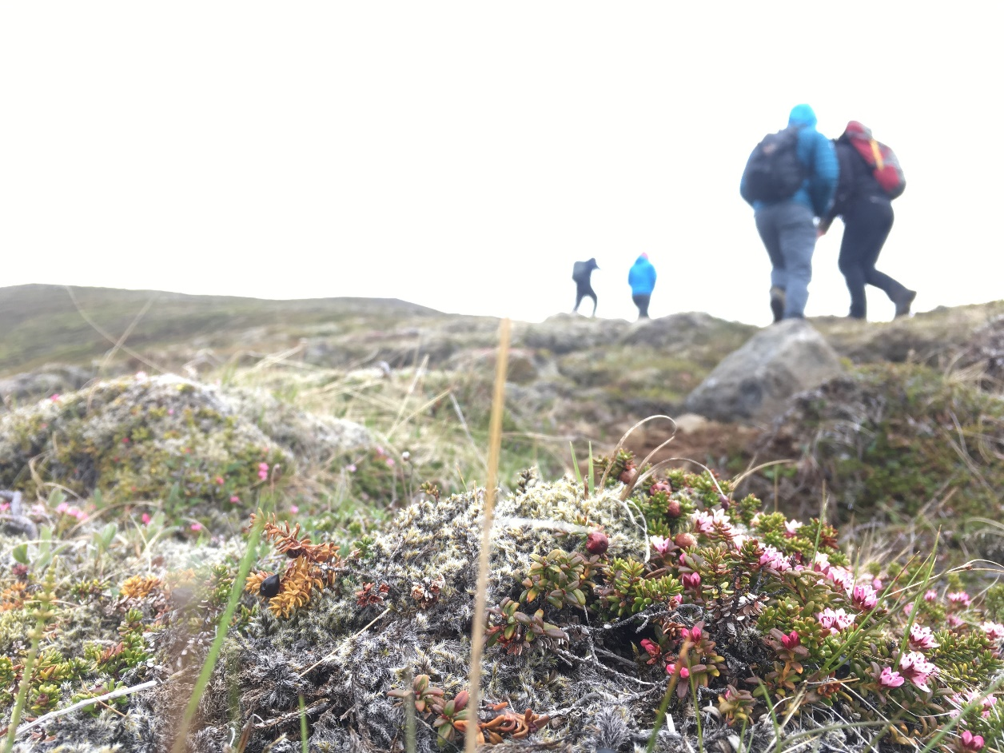
What is Facilitation?

Slide 3
Facilitation defined…
To facilitate, is to assist a process or person to make progress.
“facilitate” emanates from the French/Latin "facile" meaning "easy". Literally the process of facilitation is to make something easier.

Slide 4
Where is it used?
The phrase ‘Facilitation’ is often employed in adult education, community education, youth work and informal education to emphasise the key contrast with the: ‘emotionally congenial aspect of their practice with what they regard as the rigid and conformist nature of schooling’ (Brookfield 1986: 123).

Slide 5
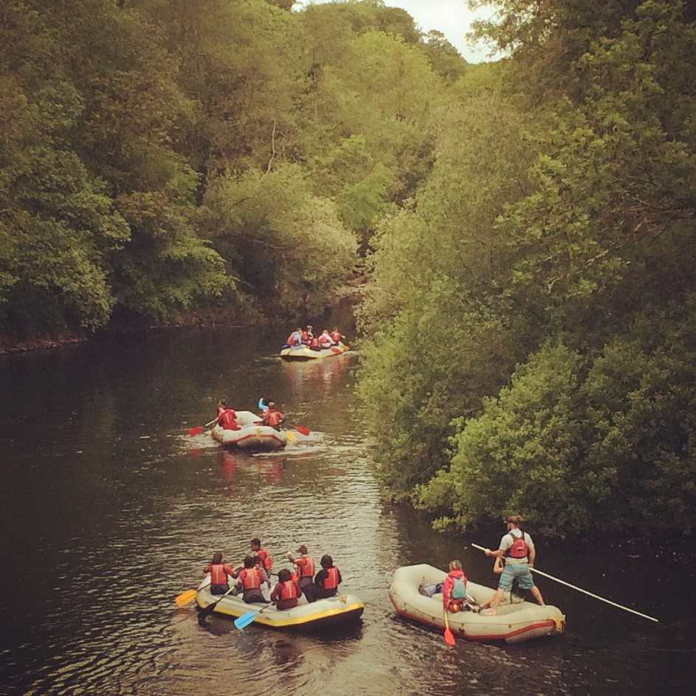
What jobs/roles may a Facilitator take?

Slide 6
Facilitator Roles
Coach
Instructor
Leader
Mentor
Teacher
Manager
Lecturer
Support worker
Advocate
Therapist

Slide 7
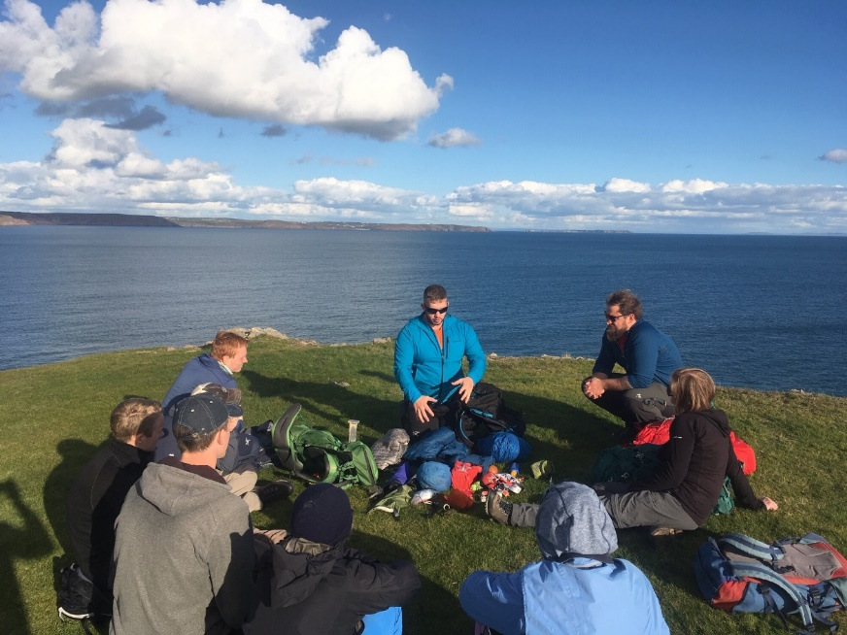
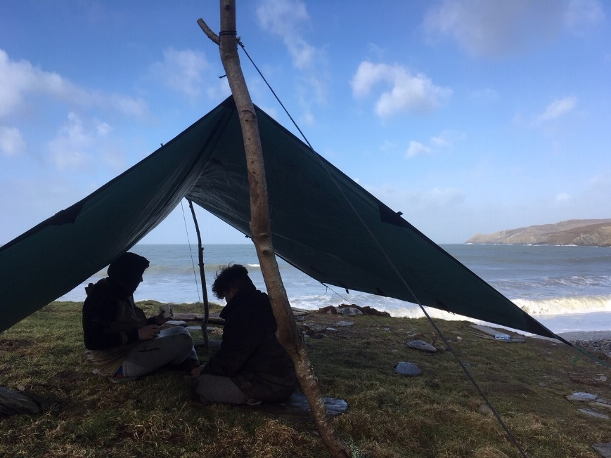
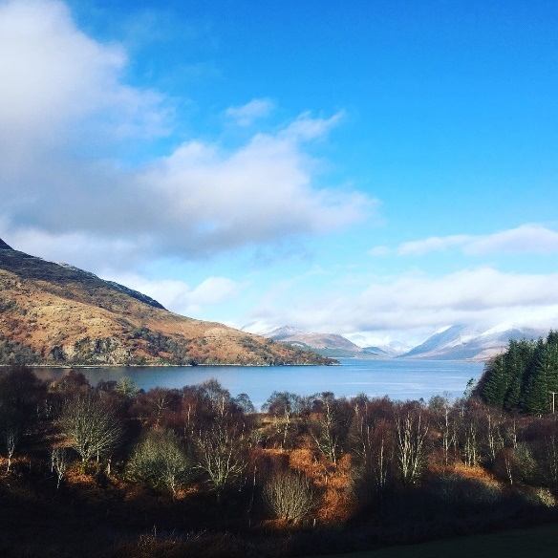
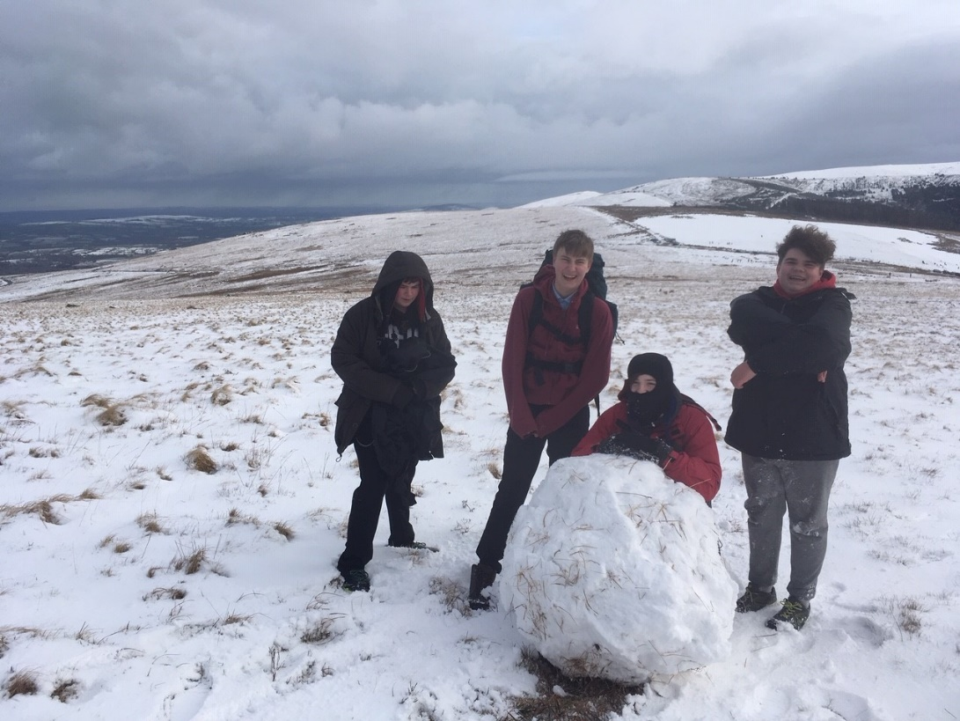
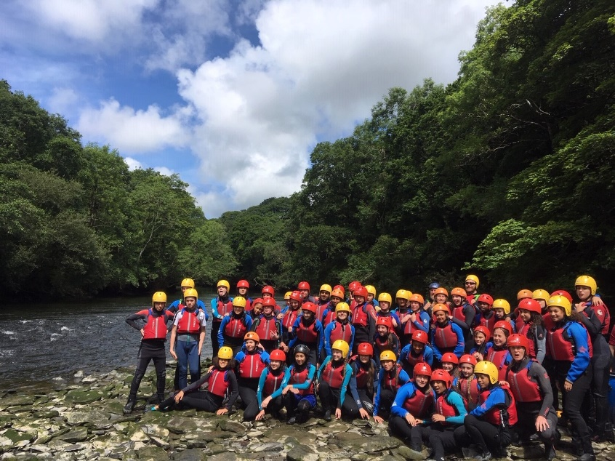
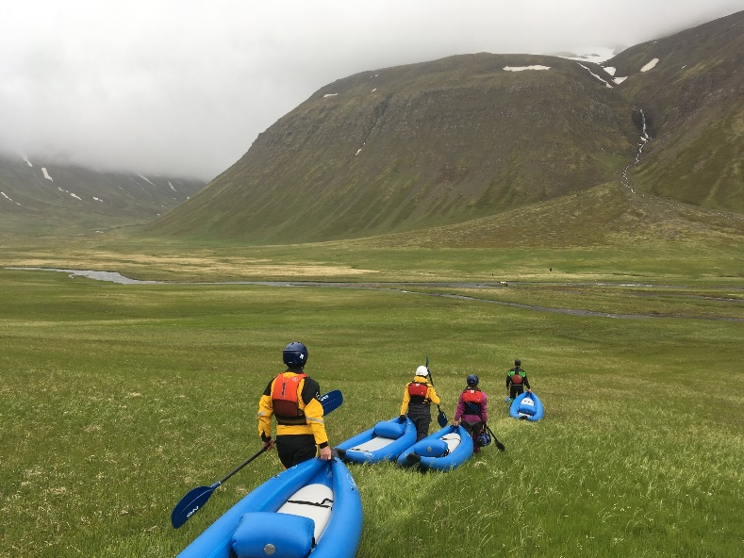
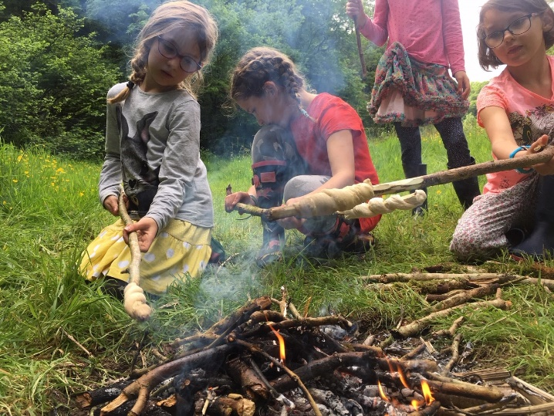

Slide 8
Facilitator Vs Instructor
Facilitating does not mean "solving a problem" or "doing it for someone". It means doing something that makes a process run a little better.
In general, the process of facilitation usually include participants analysing and better understanding their thoughts, feelings, and behaviours.

Slide 9
Why facilitation?
Learning tends to emphasise the individual
Teaching tends to emphasise the curriculum and outcomes

Slide 10
Why facilitation?
Recent developments within “mainstream education” focus on learning rather than teaching, the use of the term ‘facilitation’ has become more common place.

Slide 11
A facilitator provides opportunities, guidance or resources to assist participants towards achieving an outcome.

Slide 12
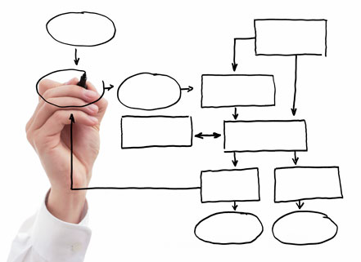
Create the process

Slide 13
In outdoor education we tend to look at facilitation as a means of helping people through the process of experiential learning
(Kolb, 1984)
This will mean different things to different people at different times and in different situations.

Slide 14
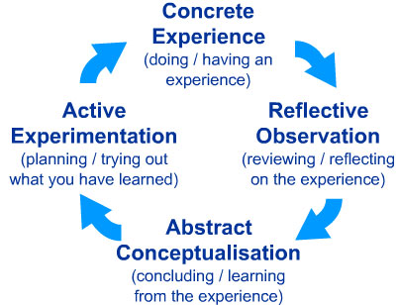

Kolb,1984

Slide 15
PLAN
REVIEW
DO

Slide 16
Create the processes…
The key skill for the facilitator is knowing how much to get involved in the processes and when.

Slide 17
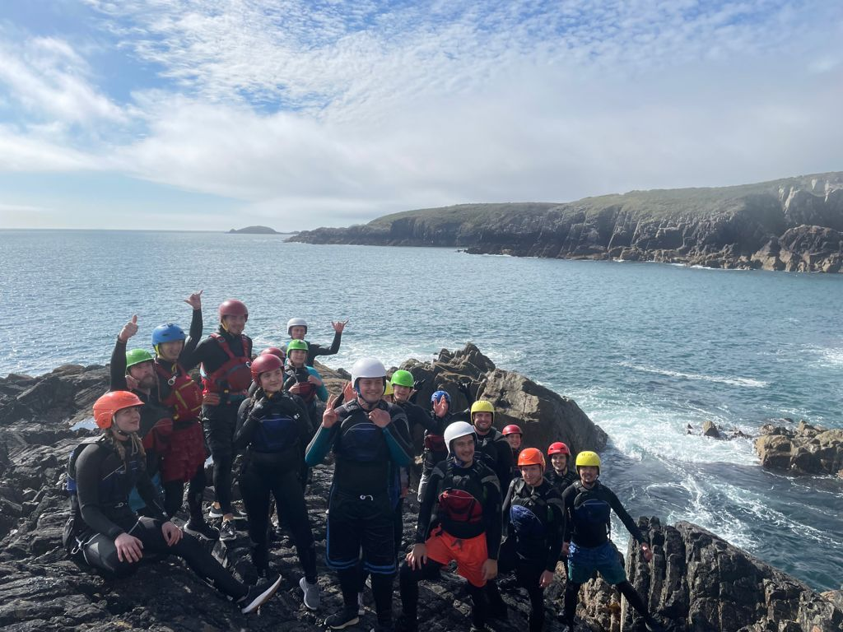
Four Stages of Group Development
Tuckman, B. (1965)

Slide 18
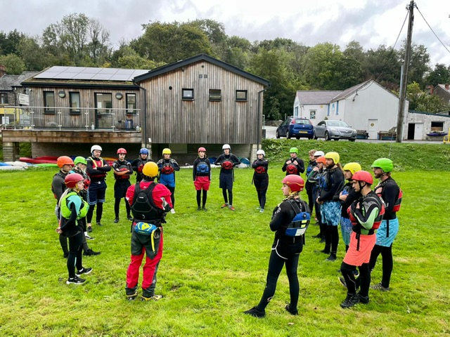
FORMING
1st Stage
The group meets, interaction begins, they start to work out what is expected of them and what the task will be. Excitement and enthusiasm might be mixed with fear and anxiety.

Slide 19
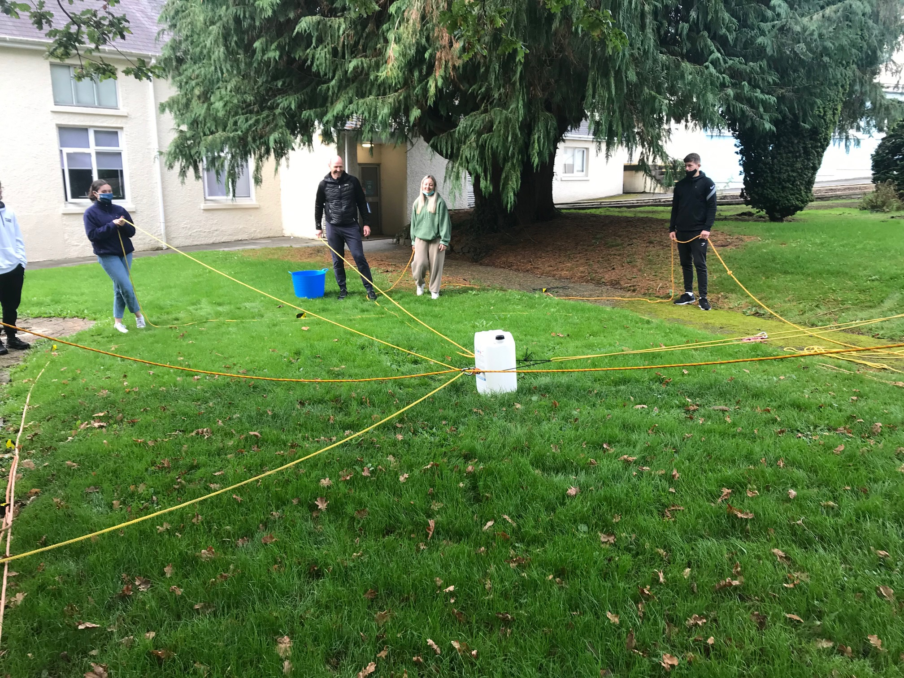
STORMING
2nd
Stage
The level of challenge is increased, possible conflicts may come to light, personal agendas may surface and the group may challenge authority.

Slide 20
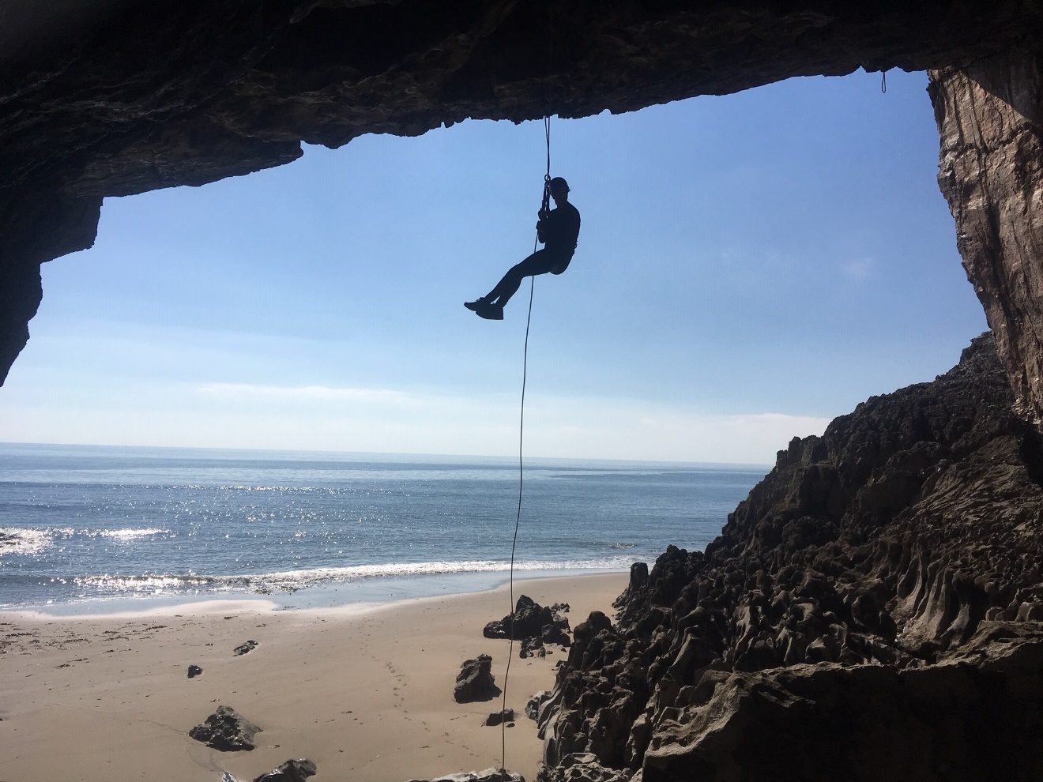
NORMING
3rd
Stage
The group finds ways of resolving conflict, and begin to emerge as a cohesive unit. Feedback and criticisms are often taken more constructively and team members generally start to work more co-operatively.

Slide 21
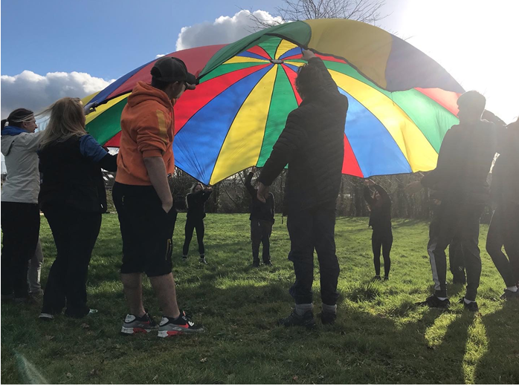
PERFORMING
4th
Stage
Trust is formed. Confidence grows both individually and as a group. Sight becomes set upon a common goal and all pull together to achieve it.

Slide 22
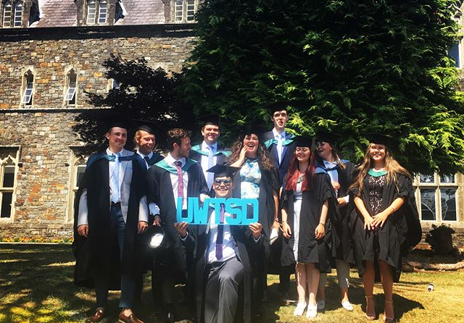
Adjourning Tuckman & Jensen (1977)
5th
Stage
The task is complete and often the group will go its separate ways at this point. They will share their sense of relief or loss depending on the successful completion of the task.

Slide 23
Core Principles…
EMPATHY
Stop – Look - Listen
VALUEING
Acknowledge contributions – focus on individual input
GENUINENESS
Share own experience of being with the group

Slide 24
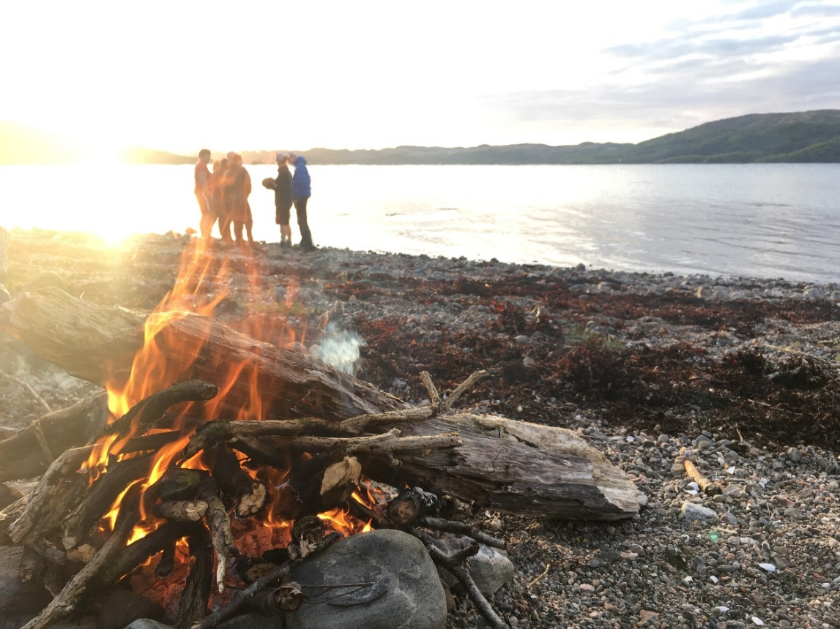
Heron’s Modes of Facilitation
Heron, J (1994) The Facilitators’ Handbook

Slide 25

Heron, J (1994) The Facilitators’ Handbook

Slide 26
Co-operative
Autonomous
Hierarchical
Processes continued ….

Slide 27
Hierarchical
Facilitator alone, acts or decides for the group.
Planning, challenge, structure, learning processes,
group emotions all sit with the facilitator.
Facilitator leads from the front taking full responsibility
for the learning environment

Slide 28
Co-operative
The facilitator and group act or decide together.
The facilitator where necessary will prompt and help the group
decide on a course of action.
Collaboration between group and facilitator is key to
success in this mode.

Slide 29
Autonomous
The group act or decides without any intervention from the facilitator.
The facilitator steps back and allows the group to evolve their own programme.
Self directed practice is encouraged and requires a subtle balance of conditions within which the group can operate in this mode.

Slide 30

Lets go try it out…

Slide 31

Discussion Points…..
Did the modes of facilitation change?
What did the facilitator do to influence the learning environment?
How did the learning process facilitate learners of different abilities?
Did the facilitated process effectively achieve the outcome?

Slide 32
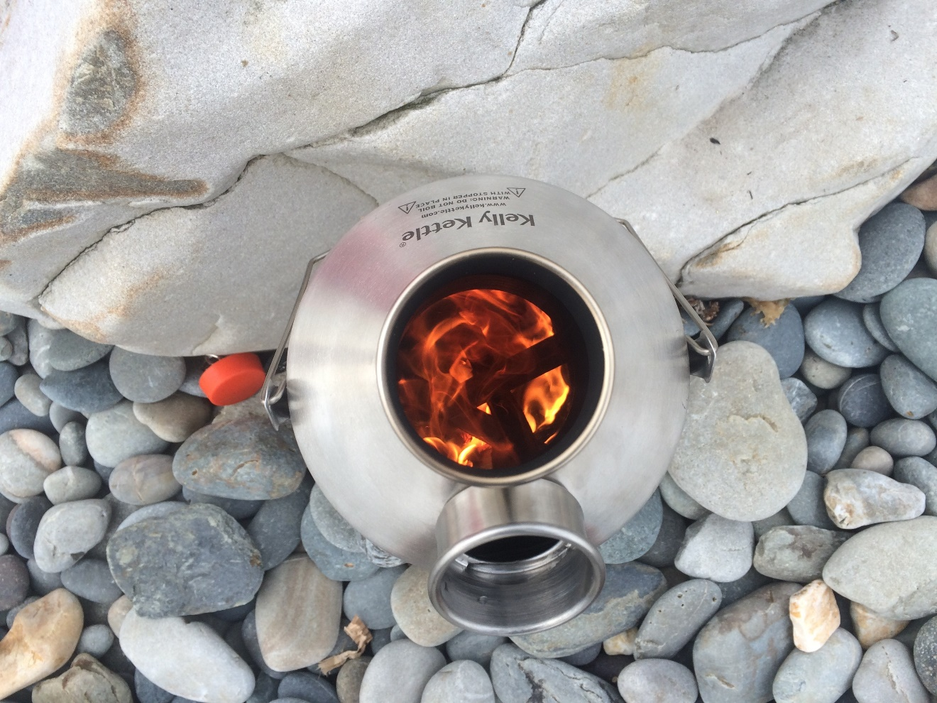
TEA BREAK
Personal Reflection

Slide 33
Personal Reflection
Reflect upon a formative facilitated process you have experienced the consider the following…..
What made it such a formative experience?
Now with an enhanced knowledge of facilitated processes can you see the deliberate actions made by the facilitator?
Can you identify different modes of facilitation and the key moments they were used?

Slide 34
References
Brookfield, S., D. (1986) Understanding and Facilitating Adult Learning. Milton Keynes: Open University Press.
Brown, M. (2002). The facilitator as gatekeeper: A critical analysis of social order in facilitation sessions. Journal of Adventure Education and Outdoor Learning, 2(2), 101-112.
Fullan, M. & Langworthy, M. (2014) A Rich Seam: How New Pedagogies Find Deep Learning, London: Pearson.
Goodyear, V. & Dudley, D. (2015) ‘“I’m a Facilitator of Learning!” Understanding What Teachers and Students Do Within Student-Centered Physical Education Models’, Quest, 67:3, 274-289, DOI: 10.1080/00336297.2015.1051236
Garvis, S. (2015) Narrative Constellations: Exploring Lived Experiences in Education, Rotterdam: Sense Publishing
Hattie, J. (2012) Visible Learning for Teachers: Maximising impact on learning, London: Routledge
Heron, J. (1999) The Complete Facilitators Handbook.

Slide 35
Kolb, D. (1984) Experiential Learning: Experience as the source of learning and development, London: Prentice-Hall
Tuckman, B. & Jensen, A. (1977) Stages of Small-Group Development Revisited. Group and Organisation Management 2(4),419-427. Sage Publications.

