Slide 1
Service Integration and Partnership Working
Service Integration and Partnership Working in HSC Practice Examples
LCHS7005
Week 4
Dr. Diola Bijlhout

Slide 2
Learning Outcomes
Apply a critical understanding of the core concepts of service integration and their relevance to practice.
Deal with complex issues both symmetrically and creatively in supporting an integrative health and social care workforce.
Comprehensively understand the key frameworks, theories, policies and practice elements of partnership working for a user centred approach.
Analyse the factors that promote, or hinder partnership working and make recommendations for their sphere of practice.

Slide 3
Session objectives
Discuss the key policies relating to integrated health and social care
Understand the application of service integration and partnership working in HSC.
Critically discuss the different practice examples of HSC service integration.
Assignment 1 Workshop

Slide 4
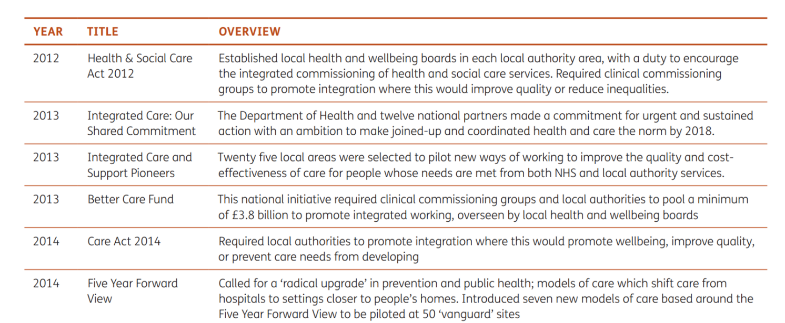
Key policies timeline
2022 Health and Social Care Act
By law integrated care systems are intended to be part of a new way of working in health and care based on principles of partnership and collective responsibility.
Table 1. Key policies and legislation relating to integrated health and social care in England between 2010 and 2022

Slide 5

Mid and South Essex
A new urgent community response team(UCRT) provides a single integrated service
  In the past three community organisation and 4 rapid response services
  1 head of UCRT
Responds to people experiencing an acute medical crisis in their own home.
  Takes referrals from other services, 7 days (8am-8pm)
Aim: avoiding admission to hospital

Slide 6
What the system faced
Four rapid response teams provided by three community organisations
  confusing for patients and for staff referring into the service.
Responding to people experiencing an acute medical crisis in their own homes
  The majority of the cases for older people, 91% of the referrals for over 65s.

Slide 7
Key benefits and outcomes
Access to a range of specialists, including prescribers and social workers to support people to stay in their own homes.
35% increase in referrals from 111 and 999,
  Helps to reduce demand elsewhere in the system.
An average of 2.7 acute bed days saved for every UCRT referral.
Collective power, helped the UCRT to integrate more effectively across the system
Invested in developing a single source of truth through streamlining data

Slide 8
Challenges
Differing views on what the service should do
Drawing together referral data from multiple sources
Building the understanding of different clinical teams in different organisations,
Remapping 111 algorithms
Train and engage 111 and ambulance crews to help them understand what the service offers.

Slide 9
South Warwickshire
Avoid conveyances where possible by using virtual wards to keep people at home.
Aim: older patients could be managed at home.
  By having clinical discussions with the ambulance crew before conveyance.
  By using virtual wards to keep people at home.
  A consultant-led service (8am to 8pm).
  Offers a high-quality level of decision-making that provides crews with the reassurance that they can leave patients at home
Joined up West Midlands Ambulance Service and the South Warwickshire NHS Foundation Trust.

Slide 10
What the system faced
Ambulance over-conveyance of older people to hospital
Once admitted may become increasingly unwell
  Stay longer than necessary
Over 70s make up 50% ambulance calls, 60% were being conveyed to hospital.
A frailty service for referrals not well used by ambulance services

Slide 11
Key benefits and outcomes
Referrals from West Midlands Ambulance Service increased by almost 500 per cent.
Demonstrated it is safe to manage patients at home.
In the over 80s where a clinical discussion took place, 48% of the conveyances were avoided.
Only 25% of the over 80s needed to be conveyed directly to the emergency department.

Slide 12
Challenges
Previous low collaboration and reaching out between ambulance crew and consultants.
Previous quality of the clinical advice was below standards.
Information governance was lacking.
Trust could not view the ambulance service CAD system.
  Patients over 75s not identified to support and visit directly.
Trust high reliance on ambulance crews calling them.

Slide 13
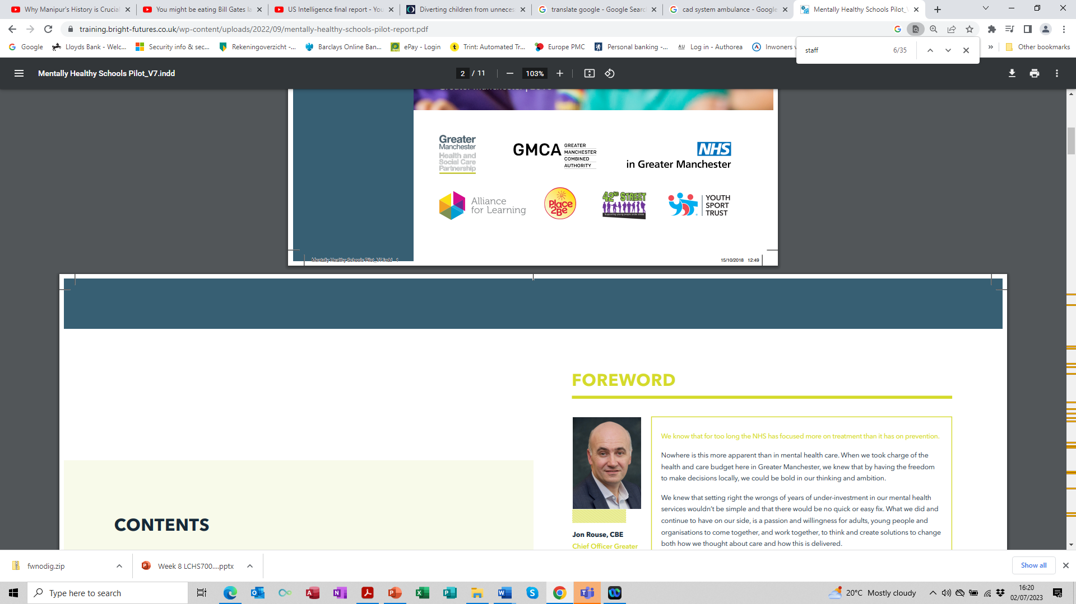
Greater Manchester
Joined up the NHS, local authority, CAMHS, Youth Sports Trust, Place2Be: children’s mental health charity, Local mental health services, Alliance for Learning (Teaching School), Schools Wellbeing Ambassadors (and many more) to support the mental health of children and young people in schools and colleges.
Aim: to help to transform mental health in Greater Manchester for children and adults.
The programme trains staff and students in mental health first aid and to become mental health champions
  Provides one-to-one support for the most vulnerable children with trained mental health workers.

Slide 14
What the system faced
A decline in communities young people’s physical, social and emotional wellbeing.
LA consider unique approaches on how schools can be better supported
Ensure utilised support for young people that need support the most.
Low support school staff in building competence and confidence to refer

Slide 15
Key benefits and outcomes
One in 10 schools in Greater Manchester (125 in total) are supported by the scheme.
Staff
  175 school staff received mental health first aid training and reported feeling more confident and able to deal with it.
  Increased confidence in dealing with students with mental health problems
  Improved knowledge about how to refer students to specialised services,
  Increased awareness about the importance of staff health and wellbeing
  Enjoy the training and improved attitudes towards mental health
Students
  Enjoy learning about mental and physical health (Y10)
  Report Improved confidence, skills and knowledge of mental and physical health (Y5)

Slide 16
Challenges
Acquiring sufficient funding
Not sufficient time for trainers across different organisations to work together and plan activities for the sessions.
Not adapting training and workshops for different schools and environments.
Not having a designated contact person that is engaged in each school.
Not having clear procedures for assessing the delivery and impact of the service (training) early in the delivery of the programme
Students are not fully aware of why workshops were taking place.

Slide 17

SEMINAR SESSION

Slide 18
Key Policy - 2022
The Health and Social Care Act 2022
What are the main changes brought about by the Act?
Is this an unnecessary top-down reorganisation?
Will the Act lead to greater involvement of the private sector in delivering and planning clinical services?
Does the Act give ministers more power over the day-to-day running of the NHS?
Will the Health and Care Act make any difference to patients?
Does the Act tackle the big challenges the health and care system currently faces?

Slide 19
NICE Guidance
Integrated health and social care for people experiencing homelessness
In pairs select a section, read it through, discuss, take notes and feedback to the whole group
  1.2 Planning and Commissioning (red)
  1.3 Models of multidisciplinary service provision (green)
  1.5 Access and engagement with services (purple)
  1.8 Transition between different settings (orange)
  1.11 Long Term Support (blue)
  1.12 Staff support and Development (yellow)

Slide 20
References
NHS Confederation (2023). System Working. Integration and Innovation in Action. https://www.nhsconfed.org/case-studies/urgent-community-response-across-mid-and-south-essex
NHS Confederation (2023). System Working. Integration and Innovation in Action. https://www.nhsconfed.org/case-studies/reducing-conveyances-older-patients-south-warwickshire
NHS Confederation (2023). System Working. Integration and Innovation in Action. https://www.training.bright-futures.co.uk/about-us/key-information/impact/gm-mentally-healthy-schools-colleges/
Nuffield Trust (2023). Timeline of integrated care policies in England, Scotland, Wales and Northern Ireland. https://www.nuffieldtrust.org.uk/integrated-care-policy-timeline
The Kings Fund (2023). Key milestones in community health services policy. https://www.kingsfund.org.uk/publications/community-services-assets/timeline

Slide 21


What did you learn today?

