Slide 1
Module Code: BMSK 5003
Understanding and engaging in the Customer Experience.
Buying decision making: Ethical Considerations such as fair trade and sustainable resources.
Rexon Nting, PhD

Slide 2
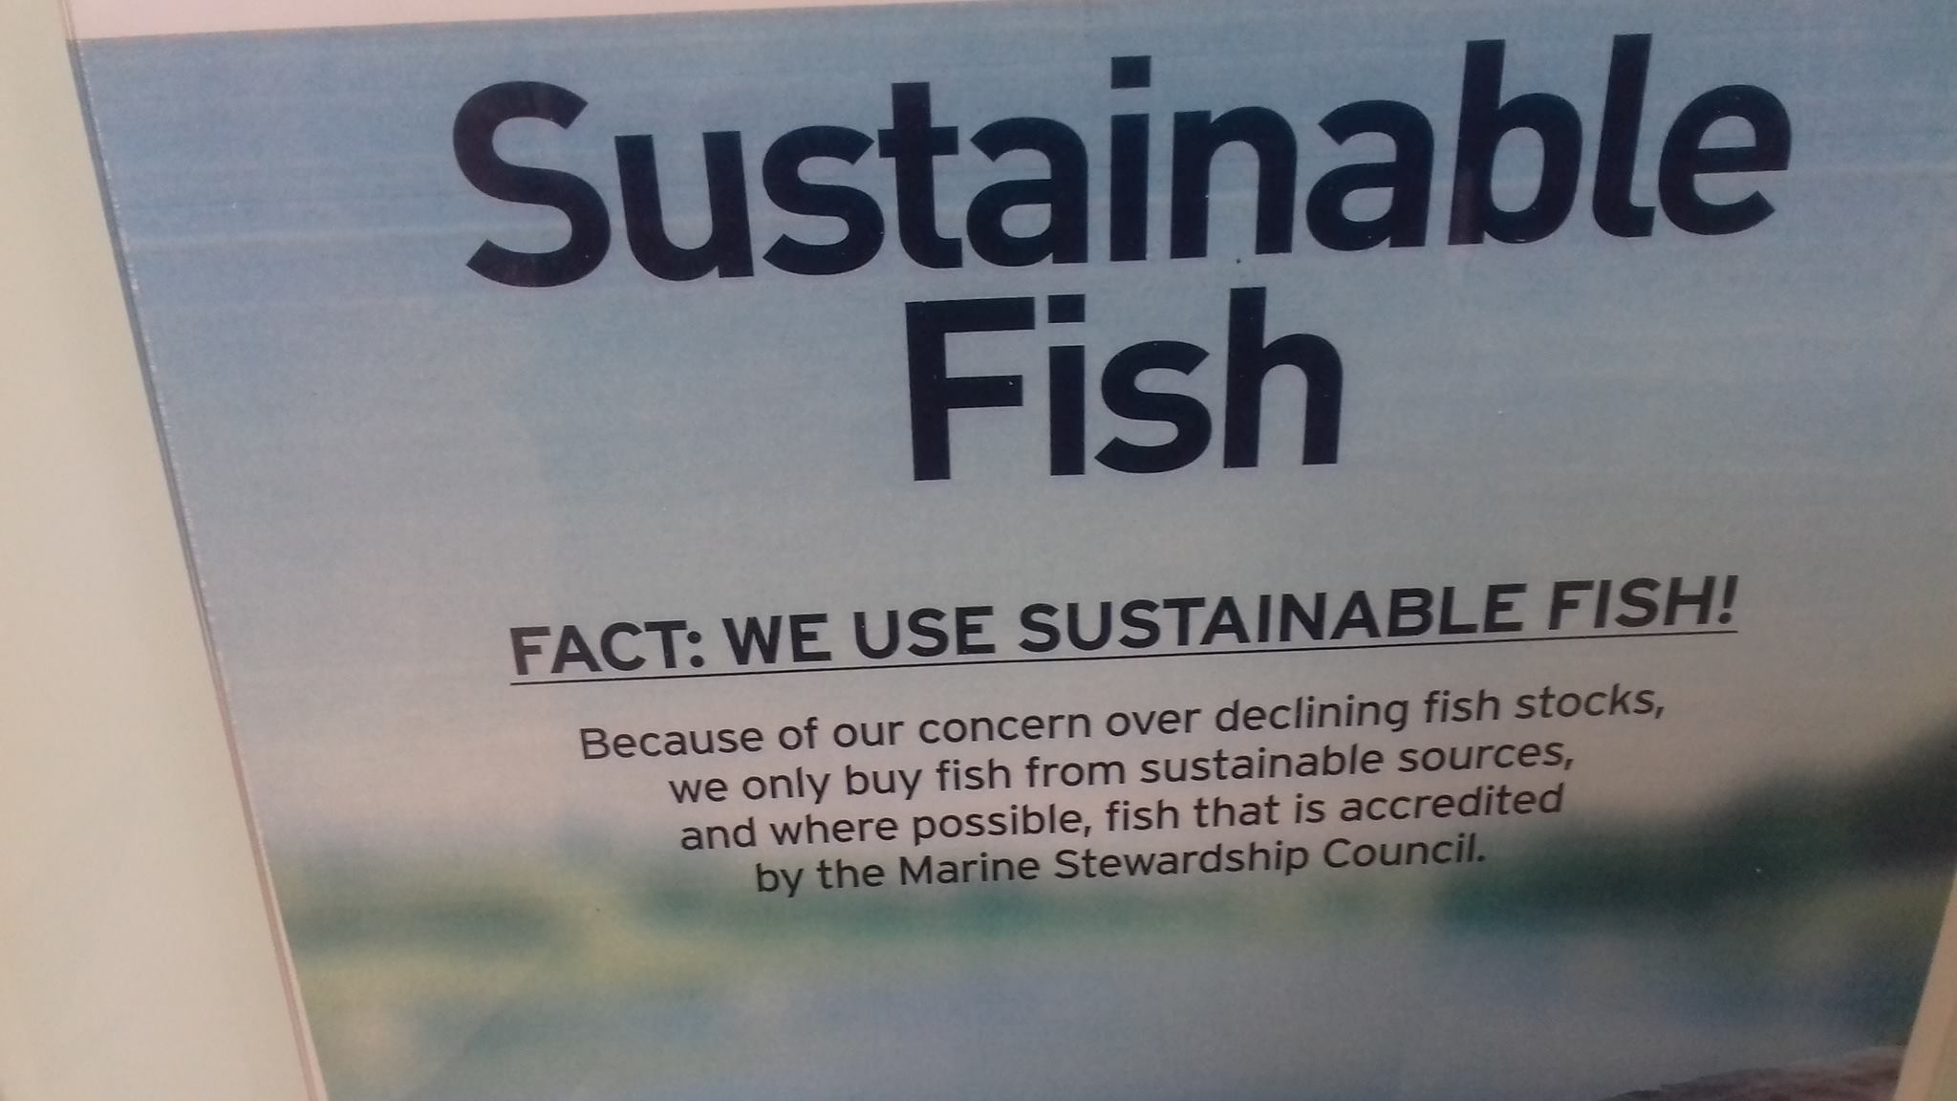
What does this mean to you?

Slide 3
Ethical Sourcing and Eco Nutrition cover the following key areas:-
Seasonality
Low environmental impact
Animal welfare
Reduction in use of non-renewable resources
Fairtrade
Viable for farmers and producers
Reduction of wastage
Supporting bio diversity
Local sourcing

Slide 4
In the food business, these areas are emerging are key trends on menus and on shelves :-
Restaurants and hotels growing their own herbs, salads and soft fruits,
Urban food projects e.g. roof gardens, community gardens
Charity projects producing sustainable food

Slide 5
Practical Questions about ethics and sustainability ?
A trip to the supermarket these days is fraught with ethical considerations.
Where and how were these strawberries grown?
Did those practices use land and water efficiently, and pesticides safely?
Who grew the coffee beans, and how were the workers treated?
Were the chickens that laid these eggs kept humanely, and what does humane chicken-rearing even look like?

Slide 6
Beyond food Safety?
Conscientious consumers are looking beyond food safety and demanding even more. They’re not just talking about it. Consumers are now basing purchasing decisions on whether the food is safe, of the highest quality and ethically sourced.
They want assurance that their food has been grown and processed in a manner that meets their own standards of social and environmental responsibility.

Slide 7
Mintel research findings
Mintel press office research tell us that consumers are not afraid to boycott brands that do not act ethically.
Indeed, half (52%) of consumers say they would stop buying products from a company if they found out it was acting unethically.
http://www.mintel.com/press-centre/food-and-drink/74-of-consumers-list-animal-welfare-among-the-top-factors-which-make-a-food-brand-ethical

Slide 8
Richard Ford, Senior Food Analyst at Mintel
“Ethics is becoming ever more ingrained into food and drink operators’ sourcing policies but it is a complex area which is important to get right. That so many consumers would stop buying from a company acting unethically highlights that operators must ensure their operating standards are not just legally, but also ethically robust, or risk boycotts and reputational damage. Social media means that any accusation of unethical practice can spread fast.”

Slide 9
5 Principles that underpin Ethical Food Choices
Transparency: We have the right to know how our food is produced.
2. Fairness: Producing food should not impose costs on others.
3. Humanity: Inflicting unnecessary suffering on animals is wrong.
4. Social Responsibility: Workers are entitled to decent wages and working conditions.
5. Needs: Preserving life and health justifies more than other desires.
Source: The way we eat: Peter Singer, Jim Mason

Slide 10
Question
What is the major factor that prevents more companies from developing ethical sourcing policies for their ingredients?

Slide 11
Starbucks Coffee Company have the view ...
The biggest factor holding companies back is the misunderstanding that it's not just the right thing to do, it's the right thing to do for business success.
We work hand-in-hand with producers to help improve quality and ensure environmental and social best practices.
The best example of our policies at work is the implementation of our C.A.F.E. Practices which we developed in collaboration with Conservation International nearly a decade ago’”.

Slide 12
Starbucks Coffee Company C.A.F.E. Practices
C.A.F.E. Practices cover guidelines in four key areas:
i) quality,
ii) economic accountability and transparency,
iii) social responsibility and
iv) environmental leadership.
Taken together, the standards help farmers grow coffee in a way that’s better for both people and the planet.

Slide 13
MARKS & SPENCER ETHICS APPROACH
“In future ethics should be as important as quality for all businesses. You wouldn't sell something that wouldn't meet your quality standard. Likewise you shouldn't sell something that doesn't meet your ethical standard.”
Louise Nicholls, Head of Responsible Trading for Food, M&S
Source: http://www.ethicaltrade.org/in-action/people/louise-nicholls

Slide 14
Learning from the World’s Most Ethical Food Companies - All Good Organics – NZ
All Good Organics believe that Fairtrade shouldn't be a special term. They think all businesses should be fair. That's why they've worked hard to buy their Fairtrade bananas from the El Guabo cooperative of small farmers in Ecuador because they know that they do more than just fair trading, they make a difference to the lives of growers, their children and the environment.

Slide 15
Where the Emphasis?
PUT THE SPOTLIGHT ON ENVIRONMENTAL MANAGEMENT IN YOUR BUSINESS
Energy consumption, water use, waste management and pollution prevention are critical to ethical business practices.

Slide 16
HOW DO YOU MAKE YOUR BUSINESS MORE SUSTAINABLE IN YOUR BUSINESS ?
START WITH ETHICAL BUYING
Given the love and care that goes into making your products, find ingredient suppliers that care and are ethical, suppliers that respect the environment, as well as the animals and people living there and with suppliers that minimise their environmental impact.

Slide 17
Ethical Sourcing Statement
What does Ethical Sourcing mean to your company?
Your commitment - write down your policy in relation to
Quality; Animal Welfare; Sourcing & Sustainability; Environment; People; Relationships With Suppliers; Ethics. Etc..
How will you Comply with your Policy?

Slide 18
Ethics, Emotions and Organic Food
‘Recycling’ was rated as the most significant activity in terms of both concern and active steps being taken by Irish people – it provided a feel good ‘halo’ effect for them with regards to many other areas on non-activity/concern
Organic Consumer Research - Ethics, Emotions and Organic Food (Bord Bia)
http://www.bordbia.ie/industry/manufacturers/insight/publications/bbreports/Documents/Organic%20Consumer%20Research%202008%20-%20Ethics,%20Emotions%20and%20Organic%20Food.pdf

Slide 19
RECYCLING
The issue of recycling is one that has been present in the minds of consumers for several years.
For many consumers it reassures them that they are ‘doing the right thing’ that they are doing something proactive/beneficial for society and the environment..

Slide 20
RECYCLING – Features.
The key features of recycling are
it is a civic act demonstrable to themselves and to others
it is easy to do - because typically the infrastructure is in place
it requires minimal disruption
ultimately, for many consumers if they only feel the need to do one thing for the environment, they choose recycling

Slide 21


Slide 22
Fairtrade - Perception
‘As a concept ‘Fairtrade’ was found to be appealing because it was perceived to be an opportunity to directly improve the living conditions of other human beings i.e. workers in the Third World. ‘
Fairtrade’ appealed to their emotional sense of justice and fair-play.

Slide 23
About Fairtrade
Widely regarded as the gold standard.
By putting the Fairtrade mark on products, stocking Fairtrade goods or serving them to customers, you have a positive impact on small farmers’ and workers’ lives in the developing world. You take part in a sustainable supply chain and you can demonstrate your ethical commitment to your clients.

Slide 24
Getting involved with Fairtrade
The Fairtrade mark operates on the basis of becoming a licensee.
For resellers/producers of Fairtrade products, the first step is to register your company with Fairtrade. They will then get in touch with you to arrange a meeting at which you can sign a licence agreement. You will then be ready to get your products certified.

Slide 25
Getting involved with Fairtrade
TRADER - you will need to register as a trader with Fairtrade in your country. Your customers will then be able to use your products or ingredients in their Fairtrade certified products.
If you are buying and selling unfinished Fairtrade products or ingredients internationally, please visit the FLO-Cert website as you will need to become an internationally certified trader.

Slide 26
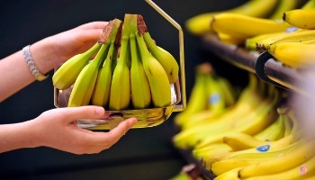
LIDL AND FAIR TRADE BANANAS

Slide 27
LIDL AND FAIR TRADE BANANAS
Lidl Ireland has revealed that one in four bananas sold in its 140 stores nationwide is certified Fairtrade, which positions the discounter at the top of the leader-board of Fairtrade commitment compared to other Irish retailers.
In fact, Lidl sell 44% of all Fairtrade bananas sold in Ireland. The remaining Irish retailers sell on average just 5% of their bananas as Fairtrade certified.

Slide 28

Ethics Based Accreditation Options
Soil Association: campaigns for healthy, humane and sustainable food, farming and land use.

Slide 29

Soil Association - UK
Soil Association Certification is the UK's largest organic certification body, responsible for certifying over 70% of all organic products sold in the country. They certify organic food and farming, organic textiles and organic beauty products.
The Soil Association organic logo on pack is the most recognised in the UK and your customer's guarantee that your produce meets the highest standards of sustainability and quality.
For foods to be labelled as organic, at least 95% of the ingredients must come from organically produced plants and animals.

Slide 30

Rainforest Alliance
The Rainforest Alliance is an international nonprofit organization that works to conserve biodiversity and ensure sustainable livelihoods.

Slide 31

Rainforest Alliance Marks
The Rainforest Alliance family of marks includes three distinct icons, which represent different relationships with our organization. In each case a company or operation must meet specific criteria and have a signed agreement with the Rainforest Alliance

Slide 32

Marine Stewardship Council
Sustainably sourced fish. www.msc.org
The MSC is an international non-profit organisation established to address the problem of unsustainable fishing, and safeguard seafood supplies for the future.
Fisheries and seafood businesses can get certified to the MSC standards to show that they support sustainable fishing and gain access to the growing market.

Slide 33
Key stages of MSC certification
1. Pre-assessment -Identifies any potential challenges for certification.
2. Full assessment - Includes opportunities for stakeholder input and peer review.
3. Certification - Lasts up to 5 years.
4. Annual audits - Carried out by the certifier to ensure continued compliance.
5. Reassessment - Within five years of the last certificate being granted.

Slide 34
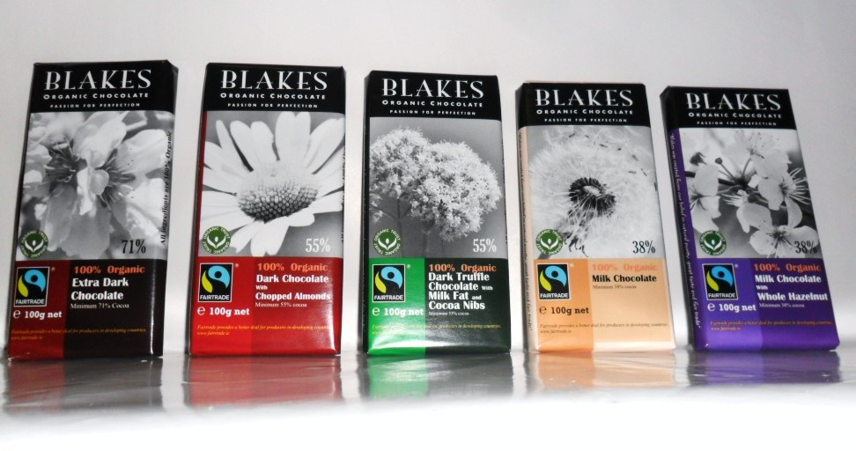
CASE STUDY –
Blakes Organic Chocolates
Blakes is an Irish company that sources seriously delicious chocolate and ethics at the heart of all it does. The products tick both the organic and Fairtrade boxes with the certification to match. The chocolates do not contain soya lecithin - an additive that binds cocoa and cocoa butter - which some people worry could be linked to soya allergies.
Blakes chocolate is made from 100% Certified Organic ingredients and are also Fairtrade certified.

Slide 35
Ethics and Corporate Responsibility
One in four consumers agree that where they shop for groceries depends on the range of ethical food products available, over two in five (45%) say that buying ethical groceries makes them feel good about themselves.

Slide 36
TESCO CORPORATE RESPONSIBILITY
Suppliers & Ethical Trading
Supporting the local economy and working with the Irish food and agricultural industry is a core value for Tesco Ireland. We are committed to sourcing local products where possible.
Tesco Ireland puts ethical trading at the heart of its operations by adhering to the Ethical Trading Initiative and making sustainable environmental impact a key business priority
http://www.tesco.ie/corporate-responsibility/suppliers-and-ethical-trading /

Slide 37
What is Econutrition?
Eco Nutrition is a sustainable way of nourishing ourselves, mainly for our own health and wellbeing, but with the added benefits that it can saves us money, reduces the burden on struggling healthcare systems; it is kind to the food growers in the developing world and the environment.
It takes us back to basics, to our powerful connections with the soil that we can lose through too much overdependence on processed food.

Slide 38
ECO NUTRITION – MOTIVATING FACTORS
We live in a world of constant information overload, rapid technological advances and expectations of instant gratification.
We are bombarded with the ‘next big thing’ – gadgets, wonder drugs, miracle anti-ageing treatments, super-foods, the latest celebrity diet.
All this makes it very difficult to know what advice to follow and what to dismiss as just another fad.

