Slide 1
Module code: LCLM4003 Effective Teamwork and Communication
Assignment Title: Group Presentation – Flight Foods Ltd
Group members:
1. Niculae Weresi
Student ID: 20242933212.
2. Robert Alexandru Gancs
Student ID: 23122503.
3. Florin Uta
Student ID: 22293444.
4. Emil-ionut Cacicovschi
Student ID: 2229348

Slide 2
Introduction
Flight Foods is losing airline customers due to consistent errors in cooking, packaging, and hygiene.
There are numerous communication issues between Gary and the workers, as indicated in the case study.
The presentation identifies five barriers and measures that communication models can fix.
Notes:
Hello everyone. We will present the topic Communication Barriers at Flight Foods Ltd. Flight Foods has numerous problems because workers and Gary can hardly communicate with one another. This brings about food safety issues. The key communication barriers will be examined, and simple communication theories will be used to expound on them. Next, we present simple solutions to the issues and enhance teamwork.

Slide 3
BARRIER 1 - LANGUAGE BARRIER
Barrier 1: Description
Employees use various languages and do not have much knowledge of English.
Gary speaks in a fast-paced English, and most of the workers are not able to understand him.
Wall signs are not that effective since the workers do not read fluently in English.
Notes:
Gary has many workers who do not comprehend his words and written signals. This creates bad practices such as leaving chicken unrefrigerated overnight (Khan et al., 2022). There is a lack of simple shared language, and hence, communication is easily broken. This obstacle leads to errors and prevents the reception of messages in a proper manner.

Slide 4
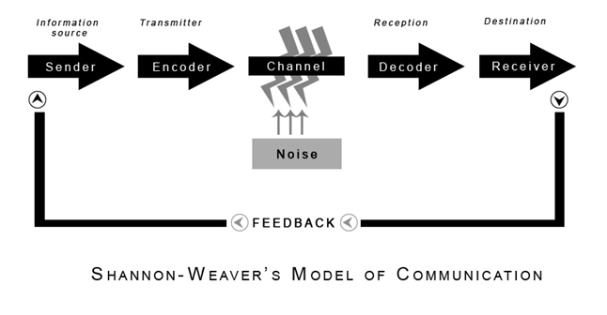
BARRIER 1 - LANGUAGE BARRIER
Barrier 1: Evaluation through the Communication Model (Shannon & Weaver)
According to Shannon-Weaver, messages are blocked by noise.
The difference in language is the source of a semantic noise, and thus, the message Gary conveys is vague.
When workers decode the message, it is modified or lost.
Communication Model (Shannon & Weaver)
(communicationtheory.org)
Notes:
The Shannon-Weaver model is a model whereby a message flows between the sender and the receiver. However, when it is disturbed by noise and the meaning is altered (Kusumalatha, 2023). The primary noise in Flight Foods is the language barrier. Gary is fluent in English, but most of the workers can only comprehend a few words. This makes it extremely difficult to decode on their part. The message they get is therefore not the same that Gary sends. At other times, they make conjectures of the meaning, at other times, they misinterpret, and at other times, they do the very thing contrary to what he requested (Abdelmotaleb et al., 2023). This is an indication that the communication linkage between Gary and the workers is weak. Due to this noise, several food safety errors occur on a daily basis.

Slide 5
BARRIER 1 - LANGUAGE BARRIER
Barrier 1: The Solution using the Model
Simple translated signs that contain pictures.
Teach short demonstrations to train workers rather than the long English instructions.
Check feedback to ensure comprehension.
Notes:
Gary needs to cut down on noise through the use of pictures and very simple language. Another way that he should request workers to demonstrate the task to him is by asking. This assists in proper decoding. Elimination of language noise will enable you to make the message easier to understand and avoid expensive errors in food (Prusty et al., 2022).

Slide 6
BARRIER 2 - PSYCHOLOGICAL BARRIER
Barrier 2: Description
Gary comes with tiredness, emotional stress, which makes his communication weak.
When Gary has rushed instructions, workers get lost.
His bad temper reflects the way he describes work.
Notes:
Emotions that lead to psychological barriers include stress and exhaustion. Gary had poor sleep, was aggravated, and hurried. This led to a lack of clarity and hygienic decisions, such as putting on an unwashed uniform (Chandler, 2021). Monetary conditions decrease attention and cause misinterpretation.

Slide 7
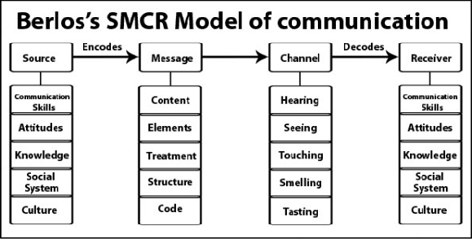
BARRIER 2 - PSYCHOLOGICAL BARRIER
Barrier 2: Model-Based Analysis (Berlo's SMCR Model)
Berlo states that the quality of communication is determined by the level of emotion of the sender.
The weakness of SMCR is a part of communication skills, and Gary is weak since he is under stress.
When the sender lacks concentration, the message tends to be ambiguous.
Berlo's SMCR Model (ResearchGate)
Notes:
According to the SMCR model by Berlo, communication relies on the Sender, the Message, the Channel, and the Receiver. When the sender happens to be exhausted, stressed, or angry, the message becomes feeble before it even enters the channel (Nag, 2024). This is what occurs with Gary. Since he could get a few hours to sleep, he came to work tired and irritated. His stress altered the way he talked and his style of explaining work. He spoke too fast, neglected key points, and failed to verify that employees were paying attention. The workers then misunderstood his ambiguous message through various means, hence resulted in erroneous activities, food contamination, and even more implications on the factory floor. This depicts the extent of emotional conditions that harm communication flow.

Slide 8
BARRIER 2 - PSYCHOLOGICAL BARRIER
Barrier 2: Solution With the Model
Gary must be able to deal with the stress prior to issuing instructions.
Be slow and calm in communication.
Get brief pauses and schedule communication more attentively.
Notes:
The message will be more obvious in case Gary looks at his mood first and speaks slowly. He ought to schedule activities in times of calmness. This will leave the communication processes enhanced since his emotional status will not hinder the way he describes significant rules of hygiene.

Slide 9
BARRIER 3 - PHYSICAL BARRIER
Barrier 3: Description
There are old, noisy machines in the factory that occlude hearing.
Employees are not able to hear what Gary is saying on the other side of the floor.
The accuracy of communication is decreased by noise and distance.
Notes:
Physical barriers are caused by the noise of machines. Gary cannot be heard by workers, and thus, instructions are lost. The environment is too noisy, even with signs. The physical space and sound assertive prohibit effective communication and elements to numerous blunders (Abdelmotaleb et al., 2023).

Slide 10

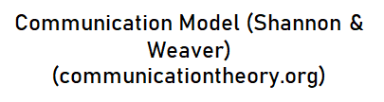
BARRIER 3 - PHYSICAL BARRIER
Model Barrier 3: Analysis With a Model (Shannon & Weaver)
In Shannon-Weaver, noise is one of the principal obstacles.
In this case, noise is tangible and prevents messages from being received by workers.
The quality of channels becomes poor, resulting in miscommunication.
Notes:
In the Shannon-Weaver model, the Communication breakdown occurs under the introduction of noise in the channel. There are outdated and highly inoperative machines in the factory of Flight Foods. This loud noise transforms into physical noise and prevents Gary from reaching the workers through voice. Even in the case that Gary raises his voice, the message is distorted or concealed by the noise. This information is somehow passed over to workers or not at all. They are not able to hear well, and hence they guess what to do, which leads to serious problems when it comes to food handling and safety (Sarıoğlu and Özdemir, 2025). The communication between Gary and the employees is extremely poor, hence there is a failure in decoding. This is an obstacle of how the environment and noise may completely derail communication within a working environment (Prusty et al., 2022).

Slide 11
BARRIER 3 - PHYSICAL BARRIER
Barrier 3: Solution With the Model
Minimize the noise through the utilization of less noisy meeting spaces.
Assign tasks by the use of hand signals or colour labels.
Give instructions clearly by the use of headsets or microphones
Notes:
The Shannon-Weaver model supports communication to be stronger as noise is minimised. Before going to work, Gary can make use of less noisy spots by holding short meetings before the start of work. Hand signals, picture cards, or colour labels should be used by him during the busy schedules so that the workers do not rely on hearing him. Headsets or small microphones can also facilitate his instructions to the workers, provided they are of low cost (Khan et al., 2022). These measures minimise the physical noise that they send to the blockage of the message. Reduced noise results in a clearer communication channel, workers process messages appropriately, and food safety errors occur less often. This demonstrates the way the environment can be controlled to correct the critical communication issues (Jainudeen Nawas, 2025).

Slide 12
BARRIER 4 - CULTURAL BARRIER
Barrier 4: Description
The workers belong to five cultural groups.
Their cultures and modes of communication vary.
There are possibilities of some workers not maintaining eye contact or questioning less, because of the culture.
Notes:
Various cultures use various means of communication. There is a chance that some workers will not ask questions, as they can be interpreted as disrespectful (Perrodin et al., 2024). Gestures might be misunderstood by others. This complicates cooperation and causes misunderstandings of hygiene regulations.

Slide 13
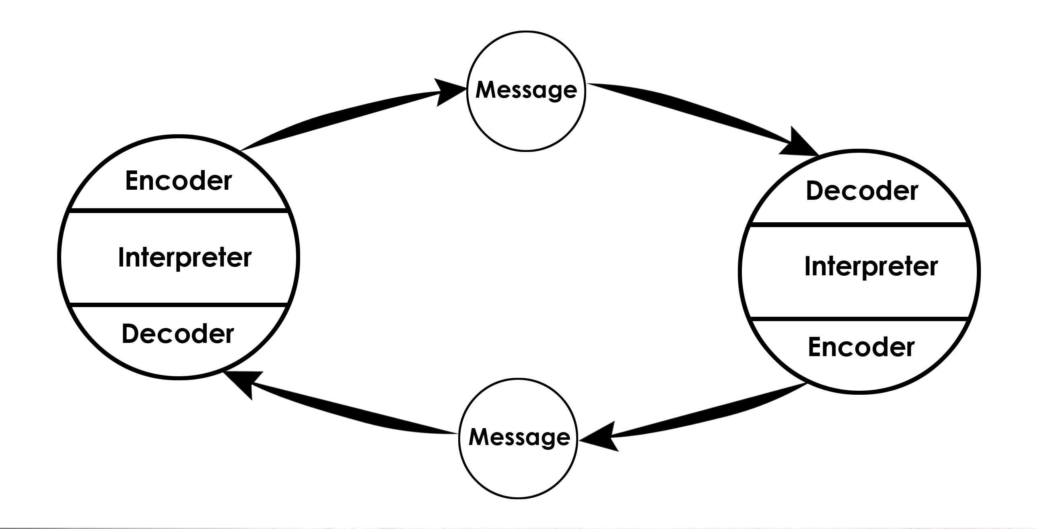
BARRIER 4 - CULTURAL BARRIER
Barrier 4: Model Analysis (Schramm's Interactive Model)
According to Schramm, meaning relies upon common experience.
The differences in the cultures decrease the common ground between Gary and his employees.
The feedback will be undefined or absent, as employees are confused.
Schramm's Interactive Model (communicationtheory.org)
Notes:
The Shannon-Weaver model supports communication to be stronger as noise is minimised. Before going to work, Gary can make use of less noisy spots by holding short meetings before the start of work. Hand signals, picture cards, or colour labels should be used by him during the busy schedules so that the workers do not rely on hearing him. Headsets or small microphones can also facilitate his instructions to the workers, provided they are of low cost (Jainudeen Nawas, 2025). These measures minimise the physical noise that they send to the blockage of the message. Reduced noise results in a clearer communication channel, workers process messages appropriately, and food safety errors occur less often. This demonstrates the way the environment can be controlled to correct the critical communication issues.

Slide 14
BARRIER 4 - CULTURAL BARRIER
Barrier 4: Solution with the Model
Conduct culture consciousness training.
Use plain symbols whose meanings are known to every group.
Get two-way feedback to develop shared meaning.
Notes:
Gary and the team develop mutual understanding should they get to understand the cultures of one another. The simple universal symbols make all people decode the messages in the same manner. Improved feedback enhances communication and minimises cultural misinterpretation (Kusumalatha, 2023).

Slide 15
BARRIER 5 - AGE/ATTITUDE BARRIER
Barrier 5: Description
The age of workers is between 16 and 60 years.
Even after he is told, Gary claims that the younger workers do something different.
Attitudes concerning age cause misunderstanding and frustrations.
Notes:
It is a matter of attitude barriers when individuals make judgments about others based on age. Gary believes that younger employees are not listeners. Young workers might feel criticised and cease interacting. Such attitudes destroy teamwork and communication.

Slide 16

BARRIER 5 - AGE/ATTITUDE BARRIER
Barrier 5. Analysis using a model (Berlo's SMCR Model)
Berlo indicates that experience and attitude influence communications.
Age groups would vary in terms of experience and learning process.
The differences in attitudes prevent the comprehension of messages.
Notes:
There is a model of Berlo that demonstrates that attitudes influence the reception of messages (Bhatt et al., 2023). The attitude of Gary to the young employees kills trust. His messages are then negatively decoded by the young staff. This brings about errors and poor collaboration.

Slide 17
BARRIER 5 - AGE/ATTITUDE BARRIER
Barrier 5: Solution with the Help of the Model
Assign workers to work in groups in unison.
When addressing younger employees, use a positive tone.
Request feedback to gain trust and respect.
Notes:
Attitude can be improved, and enhances communication. When all age groups are respected, and a friendly tone is employed by Gary, then the workers feel important. They provide feedback better, and they also observe instructions well (Nag, 2024). This eliminates doubt and enhances mistrust.

Slide 18
Conclusion
The issues at Flight Foods are caused by language, stress, noise, culture, and attitude towards age. There are basic communication models that demonstrate the Barriers that prevent messages. To minimize errors and enhance the performance of the company, it is possible to make use of clear tools and improved collaboration among the members of the team.
Notes:
The issues at Flight Foods are caused by language, stress, noise, culture, and attitude towards age. There are basic communication models that demonstrate the Barriers that prevent messages. To minimize errors and enhance the performance of the company, it is possible to make use of clear tools and improved collaboration among the members of the team.

Slide 19
References
Nag, D., 2024. Communication as a Carrier of Globalization. In Globalization and the Transitional Cultures: An Eastern Perspective (pp. 29-46). Emerald Publishing Limited.
Chandler, M., 2021. THE ADOPTION OF COMMUNICATION THEORY MODELS IN HOMILETICS. Journal of the Evangelical Homiletics Society, 21(2).
Prusty, S., Kumar, M. and Dhole, R., 2022. Extension Communication Models and Strategies. Emerging Trends in Agricultural Extension, 1, pp.35-54.
Kusumalatha, D.V., 2023. Extension Communication Models and Strategies. Chief Editor, 41.Omojuwa, B.A., 2025. Exploring the Communication Process Model (Doctoral dissertation, Mount Saint Vincent University).
Khan, A., Gupta, S. and Gupta, S.K., 2022. Emerging UAV technology for disaster detection, mitigation, response, and preparedness. Journal of Field Robotics, 39(6), pp.905-955.

Slide 20
References
Bhatt, B., Sharma, H., Arora, K., Joshi, G.P. and Shrestha, B., 2023. Levy flight-based improved grey wolf optimization: a solution for various engineering problems. Mathematics, 11(7), p.1745.
Jainudeen Nawas, M., 2025. Optimizing In-Flight Catering: Balance passenger expectation, Operational Efficiency and sustainability.
Perrodin, D.D., Liangruenrom, N. and Taworntawat, C., 2024. Navigating Intercultural Communication Challenges: Addressing Language Barriers and Foreign Language Anxiety Among Thai Low-Cost Airline Ground Staff. Trends in Psychology, pp.1-14.
Sarıoğlu, E.B. and Özdemir, Ö., 2025. Barriers to in-flight communication effectiveness: a qualitative inquiry with pilots in Türkiye. International Journal of Sustainable Aviation, 11(1), pp.39-59.
Abdelmotaleb, D.M., Mohamed, M.A., Ahmed, Y.A.A. and Amer, T.M., 2023. Barriers to the Application of the ISO22000 Food Safety Management System in Egyptian Flight Catering Companies. Journal of the Faculty of Tourism and Hotels-University of Sadat City, 7(1/1).

Slide 21
THANK YOU
DO YOU HAVE ANY QUERIES?

