Slide 1
Topic 6 – Lambda Expressions

Slide 2
Lambda Calculus
Lambda calculus was introduced in the 1930s by Alonzo Church as a mathematical system for defining computable functions.
The lambda calculus serves as the computational model underlying functional programming languages such as Lisp, Haskell, and Ocaml.
Features from the lambda calculus such as lambda expressions have been incorporated into many widely used programming languages like C++ and now very recently Java 8.

Slide 3
Lambda Calculus
The central concept in the lambda calculus is an expression generated by the following grammar which can denote a function definition, function application, variable, or parenthesized expression:
expr → λvar . expr | exprexpr | var | (expr)
We can think of a lambda-calculus expression as a program which when evaluated by beta-reductions returns a result consisting of another lambda-calculus expression.

Slide 4
Functional Programming
A style of programming that treats computation as the evaluation of mathematical functions.
Eliminates side effects.
Treats data as being immutable.
Expressions have referential transparency.
Functions can take functions as arguments and return functions as results.
Prefers recursion over explicit for-loops.

Slide 5
Why Functional Programming
Allows us to write easier-to-understand, more declarative, more concise programs than imperative programming
Allows us to focus on the problem rather than the code
Facilitates parallelism

Slide 6
Lambdas Introduced in Java 8
Java 8 is the biggest change to Java since the inception of the language
Lambdas are the most important new addition
Java is playing catch-up: most major programming languages already have support for lambda expressions
A big challenge was to introduce lambdas without requiring recompilation of existing binaries

Slide 7
Lambda Benefits
Enabling functional programming
Writing leaner more compact code
Facilitating parallel programming
Developing more generic, flexible and reusableAPIs
Being able to pass behaviors as well as data to functions

Slide 8
Introduction
Lambda expressions:
  Added new syntax elements to Java that increased the expressive power of the language.
  Added the ability to more easily take advantage of the parallel processing capabilities of multicore environments.
  Key to understanding Lambda expressions are two constructs:
    The Lambda expression itself;
    The functional interface.

Slide 9
Introduction
The Lambda expression is, essentially an anonymous (unnamed) method.
This method is not executed on its own.
It is used to implement a method defined by a functional interface.
Lambda expressions are commonly referred to a closures.

Slide 10
Introduction
A functional interface contains one and only one abstract method.
Normally this method specifies the intended purpose of the interface.
Therefore, a functional interface represents a single action.
A functional interface is sometimes referred to as a Single Abstract Method (SAM) type.

Slide 11
Lambda Expression Fundamentals
The Java Lambda operator or the arrow operator, is ->.
It divides the expression into two parts:
  The left side specifies any parameters required;
  The right side is the lambda body, which specifies the actions of the lambda expression.
If no parameters are necessary the parameter list is empty.
The -> can be verbalised as becomes or goes to.

Slide 12
Lambda Expression Characteristics
Following are the important characteristics of a lambda expression.
  Optional type declaration − No need to declare the type of a parameter. The compiler can inference the same from the value of the parameter.
  Optional parenthesis around parameter − No need to declare a single parameter in parenthesis. For multiple parameters, parentheses are required.

Slide 13
Lambda Expression Fundamentals
Java defines two types of lambda bodies:
  One consists of a single expression;
  The other consists of a block of code.
Probably the simplest type of lambda expression is shown below and equates to a constant value:
  () -> 123.45
  This lambda expression takes no parameters and returns a constant value of 123.45.
A slightly more complex lambda expression is:
  () -> Math.random() * 100.

Slide 14
Lambda Expression Fundamentals
When a lambda expression requires a parameter, it is specified in the parameter list on the left side of the lambda operator:
  (n) -> (n % 2) == 0
  True is returned if the value of the parameter is an even number.
  You can specifically specify the type of parameter.
  Often you will not need to because in most cases the type can be inferred.

Slide 15
Functional Interfaces
A functional interface specifies only one abstract method.
Below is an example of a functional interface:
  //A Functional Interface
  interface myNumber {
  double getValue();
  }

Slide 16
Functional Interfaces
A lambda expression is not executed on its own.
It forms the implementation of the abstract method defined by the functional interface that specifies the target type.

Slide 17
Example Java Lambda Expression
First reference the functional interface:
  myNumber myNum; //Declare an interface reference
Next, a lambda expression is assigned to the interface reference:
  myNum = () -> 123.45;

Slide 18
Example Java Lambda Expression
When a lambda expression occurs in a target type context:
  An instance of a class is automatically created that implements the functional interface, with the lambda expression defining the behaviour of the abstract method declared by the functional interface.
When that method is called through the target, the lambda expression is executed.
Lambda expressions give Java a way to transform a code segment into an object.

Slide 19
Example Java Lambda Expression
In the example, the lambda expression becomes the implementation for the getValue() method:
  //Call getValue(), which is provided in the previously
  //assigned Lambda expression.
  System.out.println("A fixed value: " + myNum.getValue());

Slide 20
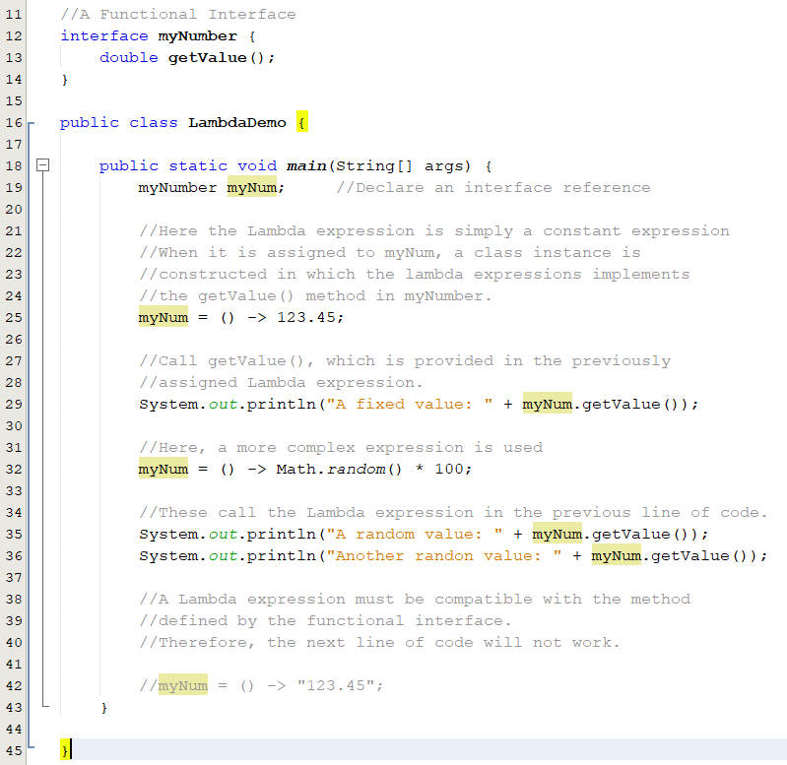

Slide 21
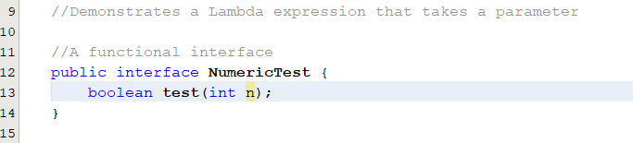
Lambda Expression with Parameter

Slide 22
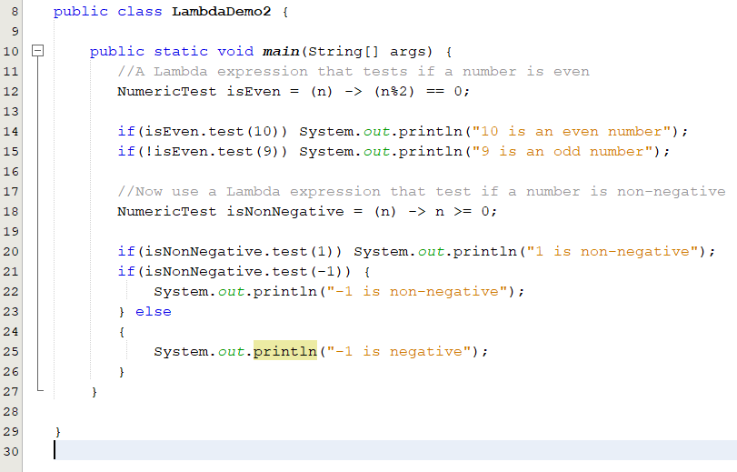

Slide 23


Lambda Expression with 2 Parameters

Slide 24
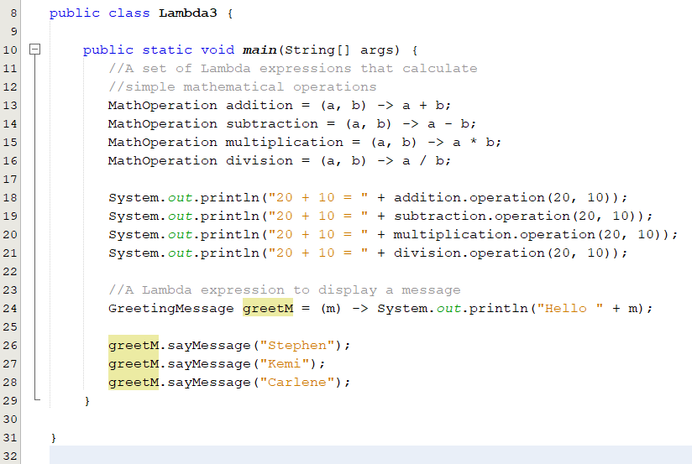

Slide 25
Block Lambda Expressions
The body of the lambdas shown in the previous examples consisted of a single expression.
  These are referred to as expression bodies.
  Lambda that have expression bodies are sometimes called expression lambdas.
Java supports a second type of lambda expression in which the right hand side of the lambda operator consists of a block of code.

Slide 26
Block Lambda Expressions
This type of lambda body is called a block body.
  Referred to as block lambdas.
Block lambdas support:
  Variables;
  Loops;
  If;
  Switch;
  You must use a return statement to return a value.

Slide 27

Block Lambda Example 1

Slide 28
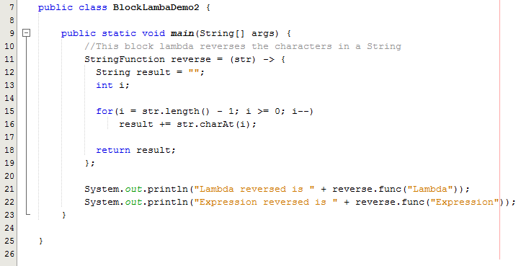
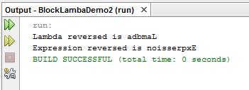

Slide 29

Block Lambda Example 2

Slide 30
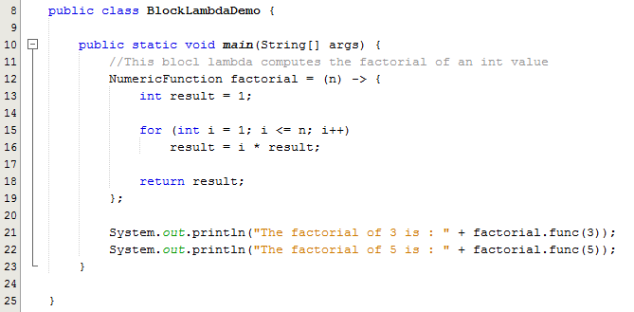
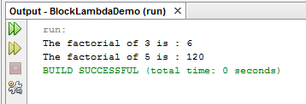

Slide 31
Generic Functional Interface
A lambda expression cannot specify type parameters.
Therefore, a lambda expression cannot be Generic.
Because of type inference, all lambda expressions exhibit generic like qualities.
The functional interface associated with a lambda expression can be generic.

Slide 32

Generic Functional Interface Example

Slide 33
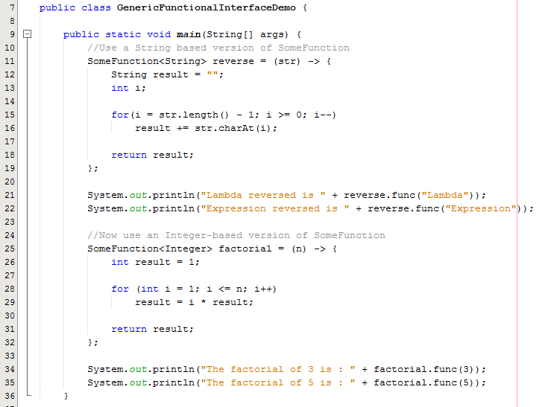
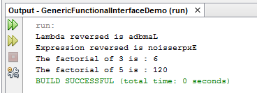

Slide 34
Exercise 1
Create a functional interface:
  To work with the following lambda expressions:
    Calculate the area of a Triangle;
    Calculate the area of a Rectangle;
    Calculate length of the Hypotenuse of a Right Angled Triangle given the lengths of the other two sides;
    Use double as the parameter type;
    Test the lambda expressions and demonstrate the output.

Slide 35
Exercise 2
Create a generic functional interface:
  To work with the following lambda expressions:
    Calculate the area of a Triangle;
    Calculate the area of a Rectangle;
    Calculate length of the Hypotenuse of a Right Angled Triangle given the lengths of the other two sides;
    Use double or float as the parameter type;
    Test the lambda expressions and demonstrate the output.

Slide 36
Lambda Expression Characteristics
Following are the important characteristics of a lambda expression.
  Optional curly braces − No need to use curly braces in expression body if the body contains a single statement.
  Optional return keyword − The compiler automatically returns the value if the body has a single expression to return the value. Curly braces are required to indicate that expression returns a value.

Slide 37
References
https://www.slideserve.com/bianca-alford/lecture-2-design-and-implementation-of-lambda-expressions-in-java-8-powerpoint-ppt-presentation
Java The Complete Reference (Eleventh Edition)
  Herbert Schildt
  Java Press
  ISBN: 978-260-44023-2

