Slide 1

Methods and Approaches in Interfaith Studies
Dr Angus M Slater

Slide 2

Introduction
This module functions as the compulsory module for the MA Interfaith Studies and DProf Interfaith Studies programmes at UWTSD.
It aims to provide you with the core material and skills needed to excel in your studies and to allow for your progression through the programme as a whole.
Dr Angus M Slater
Programme Director

Slide 3
Initial Admin

Slide 4
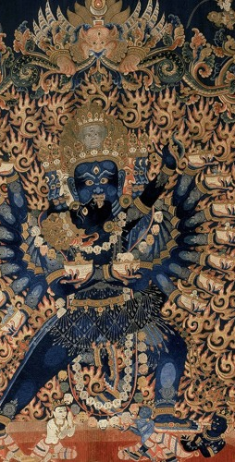
Aims of the Module
This module aims to engage you in:
critically examining key texts in Interfaith Studies.
critically assessing the main classical and contemporary methods and approaches in Interfaith Studies.
exploring theories and debates about ‘dialogue’, ‘difference’, and ‘co-existence’.

Slide 5

Learning Outcomes
By the end of the module, you should be able to:
understand and discuss the different approaches in Interfaith Studies;
investigate, by the use of examples, the strengths and limitations of approaches in Interfaith Studies;
critically assess issues involved in Interfaith Studies;
analyse the complex ways in which social categories such as class, gender, race, and sexuality shape interfaith encounters and practices of dialogue.

Slide 6

Structure
In order to equip you with these skills, the module takes a journey through a number of critical conceptual areas and methods in interfaith study.
We aim to examine both the preceding theological questions raised by the existence of the religious other and the techniques used in engaging with our own and other religious traditions.
This means we end up covering quite a lot of material, some of which may be of greater or lesser interest to you – but all of which is important!

Slide 7
General Topics
The history and development of Interfaith dialogue, with an emphasis on changes and developments in theory and practice..
Examining a range of forms and encounters in interfaith and interreligious engagement in order to illuminate theoretical concerns
Gaining a thorough understanding of the “theology of religions” paradigm and positions therein
Understanding the limitations and problematic aspects of such a model in Christian Theology and elsewhere

Slide 8
General Topics
Investigating the differing definitions and notions of dialogue – linguistically, philosophically, and teleologically.
Examining alternative approaches to interfaith studies, such as comparative theology, scriptural reasoning, critical theory approaches, and specific hermeneutical approaches.
Gaining a firm understanding of skills in the hermeneutical study of religious texts and images and their application to aspects of dialogue and encounter.
Understanding how interfaith work and scholarship relate to other “inclusivist” frameworks, such as multiculturalism and inter-culturalism.

Slide 9

Expectations
This module has certain expectations of you, the student, in order to certify your involvement with and completion of the module.
These take the form of discussions of the readings on Moodle and of your assessments.

Slide 10

Reading Discussions
Each section of the course will come with a series of expected readings for you to complete – normally 3-4 pieces of academic work, journal articles, or book chapters per section.
Once you have completed the reading material, you are expected to identify a particular question or questions that you have about the readings.

Slide 11

Reading Discussions
Once you have identified a question that you have about the readings, you are expected to post it to the provided discussion forum for that section, along with a sketch of your thinking and a potential answer.
This will allow us to engage as a learning community with the various aspects of the reading that speak to us and get to know each other better!

Slide 12

Assessments
As part of this module, you will also complete two assessments.
These assessments have been kept deliberately open in nature in order to allow the student multiple potential approaches to the question.
Do seek out the advice and guidance of the tutor before engaging in the assessments.

Slide 13

Assessment 1
Style: A short essay, including appropriate citation and bibliography
Length: 4,000 words, 50% of overall mark
Topic:
“The Theology of Religions paradigm has come under increasing criticism in contemporary writing on interfaith dialogue and encounter.
Outline and assess the continuing value of the paradigm, if any, for contemporary interfaith work”

Slide 14

Assessment 2
Style: A short essay, including appropriate citation and bibliography
Length: 4,000 words, 50% of overall mark
Topic:
“Select the work of a scholar in the field of hermeneutics or deconstruction (eg. Gadamer, Foucault, Ricoeur, etc. ).
Outline the key features of their work and demonstrate its analytical applicability to the field of interfaith studies”

Slide 15

Recommended Reading
Much reading in the field of interfaith studies approaches the matter from within a particular religion, at least initially. This means that is can be difficult to find good quality introductions to varied religious perspectives.
In this module, we begin by examining the Christian approach to other religions, the ‘theology of religions’ paradigm, as this has historically dominated the format by which contemporary interfaith interaction has been understood.

Slide 16
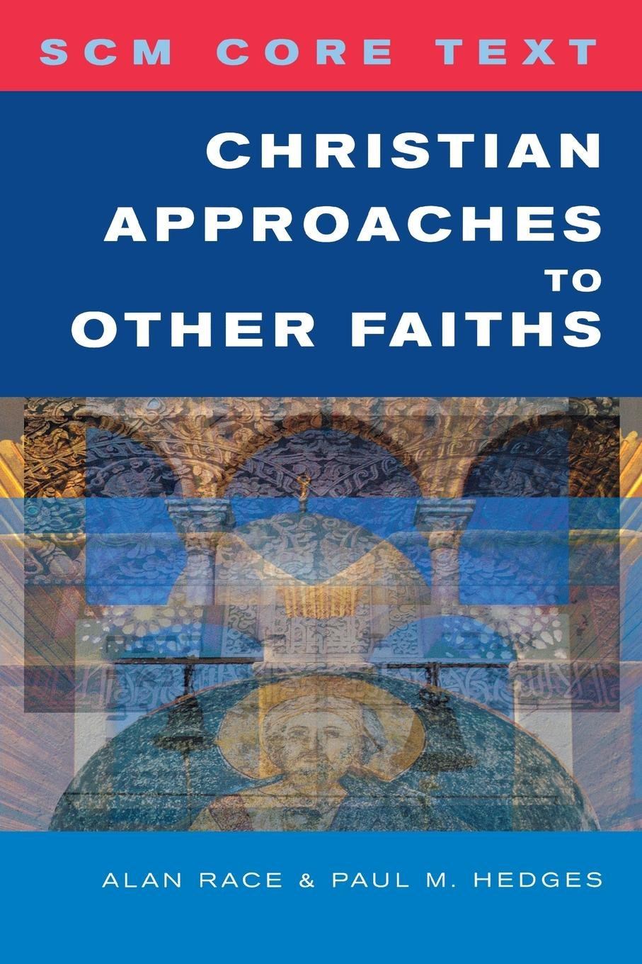
Recommended Reading
Hedges P & Race A, 2008, ‘SCM Core Text: Christian Approaches to Other Faiths’, London: SCM Press.
Available in the library catalogue.
Any edition is fine, older copies can be found on Amazon for <£20.

Slide 17
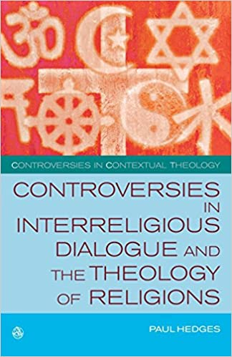
Recommended Reading
Hedges P, 2010, ‘Controversies in Interreligious Dialogue and the Theology of Religions’, London: SCM Press
Available in the library catalogue.
Any edition is fine, copies can be found on Amazon for around £25

