Slide 1
Advanced Radio
Frequency Systems
(ACDA6019)
Lecture -11

Slide 2
Content
Microstrip Patch Antenna design

Slide 3
Microstrip Patch Antenna
Microstrip rectangular patch antenna can be designed using HFSS (High Frequency structured Simulation software) or CST software
The dimensions of the microstrip rectangular patch antenna can be calculated using formula

Slide 4
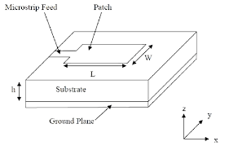
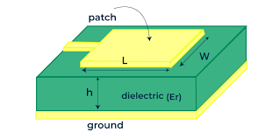
Microstrip Patch Antenna

Slide 5
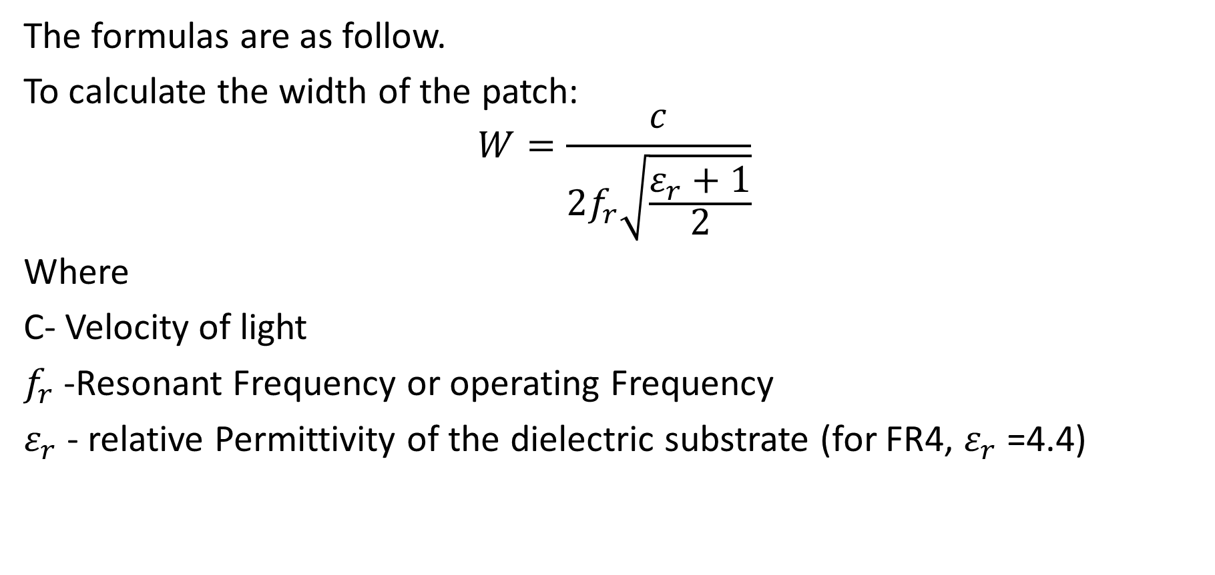
Microstrip Patch Antenna
The formulas are as follow.
To calculate the width of the patch:
$$W=\frac{c}{2f_{r}\sqrt{\frac{ε_{r}+1}{2}}}$$
Where
C- Velocity of light
$f_{r}$ -Resonant Frequency or operating Frequency
$ε_{r}$- relative Permittivity of the dielectric substrate (for FR4, $ε_{r}$=4.4)

Slide 6
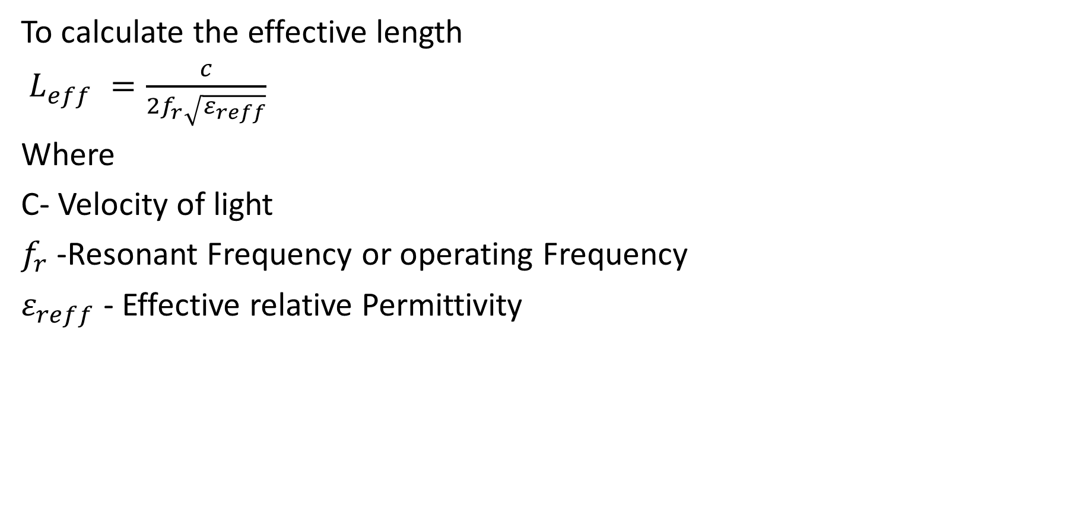
Microstrip Patch Antenna
To calculate the effective length
$L_{eff} =\frac{c}{2f_{r}\sqrt{ε_{reff}}}$
Where
C- Velocity of light
$f_{r}$ -Resonant Frequency or operating Frequency
$ε_{reff}$- Effective relative Permittivity

Slide 7
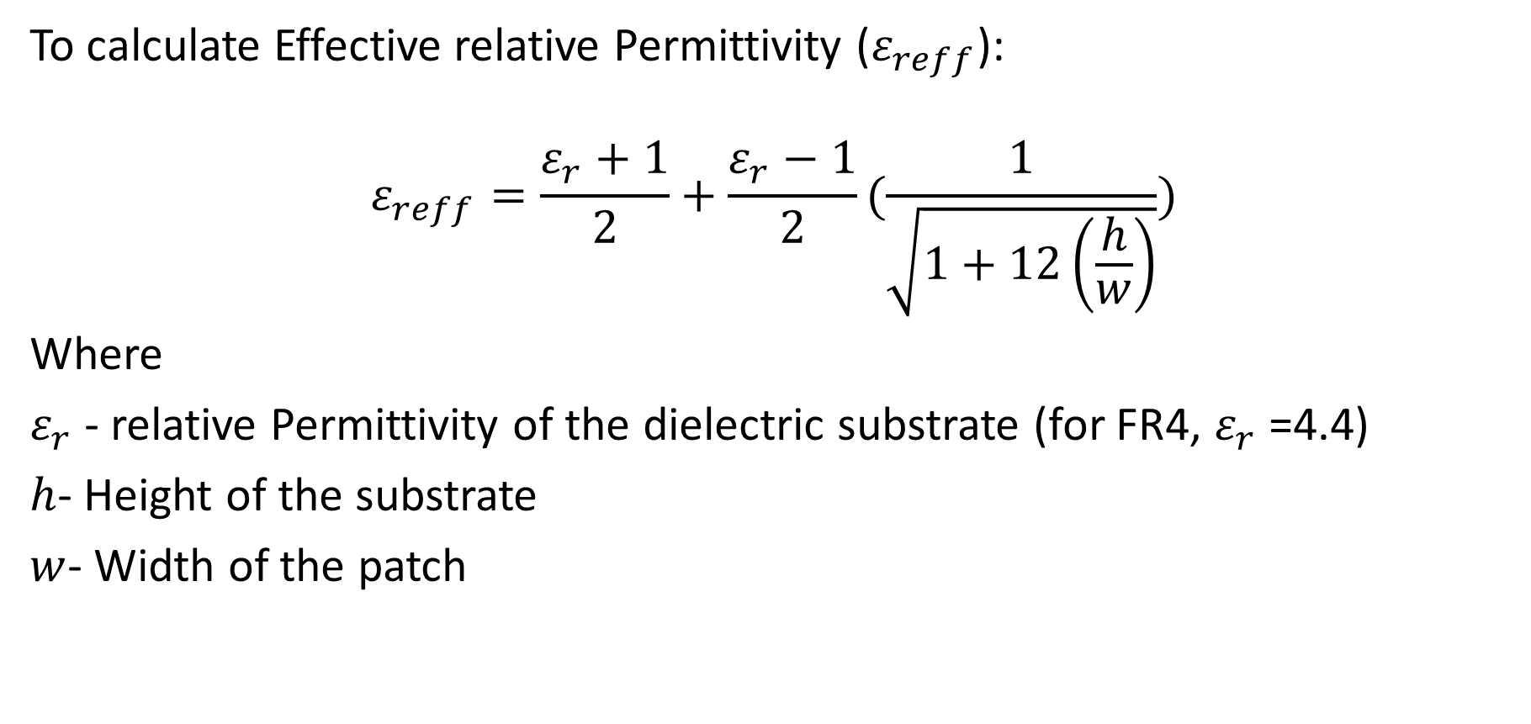
Microstrip Patch Antenna
To calculate Effective relative Permittivity ($ε_{reff}$):
$$ε_{reff}=\frac{ε_{r}+1}{2}+\frac{ε_{r}−1}{2}(\frac{1}{\sqrt{1+12\left(\frac{h}{w}\right)}})$$
Where
$ε_{r}$- relative Permittivity of the dielectric substrate (for FR4, $ε_{r}$=4.4)
$h$- Height of the substrate
$w$- Width of the patch

Slide 8
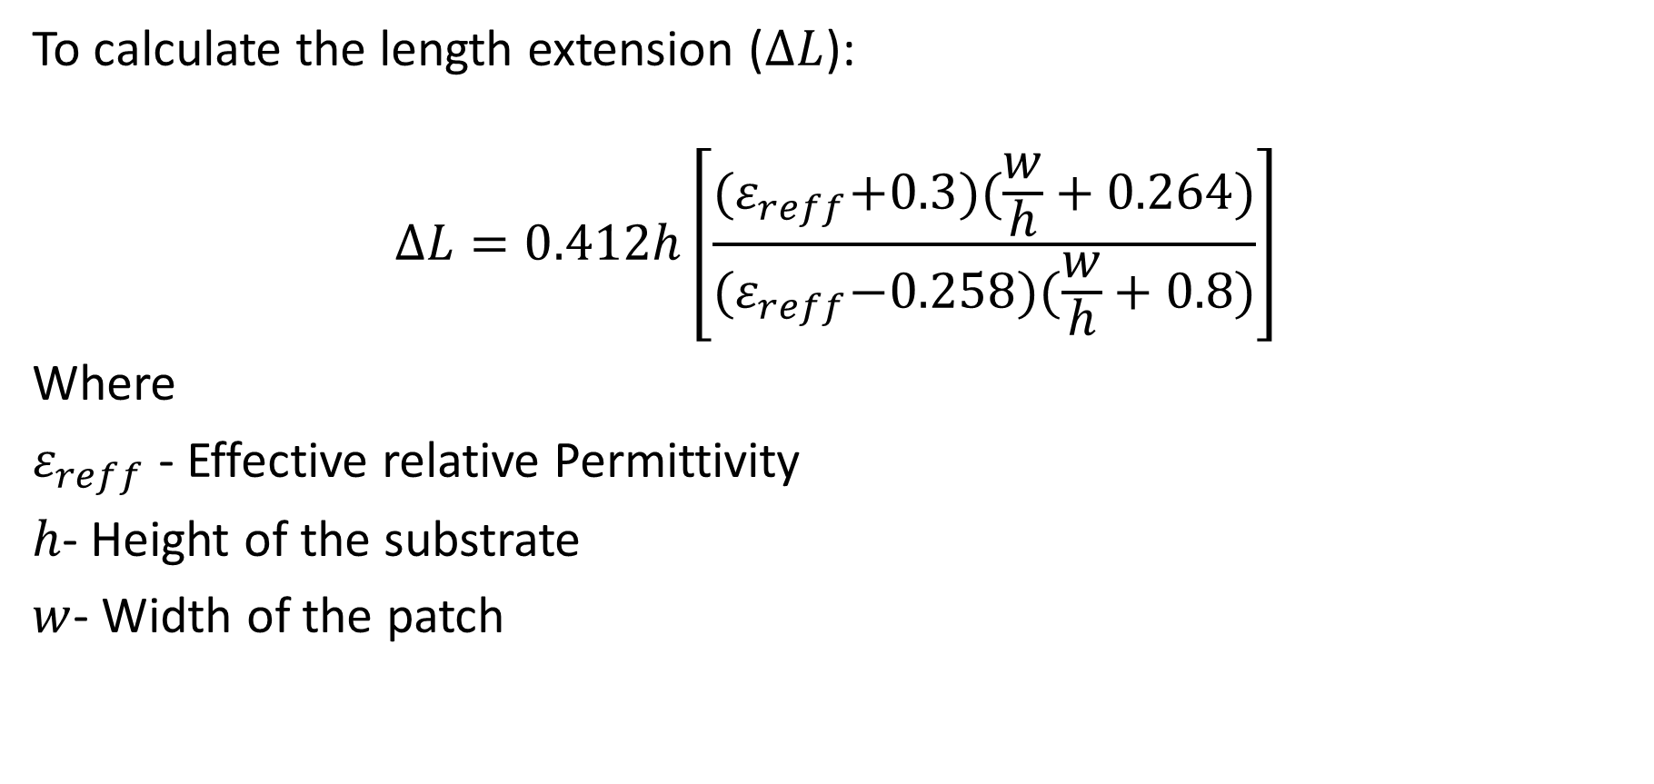
Microstrip Patch Antenna
To calculate the length extension ($∆L$):
$$∆L=0.412h\left[\frac{{(ε}_{reff}+0.3)(\frac{w}{h}+0.264)}{{(ε}_{reff}−0.258)(\frac{w}{h}+0.8)}\right]$$
Where
$ε_{reff}$- Effective relative Permittivity
$h$- Height of the substrate
$w$- Width of the patch

Slide 9
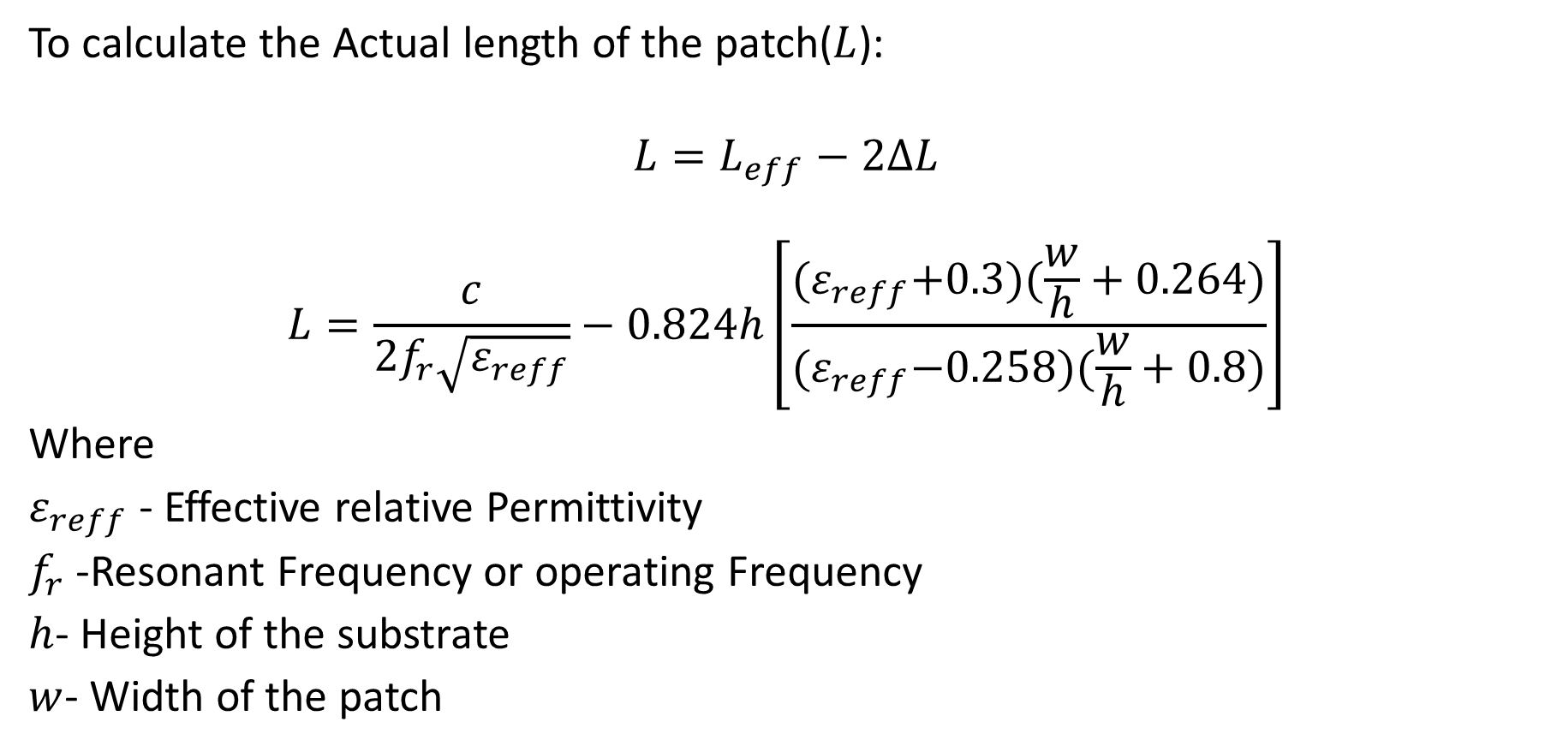
Microstrip Patch Antenna
To calculate the Actual length of the patch($L$):
$$L=L_{eff}−2∆L$$
$$L=\frac{c}{2f_{r}\sqrt{ε_{reff}}}−0.824h\left[\frac{{(ε}_{reff}+0.3)(\frac{w}{h}+0.264)}{{(ε}_{reff}−0.258)(\frac{w}{h}+0.8)}\right]$$
Where
$ε_{reff}$- Effective relative Permittivity
$f_{r}$ -Resonant Frequency or operating Frequency
$h$- Height of the substrate
$w$- Width of the patch

Slide 10
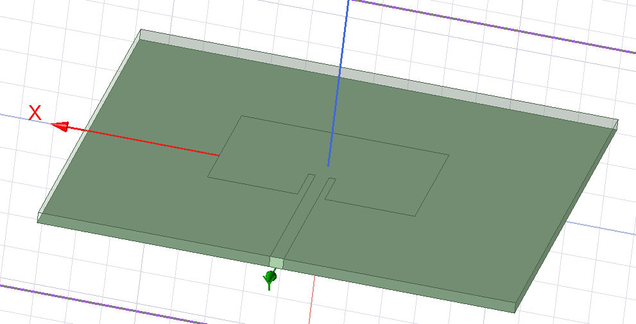
Microstrip Patch Antenna
Design

Slide 11

Thank You

