Slide 1
entrepreneurship
Neil Dyer

Slide 2
Home tasks:
NOTE: Will be emailed out to you.
Steps 1-6 on Simply Do website portal.
Draft sections 6-10 of assignment.
Prepare QUESTIONS for next week – find your weak spots. Last chance!

Slide 3
Course Outline
Wk 1: 3rd Oct | Introduction & Assignment Self-Evaluation (CV, Application & Interviews)
Wk 2: 10th Oct | Business Planning – The Formal Stuff (Structure, Legal) Idea Generation (Getting started on the business idea) Introduction to Simply Do Ideas Portal (Canvas and Sign-up) STEP 1. Concept (including SWOT Analysis of idea, value proposition, features, benefits)
Wk 3: 17th Oct | STEP 2. Customer (market research, demographics, profiling) STEP 3. Competitors (competitor analysis with 5 Forces)
Wk 4: 24th Oct | Insight into Marketing (how to Get, Keep, Grow customers – marketing, self-promotion, elevator pitch, relationship marketing, networking, pricing strategy) STEP 4. Compatibility (going back to self-evaluation, roles and responsibilities, human resource, skills) Insight into Networks (the importance of networks, alliances, partnerships – support, advice and suppliers/customers)
Wk 5: 31st Oct | Intellectual Property with Kath Penaluna STEP 5. Contents (distribution, assets, resources, equipment, training) STEP 6. Cash (key costs and income, funding) Insight into Financial Planning and Projections (Income, expenditure and profit) Insight into Funding (Crowdfunding, loans, grants)
Wk 6: 7th Nov | Mission Statement, Objectives, Management Team (the remaining sections) Assignment Review – a round-up of all sections. Open Q&A – last chance to highlight trouble areas and revisit previous sessions.
Wk 7: 14th Nov | Guest Speaker: Steve Simmons
Wk 8: 21st Nov | 1-2-1 and Group Assignment Support Slots
Wk 9: 28th Nov | No session – Work on Assignments
Wk 10: 5th Dec | ASSESSMENT: Simply Do Presentations
Wk 11: 12th Dec | ASSESSMENT: Simply Do Presentations

Slide 4
Assessment
Venture/Business Plan
Cover Page
Contents Page
Executive Summary
Mission & Vision
Objectives (SMART, short, medium and long-term)
The Management Team (Roles and responsibilities)
The Product or Service (Introduce your concept, description)
The Market (Customers, competitors, PEST analysis, trends)
The Marketing Strategy/Plan (4P’s or 7P’s, critical tasks)
Operations (Structure and formal considerations)
SWOT Analysis and Risk (Identify risks and opportunities)
Financial Forecasts (One year cash flow forecast)

Slide 5
Cover and contents
Neil Dyer

Slide 6
Cover Page
Title: Business or Venture Plan
Include Company Name
Company Logo or imagery
List of group members and student numbers
All other necessary submission details – course name, code, date, etc.
REMEMBER TO INCLUDE SUBMISSION COVER SHEET/S AND SELF-EVALUATIONS

Slide 7
Contents Page
Contents page with numbering for easy reference.
Include Appendix list and order.

Slide 8
Executive summary
Neil Dyer

Slide 9
Executive Summary
This section should be written once you have completed all of the other sections in the plan. It is a brief introduction to your plan, which incorporates the main points from each of the other 9 sections of the plan. It should be no more than one page.
You should complete the 1 year summary also.

Slide 10
Executive Summary
- Main reason for business plan
A brief description of the project
e.g:
NEODYNAMIC LTD is a new company offering a professional consultancy service based in the Neath Port Talbot/Swansea area, with services ranging from training and facilitation, management guidance, mentoring and mediation support. Specialising in business development, NEODYNAMIC LTD also offers advice in other areas including marketing management, team development and strategy. The primary focus of the business is Students’ Unions and the Higher Education sector, as well as the third sector and SME’s. The business will commence trading when all relevant resources are secured, including the graduate bursary.
- A summary of the benefits to the customer, the community and the economy

Slide 11
MISSION STATEMENT
Neil Dyer

Slide 12
Mission Statement
The Mission Statement encapsulates in a few sentences why you are going into business. You may think this is obvious, but not so. People start businesses for many reasons and their aims are just as varied. It is particularly important that teams agree on what they are trying to achieve.
For example: To be a leading consultancy service focused on progressive, dynamic and creative thinking providing business development and management support to organisations of all shapes and sizes.
Other examples at:
https://topnonprofits.com/examples/nonprofit-mission-statements/

Slide 13
OBJECTIVES
Neil Dyer

Slide 14
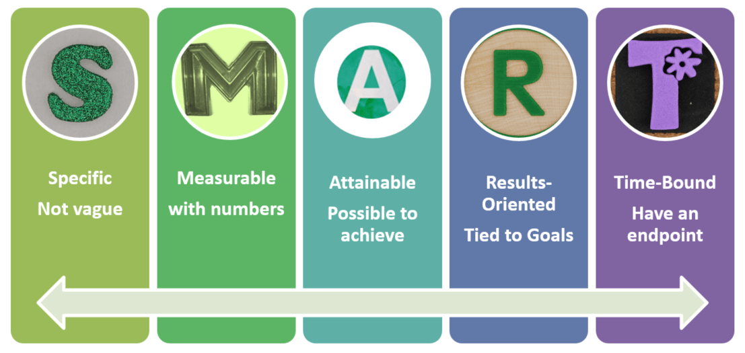
Objectives
Set some measurable objectives to aim for and which allow you to assess your progress.
Objectives and targets should always be S.M.A.R.T:

Slide 15
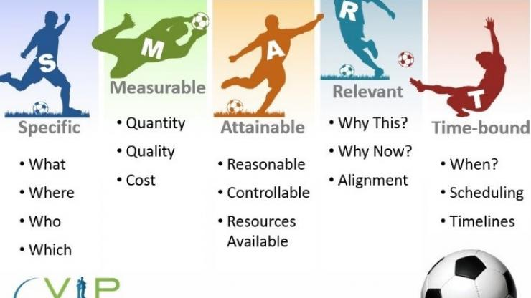
SMART Goals!

Slide 16
MANAGEMENT TEAM
Neil Dyer

Slide 17
Management Team
The single most important factor that will determine whether or not you succeed is you. The plan must tell the reader who you are, about your skills and experience, and your roles and responsibilities in the business. The reader will want to get a sense of your personality and motivation also.
-Summary of CV and business role here.
-Full CV in an appendix
If you think you have skill shortages, identify them and say what you’re going to do about it. Some of you may be inexperienced in business. How are you going to address this? If you are relying on external advisors/support – who are they?

Slide 18
Management Team
Give yourself titles based on your area of expertise or responsibility – your role in the business:
Be ordinary: Creative Director, Finance Management, Managing Director, Operations and Control, Product Development Chief, Lead Consultant, etc
Be creative: Strategic Thinker, Money Man, Marketing Guru, Chief Decision Maker, Music Maestro, Queen Gamer.
The main thing to get right is the roles and responsibilities. What are you in charge of and accountable for, and why – what skills and experience do you have that has meant you’re the best fit for that position. Refer to your CV and your compatibililty test!

Slide 19
Management Team (Other)
Employing others:
What staff will you look to employ? Or what roles might be created as the business grows? Any graduate positions maybe? Or volunteer roles?
Training and Development
Is there any required to train or develop your people to solve a skills gap? Do you need to constantly learn to remain competitive or is this a way of getting a competitive edge?
Strategic Alliances
Who’s going to help you fill your skills gaps, and help develop your business? Outsourcing, experts, funders, etc?

Slide 20
The assignment
Neil Dyer

Slide 21
Venture/Business Plan
Cover Page
Contents Page
Executive Summary
Mission & Vision
Objectives (SMART, short, medium and long-term)
The Management Team (Roles and responsibilities)
The Product or Service (Introduce your concept, description)
The Market (Customers, competitors, PEST analysis, trends)
The Marketing Strategy/Plan (5P’s)
Operations (Structure and formal considerations)
SWOT Analysis and Risk (Identify risks and opportunities)
Financial Forecasts (One year cash flow forecast)

Slide 22
Venture/Business Plan
Cover Page
Contents Page
Executive Summary
Mission & Vision
Objectives (SMART, short, medium and long-term)
The Management Team (Roles and responsibilities)

Slide 23
Venture/Business Plan
Cover Page
Contents Page
Executive Summary
Mission & Vision
Objectives (SMART, short, medium and long-term)
The Management Team (Roles and responsibilities)
The Product or Service (Introduce your concept, description)
The Market (Customers, competitors, PEST analysis, trends)
The Marketing Strategy/Plan (5P’s)
Operations (Structure and formal considerations)
SWOT Analysis and Risk (Identify risks and opportunities)
Financial Forecasts (One year cash flow forecast)

Slide 24
Finding an Idea…
Find a trend, complaint, problem or pain
Get creative on how to capitalise on it

Slide 25

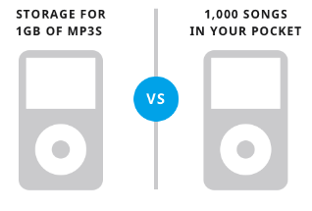
STEP 1: Concept
Features, Advantages & Benefits
Features: facts or characteristics
Advantages: what the features do
Benefits: what problem is solved or improved
People buy benefits, not features
FAB = Value Proposition

Slide 26
Venture/Business Plan
Cover Page
Contents Page
Executive Summary
Mission & Vision
Objectives (SMART, short, medium and long-term)
The Management Team (Roles and responsibilities)
The Product or Service (Introduce your concept, description)
The Market (Customers, competitors, PEST analysis, trends)
The Marketing Strategy/Plan (5P’s)
Operations (Structure and formal considerations)
SWOT Analysis and Risk (Identify risks and opportunities)
Financial Forecasts (One year cash flow forecast)

Slide 27
YOUR MARKET
MARKET RESEACH
What is the overall market like?
General description
Size (population, financial value, places)
Environment Trends (PESTEL analysis)
b. Customer research and profiling.

Slide 28
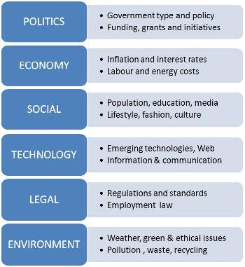
YOUR MARKET
PESTEL Analysis
... PEST is fine!

Slide 29
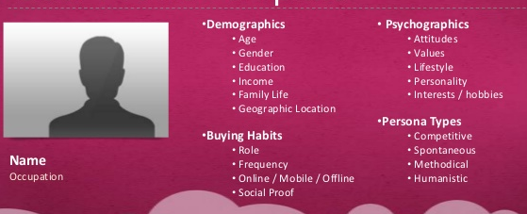
YOUR MARKET
Customer Profiling
...a way to create an unique identity for your customers to help you make marketing decisions concerning your product/service. Your customers are broken down into groups of customers sharing similar goals and characteristics and each group is given a representative with a photo, a name, and a description.

Slide 30
COMPETITORS
COMPETITIVE STRATEGY
- Who are your major competitors?
What are they good and bad at?
What can you do better?
Therefore, what are your competitive advantages?
- Is all competition bad?
Consider the benefits of competition: increased market awareness, opportunity for outsourced work, knowledge/insight.

Slide 31
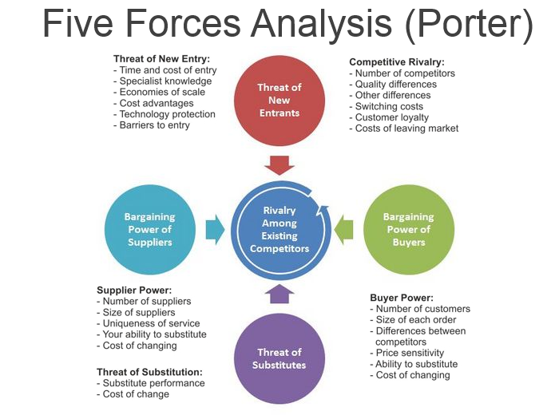
A MARKETING PLAN
(Porter, 1979)

Slide 32
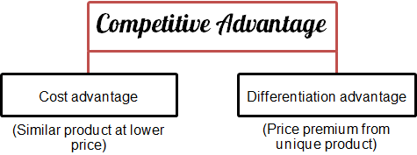
Competitive Advantage
Differentiation ‘not by price’:
Differentiation by:
Quality
Product design/features
Marketing/Branding
Customer service
Reliability/reputation
Product diversity

Slide 33
Venture/Business Plan
Cover Page
Contents Page
Executive Summary
Mission & Vision
Objectives (SMART, short, medium and long-term)
The Management Team (Roles and responsibilities)
The Product or Service (Introduce your concept, description)
The Market (Customers, competitors, PEST analysis, trends)
The Marketing Strategy/Plan (5P’s)
Operations (Structure and formal considerations)
SWOT Analysis and Risk (Identify risks and opportunities)
Financial Forecasts (One year cash flow forecast)

Slide 34

The Marketing Mix – 5 P’s

Slide 35
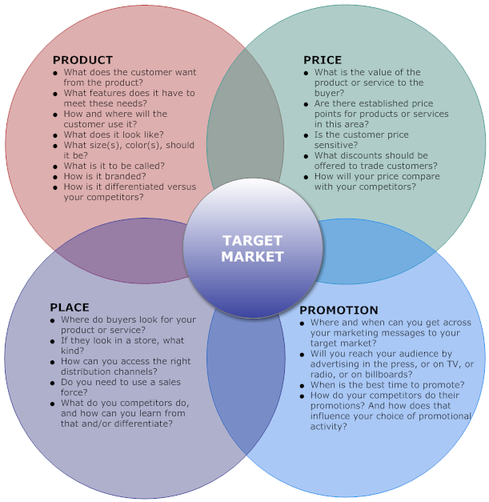

Slide 36
PRODUCT
For your assignment:
Cover the description and detail in the main ‘Product Section’.
In the Marketing section for ‘Product’ I would discuss more the design, packaging and aesthetics of your idea. The branding and ‘look’. Include images.
  What size(s), color(s), and so on, should it be?
  What is it to be called? Slogans? Logo?
  How is it branded? Any sub-brands?

Slide 37
PRICE
The three ‘real-life’ principles:
Profit = Price – cost [ACTUAL]
What price will get the work? [COMPETITIVE, REALISTIC, MARKET-DRIVEN]
What am I worth? What do I want to earn? [VALUE, OPTIMISITIC]

Slide 38
PRICE
Pricing Proposal/Strategy
Example:
5.12 Pricing Strategy
In-line with industry standards in this region, and at a competitive rate:
Full day consultancy – up to @ £500 per day
Half day consultancy – up to @ £275 per day
Hourly consultancy – up to @ £70 per hour
Training rates as per consultancy
Reduced rates for longer term contracts:
  2-5 days @ £450 per day
  5-10 days @ £400 per day
  More than 10 days @ £350 per day
Associate rates (incoming and outgoing) – 20% finder, 80% consultant
These rates may start lower as NEODYNAMIC LTD develops a reputation for itself and generates some case studies.
Invoices will be submitted to clients monthly in arrears reflecting the products/services provided in the month. Invoices are due for payment within 30 days (one calendar month) from receipt.

Slide 39
PLACE
The ‘place’ / distribution:
Distribution channel (direct to consumer, or through intermediaries)
Retail options (physical or online)
Where and how are you going to sell?

Slide 40
PROMOTION
PROMOTIONAL MIX
Public Relations (PR): press coverage, online news, sponsorship association. “About image/values”
Advertising: TV, online (Google, Facebook), press, magazines, “Create awareness, persuade, remind”
Direct Marketing: Direct mailings online (emails) and offline (postal), telemarketing, databases. “B2B”
Sales Promotion: Price discounts, vouchers, BOGOF, free credit, extended guarantees. “Short-term wins”
Personal Selling: Door-to-door, cold-calling, lead generation. “Face-to-face, or 1-to-1”
Internet/Online: “Your website design and function”. SEO and rankings. Blogs and social media interaction. [See ‘SMALL BUSINESS GUIDE’]

Slide 41
PROMOTION
ADVERTISING AND PROMOTION
Talk about all marketing and advertising channels you will use... HOWEVER,
Come up with at least 3 CREATIVE ideas for your advertising and promotion!
(Try and do something a bit different. Have fun!)

Slide 42
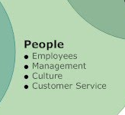

Slide 43
PEOPLE
ASSIGNMENT:
YOU AND THE PEOPLE IN THE BUSINESS THAT WILL BE INVOLVED IN GETTING THE PRODUCT/SERVICE TO THE CUSTOMER.
Who is helping you in your business? The people and services that you use in your business can impact your success. If your salespeople or your cleaner are rude, you'll lose customers and clients. What culture are you going to create for staff to ensure they portray a positive image and feeling for your business.
Don’t forget to include CV’s to support this section.

Slide 44
Networks: who would be in your support network?
Friends & Family
Business owners
Academics
Uni Enterprise advisers
Business Wales
Business advisers
Accountants
Solicitors
Industry employees
Fellow students
Big Ideas Wales
Funders
Freelance agencies
Suppliers
Buyers/customers
Journalists
Business networks
LinkedIn
Social media
Mentors
Careers Advisors
Third sector specialists
Banks
Competitors
Complimentary services
Memberships/Unions.
Anyone else...

Slide 45
RELATIONSHIP MARKETING
‘Get, Keep, Grow’ - It costs five times as much to get customers as it does to keep them.
Brand reinforcement
Feedback and improvements (communication)
Retention (be active in keeping them)
Create loyalty

Slide 46
Venture/Business Plan
Cover Page
Contents Page
Executive Summary
Mission & Vision
Objectives (SMART, short, medium and long-term)
The Management Team (Roles and responsibilities)
The Product or Service (Introduce your concept, description)
The Market (Customers, competitors, PEST analysis, trends)
The Marketing Strategy/Plan (5P’s)
Operations (Structure and formal considerations)
SWOT Analysis and Risk (Identify risks and opportunities)
Financial Forecasts (One year cash flow forecast)

Slide 47
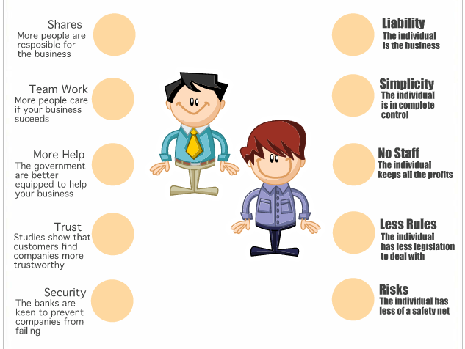
Limited Company vs Sole Trader

Slide 48
Social Enterprise / Community Interest Companies (CIC’s)
A CIC is a special type of limited company which exists to benefit the community rather than private shareholders.
They are NOT-FOR-PROFIT businesses but can still be profitable! Profits are simply reinvested.
include a ‘community interest statement’, explaining what your business plans to do for the public good.
create an ‘asset lock’- a legal promise stating that the company’s assets will only be used for its social objectives,
BENEFITS:-
  Do something you love for little risk? Be creative!
  Access to significant levels of funding.
  Can pay yourself and others a ‘reasonable’ salary.
  Far easier service/product to sell - ‘Social responsibility’

Slide 49
Business Structure
(or models or set-up or formation)
Other stuff...
VAT
Taking on staff
Allowable expenses, pensions, loans
Grants and funding
Insurance (PI/PL)
Bank accounts
Accreditations, Memberships & Unions
Tenders/Bids
Policies/Procedures
T&C’s, contracts, invoices, receipts, etc.

Slide 50
Health & Safety
Use the services of an external agency or consultant
Complete risk assessments where necessary
Look to comply with all quality standards and H&S regulations

Slide 51
Venture/Business Plan
Cover Page
Contents Page
Executive Summary
Mission & Vision
Objectives (SMART, short, medium and long-term)
The Management Team (Roles and responsibilities)
The Product or Service (Introduce your concept, description)
The Market (Customers, competitors, PEST analysis, trends)
The Marketing Strategy/Plan (5P’s)
Operations (Structure and formal considerations)
SWOT Analysis and Risk (Identify risks and opportunities)
Financial Forecasts (One year cash flow forecast)

Slide 52
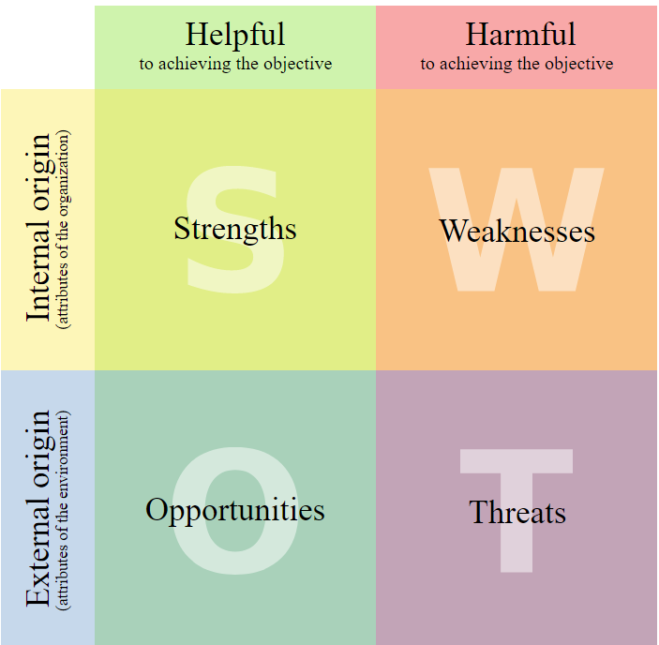
SWOT
IN
OUT

Slide 53
Venture/Business Plan
Cover Page
Contents Page
Executive Summary
Mission & Vision
Objectives (SMART, short, medium and long-term)
The Management Team (Roles and responsibilities)
The Product or Service (Introduce your concept, description)
The Market (Customers, competitors, PEST analysis, trends)
The Marketing Strategy/Plan (5P’s)
Operations (Structure and formal considerations)
SWOT Analysis and Risk (Identify risks and opportunities)
Financial Forecasts (One year cash flow forecast)

Slide 54
Finances
What are the things you need?
(Top priority resources)
Key Resources:
The resources that are necessary to create value for the customer.
They are considered an asset to a company, which are needed in order to sustain and support the business.
These resources could be human, financial, physical and intellectual.
[Will be looking for the description and the justification!]

Slide 55
Finances
WHO:
Think about your skills and any additional staff, training, experts or advisors you’ll need.
WHAT:
Think about things needed e.g. equipment, raw materials, website, promotional items, etc.
WHERE:
Think about your location such as any shop, office, studio or other business space. [ONLINE/OFFLINE]
ADDITIONAL INFORMATION (SOURCE):
Any early thoughts on how you might get these ingredients?
(friends for design work, already own equipment, University access, will use contractors equipment, Wix or Wordpress or other, etc.)

Slide 56
Finances
HOW WILL YOUR IDEA MAKE MONEY?
Think about all the different things you will sell and how.
Your offerings/products/services
Price (fixed, per situation, hourly, per contract, competitive)
Quotes
Commission
Royalties/Licensing
Selling mediums
Invoices
Enquiries
Ways of contacting you
Ways of responding
Negotiation techniques
Forms of payment (cash, BACS, credit)
Funding or financial support

Slide 57
Finances
DO YOU NEED ANY STARTUP FUNDING? ALWAYS YES
DO YOU HAVE ANY IDEAS OF HOW AND WHERE YOU MIGHT GET STARTUP FUNDING?
Business finance or loans
Grants or bursaries
Self-funding
Angel Investors (Capital Investors)
Crowd-funding

Slide 58
Venture/Business Plan
Cover Page
Contents Page
Executive Summary
Mission & Vision
Objectives (SMART, short, medium and long-term)
The Management Team (Roles and responsibilities)
The Product or Service (Introduce your concept, description)
The Market (Customers, competitors, PEST analysis, trends)
The Marketing Strategy/Plan (5P’s)
Operations (Structure and formal considerations)
SWOT Analysis and Risk (Identify risks and opportunities)
Financial Forecasts (One year cash flow forecast)

Slide 59
Appendices
Your Creative CV’s
Marketing or promotional materials
Any operational policies
Product designs or other design work
Market research or other research
Simply Do presentation/pitch
... Any else that adds value to your business proposal!!!

Slide 60
Assessment
Venture/Business Plan (70%):
Groups of 3-4 students.
Venture Plan is due on 9/1/2019 at 4pm AND IS TO BE SUBMITTED ONLINE VIA MOODLE.
Individual ‘Simply Do Ideas Pitch’ (30%):
To be completed individually.
PDF printout to be submitted by 3/12/18 (11:59pm)
Pitch/Presentations will take place on 5/12/18 and 12/12/18, and will last no longer than 10 minutes with Q&A.

Slide 61
QUESTIONS???
Neil Dyer

Slide 62
Course Outline
Wk 1: 3rd Oct | Introduction & Assignment Self-Evaluation (CV, Application & Interviews)
Wk 2: 10th Oct | Business Planning – The Formal Stuff (Structure, Legal) Idea Generation (Getting started on the business idea) Introduction to Simply Do Ideas Portal (Canvas and Sign-up) STEP 1. Concept (including SWOT Analysis of idea, value proposition, features, benefits)
Wk 3: 17th Oct | STEP 2. Customer (market research, demographics, profiling) STEP 3. Competitors (competitor analysis with 5 Forces)
Wk 4: 24th Oct | Insight into Marketing (how to Get, Keep, Grow customers – marketing, self-promotion, elevator pitch, relationship marketing, networking, pricing strategy) STEP 4. Compatibility (going back to self-evaluation, roles and responsibilities, human resource, skills) Insight into Networks (the importance of networks, alliances, partnerships – support, advice and suppliers/customers)
Wk 5: 31st Oct | Intellectual Property with Kath Penaluna STEP 5. Contents (distribution, assets, resources, equipment, training) STEP 6. Cash (key costs and income, funding) Insight into Financial Planning and Projections (Income, expenditure and profit) Insight into Funding (Crowdfunding, loans, grants)
Wk 6: 7th Nov | Mission Statement, Objectives, Management Team (the remaining sections) Assignment Review – a round-up of all sections. Open Q&A – last chance to highlight trouble areas and revisit previous sessions.
Wk 7: 14th Nov | Guest Speaker: Steve Simmons
Wk 8: 21st Nov | 1-2-1 and Group Assignment Support Slots
Wk 9: 28th Nov | No session – Work on Assignments
Wk 10: 5th Dec | ASSESSMENT: Simply Do Presentations
Wk 11: 12th Dec | ASSESSMENT: Simply Do Presentations

Slide 63
Home tasks:
Complete your draft and email to me by 8am Saturday 17th Nov.
(Later than this and I will not look at it before our 1-2-1)
Don’t be late, or miss, your 1-2-1 on Wednesday 21st Nov.
TIME | GROUP No | GROUP NAME
9.30 | 1 | Ffeel
10.00 | 2 | All The Gear, No Idea
10.30 | 3 | Artscape
11.00 | 4 | Accessible Gaming
11.30 | 5 | MannaKey
12.00 | 6 | Virtual Remedy
12.30 | 7 | Spark of Inspiration

