Slide 1
SUSTAINABLE LOGISTICS OPERATIONS
Empty Running

Slide 2
According to statistics from the Department for Transport (DfT), the percentage of UK trucks running empty has been on the rise in recent years.
While figures dropped from 31% in 1984 to 26% percent in 2001, levels have increased since then reaching 29% in 2014.
With green fingers already pointing at the industry’s contribution to CO₂ levels, we really cannot afford to let empty running by trucks go unchecked.
Empty running is of course inescapable in many situations, and hard to avoid in others.
Some specialised fleets are limited in backload or pickup opportunities when it comes to the types of load they can carry, e.g. refrigerated trucks designed for delivering chilled foods, or specialist chemical tankers.
Likewise multi-drop loads will almost certainly have an empty leg as they return to their depot.
For hauliers, new business can temporarily add one-way trips to a region beyond a fleet’s regular routes until regular backloads are established.

Slide 3
But with online freight exchanges, multi-client third party logistics providers (3PLs), and many different types of intelligent technology on the market, empty backhauls at the rate of 29% seems higher than it needs to be - particularly when lower levels have already been attained.
Empty running and even part loads equate to wasted money...and vast quantities of wasted fuel and CO₂ emissions.
According to the DfT, HGVs covered 16 billion miles on the GB road network in 2014 and 29% of those miles were empty trucks.
Reducing this to the 2001 level of 26% would equate to industry savings of around 480 million miles, 270 million litres of fuel costing around £340 million and 720 million tonnes of CO₂.
The Logistics Carbon Review includes empty running in its Top 10 of operational and vehicle design carbon saving interventions but says that the reasons behind rising rates are unclear.
Individuals contributing to the survey suggested that more efficient deployment of their core fleet on existing flows is the most effective way to reduce empty running.

Slide 4
Technology including routing and scheduling software together with telematics, is key to helping transport managers achieve efficiencies.
Multi-site route optimisation software enables vehicles at multiple sites to be treated as a single integrated transport resource.
This inter-working of multiple fleets generates route plans with efficient backloads, so that movements to and from different depots can be combined into optimised routes that reduce overall empty running.
For example, by using Paragon’s software to automatically plan the interworking of separate fleets, BOCM Pauls was able to save £250,000 in just one region.

Slide 5

The technology also enables central daily planning of more complex operations, such as those involving warehouses or production sites with different products serving the same customer base, or combined primary and secondary distribution operations.
Empty running is a necessary feature of logistics and freight operations, but together with better planning and the right technology we can help to reduce it.
With miles, fuel and CO₂ savings as benefits, it’s worth everybody’s time to keep this on the list of priorities.

Slide 6
The Paragon routing and scheduling product was first launched back in 1980 by PA Consulting Group, fulfilling a niche need in the transport industry.
By 1987 we had grown to become the UK’s leading supplier of routing and scheduling optimisation software.
Following a management buyout from PA Consulting in 1991 Paragon Software Systems was born.
http://www.paragonrouting.com/about/
Paragon has launched the latest version of its award-winning interactive User Guide to help customers make the most of its market leading routing and scheduling software. The browser-based tool incorporates a host of clever support features including a sophisticated dynamic help function, which will initially be available for the recently-introduced Route Control application before being rolled out to other modules within Paragon’s transport planning system.
http://www.paragonrouting.com/about/news/paragon-introduces-dynamic-user-guide-help-customers-boost-transport-operations-performance/

Slide 7
Paragon is increasing the number of vehicle tracking systems its routing and scheduling software integrates with to meet growing demand from customers across the globe.
Singapore-based Astrata Group’s fleet management solution is the latest system to be interfaced, with five further partner integrations planned over the coming months.
Paragon customers can take advantage of many of the most frequently used tracking systems worldwide to increase the visibility of their transport operations in real-time resulting in reduced costs and increased customer service.
“With the adoption of vehicle tracking expanding fast, it makes complete sense to use the real world information it provides to enhance transport planning,” comments William Salter, Managing Director of Paragon Software Systems.
“We are continuously developing new interfaces to our Route Execution software to integrate with a growing number of vehicle tracking solutions, in response to customer demand.

Slide 8
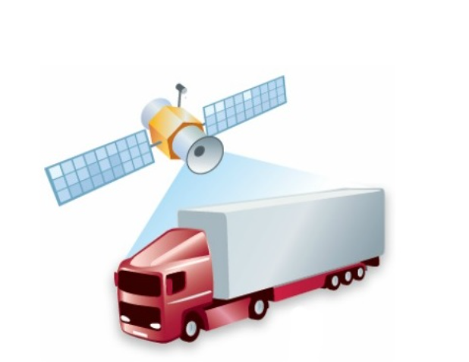

Slide 9
This latest integration undertaken by our team of dedicated developers takes the number of interfaced systems to thirty-five.”
Paragon Route Execution – one of the Paragon Live modules - provides real-time visibility of exactly how vehicles are performing against plan.
Any issues can be seen immediately so transport planners can take steps to mitigate the impact, avoiding unnecessary costs and poor service delivery.
It also provides the ability to interface multiple tracking feeds simultaneously, which is particularly important for operations that use more than one telematics system within their fleet. For example, transport organisations who want to track agency vehicles during peak periods.
“Taking advantage of highly accurate real-time information, the integration of vehicle tracking and routing and scheduling provides an early warning system.
It can alert transport planning and customer service teams to potential delivery delays or missed time windows, making it possible to better manage exceptions and understand how they will impact schedules. It also enables the analysis of what is happening on a day-to-day basis against key performance indicators, allowing transport operators to target continuous improvement and create tighter, more accurate plans for the future,” concludes Salter.

Slide 10
Whether you’re planning every day, or producing a set of fixed routes that will be operated for a short period of time, the key goal is transport efficiency and thus cost savings.
In the current economic climate it will be the operators who make the most of their route optimisation systems that will stay on top. Here are a few suggestions to get you started.
1. Switch to automated planning - If you currently manage your routing and scheduling manually, consider implementing automated planning. A route optimisation system will quickly produce accurate and reliable routes based on your business-specific criteria. Although this can look like an expensive option in the short term, many businesses see a return on investment in just a few months, giving the business freedom to grow and your transport planners the opportunity to look for further efficiency savings.
2. Repeat fixed route optimisation - As your customer list changes week by week, and seasonality kicks in, your fixed routes will become less optimal. Consider reviewing your fixed routes more frequently, factoring in changes such as customer delivery times, in order to keep costs down. Using an automated route optimisation system means this is no longer the massive headache of a manual re-routing exercise.

Slide 11
3. Conduct strategic assessments – Step back from your daily route planning and ascertain the cost savings that could be achieved by changing the way that you operate.
For example, using different vehicle sizes, drivers’ hours, delivery frequencies or delivery locations.
4. Experiment with your route optimisation parameters – Your transport plans may change over time with new customers, changes to delivery windows and increasing levels of congestion.
Check your vehicle routing system set-up remains finely tuned to optimise your operation as it evolves, so that you achieve the maximum reduction in fuel and fleet costs.

Slide 12
5. Review fuel usage - If you handle relatively heavy items and know the weight of your deliveries or collections then consider implementing a fuel reduction improvement strategy.
This approach will look to change the drop sequences to reduce fuel usage, by reducing heavily laden mileage. You will also be reducing your CO2 reductions at the same time.
6. Link to live vehicle tracking – Linking the transport plan to your preferred telematics technology will enable you to detect “off route” increases in distance and act accordingly.
It will also help you to identify areas of slack in your planning set-up which, when tightened, will result in improvements in productivity.
7. Experiment with time windows - If possible, relax the time window constraints at your delivery points.
Route optimisation software will then be able to suggest more cost effective routes that save you money overall.

Slide 13
8. Benchmark and review your progress - Ensure that your planners are generating KPI information for you each day; you will be able to use this information to benchmark the planning process and to detect trends.
Reducing costs and C02 is a continuous process for all transport operations. Here at Paragon, our experienced support team work with customers from many different sectors to help them realise savings from the outset.
http://www.paragonrouting.com/paragon-blog/8-money-saving-tips-reduce-transport-costs/

Slide 14
According to research from the Centre For Sustainable Road Freight, it is estimated that HGV operations currently account for around 6% of all UK CO² emissions.
When you consider that almost a third of heavy goods vehicles on our roads are empty, the environmental impact is frightening, but so too is the inefficiencies afforded to transport companies themselves.
Defra figures from 2012 show that for every kilometre it travels, an empty articulated 33 tonne+ lorry creates 0.69872kg of CO².
Driving from Land’s End to John O’Groats in an empty lorry would emit around one tonne of carbon dioxide – comparable to boiling a kettle 20,000 times or driving 3,000 miles in an average petrol car.
It’s no surprise, then, that some of the country’s top researchers and industry leaders have joined forces to improve road freight efficiency and reduce its environmental impact through the formation of The Centre For Sustainable Road Freight.

Slide 15
But the real drive for change and the reduction in empty journeys needs to also come from smaller fleet operators too.
There are signs that operators are beginning to look at new and inventive ways to tackle empty running and saving themselves a fortune in the process.
Returnloads.net, which is as much an online logistics community as it is a haulage exchange website.
( https://www.returnloads.net/?gclid=CJWHt4HG39ACFc277QodiooH4 )
With between 3,000-4,000 loads and vehicles available on the site each day, it’s estimated that Returnloads.net could save upwards of 50m empty running miles each year.
Not only is there a very real prospect of making a collective difference to the environment, the cost savings being made are immense.

Slide 16
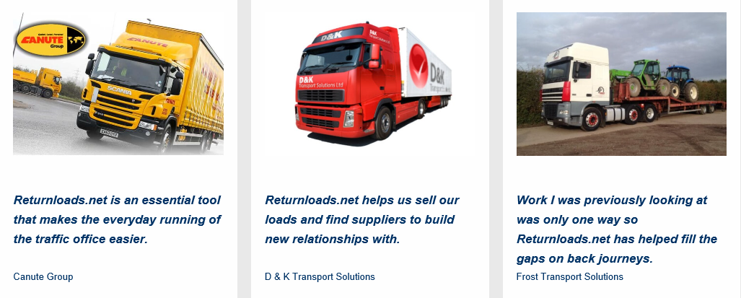

Slide 17
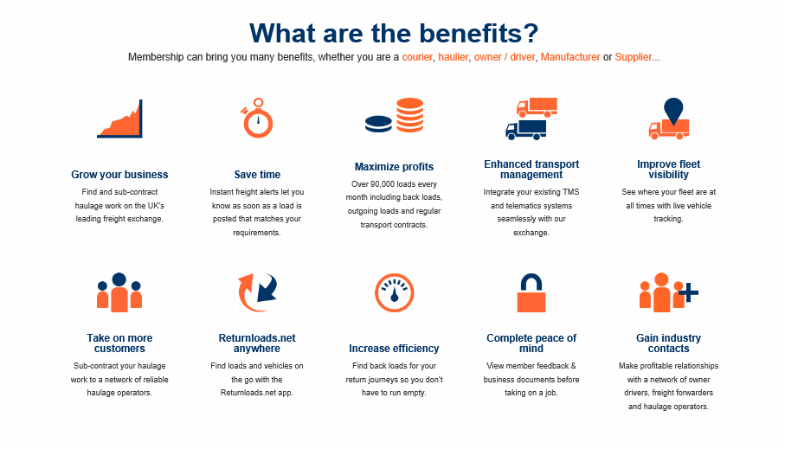

Slide 18
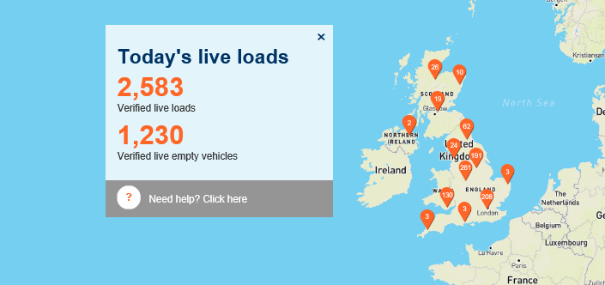
@6 December 2016, 12.21 hrs

Slide 19
It is estimated that as many as 70% of traffic offices that rely on back-loading to try and fill the gaps in their operations still use the traditional method of employing somebody to make countless phone-calls to try and arrange transportation.
Jack Richards & Son was one such company prior to 2012, but now places 200 loads and finds 100 loads per month using the resource.
Mark White, transport manager at Jack Richards, comments: “Returnloads.net helps our traffic office work far smarter and greener by looking on the site for a backload as opposed to calling companies randomly; we would literally be making hundreds of these calls every day.”
The founder of returnloads.net, Richard Newbold says: “The site was born out of my own frustrations of running a busy traffic office, but is now as much about saving the environment as it is about delivering tangible business benefits to the members.”
Currently, a significant percentage of the membership fees go straight back into further development of the site.

Slide 20
In fact, returnloads is one of the most inexpensive haulage exchanges where members can sign-up and start benefiting from as little as £29.50 per month.
It seems committed to keeping monthly subscriptions low for members whilst at the same time improving the user experience by adding new functionalities on a month-by-month basis.
Of course, it depends how you use the site, but for those placing a couple of hundred loads a month the savings could be as much as £100,000 per year. Take Barronwood Distribution Ltd, which has eight separate branches across the UK, where the savings have been immense.
Barronwood’s Stuart McMillan, comments: “We can place as many as 500 loads per week onto the site.
It’s almost impossible to quantify the exact savings and reduction in empty journeys as a result, but we used to call thousands of haulage companies over the phone before returnloads.net became available to us.”
Of course, back-loading is not without its challenges. It is an exceptionally simple concept, but many businesses still don’t know about how easy it is to connect with third parties online. As a member-based community, everybody is committed to reducing empty running by working together, with around 50% of members both placing and finding loads on a daily basis.

Slide 21
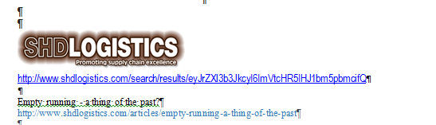
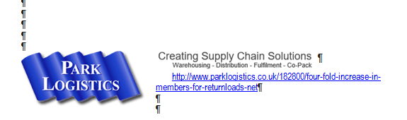
https://www.returnloads.net/

Slide 22
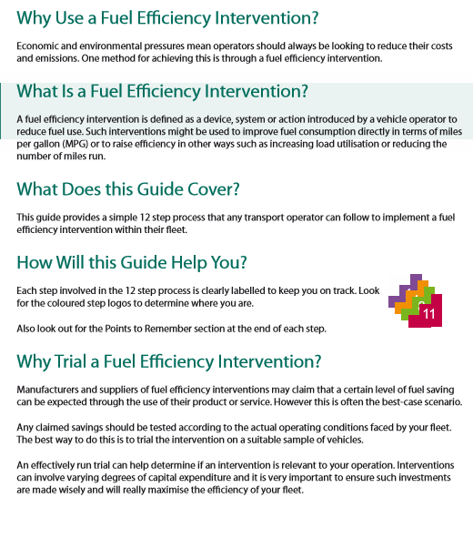
www.fors-online.org.uk/resource.php?name=FBP_FUEL_EFFICIENCY

Slide 23
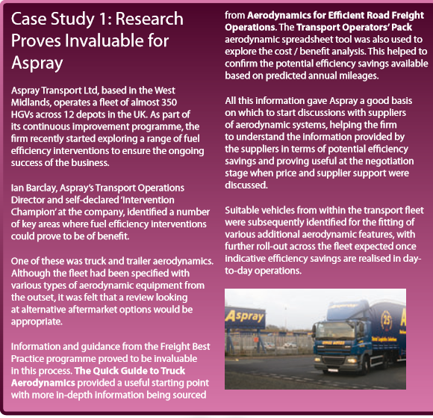
Vehicle Dynamics/Design

Slide 24
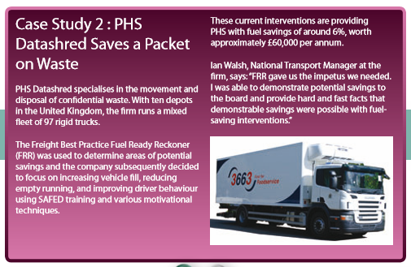
Capacity utlisation

Slide 25
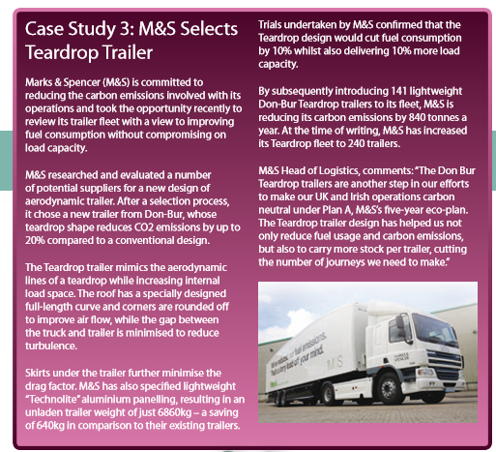
Trailer Dynamics/design

Slide 26
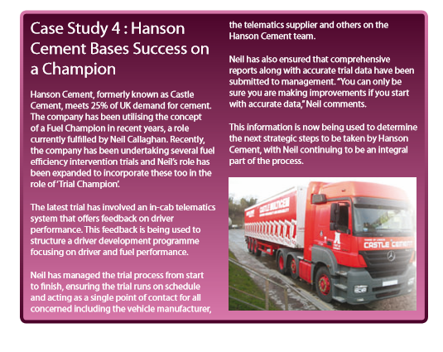
Driver’s performance

Slide 27
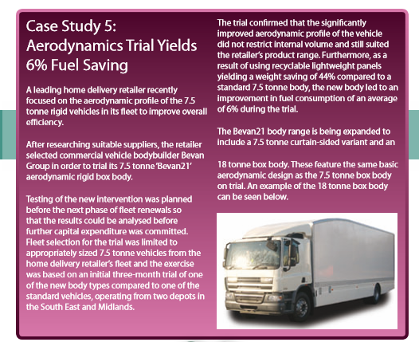
Rigid Body Design

Slide 28
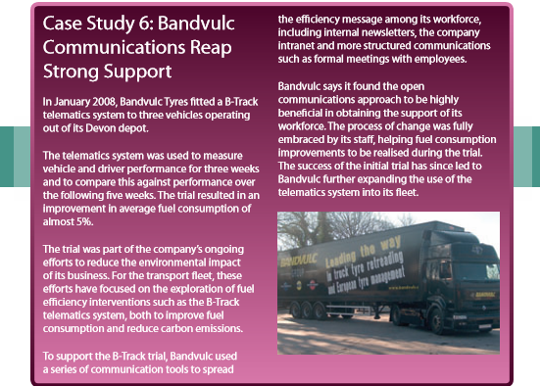
Vehicle and Driver performance

Slide 29
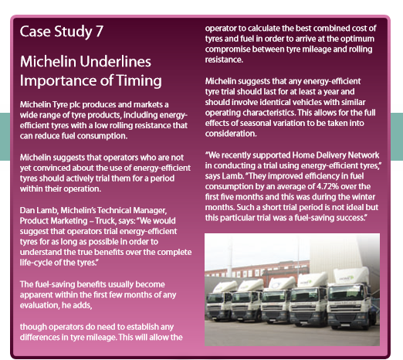
Energy efficient tyres

Slide 30
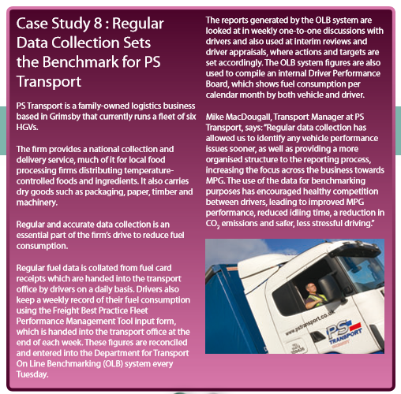
Bench Marking, Fuel Consumption

Slide 31
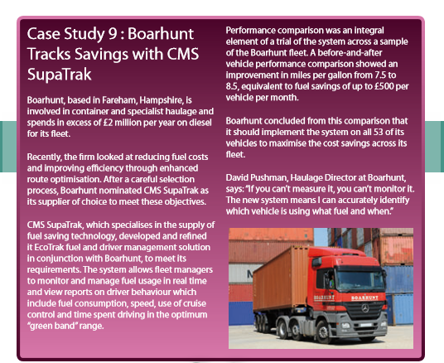
Real time monitoring of Driver’s behaviours on the road

Slide 32
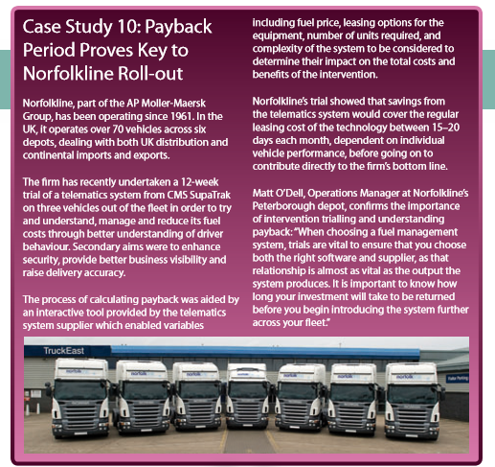
Spend to save. Balance of Investment, Return on capital invested.

Slide 33
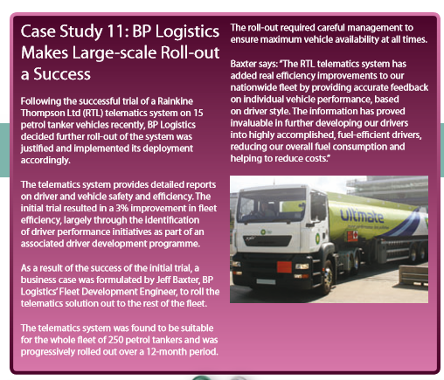
Driver performance and other development measures supporting large scale roll out .

Slide 34
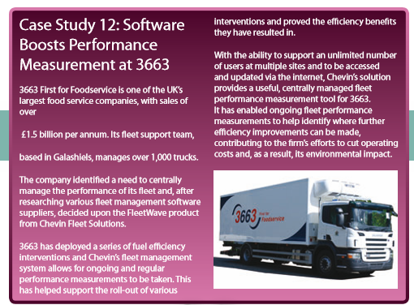
Data analysis & performance measures

Slide 35
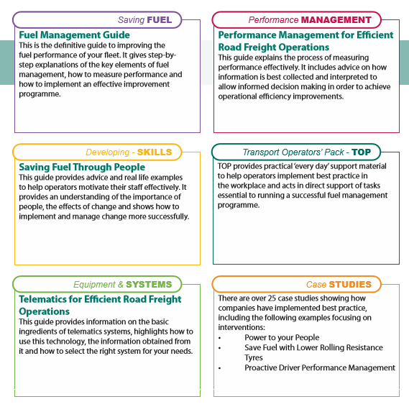
file:///C:/Users/Windows/Documents/NVQ-Swansea%20-%20Level%204%20-%20Yr%202/NVQ-Swansea%20-%20Level%204%20-%20Yr%202%20-%20Sustainable%20Logistics%20Operations/Wk10_Dec/20161206%20FBP%20Fuel%20Efficiency%20Intervention%20Trials.pdf

Slide 36
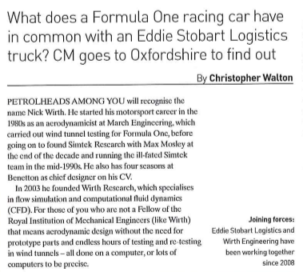

Slide 37
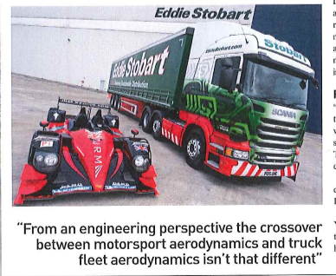

Slide 38
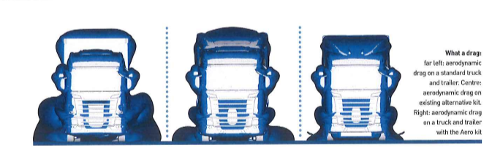

Slide 39
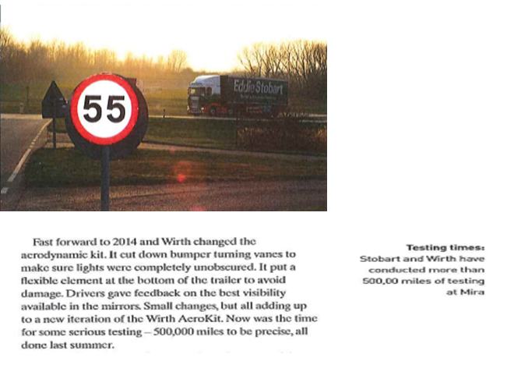

Slide 40
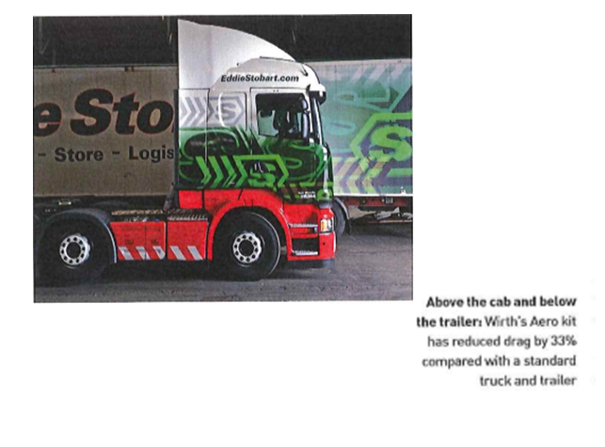

Slide 41
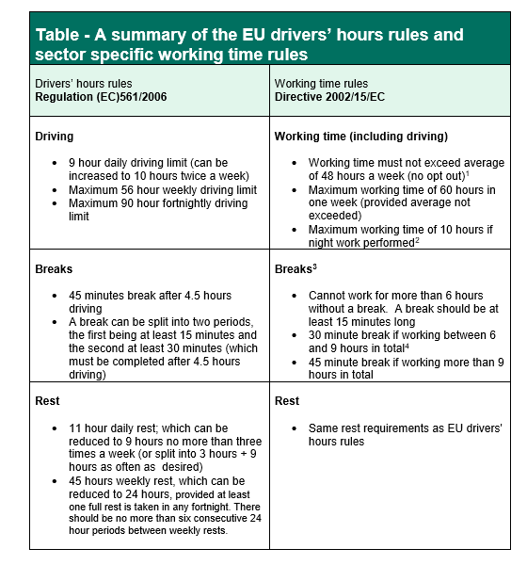
https://www.gov.uk/government/uploads/system/uploads/attachment_data/file/410321/Simplified_Guidance_-_EU_drivers__hours___working_time_rules.pdf

Slide 42
What is classed as working time?
In general any activities carried out in connection with the transport operation count as work; such as:
• driving; • loading/unloading; • training that is part of normal work and is part of the commercial operation (e.g. driver CPC); • assisting passengers boarding/disembarking from vehicle; • cleaning, maintenance of vehicle; • work intended to ensure safety of vehicle and its cargo and passengers (e.g. monitoring loading and unloading - including daily defect check and report); • administrative formalities or work linked to legal or regulatory obligations directly linked to the specific transport operations under way; • time during which the mobile worker cannot freely dispose of his/her time and is required to be at the workstation ready to take up normal work, with certain tasks associated with being on duty (e.g. working in the warehouse, or in an office or doing other activities for the employer);
• waiting periods where the foreseeable duration is not known in advance by the mobile worker, either before departure or just before the start of the period in question.
What is not included in working time?
Routine travel between home and your normal place of work; rest and breaks and periods of availability.

Slide 43
What is a Period of Availability?
A Period of Availability (POA) is basically waiting time, which is not a break or a rest. However, to count as a POA a driver must be available to answer calls to start work or resume driving on request and the period and the duration should be known to the driver in advance, either before departure or just before the start of the period in question.

Slide 44
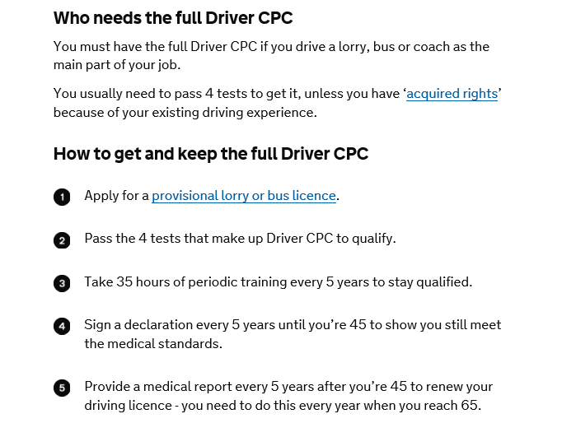

Slide 45
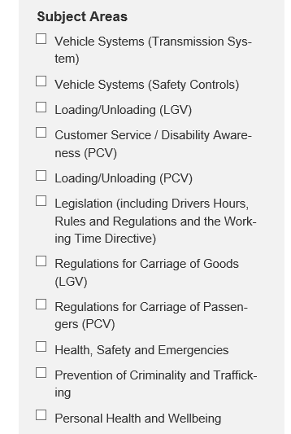
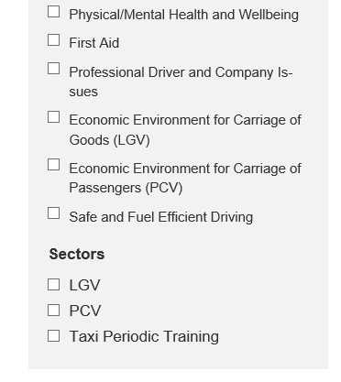
https://www.jaupt.org.uk/course-search

Slide 46
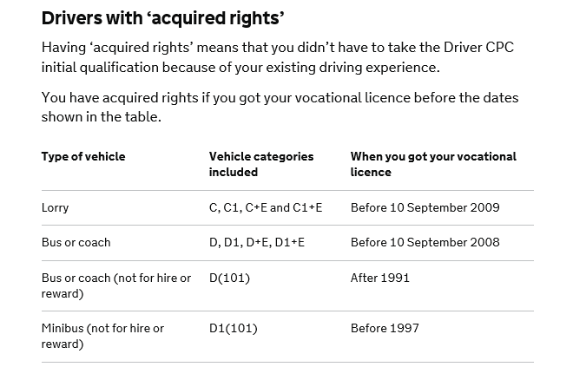

Slide 47
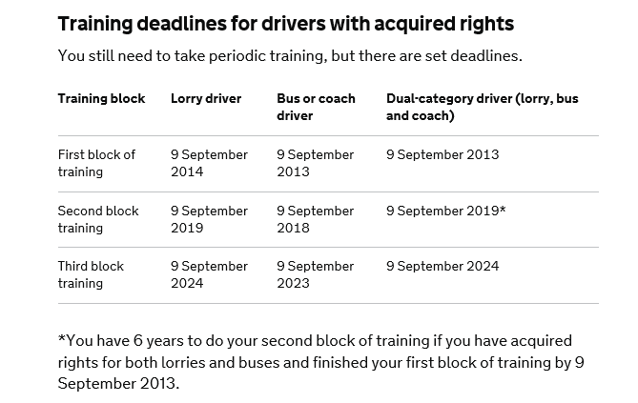

Slide 48
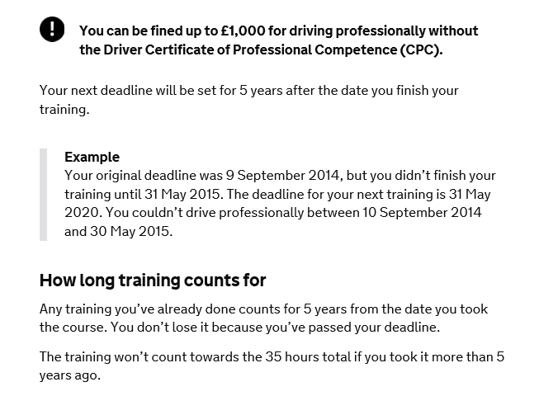
https://www.gov.uk/driver-cpc-training/if-you-miss-your-training-deadline

Slide 49
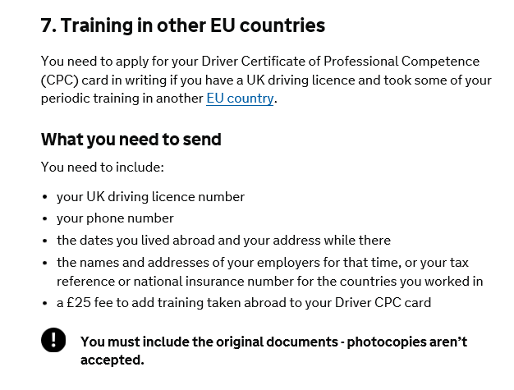

Slide 50
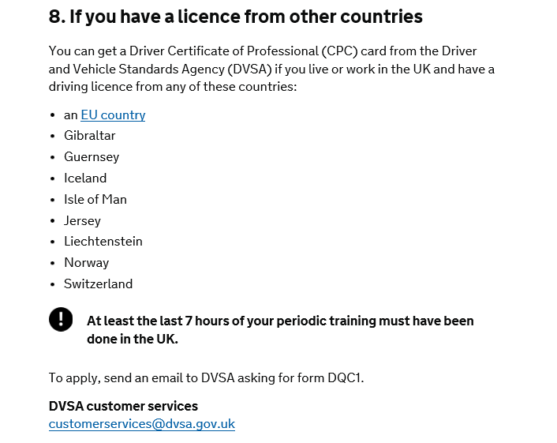

Slide 51
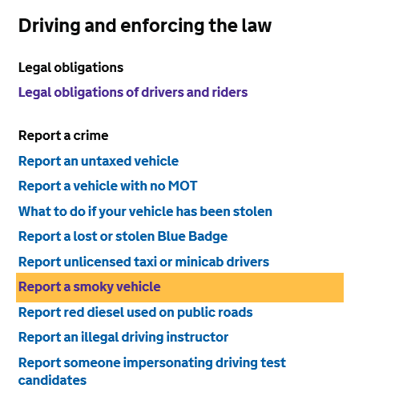
https://www.gov.uk/browse/driving/driving-enforcing-the-law

Slide 52
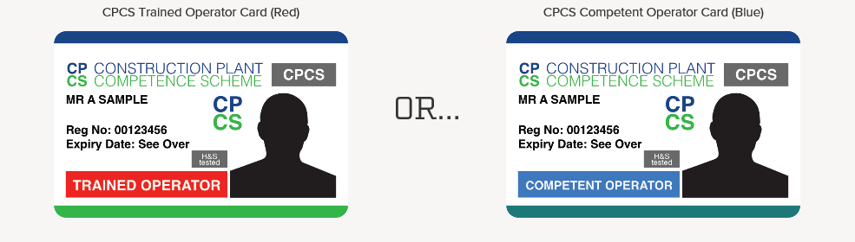
http://www.operatortraining.co.uk/

Slide 53


Slide 54
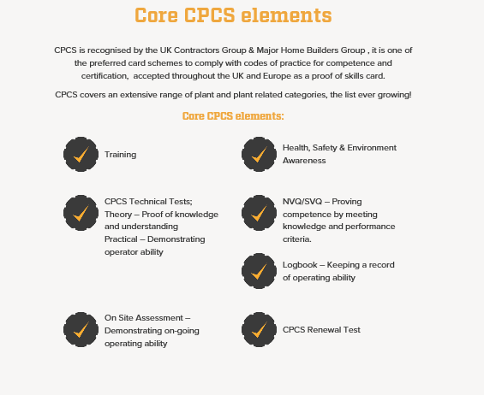

Slide 55
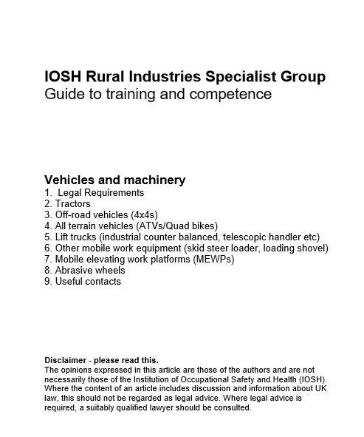
file:///C:/Users/Windows/AppData/Local/Microsoft/Windows/INetCache/IE/XI35MBZR/Vehicles%20and%20machinery%20v2.pdf

Slide 56
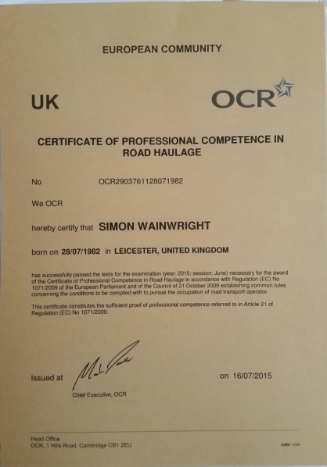

Slide 57
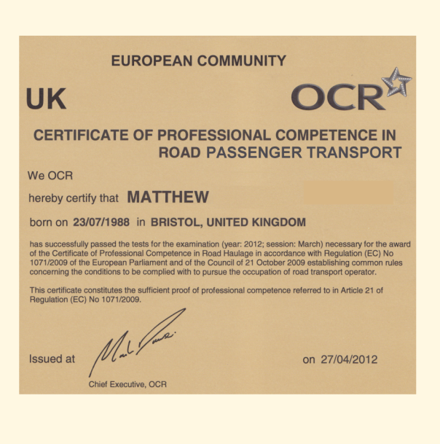

Slide 58
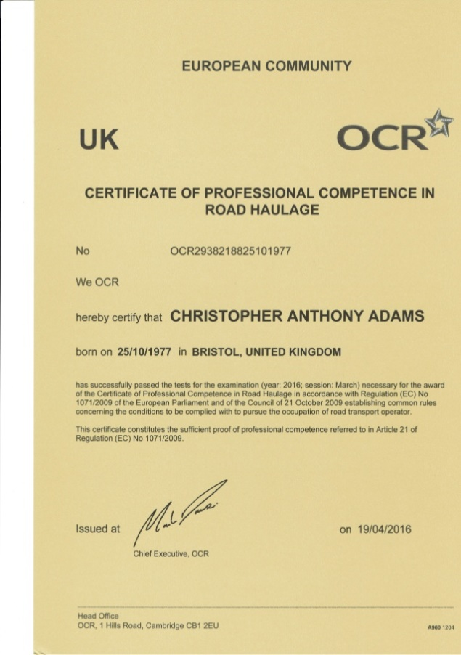

Slide 59
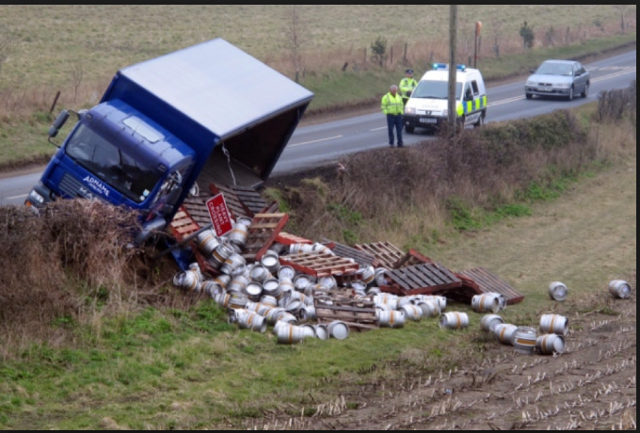
QUESTIONS
https://www.google.co.uk/search?hl=en&site=imghp&tbm=isch&source=hp&biw=1188&bih=511&q=codes+of+practice+vehicle+operators&oq=codes+of+practice+vehicle+operators&gs_l=img.12

