Slide 1

MODULE CODE: BMHP6026
COMPONENT 2: VIVA VOCE (ORAL PRESENTATION)
MODULE: DIGITAL TRANSFORMATION IN THE HEALTH AND CARE PROFESSIONS
TOPIC: Electronic Health Records (EHRs): A Critical Evaluation of Digital Transformation in UK Health and Social Care
STUDENT NAME: S. Hortense Assoh
STUDENT ID:-2245799

Slide 2
Table of contents
Introduction to Electronic Health Records (EHRs)
EHR Adoption and Implementation in the UK
Impact on the Workforce
Impact on Service Delivery
Impact on Patients and Service Users
Impact on Community and Population Health
Critical Analysis – Key Benefits of EHRs
Critical Analysis – Challenges and Limitations
Conclusion and Recommendations
References List

Slide 3
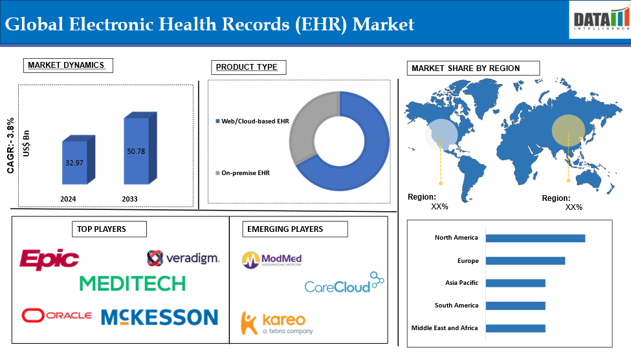
Introduction to Electronic Health Records (EHRs)
EHRs are an element of the NHS digital transformation (NHS England, 2025a).
Replace the patched paper records with inbuilt electronic systems.
Encourage evidence-based, real-time clinical decision-making.
Aim to attain efficiency, safety, and patient-centered care.
Fig 1: Global Electronic Health Records (EHRs) Market
(Source: Datamintelligence, 2025)
Notes:
The digital revolution is not a choice but rather inevitable in the contemporary healthcare system. One of the most powerful innovations that have been adopted in UK health and social care in the past ten years is electronic health records. EHRs allow access to all the information about a patient in any care setting instantly compared to the use of traditional paper records (NHS England, 2025a). This helps in evidence-based practice and multidisciplinary and safer clinical decisions. Nevertheless, EHR implementation cannot be considered a technological change itself. It relies on the organisational preparedness, labour skills and endurance. Hence, one cannot critically address the issue of EHRs and their advantages in terms of technical improvements alone but also their overall role in the quality and outcomes of healthcare.

Slide 4
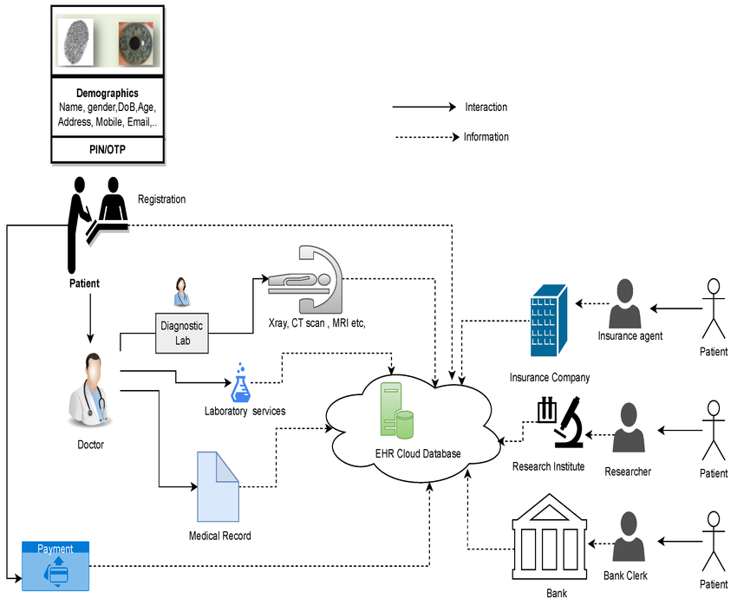
EHR Adoption and Implementation in the UK
EPRs are present in 93% of the NHS trusts.
An NHS digitisation program with a cost of 1.9 billion investment (NHS England, 2025a).
Evidence of digital engagement is over 39 million NHS App users (NHS England, 2025a).
Interoperability and resource issues are yet to even be adopted.
Fig 2: Overview of electronic health record (EHR) data utilisation
(Source: ResearchGate, 2025)
Notes:
The extensive use of EHRs signifies the interest of the NHS in the digital transformation. The move towards electronic systems (not paper-based systems) has been affected by the huge financial investment in favour of national objectives of integrated care. Moreover, as online healthcare services are becoming increasingly popular with the population, the use of the NHS app is expected to increase, which will likewise improve. However, the rates of adoption do not necessarily imply the successful implementation (NHS England, 2025a). As it can be observed, the variation of resources within organisations, digital maturity, and interoperability are some of the drivers of performance variation within the healthcare settings. Therefore, it is possible to say that its implementation is very successful, but the final success is what matters, i.e., whether the EHR systems can result in improved healthcare outcomes, efficiency, and patient experience across the NHS.

Slide 5

Impact on the Workforce
Improves clinical decision-making by availing real-time information.
Improves interdisciplinary collaboration and interaction (Alzu'bi et al., 2021)
Demands further education on digital abilities.
May contribute to the workload and computer fatigue (BMA, 2022).
Fig 3: Advantage Of Electronic Health Records (EHRs)
(Source: Avontix, 2025)
Notes:
In the workforce, EHRs have transformed the process of accessing, manipulating, and sharing information among healthcare workers. The availability of patient records is easily accessible and makes it easier to make better clinical decisions for multidisciplinary clinical teams. But studies have shown that there is a paradox. Despite the fact that EHRs should help streamline the work process, one of the groups of healthcare workers states that they spend more time at workstations and less time with patients (Alzu'bi et al., 2021). This implies that technological innovation is not necessarily useful in making the workforce more productive. The success of EHRs is dependent on the correct training and design of the system, as well as the organisational support. By doing so, healthcare leaders are expected to be able to strike a balance between technological advancements and HR concerns so that the former can be used to benefit the most and the latter can be minimised (BMA, 2022).

Slide 6
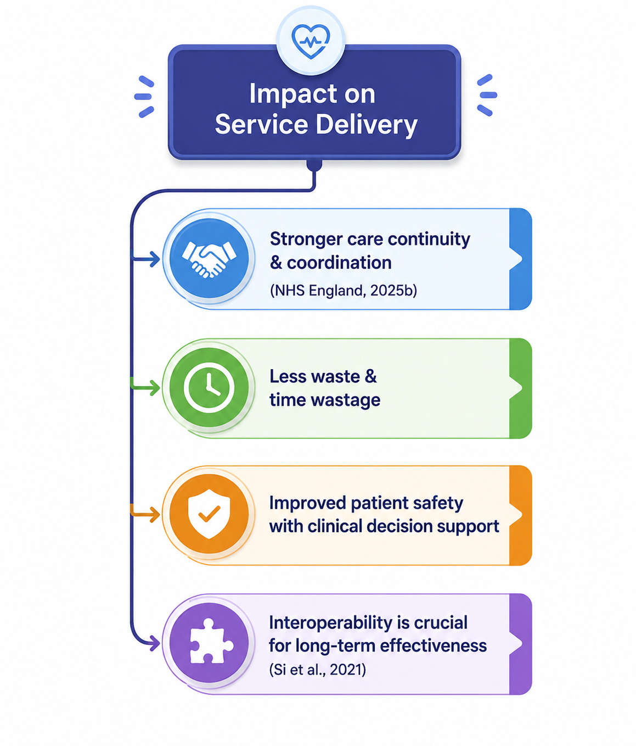
Impact on Service Delivery
Strengthens the care continuity and coordination (NHS England, 2025b)
Lessens wastage and time wastage in health.
Improves patient safety by way of clinical decision support.
Interoperability is crucial to long-term effectiveness (Si et al., 2021).
Notes:
Service delivery is one of the features based on which EHR introduction is a successful one. It will enable them to plan the care in a more sufficient manner and prevent the cases of service redundancy because they will be able to provide data to all patients through healthcare professionals. The other method in which the clinical decision-support systems come in handy is by enhancing safety by detecting drug interactions and risks of therapy. However, these advantages are not always achieved. The free flow of communication between healthcare organisations is still constrained by interoperability issues (NHS England, 2025b). This means that digitalisation projects will subject some patients to disjointed care. It confirms that the usefulness of EHRs is not just conditioned by their functionality but also by the extent of integration of healthcare systems both locally and nationally (Si et al., 2021).

Slide 7
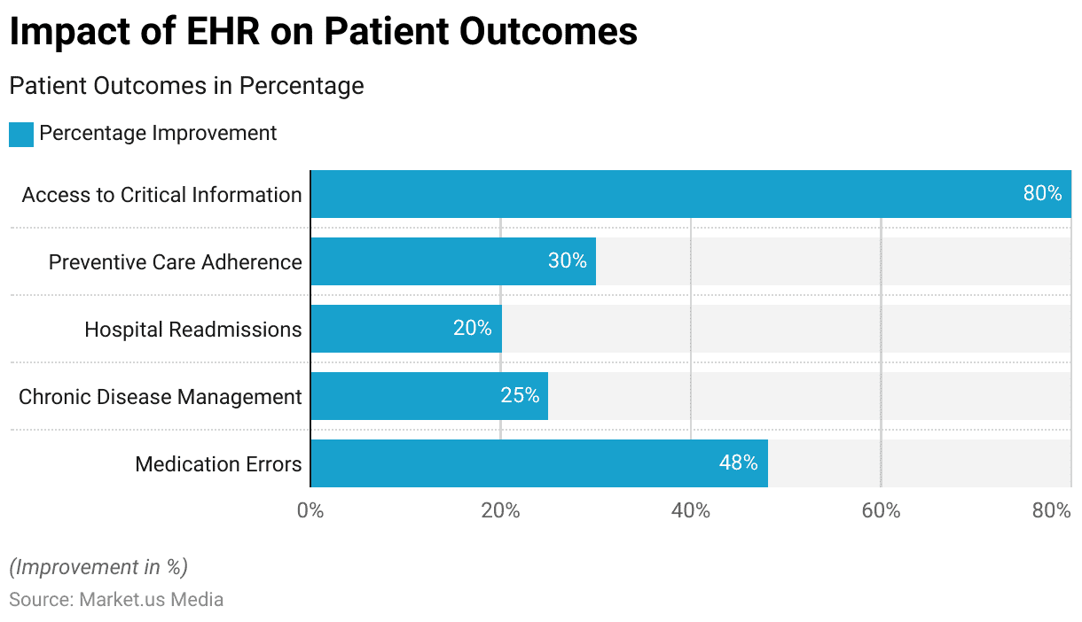
Impact on Patients and Service Users
Improves the quality and continuity of care (NHS England, 2025c)
Further encourages patient empowerment and self-management (NHS England, 2024)
Lessens the errors in prescriptions and documentation.
Raises the questions of confidentiality and privacy.
Fig 4: Electronic Health Records (EHRs) Impact on Patients and Service Users
(Source: MarketMedia, 2025)
Notes:
Patients can also be considered the primary beneficiaries of EHR implementation. The ease of access to the information about health-related issues, which will be offered by these applications, such as the NHS App, will contribute to the influx of people into the healthcare process and self-treatment of chronic illnesses (NHS England, 2025c). In addition, the enhanced patient safety will be achieved due to the accuracy of the records. Privacy, safety, and trust of patient data are, however, linked to benefiting the patient. Research has also found out that the degree of trust that individuals place in digital healthcare can be increased by transparency in managing data and a high level of cybersecurity. Thus, patient-centred care will be realised through the establishment of a balance between innovation and ethical requirements of healthcare organisations that involve the aspects of confidentiality, consent, and data protection (NHS England, 2024).

Slide 8
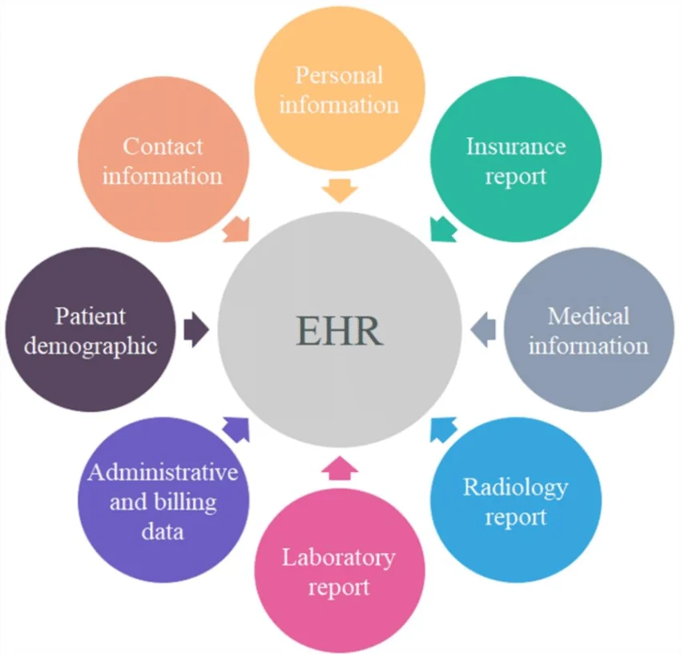
Impact on Community and Population Health
Promotes the health monitoring and planning of the population (NHS England, 2025a)
Enables interventions on population health.
Donated to the delivery of COVID-19 immunisations.
This may restrict the benefits since it does not have a digital presence (Lloyds Bank, 2023)
Notes:
The EHRs lead to patient care that will provide valuable information, which may be utilised to support the management of population health, along with the planning of public health. It was also revealed that the digital records played a relatively important part in the COVID-19 pandemic in assisting to define the at-risk groups as well as in organising vaccination programmes (NHS England, 2025a). All these features show the way EHRs may be applied in evidence-based policy-making and resource distribution. But not everything about the benefits of digital healthcare is equal. This digital inaccessibility problem is very critical, and it needs to be dealt with, especially for the low-income earners, the aged and those with less digital expertise (Lloyds Bank, 2023).

Slide 9
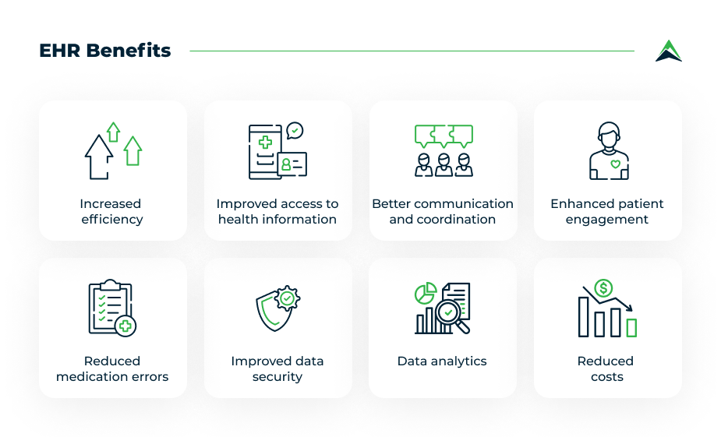
Critical Analysis – Key Benefits of EHRs
Enhances health care intersectoral communication (Alzu'bi et al., 2021)
Improves quality and safety of the patient.
Enhances efficiency and use of resources (Kohane et al., 2021)
Prefer decision-making and research to be evidence-based.
Notes:
Everything is massively weighted towards the fact that EHRs are bringing immense benefits to the healthcare systems. The enhanced communication will decrease the spread of information and support the joint care pathways. This is because the process of prescribing and better clinical decision-making is made easier by the more accessible patient information (Alzu'bi et al., 2021). Furthermore, valuable healthcare research and service planning can be done using EHR-generated data. All these benefits, however, are achieved in the best manner possible when the organisations invest in training of personnel, technological infrastructure and integration of the systems. Therefore, EHRs are not digital records but may become effective strategic tools that can improve the quality of care, operational efficiency, and health outcomes in the long run (Kohane et al., 2021).

Slide 10
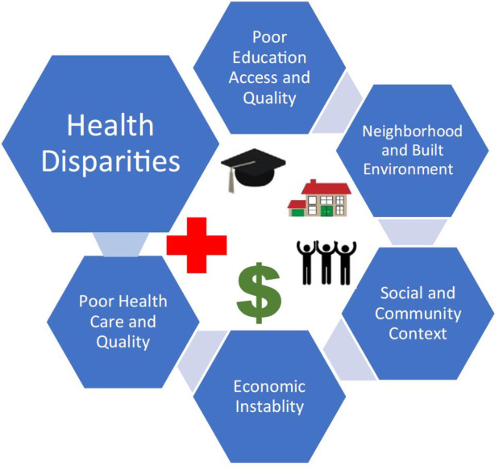
Critical Analysis – Challenges and Limitations
Large implementation and maintenance costs (Holmes et al., 2021)
Cybersecurity threats are a threat at all times.
The system lacks the interoperability which is a setback to its effectiveness.
Healthcare disparities may be a result of digital inequalities.
Notes:
Although the benefits seem to be evident, numerous difficult questions arise during the deployment of EHR. The cost of money does not just confine to the cost of the software but also the upgrade of the infrastructure, maintenance, and employee training. The vulnerability of the electronic healthcare systems is also brought by another emerging cyber threat. The interoperability problem also restricts the transfer of information and efficiency of work (Holmes et al., 2021). However, above all, the issue of digital exclusion is also ethically questionable, as long as providing healthcare on a reasonable ground is considered. These constraints imply that digital transformation cannot be seen as a panacea to the healthcare issues. Instead, it will require sustained investment, good governance, and policies that will ensure technological and social sustainability are put in place successfully.

Slide 11
Conclusion and Recommendations
Adoption of EHRs has revolutionised healthcare provision in the UK.
Negatives are not normally as numerous as the positive side.
Invest in leadership and manpower online training.
Increase interoperability, cybersecurity, and digital inclusion.
Notes:
In conclusion, the EHR has totally revolutionised health and social care in the UK by improving the interaction, workforce, delivery of services and health outcomes of the populations. The experience demonstrates that more likely it was a positive rather than a difficult experience. However, in order to implement it successfully, one needs to comprehend that technology cannot transform healthcare. The organisational culture, workforce preparedness, patient and digital trust, and readiness are as much determinants of success. The healthcare organisations will have to ignore the workforce development to continue working, enhance cybersecurity systems, offer more interoperability, and fix the digital disparities. These actions will help in making EHRs sustainable, secure, fair, and patient-centered in health care delivery in the United Kingdom.

Slide 12
References List
Alzu'bi, A.A., Watzlaf, V.J. and Sheridan, P. (2021) Electronic health record (EHR) abstraction. Perspectives in health information management, 18(2).https://ahisp.kglmeridian.com/view/journals/phim/18/2/article-1g.xml
British Medical Association (2022) Electronic health records and workload pressures in the NHS. London: BMA. [Online]. Available at: https://www.bma.org.uk/advice-and-support/nhs-delivery-and-workforce/pressures/an-nhs-under-pressure (Accessed on: 1 June 2026)
Holmes, J.H., Beinlich, J., Boland, M.R., Bowles, K.H., Chen, Y., Cook, T.S., Demiris, G., Draugelis, M., Fluharty, L., Gabriel, P.E. and Grundmeier, R. (2021) Why is the electronic health record so challenging for research and clinical care?. Methods of information in medicine, 60(01/02), pp.032-048. https://www.thieme-connect.com/products/ejournals/abstract/10.1055/s-0041-1731784
Kohane, I.S., Aronow, B.J., Avillach, P., Beaulieu-Jones, B.K., Bellazzi, R., Bradford, R.L., Brat, G.A., Cannataro, M., Cimino, J.J., García-Barrio, N. and Gehlenborg, N. (2021) What every reader should know about studies using electronic health record data but may be afraid to ask. Journal of medical Internet research, 23(3), p.e22219.https://www.jmir.org/2021/3/e22219/
NHS England, (2024) Frontline Digitisation Programme. London: NHS England. [Online]. Available at: https://www.england.nhs.uk/long-read/frontline-digitisation-programme/ (Accessed on: 1 June 2026).
NHS England, (2025a) Digital maturity assessment report 2024–2025: Key findings. [Online]. Available at: https://digital.nhs.uk/data-and-information/digital-maturity-assessment-report-2024-and-2025-results/key-findings (Accessed on: 1 June 2026).
NHS England, (2025b) NHS App statistics. Office for National Statistics (2024) Internet access – households and individuals, Great Britain. [Online]. Available at: https://www.england.nhs.uk/2025/12/record-numbers-using-nhs-app-to-manage-health (Accessed on: 1 June 2026)
Si, Y., Du, J., Li, Z., Jiang, X., Miller, T., Wang, F., Zheng, W.J. and Roberts, K. (2021) Deep representation learning of patient data from Electronic Health Records (EHR): A systematic review. Journal of biomedical informatics, 115, p.103671. https://www.sciencedirect.com/science/article/pii/S1532046420302999

