Slide 1
Ways of Perceiving
Quick review

Slide 2
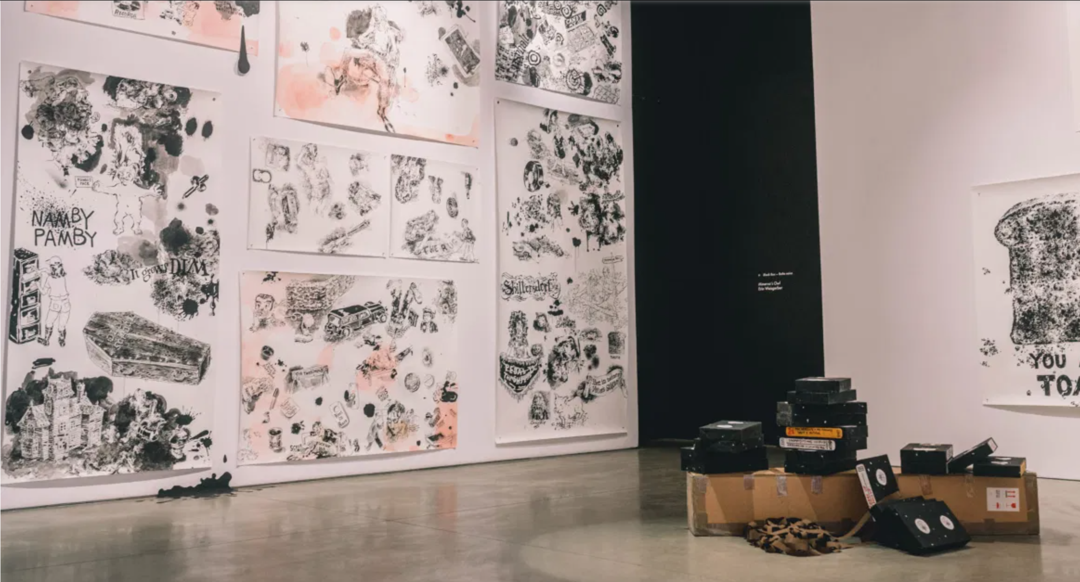
Notes:
http://theconcordian.com/2017/09/new-exhibition-occupies-indoor-and-outdoor-space/

Slide 3
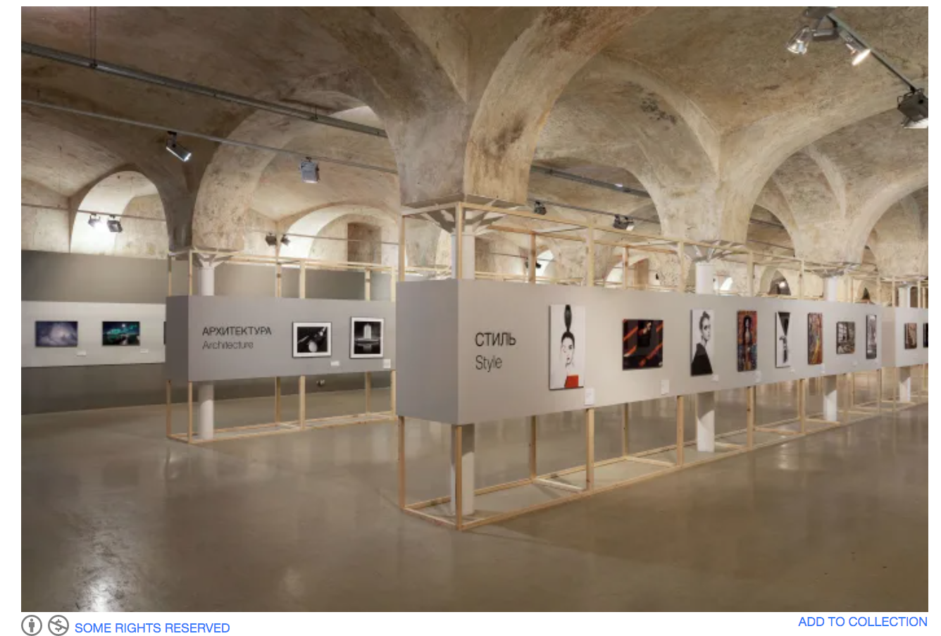
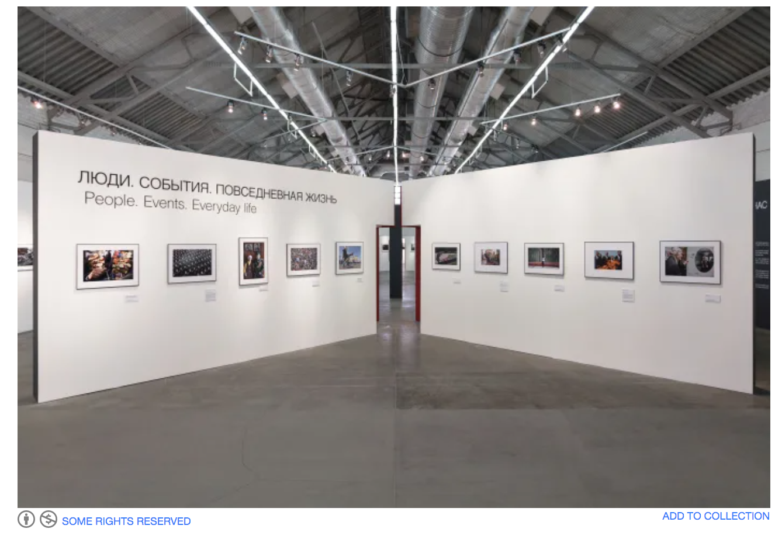
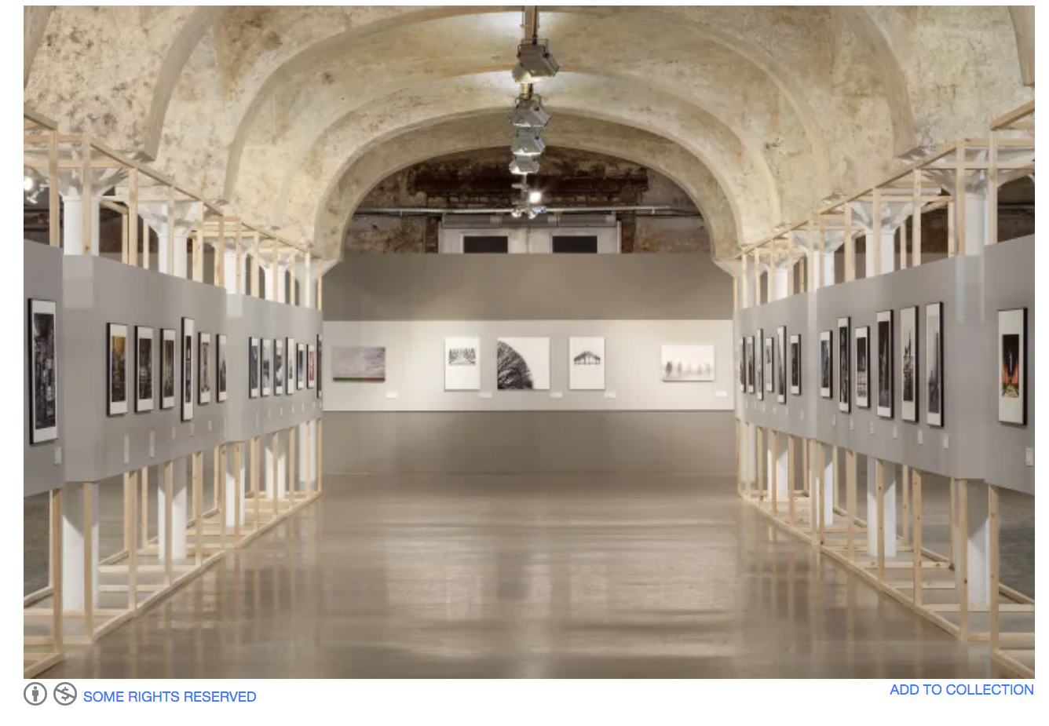
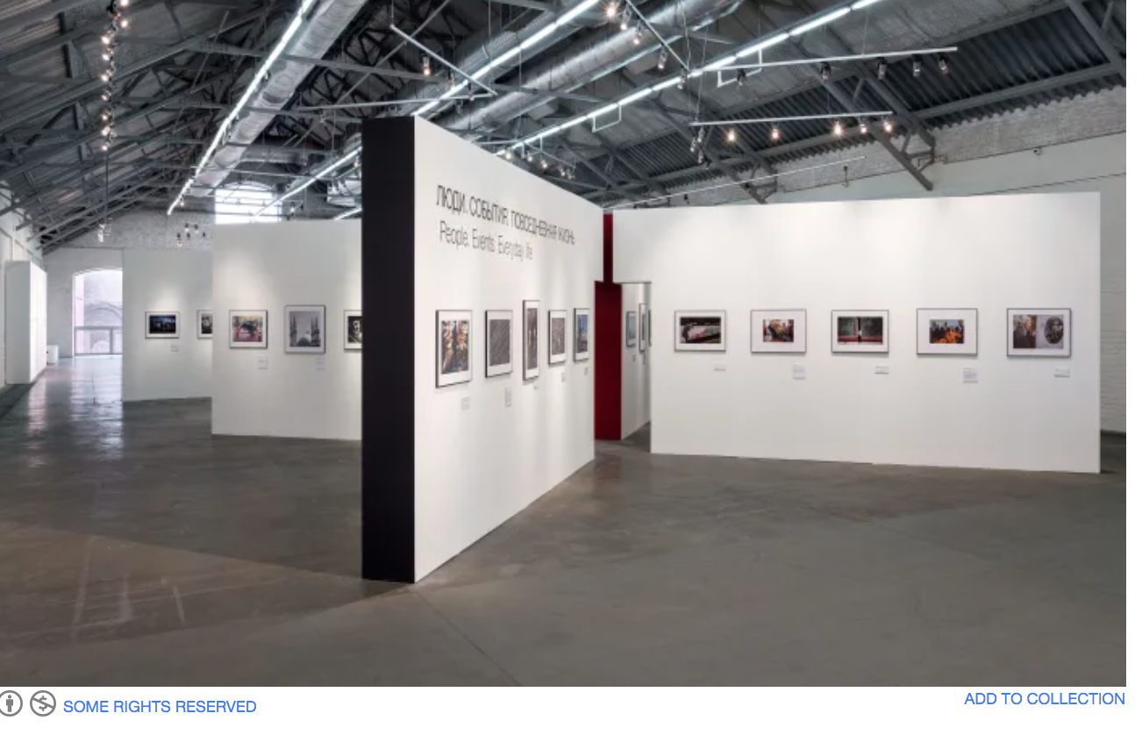
Notes:
https://divisare.com/projects/322529-nowadays-office-best-of-russia-exhibition-space

Slide 4
Module Learning Outcomes
Upon the successful completion of this module, the student should be able to:
recognise and employ a range of critical theories to the analysis of a cultural product or practice;
communicate a response to different approaches to understanding elements of cultural endeavour which makes reference to academic sources and employs appropriate citation and referencing conventions.

Slide 5
Assignment
You will work on an imagined display space which will be explored through your own interests and discipline, so it might be an exhibition, festival, performance, etc.
This task will involve research practices and approaches applied to deconstruct art and design histories.
Students will be assessed for an exploratory written piece, including maps, diagrams and images, of 1500 words.

Slide 6
The story so far…
Critical theories:
deconstruction, diologism, nation, subjectivity and your own manifesto, semiotics, curation, dramaturgy, emancipation of the spectator, and the cultural significance, social awareness, political aspiration, economic impact, personal investment and philosophical analysis of practice.

Slide 7
The story so far…
Cultural endeavor:
Creating meaning related to our own perception of ‘culture’, considering and respecting creative practice in relation to the period of creation and period of exhibition from the…social, political, philosophical, personal, economic and cultural relevance of the process of creating and exhibiting work.
The influencing and adaptation of meaning through participation.
Notes:
Affect theory/ Participatory/ immersive.

Slide 8
Who/what/where/when/how?
Who?
You need to create a written plan of an exhibition of art work to portray an idea, theme, statement of beliefs.
This can be ‘through your own interests and discipline’.
I suggest that you discuss 5 ‘pieces’ within the context of your exhibition – but that you can refer to more if you choose.

Slide 9
Who/what/where/when/how?
What?
You need to create a written plan of an exhibition of art work to portray an idea, theme, statement of beliefs.
This can be ‘through your own interests and discipline’.
This is a way of developing a critical and discourse driven way of perceiving how artwork is displayed/shared/shown/received.
You need to consider ‘how’ your exhibition communicates your message to/with/despite your intended audience.

Slide 10
Who/what/where/when/how?
Where?
You can use any space as a gallery.
This can be imagined or real – the moon or the Tate – but you should explain why you are choosing the location as your platform.
Consider the impact of the location on your intended audience.

Slide 11
Who/what/where/when/how?
When?
There are two answers here:
1- by 12pm on the 4th of May
2- ‘anytime’ – you can locate your exhibition today or in another time period – so long as you explain why you have chosen to do this in a research led manner.

Slide 12
Who/what/where/when/how?
How?
Be imaginative.
Be authentic.
Be you.
This is a task that emancipates you from real time and cost constraints – not quite a ‘thought experiment’ but an exploration of your ideas about art, and your opportunity to show what critical lenses – the influential factors and discourses - you consider to be important to your practice.

Slide 13
Some beautiful examples of real exhibitions
https://www.iloboyou.com/top-2019-outdoor-art-installations-in-public-spaces/
https://www.architecturaldigest.com/gallery/outdoor-art-exhibitions-slideshow
https://archinect.com/news/article/150032979/10-exhibition-spaces-from-around-the-world-for-your-friday-inspiration

Slide 14
Exhibitions ‘today’
I have mentioned the Glynn Vivian several times, so here it is:
https://www.glynnvivian.co.uk/
Take this tour and discuss what influential factors you recognise in / from and through the exhibition:
https://www.glynnvivian.co.uk/visit/take-a-virtual-tour/

Slide 15
Question
Is Instagram a gallery? Discuss.

Slide 16
More questions
What does access to art mean to you?
Is art and access to art a democratic topic?
How can digital art, digital representation and digital democracy change the impact of your exhibition?
What tools do you have to curate your exhibition? Intellectual, digital, physical.
What change can your exhibition illicit?
Notes:
Questions based upon Obrist’s ‘Curating the Future’ from ‘Ways of Curating’, (Penguin 2015).

Slide 17
Applied Theatre
Theatre ‘For’ – e.g. touring theatre for young people
Theatre ‘With’ – e.g. process based / workshop – involving participants in devising. Might not result in a presentation to a wider audience.
Theatre ‘By’ – e.g. a community make and perform theatre themselves. Community direct, plan, perform the event themselves.
(Prentki & Preston, 2009:10-11)
Notes:
Prentki, T & Preston, S. (2009) The Applied Theatre Reader. London: Routledge.

Slide 18
‘Theatre & Ethics’
Can work that is satisfying be ethical or are we agreeing with ourselves?
Ridout considers whether new truly ethical theatre – theatre that ‘would confront its spectators with something radically other, something that could not be assimilated by their existing understanding of the ethical’ - would be inherently un-ethical. (2009:67)
Notes:
Ridout, N. (2009) Theatre & Ethics. Basingstoke: Palgrave MacMillan

Slide 19
‘Theatre & Ethics’
Theatre needs to ‘justify itself in terms of it’s contribution to an ethical life’.
But because theatre has the power to question relationships and norms, ‘Theatre’s greatest ethical potential may be found precisely at the moment when theatre abandons ethics.’ (2009:70)
Notes:
Ridout, N. (2009) Theatre & Ethics. Basingstoke: Palgrave MacMillan

Slide 20
Gallery Ethics
‘Which is worse: accepting donations from a family linked to the manufacture of addictive drugs, or putting on an exhibition about an alleged paedophile?’ (Grosvenor, 2019)
‘Values may concern an object’s creation or ownership, its original use or subsequent uses, cultural appropriation, or research; they may be aesthetic, symbolic, educational, scholarly, cultural, political, or economic.’ (Gazi, ND)

Slide 21
Gallery Ethics
‘Ethics are not carved in stone - at different times and different places in different cultures people go about sensitive issues in different ways, and different moral values apply. If, then, the notion of ‘value’ is culturally specific, no particular system of ethics may be said to be absolutely right or wrong. Indeed, it has been suggested that ethical questions should primarily be understood as conflicts in cultural values’ (Goldstein and Kintigh 1990). (in Gazi, nd)

Slide 22
Ethics in Gazi’s article
‘Decisions about what to include and what to exclude, what is valued and what is not, the means of presentation, language, and so on, all lead to presentational styles which may shape the public’s perception in unintended ways.’

Slide 23
Ethics in Gazi’s article
’Even within the same culture ethics change as the needs and values of society, and museums, change. What was acceptable or ‘right’ in the past is not anymore, and today’s ethical standards may not apply in the future. How, then, can museums deal with ethical issues on a global scale?’ (Gazi)

Slide 24
Ethics in Gazi’s article
‘When objects are put on public display some of the values associated with them are opted for over others and this often leads to heated debates among the various parties involved (museums, curators, citizens, indigenous peoples, governments or nations, collectors, art dealers and so on’; cf. Warren 1999: 1) (in Gazi)

Slide 25
Gallery Ethics in Grosvenor, 2019
‘Which is worse: accepting donations from a family linked to the manufacture of addictive drugs, or putting on an exhibition about an alleged paedophile? It’s an unenviable ethical dilemma, but one which the National Portrait Gallery (NPG) in London has managed to become uncomfortably intimate with over the past year. It didn’t take the NPG and the Sackler Trust long to decide that, amid the opioid crisis in the US, it would be politic not to proceed with a planned £1m donation…’

Slide 26
Gallery Ethics in Grosvenor, 2019
‘..But the gallery had little hesitation in exhibiting Michael Jackson: On the Wall last year, despite the well-known allegations concerning the singer’s alleged sexual interest in children. Nicholas Cullinan, the NPG’s director (and the show’s curator), claimed it was a blockbuster but visitor numbers say otherwise—just over 82,000 bought tickets, compared with 136,000 for the NPG’s Cézanne Portraits. (Grosvenor, 2019)

Slide 27
Gallery Ethics in Grosvenor, 2019
‘You could even buy Jackson hats in the gift shop. Assessing Jackson’s impact on art might have been a valid curatorial exercise had it been done “warts and all”.’ (Grosvenor, 2019)
Point?
Chose carefully what you put on your walls and don’t be afraid to take things down if you uncover details that oppose your politic.

Slide 28
Bibliography
Gazi, A. (nd) ‘Exhibition Ethics - An Overview of Major Issues’ Journal of Museum and Conservation Studies. (Online) Available at:
https://www.jcms-journal.com/articles/10.5334/jcms.1021213/
Accessed 06/03/21
Grosvenor, B. (2019) ‘The National Portrait Gallery’s Ethical Dilemma’ The Art Newspaper. (Online) Available at:
https://www.theartnewspaper.com/blog/ethical-dilemma-and-taking-a-stand-on-copyright
Accessed 06/03/21
Prentki, T & Preston, S. (2009) The Applied Theatre Reader. London: Routledge.
Ridout, N. (2009) Theatre & Ethics. Basingstoke: Palgrave MacMillan

