Slide 1
Aribah shaffiq-2504748
Aylah Kousar-2505437
Lecturer Anika tahsin Ahmed
Lchs4007 digital skills & research methods assessments 1

Slide 2


How is excel used in a care home?
In a care home, Microsoft Excel is used as a practical tool to organize, manage, and track a wide range of tasks and records related to both residents and staff
Resident Information Management
Excel is used to create spreadsheets that store important details about each resident. This may include:
Full name, date of birth, and emergency contacts
Medical conditions and diagnoses
Allergies or dietary restrictions
Mobility level and care needs
Example: A care assistant can open an Excel sheet to quickly check whether a resident has a nut allergy before giving a snack.
Medication Administration Records (MAR)
Care homes use Excel to log when and what medications are given to residents.
A MAR chart in Excel may include:
Resident name
Medication name and dosage
Time and date to administer
Name of staff who administered the dose

Slide 3

Benefits of using excel
1.Improved Record-Keeping
Resident Records: Easily store and update resident details such as medical history, allergies, dietary needs, and emergency contacts.
Medication Logs: Track medications, dosages, administration times, and responsible staff.
Daily Notes: Document observations or incidents to monitor residents’ wellbeing over time.
2. Scheduling and Staff Management
Staff Rotas: Create weekly or monthly staff schedules, ensuring shifts are covered and staff hours are balanced.
Leave Tracking: Monitor sick leave, annual leave, and absences.
Training Logs: Track when staff completed mandatory training or certifications.
3. Financial Management
Budgeting: Monitor monthly and yearly budgets for supplies, wages, and maintenance.
Billing: Record resident payments and generate invoices.
Expense Tracking: Monitor day-to-day operational costs.
4.Care Planning and Monitoring
Care Plans: Create and update personalized care plans for each resident.
Risk Assessments: Document and track outcomes of risk assessments (e.g., falls, mobility, nutrition).
Health Monitoring: Log and analyze vital signs or weight changes over time.

Slide 4
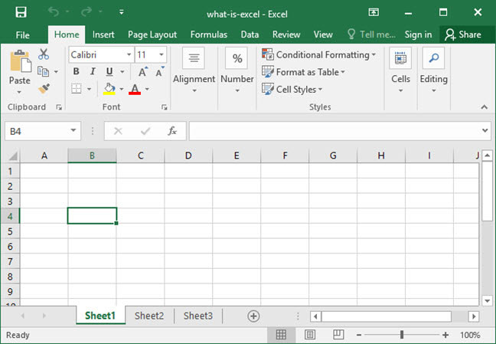

Slide 5
Here’s a table I’ve created for a quick summary of excel this can also help new staff members stay on track and organised:
Purpose | How It’s Used
Resident Care | Store health info, care plans, meds
Staff Management | Create rotas, track training and attendance
Compliance | Keep records for inspections and reports
Finances | Budgeting, billing, and expense tracking
Safety | Checklists for cleaning, equipment, etc.

Slide 6
References:
Moldskred, P. S., Snibsøer, A. K., & Espehaug, B. (2021). “Improving the quality of nursing documentation at a residential care home: a clinical audit.”
This study audits the documentation practices in a residential care home and shows how structured, improved recording systems can enhance quality of care and record integrity.
Relevance: Shows the importance of consistent, high-quality documentation in a care-home context — something that a well‑designed Excel system can help enforce (through templates, validation, prompts).
Munyisia, E. N., Yu, P., & Hailey, D. (2014). “The effect of an electronic health record system on nursing staff time in a nursing home: a longitudinal cohort study.”
This study examines how introducing an electronic health record (EHR) system (analogous to digital record‑keeping tools) affects staff time distribution in a nursing home setting.
Relevance: Suggests that digital systems (which Excel can act as) need careful implementation to avoid burdening staff, and that over time the system may stabilize without negatively impacting direct care time.
Bak­ti, N., Williamson, M., Sehjal, R., Thilagarajah, M. “The use of Microsoft Excel as an electronic database for handover and coordination of patients with trauma in a District General Hospital.”
This work (published in BMJ Innovations) compares a paper-based handover system with an Excel‑based interactive database and demonstrates significant improvements in completeness and accessibility of clinical information when using Excel.

