Slide 1
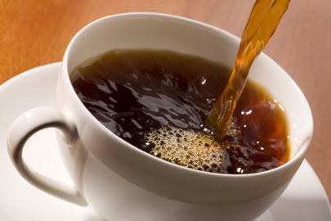
Caffeine and Ergogenic in Sport
Neurological?
Or
Physiological?

Slide 2
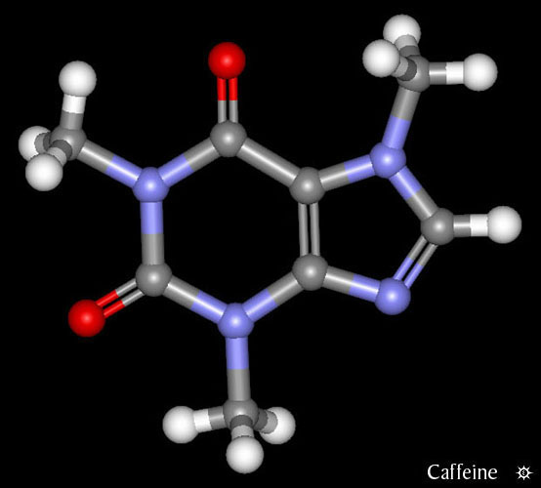
Caffeine Basics
CNS stimulant affecting
Alkaloid from a chemical group called Xanthines
Found in 63 species of plants
Excreted by the kidneys with 50-75% removed with 3-6 hours of consumption.
C₈H₁₀N₄O₂
Caffeine (1, 3, 7-trimethylxanthine) – found in coffee, sports drinks and some OTC medicine i.e proplus, lemsip
Theophylline (1, 5-dimethylxanthine) – found in tea
Theobromine (3, 7-dimethylxanthine) – found in chocolate

Slide 3
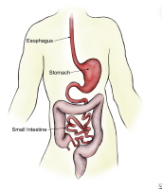
Pharmacokinetics: Route of Administration/Absorption
Absorption through:
Stomach
Small intestine
Large intestine
Effects of caffeine
Depends on:
Food in the body
Caffeine in the substance

Slide 4
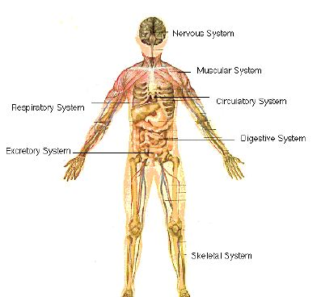
Distribution Throughout the Body
Water soluble
Throughout the body and across the blood – brain barrier.
Reaches the fetus
No accumulation within body

Slide 5
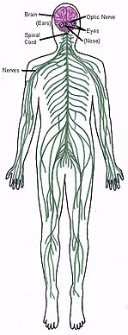
Effects on the Body
Central Nervous System - stimulant
Autonomic Nervous System - change in EMG activity
Cardiovascular System
- heart and blood vessels
- blood platelets
Gastrointestinal System - cause for ulcers?
Respiratory - increases blood and air to lungs

Slide 6
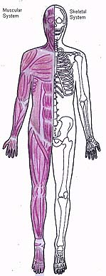
Effects on the Body
Skeletal Muscles - contraction (contrarily)
Energy Metabolism - basal metabolic rate, free fatty acids, oxidation of fats in exercise
Neurotransmitters - norepinephrine in CNS, norepinephrine and epinephrine in blood, seratonin in brain
Neuroendicrine effects - stress (high doses)

Slide 7
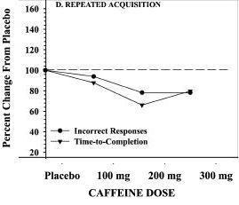
Behavioral Effects (w/ 100~200 mg)
Fig. 3-d: Percent change on a repeated acquisition test, which assesses motor learning and memory
Increases wakefulness, alleviates fatigue, facilitates concentration
Can also produce: elevated mood, shaky/jittery feeling
↑ time to fall asleep,↓ amount and quality of sleep
↑ attention/vigilance, ability to sustain performance
↑ work capacity/speed,↓ # of errors

Slide 8
Tolerance
Tolerance to respiratory effects after 8 consecutive days of daily administration.
Decreased A2a receptor expression – encode for adenosine and regulate myocardial and coronary circulation, suppresses immune cells and protects tissue from inflammation.
Increased A1 receptor expression – cause an inhibitory effect on cell metabolism, myocardial depressant.
Cross-tolerance from other substances

Slide 9

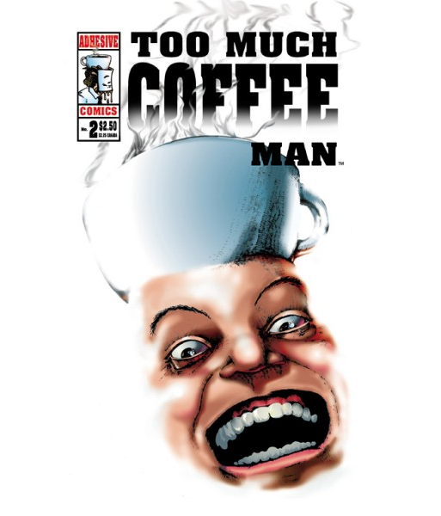
Consumption Doses
50-200 mg
- Sleepy first 5 minutes
- Blood levels peak at 30 min.
- Stimulant effects
300-1000 mg
  Prolonged ability to perform
  Exaggeration of side effects
  Pronounced insomnia
  Nervousness
  Irritability
  Tremor
  Restlessness
1000+ mg
  “Caffeinism”
  All of the above worsen
  GI disturbances
  Cardiac arrhythmias

Slide 10
Overdosing
Very rare but deadly occurrence
LD₅₀= 150mg/kg
  70 kg (154 lbs) person’s lethal dose is 10.5 grams.
  In 1986, of 2709 cases of caffeine “exposure” registered with Poison Control Centers, 0.1% or 3 cases resulted in death.

Slide 11
Health Problems
5 or more cups of coffee daily can increase the risk of heart disease due to:
- ↑ heart rate
- ↑ blood pressure
- ↑ blood cholesterol levels
Drinking coffee may cause increase of stress hormones
- adrenal gland produces adrenaline until no more can be produced
- leads to chronic fatigue, constant exhaustion and susceptibility to disease.

Slide 12
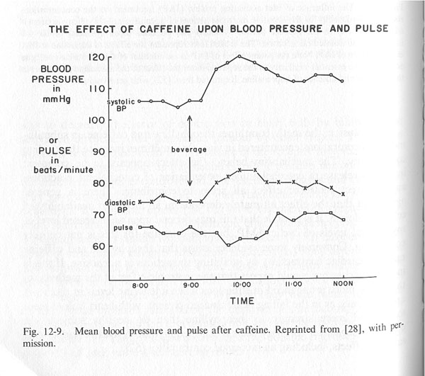
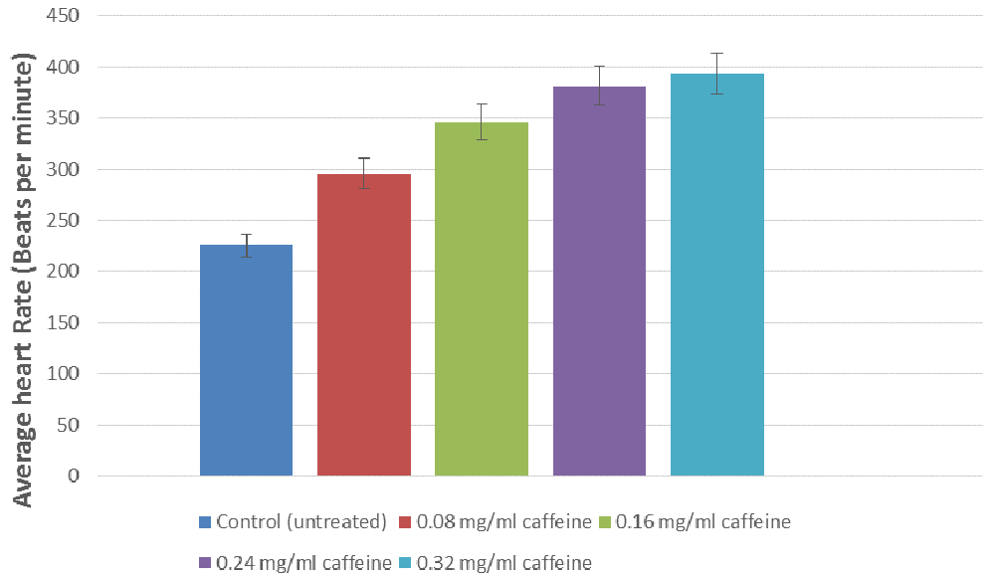
Effect of caffeine on Heart Rate and Blood pressure

Slide 13
Withdrawal
Withdrawal has been reported after stopping a dose as low as 100 mg/day - equivalent to a cup of coffee or 2-3 caffeinated soft drinks
40-70% of people who attempt to quit caffeine experience withdrawal.
Withdrawal can be totally incapacitating;
    Onset: 12-24 hours
    Peak: 20-48 hours
    Duration: 2-7 days

Slide 14
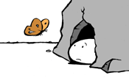
Symptoms of Withdrawal
The most commonly reported symptoms of withdrawal are:
Headache
Fatigue
Sleeplessness/Drowsiness
Difficulty Concentrating
Work Difficulty
Irritability
Depression
Anxiety
Flu-like symptoms
Impairment in psychomotor, vigilance, and cognitive performances

Slide 15
Caffeine: An Ergogenic Aid
Likely will produce a glycogen sparing effect and direct effect on CNS resulting in reduced fatigue.
Increases plasma FFA levels but not necessarily fat metabolism.
Effect is greatest in naïve caffeine users.
Effective dosage begins @ 100-300 mg
  Coffee : 100 to 150 mg per cup Costa coffee 1-shot is approx. 92mg caffeine
  Cola: 35-55 mg per 340 ml
  Tea: 20-50 mg per cup
  Proplus: 50 mg per tablet
  Redbull 80 mg

Slide 16
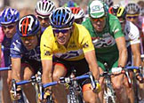
Sporting and Health Effects
Weight Loss Effects
Increased Alertness
Enhanced Concentration
Enhance Physical Endurance and Delay Fatigue
Goldstein et al (2010) International Society of Sport Nutrition position Stand: Caffeine and performance

Slide 17
Endurance Performance
Increase fat utilisation and decreases the reliance on glycogen.
5mg/kg increased intracellular fat oxidation.
6mg/kg increased endorphin levels during 2 hour cycling at 65% VO₂max leading to reduced pain perception.
100mg resulted in an increased thermogenic effect

Slide 18
Endurance performance
4.45mg/kg Run time at 85% VO₂max to exhaustion improved.
150-200mg increased 1500m time by 4.2 seconds andproduced higher VO₂ scores.
6mg/kg resulted in lower RPE scores during a cycling.

Slide 19
Caffeine and Cognitive Performance
Lieberman et al (2002) Effect of caffeine, sleep loss and stress on cognitive performance and mood.
100-300mg and tested 1 hour post consumption
Improved alertness and concentration
Improved motor learning
Improved short term memory
No advantage in elevated doses i.e. no differences between 200-300mg

Slide 20
Caffeine – High Intensity and Multi-sprint Sports
Improved sustained aerobic efforts in moderate to highly trained athletes but not in untrained athletes as assessed using;
Time to peak power - Wingate
Woolf et al demonstrated 3.1% improved performance in a 1 km cycle time trail (5mg/kg) – highly trained athletes.
Glaister et al demonstrated improved repeated sprint performance, though with greater fatigue

Slide 21
Football
6mg/kg resulted in 10% improvement in pass accuracy.
Improved ability to maintain sprint performance

Slide 22
Strength and Power
Improved performance on repeated leg press and chest press over a 60 second period.
2.1-3.0mg/kg improved 1 rep max and number of reps at 80% max for bench press but not lower body exercise, though other research did not find these effects.

Slide 23
Experimental Task
Determine the impact of 100mg of caffeine on athletic and cognitive performance
Blood pressure resting heart rate
Reaction time and accuracy
Peak power
Memory
Power

