Slide 1
Student number: 2518138
Word count – 3,291
Module Code: ECEY4005
I confirm that I have not used any AI tools in the research and creation of this assignment. I confirm that I have not presented any AI generated materials as my own work. I confirm I have copies of my drafts, notes, and other resources I used, which I may be asked to provide in evidence.
Digital Scrapbook - The First 1000 Days

Slide 2
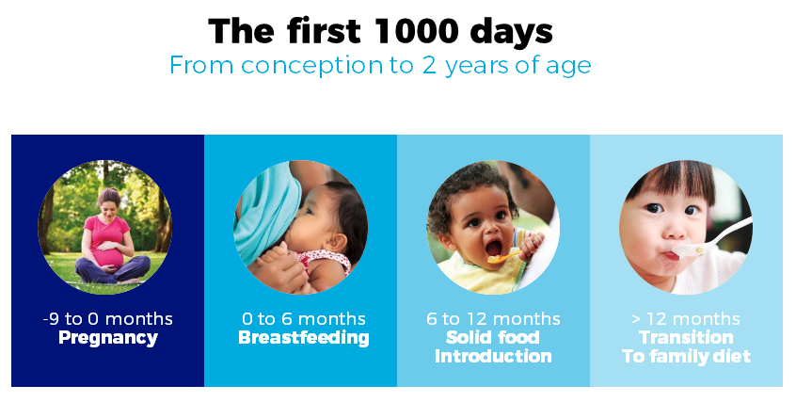
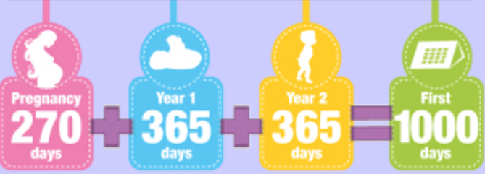
The First 1000 days
First 1,000 Days of Life
By Nasima Ali
Notes:
2

Slide 3

introduction
What is the First 1000 days ?
The first 1,000 days refer to the period from conception, through pregnancy, and up to a child’s second birthday. This stage is recognised as a critical window of development, where early experiences have a lasting impact on a child’s brain development, physical health, emotional wellbeing and ability to learn (UNICEF, 2017). What happens during this time lays the foundations for a child’s future learning, behaviour and overall life outcomes.
Nutrition plays a central role during the first 1,000 days. Adequate maternal and infant intake of key nutrients such as iron, iodine, vitamin D and folate supports the development of the brain, bones and immune system. When nutrition is poor, it can negatively affect physical growth, cognitive development and long-term health. Early nutrition also influences gene expression, shaping a child’s future wellbeing and capacity for learning (Karakochuk et al., 2018). This highlights why early intervention and nutritional support are so important during pregnancy and infancy.
Brain development occurs at an especially rapid rate during the first 1,000 days. By the age of two, a child’s brain has reached approximately 80% of its adult size (Centre for Early Childhood, 2024). Babies are born ready to learn, and their brains develop through everyday experiences and interactions. Simple routines such as talking during nappy changes, responding to facial expressions and offering comfort when a child is upset help to strengthen neural connections. These experiences reflect the EYFS principle that children learn best through positive relationships.
At Contoso, we empower organisations to foster collaborative thinking to further drive workplace innovation. By closing the loop and leveraging agile frameworks, we help business grow organically and foster a consumer-first mindset.​
20XX
presentation title
Notes:
3

Slide 4
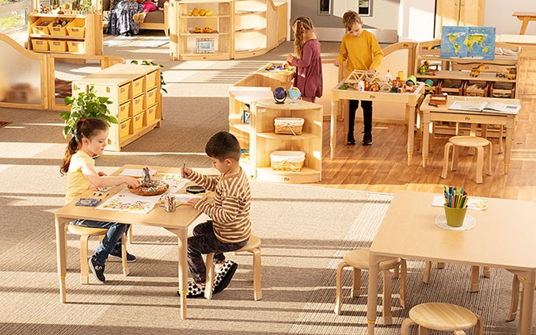
Early experiences also play a crucial role in social and emotional development. Building a secure attachment with a primary caregiver helps infants feel safe, regulate their emotions and develop confidence to explore the world around them. Secure attachments formed during the first 1,000 days support healthy relationships and emotional wellbeing later in life, highlighting the importance of sensitive, responsive caregiving (Parent Infant Foundation, 2021). In early years settings, the key person approach plays a vital role in supporting attachment and emotional security. When children have a trusted adult who consistently responds to their needs, they feel valued and safe, allowing them to explore their environment and engage fully in learning experiences (Early Years Wellbeing Toolkit, 2025).
Feeling secure supports development across the EYFS, particularly Personal, Social and Emotional Development and Communication and Language, as secure relationships provide a safe base for learning (Department for Education, 2025).
The physical environment also supports development during the first 1,000 days. Montessori-inspired settings carefully plan spaces to encourage movement, exploration and sensory engagement. Child-sized furniture, natural materials, open spaces and access to sensory experiences support babies and toddlers in developing physical skills, coordination and curiosity. These experiences closely link to the EYFS areas of Physical Development and Understanding the World (Montessori Scientific Research, 2025).
(Community Play Things, 2024)
Language development is another key focus during this period. Talking, singing, reading and sharing stories with babies and toddlers’ helps build early communication skills. Practitioners support Communication and Language by modelling language, responding to babbling and allowing children time to communicate in their own way. These early interactions lay strong foundations for later literacy and learning (Education Endowment Foundation, 2025).

Slide 5

Caregiving
Notes:
5

Slide 6
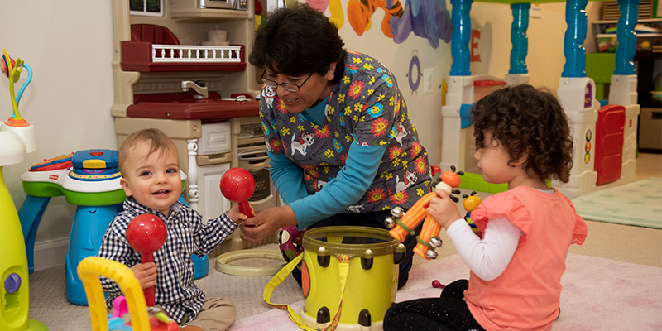
What is exceptional caregiving?
Exceptional care in the early years means providing more than just physical care, it involves respectful, responsive and relationship focused caregiving that helps children feel seen, understood and valued, supporting their emotional security, physical development and sense of self. This aligns closely with Emmi Pikler’s approach, which emphasises respectful caregiving, sensitive responses to children cues and allowing freedom of movement within safe, enabling environments. Pikler highlighted that when caregivers respond calmly and consistently during everyday care routines, children develop secure attachments, confidence and a strong sense of self (Pikler Institute, 2018). Responsive caregiving, where adults carefully observe and respond to children’s signals, has been linked to improved socio-emotional, cognitive and health outcomes and supports secure attachments that underpin lifelong wellbeing (UNICEF, 2022)
(Child Care Aware, 2019)
Notes:
6

Slide 7
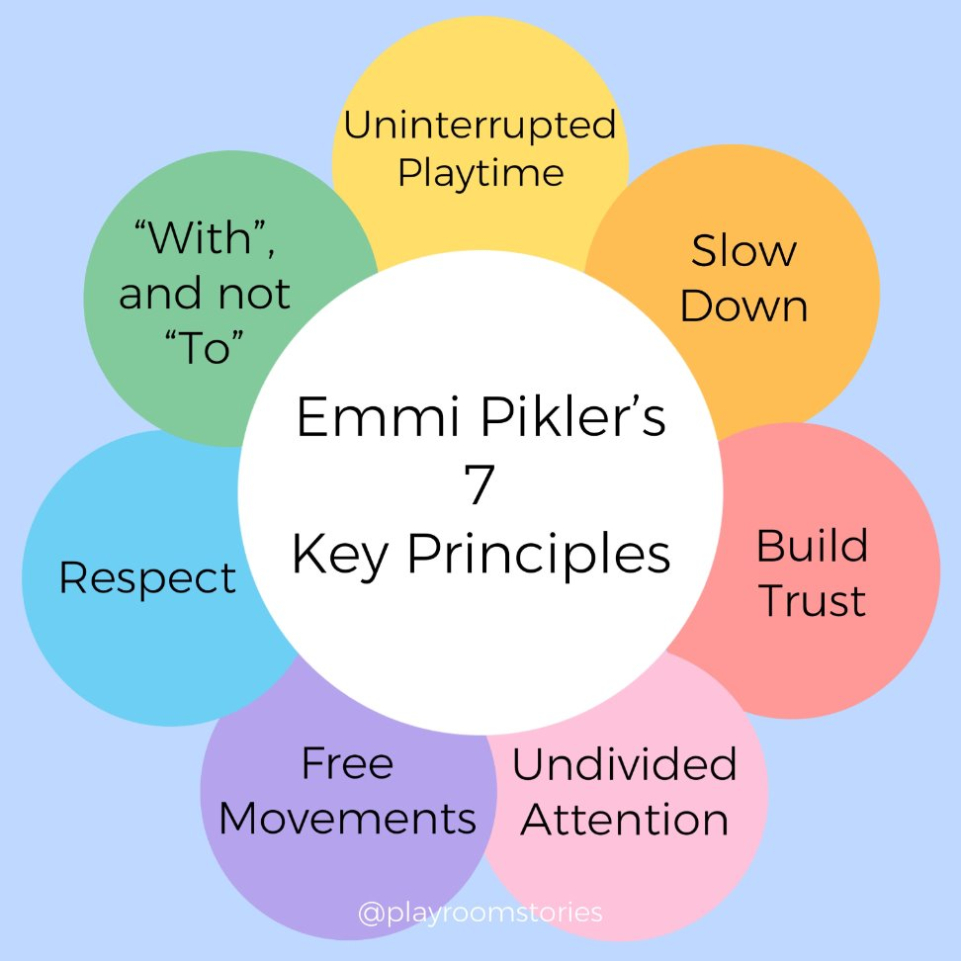
Dr Emmi Pikler showed that everyday care routines feeding, nappy changes, dressing, bathing are more than practical tasks they are opportunities to build connection and relationships.
Caregivers are encouraged to:
Give full attention so children feel respected and valued.
Move calmly to create a peaceful environment.
Communicate continuously and wait for the child’s responses.
Work “with” the child, inviting participation and respecting their pace.
Respond to children’s cues rather than ignoring them.
In this approach, caregiving becomes a dialogue, and children are seen as active participants in their own development. Respectful, responsive care builds secure attachment, emotional regulation, and confidence. (Pikler Institute, 2018)

Slide 8

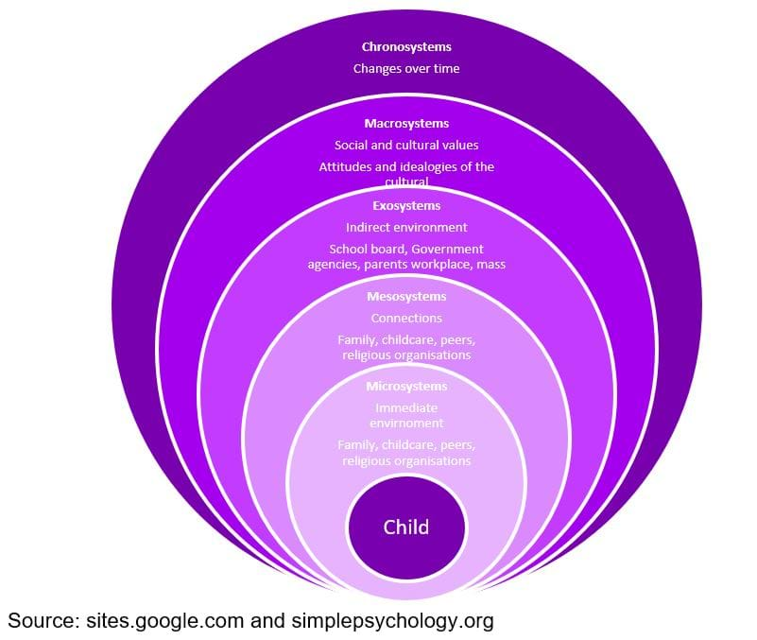
Bronfenbrenner’s ecological systems theory shows that children develop within interconnected environments such as family, early years settings and the wider community, all of which influence development (International Journal of Early Childhood Environmental Education, 2022). This highlights the importance of high-quality caregiving, as everyday relationships and environments shape children’s emotional security, confidence and learning. When practitioners provide warm, responsive care and work closely with families, they create consistency between home and setting. These positive relationships help children feel safe, valued and ready to explore, supporting holistic development and long-term wellbeing.
(The Education People, 2021)

Slide 9
Exceptional Caregiving
Nurturing Health and Wellbeing
Good health starts with meeting daily needs—from managing medication and using health services to keeping track of both physical and emotional wellbeing (Maslow, 1943/2020). Showing affection and responding to needs builds strong emotional bonds, supporting resilience and overall wellbeing (Bowlby, 2025).
Everyday Learning and Growth
Learning happens every day through talking, reading, guiding exploration, play, and modeling behavior. These moments help children develop skills, confidence, and a love of learning. Inclusive and enabling environments spark curiosity and support development (Care Learning, 2024).
Being Responsive
Being responsive means noticing and meeting needs, offering comfort, guidance, and love, and practicing responsive feeding. These actions build trust and strengthen the connection between caregivers and children (World Health Organization, 2024).
Safety and Security
Safety are essential. Daily risk checks and safe environments protect both caregivers and children, ensuring physical and emotional wellbeing.
When health, learning, responsiveness, and safety come together, it creates exceptional caregiving an environment where children and adults thrive. Exceptional caregiving is about nurturing every aspect of a child’s growth while supporting emotional bonds, curiosity, and resilience. It’s care that goes beyond the basics, fostering wellbeing, confidence, and lifelong love of learning.

Slide 10

Professional Partnerships
Notes:
10

Slide 11

Partnership Working in the First 1000 Days
It is important for parents, carers, and early years professionals to work together because strong partnerships directly benefit a child’s development in the first 1000 days. By sharing information and supporting each child consistently, adults can respond quickly to individual needs and provide a nurturing, stable environment (Kambouri et al., 2021).
Effective partnerships help children develop social, emotional, and cognitive skills, as parents and practitioners coordinate routines, play, and learning experiences both at home and in childcare settings (University of Nebraska Extension, 2021).
Key workers play a vital role by observing progress, planning activities suited to each child, and communicating closely with families. This collaboration also allows for early identification of any developmental concerns, ensuring that children get the support they need as soon as possible. When parents and professionals work together, children feel secure and valued, which strengthens confidence, attachment, and emotional wellbeing (West Sussex County Council, 2026; UK Government, 2024).
By building these partnerships, families and professionals create a consistent support network that not only nurtures early development but also lays the foundation for lifelong learning and healthy relationships.
Alamy

Slide 12
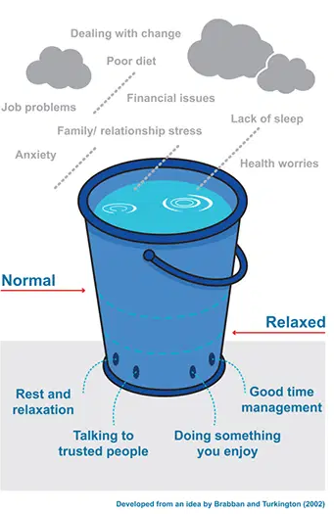
Role of Early Years Practitioners
Early years practitioners play a central role in supporting children and families during the first 1,000 days by providing high‑quality, responsive care and guidance that directly influences children’s development and family wellbeing. Practitioners observe and respond to children’s individual needs, support health and nutrition, foster early communication and language, and create nurturing environments that enable secure attachment and early learning. Practitioners also help families understand developmental milestones and promote positive routines, which contribute to cognitive, social and emotional development (Gov.uk, 2026).
Practitioners also serve as advocates for family wellbeing, identifying needs early and offering targeted support or referrals where necessary. For example, they support responsive feeding practices, play‑based learning, and early social interactions, all of which stimulate neural development and early communication skills (UNICEF, 2021).
(Mental Health UK, 2018)
Notes:
12

Slide 13


Key Person Approach
A key element of this role is the key person approach, where a designated practitioner builds strong, trusting relationships with both the child and their family. These consistent, familiar relationships support emotional security and help children feel understood and confident to explore and engage in learning (Kelsi, 2025) Regularly sharing information about children’s experiences and progress enables practitioners to tailor care and activities to children’s needs and helps families feel involved and confident in their role (Care Learning, 2024).
Merthyr
The key person approach is an important part of programs like Flying Start, ensuring each child has a dedicated adult who knows them well and can provide consistent support. A key worker helps the child settle, builds a secure relationship, observes development, plans activities for individual needs, and works closely with parents to share progress (Welsh Government, 2023). This approach supports children’s emotional wellbeing, confidence, and early learning, forming a strong foundation for later development.
Notes:
13

Slide 14
Maternal Factors Affecting Child Development and Support Offered
Maternal Factor | Impact on Child Development | Support That Can Be Offered
Maternal mental health (e.g. postnatal depression, anxiety) | Can affect bonding and attachment, increasing the risk of emotional and behavioral difficulties in children. | Early screening by midwives and health visitors, referral to perinatal mental health services, counselling, peer support groups (NHS, 2023)
Physical health and nutrition | Poor maternal health and nutrition can impact fetal brain development, infant growth, and immune function. | Antenatal and postnatal healthcare, nutritional advice, breastfeeding support, access to GP and specialist services (Public Health Wales, 2023)
High stress levels | Prolonged maternal stress can affect emotional regulation and increase behavioral difficulties in young children. | Emotional wellbeing support, stress-management strategies, family support workers, parenting programmed (Shonkoff et al., 2016)
Socio-economic difficulties (e.g. poverty, unemployment | Financial stress can limit access to resources and learning opportunities, increasing developmental inequalities. | Financial advice, benefits support, funded childcare, Flying Start and community services (Marmot et al., 2020)
Lack of social support | Isolation can reduce parental confidence and affect responsive caregiving and attachment. | Parent support groups, community networks, family hubs, early years services (Department for Education, 2021)
Domestic abuse or unsafe relationships | Exposure to abuse can lead to trauma, attachment difficulties, and developmental delays. | Safeguarding interventions, domestic abuse services, multi-agency support, safe housing (NSPCC, 2022)

Slide 15
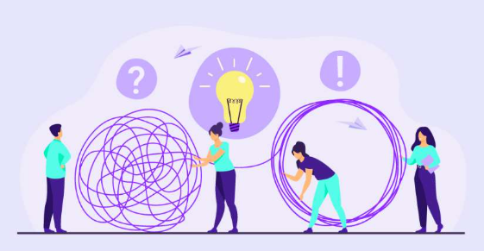
Challenges
Notes:
15

Slide 16

What are the challenges in providing high quality care?
Achieving exceptional standards of care in early years settings is essential for supporting children’s development, wellbeing and long-term outcomes (Hirsh‑Pasek, 2021) However, practitioners face a range of challenges that can limit their ability to provide consistent, high-quality, child-centred care, including poor funding, stress and burnout, limited understanding, inadequate support and staffing, health issues and lifestyle pressures
Chathampark,2023

Slide 17

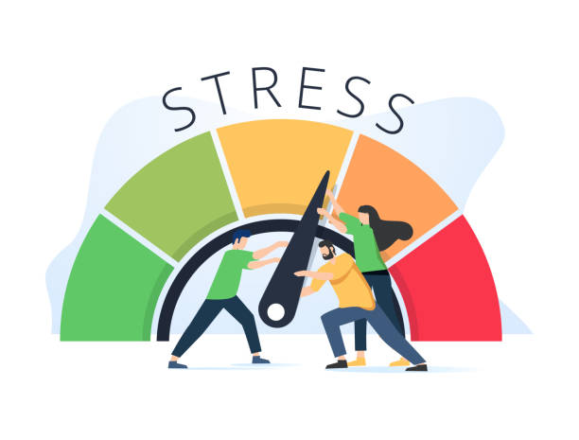
Lack of funding
Limited funding can make it difficult to provide high-quality resources, access regular training, or maintain appropriate staff-to-child ratios. When budgets are tight, learning experiences may be more limited and practitioners may have less time to offer individual support, which can affect children’s development and wellbeing (Pascal et al., 2019).
Practical solutions include increased government investment, funding for staff training and sharing resources across settings. When early years provision is better funded, practitioners can create richer learning environments and offer more inclusive, responsive care. This has a positive impact on children’s cognitive and emotional development and helps practitioners feel more supported and less stressed, which also benefits families and caregivers.
SOLUTION
Access to regular supervision, wellbeing initiatives and manageable workloads can support practitioner wellbeing. When practitioners feel supported, they are better able to provide consistent care, build positive relationships with children and promote emotional security, while also helping to retain staff within the workforce.
Stress and burnout
Managing large workloads, emotional challenges, and high accountability can leave early years practitioners feeling stressed and at risk of burnout. Burnout can reduce practitioners’ emotional availability and responsiveness, which are essential for secure attachments and positive interactions (Kim & Diefendorff, 2022).
SOLUTION
Notes:
17

Slide 18


Lack of Understanding and Training
A lack of understanding of child development, safeguarding or inclusive practice can limit practitioners’ confidence and effectiveness. This may result in missed developmental concerns or less responsive caregiving (DfE, 2021).
This can include continuous professional development, mentoring, and evidence-based training. By improving their knowledge and skills, practitioners are better able to identify children’s additional needs early, provide timely support, and give caregivers reassurance.
SOLUTION
Lack of Support and Staffing
Staff shortages and insufficient support structures reduce the quality of care by increasing workloads and limiting time for meaningful interactions. Continuity of care is particularly affected, which can undermine children’s emotional security (Early Years Alliance, 2023).
This can include better pay, clearer career pathways, and investment in recruitment and retention. Having a stable staff team helps build consistent relationships, supports children’s attachment, and gives caregivers a trusted point of contact.
SOLUTION
Notes:
18

Slide 19
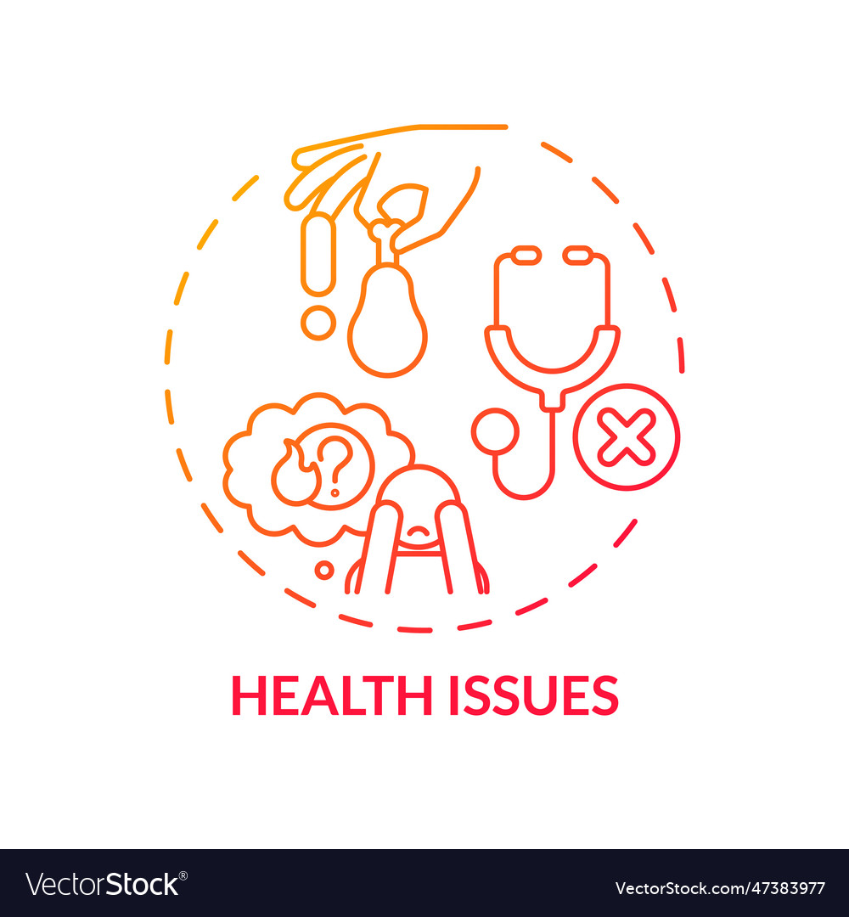

Health Issues
Physical and mental health issues among practitioners can impact energy levels, concentration and emotional responsiveness. Poor practitioner health may result in increased absences and inconsistent care (NHS England, 2022).
This can include occupational health support, flexible working arrangements, and access to mental health services. When practitioners’ health is supported, they can provide consistent, attentive care for children and help reduce disruption for families.
SOLUTION
Lifestyle
Lifestyle pressures, such as work–life imbalance, long hours and limited recovery time, can affect practitioner wellbeing and job satisfaction. These pressures may reduce practitioners’ capacity to engage positively with children (OECD, 2020).
This include flexible scheduling, supportive leadership and realistic expectations. Improved work–life balance enhances practitioner motivation and engagement, positively influencing children’s daily experiences and caregiver trust.
SOLUTION
Notes:
19

Slide 20
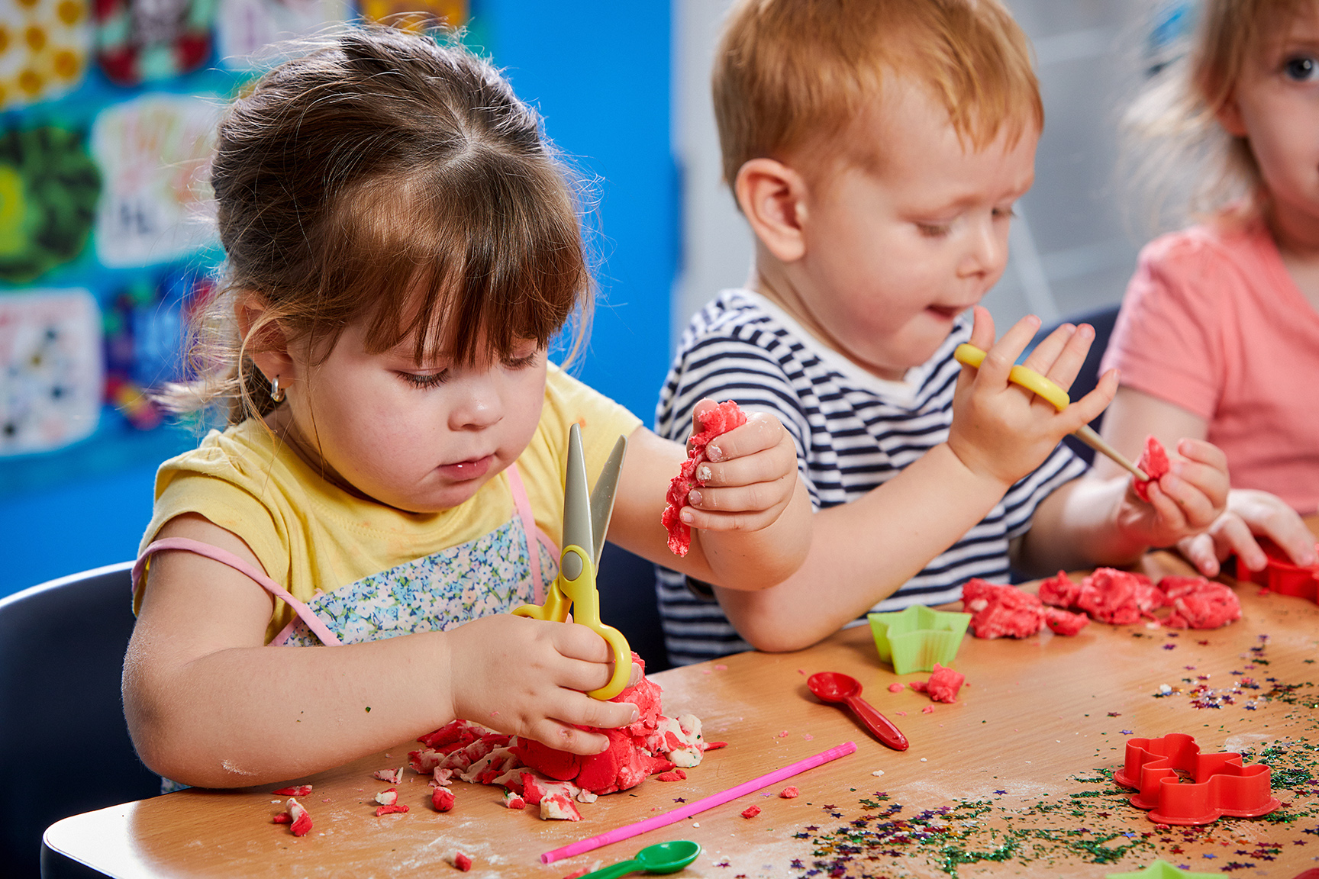
Activities
presentation title
Notes:
20

Slide 21

Activities in Early Years Settings
Early Years education highlights play-based, child-centred activities that support holistic development. Bruce (2011) shows that children learn best through exploration, hands-on experiences, and play rather than formal instruction. Activities are carefully planned to promote creativity, communication, problem-solving, and active engagement.
Children engage in a variety of experiences, including loose parts play, role play, outdoor play, creative arts, and sensory activities. Loose parts play uses open-ended materials such as stones, shells, blocks, fabric, cardboard, and recycled resources, encouraging independent thinking and imagination.
Role play allows children to explore real-life experiences through pretend scenarios, for example, acting out homes, shops, or hospitals. Outdoor play supports physical development, risk-taking, and connection with nature, while creative activities such as painting, music, and storytelling foster self-expression, language, and communication skills.
Open-ended activities give children the freedom to follow their interests and actively construct knowledge through meaningful play (Daly et al 2016).This approach is reinforced by the EYFS framework, which promotes active, exploratory learning (DfE, 2023), and aligns with the Reggio Emilia approach, which views children as capable learners expressing understanding in multiple ways (Edwards et al, 2020).
By offering a balance of structured and open-ended play, Early Years settings create rich learning environments where children develop cognitively, socially, physically, and emotionally through engaging, hands-on experiences.
Notes:
21

Slide 22

Benefits of Early Years Activities
Play-based learning is at the heart of early childhood education. It is fun, engaging, and helps children learn in meaningful ways. Meaningful learning happens when children connect new ideas to what they already know, explore actively, and understand concepts rather than just memorising them (EEF, 2026).
Cognitive Development
Children solve problems, make decisions, and think creatively when building with blocks, exploring loose parts, or doing puzzles.
Why it’s meaningful
Children learn by trying, testing, and figuring things out.
They connect new ideas to what they already know.
Skills like planning, problem-solving, and creativity are built while having fun.
Learning is hands-on, personal, and memorable (Learning through play, 2026)
This loose parts station lets children explore, build, and create. Using natural and recycled materials, they develop creativity, problem-solving, and fine motor skills while having fun.
Notes:
22

Slide 23
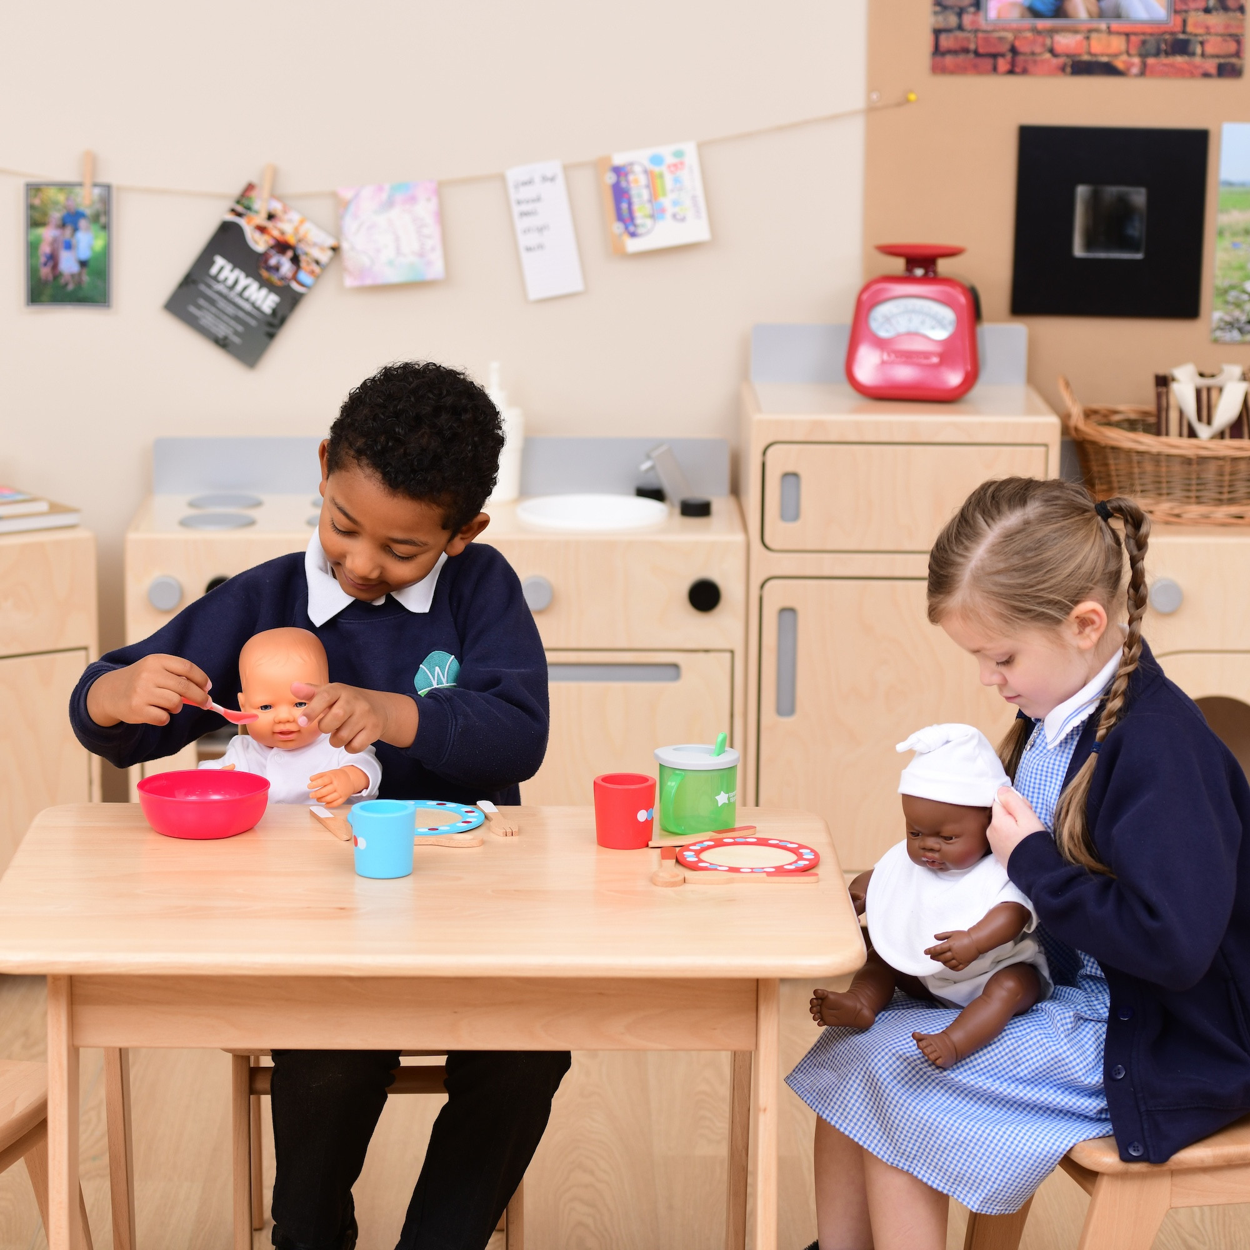
Benefits of Early Years Activities
Language & Communication
During role play or storytelling, children
Expand vocabulary – learning new words naturally while acting out roles.
Practice expressing ideas – forming sentences, explaining thoughts, and sharing stories.
Negotiate meaning with friends – working together, deciding roles, and responding to each other.
Why it’s meaningful
Role play and storytelling give children a fun and interactive way to use language, which strengthens speaking, thinking, and social skills. Children learn to communicate confidently, solve problems, and express themselves in real-life situations.
.
The children are pretending to feed and care for baby dolls, learning to take turns, use kind words, and talk about what babies need. This activity helps them practice communication, empathy, and social skills while having fun!
Notes:
23

Slide 24

Benefits of Early Years Activities
Social & Emotional Growth
Playing together helps children
Cooperate and take turns – children learn to wait, share resources, and work together to reach a goal.
Understand and share feelings – they notice how others feel and respond with kindness or help.
Manage emotions – through play, children practice handling excitement, frustration, or disappointment in a safe setting.
Build friendships and confidence – successful social interactions give children a sense of belonging and self-assurance.
Why it’s meaningful
They help children develop empathy, emotional regulation, and social skills, which are essential for forming healthy relationships, solving problems, and communicating effectively in daily life.
Building Together!
Two toddlers share and take turns with Duplo blocks, learning to cooperate and communicate.
Notes:
24

Slide 25
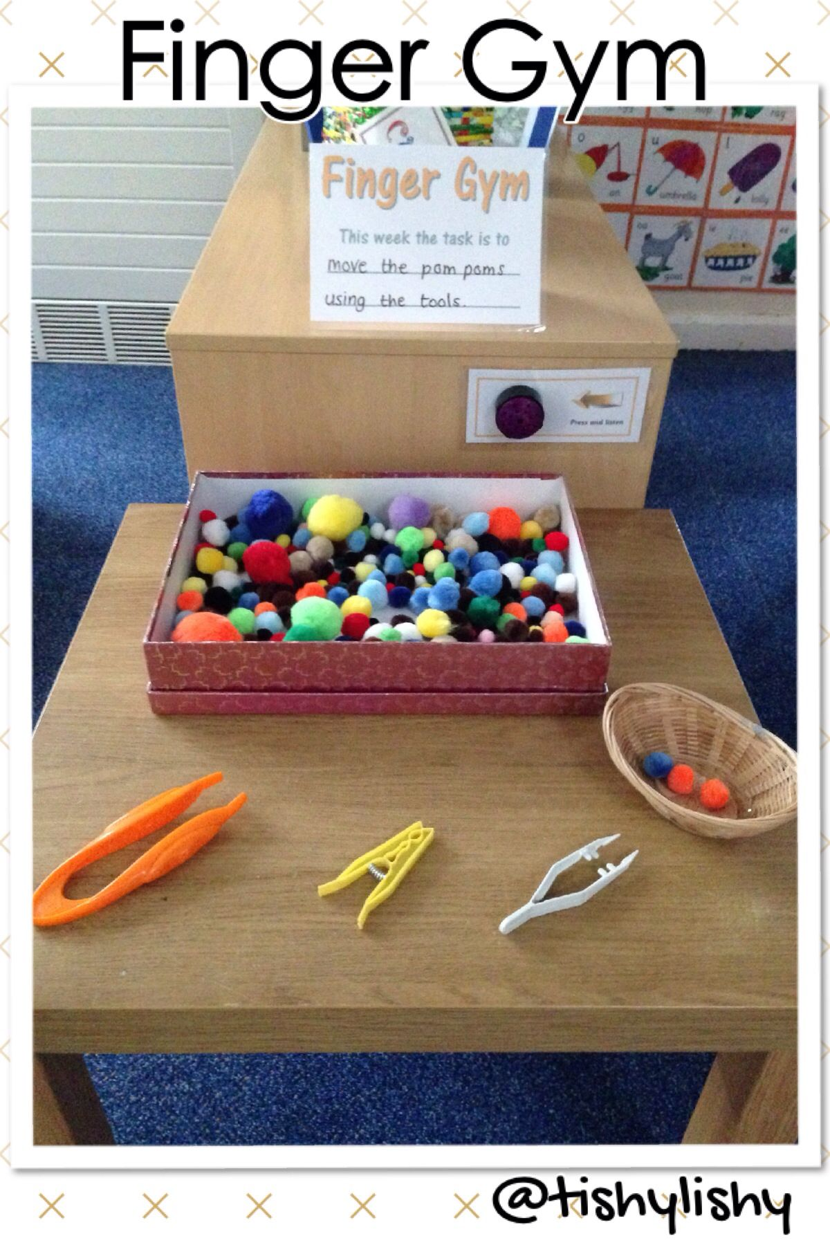
Benefits of Early Years Activities
Physical Development
Children develop strength, coordination, and control through outdoor play and hands-on activities such as running, climbing, or building.
Why it’s meaningful learning
Children improve motor skills like running, jumping, and grasping.
They practice balance and coordination while exploring different movements.
Physical activities support healthy growth, confidence, and body awareness.
Learning is active, fun, and helps children explore their environment.
This is a picture of a finger gym.
Children can use tweezers to pick up pompoms, which helps them strengthen their fingers, improve hand-eye coordination, and develop fine motor skills for writing, drawing, and everyday tasks. Early years settings often include activities like this to encourage children to explore, practice skills, and learn through hands-on play.
Notes:
25

Slide 26
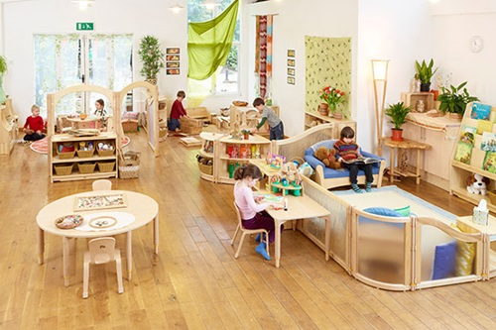
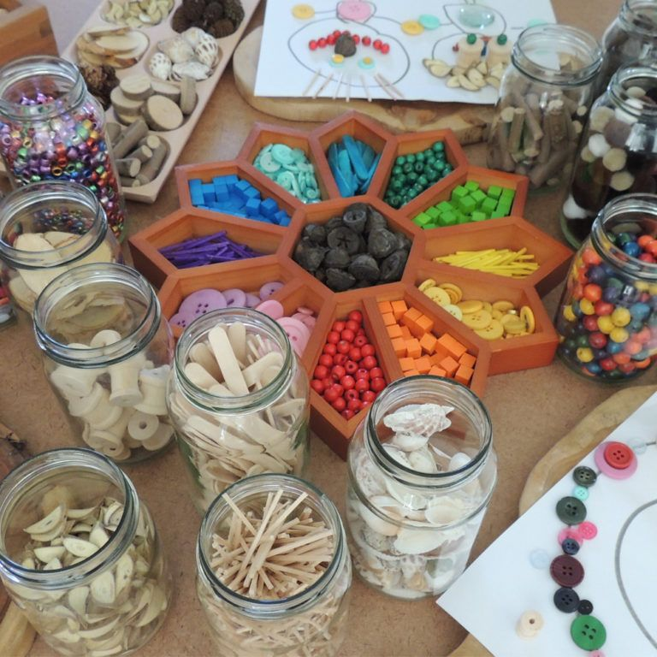
International Approaches to Early Years Education
Reggio Emilia Approach
The Reggio Emilia approach, developed in Italy, views children as competent, curious, and capable learners. Learning is project-based and driven by children’s interests. The environment is considered the “third teacher” and is carefully designed to inspire exploration and creativity. (Reggio Inspired, 2026)
Key features include:
Use of open-ended materials and loose parts
Strong emphasis on creativity and expression
Detailed documentation of children’s learning
Collaboration between educators, children, and families
Activities in Reggio Emilia settings often involve art, construction, and long-term projects where children revisit and develop ideas over time.
Notes:
26

Slide 27
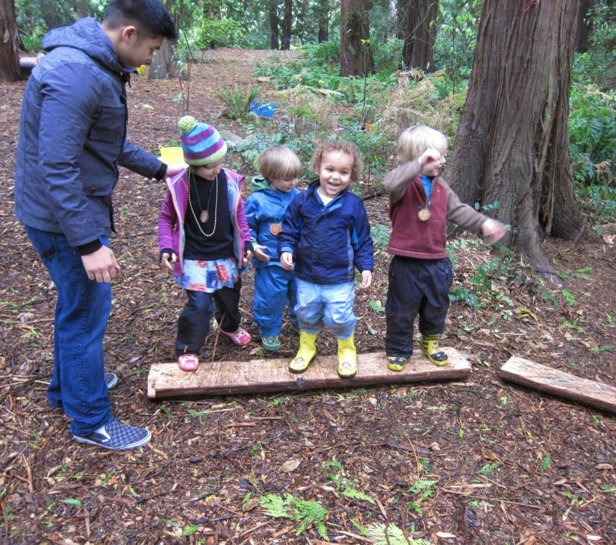
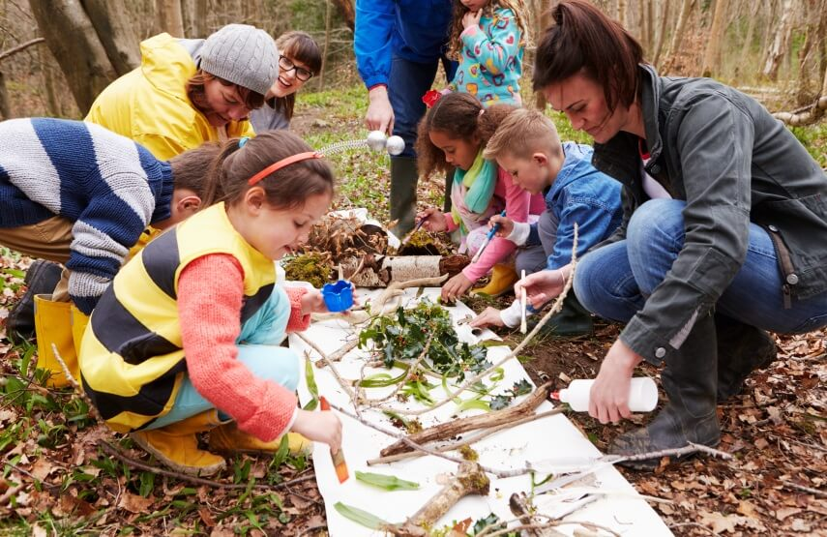
Forest School Approach
Forest School originated in Scandinavia and is widely used in the UK. It focuses on outdoor, nature-based learning with regular access to woodland or natural environments. Activities are child-led and encourage exploration, physical development, and risk-taking.
Key features include:
Outdoor learning in natural settings
Use of natural loose parts such as sticks, mud, and stones
Emphasis on independence, resilience, and confidence
Holistic development through real-life experiences
Children engage in activities such as building shelters, climbing, exploring wildlife, and using simple tools under supervision.
Children engage in activities such as building shelters, climbing, exploring wildlife, and using simple tools under supervision.
Notes:
27

Slide 28
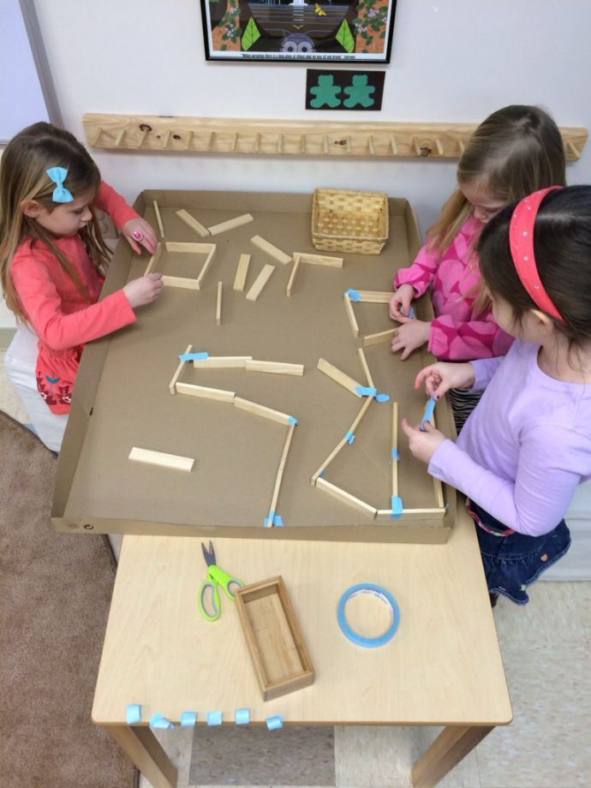

Reggio Emilia and Forest School
Similarities
Both the Reggio Emilia and Forest School approaches value child-led learning, play-based activities, and meaningful experiences. In each, children are seen as active participants who explore, investigate, and follow their interests rather than being directed through fixed lessons. Teachers in both models act as facilitators rather than traditional instructors, observing, supporting, and responding to children’s ideas and questions. Both approaches encourage curiosity, independence, problem-solving, and creativity, and use open-ended resources such as natural materials or loose parts (Forest School Association, 2025).
In contrast, Forest School is primarily outdoor based, occurring in woodland or natural settings where children spend sustained time engaging with nature regardless of weather. It emphasises physical development, resilience, risk-taking, and environmental awareness as children build shelters and engage in sensory play (Forest School Association, 2025). Forest School fosters confidence, independence, and connection to the natural world through hands-on, experiential learning.
Differences
The Reggio Emilia approach, developed in Italy, is typically carried out in indoor classroom settings that are carefully arranged with aesthetic materials, creative studio spaces, and displays of children’s work. It emphasises child-led projects, artistic expression, symbolic representation, and the documentation of learning to make thinking visible. The environment itself is considered the “third teacher,” thoughtfully designed to encourage exploration, creativity, and curiosity (Reggio Emilia approach, 2025).
Notes:
28

Slide 29
References
Alamy (no date) Partnership. Available at: https://www.alamy.com/partnership-concept-a-firm-handshake-signifying-trust-and-collaboration-with-puzzle-pieces-symbolizing-fitting-solutions-and-teamwork-vector-illustration-image609200063.html (Accessed: Jan 2026)
Bowlby, J. (2025) Attachment and caregiving in contemporary contexts. London: Routledge.
Bruce, T., 2011. Learning through play: For babies, toddlers and young children. London: Hodder Education.
Centre for Early Childhood (2024) The developing brain: foundational connections. Available at: https://centreforearlychildhood.org/wp-content/uploads/2024/11/RFCEC_BCCS_Report_and_Appendices.pdf (Accessed: 16 January 2026
Child Care Aware (2019) What is Responsive Caregiving? Available at: https://info.childcareaware.org/blog/responsive-caregiving (Accessed: Jan 2026)
Community Play Things (2024) Chairs or stools? Available at: https://www.communityplaythings.co.uk/learning-library/articles/chairs-or-stools (Accessed: Jan 2026)
Daly, B. & Beloglovsky, M., 2016. Loose parts 3: Inspiring play with infinite materials. St Paul, MN: Redleaf Press.
Department for Education (2021) Supporting families in the foundation years. London: DfE.
Department for Education (DfE) (2021) Statutory framework for the early years foundation stage. London: DfE.
Department for Education (DfE), 2023. Statutory framework for the early years foundation stage: Setting the standards for learning, development and care for children from birth to five. Available at: https://www.gov.uk/government/publications/early-years-foundation-stage-framework--2 [Accessed 18 January 2026].
Early Years Alliance (2023) Breaking point: The state of the early years workforce. London: EYA.
Early Years Wellbeing Toolkit (2025) Part 8: Key person relationships and co regulation. UK Early Years. Available at: https://content.govdelivery.com/attachments/UKERYC/2025/05/19/file_attachments/3265100/Early%20Years%20Wellbeing%20Toolkit%20 %20Supporting%20children%20with%20worries%20and%20anxieties.pdf (Accessed: 16 January 2026).
Education Endowment Foundation (2025) Communication and language approaches. Available at: https://educationendowmentfoundation.org.uk/early-years/evidence-store/communication-and-language (Accessed: 16 January 2026).
Education Endowment Foundation (EEF), 2026. Play based learning. Available at: https://educationendowmentfoundation.org.uk/early years/toolkit/play based learning [Accessed 18 January 2026].
Edwards, C., Gandini, L. & Forman, G., 2020. The hundred languages of children: The Reggio Emilia experience in transformation. 3rd ed. Santa Barbara, CA: Praeger.
First 1,000 Days of Life (no date) Available at: https://suncsalaos.org/about-us/first-1000-days-of-life/ (Accessed: Jan 2026).
Forest School Association (2025) What is Forest School?. Available at: https://forestschoolassociation.org/what-is-forest-school/ (Accessed: Jan 2026).

Slide 30
References
Hirsh Pasek, K. (2021) High quality early child care and education: The gift that lasts a lifetime. Brookings Institution. Available at: https://www.brookings.edu/articles/high-quality-early-child-care-and-education-the-gift-that-lasts-a-lifetime/ (Accessed: 18th January 2026)
Kambouri, M., Wilson, T., Pieridou, M., Flannery Quinn, S. & Liu, J. (2021) Making partnerships work: Proposing a model to support parent practitioner partnerships in the early years, Early Childhood Education Journal.
Karakochuk, C.D., Whitfield, K.C., Green, T.J. & Kraemer, K. (2018) The biology of the first 1,000 days. 1st edn. Boca Raton: Taylor & Francis. doi:10.1201/9781315152950.
Kelsi (2025) Enabling children to have positive starts. Available at: https://www.kelsi.org.uk/__data/assets/pdf_file/0014/220172/Starting-Strong.pdf (Accessed: 17 January 2026)
Kim, M. and Diefendorff, J. (2022) ‘Burnout and engagement in early childhood educators’, Early Childhood Research Quarterly, 59, pp. 279–290.
Learning through play, 2026. Learning through play. Available at: https://en.wikipedia.org/wiki/Learning_through_play [Accessed 18 January 2026].
Marmot, M., Allen, J., Boyce, T., Goldblatt, P. and Morrison, J. (2020) Health equity in England: The Marmot Review 10 years on. London: Institute of Health Equity.
Maslow, A.H. (1943/2020) ‘A theory of human motivation’, Psychological Review, 50(4), pp. 370–396
Merthyr (no date) Flying Start. Available at: https://www.merthyr.gov.uk/resident/learning-in-merthyr-tydfil/early-years-flying-start/ (Accessed: Jan 2026)
Montessori Scientific Research (2025) Montessori environments and child development. Available at: https://www.montessori.org/resources (Accessed: 17 January 2026)
Montessori Scientific Research (2025) Scientific insights on the prepared environment. Available at: https://montessori-scientific-research.org/scientific-insights-on-the-prepared-environment/ (Accessed: 16 January 2026).
NHS (2023) Perinatal mental health. Available at: https://www.nhs.uk/mental-health/conditions/post-natal-depression/ (Accessed: 15 January 2026).
NHS England (2022) Supporting the health and wellbeing of the health and care workforce. London: NHS England.
NSPCC (2022) Domestic abuse and the impact on children. Available at: https://www.nspcc.org.uk/what-is-child-abuse/types-of-abuse/domestic-abuse/ (Accessed: 15 January 2026).
OECD (2020) Early childhood education and care workforce. Paris: OECD Publishing.
Parent Infant Foundation (2021) The First 1001 Days: An Age of Opportunity. London: Parent Infant Foundation. Available at: https://parentinfantfoundation.org.uk/wp-content/uploads/2021/06/1.pdf (Accessed: 16 January 2026).
Pascal, C., Bertram, T. and Rouse, L. (2019) Improving the quality of early childhood education and care. London: UCL IOE
Pikler Institute (2018) Respectful Care in Infancy. Budapest: Pikler Institute. Available at: https://www.pikler.org/en/the-pikler-approach/ (Accessed: 17 January 2026)
Public Health England (2019) Improving health outcomes for children and young people. London: PHE.
Public Health England (2020) The importance of the first 1000 days. London: PHE.
Public Health Wales (2023) The first 1000 days programme: Summary report. Cardiff: PHW.
Pyle, A., DeLuca, C. & Danniels, E., 2017. ‘The role of play in early childhood learning’, Early Childhood Education Journal, 45(6), pp. 717–727.

Slide 31
References
Pikler Institute (2018) Respectful Care in Infancy. Budapest: Pikler Institute. Available at: https://www.pikler.org/en/the-pikler-approach/ (Accessed: 17 January 2026)
Public Health England (2019) Improving health outcomes for children and young people. London: PHE.
Public Health England (2020) The importance of the first 1000 days. London: PHE.
Public Health Wales (2023) The first 1000 days programme: Summary report. Cardiff: PHW.
Pyle, A., DeLuca, C. & Danniels, E., 2017. ‘The role of play in early childhood learning’, Early Childhood Education Journal, 45(6), pp. 717–727.
Reggio Emilia approach (2025) Wikipedia. Available at: https://en.wikipedia.org/wiki/Reggio_Emilia_approach (Accessed: Jan 2026).
Reggio Inspired (2026) Nurturing the whole child: Key components of the Reggio Emilia Approach. Available at: https://reggio.earlychildhoodireland.ie/the-approach/principles-values/ (Accessed: Jan 2026).
Shonkoff, J.P., Garner, A.S. et al. (2016) ‘The lifelong effects of early childhood adversity and toxic stress’, Pediatrics, 129(1), pp. e232–e246.
UK Government (2024) FDL0087 – Evidence on First 1000 days of life, House of Commons, available at: https://committees.parliament.uk/writtenevidence/97052/html/ (accessed 15 January 2026).
UNICEF (2017) The first 1,000 days of life: The brain’s window of opportunity. UNICEF. Available at: https://www.unicef.org/early-moments (Accessed: 16 January 2026)
UNICEF (2022) Responsive caregiving. Available at: https://www.unicef.org/early-childhood-development/responsive-caregiving (Accessed: 17 January 2026)
University of Nebraska Extension (2021) Family Childcare Partnerships in Early Childhood: First Steps to Success, available at: https://extensionpubs.unl.edu/publication/g2334/2021/html/view (accessed 15 January 2026).
Welsh Government. (2023). Flying Start programme. https://www.gov.wales/flying-start-programme
West Sussex County Council (2026) Parent partnership – Early Years Foundation Stage, available at: https://www.westsussex.gov.uk/information for childcare providers/practice support/early years foundation stage/parent partnership/ (accessed 15 January 2026).
World Health Organization and UNICEF (2022) Nurturing care framework: Providing responsive caregiving. Available at: https://www.unicef.org/india/media/2876/file/Nurturing-care-framework.pdf (Accessed: 17 January 2026).
• Care Learning (2024) Attachment and the key person role. Available at: https://carelearning.org.uk/qualifications/level-2-early-years/unit-2-attachment/1-3-explain-the-key-persons-role-in-early-attachment-and-development/ (Accessed: 17 January 2026).
• Gov.uk (2026) Getting it right from the start: how early years practitioners work with babies and toddlers. Available at: https://www.gov.uk/government/publications/getting-it-right-from-the-start-how-early-years-practitioners-work-with-babies-and-toddlers (Accessed: 17 January 2026).

