Slide 1
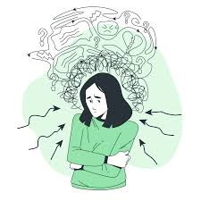
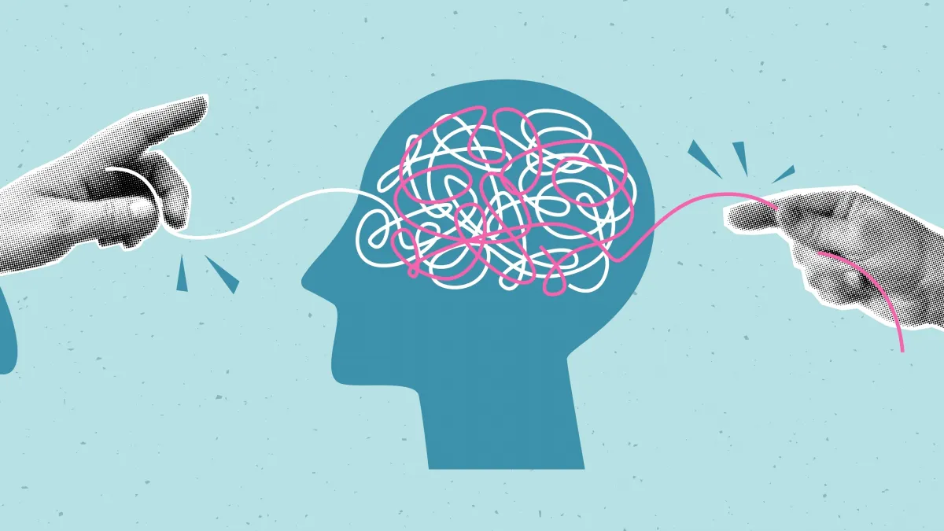
A Critical Analysis of the Historical and Contemporary Treatment and Provision of Care for Generalised Anxiety Disorder (GAD)
Student Name: Samina Shahzad
Student ID: 2328504
Module: BMHP6029 Psychological Classifications and Provisions

Slide 2
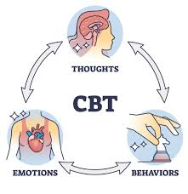

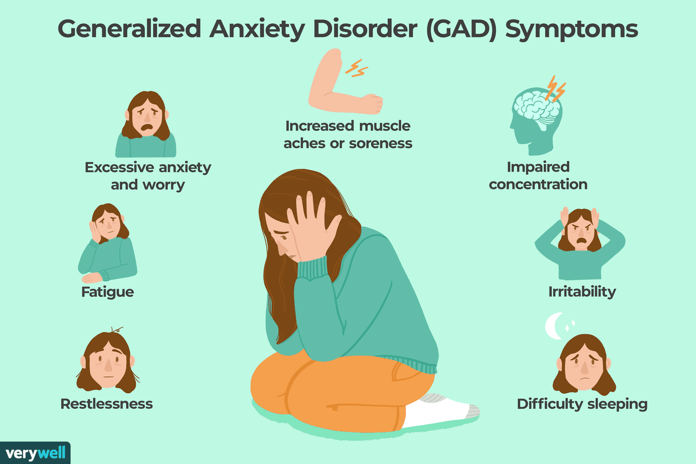



A Critical Analysis of the Historical and Contemporary Treatment and Provision of Care for Generalised Anxiety Disorder (GAD)
INTRODUCTION
Contemporary Treatment and Provision of Care
Stigma, Discrimination and Inequalities
Generalised Anxiety Disorder (GAD) is an anxiety/fear based disorder with a classification, Generalised anxiety disorder, in the ICD-11 (International classification of diseases). It is characterised by worry which is unwarranted and constant and interferes with normal functioning. Symptoms include, restlessness, muscle tension, fatigue, irritability, the inability to concentrate or sleep disturbances (WHO, 2024).
Anxiety disorders are one of the most prevalent mental disorders globally and now are a growing public health problem. When left untreated, GAD has a negative impact on your performance in school, job, work, relationships, and life. Appropriate early detection and evidence-based interventions will have a significant effect on outcomes and long-term complications (WHO, 2022).
Cognitive Behavioural Therapy (CBT)
CBT is one of the most beneficial treatments for GAD. It assists people recognize and switch their unfavorable thoughts for healthier coping mechanisms. CBT is recommended as a first-line treatment because it is thought to be more effective at helping to decrease anxiety symptoms and improve everyday functioning (NICE, 2020).
Medication
Many SSRIs, such as sertraline, are commonly used to treat anxiety symptoms. These medicines can help improve their mood and decrease abnormal levels of worrying, but can cause side effects and need to be monitored regularly (NICE, 2020).
Community-Based Care
Today, treatment for mental illness is no longer provided in a hospital but instead in the community in the form of supportive services. Access can be through a GP, NHS Talking Therapies and/or community mental health services. This does not always happen on central premises, but it encourage independence and facilitates recovery in normal settings, but in less familiar settings (NHS England, 2024).
Digital Mental Health Services
Mental health support such as online consultations, digital self-help programmes and mental health apps are more abundant than ever. Digital services can enhance accessibility, especially for individuals who do not reside in cities and those who suffer mobility issues (NHS, 2025).
Critical Analysis
Strengths
• Treatments are evidence-based and person-centred.
• Patients actively participate in treatment decisions.
• Community services support long-term recovery.
• Digital services have increased accessibility.
Weaknesses
• Long waiting lists remain a major challenge.
• Workforce shortages reduce service availability.
• Access to services is unequal across different populations.
Stigma
Stigma is a significant challenge to mental health treatment outcomes. Hiding symptoms due to fear of being judged by family, employer or society and postponing help-seeking are common issues many face (Mental Health Foundation, 2024).
Discrimination
People with anxiety can be perceived as different in the workplace, in education and health care institutions. There may be erroneous notions regarding mental health conditions that can have a negative impact on a person's employment, community, and self-confidence (Stuart, 2021).
Health Inequalities
Equality with regard to mental health services does not exist. Ethnic minority groups, from low-income families and those in rural areas are frequently faced with additional obstacles in accessing support services (DoHSC, 2019).
Critical Analysis
• Public education is needed to reduce stigma.
• Equal service availability does not always mean equal access.
• Vulnerable populations require additional support.
• Reducing inequalities should remain a national priority.
Historical Treatment of Generalised Anxiety Disorder
19th Century: Institutionalisation and Misunderstanding
In the 19th century, the nature of anxiety was not well known and anxiety was considered a personal weakness, or a failure in moral or spiritual fiber, or a punishment for sinful behavior. Many were forcibly confined to asylums, and the sole purpose of which was the control of behaviour, not recovery. Patients were extremely dependent, and often secluded from society (Pilgrim and Rogers, 2019).
Early 20th Century: Psychoanalytic Approach
The research of Freud, Freudian perspective of psychoanalysis, proposed that unresolved childhood events and unconscious incongruities caused anxiety. An advantage of this was that it helped to improve psychological awareness of mental disorders but treatment was time consuming, costly and there was little scientific support (Barker 2020).
1950s–1970s: Medication-Based Treatment
Several drugs, including sedatives (such as barbiturates or benzodiazepines) for treating anxiety symptoms, came into widespread use. Shorthalt relief from these medicines had been obtained, but the use of these medicines had also led to dependency, withdrawal and a decrease in patient independence, which had been a criticism from the NICE (2020).
Critical Analysis
Positive developments
• Anxiety gradually became recognised as a legitimate mental health condition.
• Scientific research improved understanding of psychological causes.
• Treatment options became more available.
Limitations
• Patients had limited involvement in decision-making.
• Medication was frequently overused.
• Historical treatments focused on controlling symptoms rather than promoting long-term recovery.
Recommendations for Future Policy and Practice
Increase Mental Health Funding
Increased funding is needed to grow services, fill staff vacancies and decrease waiting time.
Strengthen Early Intervention
The time for mental health screenings in schools, universities and primary health care needs to be introduced earlier in life.
Expand Public Awareness Campaigns
The promotion of mental health information and the elimination of mental health stigma can help to benefit mental health in the community by engaging in national campaigns.
Improve Digital Services
It is important that online therapy and digital support programmes are expanded to make it easier to access.
Address Health Inequalities
Ethnic minority groups, those with low incomes and people living in isolated communities should have targeted support developed for them.
Increase Workforce Capacity
To enhance the service and benefits supplied, more psychologists, therapists and mental health nurses should be recruited and trained.
Social, Cultural and Political Influences
Social Factors
Anxiety can also worsen in response to any financial troubles, unemployment, social isolation, and/or academic stress. However, modern living, stress, and using social media have also been responsible for rising anxiety especially in youth adults (WHO, 2022).
Cultural Factors
Attitudes towards mental illness are deeply rooted in cultural beliefs. In certain communities mental health issues have been linked with shame, weakness. As a result people might avoid getting help and support, which can exacerbate symptoms over time (Mental Health Foundation, 2024).
Political Factors
Government policy has a major impact on provision of mental health services. There have been a number of initiatives, including the NHS Long Term Plan, which have boosted funding for mental health services and led to a rise in mental health early help programmes. The demand for these resources is still growing, though, increasing the strain on the resources (Department of Health and Social Care, 2019).
Critical Analysis
• Policy changes have improved mental health services.
• Demand for services is increasing faster than available resources.
• Funding and workforce shortages continue to limit effectiveness.
• Additional government investment is still required.
CONCLUSIONS
Generalised Anxiety Disorder is a little-understood, broadly medicalised or quite rationalised disorder and is being viewed and treated from a different perspective. Much progress has been made, using psychological therapies and the new medicine and support services from the community. Yet stigma, the lack of workers and inequalities are significant issues. Further investment, quick interventions and better accessibility is needed to secure better mental health outcomes in the future.

Slide 3
A Critical Analysis of the Historical and Contemporary Treatment and Provision of Care for Generalised Anxiety Disorder (GAD)
References
Barker, P. (2020) Psychiatric and Mental Health Nursing: The Craft of Caring. 4th edn. London: Sage.
Department of Health and Social Care (2019) The NHS Long Term Plan. London: DHSC.
Mental Health Foundation (2024) Mental Health Statistics: Anxiety. London: Mental Health Foundation.
NHS (2025) Mental Health Services. Available at: https://www.nhs.uk
NHS England (2024) Community Mental Health Framework. London: NHS England.
NICE (2020) Generalised Anxiety Disorder and Panic Disorder in Adults: Management (CG113). London: NICE.
Pilgrim, D. and Rogers, A. (2019) A Sociology of Mental Health and Illness. 6th edn. Maidenhead: Open University Press.
Stuart, H. (2021) Reducing the Stigma of Mental Illness. Cambridge: Cambridge University Press.
World Health Organization (2022) World Mental Health Report: Transforming Mental Health for All. Geneva: WHO.
World Health Organization (2024) ICD-11 for Mortality and Morbidity Statistics. Geneva: WHO.

