Slide 1
Individual Presentation
Talent Acquisition Strategies and Monetary Methods
Module name and code: Managing People LCBB5004
Student name and ID: Valentina Pituscanu – 2124861
Lecturer name: Piyumika Gamage

Slide 2
Tabel of contents
Talent Acquisition Manager Duties
Talent Acquisition Process
Talent Acquisition Short-Term Strategies
Talent Acquisition Long-Term Strategies
Rewards Monetary
Rewards Non-Monetary
Conclusion
References

Slide 3
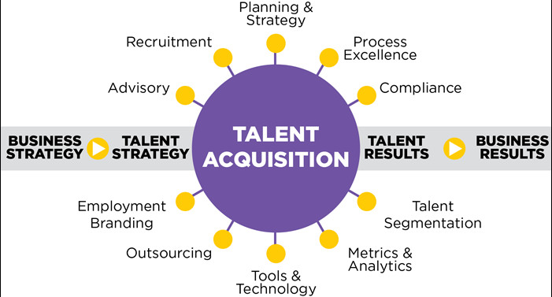
Talent Acquisiton

Slide 4
Talent Acquisition Manager
Deals with the strategies, tactics and processes for identifying, recruiting and retaining the human resources a company needs.
Is the person who is looking for talent.
Decide what is the job position the company needs.
Recruiting internal or external candidates.
After obtaining application forms, he uses different tools like test, interviews, background checks, experience to identify the right candidate.

Slide 5

Talent Acquisition Process
Make the decision
Offer trainings and develop new competencies to their employees .
Frequently assess and compensate the employees in order to keep their motivation

Slide 6
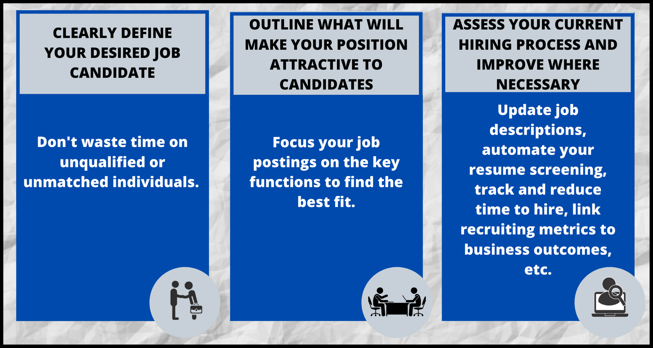
Talent Acquisition Short-Term Strategies
Using detailed job descriptions
Outreaching to qualified candidates
Attend Industry –Related Meetups

Slide 7
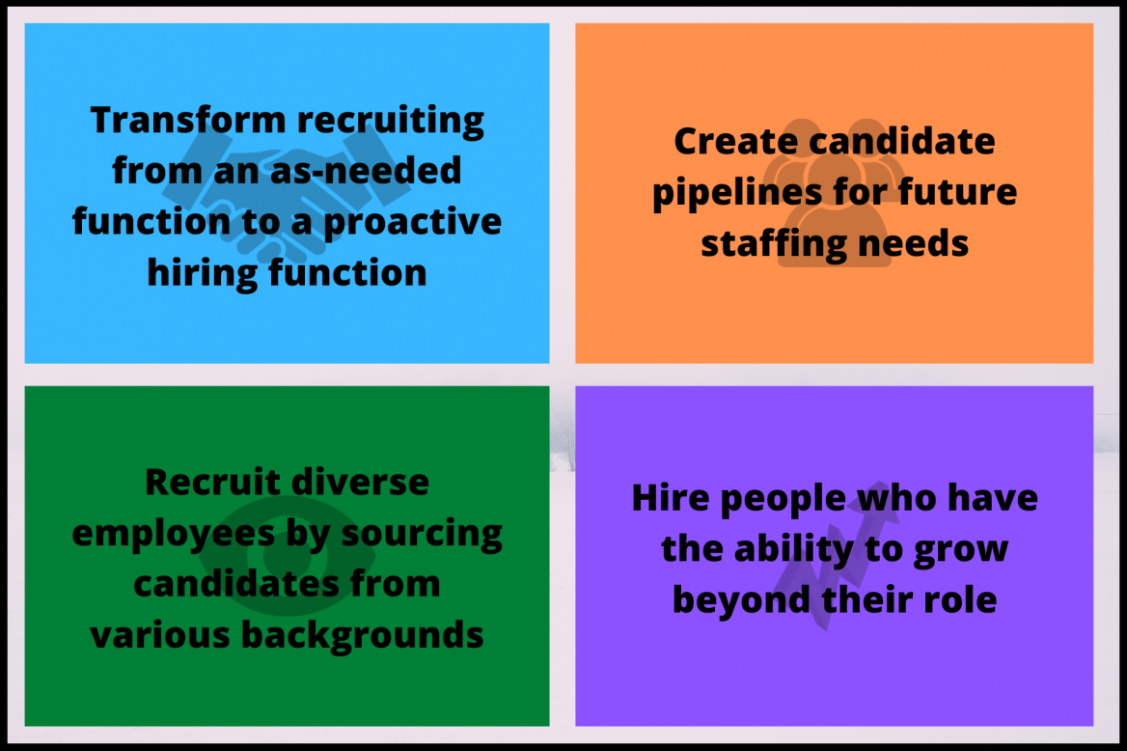
Talent Acquisition Long Term Strategies
DE&I
Employer Branding
Diversity Hiring Strategies

Slide 8

Rewards Monetary
Salary
Bonuses
Life + Health insurance

Slide 9
Rewards Non-Monetary
Flexible work hours
Working Conditions
Career development

Slide 10
Conclusion
In conclusion I would say that if we want to recruit a talent for Short-Term or Long-Term, there are a lot of strategies which should be followed in order to recruit the right person, the process may not be easy but the result will be great.

Slide 11
References
https://www.linkedin.com/pulse/implement-effective-recruiting-strategies-anatoly-denisov
https://www.edsisolutions.com/blog/5-key-talent-acquisition-strategies-for-hiring-better-talent-than-your-competitors
https://www.aihr.com/blog/non-monetary-incentives/
https://www.hifives.in/non-monetary-awards-can-work-great/
Calnan (2017b) No I’m not the HR director. I’m the vibe manager, People Management
Stewart, J. and C. Rigg (2011) Learning and Talent Development, CIPD, London.

