Slide 1
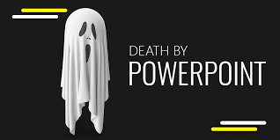
Death by PowerPoint
Tabitha junior downes:2008823
Imani Snape:2007797
Dominic Christopher:2028674
Dwain morgan:20292391

Slide 2

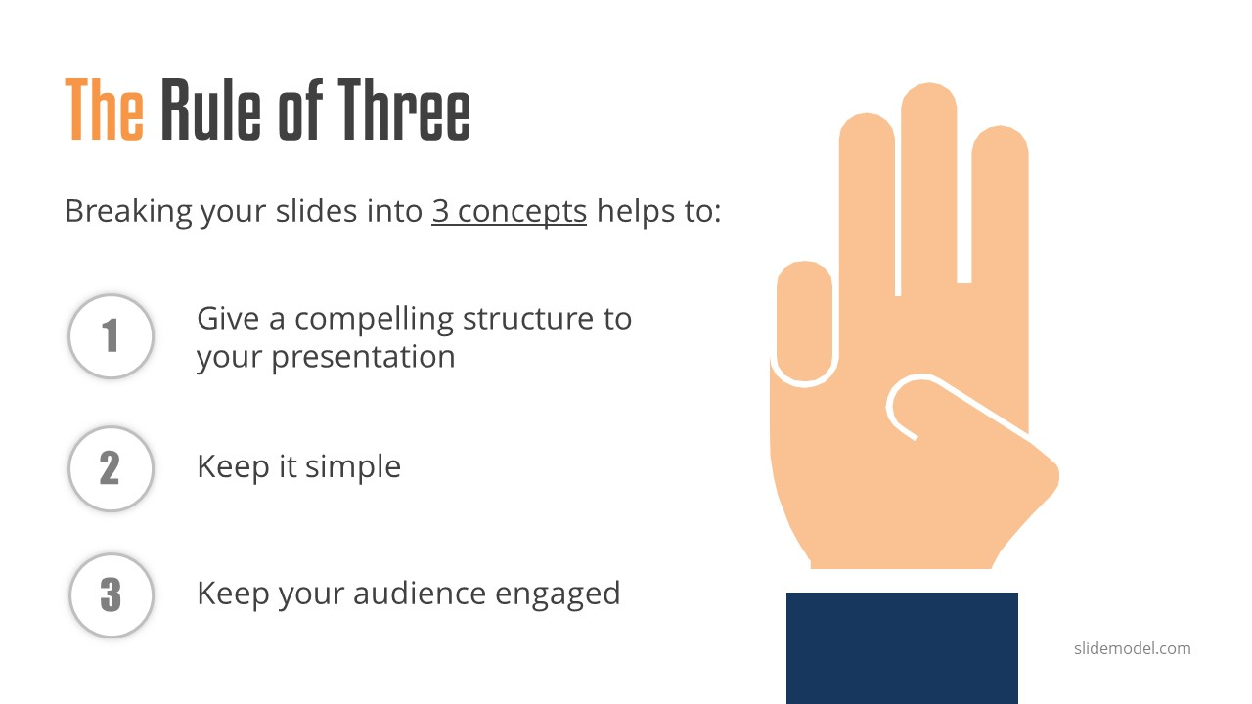
No big sentences
redundancy effect
Easily get distracted
Too much information
Notes:
Tabitha Downes: According to Ted from the video there is something in our brain called 'the redundancy effect' which means too much information on a PowerPoint slide can cause us too easily not get a full understanding on what's being presented.

Slide 3
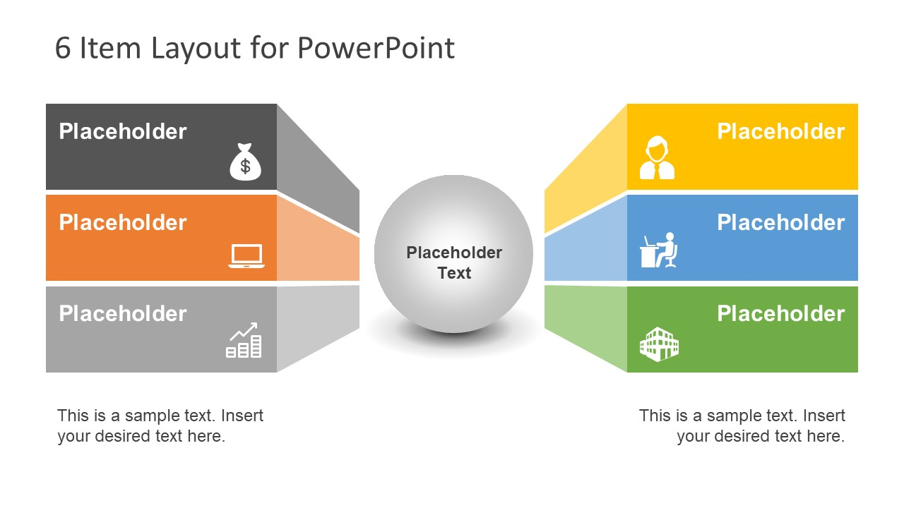
Six Objects
Text labels
Graphs
Charts
Notes:
Tabitha Downes: Six objects are much better for seeing rather than using seven or eight, according to Ted using seven or more objects can cause learners and lecturers to use 500% more energy and cognitive resources to understand whats in your powerpoint which results to death by PowerPoint. Less is more focus and more is less focus.

Slide 4
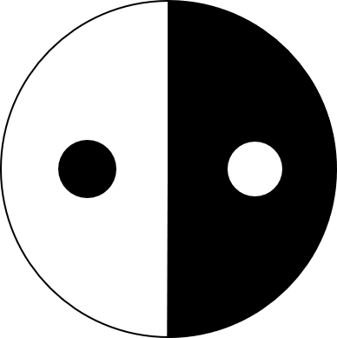

Contrast
Controls focus
Creative hope
Adaptive drive
Notes:
Dominic: Applying contrast focuses on what your talking about in your presentation.

Slide 5


Dark background
Having a dark background is the most important part of the presentation
Your eyes are relaxed
Your more focused
Words, numbers etc; stand out more
Notes:
Dwain Morgan: Dark backgrounds is better for focus and is important for visual aid.

Slide 6


Size
The texted info should be minimum.
The focus should be attracted to image.
The image should dominate the presentation
Notes:
Illoni: Referring to Ted 70% of time goes into the headline, when actually it isn’t the most important part, the most important part is the PowerPoint as it.

