Slide 1

A presentation of the critical evaluation of how Assessment for learning can be utilised in a learning episode to aid progression across a chosen area of learning and experience
ECAD5012 – Nell Evans

Slide 2

Introduction
In this presentation…
I aim to critically evaluate how assessment for learning can be used within a year four mathematics and numeracy lesson to facilitate progression.
To support understanding of using ‘fractions in practical situations, using a variety of representations’
Improve division skills linking to progression step 2 in the descriptions of learning (Welsh Government, 2020a)
The lesson will focus on calculating percentages off the original price.
Learners have previously learnt about fractions and percentages, this lessons aims to build on their prior knowledge by making connections between fractions and percentages.
By utilising AFL strategies throughout the lesson, I intend to support all learners make meaningful progress.
In the literature review, I will discuss some of the key ideas of assessment for learning, including:
The importance of providing feedback to move the learning forward.
Motivation plays a crucial role in AFL
Learner engagement is essential for promoting progress
How is AFL connected to the curriculum?
Importance of including AFL in planning to facilitate progress towards meeting the learning intentions.

Slide 3

Inside the black box
The work of Paul Black and Dylan Wiliam has had a significant impact on assessment for learning (AFL).
Studies over 250 sources to evaluate how assessment for learning can improve standards.
AFL is a key part of teaching and learning
Raise standers when learners are involved in the learning process.
For AFL to be impactful, effective feedback must be put in place to help all learners progress
“Feedback to any pupil should be about the particular qualities of his or her work, with advice on what he or she can do to improve and avoid comparisons with other people”
(Black and Wiliam, 1998)

Slide 4

Feedback
- Feedback should move the learning forward by identifying gaps and offering advice to support this.
Effective feedback is a part of the pedagogy strand from the QTS standards where teachers should provide feedback that deepens understanding and enhance the learning (Welsh Government, 2019, p. 26).
- Feedback shouldn’t focus on the pupil as it can lead to distraction from the learning and lowered self esteem (Education endowment foundation, 2021b, p. 21).
- Several teachers may serve feedback as ‘social and managerial functions’ instead of focusing on learning.
- Feedback must be personalised to improve the learning (Black, Harrison, Lee, Marshall, Wiliam, 2003, p. 11)

Slide 5

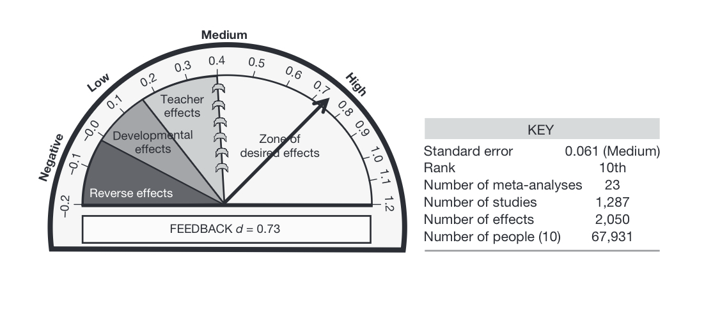
Feedback is one of the strongest factors of achievement (ranked 10th) and has a positive effect when it is from the learner to the teacher. Hattie and Clarke (2019) also emphasise the importance of providing learners with numerous opportunities to give feedback to the teacher to help with academic needs.
(Hattie, 2009, p. 173)

Slide 6

Promoting learners motivation and engagement through assessment for learning
- ‘Active engagement of the learner’ is also a key element which could be achieved when AFL is used throughout a lesson.
- Different AFL strategies can be completed by learners to allow teachers to gain insight into their understanding to adapt and support the learning (Gipps and Pickering, 2010, pp. 234-235).
- It is important that learners should not feel in competition or compared to each other when engaging in these strategies as it could de-motivate them (Black, Harrison, Lee, Marshall, Wiliam, 2003 p. 11).
-Gipps and Pickering (2010, p. 236) imply that if learners are de-motivated, they will often withdraw from learning.
- If learners are provided with motivation to engage with their learning, it can promote progress and success rather than failure.
- “Motivation can be preserved and enhanced by assessment methods which protects the learners autonomy” (Assessment reform group, 2002).

Slide 7

How is assessment for learning linked to the curriculum?
- Changes to the curriculum take time and there are many other challenges within the classroom which could effect successful AFL (Black and Wiliam, 1998, p. 3), such as:
AFL requires further professional training.
Teachers and learners may fear that changes in the classroom won’t be effective.
- Recent changes to the curriculum show that assessment for learning is becoming a central part to achieving the four purposes.
- In Donaldsons review of the assessment arrangements in Wales, he recognised that assessment for learning approaches were not fully understood by teachers and were not imbedded into lessons. He recommended that:
Assessment should be a crucial part of all lessons
Assessment should focus on progression
Connecting to the pedagogy strand from the QTS standards where learners should lead their own learning with encouragement from the teacher.
Students should engage in their own assessment
Research shows that if learners are involved in their own assessment process, it enables them to enhance the pace of progress (David, 2009, p. 16)

Slide 8

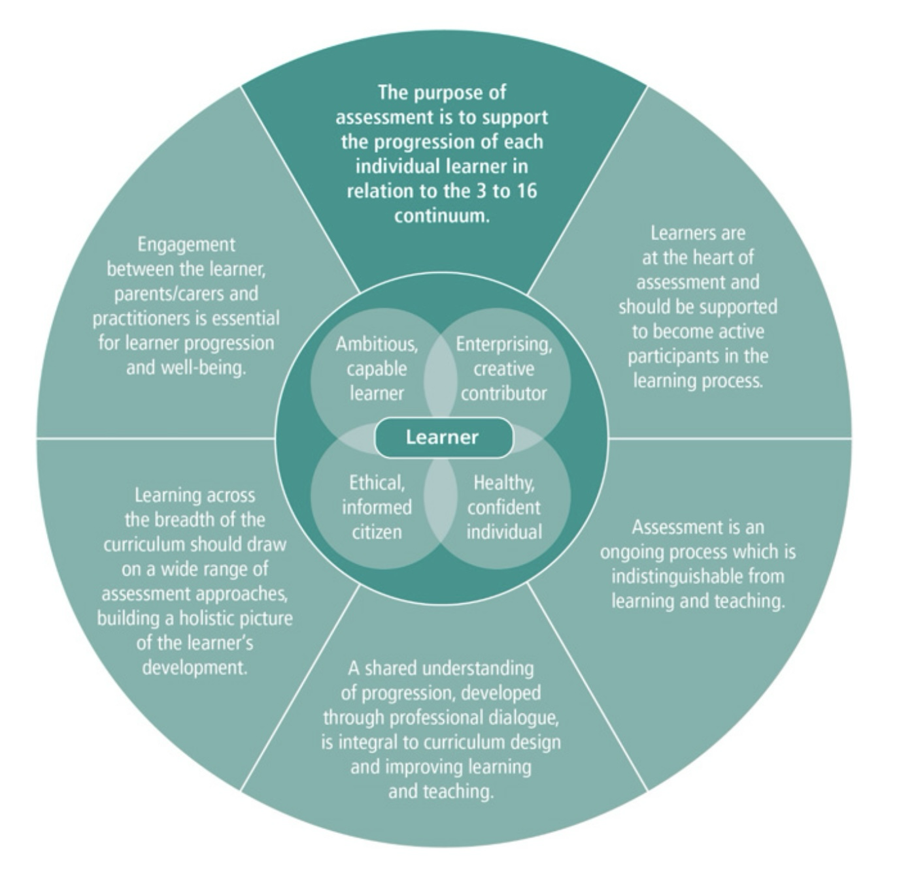
How is assessment for learning linked to the curriculum?
The Welsh Government released assessment guidance which went hand in hand with progression.
Key principles of assessment include:
Assessment should be an on-going process and should be included in day to day practice.
Placing learners at the centre of assessment.
Assessment should identify the needs and achievements of the learners.
(Welsh Government, 2020b)

Slide 9
Assessment for learning principles
(Assessment reform group, 2002)
Assessment for learning should be central to classroom practice.
Learners should receive guidance on how to improve by given information to plan their next steps in learning.
Assessment for learning should help identify learners achievements and efforts.

Slide 10
Using assessment for learning in planning
- Donaldson (2015, pp. 75-76) suggests that effective assessment for learning requires careful preparation ahead of time and should be included in lesson plans.
- Jones (2005, p. 8) further reinforces this by expressing the importance of carefully planned assessment for learning where teachers should plan opportunities for learners to progress towards the learning intentions.
Including: objectives that prioritise learning, strategies to assess children’s prior knowledge, questioning to deepen understanding and promote critical thinking, mini plenaries and self or peer assessment.
- These opportunities may vary based on the subject area, the learners current stage in their learning, their misconceptions, age and whether they have used them before (Welsh Government, 2010, p. 30)

Slide 11
Lesson overview
Used a variety of AFL strategies to aid progression in a year four class.
Mathematics and numeracy lesson with a focus of calculating percentages off the original price using division and subtraction.
Learners have previously had lessons on percentages and fractions, which are closely related.
Familiar on how to calculate percentages.
In this lesson, they will build upon prior knowledge by continuing to progress in these skills:
‘I have experienced fractions in practical situations. Using a range of representations’
‘I have explored and can use my understanding of multiplication relationships to multiply and divide whole numbers. Using a range of representations, including sharing, grouping and arrays.’
These skills are from the statement of what matters: ‘The number system is used to represent and compare relationships between numbers and quantities’ under progression step 2 (Welsh Government, 2020a).

Slide 12
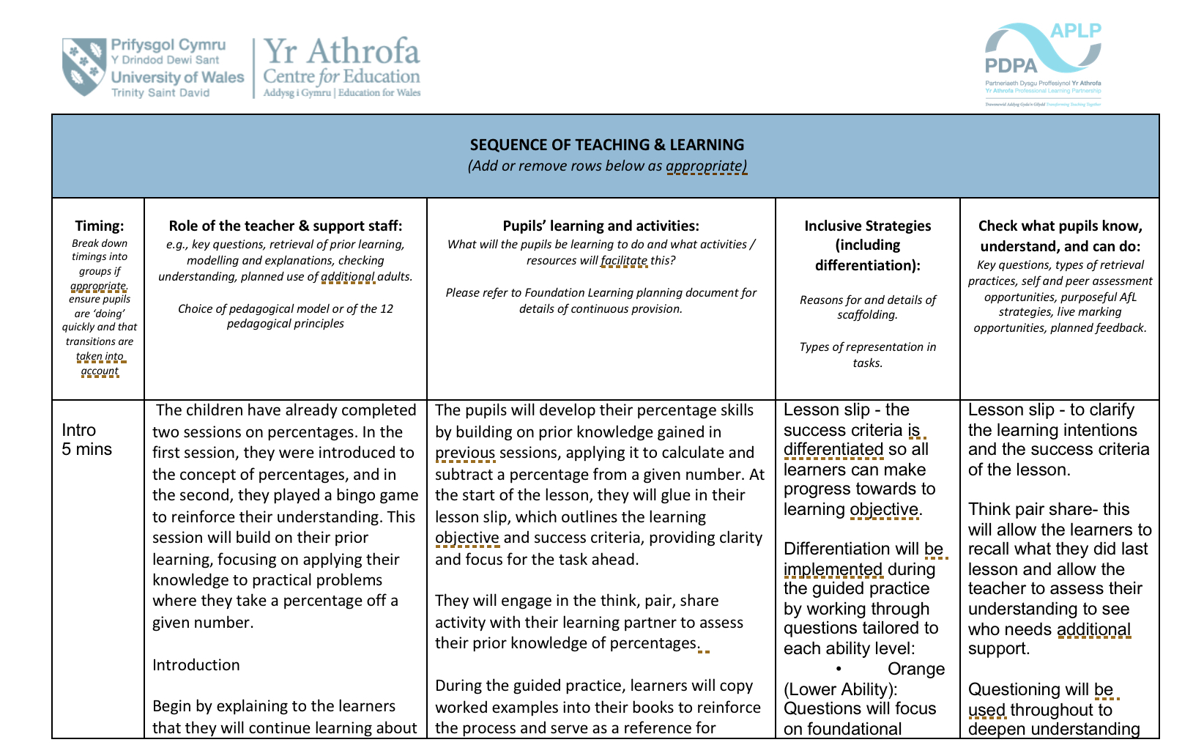
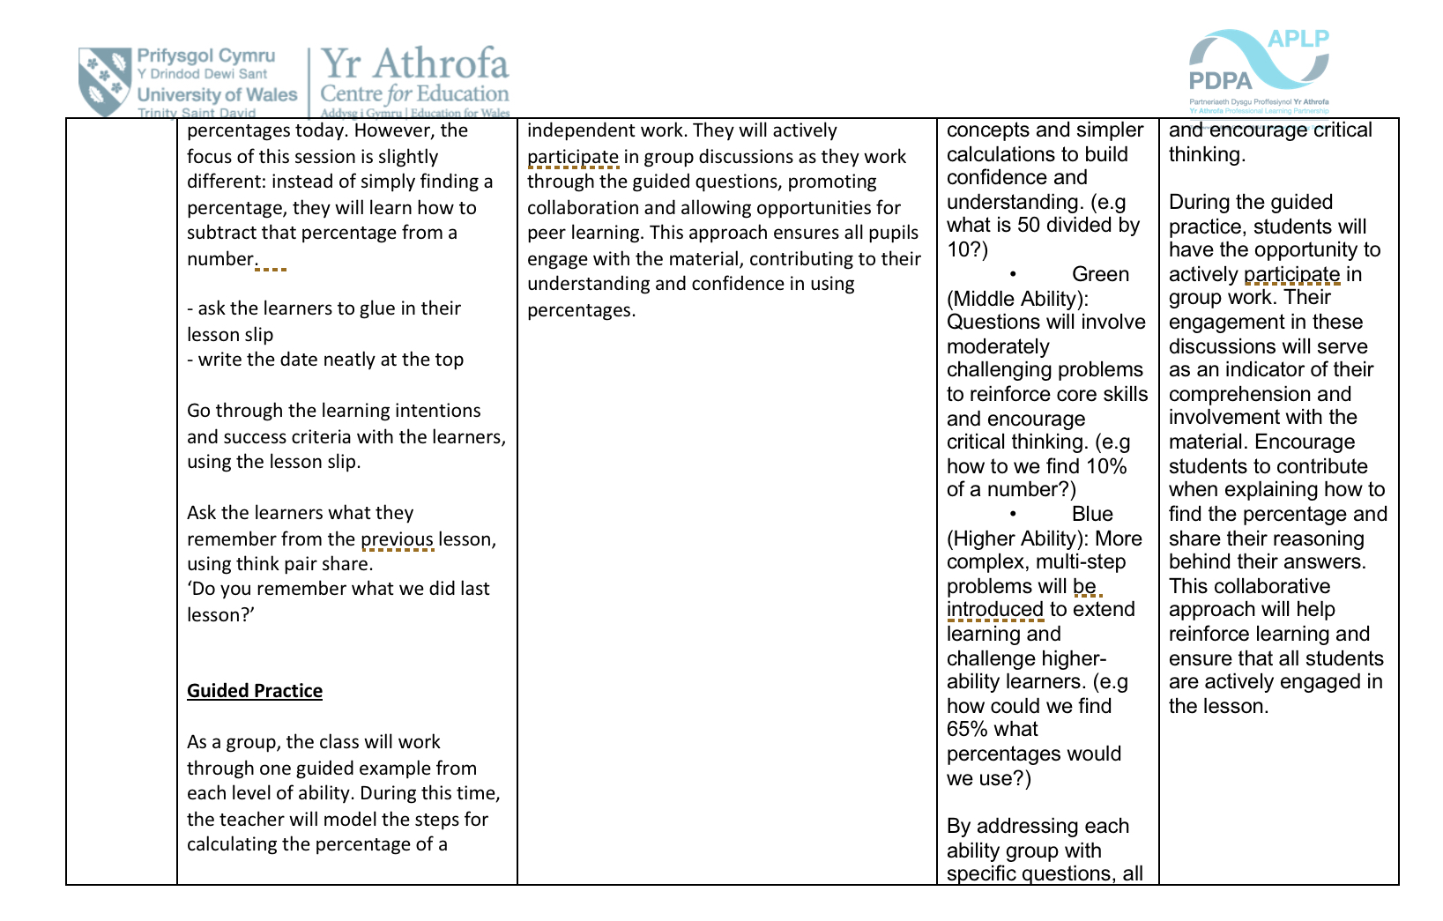
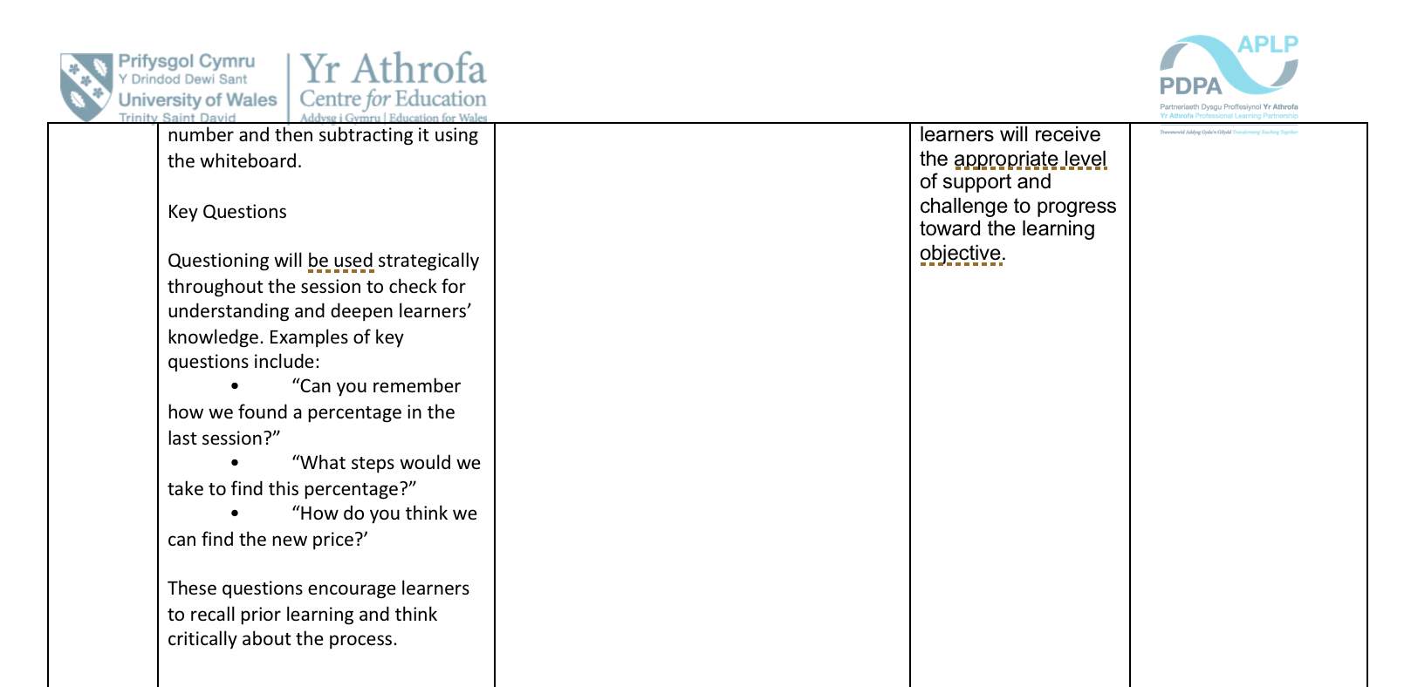
Lesson slip
In the introduction of the lesson I used a lesson slip for the learners to see the aims of the lesson and the success criteria, providing them with clear goals to work towards throughout the lesson.

Slide 13

Lesson slip
Essential that the learners understand the learning intention of the lesson as it is a vital part of AFL (Black, Harrison, Lee, Marshall, Wiliam, 20l3 p. 31).
Providing achievable learning intentions for learners to progress towards, shows them the quantity of the work that should be produced and what they will be learning about (Briggs, Woodfield, Martin, Swatton, 2008, p. 11).
Learning intentions focus on the goal of the lesson to help learners stay focused and involved (Grafwallner, 2019)
Wiliam (2011, p. 60) suggests that the learners are most likely to reach the learning intentions when given clear instructions but will not be able to further their learning and it is less likely that learning will be effective.
This could be avoided by dividing the learning intentions and the context of learning, which is why I chose to introduce the lesson slip at the start of the lesson.
By doing so it will be easier to differentiate the guidance whilst maintaining a classroom environment where all learners are working towards the same goal.

Slide 14
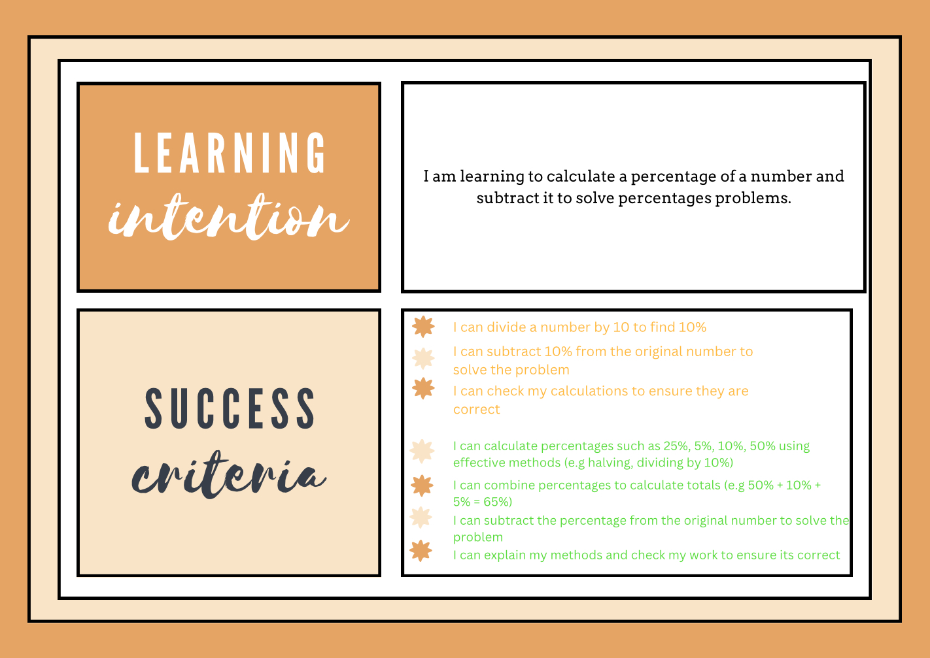
Lesson slip
I differentiated the success criteria (amber for lower/middle and green for higher).
Provided learners with a differentiated checklist to assess their own progress throughout the lesson
Could provide them a sense of motivation, achievement and ownership of their learning (Bartlett, 2015, p. 29)
Success criteria’s are ‘building blocks for successful self and peer assessment (Dunn, 2017, p. 42).

Slide 15
Lesson slip
- When some students were assessing their work against the success criteria throughout the lesson, they would tick off the criteria without thoroughly reviewing their work.
- To address this, I paid close attention to these students and helped them review their work to ensure they followed the steps outlined in the success criteria.
- I chose to do this because effective self assessment requires guidance from the teacher, especially to support lower-ability learners.
- Like many skills, self assesment takes time and practice (Welsh Government, 2010, p. 27).

Slide 16
Think, pair, share
I used think, pair, share to help the learners recall previous learning of percentages as they will be using this knowledge throughout the lesson.
The think pair share strategy involves three steps:
Think: learners will have time to think individually about the questions being asked
Pair: discuss ideas with a partner to assess and develop their response
Share: Opportunity to share their ideas with the class
(Bartlett, 2015, p. 122)
I decided to use this strategy because it has the potential to improve the quality of questions and answers.
By providing thinking time it can encourage the learners with low self- confidence to be more involved.
(Welsh Government, 2010, p. 85)

Slide 17
Think, pair, share
Thinking time (think)
Pair discussion (pair)
Allows learners to recall information and strengthen memory.
If learners move directly into pairs they might miss out on the opportunity to strengthen their memory (Jones and Wiliam, 2021)
Rowe (1972) suggested that giving learners ‘wait time’ to think about the question being asked can improve length and relevancy of a response and decrease the number of learners who fail to respond.
Enables learners to peer assess each others thinking by acting as a critical friend
Help improve their thought process from the thinking stage
Encourages learners to ask questions (Bartlett, 2015, p. 22)
Young (2024) states that during the pair phase learner can challenge each other thinking and build upon each others ideas, which could deepen understanding.
Potential disadvantage (Leon, 2024): it might be harder to assess the learners individual understanding, as some students might struggle to engage fully in partner discussion (one learner might dominate the discussion)
Could be avoided by closely monitoring the learners discussion.
Jones and William (2021) suggest that “teachers should actively support students listening, as it’s often an underrated element of think-pair-share’
Question such as ‘Could you tell me what they told you?’ Could keep the partners engaged and serve as practice for the share part of the strategy

Slide 18
Think, pair, share
Whole class discussion (share)
- I was able to assess the understanding and misunderstanding of previous learning and further learners thinking by questioning their ideas.
- Gershon (2013) advises that providing opportunities for discussion is a highly effective classroom tool
- Gives students opportunities to develop and express their original thoughts, whilst also addressing any misconceptions.
- The Education Endowment Foundation (2021) states that by recalling information it can highlight misconceptions early on which can be addressed to help the learner progress in the right direction.
To further help learners progress I asked further questions. Not only to help learners think harder about their answer but also they learning journey itself. (Cambridge assessment international education, 2025).
- Further questioning can also encourage learners to provide detail, reasoning and evidence to support their response (Campbell, 2024).

Slide 19
Guided practice
I conducted a guided practice to go through each step of calculating a percentage off a price.
Each question was differentiated towards lower, middle and higher ability.
Guided practices can effectively provide immediate feedback, if a learner misunderstands a concept or makes an error.
Teacher can identify the issues and offer support.
Boost students confidence, engagement and motivation (Cox, 2020).

Slide 20
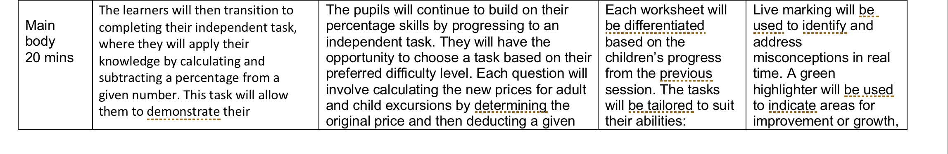
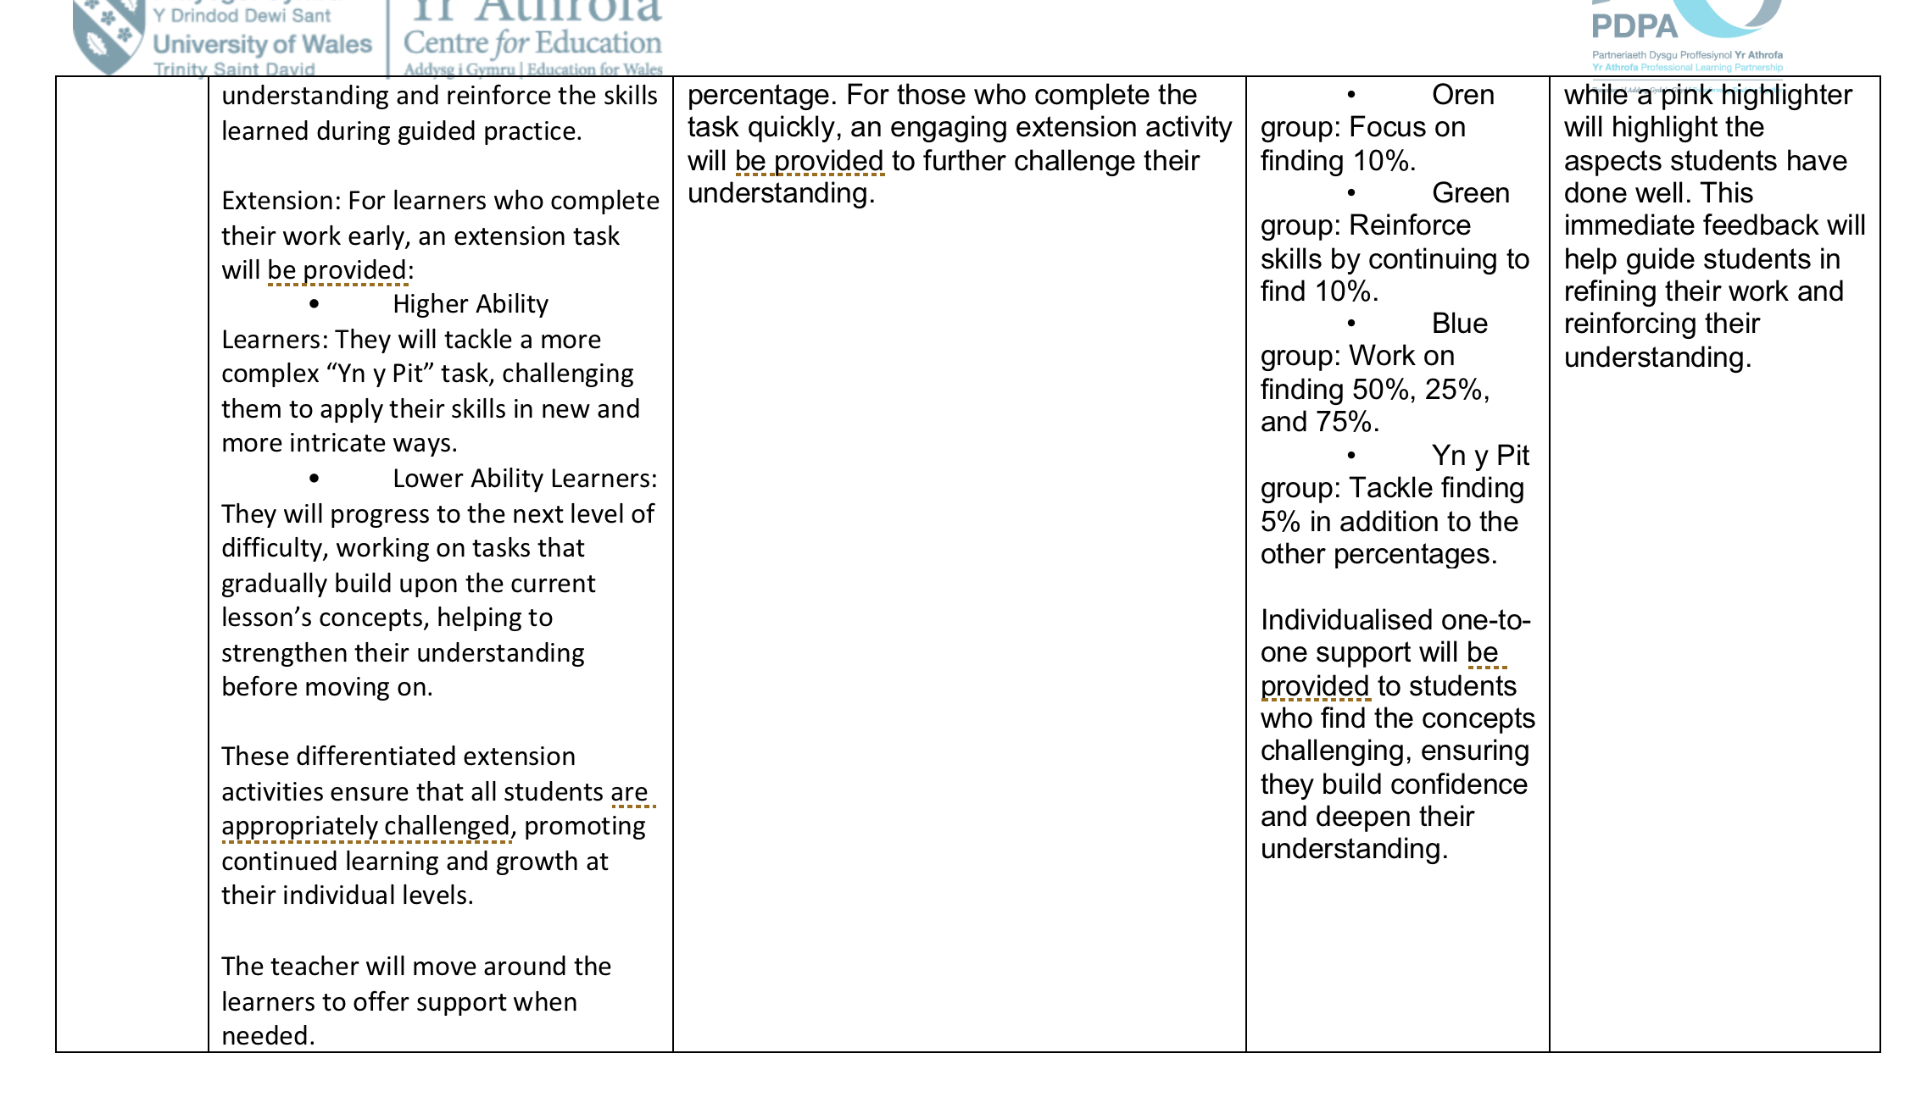
Live marking
The learners then moved on to the independent practice where I used live marking:
Green highlighter to indicate growth (green for growth)
Pink highlighter for things they did well.
Learners are familiar with this process as they use this strategy often.
I used this because live marking can provide effective immediate feedback during a lesson (Education endowment foundation, 2021a).
Provides valuable evidence for AFL, as it allows teachers to adjust their teaching accordingly.
By marking students work during the lesson, teachers can respond to students needs in real time (Wells, 2018).
Highlights the achievements of learners by using the pink highlighter which could improve self-confidence and motivation.
Could be quite time-consuming as it requires reviewing each learners work.
If a learner is missed, it could lead to the students feeling less appreciated.

Slide 21
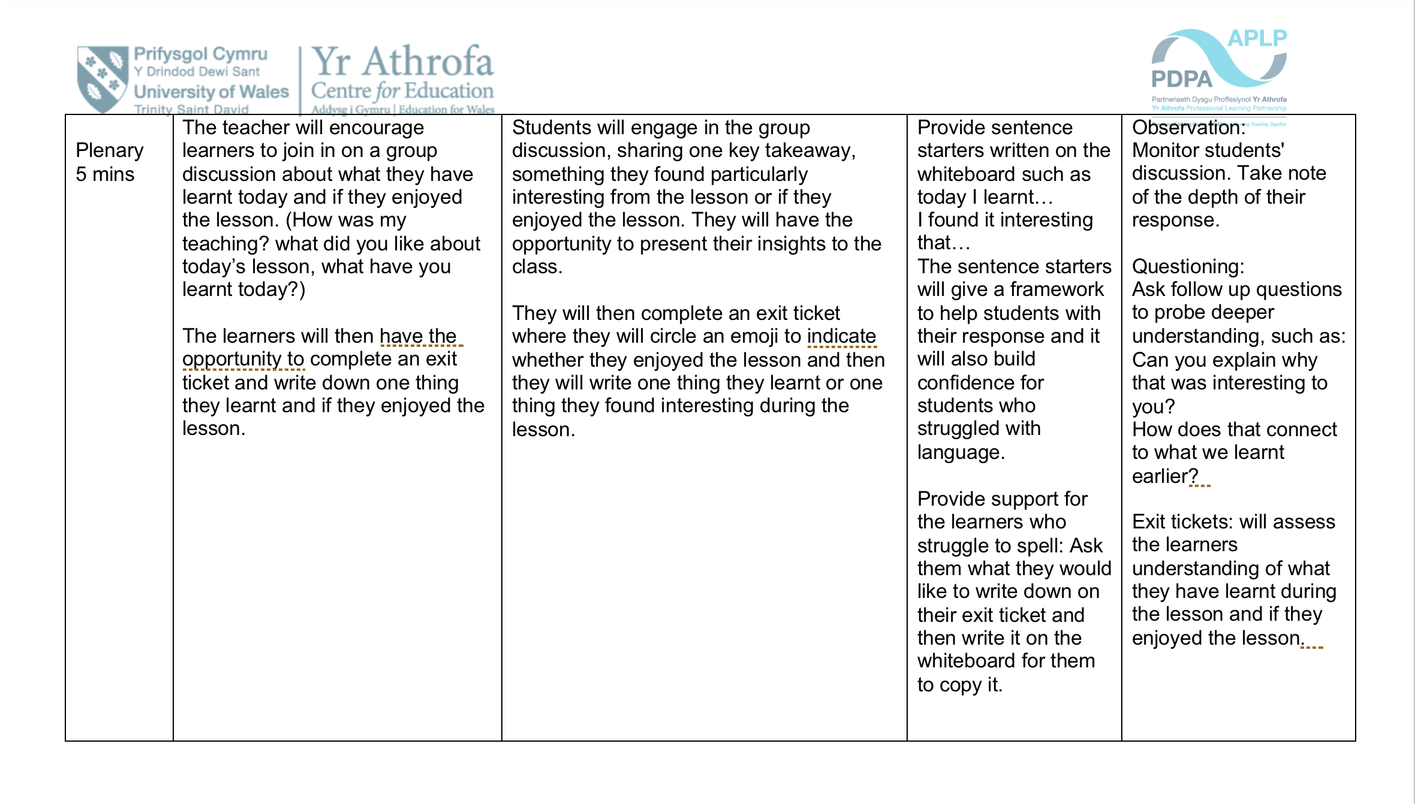
Plenary
I moved onto the plenary of the lesson where the learners had the opportunity to discuss what they learnt during the lesson. I also took this time to ask them how they found my teaching and what aspects of the lesson they liked.

Slide 22
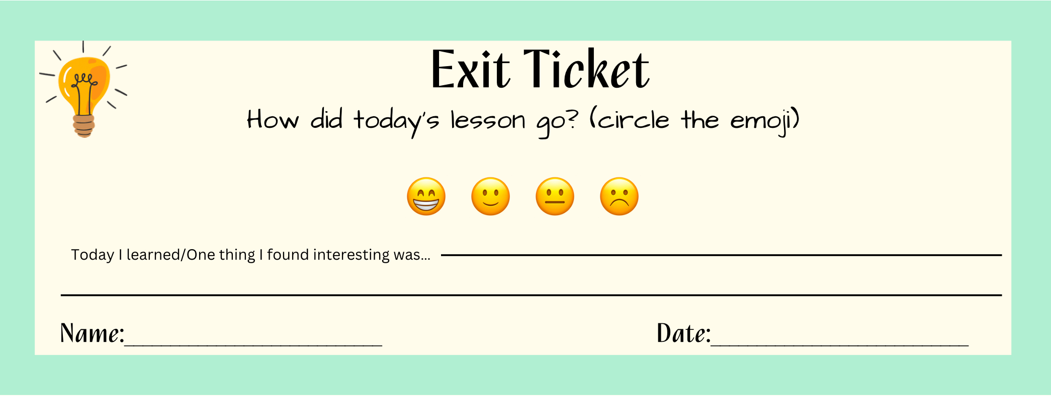
Exit tickets
I used exit tickets to gather feedback.
Allowed me to see whether they enjoyed the lesson.
I decided to use exit tickets because they can quickly evaluate learners understanding of the main ideas of the lesson.
Offer instant feedback to the teacher and learner, allowing any knowledge gaps to be pinpointed and addressed, enabling them to progress further in their learning (Johnson, 2024).
Aligns with Sarles and Owen (2012, p. 21) who state that “Exit tickets are also a safe, unobtrusive way for students to tell us what they really know and understand or in some cases, what they really don’t know and understand which informs our teaching practices”
Exit tickets are also key for self-reflection, this is crucial for students as it encourages them to think critically about what they have learnt, and wether they have effectively engaged throughout the lesson (Johnson, 2024).
I ensured that all learners would have this opportunity, by differentiation of the exit ticket.
Made sure the exit ticket was clear, so it was easy to understand and wouldn’t overwhelm the less confident learners , if the exit ticket isn’t clear, it could lead to unclear answers making it harder to assess learners understanding (Bruney, 2024).

Slide 23
Conclusion
Assessment for learning can help all learners make significant progress by providing support and guidance through feedback
Top factors of achievement (Hattie, 2009, p. 173).
Strategies such as think, pair, share and exit tickets can support this.
Important that learners understand the objective and success criteria so they can progress towards them throughout the lesson, the lesson slip provided opportunity for this.
To further my research and deepen my understanding of assessment for learning, I plan to use AFL strategies across various subjects and age groups as it will allow me to observe how they impact the learning in different contexts and identify potential adaptations.
Moving forward, I would also like to practice these strategies more with the learners as effective AFL takes time and practice.
I will trial using think, pair, share in different contexts, such as before using the exit ticket, so learners can discuss their thoughts with their learning partner before writing them down.

Slide 24

Reference list
Assessment Reform Group (2002) Assessment for Learning: 10 Principles. Research-based principles to guide classroom practice Assessment for Learning. [online] Available at: https://www.researchgate.net/publication/271849158_Assessment_for_Learning_10_Principles_Research-based_principles_to_guide_classroom_practice_Assessment_for_Learning (Accessed 20 December 2024).
Bartlett, J. (2015). Outstanding assessment for learning in the classroom. New York: Routledge.
Black, P., Harrison, C., Lee, C., Marshall, B. and Wiliam, D. (2003). Assessment for learning: Putting It into Practice. Berkshire: Open University Press.
Black, P. and Wiliam, D. (1998). Inside the black box : raising standards through classroom assessment. London: GL Education Group.
Briggs, M., Woodfield, A., Martin, C. and Swatton, P. (2008). Assessment for learning and teaching in primary schools. 2nd ed. Exeter: Learning Matters.
Bruney, A. (2024). ‘The Dos and Don’ts of Exit Tickets: Maximizing Their Effectiveness’, Mind Matters Pedagogy [blog]. 3 September. Available at: https://www.mindmatterspedagogy.com/post/the-dos-and-don-ts-of-exit-tickets-maximizing-their-effectiveness (Accessed 14 January 2025).

Slide 25
Cambridge Assessment International Education (2025). Getting started with Effective Questioning. Available at: https://cambridge-community.org.uk/professional-development/gsweq/index.html (Accessed 13 January 2025).
Cambridge International Education Teaching and Learning Team (2011). Getting Started with Assessment for Learning. Available at: https://www.cambridge-community.org.uk/professional-development/gswafl/index.html (Accessed 20 December 2024).
Campbell, M. (2024). ‘Effective Questioning Techniques for Learning and Engagement’, Growth Tactics [blog].23 February. Available at: https://www.growthtactics.net/effective-questioning-techniques/ (Accessed 13 January 2025).
Cox, J. (2020). ‘Guided vs. Independent Practice’, Teach Hub.com [blog]. 21 August. Available at: https://www.teachhub.com/professional-development/2020/08/guided-vs-independent-practice/ (Accessed 13 January 2025).
David, A. (2009). You Can Assess Pupils Progress. Warwickshire: Scholastic Ltd.
Donaldson, G. (2015). Successful Futures Independent Review of Curriculum and Assessment Arrangements in Wales. Available at: https://www.gov.wales/sites/default/files/publications/2018-03/successful-futures.pdf (Accessed 20 December 2024).
Dunn, D. (2017). How to Be an Outstanding Primary School Teacher. 2nd ed. London: Bloomsbury.
Education Endowment Foundation (2021a). ‘Guest Blog: Retrieval Practice - a Common Good or Just commonplace?’, Education Endowment Foundation [blog]. 22 July. Available at: https://educationendowmentfoundation.org.uk/news/guest-blog-retrieval-practice-a-common-good-or-just-commonplace-2 (Accessed 22 December 2024).

Slide 26
Education Endowment Foundation (2021b). Teacher Feedback to Improve Pupil Learning. Available at: https://educationendowmentfoundation.org.uk/education-evidence/guidance-reports/feedback (Accessed 20 December 2024).
Gershon, M. (2013). How to Use Questioning in the Classroom : the Complete Guide.
Gipps, C. and Pickering, A. (2010). Learning to Teach in the Primary School. 2nd ed. London: Routledge.
Grafwallner, P. (2019). ‘ A Framework for Lesson Planning’, Edutopia [blog].18 April. Available at: https://www.edutopia.org/article/framework-lesson-planning (Accessed 13 January 2025).
Hattie, J. (2009). Visible learning: a Synthesis of over 800 meta-analyses Relating to Achievement. London: Routledge.
Hattie, J. and Clarke, S. (2019). Visible Learning: Feedback. London: Routledge.
Johnson, E. (2024). ‘How To Use Exit Tickets To Find Out What Your Students Have Learned’, Third Space Learning [blog].19 December. Available at: https://thirdspacelearning.com/blog/exit-ticket/ (Accessed 13 January 2024).
Jones, D.C.A. (2005). Assessment for learning. London: Learning and Skills Development Agency.
Jones, K. and Wiliam, D. (2021). Getting the ‘Think-Pair-Share’ technique right, ascd [blog].13 October. Available at: https://ascd.org/blogs/getting-the-think-pair-share-technique-right (Accessed 21 December 2024).

Slide 27

Leon, D. (2024). ‘What Is the think-pair-share Strategy in teaching? A Collaborative Learning Routine’, HMH [blog]. 15 April. Available at: https://www.hmhco.com/blog/what-is-the-think-pair-share-strategy-in-teaching (Accessed 22 December 2024).
Rowe, M.B. (1972). Wait-Time and Rewards as Instructional Variables: Their Influence on Language, Logic, and Fate Control. Available at: https://eric.ed.gov/?id=ED061103 (Accessed 22 December 2024).
Sarles, P. and Owen, D. (2012). ‘EXIT TICKETS: THE REFLECTIVE TICKET TO UNDERSTANDING’, Library media connection, November. pp. 20–22.
Wells, A. (2018). ‘The Pros and Cons of Live Marking’, Teachertoolkit [blog]. 4 March. Available at: https://www.teachertoolkit.co.uk/2018/03/04/live-marking-2/ (Accessed 13 January 2025).
Welsh Government (2010). How to develop thinking and assessment for learning in the classroom. Available at: https://hwb.gov.wales/curriculum-2008/assessment/how-to-develop-thinking-and-assessment-for-learning-in-the-classroom/ (Accessed 20 December 2024).
Welsh Government (2019). Professional Standards for Teaching and Leadership. Available at: https://hwb.gov.wales/api/storage/19bc948b-8a3f-41e0-944a-7bf2cadf7d18/professional-standards-for-teaching-and-leadership-interactive-pdf-for-pc.pdf (Accessed 20 December 2024).
Welsh Government (2020a). Curriculum for Wales . Available at: https://hwb.gov.wales/curriculum-for-wales (Accessed 21 December 2024).
Welsh Government (2020b). Supporting learner progression assessment guidance . Available at: https://hwb.gov.wales/curriculum-for-wales/assessment-arrangements/supporting-learner-progression-assessment-guidance/ (Accessed 20 December 2024).

Slide 28
Wiliam, D. (2011). Embedded Formative Assessment. Bloomington: Solution Tree Press.
Young, N. (2024). Think Pair share: Mastering Classroom Engagement and Enhancing Active Learning. Teachfloor [blog]. 25 October. Available at: https://www.teachfloor.com/blog/think-pair-share#:~:text=Think%20Pair%20Share%20is%20a%20dynamic%20cooperative%20learning,and%20finally%20sharing%20their%20ideas%20with%20the%20class. (Accessed 22 Dec. 2024).

