Slide 1
Policing Communities

Slide 2
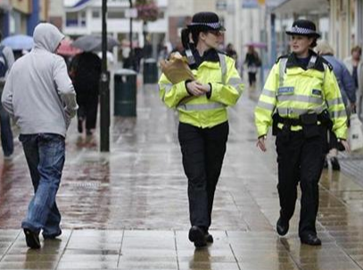
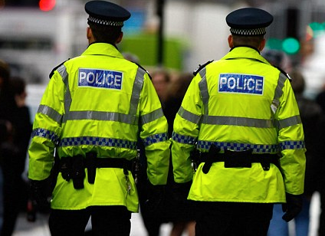
Sessions to revisit
Policing in the community
Evidence based policing

Slide 3
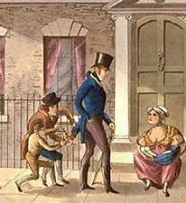
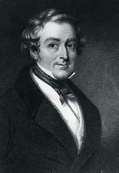
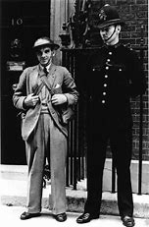
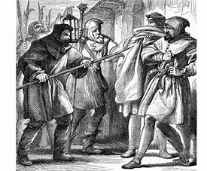
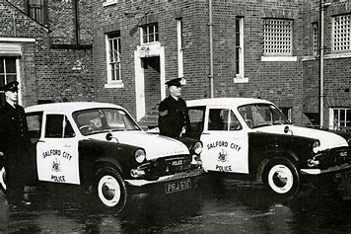
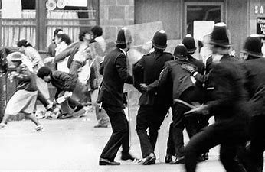
Events which have had a damaging effect on the willingness of communities to engage with police
Notes:
https://whatworks.college.police.uk/Research/Documents/Community_engagement_lessons.pdf

Slide 4
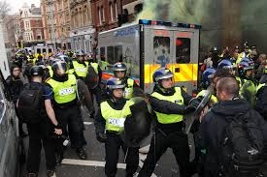
Brixton Riots

Slide 5
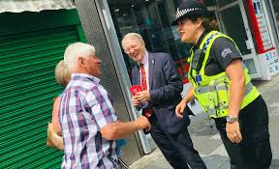
Community Engagement
The College of Policing has highlighted the importance of community engagement. Without the support of the communities that it serves the police service would not function.
Effective community engagement, can increase public confidence in the police.
The police service can enhance its legitimacy through fair decision making and positive public interaction. The public develop trust in their police service.
An increase in public perceptions of safety
A reduction in disorder and anti-social behaviour
Police officer job satisfaction

Slide 6
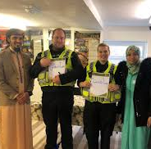
Benefits of Engagement
an increase in public perceptions of safety
a tendency towards a reduction in disorder and anti-social behaviour
an increase in confidence and trust, and in community perceptions of the police
an improvement in police officers’ attitudes and job satisfaction.

Slide 7
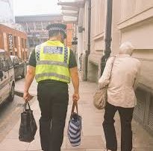

Engagement Methods
Community Impact Assessments
Understanding Community Problems
Adapting police styles to police minority groups
Other organisations initiatives
http://www.regenwales.org/upload/pdf/071415111717A%20Guide%20to%20Effective%20Community%20Engagement.pdf

Slide 8
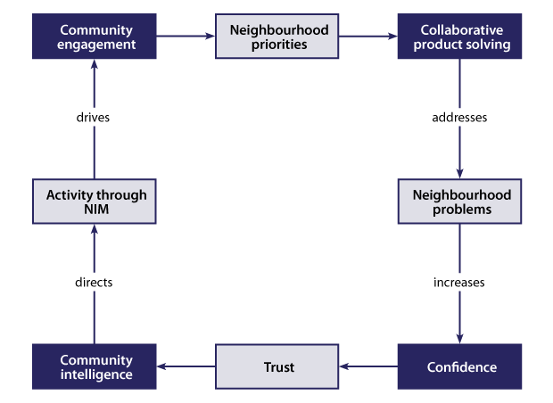

Slide 9
Key implementation issues are listed below.
• Organisational commitment and culture change
• Mainstreaming
• Sharing power with communities
• Tailoring and local flexibility
• Performance management
• Training and capacity building
• Confidence and trust
• Communication
• Partnership working

Slide 10
Risks associated with ineffective engagement
a loss of public confidence in the police
a loss of legitimacy in the eyes of the public
a negative impact on strategic policing as the police are unable to predict changes in community profile, needs and priorities
increased vulnerabilities around threat, risk and harm
withdrawal of the public from participation and problem solving, leading to services that are less responsive to the needs of the public and require increased policing resources
unrealistic public expectations regarding policing services
lack of awareness of changes in the community and tensions not being identified, leading to a negative impact upon tactical policing.

Slide 11
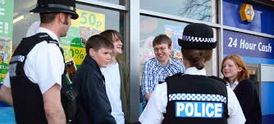
Community Cohesion
http://library.college.police.uk/docs/npia/CohesionGuide.pdf
https://www.bmgresearch.co.uk//wp-content/uploads/2019/01/1578-HMICFRS-Public-Perceptions-of-Policing-2018_FINAL.pdf
http://www.tedcantle.co.uk/publications/033%20Tension%20monitoring%20guidance%20iCoCo%202010.pdf

Slide 12
Key Principles of Effective Community Engagement
Social Justice
Self-determination
Working and Learning together
Sustainable Communities
Participation
Reflective Practice

Slide 13

https://www.app.college.police.uk/app-content/engagement-and-communication/engaging-with-communities/

Slide 14

file:///D:/Year%20Two/Year%20Two%20Lessons/16.%20Policing%20Communities/Neighbourhood%20Policing%20Guidlines.pdf

Slide 15
An evaluation of the impact of the National Reassurance Policing Programme
http://library.college.police.uk/docs/hors/hors296.pdf

