Slide 1

Lecture - Eye Witness Testimony, memory and the police

Slide 2
Sour Sugar Toffee
Nice Pop Taste
Candy Bitter Cake
Honey Chocolate Tooth
Pie Good Tart

Slide 3
Mad Fight Fury
Wrath Rage Calm
Fear Hatred Emotion
Happy Temper Enrage
Hate Mean Annoy

Slide 4
Some interesting facts:
Two thirds of wrongful conviction comes from EWT in the US.
EWT can be both accurate and inaccurate: good for gender and eye shape, appalling for beards and moustaches!
Post incident events greatly effect EWT.
EWT confidence is not related to accuracy!
Lineups and identification processes need careful planning if they are to be of use...
BUT- Police and the jury have a great deal of faith in EWT…

Slide 5
Aims of this lecture:
Revisit historical findings that relate to EWT accuracy
Revisit historical findings that relate to EWT confidence
Revisit historical findings that relate to memory fallibility overall
Explore contemporary findings that relate to EWT
Explore contemporary findings that relate to system and estimator variables
Explore contemporary findings that relate to improving EWT

Slide 6
Some findings…
According to Wise and Safer (2010), in a study comparing undergraduates, law students and judges, the latter two groups were no more knowledgeable of the factors influencing EWT accuracy than the undergraduate group.
Additionally, Wise, Safer & Maro (2011) found a similarly low level of knowledge amongst law enforcement officers.
Moreover, lawyers are very much aware that visual knowledge is the most persuasive element of EWT and often determines the outcome of a case regardless of how logical or `tight` the case may be (Brewer et al., 2012).

Slide 7
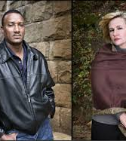
The role of memory in questioning and the courtroom
The case of wrongful conviction
Eyewitness: How accurate is visual memory? | 60 Minutes Archive

Slide 8
Memory and EWT:
Juries tend to pay extra attention to eyewitness testimony and generally see it as very trustworthy and convincing.
However, research from cognitive psychology tells us that generally people's memories are fallible.
Research can be broadly split into two categories:
Reconstructive Errors & Leading Questions
Weapon Focus and Violence Distraction
Other researchers make a distinction between -
`Estimator Variables` and `System Variables`: perception and memory, and information gatherers, respectively.

Slide 9
Estimator and System Variables (Wells, 1993)
Estimator variables are those beyond the control of the CJS, and usually occur before investigations take place. These include stress, anxiety, exposure, memory, perception and others.
System variables are usually under the control of the CJS and are essentially preventable. They include interviewing, offender identification, among others.

Slide 10
An example of Estimator Variables:
Situational factors.
The research is limited in terms of real-life scenarios, but relies heavily on psychological research relating to perception and memory.
One example is TIME:
1. Exposure –
longer exposure = accurate recall
(Palmer et al., 2013).
2. Frequency of exposure-
limited research because it is common-sensical (Loftus, 1979).
3. Pace of events- fast moving information is harder to process, but virtually no research for EWT.
4. Retention interval –
the longer the time, the less accuracy (Deffenbacher et al., 2010).
WHY?

Slide 11
BRIEF HISTORY:
The Devlin Report (1976) investigated the accuracy and importance of EWT following serious miscarriages of justice.
The report examined over 2000 ID parades in England and Wales in 1973 and followed them through to their outcomes in court. 45% (900) resulted in a suspect being identified and out of these 82% were convicted.
In over 300 cases the EWT was the ONLY evidence provided and 74% of these were convicted!
Although juries love EWT, it may not be as accurate as we like to think.

Slide 12
We know that we do not store information exactly as it is presented. Rather, we extract the gist, or underlying meaning.
We store information in the way that makes the most sense. We make sense of information by trying to fit it into our schemas, which allow us to make sense of what we encounter in order to predict events and our subsequent response.
Memory can be distorted at each of the three stages: acquisition, retention and retrieval (Loftus, 2005).

Slide 13

Cohen (1981)
Cohen (1981) showed how an individual’s schema for particular occupations can affect recall.
He showed participants a video and described the woman as either a waitress or a librarian.
Participants were then asked questions about the woman such as “What was she doing?”
Participants were more likely to recall those details which fitted with the stereotype for the job they had been told about.

Slide 14
Loftus and her work on EWT.
Participants required to act as jurors and decide the guilt or innocence of role-playing thieves.
When evidence was circumstantial, i.e. the suspect being seen entering the building of the crime, only 18% were judged as guilty.
However, when the testimony of an eyewitness was added, this figure rose to 72%
Even when the witness admitted that they had bad eyesight and they were not wearing glasses, 68% of jurors were still prepared to convict on EWT alone!

Slide 15
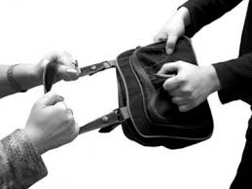
In a classic American study (Buckhout, 1980), a 13-second clip of a mugging was shown on TV. An identity parade of six suspects was later shown and viewers were asked to phone in and identify the culprit.
Given that there were only six suspects, chance alone would suggest that 17% would get it right.
In fact only 14% identified the person correctly, thus suggesting that EWT is not particularly accurate!

Slide 16
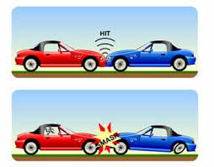
Loftus & Palmer (1974)
No need to remind you of this one!
Participants shown a series of slides of car crashes. They were then asked ‘How fast the cars going when they bumped into each other?’ The verb was substituted for words such as ‘smashed’ or ‘hit.’
An average speed for each verb was calculated.
Findings: the estimated speed varied according to the verb. ‘Smashed’ produced an average estimate of 41mph whereas ‘hit’ reduced the estimates to 34mph.
A week later participants were asked if there was broken glass. This time participants who had received the verb ‘smashed’ were more likely to recall seeing glass.

Slide 17

Loftus, Miller & Burns (1978) found that they were able to get some participants to recall having seen a sign by the road, even though there was no sign.
This study also showed that most participants were unaware that they had been misled, which helps to reduce the possibility that results like these are simply the result of demand characteristics.

Slide 18
The use of leading questions
Leading questions is referred to as a `System Variable` and more recent research has indicated that is may be better referred to as a misinformation effect (Loftus, 2005).
E.g. `What colour was the tattoo…`
Moreover, recent findings suggest that those with a higher degree of intelligence are less prone to the misinformation effect (Zhu, et al., 2010).

Slide 19
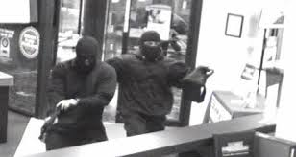
Fear and Anxiety
Christianson & Hubinette (1993) found that fear/anxiety can have an effect.
They asked people involved in real bank robberies (victims and onlookers) about the incident.
The recall of the victims was more accurate than that of the onlookers, suggesting the stress of the situation had aided recall.
The better recall was still present 15 months later.

Slide 20
Anxiety
Deffenbacher et al. (2004) carried out two meta-analyses comparing the effects of anxiety on (a) facial recognition and (b) details at the scene of the crime.
In both cases high levels of anxiety were shown to significantly reduce accuracy of recall.
However, some research suggests that anxiety can have beneficial effects (like Christianson & Hubinette, 1993).
These seemingly contradictory findings could be explained by the Yerkes-Dodson Law:
This suggests that moderate levels of anxiety can be beneficial to recall, however as anxiety increases it begins to have an adverse effect.

Slide 21
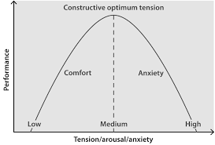
The inverted U relationship or Yerkes-Dodson law
This states that stress or anxiety increases performance up to an optimal point.
After that, further increases in anxiety lead to a reduction in performance.
This also seems to apply to the relationship between anxiety and recall.

Slide 22
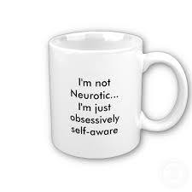
Individual differences
Bothwell et al. (1987) established participants level of neuroticism.
They then witnessed a ‘crime’ and had to identify the culprit from an ID parade.
When exposed to low levels of stress the participants high in N tended to out-perform those low in N.
Low stress + High N = High recall
High stress + High N = Low recall.
Implications…

Slide 23
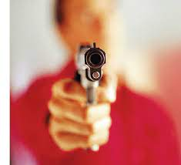
Weapon focus
When faced with a knife or gun you’re most likely be focusing you’re attention on the weapon rather than the attacker.
Loftus et al. (1987) asked participants to listen to a series of arguments between two people, one of which sounded more violent than the other.
In the quieter argument a man with greasy hands emerges holding a pen.
Following the noisy incident a man emerges with a blood drenched knife.
Participants could accurately recall the identity of the ‘pen-fiend’ on 49% of occasions but the knifeman on only 33%.
In a subsequent study, Loftus recorded pp`s eye movements and found the focus of attention was directed towards the knife, diverting attention from the identity of the perpetrator.

Slide 24
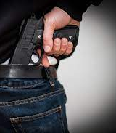
Weapon Focus
Many researchers have examined the relationship between the level of violence and recall. It is frequently reported that the higher the level of violence depicted, the poorer participants' recall.
There are two possible reasons why:
Violent incidents, like weapons, draw the focus of the witnesses' attention, leading to little or no processing of other information.
Violent incidents increase anxiety and autonomic arousal, which has a detrimental effect on memory generally.
However, some research has shown that if circumstances are right, witness recall can be extremely accurate.

Slide 25
In their seminal paper, Yuille & Cutshall (1986) examined the recall of witnesses to a shooting where a man attempted to rob a gun shop during which he shot the shop owner. The owner returned fire, killing the would-be robber.
The incident occurred in daylight and in front of many witnesses. Some months later, Yuille and Cutshall tracked down the witnesses and interviewed them and found:
The witnesses were able to recall the incident in a great deal of detail.
There was a very high level of agreement between the accounts given by the different witnesses.
The witnesses accounts did not alter in response to leading questions.
But, consider the circumstances…

Slide 26
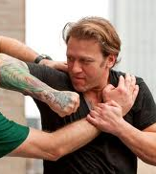
Violence and memory
Even simulated violence is likely to reduce recall of specific details of a given situation for a given witness (Hope et al., 2012).
This reduction includes but is not limited to peripheral details (Reisberg & Heuer, 2007), although core information, less dependent upon specific details, may be relatively preserved.
Stress under situations of simulated violence has been shown to reduce detail recall in both police and civilians (Stanny & Johnson, 2000), and even more when physical stress is added (Hope et al.,).

Slide 27
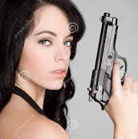
Finally, for weapon focus:
The effects of weapon focus can be reduced with a longer exposure duration (Fawcett, Russell, Peace & Christie, 2013).
And Pickrel (2009) found that guns have more memorable effects when held by females! WHY?

Slide 28
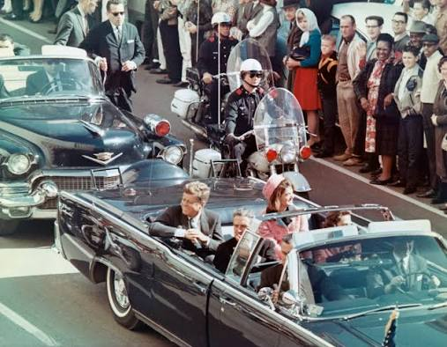
Flashbulb memories and emotion
One possible theory to explain how emotion may improve memory is flashbulb memories.
Brown and Kulik (1977) first coined this term to describe vivid, long-lasting memories which occur at times of heightened emotion.
They observed that people were able to describe exactly what they were doing when they heard of JFK’s assassination.
Famous examples of common flashbulb memories include 9/11 and Princess Diana’s death.
Flashbulb memories are different from normal memories as they appear to be long-lasting, highly detailed, and supposedly immune to decay.

Slide 29
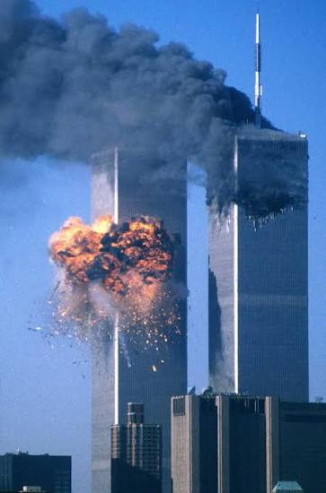
Flashbulb memories
Research suggests that flashbulb memories do exist, and that they may be a special type of memory resistant to change.
Odiniot et al. (2009) interviewed 14 witnesses to an armed robbery and checked their recall against security footage.
84% of the information recalled was correct, and witnesses who reported a higher level of emotional impact had the most accurate recall.

Slide 30
Flashbulb memory, emotion and witness confidence.
Research suggests that the confidence is not a truthful representation of accuracy.
Talarico and Rubin (2003) asked 54 students to recall their memories of the 9/11 attacks on September 12th 2001.
They also asked about another recent event. They were tested again 1, 6, or 32 weeks later.
Consistency for flashbulb and everyday memories did not differ; in both cases there were declines in memory over time. However, the participants rated their recall of 9/11 as being much more vivid, and had much greater confidence in their accuracy.

Slide 31
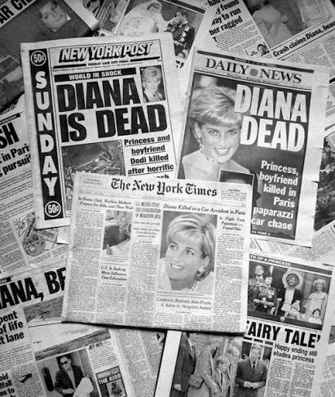
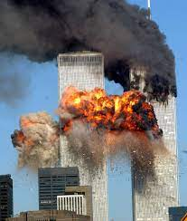
This is important, as eyewitnesses may be asked to give evidence months or even years after an event and suggests that highly emotional memories may feel more accurate than they actually are.
This may lead eyewitnesses to overestimate their accuracy, and be overconfident. If asked to give evidence, this confidence may be a deciding factor for juries…
Nolan and Markham (1998) found that confident witnesses were more likely to be seen as credible compared with anxious or unsure witnesses, even though actual accuracy may not differ.

Slide 32
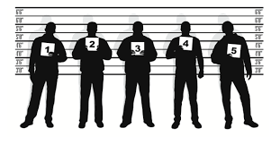
Witness confidence
Much evidence questions the association between confidence and accuracy:
Can we tell when EWT is accurate?
The ten second rule (Dunning & Perretta, 2002).
Comes from evidence that witnesses that make their decisions quickly from a line up are most accurate.

Slide 33

Confidence and Accuracy
In every one of the DNA exoneration cases involving EW misidentification examined by Garrett (2011), witnesses who mistakenly identified innocent defendants did so with high confidence when the case was tried in a court of law.
Over the last 20 years, EW researchers have discovered that when EW are tested using appropriate procedures, the confidence they express can be a highly reliable indicator of accuracy (Brewer & Wells, 2006)
But… can we be certain?

Slide 34
Accuracy and Confidence cont`d
The only time that confidence is known to be a highly reliable predictor of accuracy is when memory is first tested, before there is much opportunity for memory contamination to occur.
An expression of low confidence on that first test is a glaring red flag because it is almost always an indication that the risk of error is high. Instead of being ignored, an initial expression of low confidence should take centre-stage.

Slide 35

Confidence and accuracy…
Over time research has supported the idea that EWT confidence expressed by someone who identified a suspect from a lineup provides little information as to the accuracy of that identification.
There was a time when this assessment was reasonable because of the questionable eyewitness-identification procedures that police commonly employed.
However, after 30 years of EWT research, our understanding of lineups has evolved, and how EWT confidence can inform accuracy under pristine testing conditions (e.g., initial, uncontaminated memory tests using fair lineups, with no lineup administrator influence, and with an immediate confidence statement).
Under those conditions, mock-crime studies and police field studies have shown that, for adults,
(a) confidence and accuracy are strongly related and
(b) high-confidence suspect identifications are remarkably accurate.
However, when certain non-pristine testing conditions prevail, the accuracy of even a high-confidence suspect ID is seriously compromised.
Wixted and Wells (2017)

Slide 36

Line up research
90% of mock witnesses expect the perpetrator to be present in the line up.
In line-ups there should be 8 foils chosen to look like the suspect, and not similar to the description of the perpetrator;
What potential problems are there here?
Research on investigator bias suggests that the whole process should be double blind, but…

Slide 37
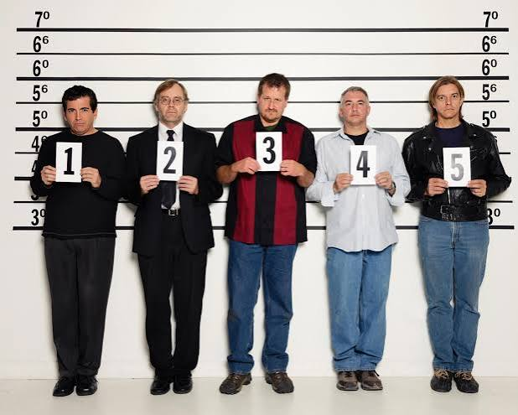
Lineup research:
In terms of the line-up procedure, typically the `relative judgement strategy` has been used. However, many psychologists (Wells in particular) argue for the use of the `absolute identification strategy`.
This has found to significantly reduce incorrect or false identification, but unfortunately also reduces correct identifications!
In other words, should line-ups be sequential or simultaneous?
Post identification feedback is another crucial variable.

Slide 38
Accuracy, Confidence and Lineups
Line-ups as experiments – According to Wells (2017) this approach should be adopted.
The officer administering the lineup should be blind to who the suspect is, and the witness is also blind making it a double- blind procedure.
Only one suspect should be in a line-up the rest are innocents.
The suspect should NOT stand out!
Caution that the offender may not be in the line-up
Collect a confidence statement at the time of identification- again a double-blind procedure, this is where the confidence-accuracy relationship is important.

Slide 39
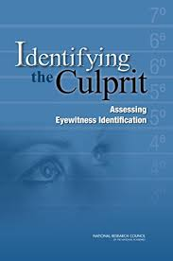
Takeaway message - EWT validity in line-ups
Just one suspect in any line up.
If witnesses have seen photographs, they should not be included in line up.
Good instructions- awareness that suspect may not be present.
No feedback should be given
Ignore any statements regarding confidence, stick to measuring time frame

Slide 40
The Cognitive Interview
The Cognitive Interview (CI) is one of the most successful developments in psychology and law research in the last 25 years.
It is a method that comprises a series of memory retrieval and communication techniques designed to increase the amount of information that can be obtained from an interviewee.
The CI was initially developed 25 years ago by psychologists Ed Geiselman and Ron Fisher as a response to the many requests they received from police officers and legal professionals for a method of improving witness interviews.
It is based upon established psychological principles of remembering and retrieval of information from memory, and research has documented its ability to dramatically improve the number of correct details while only slightly increasing the number of incorrect details (Schrieber & Fisher, 2006).
Field tests have also indicated that police officers trained in its techniques gain more detailed information from eyewitnesses in investigative contexts (Fisher & Schrieber, 2007).
The CI is also useful in other contexts where accurate information gathering is the goal, such as in the investigation of accidents and near-miss events in organizations (Flin, O‟Connor, & Crichton, 2008).

Slide 41
What exactly is the cognitive interview?
The CI engages the witness in a detailed retrieval of the original event. The original CI (Geiselman et al., 1984) was comprised of four techniques designed to enhance participants recall of a prior event.
The first technique involves context reinstatement, in which the interviewee is encouraged to mentally reconstruct the physical and personal context that existed at the time of the event.
The second technique is to ask participants to report everything they can recall, even if it is partial or incomplete.
The third method is based on the premise that different retrieval cues may access different aspects of a complex event. Witnesses are instructed to recall from a variety of perspectives
Finally, witnesses engage in further retrieval attempts in a different temporal order - from the start, from the end working backwards in time, the middle or any other point in time that may be salient to the individual (see Memon, 2006).

Slide 42
Enhanced Cognitive Interview (ECI)
In 1992, Fisher and Geiselman published an enhanced version of the CI (ECI) that included a framework for building rapport and communicating effectively with the witness.
Throughout the interview process, the interviewer is discouraged from interrupting the witness and is instructed to allow the witness to control the flow of information and to listen actively to what the witness has to say.
This witness centred interview procedure is a major characteristic of the enhanced CI. The interviewer facilitates this process by use of open-ended questions about neutral topics.
The next phase o involves context reinstatement followed by the interviewee’s free narrative account of the incident. The interviewer reminds them at this point of the importance of providing a detailed account (report everything) and requests that they do not guess or fabricate but simply tell the interviewer if they don’t know.
Research had shown that witnesses are more likely to maintain high accuracy if they are reminded not to guess (Koriat & Goldsmith, 1996).
Following the free narrative, the interviewer questions the witness about details provided, via the use of focused memory techniques, which involve instructing the witness to concentrate on mental images of the various parts of the event such as the suspect’s face and using these images to guide recall.
An important principle of the ECI is that event details will be most accessible when they are perceptually related to the witness’s image and thus interviewers should time their questions accordingly (Fisher & Schreiber, 2007).

Slide 43
Moving forward…
Since then, another version of the CI has become increasingly popular – the modified CI (MCI) which is an adaption of the ECI.
Holliday (2003) has modified the CI so that it is suitable for use with young children (4-9 year olds). In her version, the change perspective instruction is removed.
Moreover, Davis, McMahon, and Greenwood (2005) presented another version of the MCI involving a shortened variation of the interview in which the change order and change perspective techniques are omitted and replaced with an additional prompt to go through the event once more in chronological order.
However, the fact that some researchers have come up with their own versions of the MCI is potentially problematic.

Slide 44
Who are the witnesses and interviewers in research studies?
Is the CI is based on a representative sample of witnesses and can the effects can be generalized beyond the typical participant (young educated adult) in lab studies.
Young adults drawn from college populations are overly represented in the CI studies with the exception that children are well represented in more recent studies of the MCI.
Of 65 published studies, 42 studies used young adult witnesses.
28% involved younger (pre-school) or older children, while 8% used older adults and 6% used special populations (learning disabled).

Slide 45
A meta-analysis (Memon et al. (2010)
Interviews were conducted by researchers (68%) or students (17%). Only 12% of studies included professional law enforcement as interviewers.
Training police officers to change the techniques they use is challenging than training researchers to adopt new ones (Fisher, 2010).
When questioned about their use of the CI, UK police officers state they use some of the CI components such as the “report everything” instruction while some techniques (such as the “change perspective” and “recall in reverse order”) are seldom used (Dando et al., 2009)

Slide 46
The type of CI
Analysis of the type of CI used suggests substantial deviations from the original and enhanced interviews in recent years.
Early studies (80`s and 90`s) examining the CI consistently used the original version (OCI) – however, only 32% of the studies in the current analysis used the OCI.
In the last 10 years various modified and shortened versions of the CI have emerged in the literature (45% of studies).
There are good reasons for modifying the CI. First, one of the purposes is to adapt the CI to meet the individual needs of the witness, with vulnerable witnesses providing a good example.
Consistent with this hypothesis, 45% of the MCI studies have used child witnesses and 10% older adult witnesses.
Four studies have directly compared the ECI and MCI, reporting similar increases in correct details with each version of the CI (Dando et al., 2009).

Slide 47
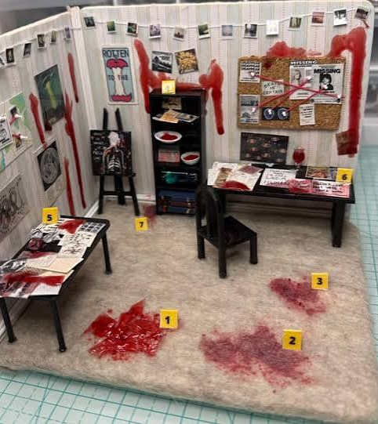
The type of event: Witness involvement and arousal
The majority (74%) of studies have used video to present events with 83% of the more recent MCI studies falling into this category.
Incidents which consisted of a crime or accident scenario was coded as “emotional” or “arousing” and any other scenarios were coded as “neutral.”
This was to see whether the CI generalizes across different types of events. A meta-analysis of the effects of heightened stress indicates that it negatively impacts eyewitness recall of details of a crime, as well as identification of a perpetrator or target person.

Slide 48
The CI and emotional retrieval
Two theoretical perspectives on the effects of emotion on memory predict that emotion will improve recall of central details, but at a cost to peripheral details.
The Easterbrook cue-utilisation hypothesis suggests that high arousal narrows the focus of attention so that central details that are attended to are recalled (Christianson, 1992).
Similarly, arousal is thought to elicit consciously-controlled processing regarding the cause of the arousal (e.g. a weapon).
Christianson speculated that effortful elaboration after an arousing experience results in a focus on the central actions and events in a scenario. For example, the sight of weapons or gruesome injuries might consist of reliving and evaluating the critical moment (Hulse et al., 2007), which can in turn can enhance recall.

Slide 49
The effectiveness of the CI across long delays and multiple interviews.
The effects of multiple interviews and long delays on accuracy are an important question because witnesses (and in particular children) are often interviewed repeatedly during a criminal investigation (Lamb, & Pipe, 2009) and long delays between the interviews are not unusual.
The majority (48%) of studies incorporate a delay period between 24-72 hours, and 31% have either no delay or a very brief (minutes) delay.
This is unfortunate because the moderating effects of delay have not been investigated systematically within the eyewitness literature (Dysart & Lindsay, 2007).

Slide 50
Delayed and repeated testing
It is known that interviews occurring relatively soon after an event can serve as a buffer against forgetting (LaRooy et al., 2005), delay can cause errors to increase over time particularly when biased questioning procedures are used.
Given the importance of the two variables (delay and repeated testing) in real world contexts it is surprising that these variables have been almost entirely overlooked.
A lack of research on the effects of repeated testing with a CI and carryover effects of an early CI on subsequent recall weakens the generalizability of the CI and more research is needed on this issue.

Slide 51
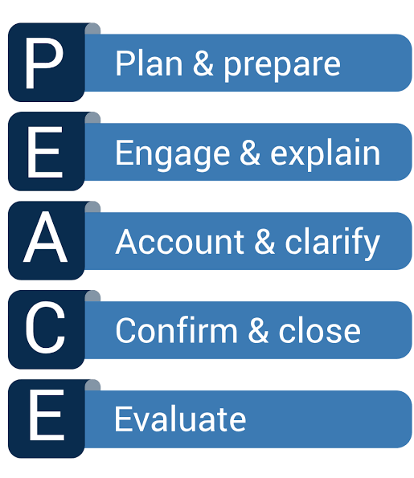
What is PEACE?
The PEACE model is a framework for ethical, evidence-based investigative interviewing used widely in the UK, Australia, New Zealand, Canada, and several European countries.
It was developed in the early 1990s after a series of wrongful convictions caused by coercive or manipulative police interrogations (notably in England and Wales).

Slide 52
PEACE:
Letter | Stage | Purpose
P | Planning and Preparation | The interviewer gathers all available information, defines interview objectives, and plans structure and logistics.
E | Engage and Explain | Build rapport, explain the interview’s purpose and procedures, and ensure the interviewee understands their rights.
A | Account, Clarify, and Challenge | The core phase: obtain the interviewee’s free, uninterrupted account; clarify ambiguities; challenge inconsistencies respectfully.
C | Closure | End the interview on a positive note, summarize key points, and explain what will happen next.
E | Evaluate | Assess the information obtained and the interviewer’s own performance to inform future interviews or investigation steps.

Slide 53
PEACE
Open-ended questioning: “Tell me everything you remember about…” rather than yes/no or leading questions.
Active listening and careful follow-up to clarify or expand witness memory.
No deception or pressure: The model prohibits intimidation, trickery, or leading tactics.
Adaptability: Applicable to suspects, witnesses, and victims.
Training emphasis: Interviewers receive structured training and evaluation (UK “Tier” system).

Slide 54
Comparison with Traditional Interviewing
Traditional (accusatorial) | PEACE (investigative)
Goal: obtain confession | Goal: obtain accurate information
Confrontational | Cooperative and respectful
Presumes guilt | Open-minded and hypothesis-testing
May use deception | Prohibits deception
Higher risk of false confession | Lower risk; better evidential quality

Slide 55
Evidence:
Walsh & Bull (2010) – Interviewing suspects of social security benefit fraud, found that good interviewing in each of the recommended stages of the PEACE model led to better interviews, indicating the importance that each stage contributes to overall interview quality.
Further, the quality of interviews was compared against a range of interview outcomes, and it was found that skilled PEACE interviewing was associated with the securing of full accounts, including confessions.
However…
Walsh & Bull (2012) - This study examined 142 actual interviews with suspects, focussing on key tasks that aid rapport.
It was found that opportunities were often missed to build rapport in the initial stages as several tasks were overlooked. Also, where any rapport had been initially built, it was not always maintained.
Thus, initial rapport building of itself, therefore, is not sufficient in influencing overall interview quality and outcomes, since rapport also has to be maintained throughout the interview.

Slide 56
Gudjonsson & Pearse (2011)
This paper reviews two influential methods of police interviewing practice and their associations with false confessions. These are the Reid technique, which is commonly used by police forces in the United States, and the PEACE model, which is routinely used in the United Kingdom.
Researchers have concerns about the guilt-presumptive and confrontational aspects of the Reid technique and its association with false confessions and recommend that it be replaced by the PEACE model.
The review concluded that all interviews should be recorded and discarded if any coercion or intimidation takes place.

Slide 57
Reading for Eyewitness Testimony Accuracy:
Chevroulet, C., Paterson, H. M., Yu, A., Chew, E., & Kemp, R. I. (2021). The impact of recall timing on the preservation of eyewitness memory. Psychiatry, psychology, and law : an interdisciplinary journal of the Australian and New Zealand Association of Psychiatry, Psychology and Law, 29(3), 471–486. https://doi.org/10.1080/13218719.2021.1926366
Seale-Carlisle, T. M., Quigley-McBride, A., Teitcher, J. E. F., Crozier, W. E., Dodson, C. S., & Garrett, B. L. (2025). New Insights on Expert Opinion About Eyewitness Memory Research. Perspectives on psychological science : a journal of the Association for Psychological Science, 20(5), 903–924. https://doi.org/10.1177/17456916241234837
Sim, M., Eiger, Y., & Kohno, T. (2026). AI-Enabled Human Memory Manipulation: Misleading AI-Generated Summaries Distort Human Memory. arXiv preprint arXiv:2609.28820.
Wixted, J. T., Mickes, L., & Fisher, R. P. (2018). Rethinking the Reliability of Eyewitness Memory. Perspectives on psychological science : a journal of the Association for Psychological Science, 13(3), 324–335. https://doi.org/10.1177/1745691617734878

Slide 58
Reading for the Cognitive Interview
Dando, C., Wilcock, R., Milne, R. & Henry, L. (2009), A modified cognitive interview procedure for frontline police investigators. Applied Cognitive Psychology. 23: 698-716. https://doi.org/10.1002/acp.1501
Memon, A., & Gawrylowicz, J. (2025). The cognitive interview. In O. Hargie (Ed.), The handbook of communication skills (5th ed., pp. 583-600). Routledge. https://doi.org/10.4324/9781003367796-22
Odinot, G., Memon, A., La Rooy, D., & Millen, A. (2013). Are two interviews better than one? eyewitness memory across repeated cognitive interviews. PloS one, 8(10), e76305. https://doi.org/10.1371/journal.pone.0076305
Scott, K., Ummer, O., & LeFevre, A. E. (2021). The devil is in the detail: reflections on the value and application of cognitive interviewing to strengthen quantitative surveys in global health. Health policy and planning, 36(6), 982–995. https://doi.org/10.1093/heapol/czab048

Slide 59
Reading for PEACE
Bull, R., & Soukara, S. (2010). Four studies of what really happens in police interviews with suspects. Criminal Justice and Behavior, 37(9), 1109–1129. https://doi.org/10.1177/0093854810374274
College of Policing. (2022). Authorised professional practice (APP): Investigative interviewing. https://www.college.police.uk/app/investigations/investigative-interviewing
Gudjonsson, G. H., & Pearse, J. (2011). Suspect interviews and false confessions. Current Directions in Psychological Science, 20(1), 33–37. https://doi.org/10.1177/0963721410396824
Meissner, C. A., Redlich, A. D., Bhatt, S., & Brandon, S. (2014). Interview and interrogation methods and their effects on true and false confessions: A meta-analytic review. Journal of Experimental Criminology, 10(4), 459–486. https://doi.org/10.1007/s11292-014-9207-6
Walsh, D., & Bull, R. (2010). What really is effective in interviews with suspects? Psychology, Crime & Law, 16(4), 493–506. https://doi.org/10.1080/10683160902971063
Walsh, D., & Bull, R. (2012). Examining rapport in investigative interviews with suspects: Does its building and maintenance work? Journal of Police and Criminal Psychology, 27(1), 73–84. https://doi.org/10.1007/s11896-011-9087-x
Walsh, D., Oxburgh, G., Redlich, A. D., & Myklebust, T. (Eds.). (2016). International developments and practices in investigative interviewing and interrogation (Vols. 1–2). Routledge.

