Slide 1
Ordnance, Munitions and Explosives
Applied Computing
Wales Institute of Science and Art (WISA)
Pre-Apprenticeship Induction

Slide 2

What is OME?

Slide 3

OME: The study of energetic materials and their application within ordnance, munitions and explosives
Requirement: A national imperative – rebuilding energetic materials science and technology capability
Action: industrial capacity being restored with industry and government responding to the investment challenges required. Universities responding with new funding sources to build their teaching and research activities.

Slide 4
OME Governance and Structure (UK)
Notes:
This is the current OME governance structure for the UK. In 2022/23 the OME BEng/HNC and EE programmes reached no more than 5% of the community, with little access to commercial frameworks, funding opportunity, communities of interest of technology bases. In the space of 12 months we have are now a member of the Board at the Sector Skills Strategy Group (Gareth) and have increased reach to 10%. This has returned a revenue increase of just over £1.5M for OME and EE programmes. Much of industry is now interested in the courses currently on offer, modular aspects of those courses, or NEW courses (specifically the SIS).

Slide 5
OME Programme Core Team
Academic Staff
Dr Ewa Kazimierska, Programme Manager
Dr Jenni Steen, Lecturer and Major Project
Prof Kelvin Donne, Lecturer (PT)
Mr David Holley, Lecturer and Group Project
Dr Mark Broadhead, Senior OME Technician
Professional OME Services and Contracts
Mr Gareth Collett, Executive Director HSCA
Apprenticeship Unit
Mr Carl Thomas, OME ALO
Mr Dave Holley, OME ALO & Lecturer
Mr Tony Bourne, OME ALO
Ms Emma Moseley, OME ALO
Ms Bridget Moseley, Head of Apprenticeship
Unit
Dr Kapilan Radhakrishnan, Academic Director

Slide 6
Module Code | Module Title | Module type (component pass, core, compulsory, optional)
Year 1 | Level 4 | Semester 1
ACDB4010 | Study Skills | Core
ACDA4008 | Mathematics | Core
Year 1 | Level 4 | Semester 2
ACDB4007 | Physics (OME) | Core
ACDB4011 | Chemistry (OME) | Core
Year 1 | Level 4 | Semester 3
ACDA4018 | Fundamentals of Electrical and Electronic Systems | Compulsory
Year 2 | Level 4/5 | Semester 1
ACDB4005 | Principles of Systems Engineering | Core
ACDC5009 | Electromagnetic Radiation | Compulsory
Year 2 | Level 4/5 | Semester 2
ACDA4019 | Principles of OME | Core
ACDB5007 | Computer Aided Engineering | Compulsory
Year 2 | Level 5 | Semester 3
ACDB5013 | Safety and Hazard Assessment | Core
Year 3 | Level 5 | Semester 1
ACDB5011 | Instrumentation and Control | Compulsory
ACDB5015 | Advanced Physics of OME | Core
Year 3 | Level 5 | Semester 2/3
ACDA5022 | Work-based Group project | Compulsory
Year 3 | Level 5 | Semester 2
ACDA5021 | Systems Engineering | Core
Modules

Slide 7
Modules
Module Code | Module Title | Module type (component pass, core, compulsory, optional)
Year 4 | Level 6 | Semester 1
ACDA6020 | Advanced Chemistry of OME | Core
ACDA6021 | Data Capture and Evaluation | Compulsory
Year 4/5 | Level 6 | Semester 2/3/1/2
ACCA6020 | Independent Project | Compulsory
Year 4 | Level 6 | Semester 2
ACDB6008 | Scientific Principles of OME Design | Core
Year 5 | Level 6 | Semester 1
ACDA6022 | OME Safety Management and Legislation | Core

Slide 8
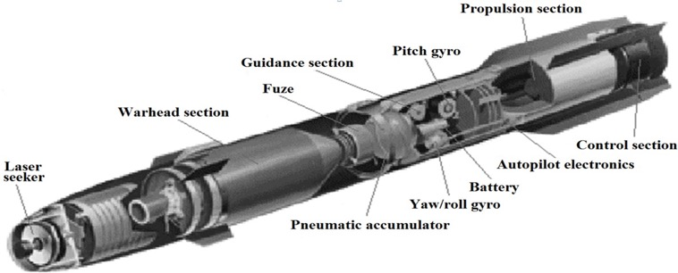











The Foundation:
ACDA 4005 – Principles of Systems Engineering
ACDB 4007 – Physics OME
ACDA 4008 – Mathematics.
ACDB 4010 – Study Skills
ACDB 4011 – Chemistry OME
ACDA 4018 – Fundamentals of Electronics
ACDA 4019 – Principles of OME
ACDA 4020 – Human Factors in High Hazard
Understand:
ACCA 6020 – OME Major Project
The OME Programme
ACDC 5009 - EMR
ACDB 5011 –
Instrumentation & Control
ACDC 5009 - EMR
ACDB 5011 –
Instrumentation & Control
ACDC 5009 - EMR
OME
CADMID
ACDA 6016 – Material Science
ACDA 6020 - Advanced Chemistry of OME
ACDB 5015 – Advanced Physics OME
ACDA 6008 – Scientific Principles of OME
ACDB 5011
ACDB 5013 – Safety & Hazard Assessment
ACDA 5021 – Systems Engineering
ACDA 5022 – Group Project
ACDA 5023 – Nuclear Safety
ACDA 5024 – Technical Authoring
ACDA 6022 – OME Safety Management & Legislation
ACDB 5007 – Computer Aided Engineering
ACDA 6021 – Data Capture & Evaluation

Slide 9
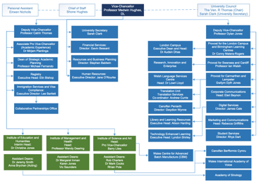
Academic
Vocational
Governance and Oversight
Governance:
ILG – 4/12
PRB – 12/12
SSSG – 2/12
IExpE – 1/12
OFSTED
DCS
Moodle
Programme of Study
Apprenticeship Handbook
Module Directory
Lecturers
PM
Student/
Apprentice
Employers
ALO
Line Managers
SOAC
AU
HSCA
UWTSD
WISA
UWTSD
WISA
Key:
Primary Contact for student/apprentice
Secondary Contact ….
No direct input…..
Academic and Vocational Governance
Notes:
Process Diagram: OME Apprenticeships – Command, Control and Communication
The two main contacts for students/apprentices are PM (academic) and ALO (vocational/administrative). Reaching out beyond either POC causes delay and confusion.
Each student has a dedicated ALO to provide expediency.
Lecturers deliver indicative content based on the UWTSD PoS and Module Directory. They are supported by the PM.
Students/apprentices may approach lecturers directly for matters of academic clarification during normal academic study/process (lectures, feedback, marks awarded etc).
The ALO provides Apprentice Handbooks, which are employer facing and based on the PoS and Module Directory.
If resolution cannot be provided on either administrative or academic matters, then the process in the PoS should be followed (owned by PM), or the Apprentice Handbook (owned by ALO).
The Document Management System for the OME apprenticeship is MOODLE. This is explained clearly within the PoS, which is issued annually to all students/apprentices on MOODLE.
The main modes of formal communication are to be university e-mail addresses and Teams. It may not be possible for UWTSD staff to respond to work email owing to GDPR.
Governance of the OME apprenticeship is regulated by the PoS and Apprenticeship Handbook. Matters of governance are managed by UWTSD, with employer input provided directly to the ALU.
The ILG is the formal face between employer and UWTSD. It meets quarterly. The PRB is subordinate to the ILG and manages the actions of the ILG It meets monthly.
Matters of University Academic Planning, Admissions, Registry, Financial Services, Timetabling, and Compliance are central functions, encompassing 22,000 students and apprentices globally. These matters are outside the control of SOAC and are set by Charter Statutes and Ordinances. Every attempt shall be made by the PM and ALO to provide timely information, but the OME apprenticeship complies with directives set by UWTSD WISA.

Slide 10
Your Primary Contacts
Programme Manager OME (University Facing) - Point of contact:
  Ewa Kazimierska – e.kazimierska@uwtsd.ac.uk
Apprentice Liaison Officer (Employer Facing) – Point of Contact
  Carl Thomas – c.thomas@uwtsd.ac.uk
  Dave Holley – d.holley@uwtsd.ac.uk
  Tony Bourne – t.bourne@uwtsd.ac.uk
  Emma Moseley e.moseley@uwtsd.ac.uk
Only through University email address – GDPR, Safeguarding, PREVENT

Slide 11
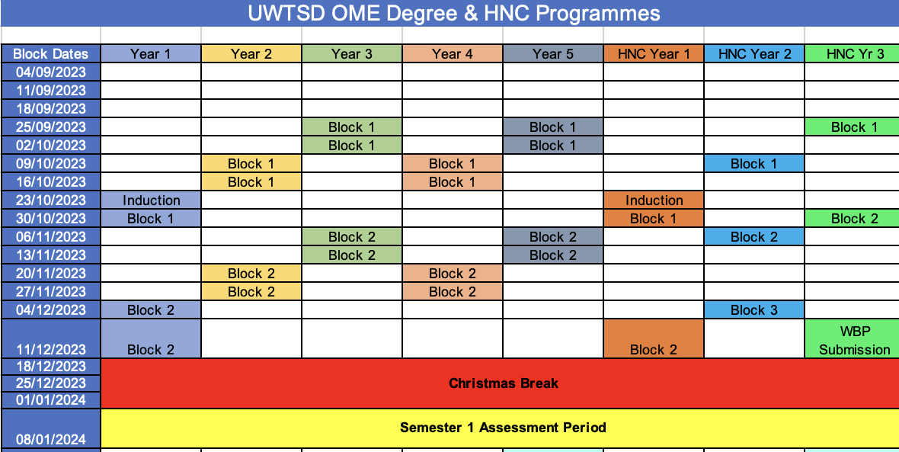
Example Block Dates (Semester 1)
Results portal MyTSD – Feb, June, and Aug

Slide 12
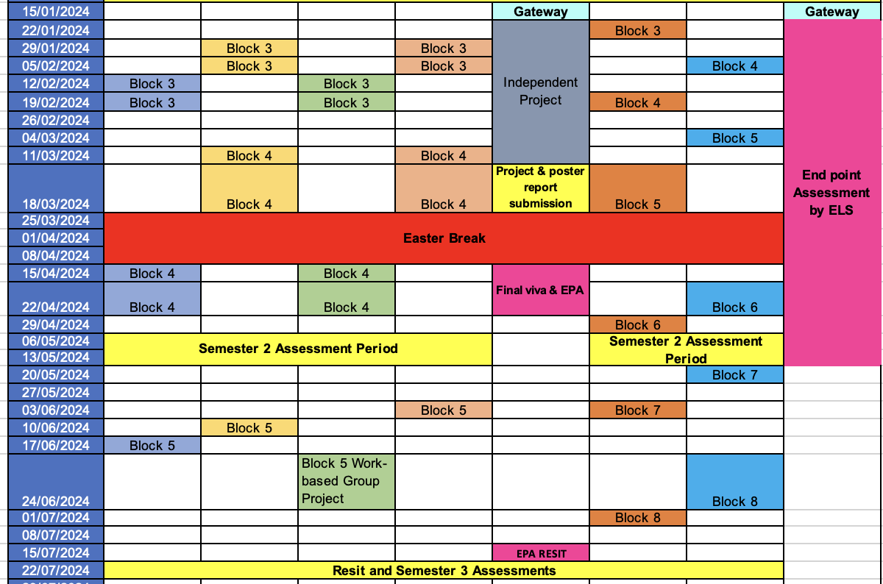
Example Block Dates Key Dates (Semesters 2&3)
Results portal MyTSD – Feb, June, and Aug

Slide 13
Working Hours & Personal Commitment
You are now in Higher Education
Adult Rules for Adults……..you are in paid employment
  24% taught study (F2F, hybrid or remote)
  76% independent study and reflection
Contract between UWTSD and your employers:
  Two weeks block
  Monday 0900 start
  Friday 1500 hrs finish
Lecturers CANNOT change timetables once set by Timetabling as the apprenticeships are set within BLOCKS of LEARNING

Slide 14
Course Information
Programme of Study Handbook
Module Directory
Virtual Learning Environment
Apprenticeship Standards (KSB)
End Point Assessment
Student Engagement Policy
Feedback – 20 working days
Student Voice
Course reps
Student Charter
Safeguarding
PREVENT
British Values
Professionally Registered
Engineer
Academic Qualifications
BEng
Cert/Dip HE
HNC

Slide 15

Few points to remember
Team working
Time management
Do not leave till late
Talk to us
Be respectful
We are here to support you.

