Slide 1
BMTP6018
Global Sports & Tourism
Event Management
Strategic Management

Slide 2
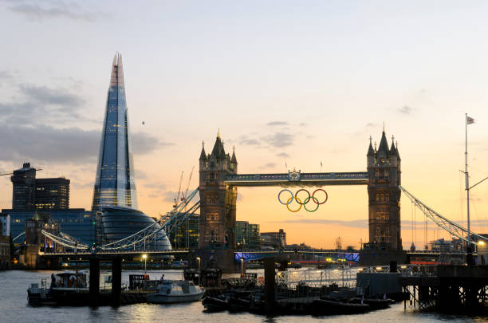
Sports Events Organisations
International Governing Bodies
National Governing Bodies
International Olympic Committee
National Olympic Committees
Regional Organisations
Confederations
Event Organisers and Owners
Host Cities

Slide 3
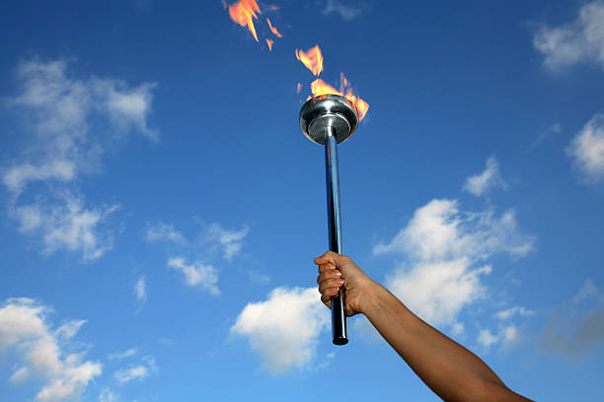
Stakeholders
SPECTATORS
Individuals
Corporate
Media
Advertisers
Competitors
Spectator Experience
Fan Engagement Strategies

Slide 4
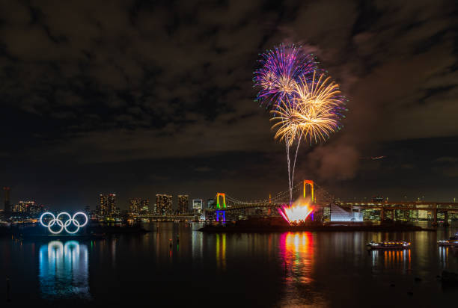
Stakeholders
SUPPLIERS
Services
Equipment
F And B
Accommodation
Legal Support
Transport
Emergency Services

Slide 5
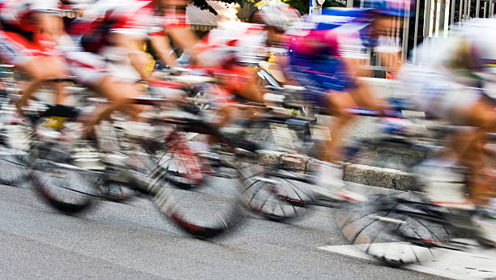
Stakeholders
Partnerships
Governments
Regional authorities
Cities
Stadiums/facilities
Sponsors
Investors
Media

Slide 6

Stakeholders
INFLUENCERS
Managers and Directors
Staff (short and long term)
Competitors
Volunteers / Games makers
Subcontractors
Local communities
Pressure Groups
Governments – Legal, economic, h and s, cultural, social and political influences

Slide 7

Sports Events Management Process
Objectives
Concept
Feasibility
Proceed ? To bid Process
Implementation Planning (ST, MT and LT)
Implement Event
Handover
Evaluation
Feedback – Continuous evaluation feedback and alignment with objectives

Slide 8

Event Objectives
Why, What, Who, Where, When and How
Impacts
Legacies
Financial Return
Social, Political, cultural, economic, environmental, sports / tourism Development Objectives
Timescale
Bidding process considerations

Slide 9
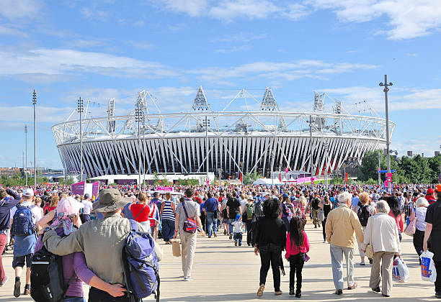
Feasibility Studies
Test the event design
Responsibility for short and long term objectives
Resource Identification
HR, facilities, transport, marketing, media, services, support infrastructure
Coordination of bid process, event implementation, legacies and post event
Leverage
Long term use and management
Timescales
Finance
Budgets
Cost benefit analysis
Partnerships
Legacy
Decision to proceed?

Slide 10
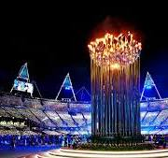
Event Planning & Implementation
Operational Strategies – NOP’s
Finance and funding
Facilities
HR
Partnerships
Suppliers
Transport
Support Services/Infrastructure
Emergency Services
Equipment
Emergency procedures
Critical path and performance indicators
Legacy strategy

Slide 11
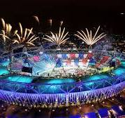
Event Management Steps
Step 1 Scope of work
Amount of work required
Step 2 Work Breakdown
Personnel – Staff, volunteers, officials, stakeholders
Communication, venues/equipment, legal and licencing, financial control, marketing, services, H and S
Step 3 Task Analysis
Resourcing and costing for each Work Breakdown category
Budgets
Step 4 Scheduling
Timelines
Step 5 Critical Path
Timelines combined into a Gannt Chart
Deadlines set
Step 6 Responsibility Allocation
Organisational structures
Communication lines

Slide 12
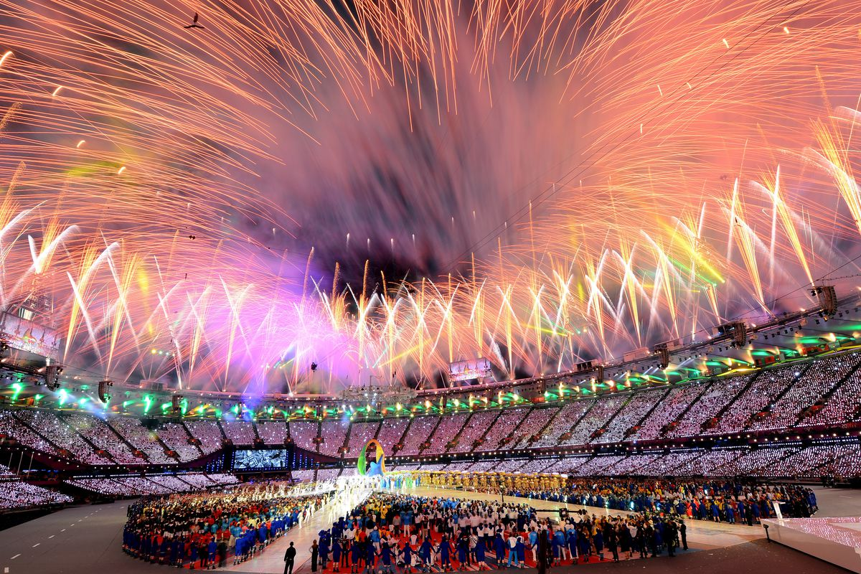
Post Event
Handover of event
Handover / reuse of facilities
Post event use
Legacy
Evaluation
Short term Research – Impacts
Costs, benefits, economic impacts & performance
Medium and Long term Legacies
Continual evaluation
Feedback
Recommendations
Future event support

