Slide 1
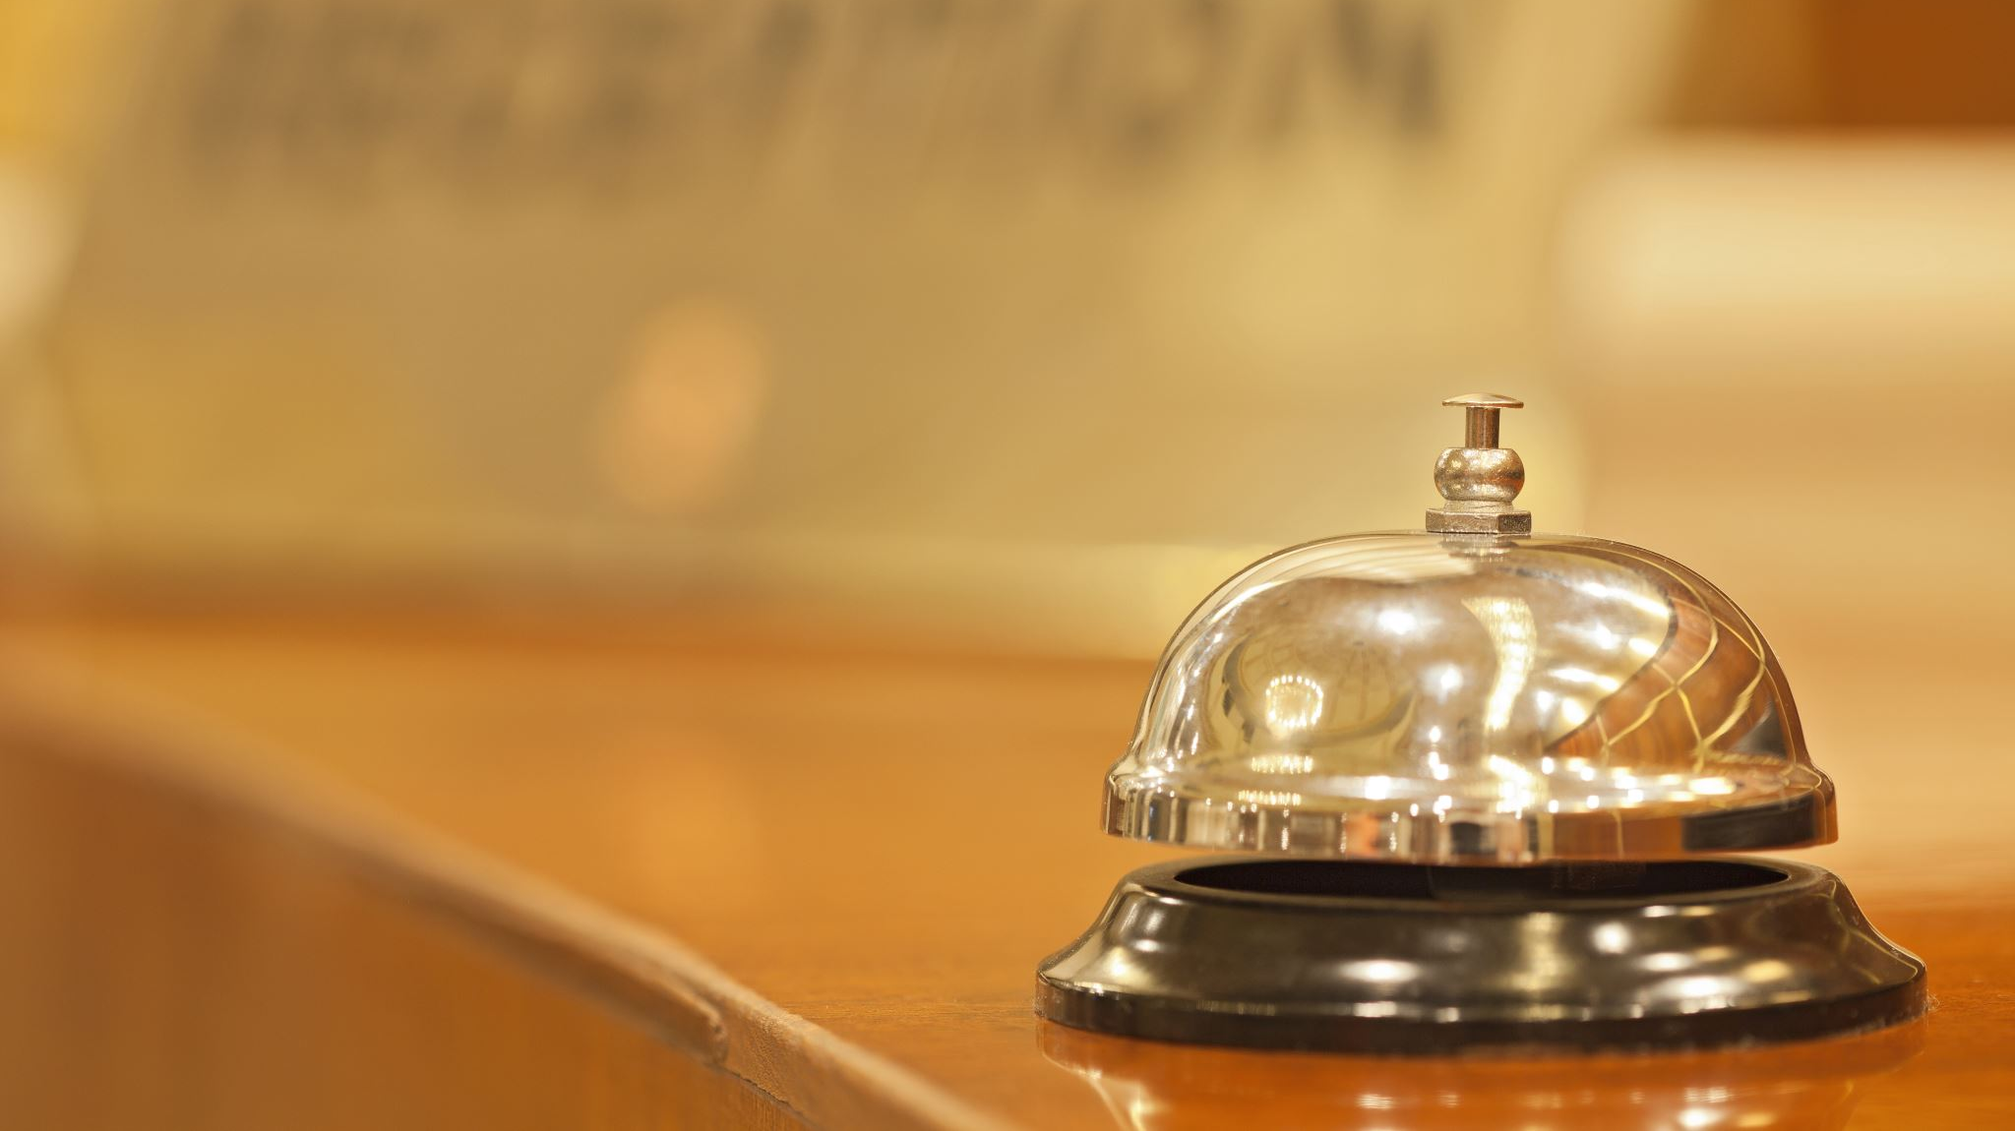
Culture awareness and polyglotism IN HOSPITALITY
DIVERSITY HOTEL & SPA LONDON
https://uowtsd-my.sharepoint.com/:v:/r/personal/2210857_student_uwtsd_ac_uk/Documents/Recording-20231027_184005.webm?csf=1&web=1&e=wrqduU&nav=eyJyZWZlcnJhbEluZm8iOnsicmVmZXJyYWxBcHAiOiJTdHJlYW1XZWJBcHAiLCJyZWZlcnJhbFZpZXciOiJTaGFyZURpYWxvZyIsInJlZmVycmFsQXBwUGxhdGZvcm0iOiJXZWIiLCJyZWZlcnJhbE1vZGUiOiJ2aWV3In19
SPANISH CULTURE AND LANGUAGE

Slide 2
introduction
DIVERSITY HOTEL & SPA LONDON
  Heller (2012) says, cultural awareness is the ability to feel and understand the differences between people from different cultures and backgrounds.
  In terms of hospitality sector to create an enjoyable and inclusive experience for its visitors from various backgrounds, cultural understanding is essential.
  Cultural awareness in this industry encourages inclusivity and produces positive guest experiences that increase consumer satisfaction.(Okumus, et al.,2010)
  One of most important skills, for an employee, needed in hospitality is polyglotism. Knowing at least a second language is a “must” for many companies.

Slide 3
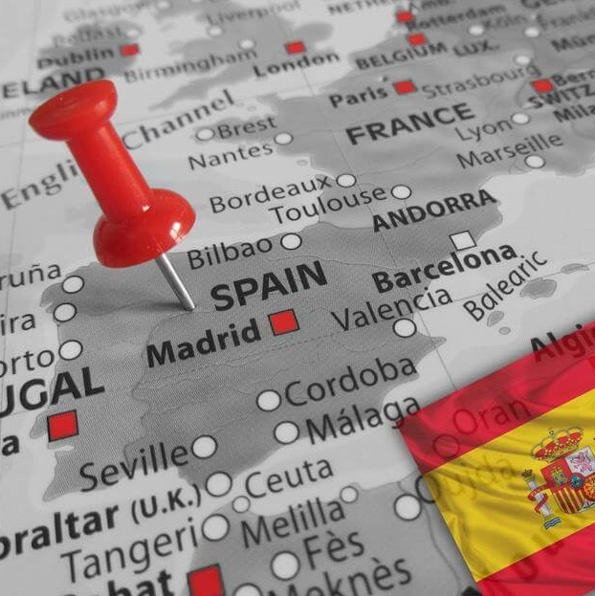
Spanish language- facts
DIVERSITY HOTEL & SPA LONDON
Spanish is a very popular language spoken by over 360 million people worldwide.
It is spoken in Spain and 20 countries from Central and South America.
Spanish is the world’s second most-spoken mother language.
Spanish is also said to be one of the easiest languages to learn, being a very phonetic language where most of words are pronounce how is spell.

Slide 4
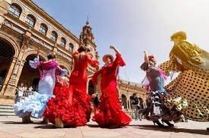
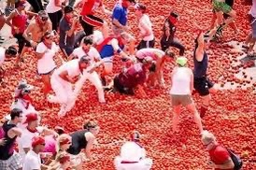
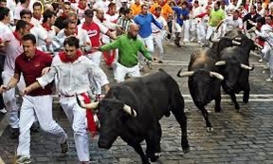
Spanish culture
DIVERSITY HOTEL & SPA LONDON
Spaniards could be very direct, for example “Dame un café/give me a coffee” is not considered impolite without saying ‘please”
”Siesta” means an afternoon rest, and many businesses are closed so that siestas can have place.
Spanish culture is deeply rooted in religion, during the year in Spain are held over 250 “fiestas”.
One of the most significant components of Spanish culture is eating, Spanish people are used to eat later, lunches don’t start before 1:30pm, and dinner not earlier than 9:00pm.

Slide 5
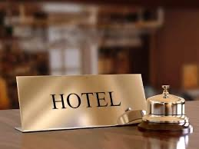
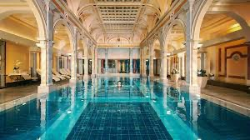
Importance of cultural sensitivity in hospitality
DIVERSITY HOTEL & SPA LONDON
The hospitality sector is distinguished by its multicultural customers, which consists of people from different cultural backgrounds looking for unique experiences.
It is critical for hospitality employees to promote cultural sensitivity in order to deliver great service.
To satisfy customers specific needs, staff might customize their services.
Visitors are more likely to have a pleasant experience when they feel appreciated, acknowledged, and understood.

Slide 6
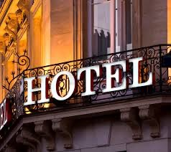
Importance of cultural sensitivity in hospitality
DIVERSITY HOTEL & SPA LONDON
Through cultural sensitivity trainings and the wide variety of multilingual workers, barriers to cross-cultural communication, such as language and cultural nuances, can be reduced.
Hospitality professionals can reach a wider customer base and make sure that visitors feel valued and appreciated by fostering an atmosphere that recognizes and respects ethnic diversity.
Cultural sensitivity is not just a moral right approach, but it is additionally a crucial business tactic for success in a globally interconnected world.

Slide 7
references
Cenoz, J., & Gorter, D. (2015) Multilingual Education: Between Language Learning and Translanguaging. Cambridge, UK: Cambridge University Press.
Garcia, O., & Cuervo, A. (2016) The Handbook of Bilingualism and Multilingualism (2nd ed.). Chichester, UK: Wiley-Blackwell.
Heller, M. (2012) Pathways to Multilingualism: Evolving Perspectives on Immersion Education. Bristol, UK: Multilingual Matters.
Okumus, F., Altinay, L., & Chathoth, P. (2010). Strategic Management for Hospitality and Tourism. Oxford, UK: Butterworth-Heinemann.
Velasco, S., & Tano, M. (2019) Practice Makes Perfect: Spanish across the World. New York, NY: McGraw-Hill Education.

