Slide 1

Referencing Your Work

Slide 2
We are going to look at…
What is a reference?
Why do we reference?
When do we reference?
How do we reference?

Slide 3



Referencing in Context
Assignment
Evidence to support your ideas or argument
Acknowledge sources used
Briefly, in your text
In full, at the end
Read and Take Notes
Paraphrase
Direct
quote

Slide 4
What is a Reference?
An acknowledgement that you have referred to (cited) information from published sources in your own work.
In other words, it is recognition that you have borrowed other people’s work, ideas or opinions.

Slide 5
Why use a referencing system?
Academic reasons
To show the range of sources you have used in your assignment, and that they are relevant and trustworthy
To provide published evidence to support your own ideas/argument/point of view or give examples, making your work more credible
Avoiding plagiarism - using other people’s work and ideas as your own without acknowledgement
Part of the marking scheme.

Slide 6
Why use a referencing system?
Practical reasons
To help a reader to trace the sources you have used
To help you to retrace sources used in the past
To help markers to examine the validity of sources they may not be familiar with.

Slide 7

When to Reference ???
A particular theory, argument or viewpoint
Statistics, examples, case studies
“Direct quotations” – (writer’s exact words) Use sparingly!
Paraphrasing.

Slide 8

When NOT to reference…
Common Knowledge

Slide 9

Top Tips
You will ALWAYS receive more marks when you paraphrase or summarise information
This means putting information you have read into your own words rather than directly copying word for word
It takes understanding and synthesis to paraphrase, summarise and explain, however…
ANYONE can cut and paste information!!
If using direct quotations they must kept to a minimum,and ALWAYS be in “quotation marks”.

Slide 10
How to Reference
There are various systems for referencing
The Harvard Referencing System is what we use
In it, we are required to provide 2 things for every source we use…
    Brief details within the main body of the assignment – A Citation
    Full details in the reference list at the end of the assignment – A Reference

Slide 11

In the Harvard Referencing System…
The reference list is always placed at the end of the essay/report/presentation
We list all sources cited in the assignment by the author’s surname, and in alphabetical order.
Notes:
Other systems of referencing?:-
Modern Humanities Research Association (MHRA),
The Harvard System (often called the 'Author Date System'),
Chicago System
Modern Language Association of America (MLA)
American Psychological Association (APA)
Available on line at:
Http://www.bristol.ac.uk/arts/exercises/referencing/referencing%20skills/page_05.htm
Accessed 20th October 2012

Slide 12
Advantages of the Harvard system
It ensures that the author's name and year of publication appear within the text’s main body
The alphabetical order of the reference list makes it easy to consult/browse
For each source cited in the text, only one entry in the reference list is necessary, no matter how many times you refer to them.

Slide 13
When using the Harvard Referencing System…
…we do 2 things for each source used –
Provide brief information about the source in the main body – A Citation
Provide full information about the source at the end - A Reference

Slide 14

When do we cite…?
We ‘Cite when we write!’

Slide 15
How to provide a Citation
Your citation will usually come at the beginning of a sentence or follow information provided at the end of a sentence. - This is so the reader can tell which source the information has been taken from
There are many ways to provide a citation. - This depends upon how many words / lines you are going to take from the information. It also depends on how you want to write the information.

Slide 16
Providing a Citation…
When providing a citation we need at least 2 things…
Author’s surname
Year of publication
When providing a citation for a direct quote we need 3 things…
Author’s surname
Year of publication
Page number (if applicable)

Slide 17
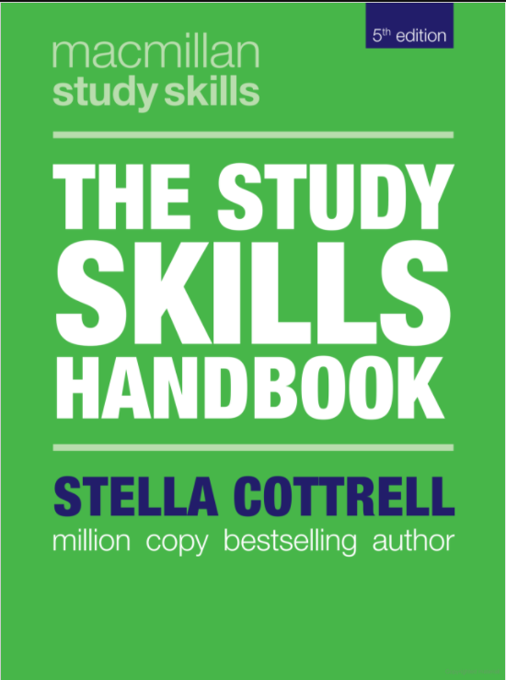
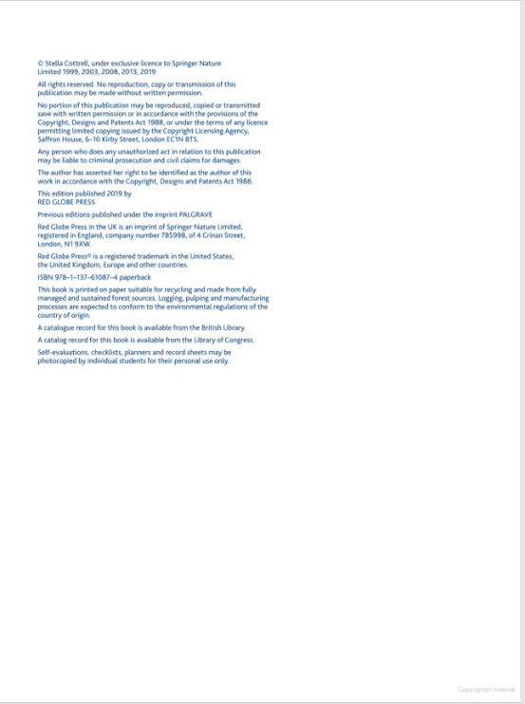

Providing a Citation…
Direct Quote
Surname – Cottrell; Year – 2019

Slide 18
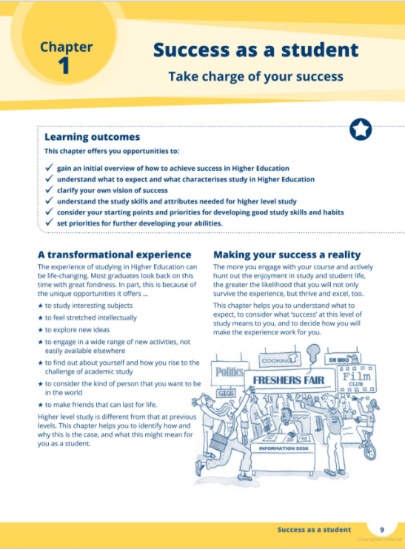
Page No - 9

Slide 19

“The experience of studying in Higher Education can be life-changing”
“The experience of studying in Higher Education can be life changing” (Cottrell, 2019, p. 9).
Cottrell (2019, p. 9) states that “the experience of studying in Higher Education can be life changing”.
Cottrell (2019, p. 9) refers to the process of HE study as “life changing”.
These are all direct quotes – so must all have 3 parts to the citation – Authors Surname, Year of Publication & Page Number
Don’t forget the quotation marks!!!

Slide 20
Where to place the brackets????
“The experience of studying in Higher Education can be life changing” (Cottrell, 2019, p. 9).
Cottrell (2019, p. 9) states that “the experience of studying in Higher Education can be life changing”.
Cottrell (2019, p. 9) refers to the process of HE study as “life changing”.
Always put in brackets what you would not say out loud!!!

Slide 21
Example of indented long direct quote
Larger quotes (2 lines or 30 words +): Start quote on new line and indent.
Lev Semyonovich Vygotsky (Russian: Лев Семёнович Вы́готский or Выго́тский Lev Semyonovich Vygotskiy, born Лев Симхович Выгодский Lev Simkhovich Vygodskiy, November 17 [O.S. November 5] 1896 – June 11, 1934) was a Soviet psychologist, the founder of a theory of human cultural and bio-social development commonly referred to as cultural-historical psychology, and leader of the Vygotsky Circle (Vygotsky 1932, p.106).
“Vygotsky's main work was in developmental psychology, and he proposed a theory of the
development of higher cognitive functions in children that saw reasoning as emerging
through practical activity in a social environment. During the earlier period of his career
he argued that the development of reasoning was mediated by signs and symbols, and
therefore contingent on cultural practices and language as well as on universal cognitive
processes” (Vygotsky 1932, p.106).
Vygotsky (1932:106) also posited a concept of the zone of proximal development, often understood to refer to the way in which the acquisition of new knowledge is dependent on previous learning, as well as the availability of instruction. During his lifetime Vygotsky's theories were controversial within the Soviet Union. In the 1930s Vygotsky's ideas were introduced in the West where they remained virtually unknown until the 1970s when they became a central component of the development of new paradigms in developmental and educational psychology. While initially Vygotsky's theories were ignored in the West, they are today widely known, although scholars do not always agree with them, or agree about what he meant (Vygotsky 1932. p.106).
Quotes this size should be reserved for writing your dissertations in Level 6 and should never be used in Level 4.

Slide 22
Useful verbs and phrases for introducing direct quotes
As Cottrell (2019 pp. 9) states/ believes/ suggests /indicates/ points out / observes/ explains/ argues/ outlines/ contradicts / proposes, “…….”.
Cottrell (2019 pp. 9) has argued that “……”.
According to Cottrell (2019 pp. 9), “…….”.
Cottrell (2019 pp. 9) suggests/ believes/ observes that “…..”.

Slide 23

Providing a Citation…
Paraphrasing
Undertaking a course at university can have a profound impact upon a student’s future (Cottrell, 2019).
Cottrell (2019) suggests that many individuals lives can be transformed significantly by undertaking study in college or university.
No need for quotation marks or page numbers!!

Slide 24
Where to put the brackets????
Sticking to our rule of ‘only put in brackets what you would not read aloud’…
Check if the brackets are in the right place!
Undertaking a course at university can have a profound impact upon a student’s future (Cottrell, 2019).
Cottrell (2019) suggests that many individuals lives can be transformed significantly by undertaking study in college or university.

Slide 25

Providing a citation…
Paraphrasing – Top Tip
When paraphrasing do not use the word ‘states’.
States means ‘word for word’, so not appropriate when paraphrasing…
Try something gentler, like suggests, indicates, proposes, advises, recommends…

Slide 26
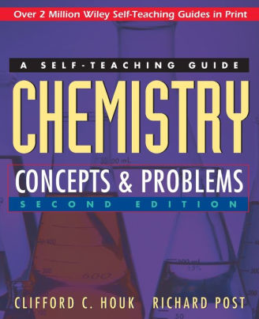
Different Citations…
2 author’s…
(Houk and Post, 1996)
Houk and Post (1996)

Slide 27
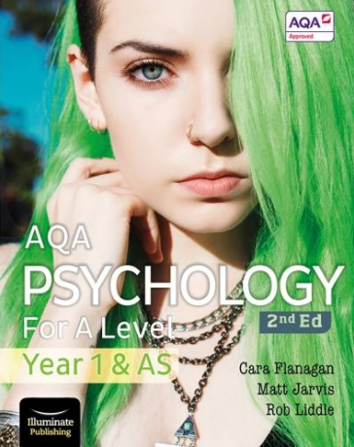
Different citations….
3 authors…
(Flanagan, Jarvis and Liddle, 2019)
Flanagan, Jarvis and Liddle (2019)

Slide 28
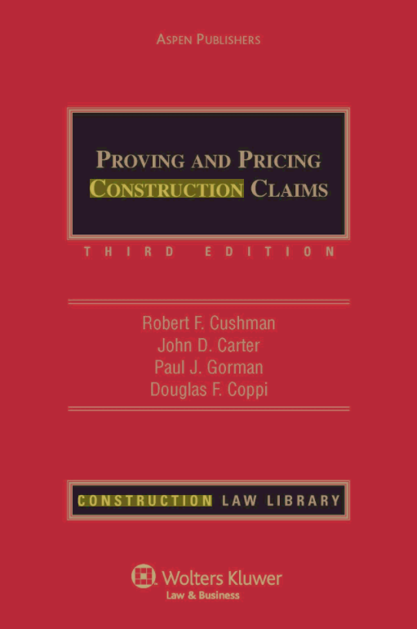
Different Citations….
4 or more authors…
(Cushman et al, 2001)
Cushman et al (2001)

Slide 29

Different Citations…
Organisation
(Department of Health, 2014)
Department of Health (2014)

Slide 30
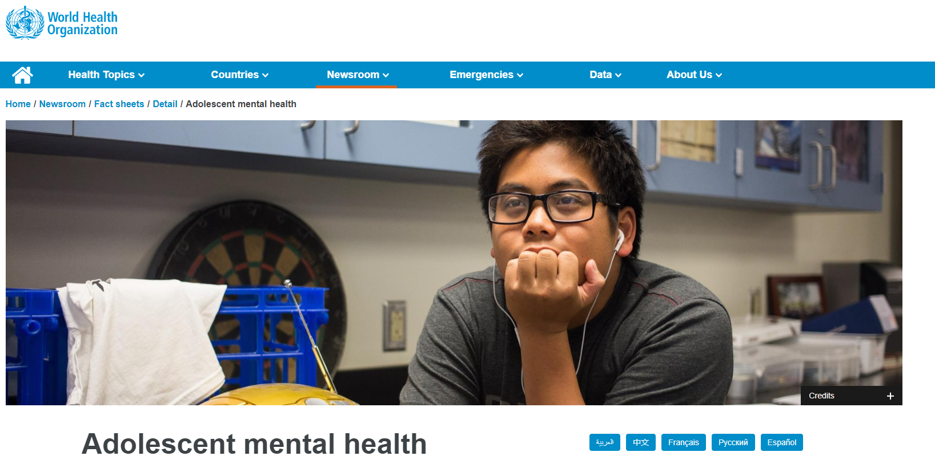
Different Citations…
Website
(World Health Organization, 2021)
World Health Organization (2021)

Slide 31
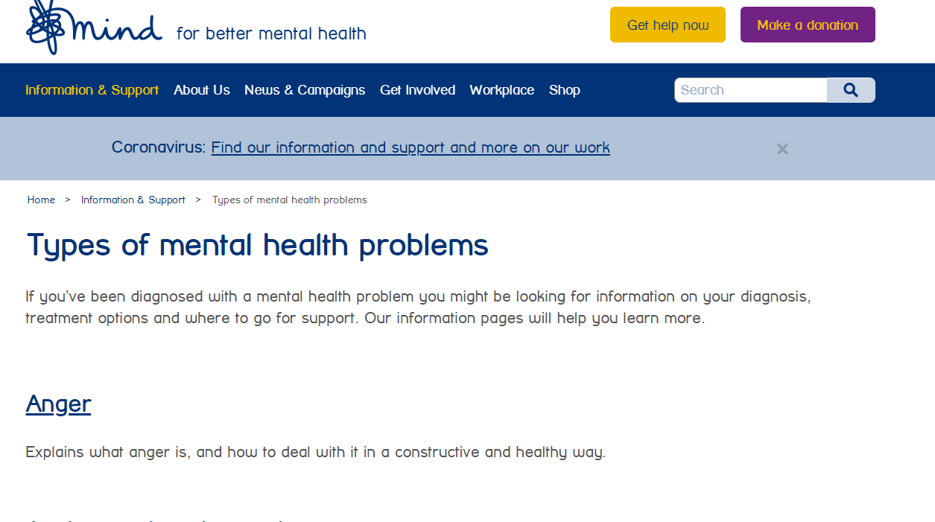
Different Citations….
Website… No date?
(Mind, 2022)
Mind (2022)

Slide 32

Citations…
Points to Remember…
There’s at least 2 items you need for a citation
  Author’s Name
  Year of Publication
A 3rd item is needed for a direct quote
  Page number
If in doubt… Don’t use it!

Slide 33
Citations…
Points to Remember…
There is always an author
  (may be an organisation)
There is always a year of publication
  (some websites are continuously updated)
If in doubt… Don’t use it!

Slide 34

Citations…
Direct Quotes…
If using direct quotes they must kept to a minimum, ALWAYS be in “quotation marks” and citations must include the page number of the source, where available.

Slide 35

Don’t Forget….
You cite when you write

Slide 36

Kahoot!!!!
Lets Play!

Slide 37

Time for a break….?

Slide 38
References or Bibliography – what’s the difference?
Reference list – a single alphabetical list by author, of everything you have ‘made reference to’ in your assignment. (Requirement for all University assignments)
Bibliography – a list of sources you have read, found interesting but not specifically mentioned in your assignment.(Not required, but may occasionally be asked for)

Slide 39

Referencing Different Sources
Books
Journal Articles/magazines
Web Sources
Chapters within books
They are all referenced in slightly different ways….
It’s important to know the differences.

Slide 40
What information do I need to include to reference a book?
Name of the Authors – Surname & Initials
(Year published)
Full title
Edition - if applicable
Where it was published (Town or City)
Publisher

Slide 41
Referencing a book…

Slide 42
Referencing books
Using the title page and the first page, note the:
Author(s) - Cottrell, S
(Year of Publication) – 2019
Title – The Study Skills Handbook
Edition (if not the first) – 5th edn
Place of publication - London
Publisher – Red Globe Press
Cottrell, S. (2019) The Study Skills Handbook. 5th edn. London: Red Globe Press.

Slide 43


Book Reference Example
Author(s)
Year of Publication
Title
Edition
Place of publication
Publisher
Cottrell, S. (2019) The study Skills Handbook. 5th edn. London: Red Globe Press.
Comma
Full stop
Brackets
Italics
Full stop
Colon

Slide 44

Multiple / Different Authors…
  In referencing the same principles for each type of source apply no matter the authors

Slide 45
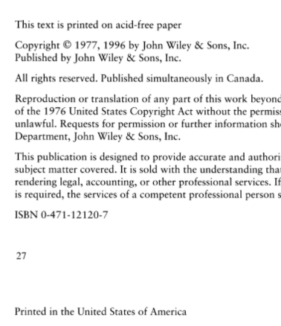


Lets try together…

Slide 46
2 Authors
Author(s) – Houk, C. C. and Post, R.
Year of Publication – 1996
Title – Chemistry Concepts & Problems: A self-teaching guide
Edition (if not the first) – 2nd edn
Place of publication – New York
Publisher – John Wiley & Sons Inc
Houk, C. C. and Post, R. (1996) Chemistry Concepts & Problems: A self-teaching guide. 2nd edn. New York: John Wiley & Sons Inc.

Slide 47


Book Reference (2 Authors)Example
Authors
Year of Publication
Title
Edition
Place of publication
Publisher
Houk, C. C. and Post, R. (1996) Chemistry Concepts & Problems: A self-teaching guide. 2nd edn. New York: John Wiley & Sons Inc.
Comma
Full stop
Brackets
Italics
Full stop
Colon

Slide 48

3 Authors
(Flanagan, Jarvis and Liddle, 2019)
Flanagan, C., Jarvis, M. and Liddle, R. (2019) AQA Psychology for A Level: Year 1 & AS. 2nd edn. Essex: Illuminate Publishing.

Slide 49
4 or More Authors
(Cushman et al, 2001)
Cushman, R. F., Carter, J. D., Gorman, P. J. and Coppi, D. F. (2001) Proving and Pricing Construction Claims. 3rd edn. Aspen: Aspen Publishers

Slide 50
Chapter in an Edited Book
Author(s) of Chapter - Mears, M.
(Year of Publication of book) - 2013
‘Title of Chapter’ - The Social Context of Health and Social Care (not italics)
Editors - Brotherton, G. and Parker, S. (Eds)
Title of book - Your Foundation in Health and Social Care
Edition (if not the first) - 2nd Edn
Place of publication - London
Publisher - Sage
Citation ? - Mears (2013) or (Mears, 2013)
Mears, M. (2013) ‘The Social Context of Health and Social Care’, in Brotherton, G. and Parker, S. (Eds.) Your Foundation in Health and Social Care. (2nd Ed.) London: Sage.

Slide 51
Multiple works by Same Author
Different years
  McNamara, B. M. (2012) Education for Life. Maidenhead: Riverstory.
  McNamara, B. M. (2017) Lifelong Learning. Maidenhead: Riverstory.
Same year
  Phelps, P. J. (2016a) Healthy Learning. Edinburgh: Castle Books.
  Phelps, P. J. (2016b) Nutrition in the Early Years. Edinburgh: Castle Books.
(Phelps, 2016a) (Phelps, 2016b)

Slide 52
Referencing Journal/Magazine Articles
Author
Year of publication (in brackets)
Title of article in ‘inverted commas’
Title of journal in italics
Volume number (if present)
Part/issue number (if present)
Page number(s)

Slide 53

From the list of requirements, try looking at the journal article on the next page and see if you can work out what the citation and reference would be!

Slide 54
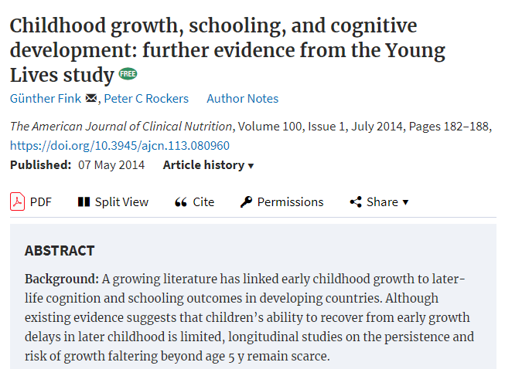
Fink, G. and Rockers, P. C. (2014) ‘Childhood growth, schooling, and cognitive development: further evidence from the Young Lives Study’, The American Journal of Clinical Nutrition, 100(1), pp.182 – 188.

Slide 55




Journal Referencing Example
Author
Year
Article Title
Journal Title
Vol
Issue
Pages
Mercer, J. (2004) ‘Making the news’, Journal of International Media History, 10(3), pp. 187-199.
Comma
Full Stop
Brackets
Inverted commas
Italics
Brackets

Slide 56
Referencing a Web Site
Author/Organisation
(Year written or updated) (in brackets)
Title of page accessed - in italics
URL - web page address
(Date you accessed it) (in brackets)

Slide 57
From the list of requirements, try looking at the website on the next page and see if you can work out what the citation and reference would be!

Slide 58
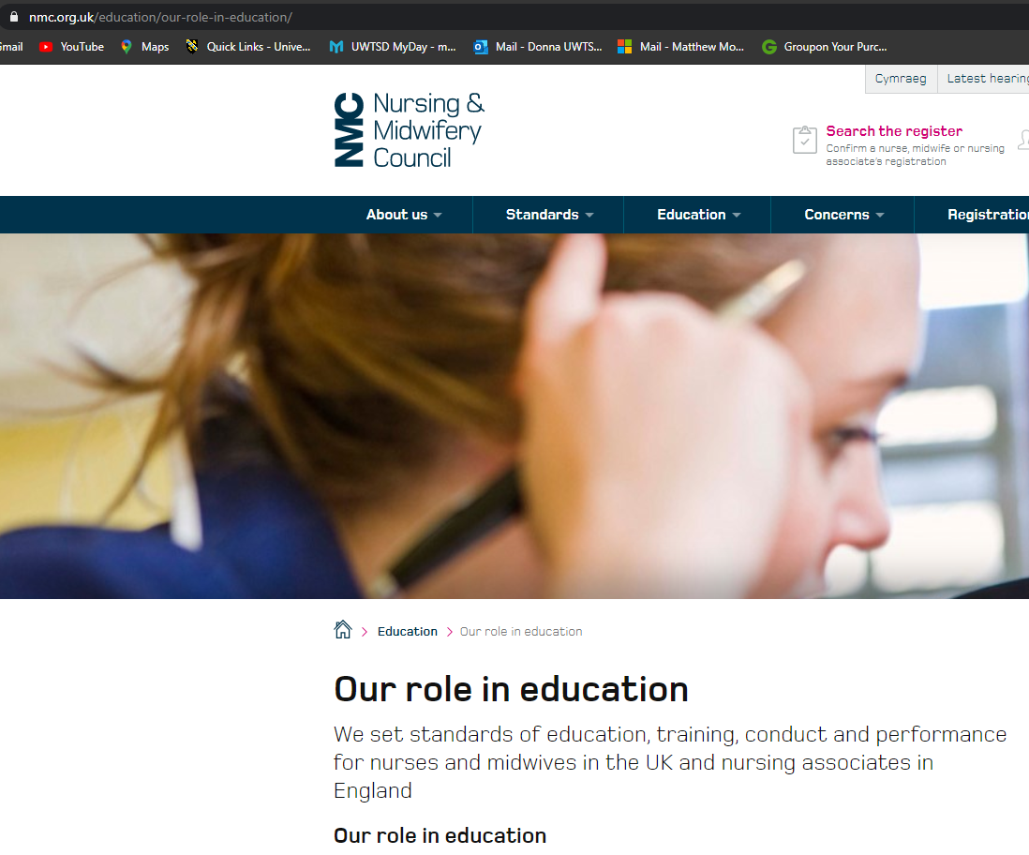
Nursing & Midwifery Council (2022) Our role in education. Available at: https://www.nmc.org.uk/education/our-role-in-education/ (Accessed on 9th October 2022).

Slide 59
Web Referencing Example
Title of Page Accessed
Author
Year of Publication
Available at
Full Web Address (url)
Date Accessed
Department of Health (2002) A health service of all the talents: developing the NHS Workforce. Consultation document on the Review of Workforce Planning. Available at: http://www.doh.gov.uk/pdfs/workforce.pdf (Accessed 17 July 2002).
Colon
Brackets
Format as it appears on Web page
Brackets
Italics
Citation - Department of Health (2002)
Or - (Department of Health, 2022)

Slide 60
Examples of web sources to avoid
pschycology.about.com
simplypschycology.org
www.ehow.com
Wikipedia
Make sure web sources used are relevant to the UK/Wales
Avoid using Anon when referencing – there is ALWAYS an author.

Slide 61

Presentation of Reference List
When using the HRS all references…
Must be in the same font size
Must be in alphabetical order
Must correspond with a citation within the main body
Must be on a separate page from your assignment

Slide 62

The following reference list consists of all the references we have used in this PowerPoint and is an example of how a properly constructed reference list should look

Slide 63
Reference List
Cottrell, S. (2019) The Study Skills Handbook. 5th edn. London: Red Globe Press.
Cushman, R. F., Carter, J. D., Gorman, P. J. and Coppi, D. F. (2001) Proving and Pricing Construction Claims. 3rd edn. Aspen: Aspen Publishers.
Department of Health (2002) A health service of all the talents: developing the NHS Workforce. Consultation document on the Review of Workforce Planning. Available at: http://www.doh.gov.uk/pdfs/workforce.pdf (Accessed 17 July 2002).
Fink, G. and Rockers, P. C. (2014) ‘Childhood growth, schooling, and cognitive development: further evidence from the Young Lives Study’, The American Journal of Clinical Nutrition, 100(1), pp.182 – 188.
Flanagan, C., Jarvis, M. and Liddle, R. (2019) AQA Psychology for A Level: Year 1 & AS. 2nd edn. Essex: Illuminate Publishing.
Houk, C. C. and Post, R. (1996) Chemistry Concepts & Problems: A self-teaching guide. 2nd edn. New York: John Wiley & Sons Inc.

Slide 64
McNamara, B. M. (2012) Education for Life. Maidenhead: Riverstory.
McNamara, B. M. (2017) Lifelong Learning. Maidenhead: Riverstory.
Mears, M. (2013) ‘The Social Context of Health and Social Care’, in Brotherton, G. and Parker, S. (Eds.) Your Foundation in Health and Social Care. (2nd Ed.) London: Sage.
Mercer, J. (2004) ‘Making the news’, Journal of International Media History, 10(3), pp. 187-199.
Mind (2021) Types of Mental Health Problems. Available at: https://www.mind.org.uk/information-support/types-of-mental-health-problems/ (Accessed on 9th October 2022).
Nursing & Midwifery Council (2021) Our role in education. Available at: https://www.nmc.org.uk/education/our-role-in-education/ (Accessed on 4th October 2021).
Phelps, P. J. (2016a) Healthy Learning. Edinburgh: Castle Books.
Phelps, P. J. (2016b) Nutrition in the Early Years. Edinburgh: Castle Books.

Slide 65

Top Tips…
Create your reference list as you go along.
Jot down the websites as you go in to them – one click and the webpage you are on may be lost forever
Once finished proof read for any errors
Check your citations correspond to your reference list entries
Most importantly….

Slide 66

…Stay Calm!!!!

Slide 67

You are now ready to tackle practice Referencing Activities on your Moodle page!!

